Slide 1






PIZZA SALES
ANALYSIS
By Aditya Jatav

Slide 2




OBJECTIVE
The objective of this project is to analyze pizza sales data to identify trends and provide actionable insights that can help to increase sales and aim to uncover key metrics and patterns within the sales data by leveraging SQL queries in MySQL.

Slide 3


Data Overview
Description of the datasets:
pizza.csv: Pizza ID, Price, Pizza Type, Size
pizza_types.csv: Pizza Type ID, Name, Category, Ingredients
orders.csv: Order ID, Date, Time
order_details.csv: Order Details ID, Order ID, Pizza ID, Quantity
Our analysis uses four datasets: pizza.csv (pizza details), pizza_types.csv (pizza types), orders.csv (order details), and order_details.csv (order specifics). Together, they provide a comprehensive view of sales trends, product performance, and customer behavior.

Slide 4
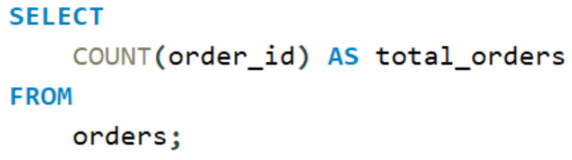
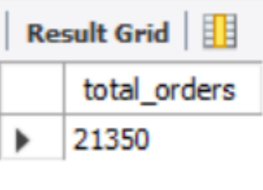
Problem-1
The total number of order place
Solution
Result
01
02

Slide 5
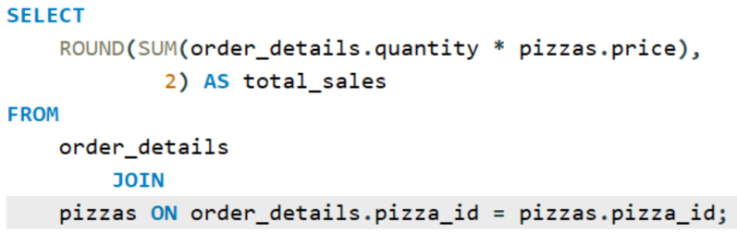


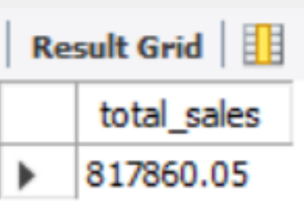
01
PROBLEM-2
Solution
The total revenue generated from pizza sales
02
Result

Slide 6
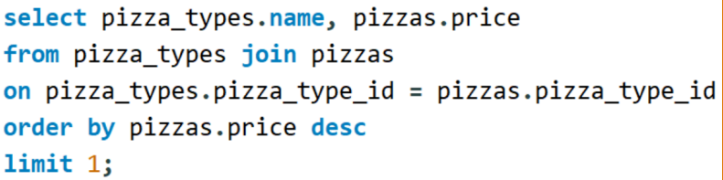
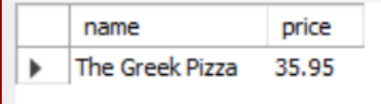
Problem-3
The highest priced pizza
Solution
Result
02
01

Slide 7
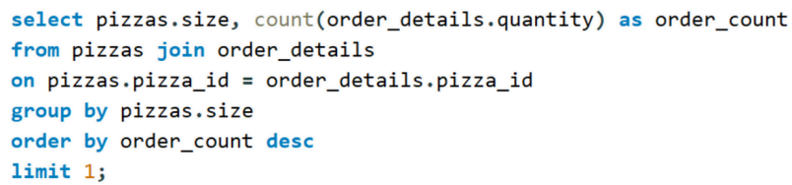
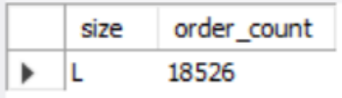
PROBLEM-4
01
Solution
The most common pizza size ordered
02
Result

Slide 8
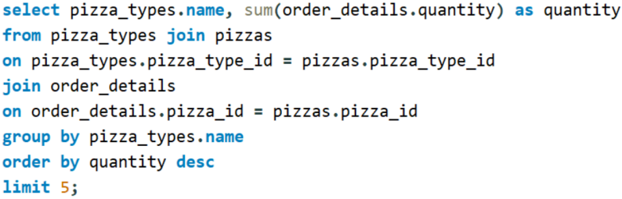
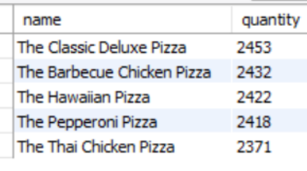
Problem-5
The top 5 most ordered pizza types along their quantities
Solution
Result
02
01

Slide 9
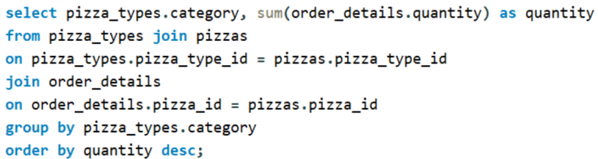
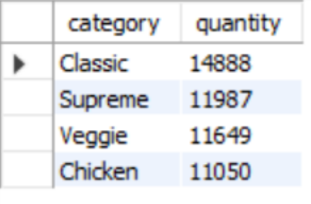
PROBLEM-6
01
Solution
The quantity of each pizza categories ordered
02
Result

Slide 10
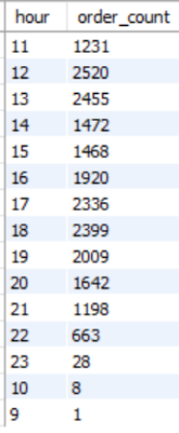
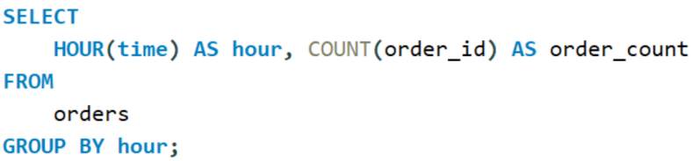
Problem-7
The distribution of orders by hours of the day
Solution
Result
01
02

Slide 11
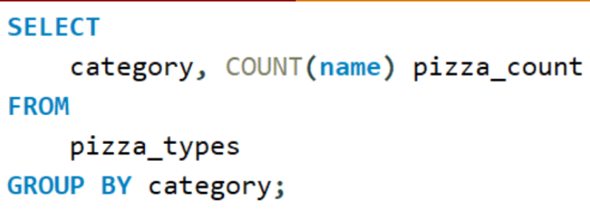
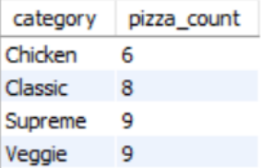
PROBLEM-8
01
Solution
The category-wise distribution of pizzas
02
Result

Slide 12
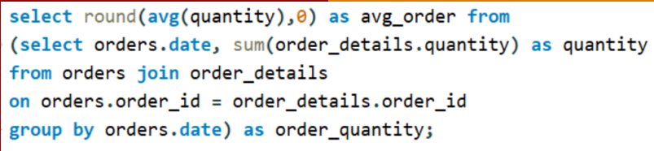
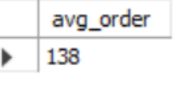
Problem-9
The average number of pizzas ordered per day
Solution
Result
01
02

Slide 13
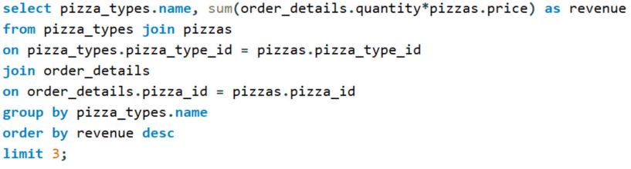
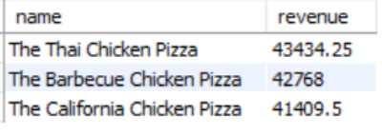
PROBLEM-10
01
Solution
Top 3 most ordered pizza type base on revenue
02
Result

Slide 14
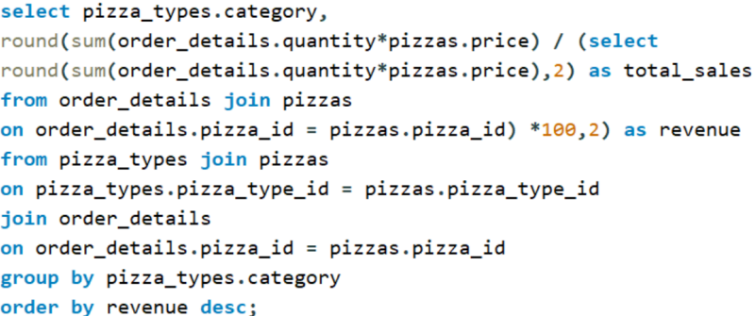
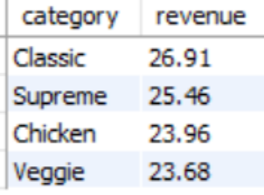
Problem-11
The percentage contribution of each pizza type to revenue
Solution
Result
02
01

Slide 15
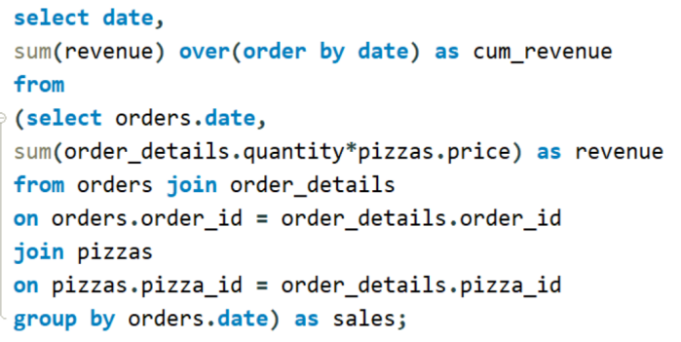
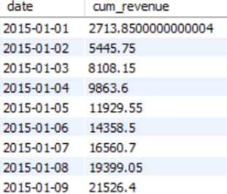
PROBLEM-12
01
Solution
The cumulative revenue generated over time
02
Result

Slide 16
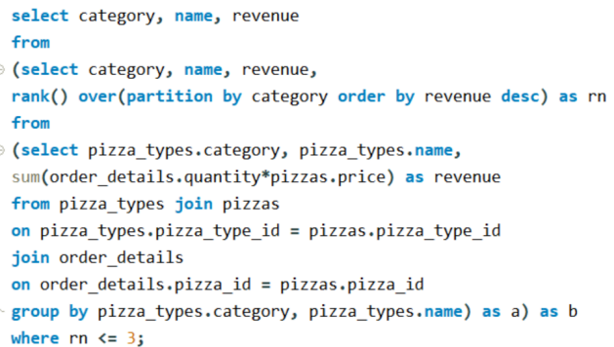
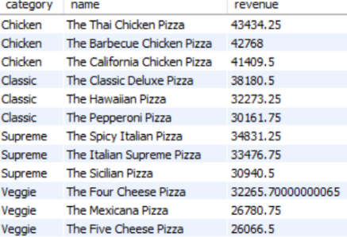
Problem-13
The top 3 most ordered pizza type based on revenue for each pizza category
Solution
Result
02
01

Slide 17

Feel free to ask any questions about the pizza sales analysis. We're here to clarify data points, insights, and recommendations, and discuss opportunities for improving our sales strategy.

Slide 18

Thank You
“let's cook up greater sales and savor success with every slice !”

