Slide 1


Project: Tour Booking Application
Subject Name: FSE (22CS037)
Submitted By:
1. Nishit Ranjan (2210991991)
2. Parth Kaushal(2210992030)
3. Kavay (2210991772)
Department of Computer Science and Engineering
Chitkara University, Punjab
<number>
Notes:
<number>

Slide 2
Problem Statement
1) Current Issues with Online Tour Booking:
:- Users must interact with multiple platforms for booking and managing tours.
:-Existing solutions lack comprehensive user management features, such as profile updates and role-specific access.
:-Secure payment processing is often poorly integrated.
2) Challenges Faced:
:-Fragmented user experience.
:-Inefficiencies for administrators managing tours and bookings.
3) Solution Proposal:
:-A centralized, user-friendly tour booking application is needed to integrate all essential features on one platform
<number>

Slide 3
Objectives
Streamline User Experience: Develop a user-friendly platform that simplifies tour discovery, booking, and management, providing an intuitive experience across web and mobile devices.
Implement Role-Based Access Control: Design a system with distinct user roles (regular users, admins, lead guides, guides) and manage permissions effectively to ensure appropriate access and functionality for each role.
Enable Comprehensive Tour Management: Allow admins and lead guides to create, update, and delete tours while providing users with detailed information, maps, reviews, and ratings for each
<number>
Notes:
<number>

Slide 4
Key Learning
Full-Stack Development Skills: Gain hands-on experience with the MERN stack (MongoDB, Express.js, React.js, Node.js), learning how to integrate these technologies to build a robust and scalable web application.
User Authentication and Authorization: Understand the implementation of secure authentication mechanisms (like JWT and OAuth) and role-based access control to manage user roles and permissions effectively.
Payment Integration: Learn to integrate and manage third-party payment gateways (e.g., Stripe) for processing transactions securely, handling payment flows, and ensuring compliance with payment security standards.
<number>
Notes:
<number>

Slide 5
Options available to execute the project
1) MERN Stack Development: Build the application using MongoDB, Express.js, React.js, and Node.js for full control and customization.
2) Pre-Built Platform: Customize an existing tour booking software to meet project requirements.
3) Hybrid Approach: Combine custom development with pre-built components for efficiency and flexibility.
4) Low-Code/No-Code Platform: Use a low-code or no-code tool to quickly develop t the application with minimal coding.
<number>
Notes:
<number>

Slide 6
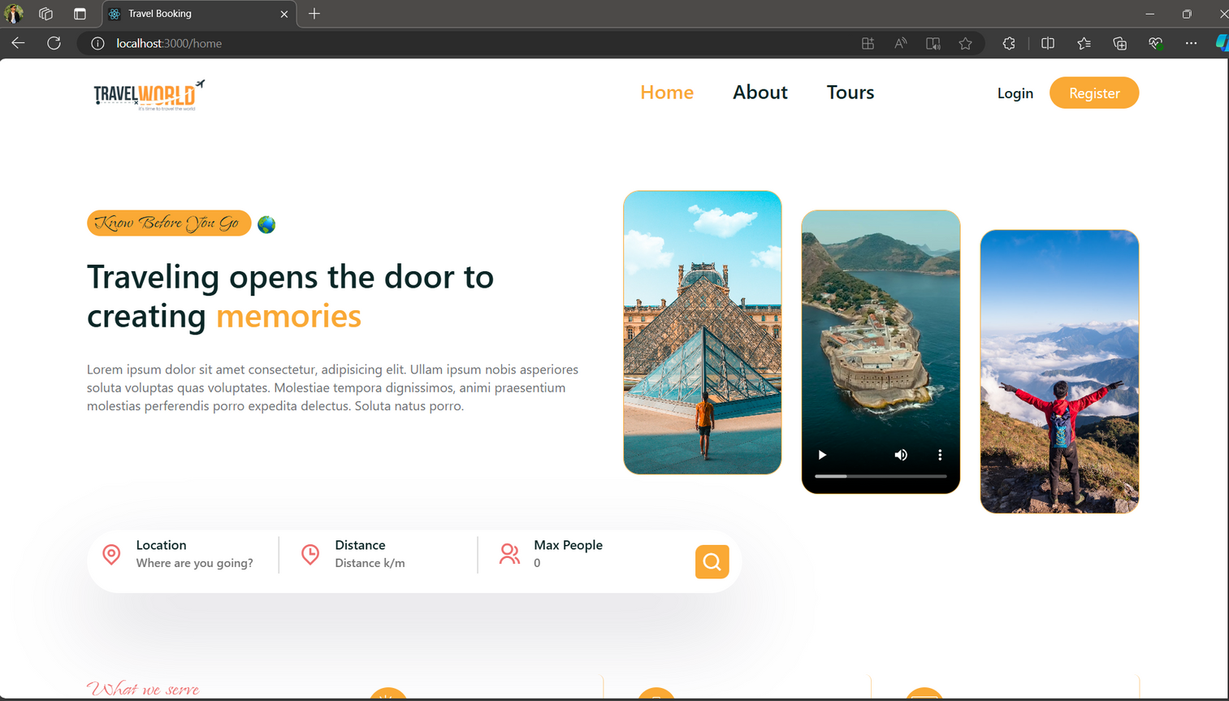
Code Snippets
FrontEnd:- Home Page.
<number>
Notes:
<number>

Slide 7
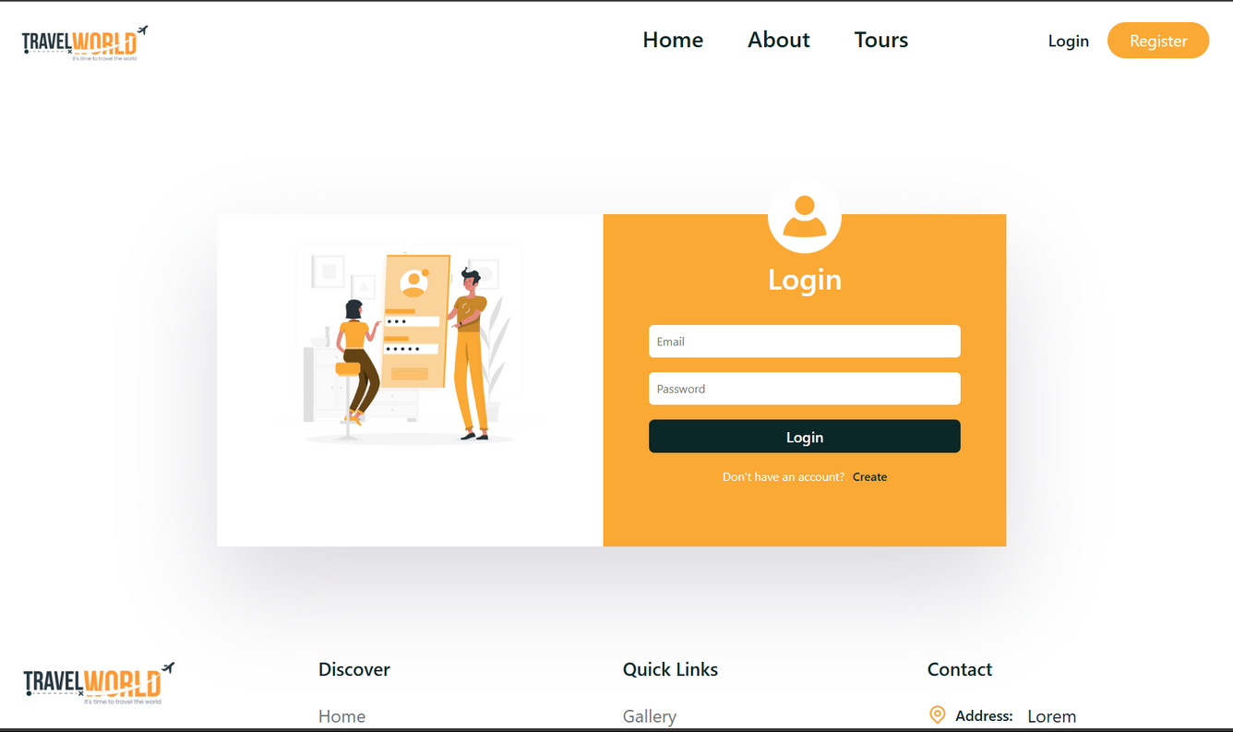
Code Snippets
FrontEnd:- Login Page.
<number>
Notes:
<number>

Slide 8
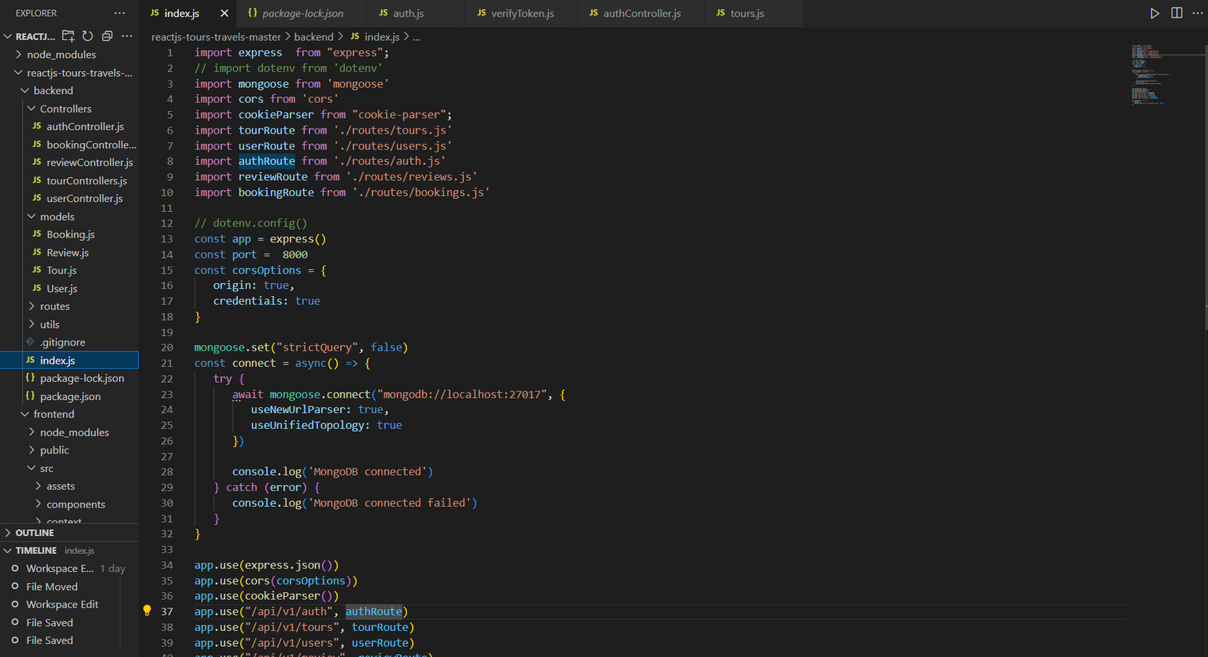
Code Snippets
Index.js
<number>
Notes:
<number>

Slide 9
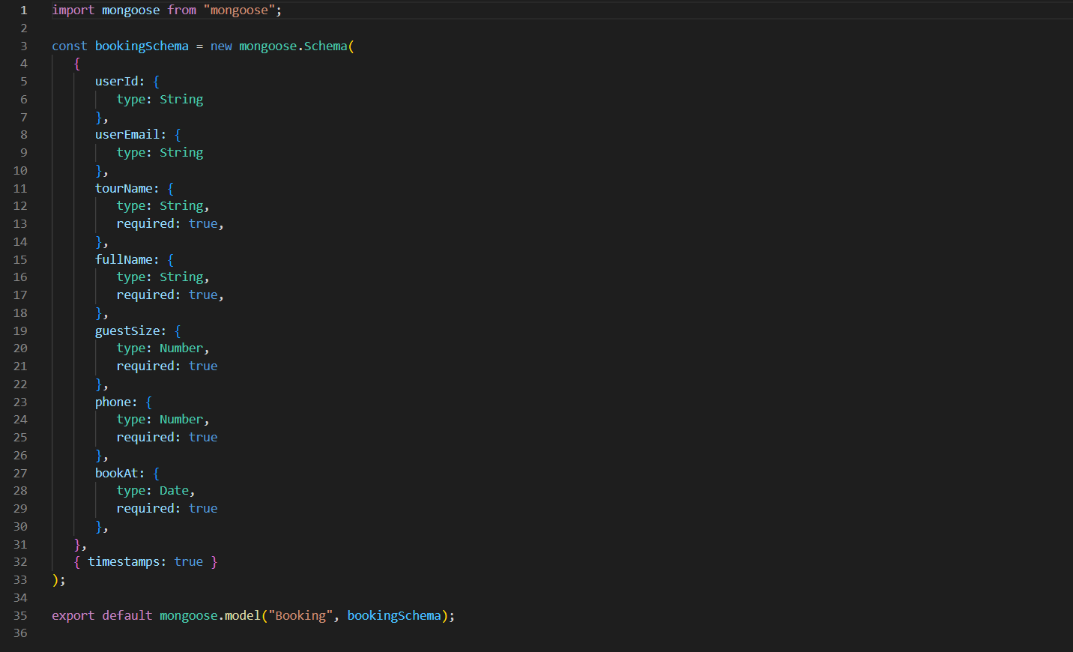
Code Snippets
Booking.js
<number>
Notes:
<number>

Slide 10
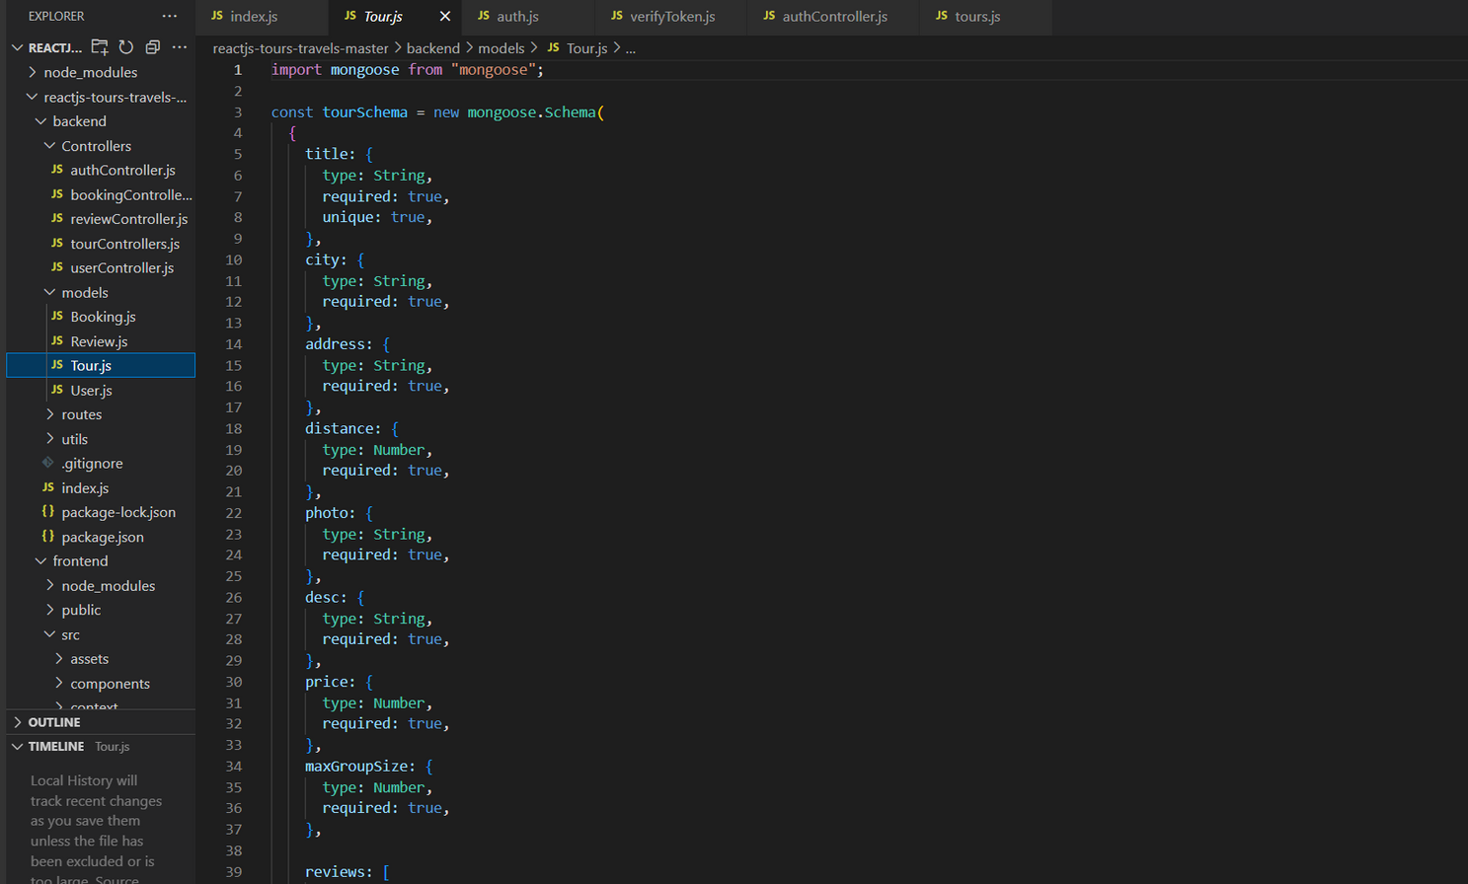
Code Snippets
Tour.js
<number>
Notes:
<number>

Slide 11
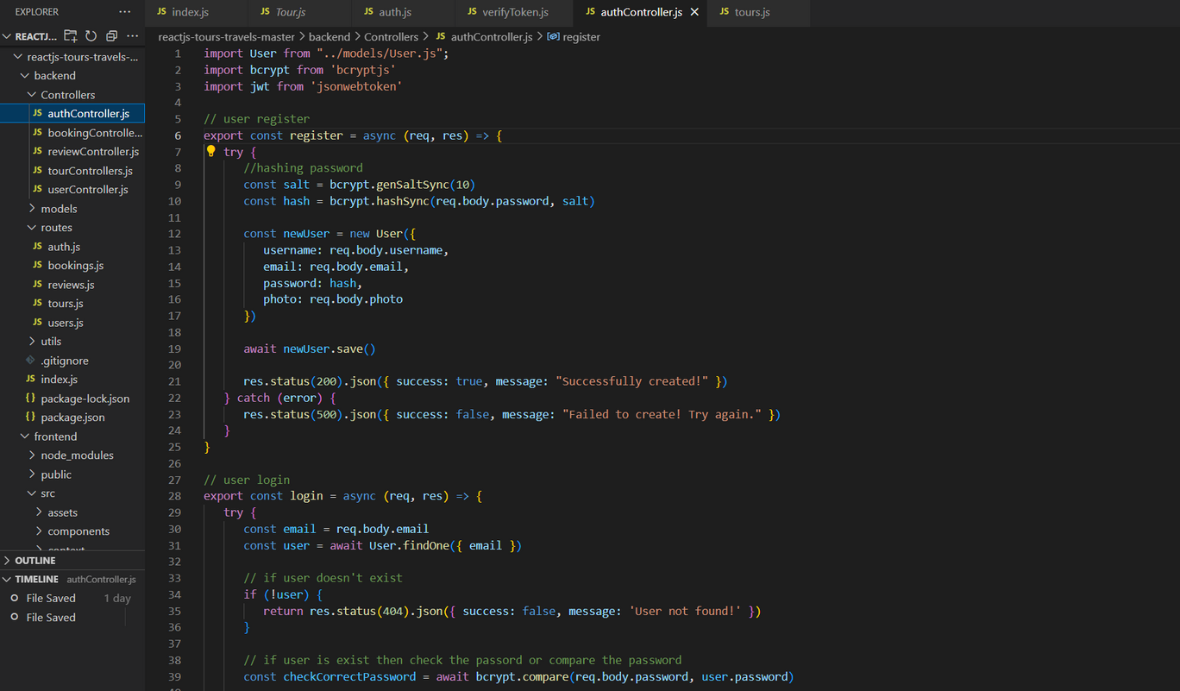
Code Snippets
AuthController
<number>
Notes:
<number>

Slide 12
Conclusion
1) Centralized Solution:
The application provides a comprehensive, all-in-one platform for booking and
managing tours, addressing user and administrator needs efficiently.
2) Enhanced User Experience:
Simplifies the process of discovering, booking, and reviewing tours, ensuring a
seamless and enjoyable experience for end-users.
3) Efficient Administration:
Streamlines administrative tasks, enabling administrators and tour guides to manage tours, bookings, and user roles with ease
<number>
Notes:
<number>

Slide 13
Advantages
Managing tours, enhancing overall satisfaction.
Comprehensive Management: Centralizes tour management, bookings, and user profiles in one platform, simplifying administrative tasks.
Secure Transactions: Integrates secure payment processing to protect user data and prevent fraud.
Role-Based Access: Allows effective management of user permissions and roles, ensuring appropriate access to features and data.
Scalability: Designed to handle growth in users and features, accommodating future enhancements and increasing demand.
<number>
Notes:
<number>

Slide 14
References
React Documentation: https://react.dev
Express.js Documentation: https://expressjs.com/
Node.js Documentation: https://nodejs.org/docs/latest/api/
Tutorials from W3Schools: https://www.w3schools.com/nodejs/
<number>
Notes:
<number>

