Slide 1

Module 1 Introduction of Android
By: Misha Patel

Slide 2
Outline
Introduction to Subject
What is Android?
What is “Open Handset Alliance”?
Why Android?
Android Version
Features of Android
Architecture of Android

Slide 3
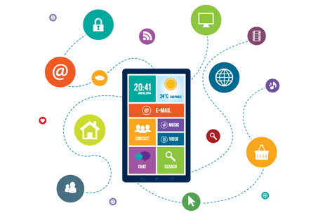
What is Mobile Application Development?
Mobile application development is the set of processes and procedures involved in writing software for small, wireless computing devices, such as smartphones and other hand-held devices.

Slide 4
Types of Mobile Apps by Technology
There are three basic types of mobile apps if we categorize them by the technology used to code them:
Native apps are created for one specific platform or operating system.
Web apps are responsive versions of websites that can work on any mobile device or OS because they’re delivered using a mobile browser.
Hybrid apps are combinations of both native and web apps, but wrapped within a native app, giving it the ability to have its own icon or be downloaded from an app store.

Slide 5
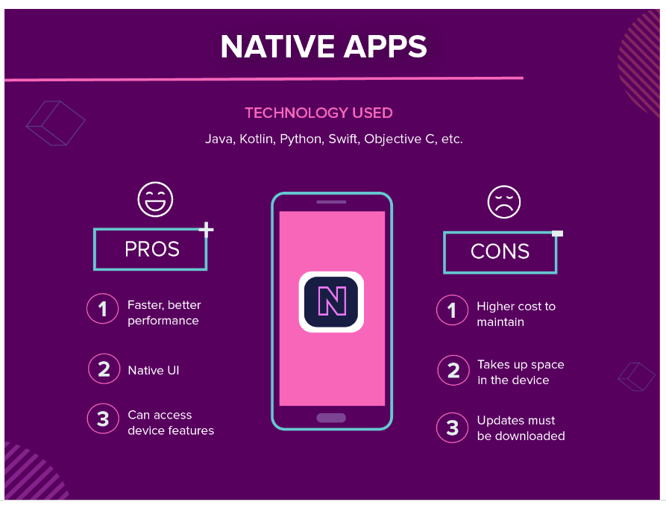
Native Apps

Slide 6
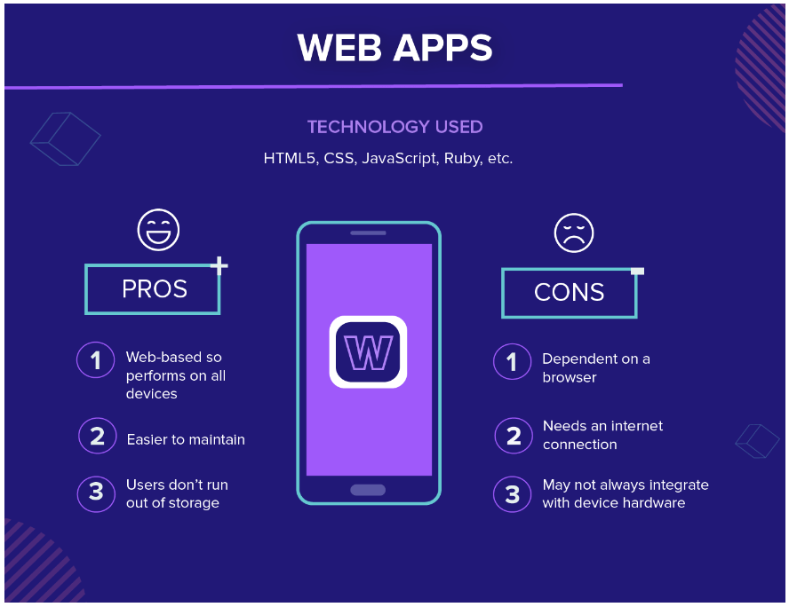
Web Apps

Slide 7
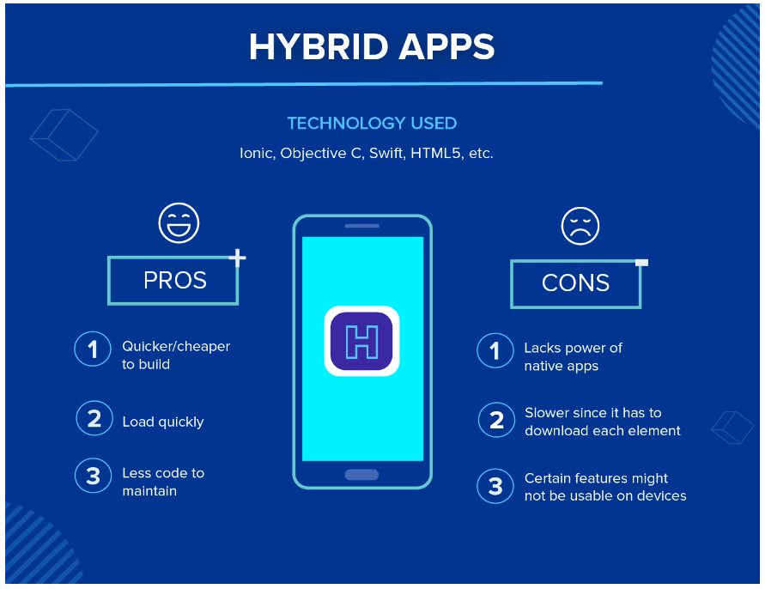
Hybrid Apps

Slide 8

What is Android?
Android is a Linux based mobile operating system.
Initially Android was available for mobile devices only.
Later on android is also available for tablets,ware, big screen(TV), automobile etc.
Android was unveiled during 2007 along with the founding of the Open Handset Alliance

Slide 9
What is “Open Handset Alliance”?
Open Handset Alliance(OHA) was formed in November 2007.
The OHA is the group that is in charge of the Android Smartphone Operating System. It was created by Google.
The OHA is a business alliance that consists of 84 companies for developing open standard platform for mobile devices.
The members of OHA includes handset manufacturers, chip makers, commercialization companies, software companies and mobile operators.

Slide 10
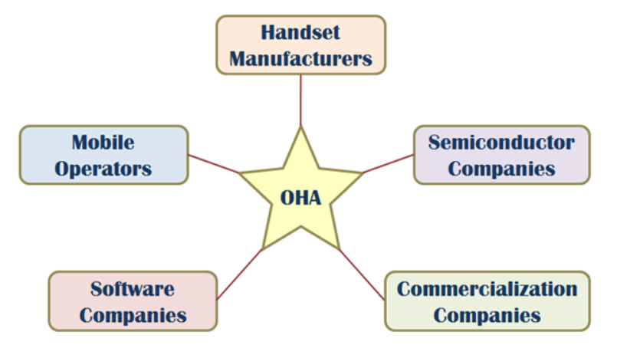
OHA

Slide 11
Developer
Android OS is designed in October 2003 by Andy Rubin, Rich Miner, Nick Sears, and Chris White.
Handover to the Google in Corporation in the year of 2007.

Slide 12
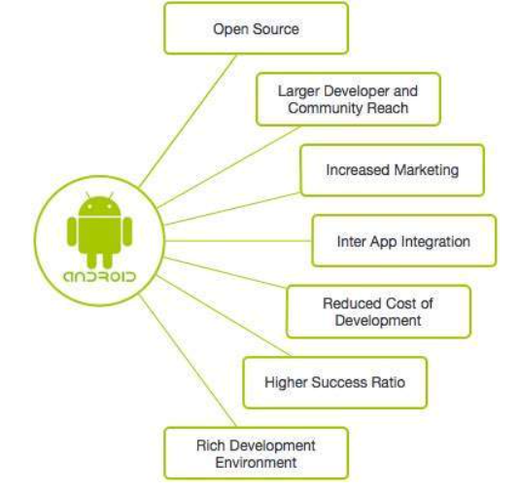
Why Android ?
Android applications are usually developed in the Java language using the Android Software Development Kit.
Once developed, Android applications can be packaged easily and sold out either through a store such as Google Play, SlideME, Opera Mobile Store, Mobango, F-droid and the Amazon Appstore.
Android powers hundreds of millions of mobile devices in more than 190 countries around the world. It's the largest installed base of any mobile platform and growing fast.
Every day more than 1 million new Android devices are activated worldwide.

Slide 13
Features of Android
Open Source: the original source code of android is available for modifications.
Android OS is device independent.
Android OS supports NFC(Near Field Communication)
Transfer any amount of data by simply touching the two devices.
Maintain less than 1 cm distance in between two devices.
4. Android OS supports IPC(Inter Process Communication)
5. By default Android OS is available with SQLite.
This database is open source & supports RDBMS

Slide 14
Features of Android
6. Android OS supports for SSL(Secure Socket Layer)
TLS(Transport Layer Security)
In SSL client & server interaction done in encrypted mode.
7. Android OS will support Text to Speech and Speech to Text conversion.
8. Android device can be controlled through voice commands.
9. Android supports all types of images, audio, video,different types of languages, different types of fonts.

Slide 15
Features of Android
10. Android OS supports basic graphics and 2-D,3-D animation.
11. Supports Video calling.
12. External storage
Most Android devices include microSD slot and can read microSD cards formatted with FAT32,Ext3 or Ext4 file system.

Slide 16
Android Versions
Version | Nickname | Release Date
1.0 | Android | September 23,2008
1.1 | Beta Android | February 9,2009
1.5 | Cupcake | April 27,2009
1.6 | Donut | September 15,2009
Android 1.x Mobiles only
Android 2.0/2.1 | Éclair | October 26,2009
2.2 – 2.2.3 | Froyo | May 20,2009
2.3 – 2.3.7 | Gingerbred | December 6,2010
Android 2.x is also designed for mobiles but from 2.x android started supporting API. - By using Google API android application can interact with Google products such as Gmail, YouTube, google maps, navigation, google search engine, google Clouds

Slide 17
Android Versions
Version | Nickname | Release Date
Android 3.0 – 3.2.6 | Honey Comb | February 22,2011
Android 3.x is specially designed for tablets. Started supporting Fragments.
Android 4.0 – 4.0.4 | Ice-cream Sandwich | October 18,2011
4.1 – 4.3.1 | Jellybean | July 9,2012
4.4 – 4.4.4 | KitKat | October 31,2013
4.4.w supports for wearable devices like wrist-watch. From 4.x android started supporting mobiles & tablets application. It means single app can run in mobiles & tablets

Slide 18
Android Versions
Version | Nickname | Release Date
Version | Nickname | Release Date
5.0 – 5.1.1 | Lollypop | November 12,2014
Android 5.x designed for Big Screens ie. TV
Android 6.0 – 6.0.1 | Marshmallow | October 5,2015
Android 6.0 designed for Automobiles(speed of car, km)
Android 7.0 – 7.1.2 | Nougat | August 22,2016
8.0 – 8.1 | Oreo | August 21,2017
9.0 | Pie | August 6,2018
10.0 |  | September 3,2019
11.0 |  | September 8,2020
12.0 |  | October 19, 2021

Slide 19
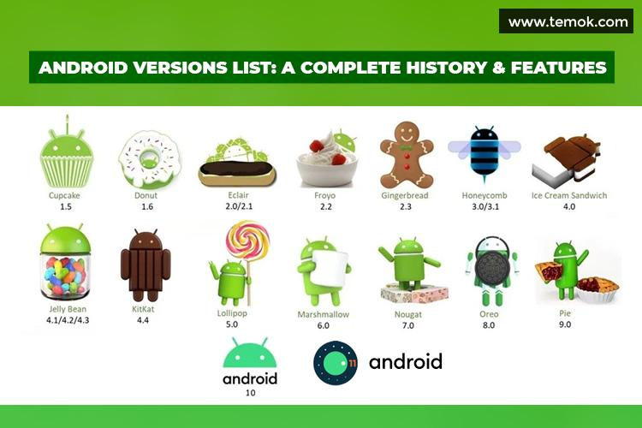
ANDROID Version History

Slide 20
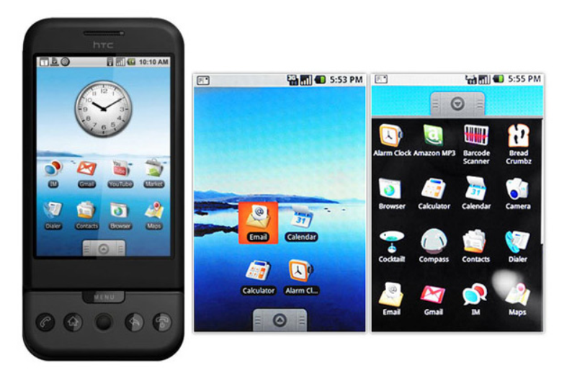
Android 1.0 to 1.1(September 23, 2008)
Features:
Google Maps.
Camera.
Gmail, Contacts, and Google Synchronization.
Web Browser.
Wireless supports – Wi-Fi and Bluetooth.

Slide 21
Beta 1.1(February 9, 2009)
released on February 9, 2009.
Features:
Add Save attachment in the message.
Provides reviews and details when the user search business on maps.

Slide 22
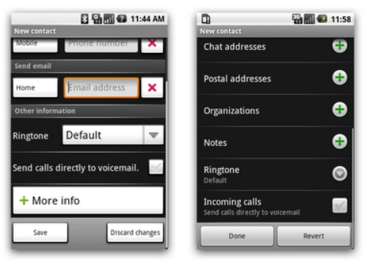
Android version 1.5: Cupcake April 30, 2009
Features:
New upload service on YouTube and Picasa like Uploading Videos and Photos.
Supporting in MPEG-4, Video recording.
Improving Web Browser-Copy and Paste facility.

Slide 23
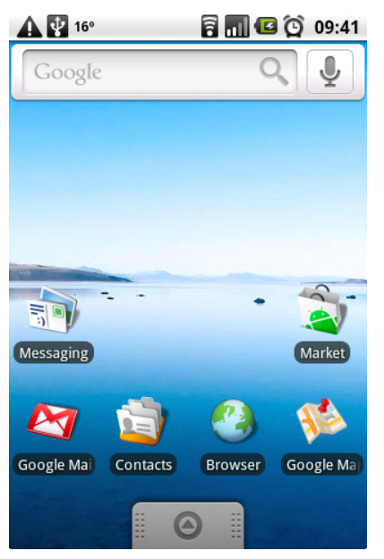
Android version 1.6: Donut September 15, 2009.
Features:
The main enhancement was a Power Control widget for managing Wi-Fi, Bluetooth, GPS, etc.
Provided Gallery and Camera features with quick toggling features.
Improve the speed in system apps.
Introduction of the Quick Search Box.

Slide 24
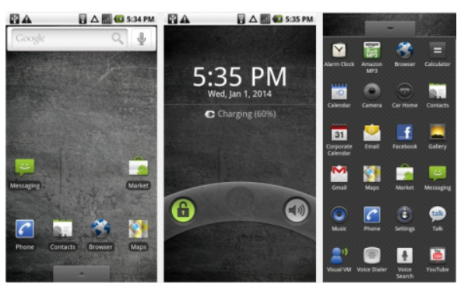
Android versions 2.0 to 2.1: Eclair December 3, 2009.
Features:
Update UI.
Support Live Wallpaper.
Support Bluetooth 2.1.
Improve Google map.
Minor API Changes.

Slide 25
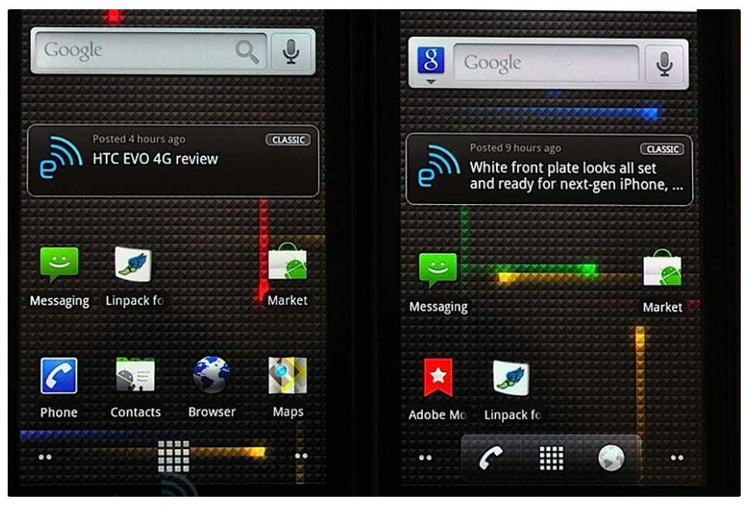
Android version 2.2: Froyo May 20, 2010.
Features:
Support for Animated GIF.
Wi-Fi Support Hotspot functionality.
Speed improvements.
Upload file support in the browser.
Support numeric and alphanumeric passwords.

Slide 26
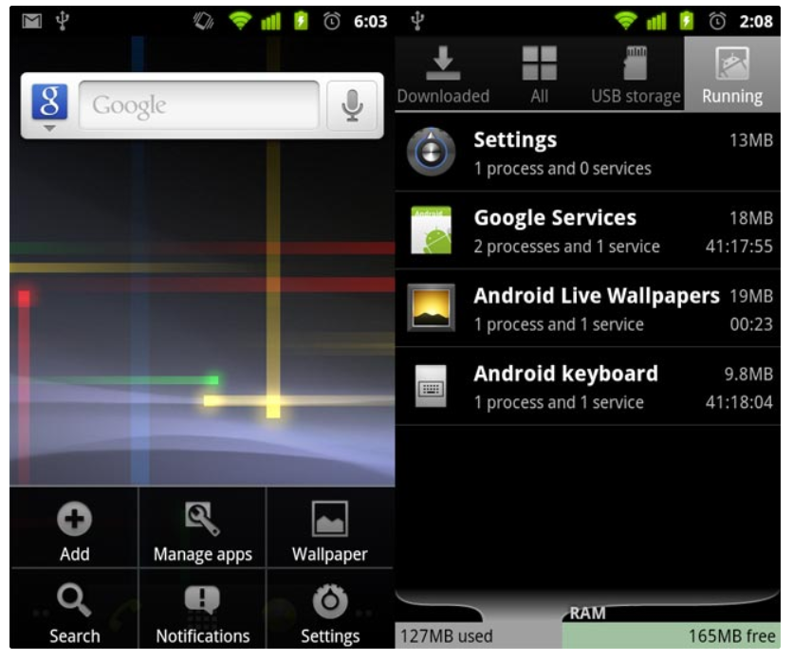
Android version 2.3: Gingerbread December 6, 2010
Features:
Improve Copy-Paste Facility.
Updated UI design.
VP8 and WebM video format support.
Social Networking Supports.
Easy use of the keyboard.
Multiple camera support (usually known as a selfie camera nowadays).

Slide 27
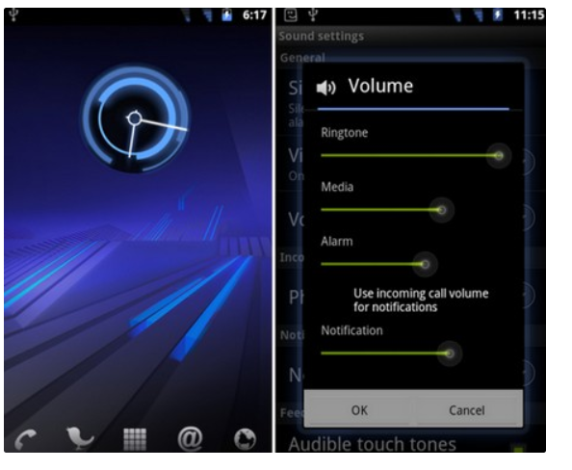
Android 3.0/3.1/3.2 – Honeycomb
Features:
Gmail App improvements.
Updated 3D UI.
Supports multiprocessors and hardware
acceleration for graphics.
Media Sync from SD Card.
Google eBooks.
Google Talk Video Chat.
Support Adobe Flash in Browser.
High-performance Wi-Fi Connections and Lock.
Chinese handwriting.

Slide 28
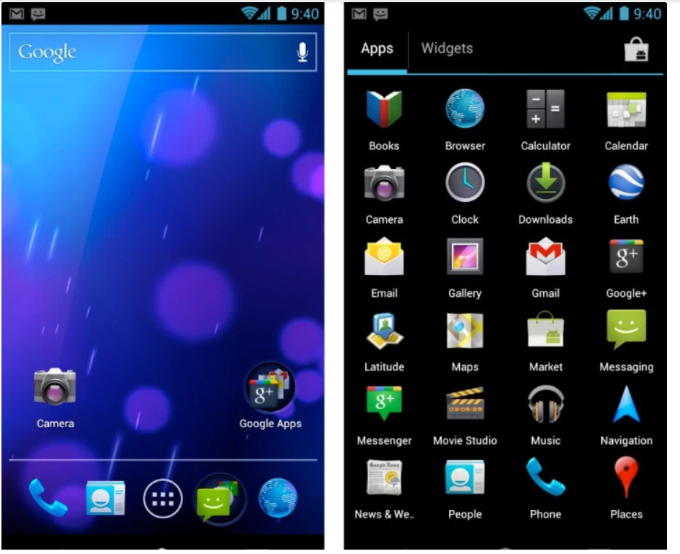
Android version 4.0: Ice Cream Sandwich October 19, 2011
Features:
Improved text input and spelling check.
Wi-Fi direct (Sharing information using NFC).
Photo Decor facility.
Improved keyboard correction.
Unlocking with face-fixing.
Improved video recording resolution.
Camera performance.
Up to 16 tabs in the web browser.

Slide 29
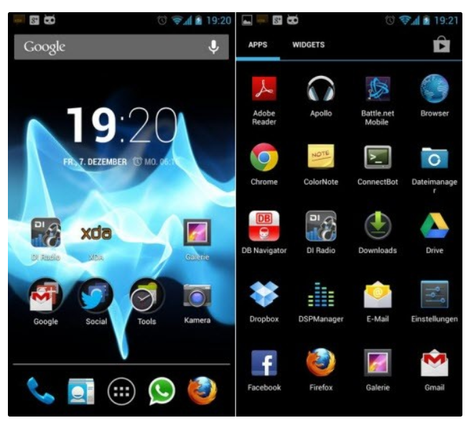
Android versions 4.1 to 4.3: Jelly Bean
Features:
Voice search.
Panorama.
Daydream as a screensaver.
Power control.
Improve camera application.
Security enhancement.
Voice typing.
Multiple user accounts on tablets only.
4k resolution support.
Supporting Bluetooth Low Energy.
Bi-directional text and other language support.
Support USB audio.
Set the volume of incoming calls and show a
message alert.
Native emoji support.

Slide 30
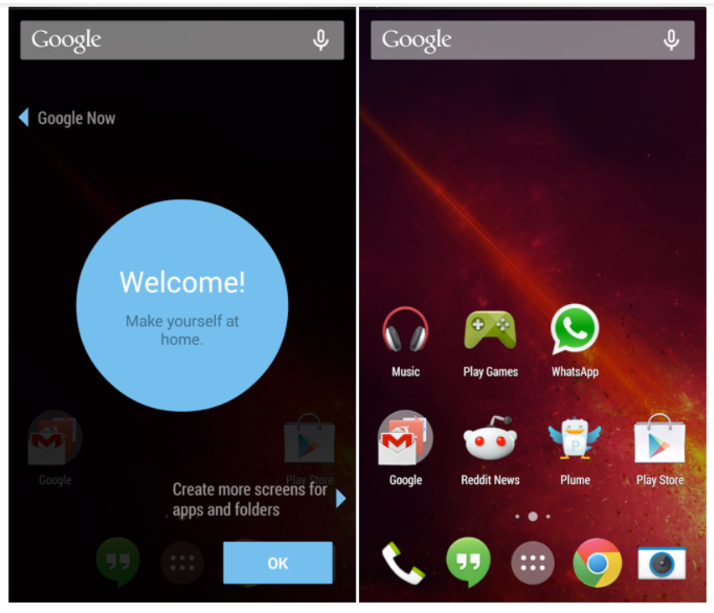
Android version 4.4: KitKat September 3, 2013.
Features:
Screen Recording.
KitKat adds a feature in ‘Google now’. Its name is
‘OK Google’.
“OK, Google” allows access to Google to the users without touching your mobile phone.
GPS Support.
Offline music support.
UI updates for google map navigation and alarm.
Introduction of ‘Emoji’ to the google keyboard.

Slide 31
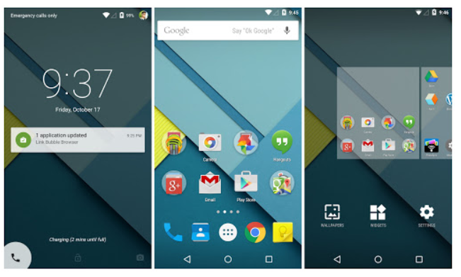
Android versions 5.0 and 5.1: Lollipop November 12, 2014
Features:
Support ART( Android Runtime).
Improvement in UI.
New material design.
Notifications on the Lock screen.
Revamped navigation bar.
Multiple sim card support.
High definition voice call.

Slide 32
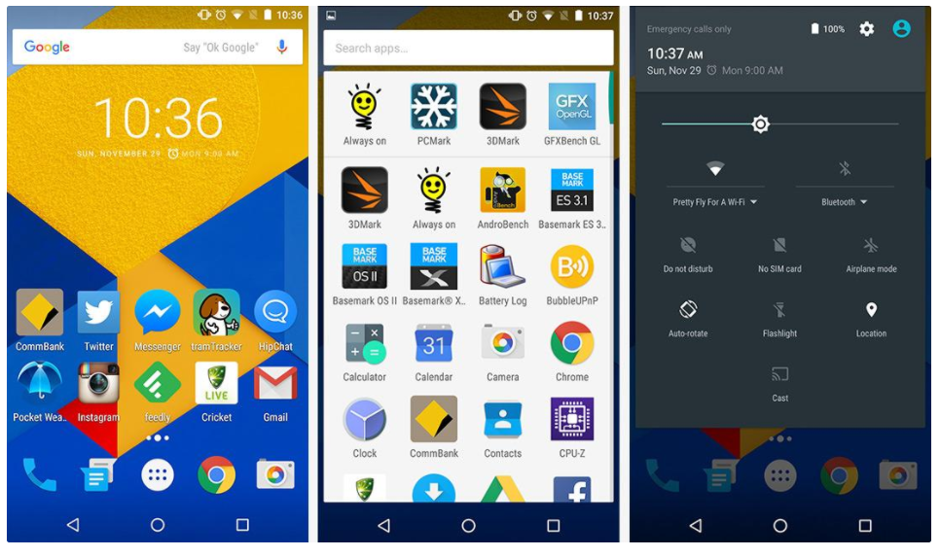
Android version 6.0: Marshmallow
Features:
Fingerprint authentication to unlock the screen.
USB Type C support.
Multi-window experiments (user can use two different apps in one screen).
Save battery-’Sleep Mode’.
App permission model-OPT(send a request for permission).

Slide 33
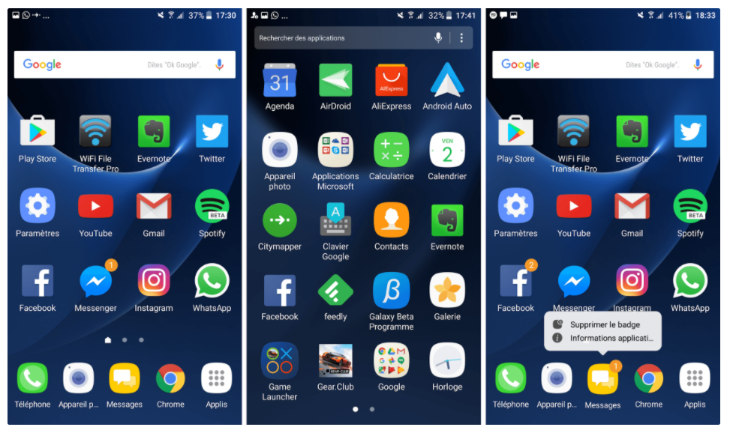
Android versions 7.0 and 7.1: Nougat March 2016
Features:
Provide multitasking.
Inline reply to messages and notifications so you won’t have to open up your Messenger application for quick replies.
Providing multi-window mode.
Improvements in storage manager.
Display touch improvement.

Slide 34
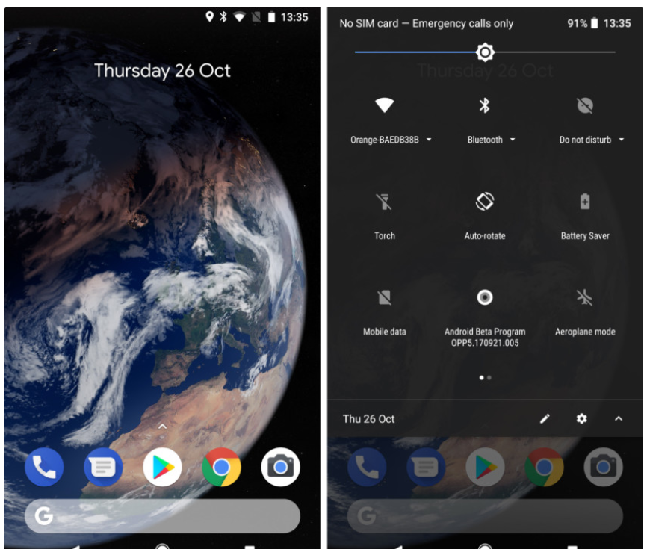
Android version 8.0 and 8.1: Oreo
Features:
Support PIP(Picture-in-Picture).
Multi-display support.
Google Play support.
Adaptive icons.
Revamped notification section(Users can set which notifications you want to show).

Slide 35
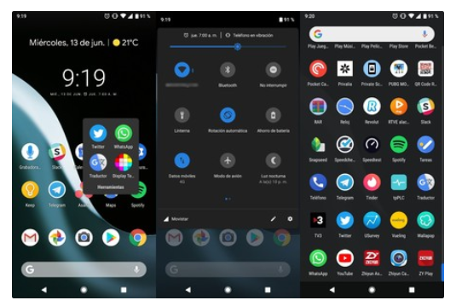
Android version 9: Pie August 2018.
Features:
New Gesture Navigation.
Artificial intelligence (AI) Compatible.
Adaptive Battery and Brightness.
App Actions.
New Screenshot Shortcuts.
Easier Screen Rotation.
Volume and Sound Improvement.
Selectable Dark Mode.
Slices.
Improved Security Features.
Digital Wellbeing.
New Accessibility Menu.
Easier Text Selection.
More Notification Information.

Slide 36
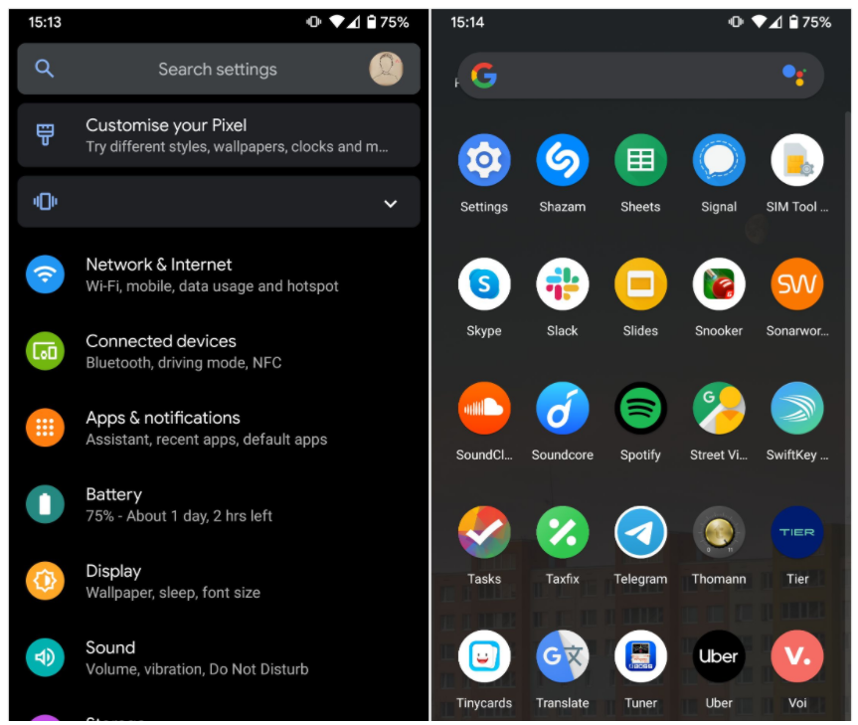
Android version 10: Android Q September 3, 2019
Features:
Support for the upcoming foldable
smartphones with flexible displays which is an upcoming rush.
System-wide dark mode.
Navigation control over gesture.
Smart reply for all messaging apps.
Support for Live caption.
Better notification control.

Slide 37
Android version 11 (Developer Preview) preview on February 19 of year 2021.
Features (announced):
New Support for 5G.
Privacy and Security; A new privacy choice for apps is the “Only This Time” option when you’re allowing the app access to your location, microphone, or camera.
Support new screen types (pinhole and waterfall).
Low Latency Options; adds low latency support in new MediaCodec APIs and HDMI which is very useful for use on external displays and TVs.

Slide 38
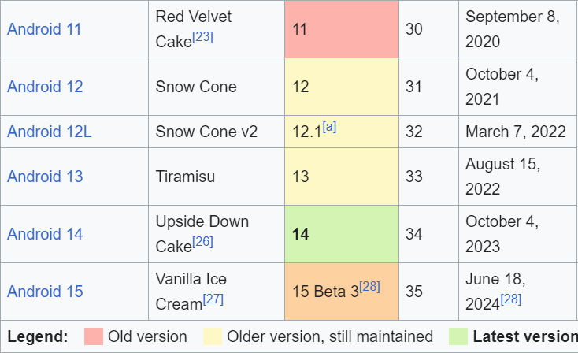
Android version summary
After version 10

Slide 39
SUPPORTING DEVICES

Slide 40
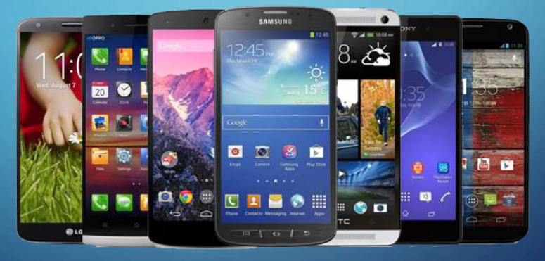
Mobile Phones

Slide 41
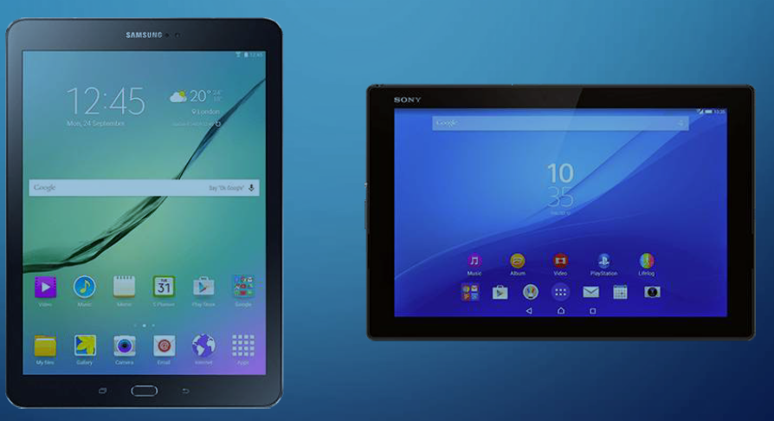
ANDROID TABLETS

Slide 42
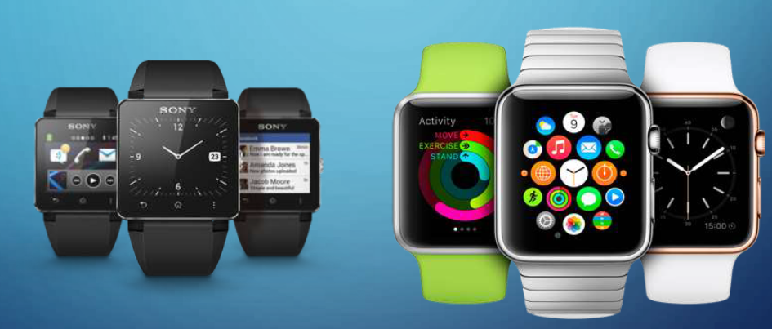
SMARTWATCHES

Slide 43
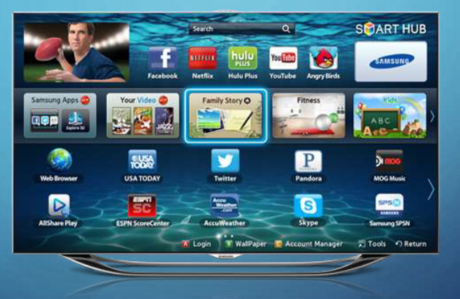
SMART TVs

Slide 44

SMART GLASSES

Slide 45
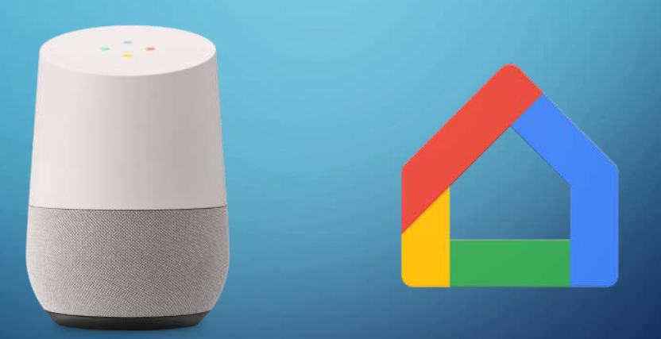
HOME APPLIANCES

Slide 46
Android Architecture
Android is a mobile platform which consists three things:
Android OS
Middleware
Key Applications

Slide 47
Android Architecture
Android OS is a software stack of different layers, where each layer is a group of several program components.
Android has the following layers:
Applications
Application Framework
Libraries
Android Runtime
Linux Kernel

Slide 48
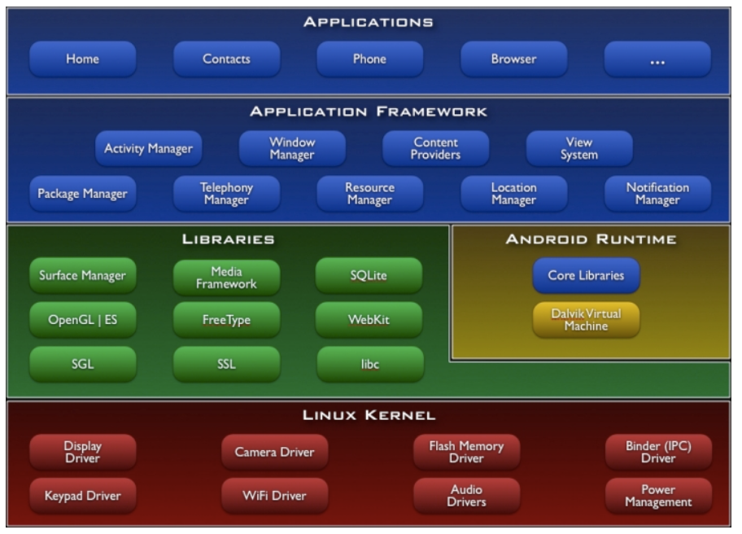
Android Architecture

Slide 49
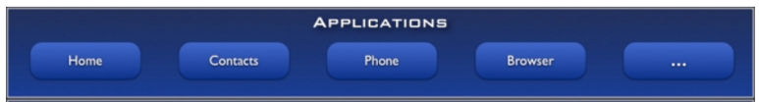
Applications
Written using Java Language
Email Client
SMS Program
Maps
Browser
Calendar
Contacts
Supports Parallel running
No compulsory applications

Slide 50
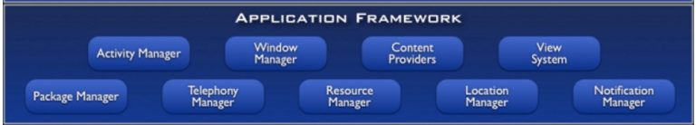
Application Framework
The Application Framework layer provides many higher-level services to applications in the form of Java classes.
Application developers are allowed to make use of these services in their applications.

Slide 51
Application Framework
The Android framework includes the following key services −
Activity Manager − Controls all aspects of the application lifecycle and activity stack.
Window Manager − Determine screen information to determine the requirements needed to crete windows for the application.
Content Providers − Allows applications to publish and share data with other applications.
View System − An extensible set of views used to create application user interfaces.
Telephony Manager − sim card, and device part such as the microphone, camera, and speakers.
Resource Manager − Provides access to non-code embedded resources such as strings, color settings and user interface layouts.
Location Manager − Location permission from the users, deliver location, and aware experiences.
Notifications Manager − Allows applications to display alerts and notifications to the user.

Slide 52
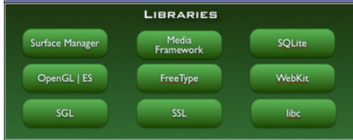
Libraries
Useful to develop any third-party application.
Native libraries are written in a language that compiles to native code for the platform it run.

Slide 53
Libraries
1. SQLite - Responsible for Database Operation
2. Free Type - Font Support
3. Media F/W - Audio,Video Format
4. Open GL(Open Google Library) - 2D,3D Graphics Support
5. SSL - Encrypted Communication between Client and Server
6. SGL (Scalable Graphics Libraries)- For Basic Graphics Support
7. Webkit - Allows web browser capabilities & supports

Slide 54
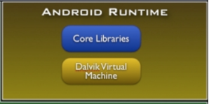
Android Runtime
Android Runtime consists of Core Libraries and Dalvik Virtual Machine.
Core Libraries are written in C/C++ languages. This libraries are helpful for runtime environment. Some of the core libraries are Data Structure, File Access, Network Access, Utilities and Graphics.

Slide 55
DVM(Dalvik Virtual Machine)
Runtime environment for running android application.
JVM is used to run high-end applications while DVM is used for small-end applications.
DVM was first written by "Dan Bornstein“
Unlike JVM, the DVM does not run .class files but it runs .dex files.
.dex files are built from .class file at the time of compilation and provide higher efficiency in row resource environments.

Slide 56
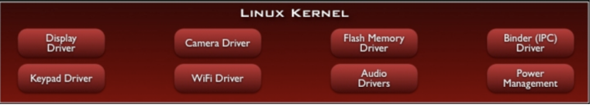
Linux Kernel
Linux Kernel is a Root layer of android Architecture which is responsible for device drivers(display, camera, Bluetooth, flash, web driver, usb, keypad,wifi etc.)
HAL (Hardware Abstraction Layer): allows you to implement functionality without affecting the higher level system.
power management, memory management and resources/drivers management.
Binder: Allows sharing of data from one app to another (Inter Process Communication) | Flash Memory: Easy share of data & read/write.

Slide 57
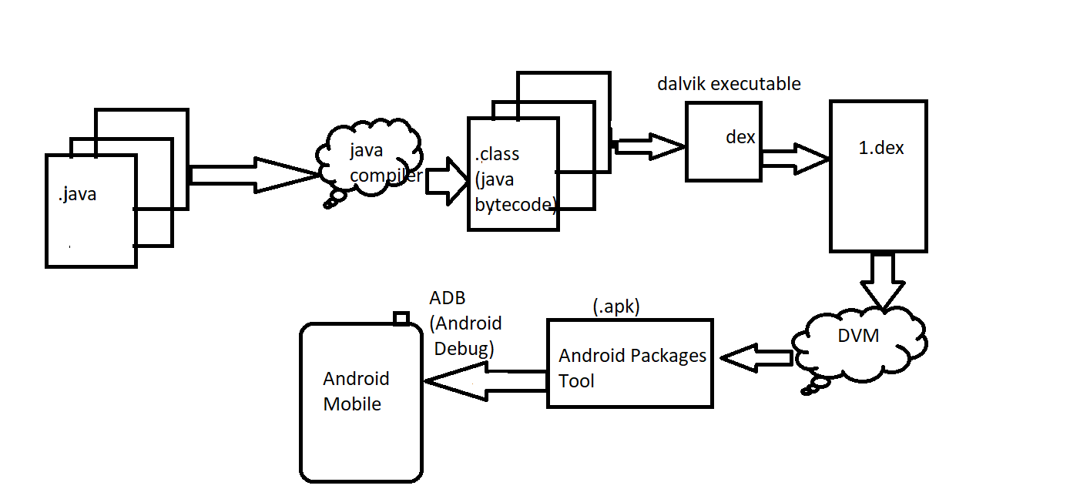
How Android Works?

Slide 58
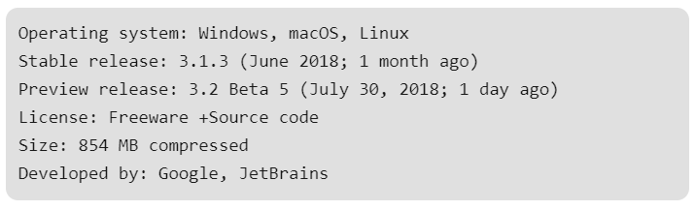
Download and Install Android Studio
Android Studio is the official integrated development environment for Google’s Android operating system, built on JetBrains’ IntelliJ IDEA software and designed specifically for Android development.

Slide 59
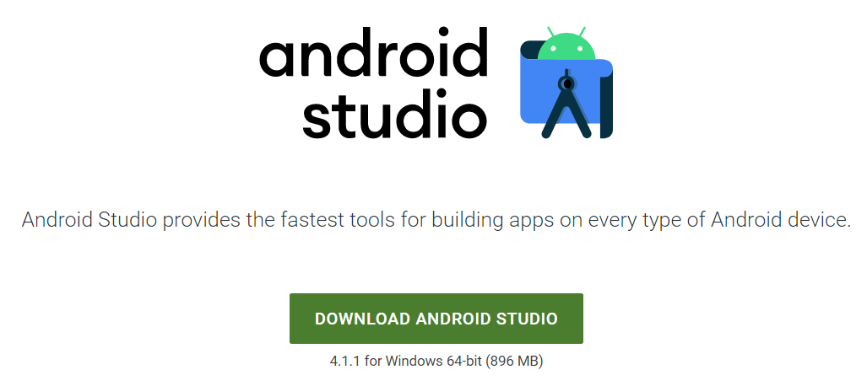
Installation guide:
Step – 1 : Go to URL https://developer.android.com/studio to get the Android Studio executable or zip file .
Step – 2 : Click on the download android studio button

Slide 60
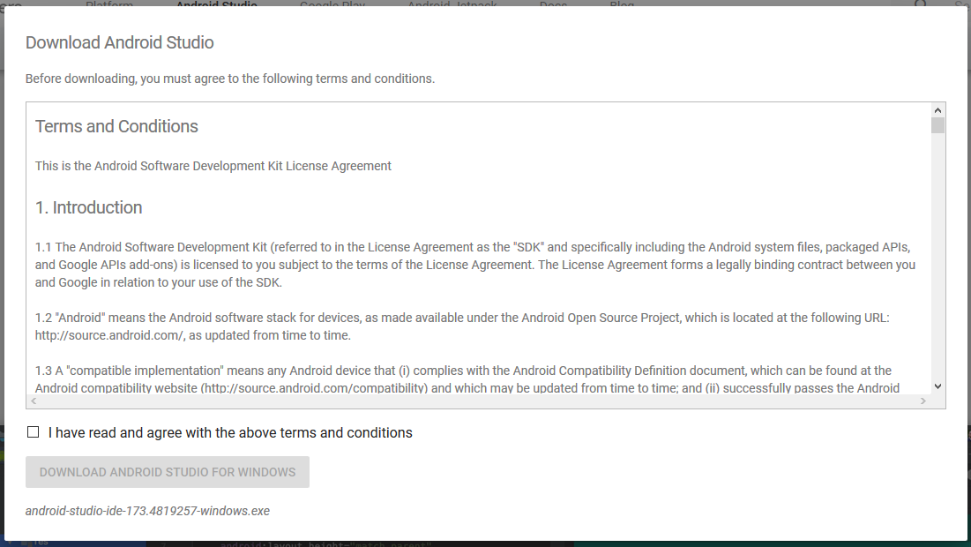
Click on the “I have read and agree with the above terms and conditions” checkbox followed by the download button.

Slide 61
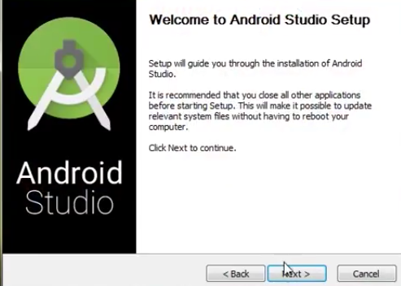
Step – 3:After the downloading has finished, open the file from downloads and run it . It will prompt the following dialogue box .

Slide 62
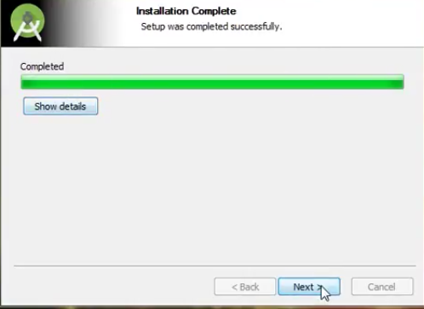
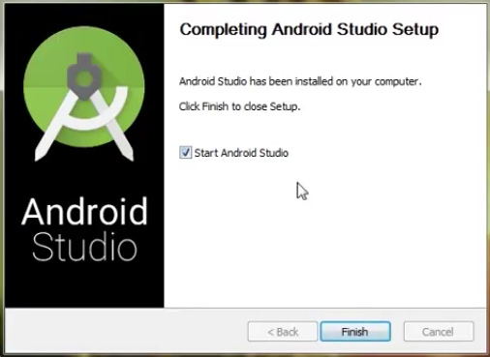
Step – 4 :It will start the installation, and once it is completed, it will be like the image shown below .

Slide 63
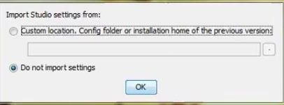
Step – 5 :Once “Finish” is clicked, it will ask whether the previous settings needs to be impoerted [if android studio had been installed earlier], or not. It is better to choose the ‘Don’t import Settings option’ .

Slide 64
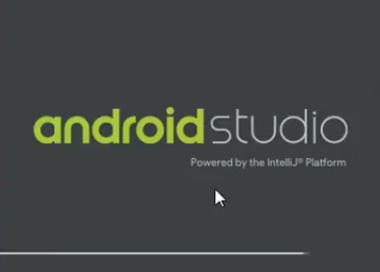

Step – 6 :This will start the Android Studio. Meanwhile it will be finding the available SDK components .

Slide 65
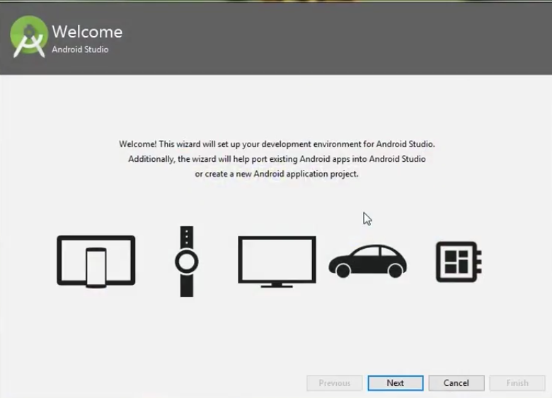
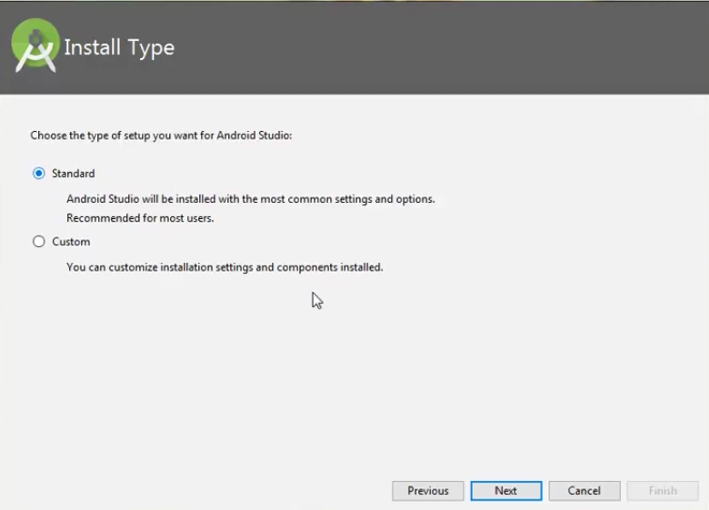
Step – 7:After it has found the SDK components, it will redirect to the Welcome dialog box .

Slide 66
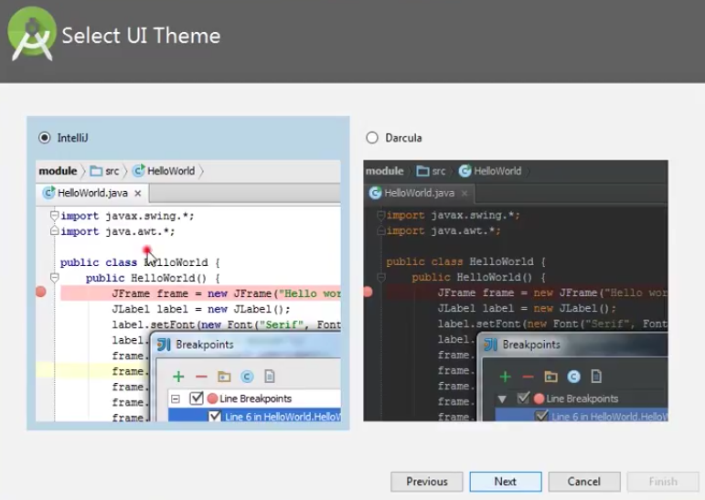
Choose Standard and click on Next. Now choose the theme, whether Light theme or the Dark one . The light one is called the IntelliJ theme whereas the dark theme is called Darcula . Choose as required.

Slide 67
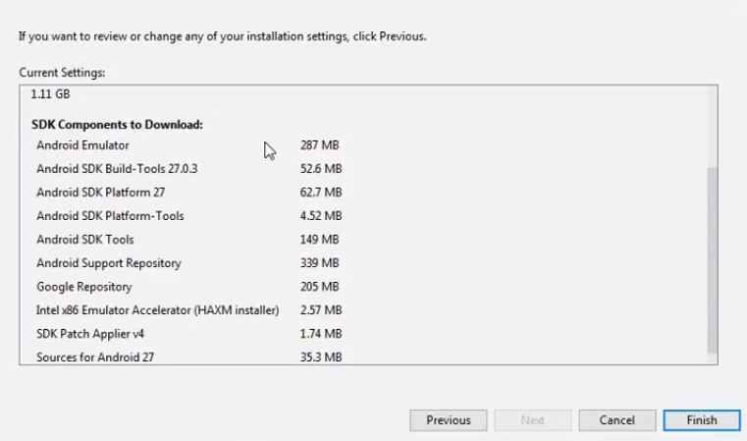
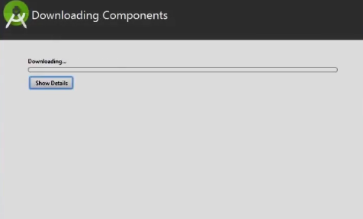
Step – 8 :Now it is time to download the SDK components .

Slide 68
C:\Users\Misha Patel\AppData\Local\Android\Sdk

Slide 69
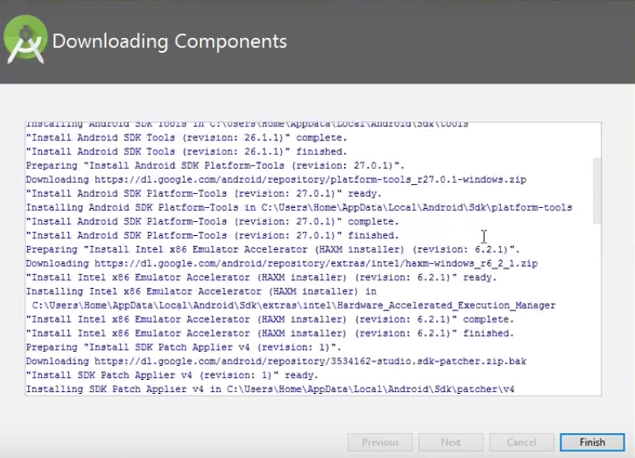
It has started downloading the components

Slide 70

Step – 9 :Click on ‘Start new android project’ to build a new app.

Slide 71
Exploring Android SDK
Android SDK is a software development kit developed by Google for the Android platform.
Android SDK comes bundled with Android Studio, Google's official integrated development environment (IDE) for the Android operating system

Slide 72
What Is the Android SDK?
The Android SDK is a collection of software development tools and libraries required to develop Android applications.
Every time Google releases a new version of Android or an update, a corresponding SDK is also released which developers must download and install.
The Android SDK comprises all the tools necessary to code programs from scratch and even test them. These tools provide a smooth flow of the development process from developing and debugging, through to packaging.
The Android SDK is compatible with Windows, macOS, and Linux, so you can develop on any of those platforms.

Slide 73

Android SDK

Slide 74

How to Install the Android SDK?
To install the Android SDK from within Android Studio, first start Android Studio.
From the Android Studio start page, select Configure > SDK Manager.

Slide 75

If you already have Android Studio open, the SDK Manager icon is found on the top right corner, as shown below.

Slide 76
Components of the Android SDK
The Android SDK consists of an emulator, development tools, sample projects with source code, Google API, and the required libraries to build Android applications

Slide 77
Android SDK Platform
Provided in the android.jar file that made up of several important packages.
Top-Level Package Name | Description
android.* | Android application fundamentals
dalvik.* | Dalvik Virtual machine support fundamentals
java.* | Core java classes and generic utilities for networking, security, math and so on
javax.* | Encryption support
junit.* | Unit-Testing support
org.apache.http.* | HTTP Protocol support
org.json | JavaScript Object Notation Support

Slide 78
Few Popular Third-Party Android APIs
Com.google.android.gms.ads.* = Google Mobile Ads SDK Package.
Com.google.android.gms.analytics.* = Google Analytics SDK for Android Package.
Com.google.android.gms.gcm = Google Cloud Messaging for Android.
Com.google.android.gms.appindexing = Google App Indexing Package.
Com.google.android.gms.appinvite = Google App Invites Package
Com.google.android.gms.games = Google Play Games Services Package
Com.google.android.gms.fitness = Google Fit Package

Slide 79
Android SDK Tools
Android SDK provides many tools to design, develop, debug and deploy your applications.
Android Studio
Android SDK and AVD Managers
Android Emulator

Slide 80
Android Studio
Launch the Android Virtual Device Manager.
Launch the Android SDK Manager.
Launch the Android Device Monitor

Slide 81
Android SDK and AVD Managers
Different Android Devices run different version of the Android Operating System.
Developers need to be able to target different Android SDK versions with their applications.
The Android Virtual Device Manager organizes and provides tools to create and edit AVDs.

Slide 82
SDK Platform-Tools
Android Platform-Tools are used to support the features for the current Android platform and are necessary for Android app development.
Android Debug Bridge (adb): This is a handy command-line tool that lets you communicate with a device. The adb command allows you to perform device actions, such as installing and debugging apps. It also provides access to a Unix shell that you can use to run a variety of commands on a device.
fastboot: This lets you flash a device with a new system image.
systrace: This tool helps collect and inspect timing information across all processes running on your device at the system level. It's crucial for debugging app performance.

Slide 83
Android Emulator
The Android Emulator is a device-emulation tool that simulates Android devices on your computer, allowing developers to test applications on different devices and Android API levels, without needing to have physical devices for each.
The emulator comes with configurations for various Android phones, tablets, Wear OS, and Android TV devices.

Slide 84
Android Emulator
The Android emulator provides almost all of the capabilities of a real Android device. You can perform the following activities:
simulate phone calls and text messages
simulate different network speeds
specify the location of the device
simulate hardware sensors such as rotation
access Google Play Store and much more
Often it is faster and easier to test your app with an emulator instead of using a physical device.

Slide 85

Emulators vs Simulators

Slide 86
Android Terminologies
XML
In Android, XML is used for designing the application’s UI like creating layouts, views, buttons, text fields etc. and also used in parsing data feeds from the internet.
View
A view is an UI which occupies rectangular area on the screen to draw and handle user events.
Layout
Layout is the parent of view. It arranges all the views in a proper manner on the screen.
Activity
An activity can be referred as your device’s screen which you see. User can place UI elements in any order in the created window of user’s choice.
android.app.Activity class

Slide 87
Android Terminologies
Emulator
An emulator is an Android virtual device through which you can select the target Android version or platform to run and test your developed application.
Manifest file
Manifest file acts as a metadata for every application. This file contains all the essential information about the application like app icon, app name, launcher activity, and required permissions etc.

Slide 88
Android Terminologies
Service
Service is an application component that can be used for long-running background processes.
It is not bounded with any activity as there is no UI. Any other application component can start a service and this service will continue to run even when the user switches from one application to another.
android.app.service class
Broadcast Receiver
Broadcast Receiver is another building block of Android application development which allows you to register for system and application events.
It works in such a way that, when the event triggers for the first time all the registered receivers through this broadcast receiver will get notified for all the events by Android Runtime

Slide 89
Android Terminologies
Fragment
Used to hold the code and screen logic for placing the same user interface components in multiple screens, which are represented by multiple Activity classes.
android.app.Fragment
Intent
Intent is a messaging object which can be used to communicate between two or more components like activities, services, broadcast receiver etc.
Intent can also be used to start an activity or service or to deliver a broadcast messages.

Slide 90
Android Terminologies
Context:
The Context class(android.content.context) is a fundamental building block of any android application and provides access to application-wide features such as the application’s private files and device resources, as well as system-wide services.
The application wide Context object is instantiated as an Application object(android.app.Application).

Slide 91
Performing Application Tasks with Activities
Activity class is the core of any Android Application.
You define and implement Activity class for each screen in your application.
For example a simple game application might have the following five activities:
A starting screen: displays the application name and version
A main menu screen: users choose what they want to do within the application.
A game play screen
A high score screen
A help/about screen

Slide 92

Android Activity

Slide 93

The Activity stack

Slide 94
Method stubs of Activity class
public class MyActivity extends Activity
{
protected void onCreate(Bundle savedInstanceState);
protected void onStart();
protected void onRestart();
protected void onResume();
protected void onPause();
protected void onStop();
protected void onDestroy();
}

Slide 95

Android Activity Lifecycle methods

Slide 96

Activity Lifecycle

Slide 97
Managing Activity Transitions with Intents
Launching the new Activity by Class Name (Explicit Intent)
Intent intent = new Intent(MainActivity.this,SecondActivity.class); startActivity(intent);
Launching an Activity Belonging to Another Application (Implicit Intent)
Uri number = Uri.parse(“tel: 9998580268”);
Intent dial = new Intent(Intent.ACTION_DIAL,number);
startActivity(dial);

Slide 98
Android Services
Android Services are the application components that run in the background.
We can understand it as a process that doesn’t need any direct user interaction.
As they perform long-running processes without user intervention, they have no User Interface(connection to server).
They can be connected to other components and do inter-process communication (IPC).
Services must be registered in the Android manifest file.

Slide 99
Android Services
A whether,email or social network app might implement a service to routinely check for updates on the network.
A game might create a service to download and process the content for the next level before the user actually needs it.
A news application might implement a service to “preload” content by downloading news stories before the user launches the application, to improve performance and responsiveness.

Slide 100
Receiving and Broadcasting Intents
You can broadcast an Intent(via a call to the sendBroadcast() method of the Context class) to the Android system at large,allowing any interested application(called a BroadcastReceiver) to receive that broadcast and act upon it.
Broadcasts are generally used to inform the system that something interesting has happened.
For example, a commonly listened-for broadcast Intent is ACTION_BATTERY_LOW, which is broadcast as a warning when the battery is low.

Slide 101
Context in Android
Context of the current state of our application.
We can break the context and its use into three major points:
It allows us to access resources.
It allows us to interact with other Android components by sending messages.
It gives you information about your app environment.

Slide 102
Context in Android
current state of the application.
Usually, the app got multiple screens like display/inquiry/add/delete screens. So when the user is searching for something, the context is an inquiry screen in this case.
It can be used to get information regarding the activity and application.
The inquiry screen’s context specifies that the user is in inquiry activity, and he/she can submit queries related to the app
It allows us to interact with other Android components by sending messages.
Both the Activity and Application classes extend the Context class.

Slide 103
Understanding Context by a Real
World Example
Let’s a person visit a hotel. He needs breakfast, lunch, and dinner at a suitable time. Except for these things there are also many other things, he wants to do during the time of stay. So how does he get these things? He will ask the room-service person to bring these things for him. Right?
So here the room-service person is the Context considering you are the single activity and the hotel to be your app, finally, the breakfast, lunch & dinner have to be the resources.

Slide 104

Types of Context in Android

Slide 105
getApplicationContext()
It is used to return the context which is linked to the Application which holds all activities running inside it.
When we call a method or a constructor, we often have to pass a context and often we use “this” to pass the activity context or “getApplicationContext” to pass the application context.
This method is generally used for the application level and can be used to refer to all the activities.
For example, if we want to access a variable throughout the android app, one has to use it via getApplicationContext()

Slide 106




Slide 107
Activity Context
It is the activity context meaning each and every screen got an activity.
For example, EnquiryActivity refers to EnquiryActivity only and AddActivity refers to AddActivity only.
The method of invoking the Activity Context is getContext().
Some use cases of Activity Context are:
The user is creating an object whose lifecycle is attached to an activity.
Whenever inside an activity for UI related kind of operations like toast, dialogue, etc

Slide 108

Example

