Slide 1
Secure data hiding using steganography
CAPSTONE PROJECT
Presented By: Parth Pawar
Student Name : Parth Pawar
College Name & Department : NBN Sinhgad Technical Institutes Campus

Slide 2
OUTLINE
Problem Statement
Technology used
Wow factor
End users
Result
Conclusion
Git-hub Link
Future scope

Slide 3
Problem Statement
Develop a Python-based steganography system that securely hides a secret message inside an image using OpenCV. The system should include:
1. Takes a text message and a password, embeds the message into an image, and saves it.
2. Extracts the hidden message from the encrypted image after verifying the password.
3. The system should store the message length in the image to prevent decoding extra unwanted characters.
4. The password should be hashed using SHA-256 to ensure authentication before decryption.

Slide 4
Technology used
Programming Language: Python
Libraries:
- OpenCV (cv2) → For image processing (reading, modifying, and saving images)
- hashlib → For secure SHA-256 password hashing
- os (optional) → For handling file operations (if needed)
Platform: Works on Windows, Linux, and macOS (requires Python & OpenCV installed)
Image Format: Supports common formats like PNG, JPG (PNG recommended to avoid compression loss)

Slide 5
Wow factors
1. Uses SHA-256 hashing to verify decryption, preventing unauthorized access. Unlike basic steganography, this adds an extra layer of security.
2. Stores the secret message inside pixel values without altering the image visibly, keeping the quality intact. (PNG recommended for best results)
3. Unlike naive implementations, this project stores the message length in the image, ensuring accurate decryption without extra unwanted characters.
4. Uses OpenCV for efficient pixel manipulation, making it faster and more optimized than traditional LSB (Least Significant Bit) steganography.
5. Works on Windows, Linux, and macOS with no major changes needed, making it flexible and easy to use.

Slide 6
End users
1. Cybersecurity Enthusiasts & Ethical Hackers
2. Journalists & Whistleblowers
3. Students & Researchers
4. Intelligence Agencies & Investigators
5. Data Security Professionals

Slide 7
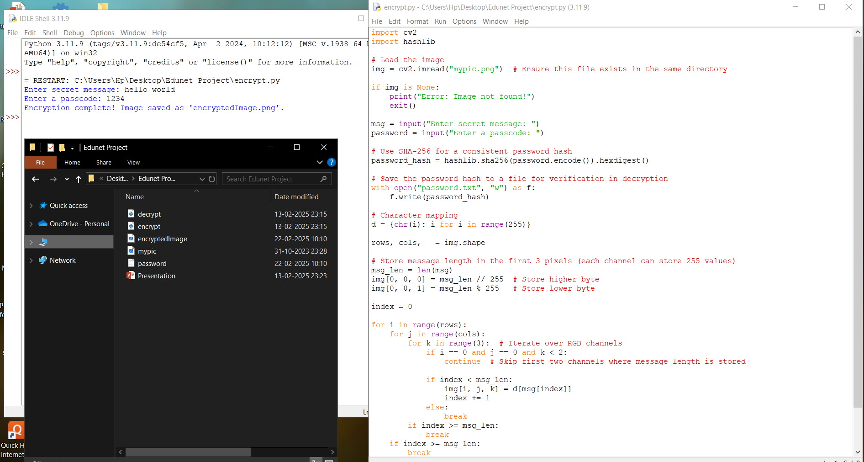
Results

Slide 8
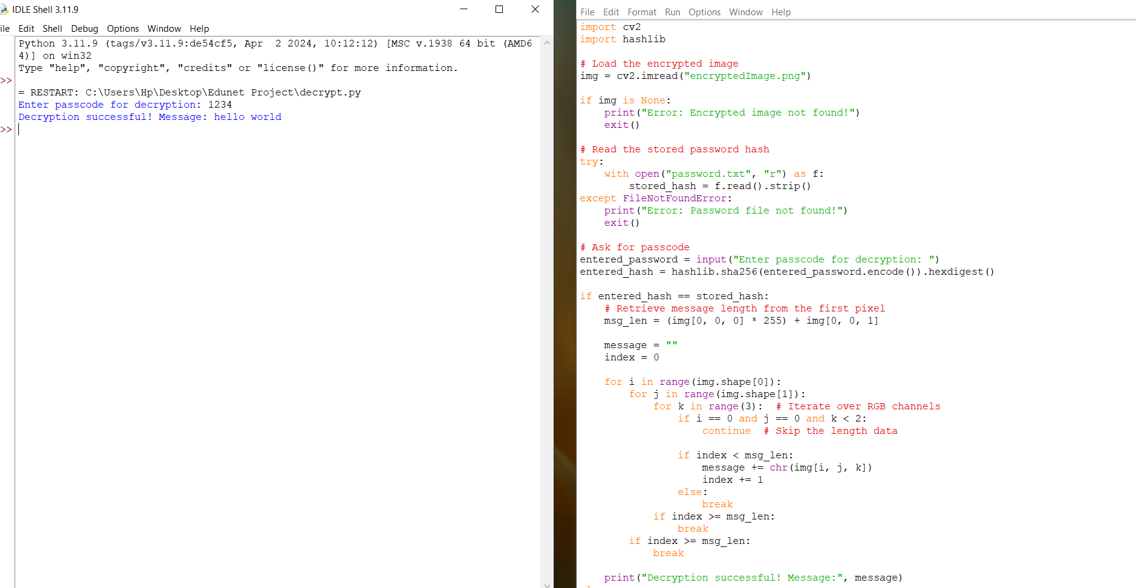

Slide 9
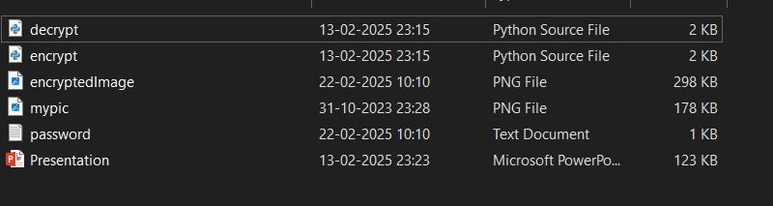

Slide 10
Conclusion
This project successfully implements a secure image steganography system that allows users to hide and retrieve secret messages within an image using password-based encryption. By leveraging OpenCV for image processing and SHA-256 hashing for authentication, it ensures both data confidentiality and integrity.
Unlike traditional steganography, this solution eliminates garbage characters during decryption by storing the message length within the image. The project is simple, efficient, and cross-platform compatible, making it a practical tool for secure communication in various fields, including cybersecurity, journalism, and data protection.

Slide 11
GitHub Link
https://github.com/parth-pawar/Image-Steganography

Slide 12
Future scope(optional)
1. Advanced Encryption – Integrate AES to further enhance message security before embedding it into the image.
2. Support for Multiple Image Formats– Extend compatibility to formats like BMP, TIFF, and even GIF frames for diverse use cases.
3. Mobile & Web Application – Develop a mobile app or web-based tool for easy encryption and decryption without requiring Python installation.
4. Text-Based Image Watermarking – Enhance the system to embed invisible watermarks in images, useful for copyright protection.
5. AI-Based Steganalysis Defense – Implement AI-based detection resistance to prevent steganography detection techniques from exposing hidden messages.
6. Secure Data Transmission – Apply this technique for covert messaging in military, forensic investigations, and intelligence to ensure private communications.

Slide 13
THANK YOU

