Slide 1


Smart AI Polymorphic System
Prepared By: Guided By:
Parth.T.Shah (202202100410014) Mr. Sandip Patel
Harpreet Singh Lohia(202202100410012) Lecturer (CE)
Paramjeet Singh Lohia(202202100410040) CGPIT.
Prince Unadkat(202202100410053)
Diploma(6th Semester) (CE)
CGPIT.

Slide 2
Outline
2
Introduction
Motivation
Objective
Functionality and Features
Diagrams
Technologies/Platform to be used for development
Wireframe and Implementation
Future work
References
Project Title, CGPIT

Slide 3
Introduction
This project is intended for the construction of a smart garbage management device to enhance waste collection efficiency and provide real-time monitoring.
Why This Project?
Advantages:
  Efficient Area Cleaning: The smart system helps in optimizing waste collection routes and schedules.
  Real-time Monitoring with App Notifications: Provides updates and alerts on waste levels and system status.
Rationale:
  As this is a college project, we are incorporating advanced ICs and components to gain hands-on experience with these technologies and their environments. This practical experience is crucial for understanding and implementing modern waste management solutions.
Project Title, CGPIT

Slide 4
Team Contributions:
Parth:
Coding phase
Document phase
Working on IC , Building the real model
Prince:
3D modeling
Documentation assistance , Component specification
Paramjeet & Harpreet:
Research on app development
Real-time database integration
Guidance from YouTube videos , Website contribution
Previous Work Issues:
Integration challenges with existing components.
Need for effective power management solutions.
Optimization required for real-time data processing and object detection.
Project Title, CGPIT

Slide 5
Motivation
Reason for Selection:
Addresses the challenge of efficient waste management.
Need for Software:
Optimizes Collection: Real-time data reduces unnecessary trips.
Enhances User Convenience: Notifications for full dustbins.
Reduces Costs: Efficient resource use and operational savings.
Supports Environment: Contributes to cleaner, healthier spaces.
Why This Project:
Technological Integration: Hands-on experience with GPS, cameras, IoT.
Practical Benefits: Improves waste collection efficiency and user experience.
Promotes Innovation: Sets a new standard in waste management solutions.
Project Title, CGPIT

Slide 6
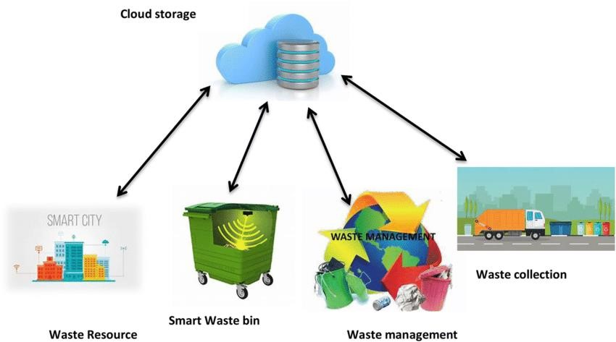
Project Title, CGPIT

Slide 7
Objective
Real-Time Monitoring: Use sensors to track fill levels and optimize collection schedules.
Optimized Collection Routes: Analyze data to reduce fuel consumption, traffic, and emissions.
Cost Reduction: Lower operational costs through efficient routes and schedules.
Prevent Overflow and Littering: Receive alerts to prevent bin overflow and maintain cleanliness.
Resource Efficiency: Improve resource allocation by collecting waste only when necessary.
Data-Driven Decisions: Utilize data for informed decision-making and trend analysis.
Remote Monitoring: Manage and monitor bins remotely, enhancing efficiency in large-scale systems.
Environmental Sustainability: Minimize carbon footprint and environmental impact through optimized operations.
Project Title, CGPIT

Slide 8
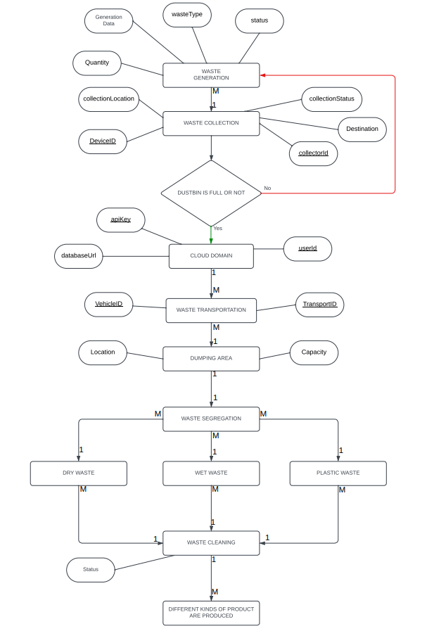
Entity-Relationship Diagram
Project Title, CGPIT

Slide 9
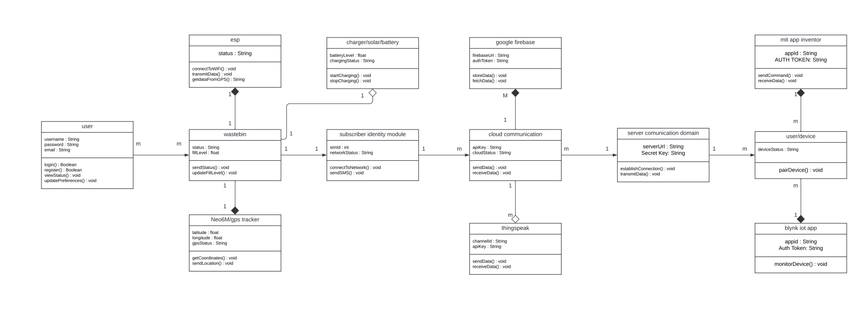
Class Diagram
Project Title, CGPIT

Slide 10
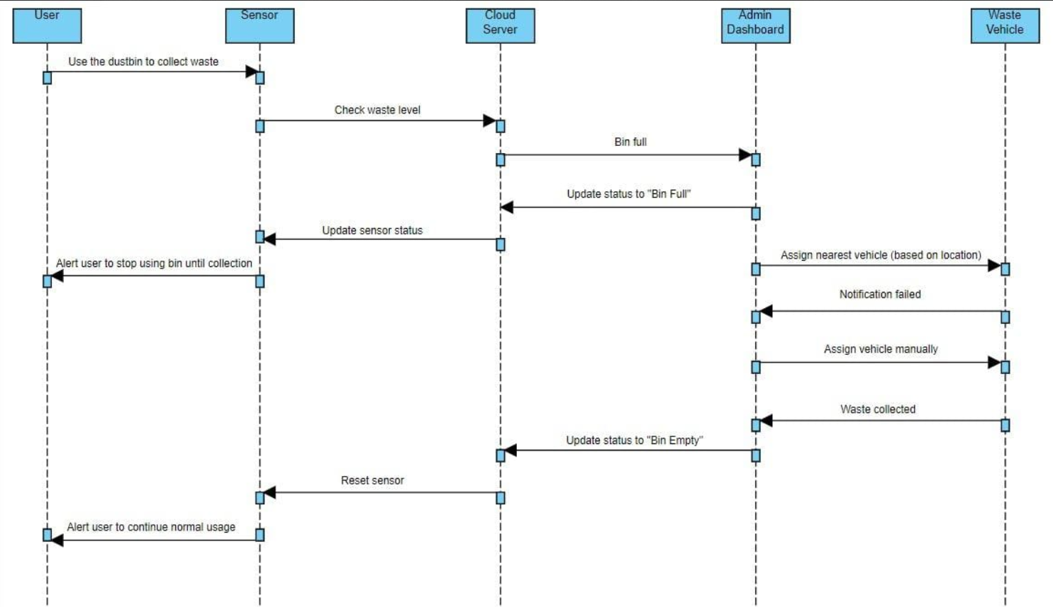
Sequence Diagram
Project Title, CGPIT

Slide 11
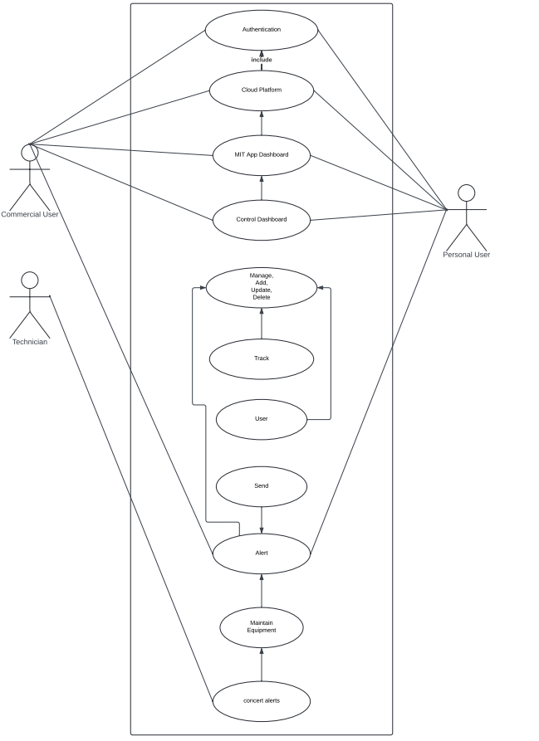
Use Case Diagram
Project Title, CGPIT

Slide 12
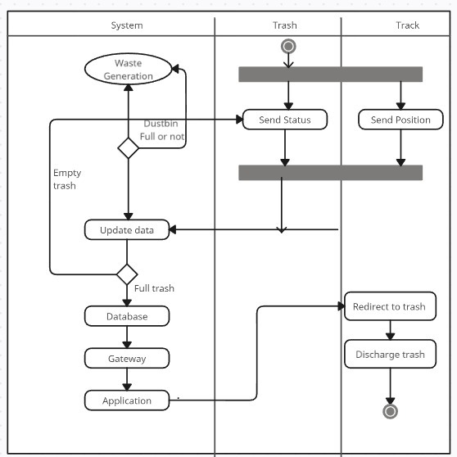
Activity Diagram
Project Title, CGPIT

Slide 13
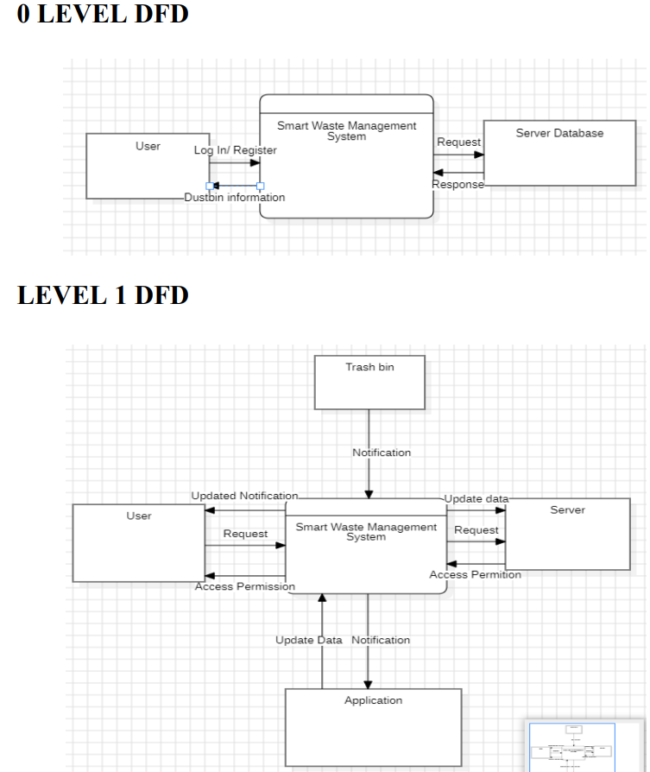
Data Flow Diagram
Project Title, CGPIT

Slide 14
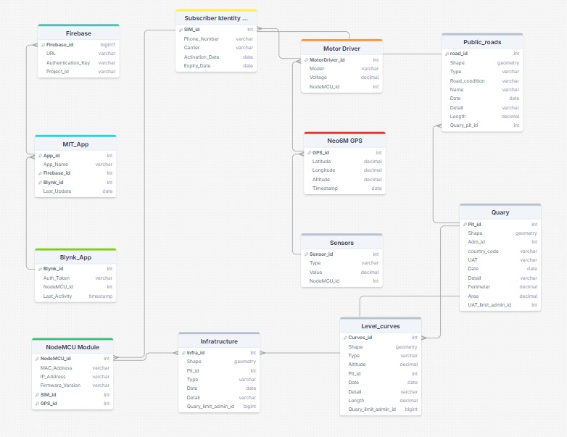
Database Schema Diagram
Project Title, CGPIT

Slide 15
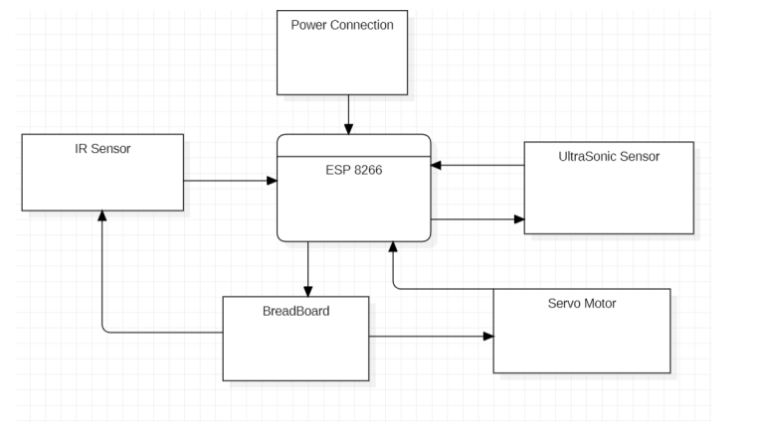
Basic Circuit Diagram
Project Title, CGPIT

Slide 16
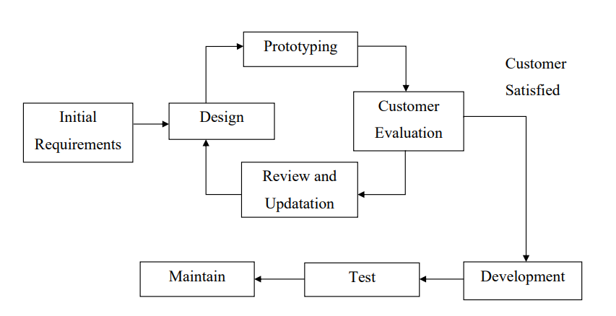
Prototype Model
Project Title, CGPIT

Slide 17
Functionality and Features
Data-Driven Insights:
  Analytics and reports on waste levels and collection performance.
Remote Management:
  Manage and monitor bins and schedules remotely.
Environmental Sustainability:
  Reduce carbon footprint and improve urban cleanliness.
Public Engagement:
  Notifications and feedback channels for users.
Scalability:
  Adaptable to growing urban areas and changing waste patterns.
Smart City Integration:
  Align with smart city initiatives for cohesive urban infrastructure.
Project Title, CGPIT

Slide 18
Technologies/Platform to be used for development
Technology: C++
Description: C++ is a powerful, high-performance programming language commonly used in embedded systems. It provides efficient control over system resources and hardware, making it ideal for developing firmware and managing the low-level operations of the Smart Waste Management System.
Platform: Arduino IDE
Description: The Arduino Integrated Development Environment (IDE) is a user-friendly platform for programming microcontrollers. It supports C++ and provides a simplified interface for writing, debugging, and uploading code to various microcontroller boards, including the NodeMCU. The Arduino IDE facilitates rapid development and testing of embedded applications, making it a suitable choice for developing and managing your smart waste management system.
Project Title, CGPIT

Slide 19
Components Used
Ultrasonic Sensor: Detects dustbin fill levels.
IR Sensor: Manages waste processing signals.
GPS Tracker (Neo6M): Provides location tracking for routes.
Power Circuit & Battery: serving as an alternative to solar panels.
Miniature Camera: Detects objects to avoid collisions.
SIM IC: Enables internet connectivity for remote communication.
Motors & Wheels:Enables movement and mobility of the project.
Motor Driver: Controls motor functions for precise movement.
NodeMCU: ESP8266 WiFi Module: Core of NodeMCU with:
    32-bit Microprocessor: High performance.
    4MB Flash Memory: Ample storage for programming.
    GPIO, ADC, PWM, I2C, SPI Pins: Versatile connectivity.
    USB-TTL Interface: Simplifies programming.
    Arduino IDE Compatibility: Easy integration with existing code.
Project Title, CGPIT

Slide 20
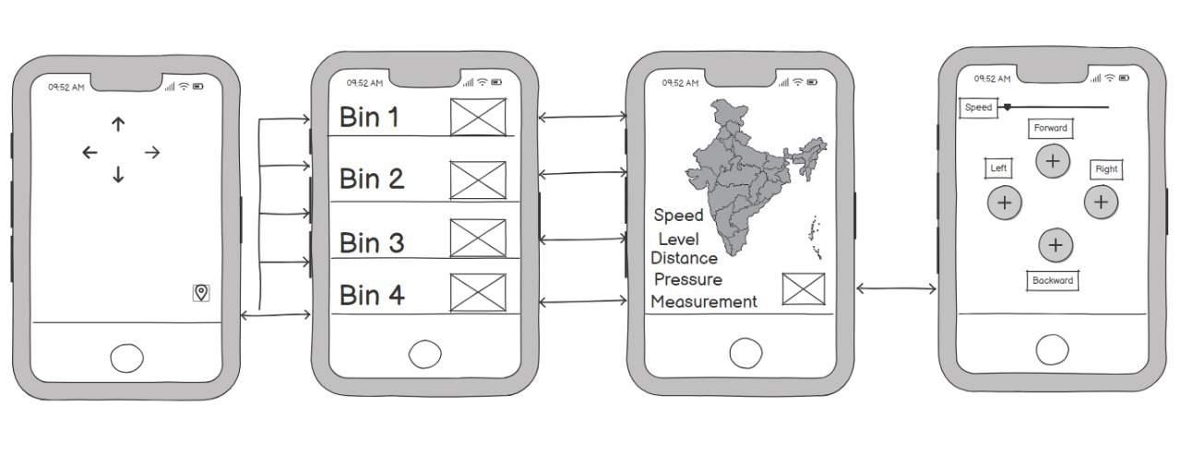
Implementation
Wire Framing of
Smart Waste Management System
Project Title, CGPIT

Slide 21
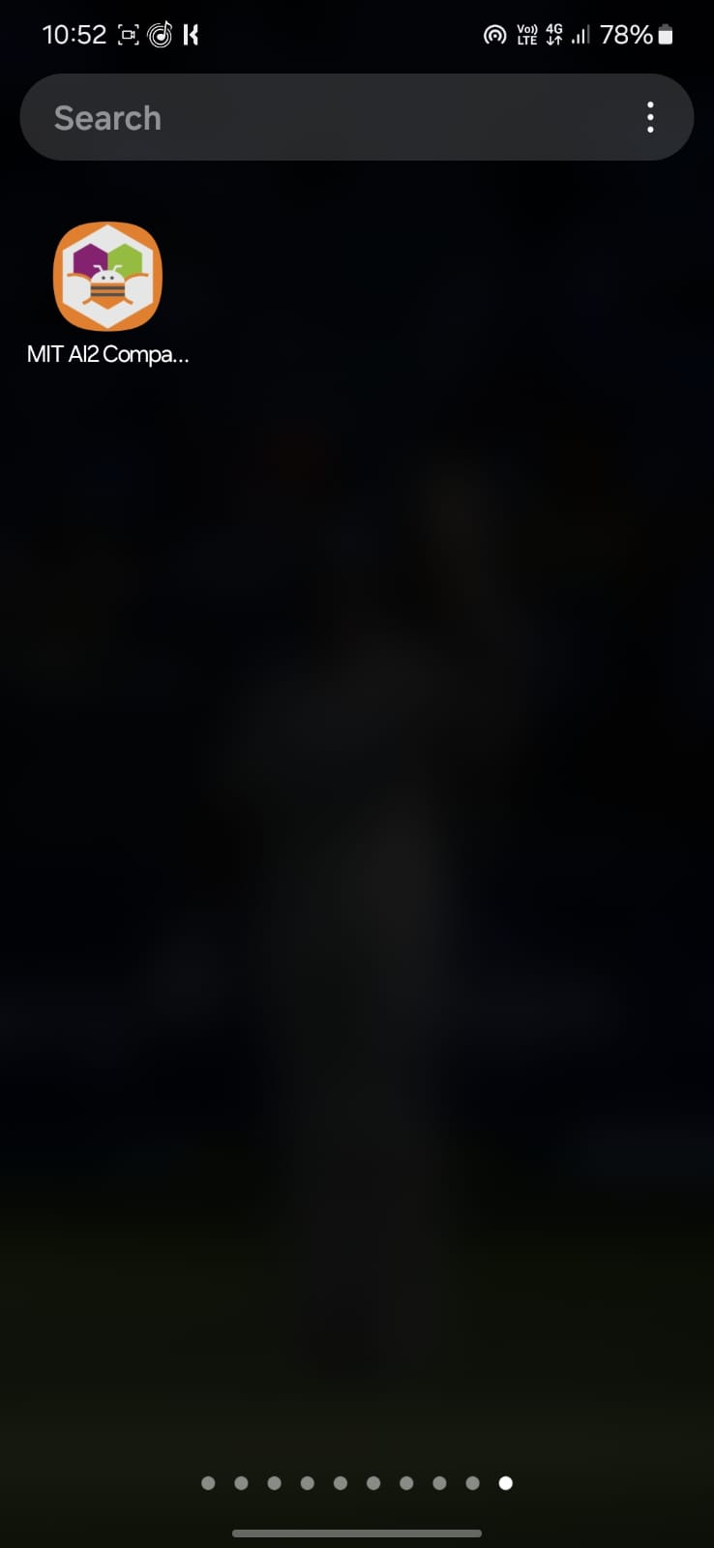
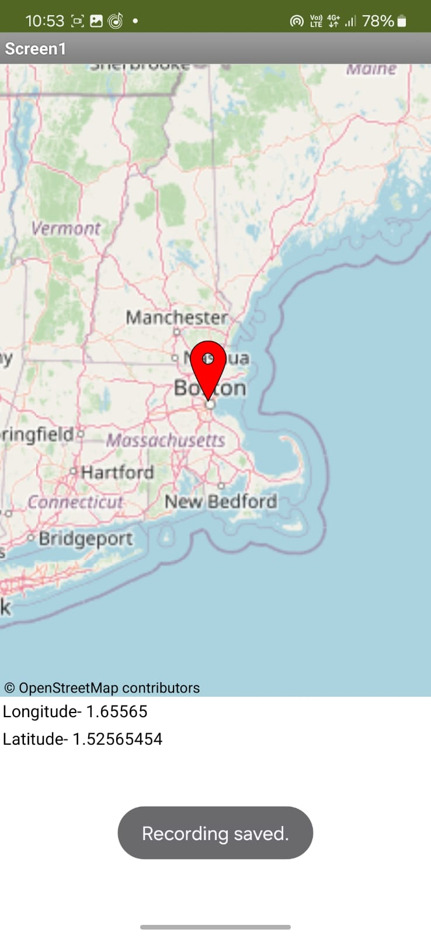

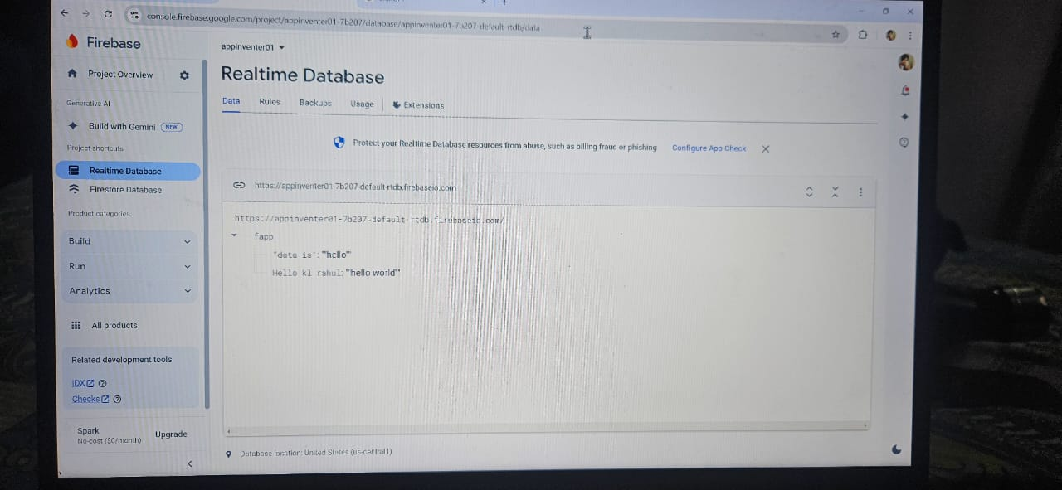
Interface
RealTime Gps Data
Project Title, CGPIT

Slide 22

Future work
This Project offers a lot of scope for adding newer features It is probable that in the future, waste management systems will prioritize sustainability by integrating cutting-edge technologies for effective sorting, recycling, and waste-to-energy procedures. While creative educational initiatives could raise public awareness and engagement, astute monitoring and data analytics could optimize collecting routes. The elimination of single-use items and promotion of reuse are two aspects of the circular economy that will probably have a big impact on waste management in the future. Further developments in biodegradable packaging and bio-based materials may help reduce their negative effects on the environment
Project Title, CGPIT

Slide 23
References [If applicable]
Book References
David L. Poole, Alan K. Mackworth, "Artificial Intelligence: Foundations of Computational Agents", Cambridge University Press, 2017.
Michael Margolis, "Arduino Cookbook", O'Reilly Media, 2011.
A. N. P. P., "Smart Cities: Big Data, Civic Hackers, and the Quest for a New Utopia", MIT Press, 2016.
Web references
Robu.in: Robu.in
Adafruit: Adafruit
SparkFun: SparkFun
Arduino Official Website: Arduino
Instructables: Instructables
Project Title, CGPIT

Slide 24
Paper references
G. S. V. H. M. Rao, R. R. C. K. Reddy, "IoT-Based Smart Waste Management System", International Journal of Advanced Research in Computer and Communication Engineering, vol. 6, no. 3, pp. 149-153, March 2017.
A. S. J. G. S. Patel, "Smart Waste Management System using IoT", IEEE Conference on Communication and Network Technologies (ICCNT), pp. 105-110, July 2018.
S. K. M. N. S. Patil, P. M. B. Jadhav, "An IoT-Based Smart Waste Management System", International Journal of Engineering Science and Technology (IJEST), vol. 4, no. 6, pp. 2456-2460, June 2016.
Project Title, CGPIT

Slide 25
Thank You
Project Title, CGPIT

