Slide 1




Trends
Changes over time and/or sensor site
Analysis-1
Sudden change over time or one site significantly different from others
Anomalies
Missing Data
Missing Data
Change in collection frequency
Analysis-2
Collectiion Freq.
Unrealistic values (e.g. water temperature
Unrealistic Values
higher than 100 degrees).

Slide 2

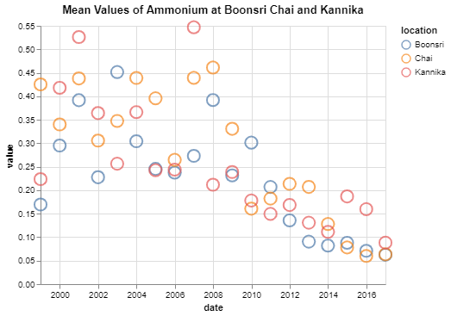
The Trend
We can see that the average values of Ammonium at Boonsri, Chai and Kannika declined with the passage of years.

Slide 3
Anomalies
With the decline of values of Ammonium we can see that there are a lot of anomalies. We can see most of them can be found in Chai location such as in year 2007-2008 or in Kannika in year 2007. Despite that the average values have a decreasing graph with time.

Slide 4
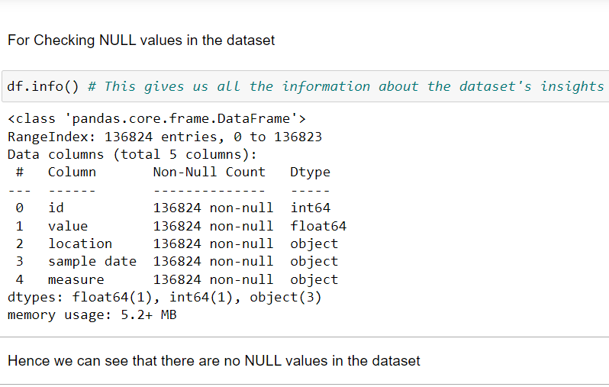
Missing Data
With the help of df.info() we can see that there are no NULL values in the dataset, therefore we do
not have to deal with them.

Slide 5
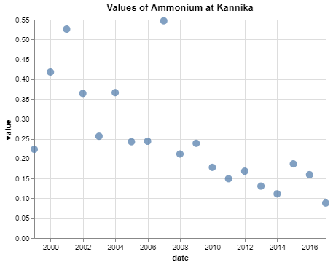
Change in collection frequency
We did filtering, indexing, statistical analysis such as taking mean of chemical values per year to see how the values are changing per year.

Slide 6
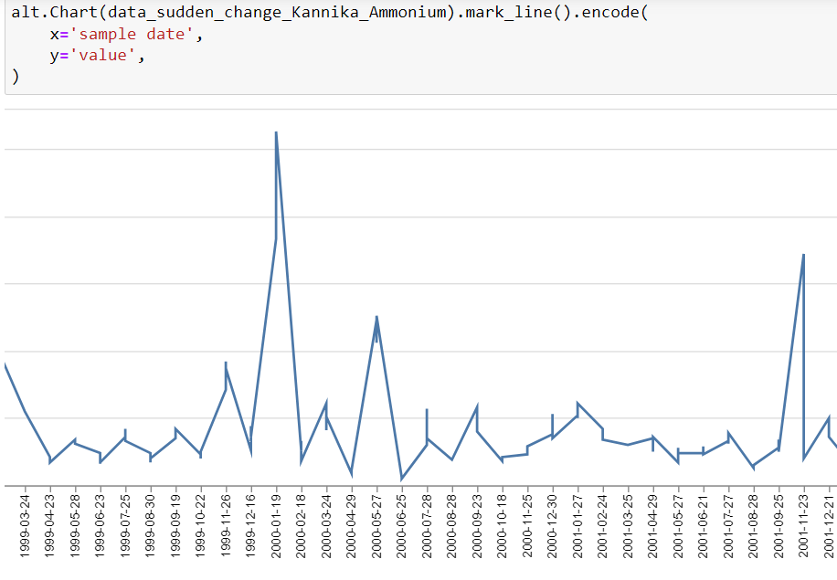
Unrealistic Values
We can see that there are anomalies in the dataset, as we can see in the figure, value of Ammonium at Kannika location rised steepely.
Maximum no of anomalies can be
found in Chai.

Slide 7
Altair Visualizations

Slide 8
Requirements
Visualization for
Trend/Anomaly of Analysis Questions
Advanced Altair Visualizations
Findings
Non-Visual Analysis
How Visuaization Support Analysis?

Slide 9
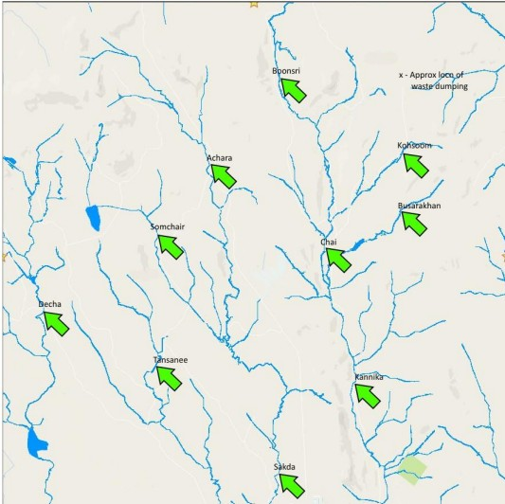
What are the
Findings?
Findings are that the value of "measure" is decresing per year for every "location". Though there are few anomalies but still the values are decreasing.

Slide 10
Visualization for Trend/Anomaly of Analysis Questions
We can easily see the trend is decreasing values of Ammonium with the passage of time.
There are few anomalies such as in year 2007 steep rise in value.

Slide 11
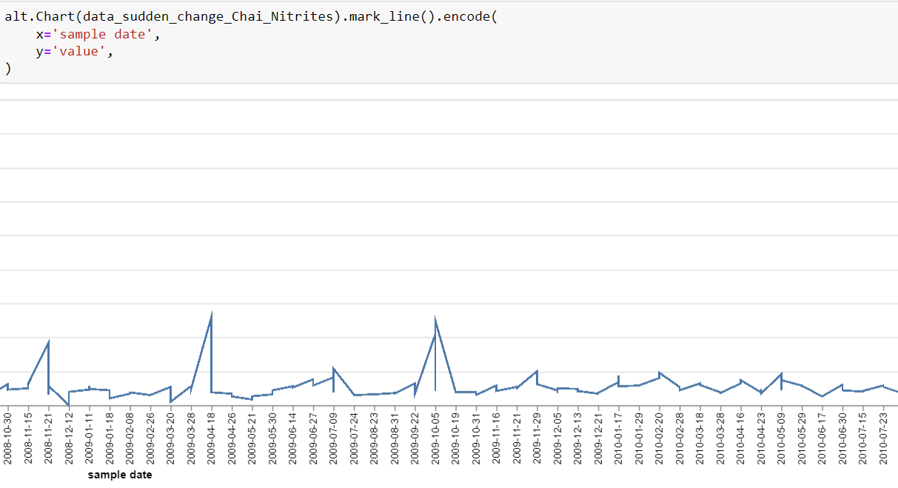
How Visualization Support Analysis?
With the increasing time, the value of measures found at locations such as Chai, Kannika, Boonsri etc. are decreasing and in the later 20's they become stable.

Slide 12

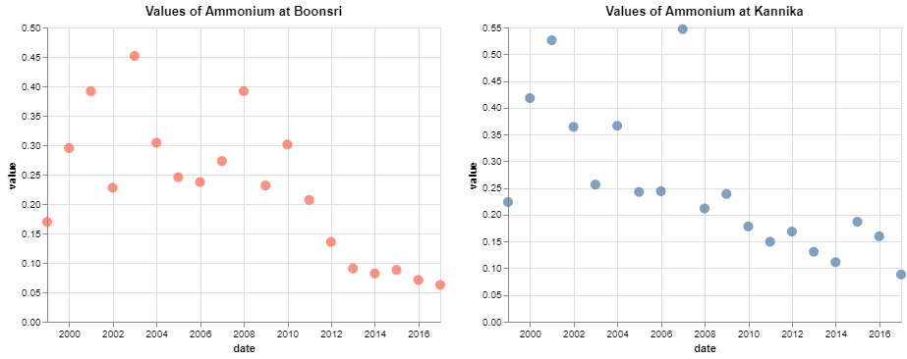
Advanced Altair Visualizations
Advanced techniques of Altair such as Multi Layer Visualization and Chart Concatenation etc. are used.

Slide 13
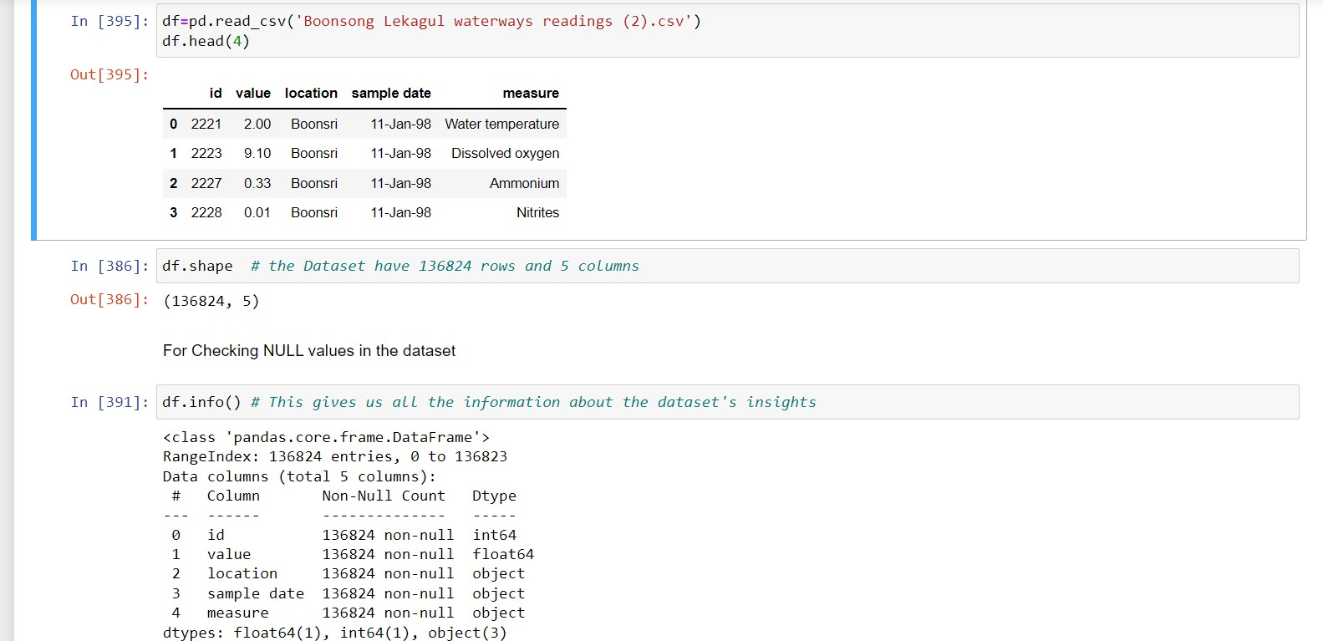
Non-Visual Analysis
Using various functions of pandas such as we can see the that how the value of vaiour measures are changing.

Slide 14
Visualization
Why/What
Statistical Analysis
Additional features such as sorting, filtering etc.

Slide 15
Why/What
These Charts drawn using Altair help us to visualize the data well, shows the trends and anomalies in values, thus helps in visualizing well. Choice of mark is point chart, even though in .ipynb file various other ways if visualization have also
been used
but preferable is point
visualization.

Slide 16
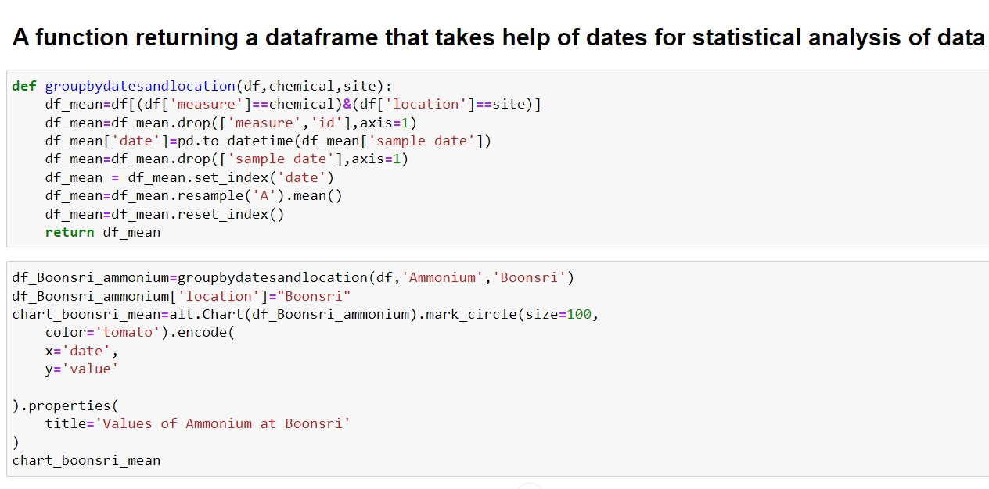
Additional features such as sorting, filtering etc.
Techniques such as Indexing of Dataframe according to date and even taking average value of 'measures' per year has been used. This included filtering, sorting and even statistics.

Slide 17
Statistical Analysis
Mean values of "measures" such as Nitrites, Ammonium and Calcium have been evaluated to get a better visual of how the trend has been.

Slide 18
Conclusion
After drawing various types of visualization using Altair such as Circle, Point and line we can evaluate the trend how value of "measures" such as Ammonium, Nitrites and Calcium changes for locations such as Chai, Boonsari, Kannika etc.
The value kept on decreasing and became very less after in 20's. Statistical Analysis, filtering and indexing etc, various techniques were used.

