Slide 1


Predictive Cloud
Resource Management
ML-based forecasting with SLA-aware auto-scaling
Advanced Cloud Computing
Lab-CA implementation
25 October 2026
Parth Dhande 16010123232
Purab Madhan 16010123242
Pushkar Rai 16010123243
01 / 24
Notes:
Presenter: Parth
Suggested time: 15 seconds
We built an ML-based predictive cloud resource manager. This presentation replaces the live walkthrough with captured execution evidence and measured comparisons. The approved title is ML-Based Predictive Cloud Resource Management with SLA-Aware Auto-Scaling, Cost Optimization, and Adaptive Workload Handling.
Evidence sources:
Repository: https://github.com/parth1056/accml
Core code at commit 64f7a68. Main benchmark records retain their original source/model fingerprints.
README.md

Slide 2
The problem and the demonstration goal
Demand changes faster than new workers become ready.
Too little capacity increases latency. Keeping maximum capacity wastes resources.
Our operating target
p95 latency at or below 250 ms
At least 99% successful requests
1 to 4 worker replicas
Predict the next 30-second peak, then allocate enough capacity within the configured limit.
02 / 24
Notes:
Presenter: Parth
Suggested time: 20 seconds
Our target is a p95 latency of at most 250 milliseconds and at least 99 percent successful requests. Prediction helps because workers need time to become ready. The controller also limits allocation and responds when its prediction is wrong. These are project targets rather than an external cloud service guarantee.
Evidence sources:
Repository: https://github.com/parth1056/accml
Core code at commit 64f7a68. Main benchmark records retain their original source/model fingerprints.
scaler/policy.py
scaler/experiment.py

Slide 3
The system runs on local Kubernetes
Load generator
Real HTTP replay
Gateway
Routes to ready pods
Workers
CPU work and telemetry
ML controller
Forecast and scale
Feedback every 10 seconds
The controller reads actual demand, p95 latency and pod readiness.
It changes the worker Deployment through the Kubernetes API.
Docker Desktop hosts Minikube on a single laptop.
Application replicas share one node.
03 / 24
Notes:
Presenter: Parth
Suggested time: 25 seconds
Docker Desktop runs a dedicated Minikube cluster. A host load generator sends real HTTP traffic through the gateway to ready worker pods. The controller collects demand and latency, forecasts future workload, and updates the worker deployment. The final box represents the feedback controller. This scales application replicas on one local node, not physical cloud servers.
Evidence sources:
Repository: https://github.com/parth1056/accml
Core code at commit 64f7a68. Main benchmark records retain their original source/model fingerprints.
scaler/fleet.py
scaler/gateway.py
scaler/worker.py
k8s/application.yaml

Slide 4
Forecasting uses only completed observations
Input or target | Definition
Six demand lags | Actual sends per 10-second window
Four derived features | Mean, standard deviation, maximum and slope
Prediction target | Peak RPS in the next three windows
Other controller signals | p95 latency, errors, ready and pending pods
60 seconds of past demand produces a 30-second forecast. The future arrival schedule never enters the model.
04 / 24
Notes:
Presenter: Parth
Suggested time: 25 seconds
There are ten input features: six completed demand windows plus their mean, standard deviation, maximum and slope. Offered demand comes from actual sends, including requests still in flight. Latency and pod readiness guide the controller but are not model features. The target is the maximum offered rate over the following three windows, so the feature window never includes future demand.
Evidence sources:
Repository: https://github.com/parth1056/accml
Core code at commit 64f7a68. Main benchmark records retain their original source/model fingerprints.
planning_pilot/pilot.py:features and supervised
scaler/traffic.py:Load.window
scaler/experiment.py:run_once

Slide 5
Ridge training produces a reusable model
Standardized Ridge regression
Fast inference, inspectable coefficients
8,544 synthetic training rows
4,272 validation rows
Validation selects alpha = 10
Saved coefficients drive online inference
Synthetic holdout | MAE, RPS
Ridge | 1.67
Persistence | 2.61
Independent test seed 99. This is a model-only synthetic holdout.
05 / 24
Notes:
Presenter: Parth
Suggested time: 25 seconds
We retrained the model to reproduce these numbers. Training seeds zero through eleven differ from validation seeds fifty through fifty-five and holdout seed ninety-nine. Validation selects regularization and an empirical underprediction buffer. The saved JSON stores coefficients and feature scaling. The model trains offline and predicts during the live run. This holdout result does not claim better performance on all real HTTP replays.
Evidence sources:
Repository: https://github.com/parth1056/accml
Core code at commit 64f7a68. Main benchmark records retain their original source/model fingerprints.
runtime/slides/training-output.txt
output/training_evaluation.json
output/trained_model.json
scaler/forecast.py

Slide 6
Calibration sets the safe worker capacity
One worker | Observed behaviour | Decision
18 RPS | Repeated checks pass the target | Capacity reference
24 RPS | Near the boundary, some windows fail | Avoid as safe rate
30 RPS | p95 about 1,502 ms, 2.63% failures | Overloaded
Safe capacity = 18 × 0.80 = 14.4 RPS per worker
Each worker has a 250m CPU limit and a five-second readiness delay. Repeat calibration on a different machine.
06 / 24
Notes:
Presenter: Parth
Suggested time: 25 seconds
The workload performs real PBKDF2 CPU work for every request. We measured one-worker capacity before choosing a scaling threshold. Eighteen requests per second passed repeated checks, while the higher rates reached the latency boundary or overloaded the service. We reserve twenty percent headroom, giving fourteen point four RPS per worker. This capacity is specific to this workload and machine.
Evidence sources:
Repository: https://github.com/parth1056/accml
Core code at commit 64f7a68. Main benchmark records retain their original source/model fingerprints.
output/live/calibration-kubernetes.json
scaler/worker.py
k8s/application.yaml

Slide 7
Prediction and rescue drive scaling
Target replicas
ceil(max(observed demand, forecast + buffer) / 14.4)
Protection | Controller response
High p95 or errors | Add rescue capacity when no scale-out is pending
Lower demand | Wait for stability, then remove one replica at a time
Budget or replica ceiling | Hold the cap and record CAPACITY_LIMITED
07 / 24
Notes:
Presenter: Parth
Suggested time: 30 seconds
The forecast is one input to the allocation decision. Guarded prediction takes the greater of observed demand and forecast plus buffer. It rounds up by calibrated worker capacity and applies bounds. Latency and error rescue add capacity when no previous scale-out is pending. Thirty-second stabilization and one-step downscale reduce oscillation. The configured budget can lower the normal four-replica ceiling.
Evidence sources:
Repository: https://github.com/parth1056/accml
Core code at commit 64f7a68. Main benchmark records retain their original source/model fingerprints.
scaler/policy.py

Slide 8
The lab is ready before traffic starts
Actual Kubernetes readiness check
NAME READY UP-TO-DATE AVAILABLE AGE
gateway 1/1 1 1 9h
worker 1/1 1 1 9h
Demo command
python -m scaler.experiment run --backend kubernetes
--scenario flash --policy guarded_predictive
--safe-rps 14.4 --duration 240 --warmup 60 --seed 707
08 / 24
Notes:
Presenter: Purab
Suggested time: 20 seconds
The captured readiness output confirms that both gateway and worker deployments are available before starting traffic. The command runs a four-minute flash-demand replay with one minute excluded as warm-up. We use seed seven-zero-seven for the presentation capture. This fresh walkthrough is separate from the frozen twelve-run comparison shown later.
Evidence sources:
Repository: https://github.com/parth1056/accml
Core code at commit 64f7a68. Main benchmark records retain their original source/model fingerprints.
runtime/slides/cluster-ready.txt
runtime/slides/demo.log
StartLabConnections.ps1

Slide 9
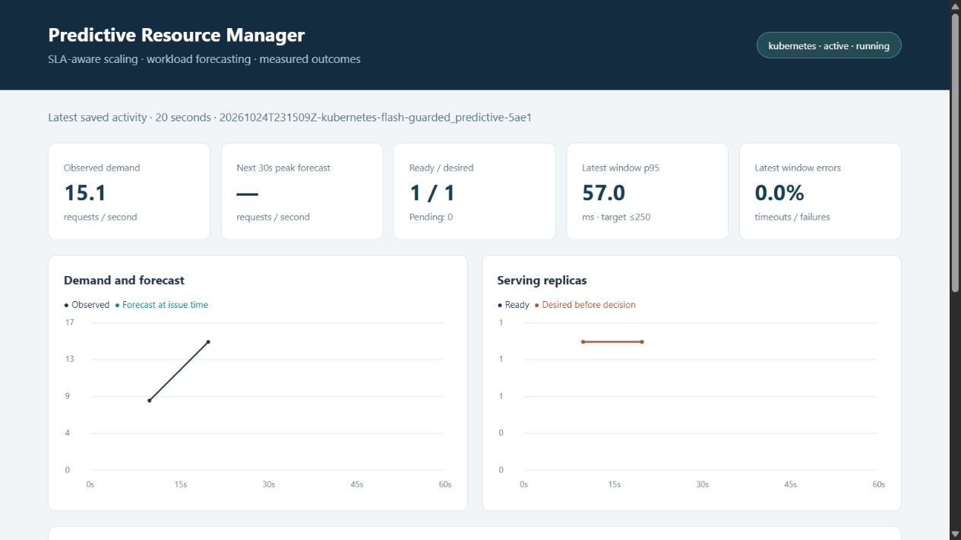
Demo: scale-out during model warm-up
20 seconds
Target: 2 workers
The model needs six windows.
Observed demand already exceeds one worker’s safe rate.
The cards show state before the latest decision.
09 / 24
Notes:
Presenter: Purab
Suggested time: 20 seconds
20 seconds
Target: 2 workers The model needs six windows.
Observed demand already exceeds one worker’s safe rate.
The cards show state before the latest decision.
Evidence sources:
Repository: https://github.com/parth1056/accml
Core code at commit 64f7a68. Main benchmark records retain their original source/model fingerprints.
output/live/20261024T231509Z-kubernetes-flash-guarded_predictive-5ae1/decisions.csv
runtime/slides/demo-start.png

Slide 10
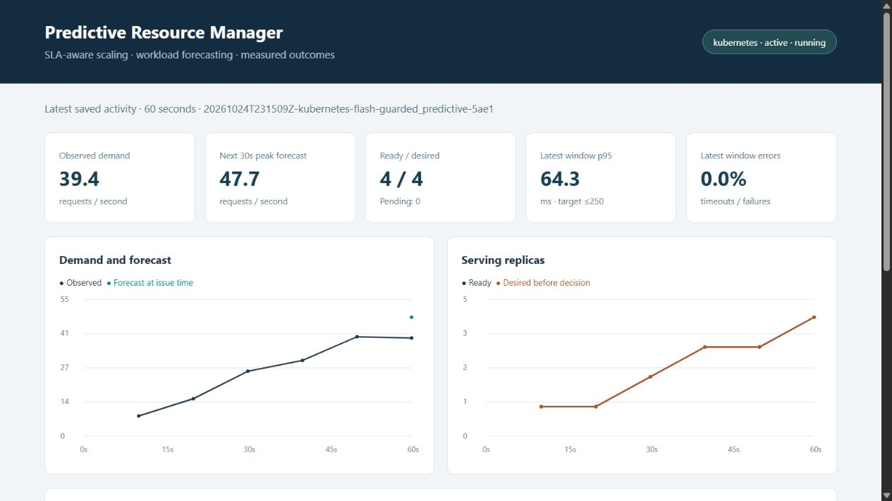
Demo: forecasting begins at 60 seconds
39.4 RPS observed
47.7 RPS forecast
Four workers are ready.
p95 is 64.3 ms in this window.
The trend shows earlier real scale-out actions.
10 / 24
Notes:
Presenter: Purab
Suggested time: 20 seconds
39.4 RPS observed
47.7 RPS forecast Four workers are ready.
p95 is 64.3 ms in this window.
The trend shows earlier real scale-out actions.
Evidence sources:
Repository: https://github.com/parth1056/accml
Core code at commit 64f7a68. Main benchmark records retain their original source/model fingerprints.
output/live/20261024T231509Z-kubernetes-flash-guarded_predictive-5ae1/decisions.csv
runtime/slides/demo-forecast.png

Slide 11
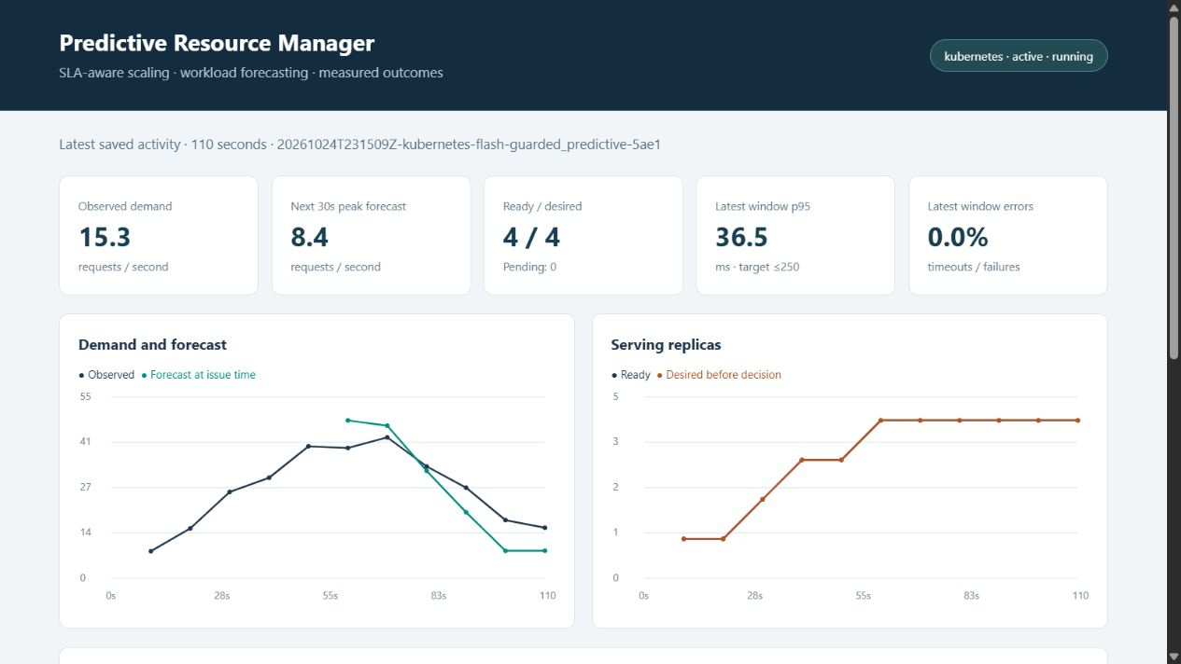
Demo: stable downscale at 110 seconds
110 seconds
Target: 3 workers
Demand falls to 15.3 RPS.
The controller waits before scaling down.
Ready / desired still shows 4 / 4 before applying the new target.
11 / 24
Notes:
Presenter: Purab
Suggested time: 20 seconds
110 seconds
Target: 3 workers Demand falls to 15.3 RPS.
The controller waits before scaling down.
Ready / desired still shows 4 / 4 before applying the new target.
Evidence sources:
Repository: https://github.com/parth1056/accml
Core code at commit 64f7a68. Main benchmark records retain their original source/model fingerprints.
output/live/20261024T231509Z-kubernetes-flash-guarded_predictive-5ae1/decisions.csv
runtime/slides/demo-downscale.png

Slide 12
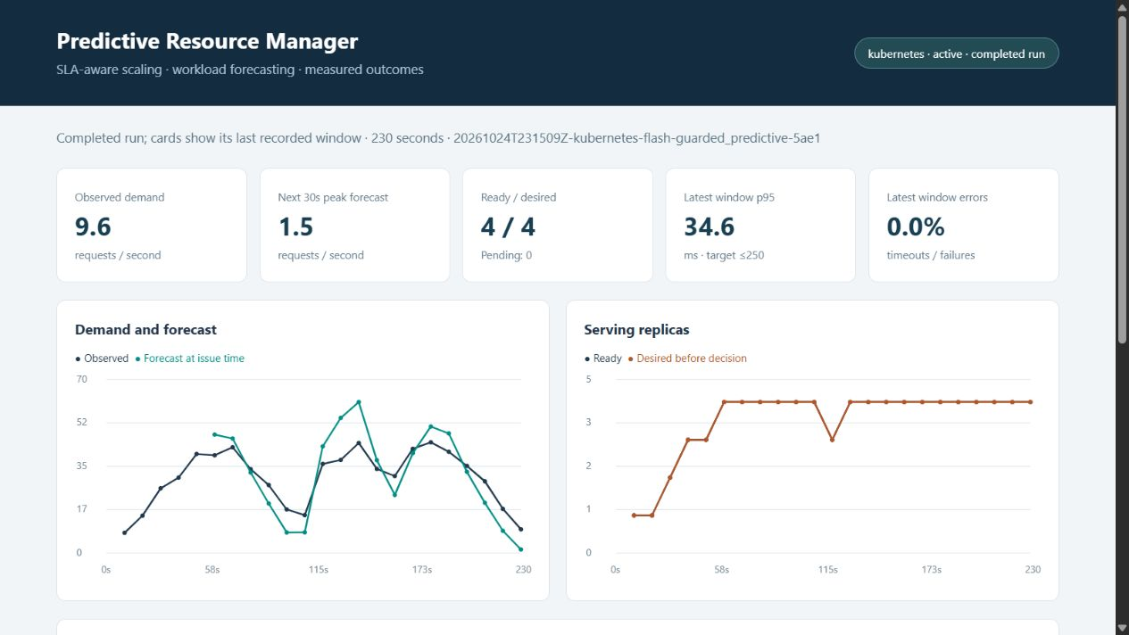
Demo: the flash burst and replica ceiling
Completed run
Ceiling: 4 workers
The graph records the burst and recovery.
The deployment never exceeds four workers.
The cards show the final recorded window.
12 / 24
Notes:
Presenter: Purab
Suggested time: 20 seconds
Completed run
Ceiling: 4 workers The graph records the burst and recovery.
The deployment never exceeds four workers.
The cards show the final recorded window.
Evidence sources:
Repository: https://github.com/parth1056/accml
Core code at commit 64f7a68. Main benchmark records retain their original source/model fingerprints.
output/live/20261024T231509Z-kubernetes-flash-guarded_predictive-5ae1/decisions.csv
runtime/slides/demo-burst.png

Slide 13
The comparison uses matched workloads
Controlled element | Experimental design
Policies | Fixed 4, reactive, guarded predictive
Workloads | Periodic and flash, two seeds each
Coverage | 12 completed Kubernetes runs
Fairness checks | Same planned arrivals, model and source within the suite
Scoring | 240-second runs, first 60 seconds excluded
Latency, failures, allocation and CPU come from real execution. Cost and energy use explicit assumptions.
13 / 24
Notes:
Presenter: Purab
Suggested time: 25 seconds
The evaluation compares three policies across two scenarios and two repeat seeds, for twelve completed runs. The manifest verifies matching arrival schedules and identical model and source fingerprints inside that suite. Actual sends, latency and pod timing still vary naturally. Scored results exclude the first minute. We compare allocation and service quality together, rather than declaring the cheapest run the winner.
Evidence sources:
Repository: https://github.com/parth1056/accml
Core code at commit 64f7a68. Main benchmark records retain their original source/model fingerprints.
output/live/matrix.json
output/evaluation/audit.json
tools/evaluate_matrix.py

Slide 14
Guarded scaling: capacity and latency
Scenario / policy | Run p95 range, ms | Mean replica-s | SLA windows
flash / fixed | 42.8 to 43.2 | 720.0 | 0.00%
flash / guarded | 44.0 to 46.9 | 705.3 | 0.00%
flash / reactive | 64.1 to 65.8 | 561.3 | 0.00%
periodic / fixed | 34.6 to 55.3 | 720.0 | 0.00%
periodic / guarded | 49.0 to 56.6 | 643.1 | 0.00%
periodic / reactive | 71.5 to 503.9 | 498.8 | 5.56%
Guarded uses 10.7% fewer replica-seconds than fixed in periodic demand and 2.0% fewer in flash demand.
14 / 24
Notes:
Presenter: Purab
Suggested time: 30 seconds
Every main-suite request succeeded. Guarded prediction had no violating scored windows across its four runs. In periodic demand, reactive used less allocation but one repeat reached a p95 of about five hundred four milliseconds. Guarded uses more capacity than reactive to protect latency. Savings versus fixed maximum allocation are modest: ten point seven percent for periodic and two percent for flash.
Evidence sources:
Repository: https://github.com/parth1056/accml
Core code at commit 64f7a68. Main benchmark records retain their original source/model fingerprints.
output/evaluation/audit.json

Slide 15
Utilization, cost and energy trade-offs
Periodic policy | CPU utilization | Cost proxy | Energy proxy
Fixed | 22.2% | 0.00400 | 2.22 Wh
Reactive | 31.9% | 0.00277 | 1.61 Wh
Guarded | 25.4% | 0.00357 | 2.01 Wh
Cost = replica-hours × 0.02 illustrative units
Energy = 10 W per allocated worker + 20 W per measured CPU core
CPU utilization is measured against worker CPU allocation. Cost is not a cloud bill. Energy is an assumed power model.
15 / 24
Notes:
Presenter: Pushkar
Suggested time: 25 seconds
This table reports periodic-demand averages across two repeats. Reactive has higher utilization because it runs fewer workers. Guarded keeps more headroom and therefore costs more than reactive. Cost multiplies allocated replica-hours by an illustrative rate. Energy combines assumed idle power with measured worker CPU time. Gateway, host and fixed infrastructure overhead are excluded, so these are relative proxies rather than a bill or physical power measurement.
Evidence sources:
Repository: https://github.com/parth1056/accml
Core code at commit 64f7a68. Main benchmark records retain their original source/model fingerprints.
output/evaluation/audit.json
scaler/experiment.py:summarize

Slide 16
Persistence wins on the recorded replays
64 main-replay forecast targets | MAE, RPS
Ridge | 11.24
Persistence | 9.39
Trailing five-window mean | 12.06
Persistence wins overall on these replays. Ridge does better during falling demand.
The measured controller result depends on its guardrails as well as its forecast.
16 / 24
Notes:
Presenter: Pushkar
Suggested time: 25 seconds
We also scored the frozen predictions against simple baselines using exactly aligned future targets. Persistence beats Ridge overall on these HTTP replays, despite Ridge winning the synthetic model holdout. Ridge does better on falling-demand slices. We therefore attribute the demonstrated service-quality trade-off to the full controller, including its safety policy. We do not claim universal forecasting superiority.
Evidence sources:
Repository: https://github.com/parth1056/accml
Core code at commit 64f7a68. Main benchmark records retain their original source/model fingerprints.
output/evaluation/forecast_diagnostics.json
tools/forecast_diagnostics.py

Slide 17
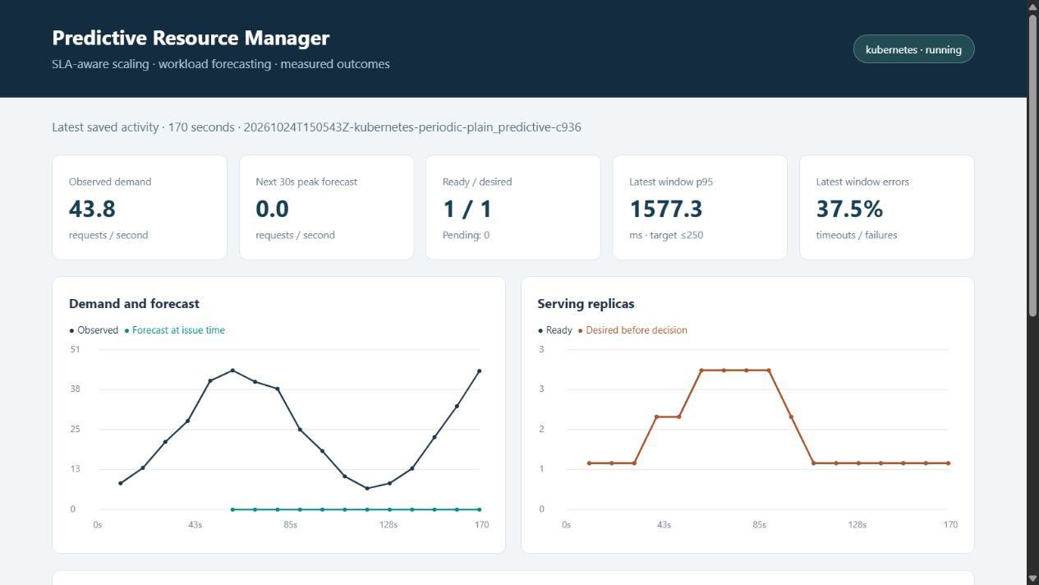
Fault test: plain prediction under zero forecasts
13.35% failures
1,547.7 ms run p95
The predictor deliberately returns zero.
Plain prediction removes capacity despite rising demand.
The screenshot shows one overloaded window.
17 / 24
Notes:
Presenter: Pushkar
Suggested time: 20 seconds
13.35% failures
1,547.7 ms run p95 The predictor deliberately returns zero.
Plain prediction removes capacity despite rising demand.
The screenshot shows one overloaded window.
Evidence sources:
Repository: https://github.com/parth1056/accml
Core code at commit 64f7a68. Main benchmark records retain their original source/model fingerprints.
output/evaluation/fault_checks.json
output/evidence/zero_forecast_plain.png

Slide 18
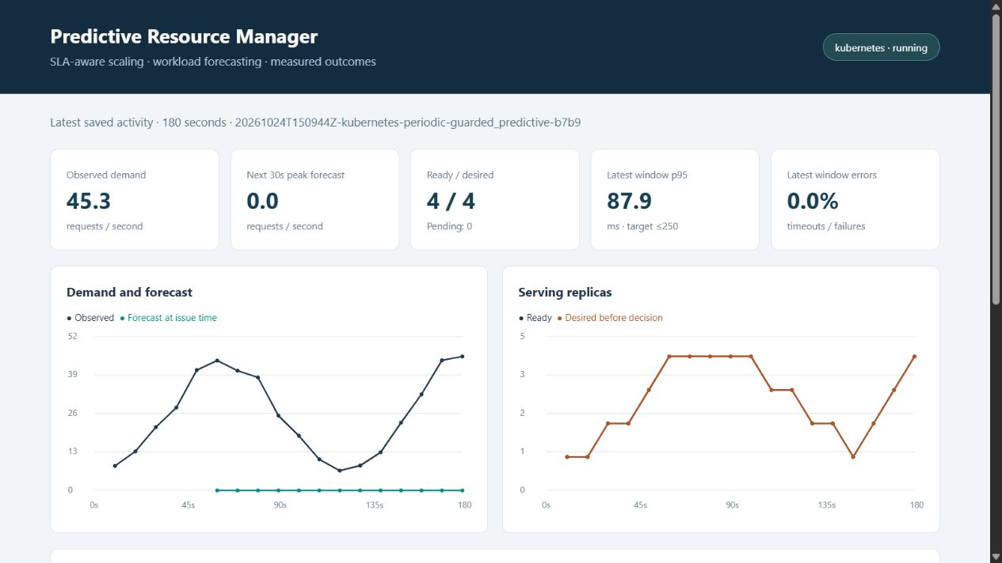
Fault test: recovery despite a zero forecast
0% failures
215.1 ms run p95
Same planned workload and zero forecast.
Guarded scaling adds capacity using observed demand and SLA signals.
One scored window still violates the target.
18 / 24
Notes:
Presenter: Pushkar
Suggested time: 25 seconds
0% failures
215.1 ms run p95 Same planned workload and zero forecast.
Guarded scaling adds capacity using observed demand and SLA signals.
One scored window still violates the target.
Evidence sources:
Repository: https://github.com/parth1056/accml
Core code at commit 64f7a68. Main benchmark records retain their original source/model fingerprints.
output/evaluation/fault_checks.json
output/evidence/zero_forecast_guarded.png

Slide 19
A hard budget can prevent SLA recovery
One-replica budget stress | Measured outcome
Maximum allowed replicas | 1
Failed requests | 17.73%
Run p95 latency | 1,563.2 ms
Violating scored windows | 66.7%
The controller respects the budget and records insufficient capacity. More forecasting accuracy cannot create unavailable resources.
19 / 24
Notes:
Presenter: Pushkar
Suggested time: 20 seconds
The separate budget stress test limits allocation to one worker. The controller obeys that bound, but latency and errors increase when demand needs more capacity. This is a real resource trade-off: a strict budget and a strict latency objective may conflict. The run records the capacity limit so an operator can explain the service degradation.
Evidence sources:
Repository: https://github.com/parth1056/accml
Core code at commit 64f7a68. Main benchmark records retain their original source/model fingerprints.
output/evaluation/fault_checks.json
scaler/policy.py

Slide 20
Shadow mode and failure handling
Check | Verified behaviour
Read-only shadow run | 7 recommendations, 0 scaling actions
Deployment before and after | 1 replica, unchanged generation 81
Broken model output | Use observed demand and prevent model-failure downscale
Stale or invalid demand | Hold current capacity
Project test suite | 17 tests pass
Shadow mode also avoids startup and cleanup scaling. It still sends real test traffic.
20 / 24
Notes:
Presenter: Pushkar
Suggested time: 25 seconds
Shadow mode lets us inspect proposed actions without changing replicas. The real eighty-second check made seven recommendations, made no scaling calls, and left both deployment replica count and generation unchanged. The test suite also injects an inference exception and checks the complete shadow lifecycle. Invalid forecasts fall back to observed demand, while stale or invalid demand holds existing allocation.
Evidence sources:
Repository: https://github.com/parth1056/accml
Core code at commit 64f7a68. Main benchmark records retain their original source/model fingerprints.
output/evaluation/shadow_check.json
tests/test_live.py
runtime/slides/tests-output.txt

Slide 21
The repository preserves the evidence
https://github.com/parth1056/accml
Evidence | Where to find it
Implementation | scaler/ and k8s/
Every experiment | output/live/: arrivals, requests, decisions, resources and model
Matched results and fault checks | output/evaluation/
Report and screenshots | output/ and output/evidence/
We demonstrated real replica control, measured service quality, and explicit behaviour when predictions or budgets fail.
21 / 24
Notes:
Presenter: Pushkar
Suggested time: 20 seconds
The repository includes the executable workload, Kubernetes deployment, model, controller and raw evidence behind every reported result. Our implementation demonstrates predictive allocation with explicit safeguards and an honest evaluation. The local prototype does not provision cloud virtual machines. The most useful next step is a better validated forecasting model followed by fresh matched controller comparisons. The repository is private, so the evaluator needs access.
Evidence sources:
Repository: https://github.com/parth1056/accml
Core code at commit 64f7a68. Main benchmark records retain their original source/model fingerprints.
README.md
output/evaluation/audit.json

Slide 22
Appendix: mean results across repeats
Scenario / policy | p95 ms | CPU % | Cost proxy | Energy Wh
flash / fixed | 43.0 | 27.2 | 0.00400 | 2.27
flash / guarded | 45.5 | 28.1 | 0.00392 | 2.23
flash / reactive | 65.0 | 35.0 | 0.00312 | 1.83
periodic / fixed | 45.0 | 22.2 | 0.00400 | 2.22
periodic / guarded | 52.8 | 25.4 | 0.00357 | 2.01
periodic / reactive | 287.7 | 31.9 | 0.00277 | 1.61
Two repeats per row. Mean of run p95 values, not pooled p95. All main-suite runs have zero request failures.
22 / 24
Notes:
Presenter: All members
Suggested time: 0 seconds
Reference slide for questions. Values are arithmetic means across two repeated runs per scenario and policy. The p95 column averages per-run p95 values. The main results slide also shows min/max across repeats. Cost and energy remain proxies with the assumptions already stated.
Evidence sources:
Repository: https://github.com/parth1056/accml
Core code at commit 64f7a68. Main benchmark records retain their original source/model fingerprints.
output/evaluation/audit.json

Slide 23
Appendix: reproduction and settings
Reproduction sequence
Runtime settings
1. SetupLab.ps1
2. Capacity calibration
3. Model training
4. RunDemo.ps1
5. Matrix and fault checks
6. Analysis and report export
Kubernetes v1.34.0
2 CPUs, 2,300 MB Minikube
250m CPU per worker
60,000 PBKDF2 iterations
5-second readiness delay
30-second downscale stabilization
One local node limits total capacity. Four application replicas do not mean four cloud VMs.
23 / 24
Notes:
Presenter: All members
Suggested time: 0 seconds
This appendix supports reproduction. Start Docker Desktop before SetupLab.ps1. The lab uses a dedicated acc-lab context and namespace. StartLabConnections.ps1 exposes only local API and application connections. Repeat calibration on another host. The workload has no payment or database dependency and uses bounded CPU work. No AWS or Azure deployment is claimed.
Evidence sources:
Repository: https://github.com/parth1056/accml
Core code at commit 64f7a68. Main benchmark records retain their original source/model fingerprints.
SetupLab.ps1
RunDemo.ps1
k8s/application.yaml
scaler/worker.py

Slide 24
Appendix: the unpromoted model candidate
Recorded-data candidate | Current status
Train / validation / test rows | 32 / 16 / 16, separate replay seeds
Candidate test MAE | 4.96 RPS
Primary model / persistence MAE | 11.06 / 10.65 RPS on that small holdout
Promotion decision | Exploratory only, default model unchanged
The small replay holdout is not production validation. A model change requires a fresh matched controller suite.
24 / 24
Notes:
Presenter: All members
Suggested time: 0 seconds
This candidate learns from recorded HTTP replay observations and keeps separate training, validation and test seeds. Its small holdout improves model accuracy, but we have not promoted it or reused the original controller results to claim a new benefit. Future work includes larger diverse traces, phase-specific validation, and new repeated controller comparisons. The project also uses assumed energy rather than physical energy measurements.
Evidence sources:
Repository: https://github.com/parth1056/accml
Core code at commit 64f7a68. Main benchmark records retain their original source/model fingerprints.
output/evaluation/recorded_training.json
tools/train_recorded_candidate.py

