Slide 1


Predictive Cloud
Resource Management
ML-based forecasting with SLA-aware auto-scaling
Advanced Cloud Computing
Lab-CA implementation
Parth Dhande 16010123232
Purab Madhan 16010123242
Pushkar Rai 16010123243
01 / 18
Notes:
Presenter: Parth
Suggested time: 15 seconds
We built an ML-based predictive cloud resource manager. This presentation replaces the live walkthrough with captured execution evidence and measured comparisons. The approved title is ML-Based Predictive Cloud Resource Management with SLA-Aware Auto-Scaling, Cost Optimization, and Adaptive Workload Handling.
Evidence sources:
Repository: https://github.com/parth1056/accml
Core code at commit 64f7a68. Main benchmark records retain their original source/model fingerprints.
README.md

Slide 2
Problem and objectives
Demand changes faster than new workers become ready.
Too little capacity increases latency. Keeping maximum capacity wastes resources.
Our operating target
p95 latency at or below 250 ms
At least 99% successful requests
1 to 4 worker replicas
Predict the next 30-second peak, then allocate enough capacity within the configured limit.
02 / 18
Notes:
Presenter: Parth
Suggested time: 25 seconds
Our target is a p95 latency of at most 250 milliseconds and at least 99 percent successful requests. Prediction helps because workers need time to become ready. The controller also limits allocation and responds when its prediction is wrong. These are project targets rather than an external cloud service guarantee.
Evidence sources:
Repository: https://github.com/parth1056/accml
Core code at commit 64f7a68. Main benchmark records retain their original source/model fingerprints.
scaler/policy.py
scaler/experiment.py

Slide 3
System architecture
Load generator
Real HTTP replay
Gateway
Routes to ready pods
Workers
CPU work and telemetry
ML controller
Forecast and scale
Feedback every 10 seconds
The controller reads actual demand, p95 latency and pod readiness.
It changes the worker Deployment through the Kubernetes API.
Docker Desktop hosts Minikube on a single laptop.
Application replicas share one node.
03 / 18
Notes:
Presenter: Parth
Suggested time: 25 seconds
Docker Desktop runs a dedicated Minikube cluster. A host load generator sends real HTTP traffic through the gateway to ready worker pods. The controller collects demand and latency, forecasts future workload, and updates the worker deployment. The final box represents the feedback controller. This scales application replicas on one local node, not physical cloud servers.
Evidence sources:
Repository: https://github.com/parth1056/accml
Core code at commit 64f7a68. Main benchmark records retain their original source/model fingerprints.
scaler/fleet.py
scaler/gateway.py
scaler/worker.py
k8s/application.yaml

Slide 4
ML inputs and prediction horizon
Input or target | Definition
Six demand lags | Actual sends per 10-second window
Four derived features | Mean, standard deviation, maximum and slope
Prediction target | Peak RPS in the next three windows
Other controller signals | p95 latency, errors, ready and pending pods
60 seconds of past demand produces a 30-second forecast. The future arrival schedule never enters the model.
04 / 18
Notes:
Presenter: Parth
Suggested time: 25 seconds
There are ten input features: six completed demand windows plus their mean, standard deviation, maximum and slope. Offered demand comes from actual sends, including requests still in flight. Latency and pod readiness guide the controller but are not model features. The target is the maximum offered rate over the following three windows, so the feature window never includes future demand.
Evidence sources:
Repository: https://github.com/parth1056/accml
Core code at commit 64f7a68. Main benchmark records retain their original source/model fingerprints.
planning_pilot/pilot.py:features and supervised
scaler/traffic.py:Load.window
scaler/experiment.py:run_once

Slide 5
ML training and prediction accuracy
Standardized Ridge regression
Fast inference and interpretable coefficients
8,544 synthetic training rows
4,272 validation rows
Independent test seeds
Saved model runs online after training
Test setting | Ridge MAE | Persistence
Synthetic holdout | 1.67 RPS | 2.61 RPS
Recorded replays | 11.24 RPS | 9.39 RPS
Ridge wins the synthetic holdout. Persistence wins on the recorded replays.
05 / 18
Notes:
Presenter: Parth
Suggested time: 25 seconds
We use standardized Ridge regression because inference is fast and its coefficients can be inspected. Synthetic training, validation and test traces use separate seeds. Validation selects alpha ten and an underprediction buffer. The saved model supplies online predictions. The two test settings must be distinguished: Ridge beats persistence on the synthetic holdout, but persistence has lower MAE across the 64 recorded replay targets. The controller therefore needs its observed-demand and SLA safeguards.
Sources: scaler/forecast.py; output/training_evaluation.json; output/evaluation/forecast_diagnostics.json

Slide 6
Capacity calibration and scaling policy
18 RPS passed repeated one-worker checks.
20% headroom gives 14.4 safe RPS per worker.
Target = ceil(max(observed demand, forecast + buffer) / 14.4)
Condition | Controller response
High latency or errors | Add rescue capacity when no scale-out is pending
Falling demand | Wait 30 seconds, then remove one replica at a time
Resource constraint | Apply the configured budget and 1–4 replica bound
06 / 18
Notes:
Presenter: Parth
Suggested time: 25 seconds
Before scaling, we calibrate the real CPU workload. Eighteen requests per second passed repeated one-worker checks, so a twenty-percent reserve gives a safe rate of fourteen point four. The controller takes the larger of observed demand and forecast plus buffer, divides by safe capacity, and rounds up. It adds latency or error rescue when no previous scale-out is pending. Downscale waits for stability and removes capacity gradually. Bounds and a hard budget cap always constrain allocation.
Sources: output/live/calibration-kubernetes.json; scaler/policy.py; k8s/application.yaml

Slide 7
Demonstration setup
Docker Desktop and Minikube
Before traffic | Ready
Gateway | 1 / 1
Worker | 1 / 1
One gateway routes traffic to ready workers.
Each request performs real CPU work.
The controller loads the saved Ridge model.
The dashboard displays observations and decisions.
Four-minute flash workload. The first 60 seconds are warm-up.
07 / 18
Notes:
Presenter: Purab
Suggested time: 25 seconds
Both gateway and worker are ready before a demonstration begins. The CPU workload performs sixty thousand PBKDF2 iterations per request and each worker has a quarter-core CPU limit. A host load generator sends real HTTP requests. The controller uses the saved model, while a read-only dashboard displays the measurements. The next screenshots follow one four-minute flash-demand demonstration. Its first minute is warm-up, and it is separate from the frozen comparison suite.
Sources: k8s/application.yaml; scaler/worker.py; output/evidence/presentation/cluster-ready.txt; output/live/20261024T231509Z-kubernetes-flash-guarded_predictive-5ae1/

Slide 8
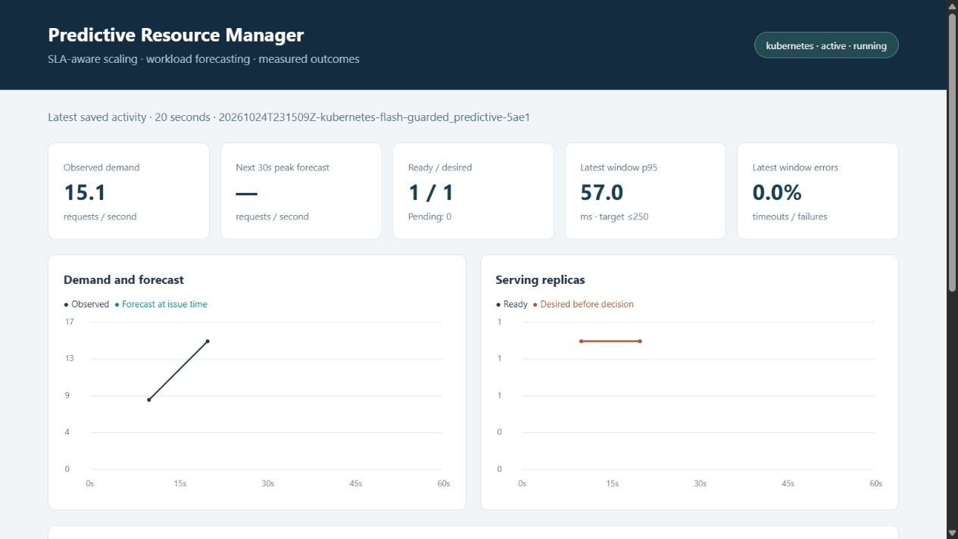
Demo: scale-out during model warm-up
20 seconds
Target: 2 workers
The model needs six windows.
Observed demand already exceeds one worker’s safe rate.
The cards show state before the latest decision.
08 / 18
Notes:
Presenter: Purab
Suggested time: 25 seconds
20 seconds
Target: 2 workers The model needs six windows.
Observed demand already exceeds one worker’s safe rate.
The cards show state before the latest decision.
Evidence sources:
Repository: https://github.com/parth1056/accml
Core code at commit 64f7a68. Main benchmark records retain their original source/model fingerprints.
output/live/20261024T231509Z-kubernetes-flash-guarded_predictive-5ae1/decisions.csv
runtime/slides/demo-start.png

Slide 9
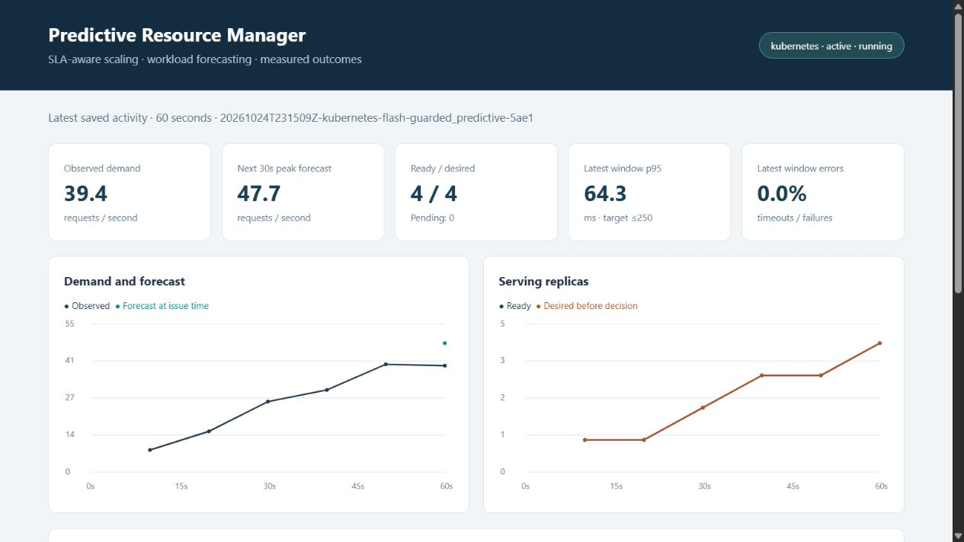
Demo: forecasting begins at 60 seconds
39.4 RPS observed
47.7 RPS forecast
Four workers are ready.
p95 is 64.3 ms in this window.
The trend shows earlier real scale-out actions.
09 / 18
Notes:
Presenter: Purab
Suggested time: 25 seconds
39.4 RPS observed
47.7 RPS forecast Four workers are ready.
p95 is 64.3 ms in this window.
The trend shows earlier real scale-out actions.
Evidence sources:
Repository: https://github.com/parth1056/accml
Core code at commit 64f7a68. Main benchmark records retain their original source/model fingerprints.
output/live/20261024T231509Z-kubernetes-flash-guarded_predictive-5ae1/decisions.csv
runtime/slides/demo-forecast.png

Slide 10
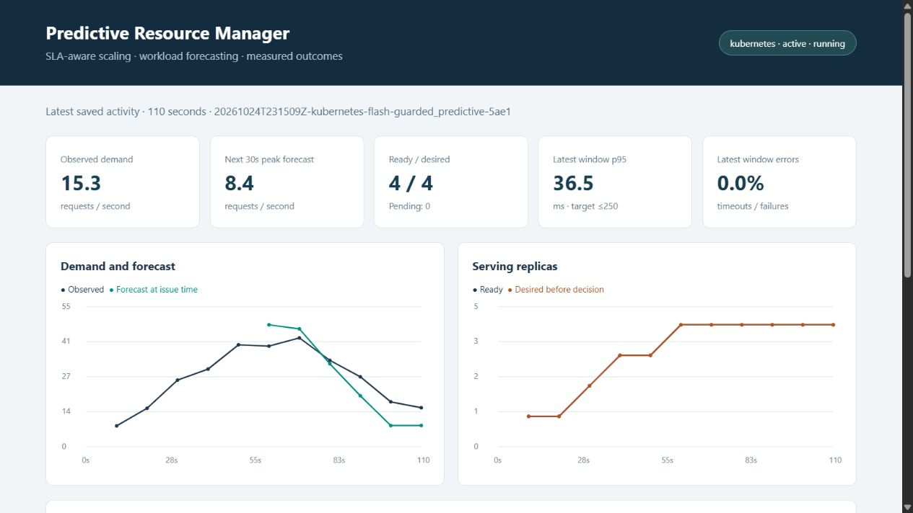
Demo: stable downscale at 110 seconds
110 seconds
Target: 3 workers
Demand falls to 15.3 RPS.
The controller waits before scaling down.
Ready / desired still shows 4 / 4 before applying the new target.
10 / 18
Notes:
Presenter: Purab
Suggested time: 25 seconds
110 seconds
Target: 3 workers Demand falls to 15.3 RPS.
The controller waits before scaling down.
Ready / desired still shows 4 / 4 before applying the new target.
Evidence sources:
Repository: https://github.com/parth1056/accml
Core code at commit 64f7a68. Main benchmark records retain their original source/model fingerprints.
output/live/20261024T231509Z-kubernetes-flash-guarded_predictive-5ae1/decisions.csv
runtime/slides/demo-downscale.png

Slide 11
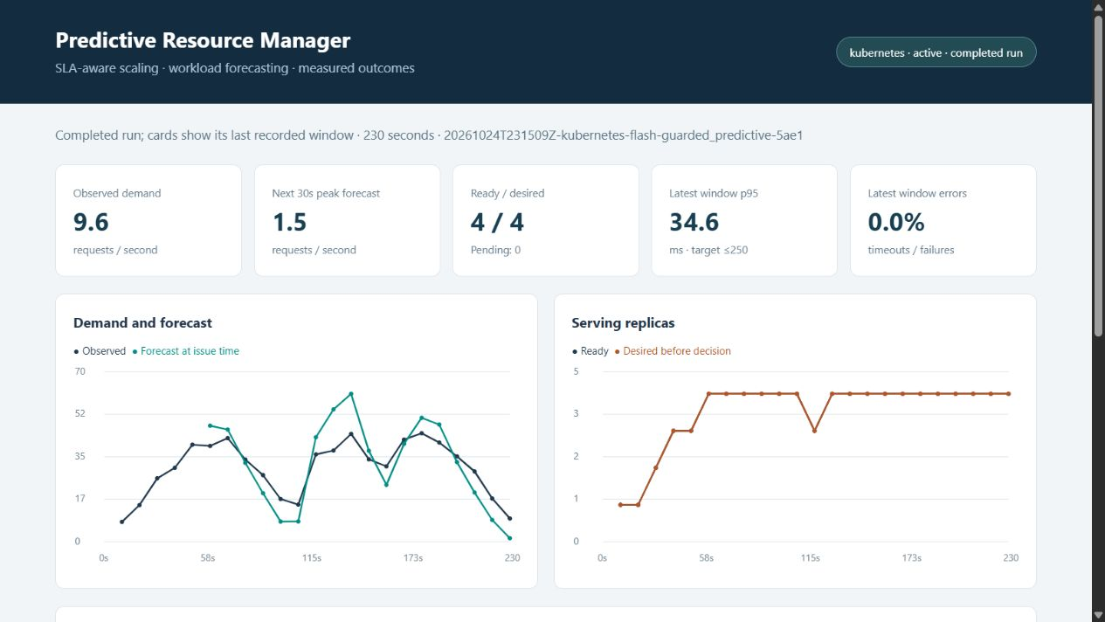
Demo: the flash burst and replica ceiling
Completed run
Ceiling: 4 workers
The graph records the burst and recovery.
The deployment never exceeds four workers.
The cards show the final recorded window.
11 / 18
Notes:
Presenter: Purab
Suggested time: 25 seconds
Completed run
Ceiling: 4 workers The graph records the burst and recovery.
The deployment never exceeds four workers.
The cards show the final recorded window.
Evidence sources:
Repository: https://github.com/parth1056/accml
Core code at commit 64f7a68. Main benchmark records retain their original source/model fingerprints.
output/live/20261024T231509Z-kubernetes-flash-guarded_predictive-5ae1/decisions.csv
runtime/slides/demo-burst.png

Slide 12
Measured scaling results
12 matched runs: fixed, reactive and guarded policies across two workloads and two seeds.
Workload / policy | Run p95 range, ms | Mean replica-s | Violating windows
flash / fixed | 42.8–43.2 | 720.0 | 0.00%
flash / guarded | 44.0–46.9 | 705.3 | 0.00%
flash / reactive | 64.1–65.8 | 561.3 | 0.00%
periodic / fixed | 34.6–55.3 | 720.0 | 0.00%
periodic / guarded | 49.0–56.6 | 643.1 | 0.00%
periodic / reactive | 71.5–503.9 | 498.8 | 5.56%
Guarded saves 10.7% allocation versus fixed in periodic demand, with zero violating windows in the main suite.
12 / 18
Notes:
Presenter: Purab
Suggested time: 25 seconds
The twelve-run suite holds planned arrivals, model, code and service configuration constant within the comparison. Warm-up is excluded from scored results. All requests succeeded in the main suite. Guarded prediction has no violating scored windows in its four runs. It saves ten point seven percent allocation versus fixed maximum capacity in periodic demand and two percent in flash demand. Reactive uses less allocation, but one periodic repeat reaches about five hundred four milliseconds p95. This is a cost and service-quality trade-off.
Sources: output/live/matrix.json; output/evaluation/audit.json

Slide 13
Utilization, cost and energy
Periodic policy | CPU utilization | Cost proxy | Energy proxy
Fixed | 22.2% | 0.00400 | 2.22 Wh
Reactive | 31.9% | 0.00277 | 1.61 Wh
Guarded | 25.4% | 0.00357 | 2.01 Wh
Cost = replica-hours × 0.02 illustrative units
Power proxy = 10 W per worker + 20 W per measured CPU core
CPU utilization is measured. Cost is illustrative. Energy integrates the assumed power over time.
13 / 18
Notes:
Presenter: Pushkar
Suggested time: 25 seconds
This table reports periodic-demand averages across two repeats. Reactive has higher utilization because it runs fewer workers. Guarded keeps more headroom and therefore costs more than reactive. Cost multiplies allocated replica-hours by an illustrative rate. Energy combines assumed idle power with measured worker CPU time. Gateway, host and fixed infrastructure overhead are excluded, so these are relative proxies rather than a bill or physical power measurement.
Evidence sources:
Repository: https://github.com/parth1056/accml
Core code at commit 64f7a68. Main benchmark records retain their original source/model fingerprints.
output/evaluation/audit.json
scaler/experiment.py:summarize

Slide 14
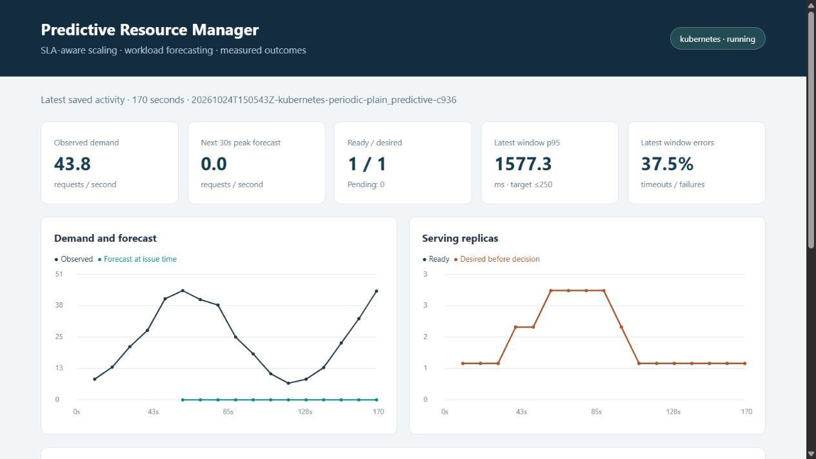
Fault test: plain prediction under zero forecasts
13.35% failures
1,547.7 ms run p95
The predictor deliberately returns zero.
Plain prediction removes capacity despite rising demand.
The screenshot shows one overloaded window.
14 / 18
Notes:
Presenter: Pushkar
Suggested time: 25 seconds
13.35% failures
1,547.7 ms run p95 The predictor deliberately returns zero.
Plain prediction removes capacity despite rising demand.
The screenshot shows one overloaded window.
Evidence sources:
Repository: https://github.com/parth1056/accml
Core code at commit 64f7a68. Main benchmark records retain their original source/model fingerprints.
output/evaluation/fault_checks.json
output/evidence/zero_forecast_plain.png

Slide 15
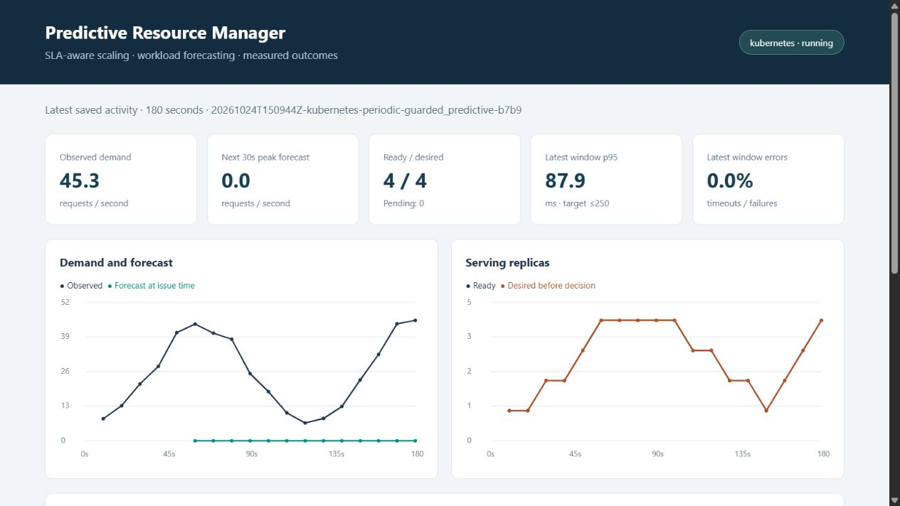
Fault test: recovery despite a zero forecast
0% failures
215.1 ms run p95
Same planned workload and zero forecast.
Guarded scaling adds capacity using observed demand and SLA signals.
One scored window still violates the target.
15 / 18
Notes:
Presenter: Pushkar
Suggested time: 25 seconds
0% failures
215.1 ms run p95 Same planned workload and zero forecast.
Guarded scaling adds capacity using observed demand and SLA signals.
One scored window still violates the target.
Evidence sources:
Repository: https://github.com/parth1056/accml
Core code at commit 64f7a68. Main benchmark records retain their original source/model fingerprints.
output/evaluation/fault_checks.json
output/evidence/zero_forecast_guarded.png

Slide 16
A hard budget can prevent SLA recovery
One-replica budget stress | Measured outcome
Maximum allowed replicas | 1
Failed requests | 17.73%
Run p95 latency | 1,563.2 ms
Violating scored windows | 66.7%
The controller respects the budget and records insufficient capacity. More forecasting accuracy cannot create unavailable resources.
16 / 18
Notes:
Presenter: Pushkar
Suggested time: 25 seconds
The separate budget stress test limits allocation to one worker. The controller obeys that bound, but latency and errors increase when demand needs more capacity. This is a real resource trade-off: a strict budget and a strict latency objective may conflict. The run records the capacity limit so an operator can explain the service degradation.
Evidence sources:
Repository: https://github.com/parth1056/accml
Core code at commit 64f7a68. Main benchmark records retain their original source/model fingerprints.
output/evaluation/fault_checks.json
scaler/policy.py

Slide 17
Scope and limitations
What we measured
Limits of this prototype
Real HTTP latency and failures
Worker CPU utilization
Kubernetes replica changes
Behaviour under wrong predictions
and a constrained resource budget
Synthetic workload arrivals
One laptop and one Kubernetes node
Cost and energy use assumed rates
Forecast quality needs broader
workload validation
17 / 18
Notes:
Presenter: Pushkar
Suggested time: 25 seconds
This is an implemented local Kubernetes prototype. Latency, request failures, worker CPU and actual replica actions are measured. Arrivals are synthetic, all pods share one laptop, and adding replicas does not add physical cloud machines. Cost and energy are explicit proxies rather than a cloud bill or a physical power measurement. We have also shown that forecast quality varies by workload. These boundaries make the results interpretable and identify what needs validation before deployment on a real cloud service.
Sources: scaler/experiment.py; output/evaluation/audit.json; output/evaluation/forecast_diagnostics.json

Slide 18
Conclusion
The system predicts workload and scales real workers.
Guarded scaling protects service quality when the forecast is wrong.
It reduces allocation versus fixed maximum capacity, while exposing the cost of extra headroom.
The next improvement is a stronger forecast validated on more varied workloads.
Source code: github.com/parth1056/accml
18 / 18
Notes:
Presenter: Pushkar
Suggested time: 25 seconds
The complete system combines a trained workload predictor with an SLA-aware allocation policy and real Kubernetes control. The strongest result is its guarded behaviour, especially when a forecast fails. It trades some headroom for stable latency and reduces allocation compared with always keeping maximum capacity. The next step is broader forecast validation followed by fresh matched controller experiments. This completes the demonstration.
Sources: README.md; output/evaluation/audit.json; output/evaluation/fault_checks.json

