Slide 1
An intelligent question paper generator using randomized algorithm

Slide 2
PROJECT BY :
Parth Shah ( 119IT3345A)
Uzair Faquih (119IT3270A )
Rutuja Devkar (119IT3222B )
PROJECT GUIDE :
Prof. Yogesh Shahare

Slide 3
Table of content
Current Process
Problem Statement
Proposed System
System Architecture
Features & Modules
Use-Case & Sequence Diagram
Scope
Work-Flow
Application

Slide 4
Current process
1
The Old Retro Way

Slide 5
CURRENT PROCESS
Examination Process is Important
----------------BUT-----------------
Preparing Question is Challenging

Slide 6
Problem statement
2
Concise Description

Slide 7
Traditionally, there was no such system.
In existing system, university use to generate question papers.
And distribute the question papers to respective colleges manually.
There might be chances of paper leak due to existing manual system.
In traditional system, question paper may not reach the respective colleges on time.

Slide 8
Proposed system
3
What we’ve proposed

Slide 9
Smart question paper generating system for universities.
Allow universities to generate question papers with random questions within a sec.
Also allow to give the difficulty level of questions and paper.
Universities can mail this papers to college instantly using this system.
User login: User only add the questions with difficulty level.
Admin login: Admin can generate question paper and add Teacher & Course.
Just Specify Content & Structure & it’ll efficiently do the Job for you.

Slide 10
System architecture
4
Conceptual Model

Slide 11
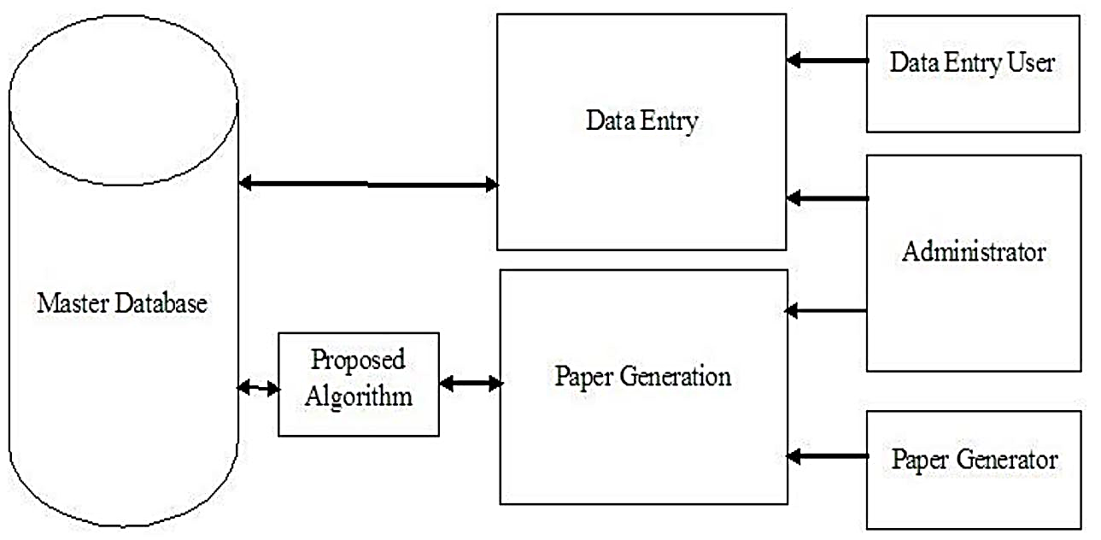

Slide 12
Features & modules
5
Attributes & Its Building Block

Slide 13
Admin Login: Admin would be having a login account. He can add questions in the system and their respective answers.
Question Insertion: User may insert questions as per weight age, difficulty, subject and chapter in the system.
Difficulty Choosing: User may then choose the paper difficulty level
Random Paper generation: The system now automatically chooses random questions as per the selected difficulty level.
Wide Chapter Coverage: The system tries to cover as many chapters as possible for that subject.
Doc File Creation: The system now exports the well formatted question paper in a doc file.
Emailing: The file is now emailed to various users ie college/exam centers just minutes before the exam.

Slide 14
Admin Login
Question Insertion
Difficulty Choosing
Random Paper generation
Doc File Creation
Emailing

Slide 15
Use-case & sequence diagram
6
The Illustration

Slide 16
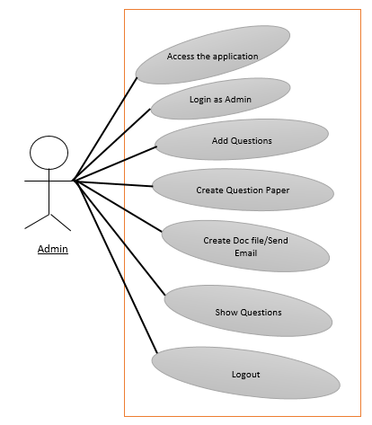

Slide 17
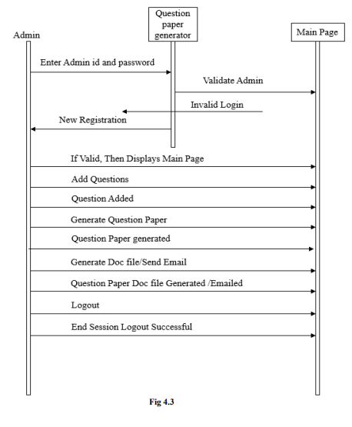

Slide 18
Scope of system
7
To The Extent

Slide 19
SCOPE
Free from tension of collecting question as Built in ready to use question bank is available.
One can make many sets of paper from one database.
Question paper once generated can be downloaded or emailed.
Three level of difficulty of questions are provided i.e. Easy, Medium, and Difficult.
Question paper can be generated and viewed only by admin and password security is provided.

Slide 20
Workflow
8
Here’s How it Works

Slide 21
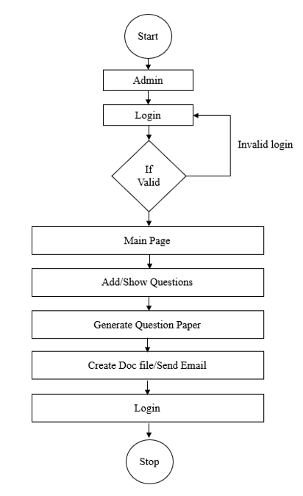

Slide 22
Application
9
Real-Time Usefulness

Slide 23
The system can be used in universities for generating and distributing question papers.
The system can also be implemented in different organizations that conduct regular exams.

Slide 24

Thank You !!

