Slide 1

BIGBULL Bank Of India

Slide 2


Hello!
Enterprise Network Design
Project Co-Ordinator
Prof. Dr Swati Sinha
Project By -
Parth Shah (58)
Omkar Mahadik (39)
Jay Patel (46)
Ritik Singh (65)

Slide 3

Content of Table
ABOUT THE TECHNOLOGY
INTRODUCTION
SCOPE & OBJECTIVE
FEATURES
NETWORK DESIGN
COMPONENTS & BOM
NETWORK DISASTER RECOVERY PLANNING
DESIGN SNIPPET

Slide 4
1.
ABOUT THE TECHNOLOGY
Mechanics Description

Slide 5

About the Technology – BigBull Bank Of India
Cisco Packet Tracer is a powerful n/w simulation program that allows us to experiment with n/w behaviour and ask “what if “ questions.
Key Features of the software includes
Logical & Physical Workspaces
Realtime & Simulation Modes
User friendly CLI
Global event list (Packet Sniffer)
LAN, Switching ,TCP/IP Protocol
Multiple Platform Support

Slide 6
2.
INTRODUCTION
Concept Foundation

Slide 7

Introduction – BigBull Bank Of India
BigBull Bank is setting up a new 3-storey branch in Mumbai.
It is planning to have 6 departments allocated on their new branch BigBull Bank have proposed to have departments of internal IT supports, ATM services, consumer banking, investment banking, loans and insurance.
All their departments network is separated but able to communicate with each other.
BigBull Bank has a budget of ₹3,614,000 and prefer the branch to have a balance between network performance network performance, security and cost effectiveness.

Slide 8
3.
SCOPE & OBJECTIVE
Concept Foundation

Slide 9
SCOPE & OBJECTIVE – BigBull Bank Of India
Below are the main goals of the network being to achieve several operational objectives which are:
Every department network is separated. All staffs can communicate through emails.
There should be a guest Wi-Fi is provided to customers. This is an isolated network isolated with only web browsing capabilities.
The IT department consists of a small team that the staffs are mainly performing operational tasks instead of planning and implementations. Your team is required to provide detail documentations so that the IT staffs can troubleshoot their systems with references.
Your team are working to strike a balance between network performance, security and cost effectiveness so that your team can close this deal.

Slide 10
4.
FEATURES
Attributes & Its Building Block

Slide 11

KEY Features – BigBull Bank Of India
REDUNDANCY
OSPF ROUTING PROTOCOL
SITE-TO-SITE VPN
NAT/PAT IMPLEMENTATION
SUBNETTING
VLAN
MULTILAYER SWITCHING
DHCP DYNAMIC IP ALLOCATION
EDGE MODULE
SMTP/FTP/DNS/HTTP SERVER

Slide 12
5.
NETWORK DESIGN
Conceptual Illustration Model

Slide 13
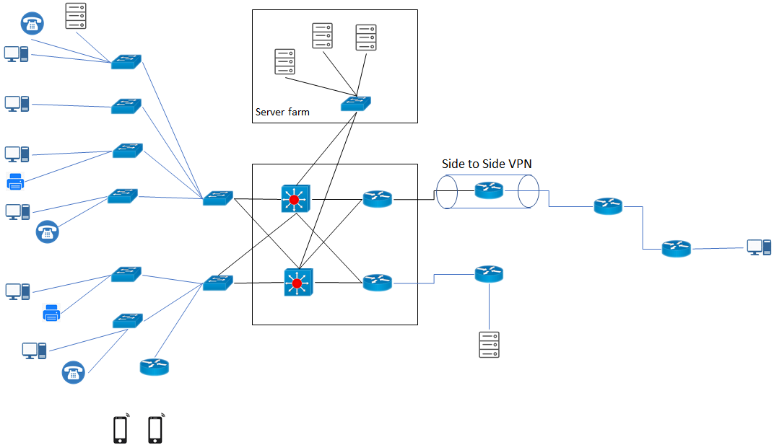

Slide 14
6.
COMPONENTS & BOM
Bricks Used in Wall

Slide 15
Components & BOM– BigBull Bank Of India
CISCO ROUTERS
MULTILAYER SWITCHES
L2 SWITCHES
PERSONAL COMPUTERS
SERVERS
PRINTERS
HOME ROUTER
IP TELEPHONES
Components | No. of Components | Total Cost
Multilayer Switch 3650-24PS | 2x | 2,95,000
Layer 2 Switch 2960-24TT | 9x | 9,62,100
Router 2911 | 6x | 20,45,230
PC(Personal Computer): | 9x | 2,15,618
Servers | 5x | 10,04,000
Printer | 2x | 20000
IP Telephone | 3x | 45000
 |  | 43,53,330

Slide 16
7.
N/W D-R PLANNING
Safe-Keeping the Network

Slide 17


N/W D-R Planning – BigBull Bank Of India
A network disaster recovery plan includes a set of procedures required to effectively respond to a disaster that affects a network and causes its disruption. The main purpose of network disaster recovery is to ensure that services can be delivered to customers despite a disruption in network connectivity.
Back up network configuration files
Regularly test and update the plan
Assess potential risks and threats
Create an IT recovery team and assign responsibilities
Document steps of the network disaster recovery process.

Slide 18
8.
DESIGN SNIPPET
Overall Snap

Slide 19
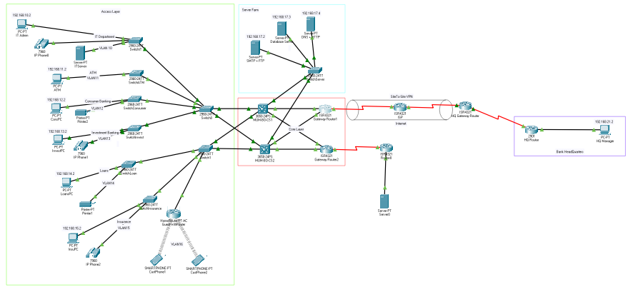
Network Design
.

Slide 20
Effective networking isn't a result of luck - it requires hard work and persistence.

Slide 21

That’s All !

