Slide 1

BIGBULL Bank Of India

Slide 2


Hello!
Enterprise Network Design
Project Co-Ordinator
Prof. Dr Swati Sinha
Project By -
Parth Shah (58)
Omkar Mahadik (39)
Jay Patel (46)
Ritik Singh (65)

Slide 3

Content of Table
INTRODUCTION
KEY FEATURES
NETWORK DESIGN
COMPONENTS & BOM
DESIGN SNIPPET

Slide 4
1.
INTRODUCTION
Concept Foundation

Slide 5

Introduction – BigBull Bank Of India
BigBull Bank is setting up a new 3-storey branch in Mumbai.
It is planning to have 6 departments allocated on their new branch BigBull Bank have proposed to have departments of internal IT supports, ATM services, consumer banking, investment banking, loans and insurance.
All their departments network is separated but able to communicate with each other.
BigBull Bank has a budget of ₹45,00,000 and prefer the branch to have a balance between network performance network performance, security and cost effectiveness.

Slide 6
2.
FEATURES
Attributes & Its Building Block

Slide 7

KEY Features – BigBull Bank Of India
REDUNDANCY
OSPF ROUTING PROTOCOL
SITE-TO-SITE VPN
NAT/PAT IMPLEMENTATION
SUBNETTING
VLAN
MULTILAYER SWITCHING
DHCP DYNAMIC IP ALLOCATION
EDGE MODULE
SMTP/FTP/DNS/HTTP SERVER

Slide 8
3.
NETWORK DESIGN
Conceptual Illustration Model

Slide 9
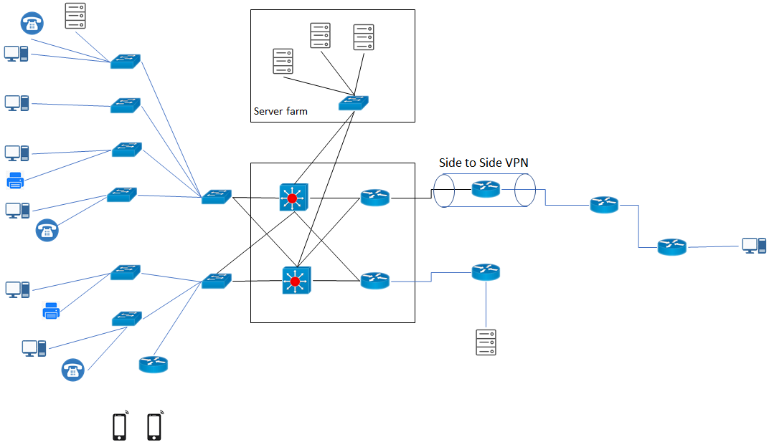

Slide 10
4.
COMPONENTS & BOM
Bricks Used in Wall

Slide 11
Components & BOM– BigBull Bank Of India
CISCO ROUTERS
MULTILAYER SWITCHES
L2 SWITCHES
PERSONAL COMPUTERS
SERVERS
PRINTERS
HOME ROUTER
IP TELEPHONES
Components | No. of Components | Total Cost
Multilayer Switch 3650-24PS | 2x | 2,95,000
Layer 2 Switch 2960-24TT | 9x | 9,62,100
Router 2911 | 6x | 20,45,230
PC(Personal Computer): | 9x | 2,15,618
Servers | 5x | 10,04,000
Printer | 2x | 20000
IP Telephone | 3x | 45000
 |  | 43,53,330

Slide 12
5.
DESIGN SNIPPET
Overall Snap

Slide 13
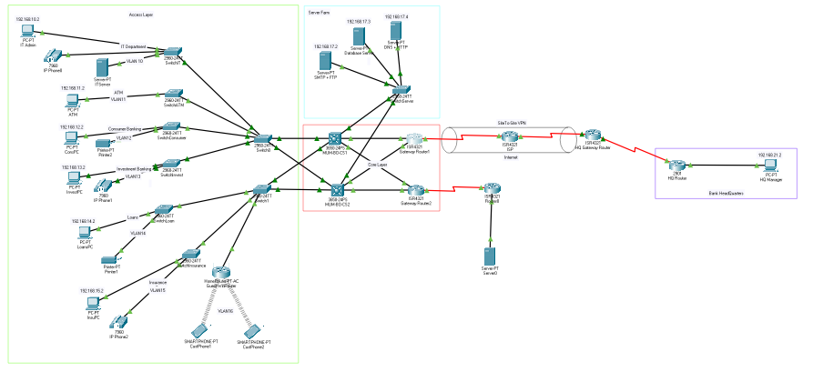
Network Design
.

Slide 14
Effective networking isn't a result of luck - it requires hard work and persistence.

Slide 15

Let’s Move to the Main Demonstration of Design

