Slide 1


NewsChord
Clemson Team: PArth Patel (Project Leader)
Notes:
I’ve always hated how to figure out the real unbiased story behind a headline, I had to jump from article to article and piece together the right information. But I never bothered to fix this, as it was what every educated news reader should do and its what was taught to me in school.

Slide 2

Notes:
But the last 12 months has been some of the most transformative times for me along with many other people. Since March 2020, The nation has experienced many textbook Historical events such the COVID Pandemic, Racial unrest movements, and presidential election events. If there’s one piece of grandfather wisdom I gathered, it's that "out of crisis comes clarity". There are moments in time when a problem that was always there doesn’t become crystal clear until there’s a triggering circumstance. The problem for me that finally flashed in front of my eyes was not having easy access to balanced information. There was alot of polarization in the news, and my only options were to piece together the story myself or just stick with a single source's perspective.

Slide 3

Mission and Vision
Vision: To ease the news article reading experience.
Mission: To allow users to view all the different perspectives to a news headline to collectively provide balanced news.
Notes:
Since October 2020, I’ve been working on solution and developed what I’d like to introduce as NewsChord. NewsChord aims to change the news article reading experience by emphasizing news reading by headline. Across platforms, Giving you the direct information you want instead of you having to click around, scroll and find it on your own. The overall vision being to ease the News Article reading experience.

Slide 4
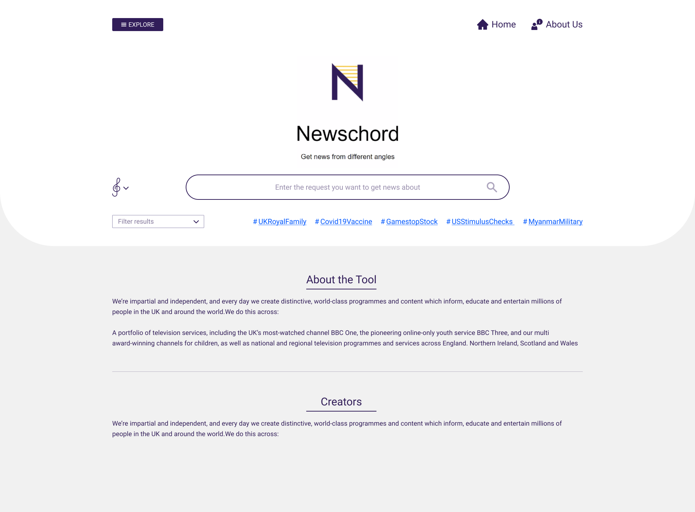
1
3
2
Notes:
In its infancy, NewsChord is a website that acts as a search engine for sensitive news. Upon arriving to the site, this is the page first rendered. Users have the option to digging for a headline via our “explore” menu, select a trending quick search headline or directly search a headline themselves

Slide 5
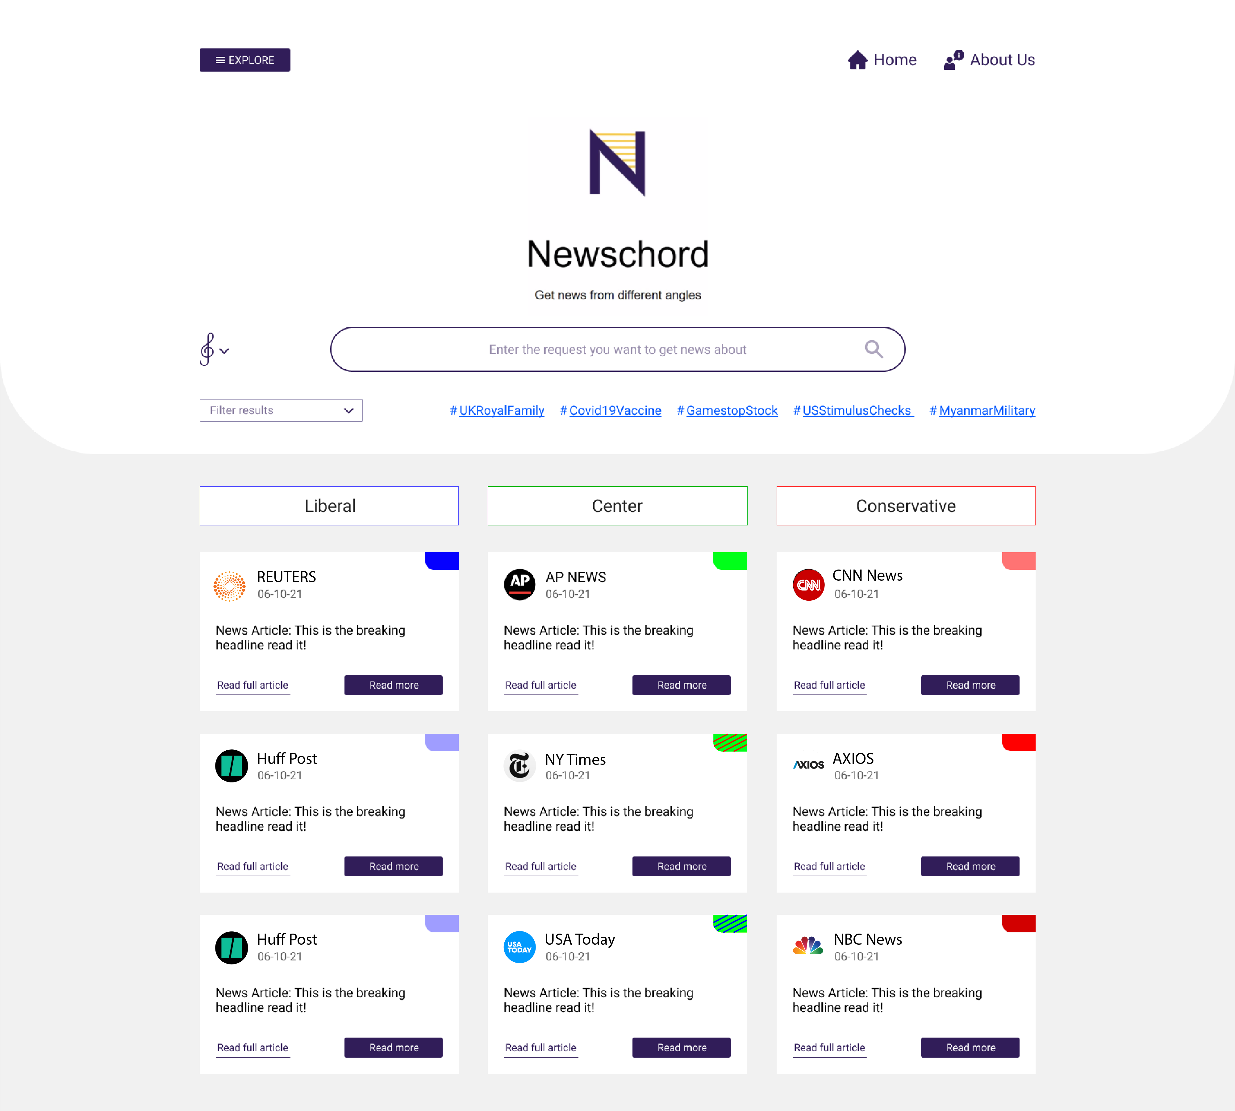
*
Notes:
The output of a search is a table format organizing various articles from various sources. Allowing users to see the spread of coverage. By-default articles that are depicted in each column are the most popular articles on that headline. However, there is are alot of customized search options available via the filter menu. Where the organization and filtering of articles can be tweaked.

Slide 6
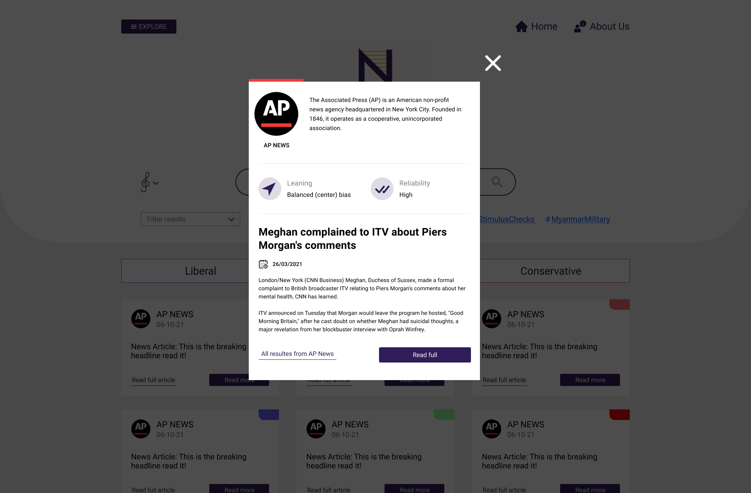
Notes:
For each article, User can open up a pop-up menu. The pop-up will provide additional information about the news source and the article. Moreover, see in-depth stats and ratings of leaning and reliability. These ratings are an aggregate of news source data created by media research organizations which is combined with machine learning analysis of the article itself.
If forced to simplify ourselves to look for competitors, NewsChord is a google search bar for news

Slide 7
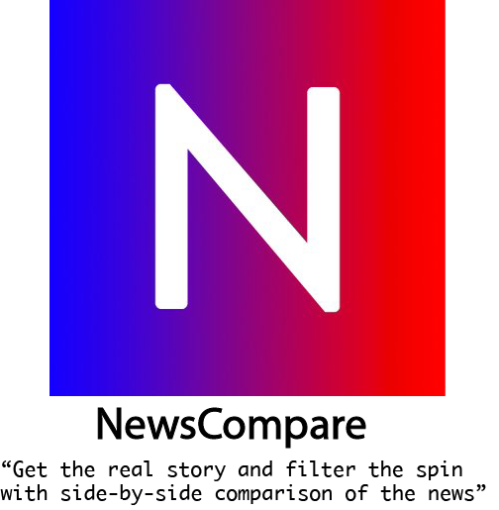
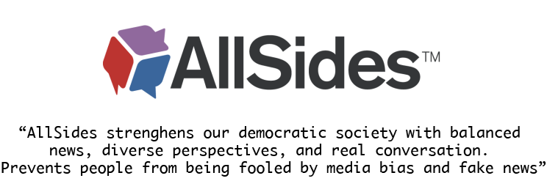

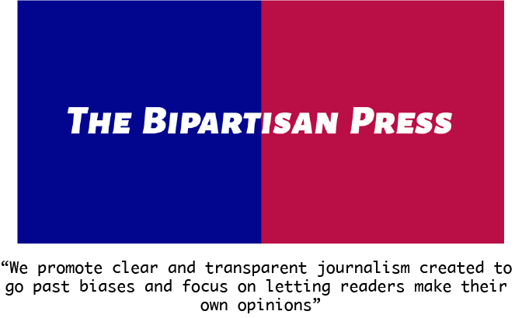
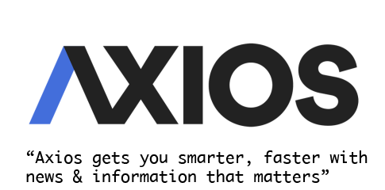
Competitors
Notes:
If forced to categorize, NewsChord is both a news aggregator with an emphasized search engine (a google search bar for news) AND a website that provides news stats.
Other competitors we found have critical shortcomings. Whether it be the UI, the experience, or intuitiveness. We are different from others because we place emphasis on “Finding News by Headline.” All of the articles outputted by our search engine will be about the respective headline. Additionally, our interface is intuitive. NewsChord adheres to a focus of easing the news article searching and reading experience.

Slide 8






Slide 9


User Market
Target Market: Educated News Readers
News consumer groups: Too Many!
Target Early Adopters!
Notes:
Going into the specifics, in regards to the User market.
It is worth noting that there are different news consumer groups. They may have different motives for reading the news, different news reading habits, different preferred sections, and different levels of sensitivity to the news. Through research and development, we’ve learnt that the demand or niche for NewsChord is as an educational product. Our ideal users are people that care about where their news comes from and are educated news readers. They won’t read news off of facebook or social media and take it at face value.
However, even with highly educated people, we noticed that some news readers fall into a comfort zone where they tend to stick to a specific news source. This may be a barrier for adoption. Which is why our initial users are those that don’t have a specific go-to source, those that have an occupational pressure to use NewsChord, or those that refuse to fall into that comfort zone. Examples would be college students, Academia professors, or small-time news analysts.
This group holds the most potential as they will be people that “love” or product as opposed to simply “liking” it. Which should allow us to gain the most traction, as they won’t require extensive customer retention strategies, will provide detailed user feedback, and also provide word-of-mouth marketing.

Slide 10

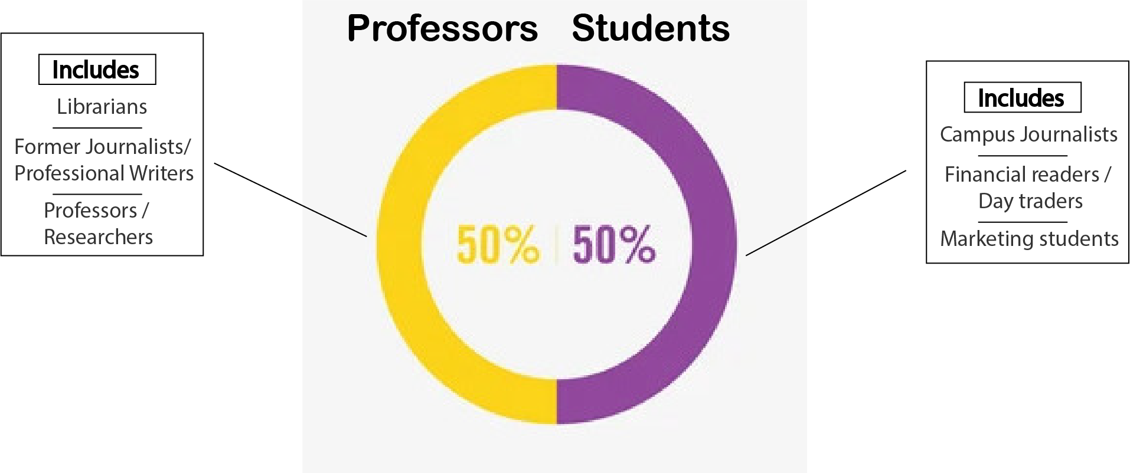
Idea Feedback
Notes:
It is worth noting that there are different news consumer groups. They may have different motives for reading the news, different news reading habits, different preferred sections, and different levels of sensitivity to the news. Through research and development, we’ve learnt that the demand or niche for NewsChord is as an educational product. Our ideal users are people that care about where their news comes from and are educated news readers. (To give you a better grasp of what I mean, the polar opposite group would be the nonchalant news reader that consumes news from facebook or social media).
This group holds the most potential as they will be people that “love” or product as opposed to simply “liking” it. Which should allow us to gain the most traction, as they won’t require extensive customer retention strategies, will provide detailed user feedback, and also provide word-of-mouth marketing

Slide 11
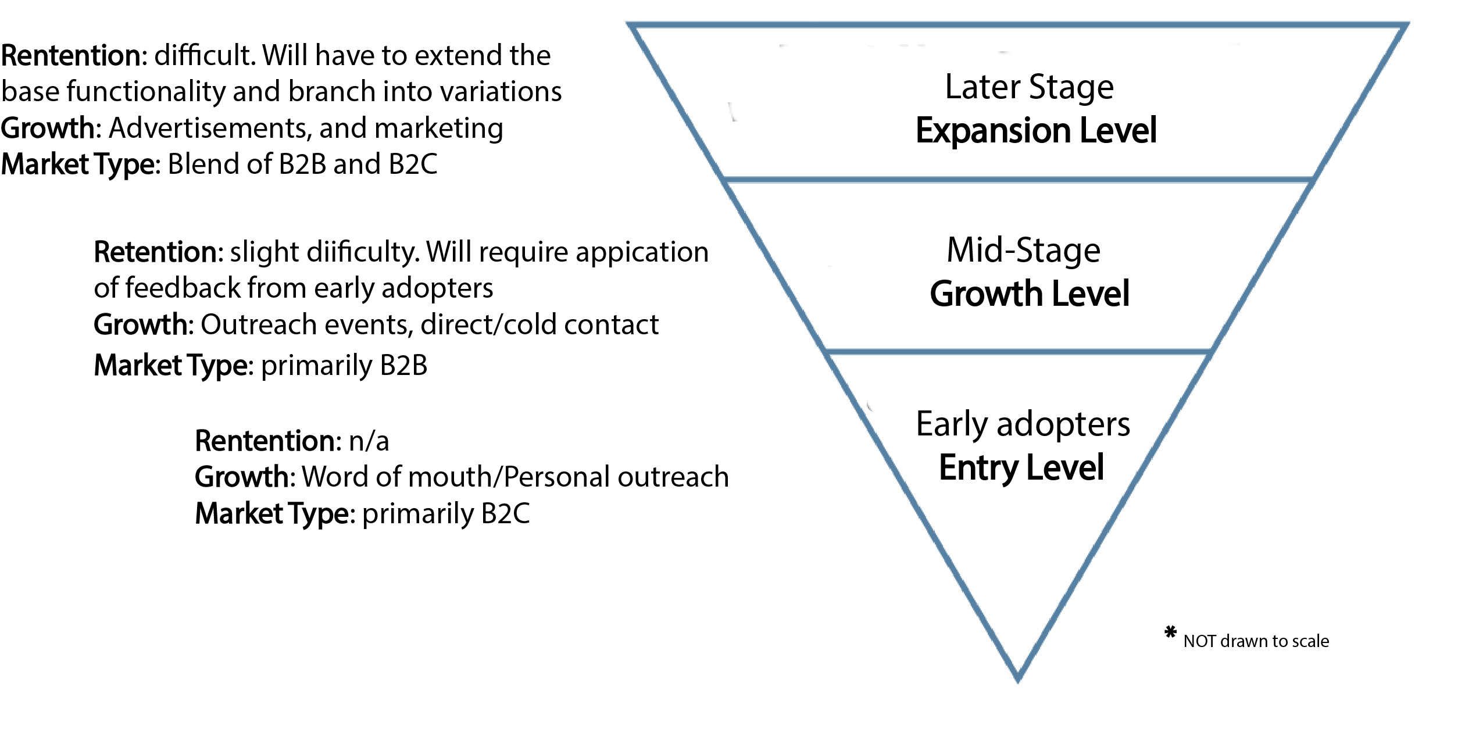
Market Segmentation

Slide 12

Business models
Freemium
Free User - Ads (labeled ads)
Paid User – Organizational and individual
Notes:
Bringing everything back around, the fact that an idea must be monetizable cannot be ignored. NewsChord is essentially a software business. This allows not only high scalability but high profitability. The base business model is a freemium model. Where users can use basic functionality with ads or use advanced functionality without ads. Examples of advanced functionality would be access to advanced filters, newsletter subscriptions, or tracking analytics of news consumption.
The revenue source from free users will be ads. Or more specifically native advertisement AND Corporate and Social responsibility advertisement (CSR) advertisement.
The revenue sources from paid users obviously be the paid subscription. There will be two divisions of paid users: organizational users and individual users. Organizational users will have the added benefit of bulk pricing, and backend management and analytics.

Slide 13
The End
We Can Ease your Online News reading

Slide 14


Costs
Flat
Hosting: $10 monthly
Domain: $30 annually
Variable
Other: Average $4 per month per user
Notes:
Last but not least, the associated costs with NewsChord.com are shown here. Currently, NewsChord.com is still in development and requires roughly $10 a month. However, these costs reflect the steady-state costs expected in the next 1-2 months.
I hope the judges have questions for me, because I was forced to simplify this presentation to fit within a timeframe.

