Slide 1
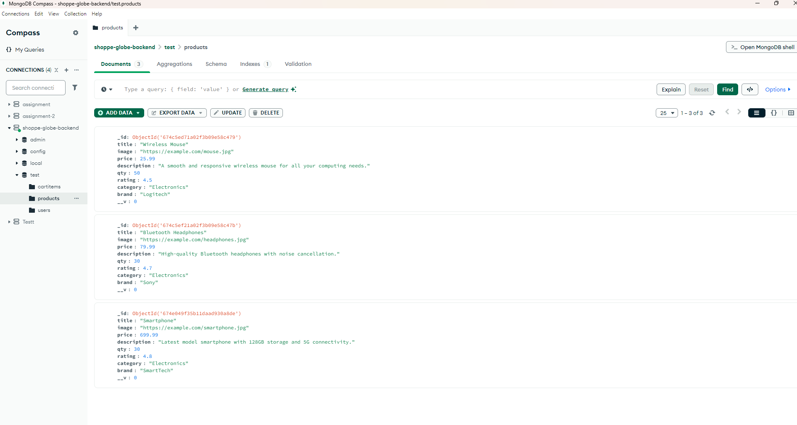
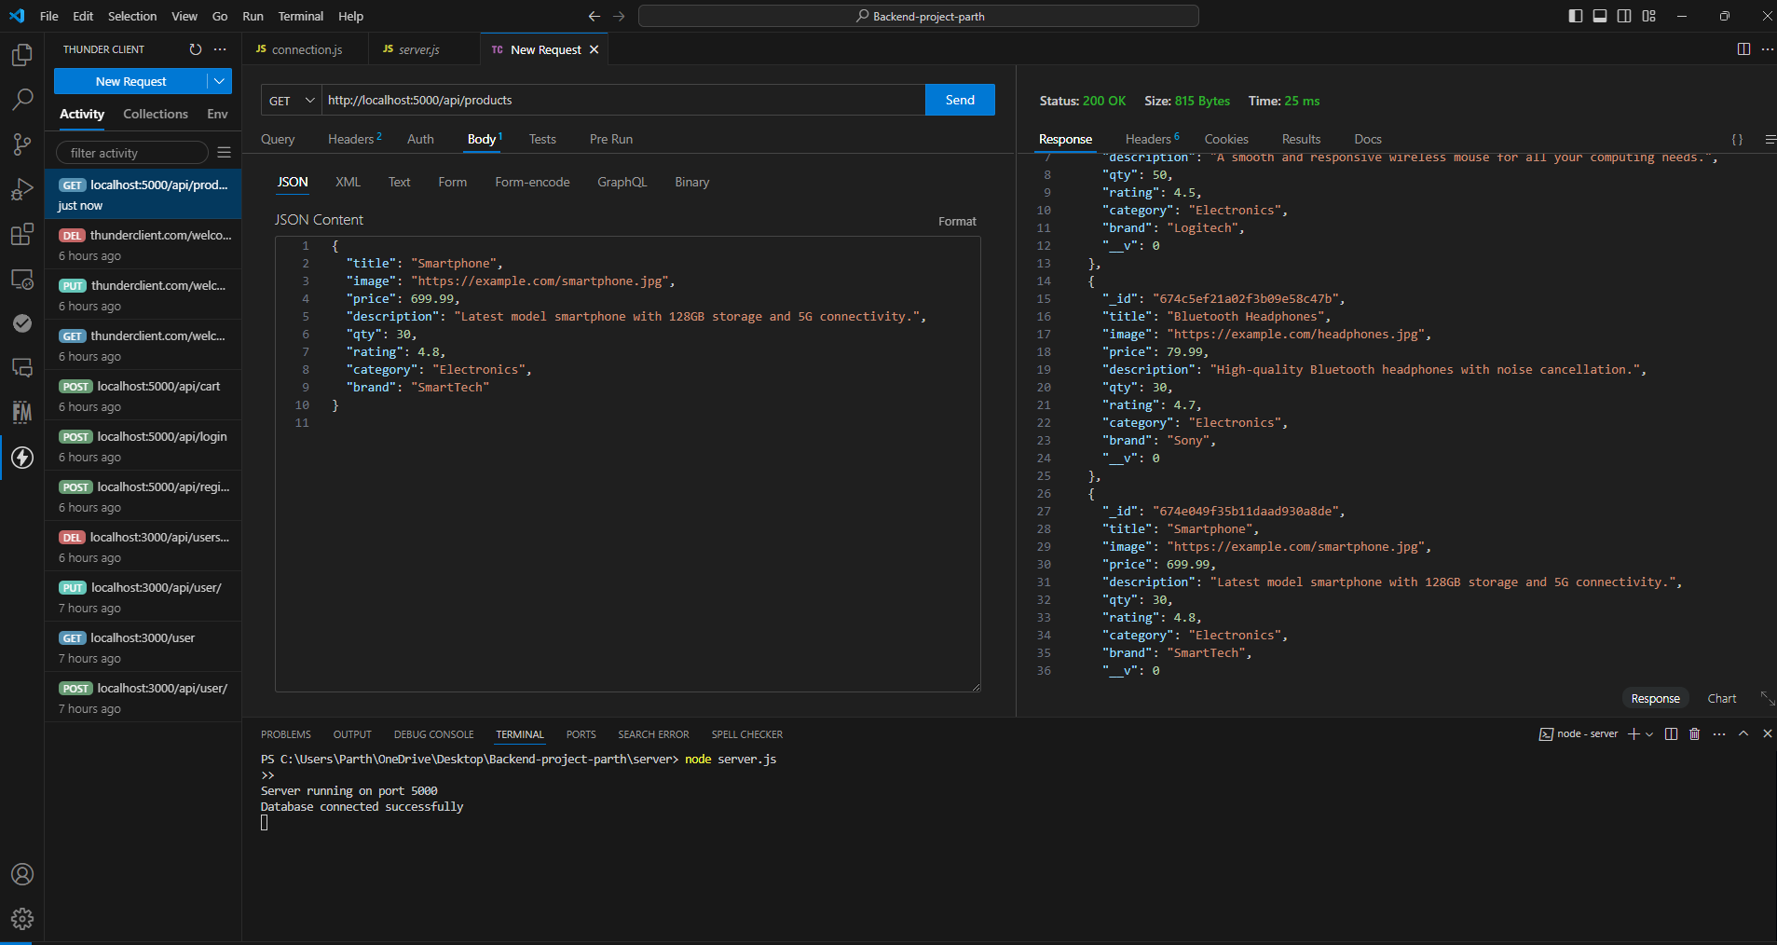
Backend - project
○ GET /products: Fetch a list of products from MongoDB.
Github:- https://github.com/parth12638/ShoppyGlobe-BE/tree/main

Slide 2
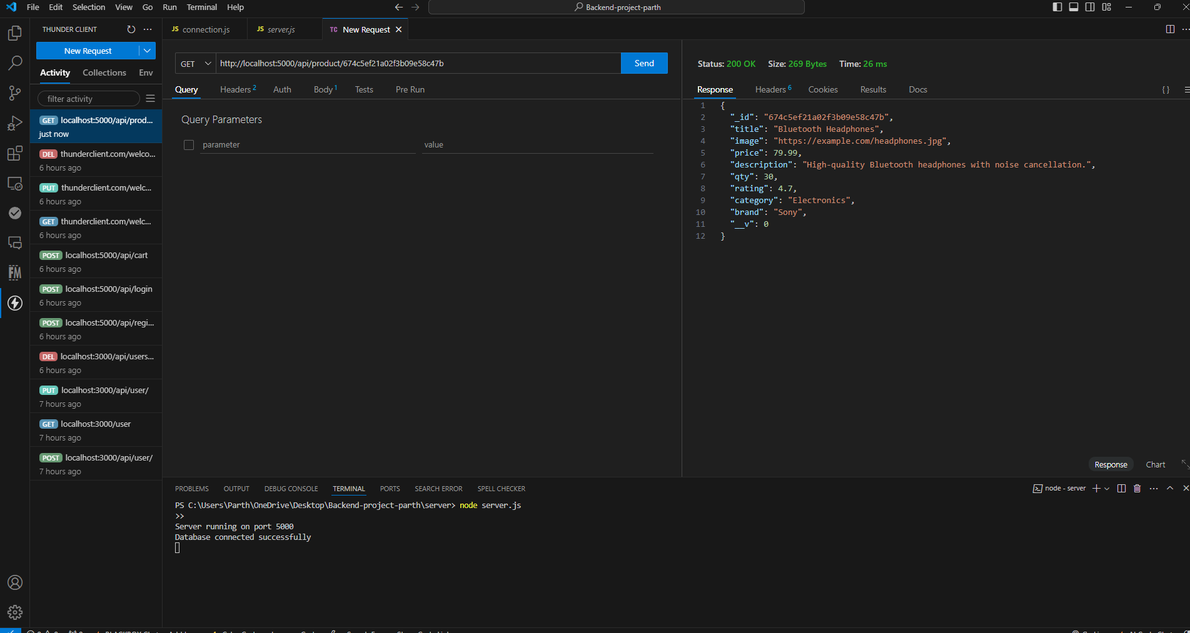
Backend - project
○ GET /products/ : Fetch details of a single product by its ID

Slide 3
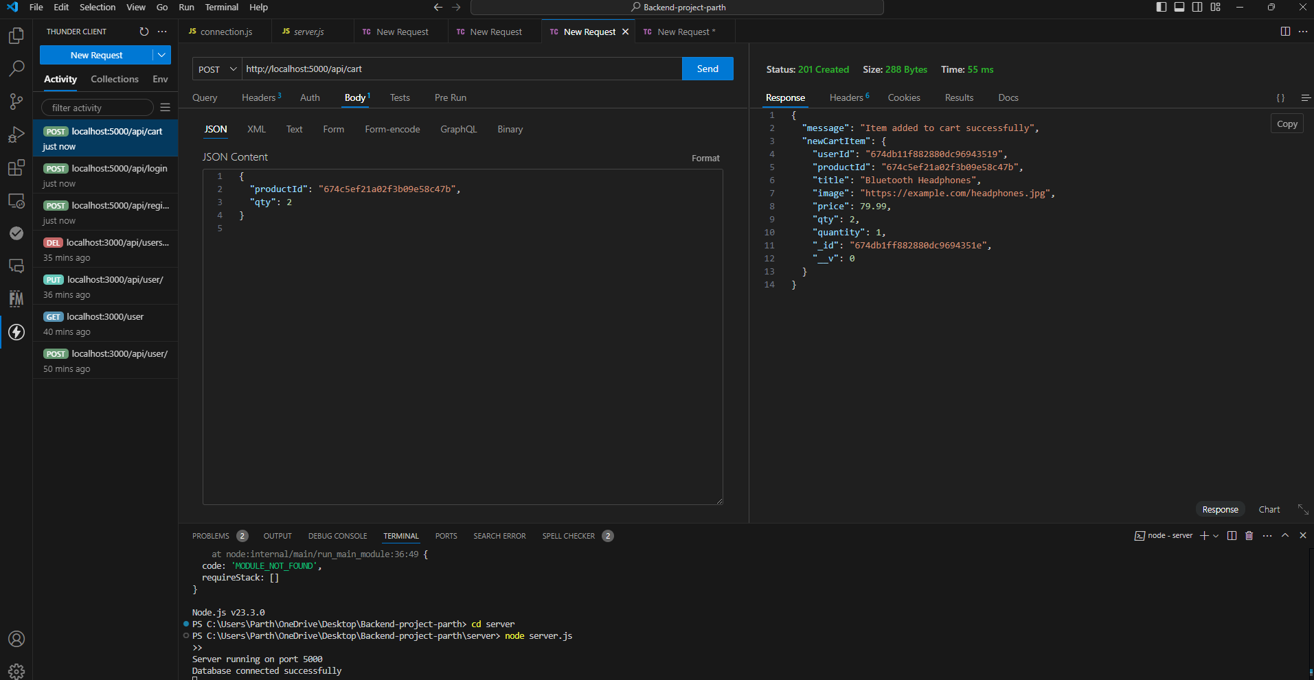
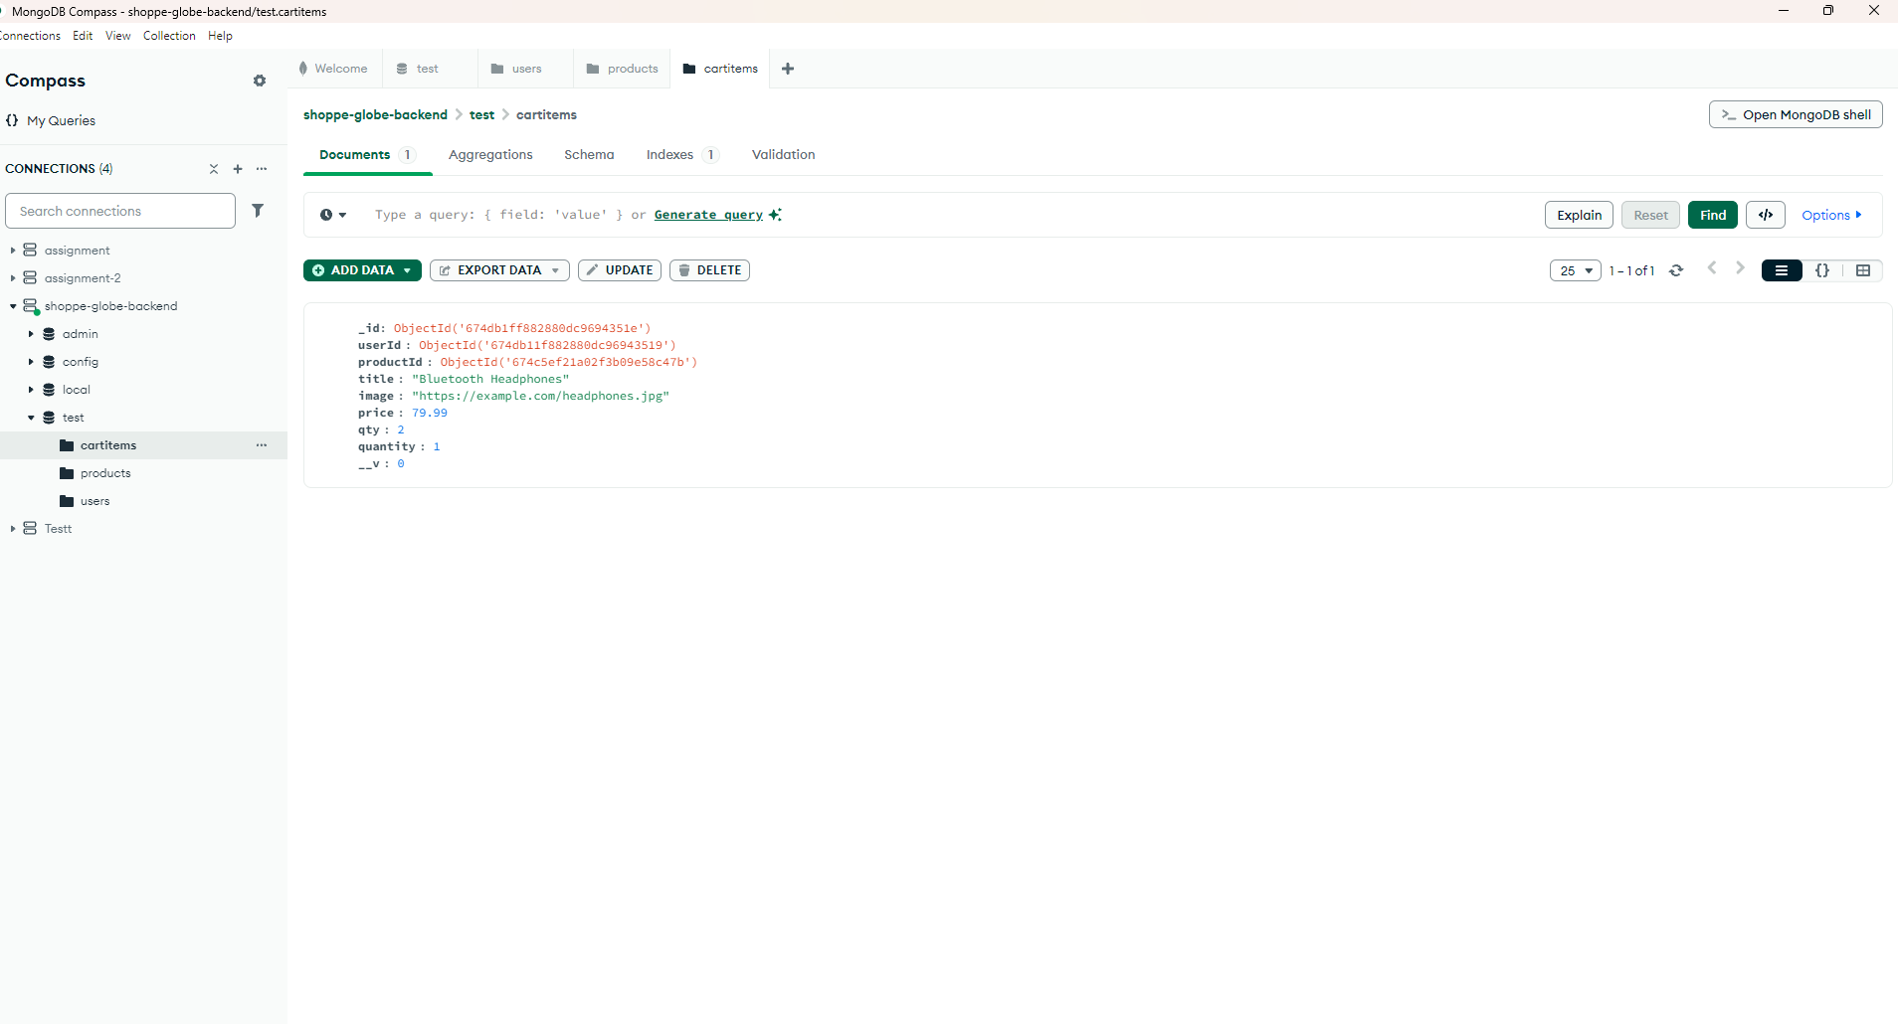
Backend - project
○ POST /cart: Add a product to the shopping cart.

Slide 4
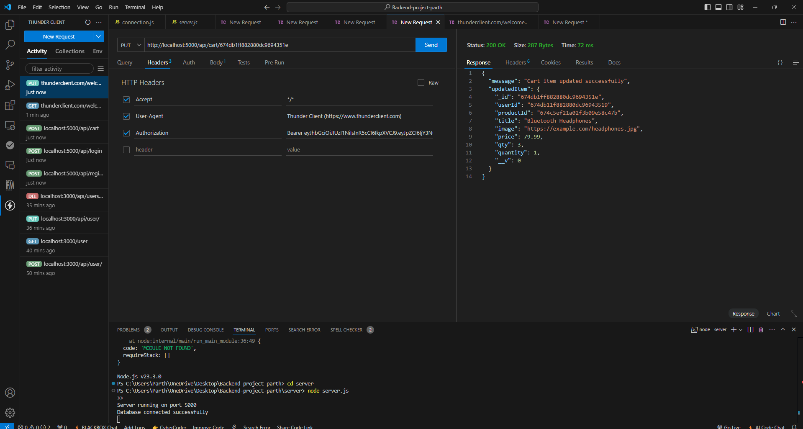
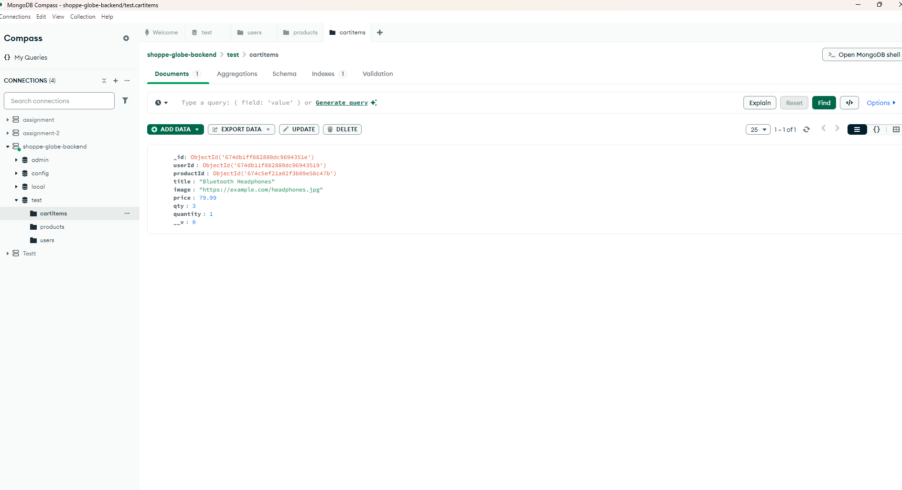
Backend - project
○ PUT /cart/ : Update the quantity of a product in the cart
Products quantity increased from 2 to 3

Slide 5
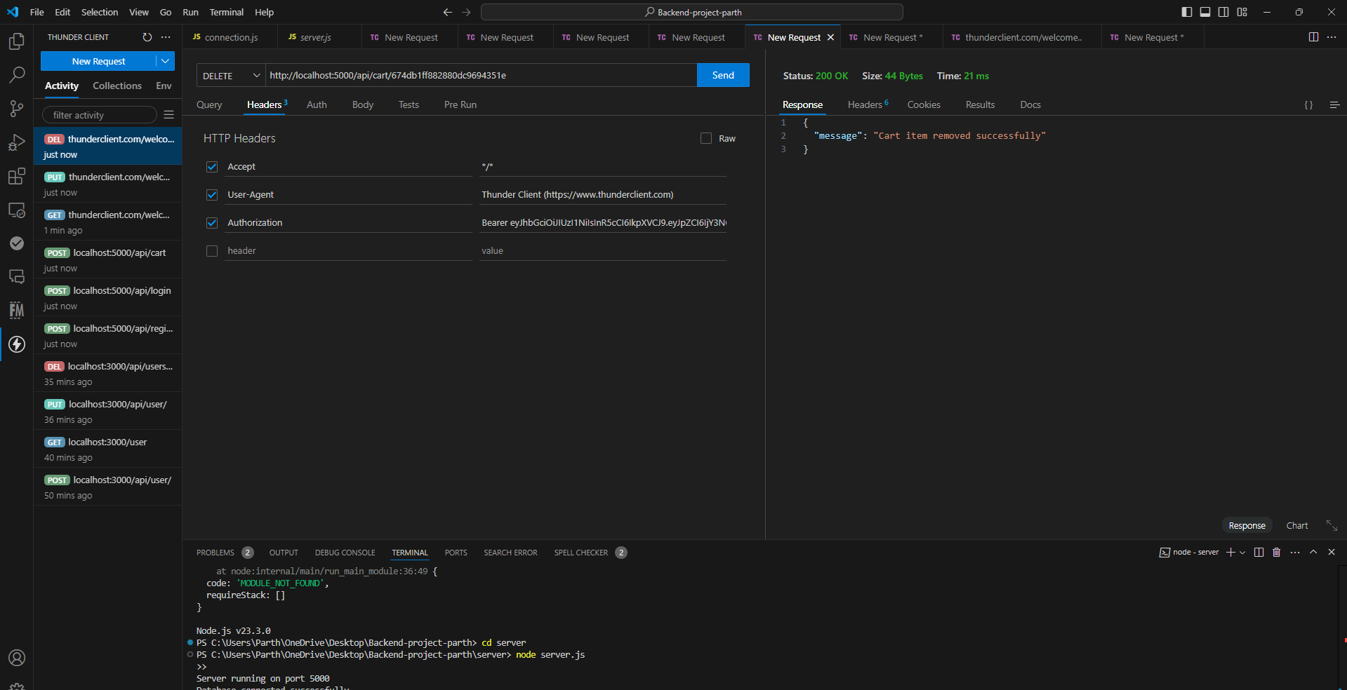
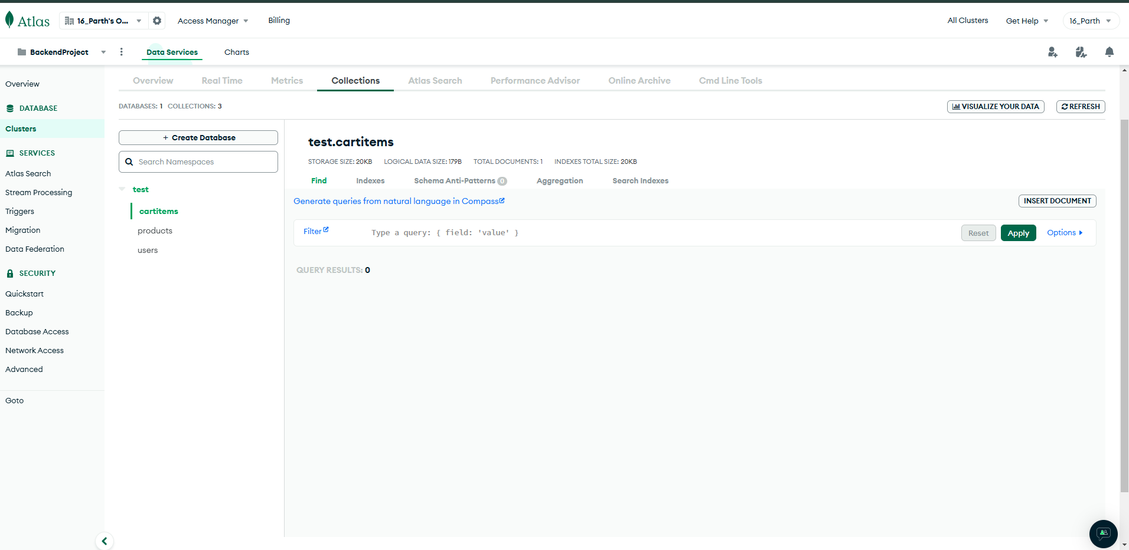
Backend - project
○ DELETE /cart/ : Remove a product from the cart.

Slide 6
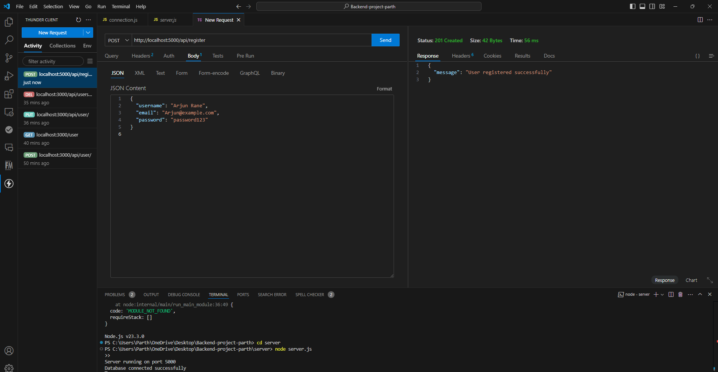
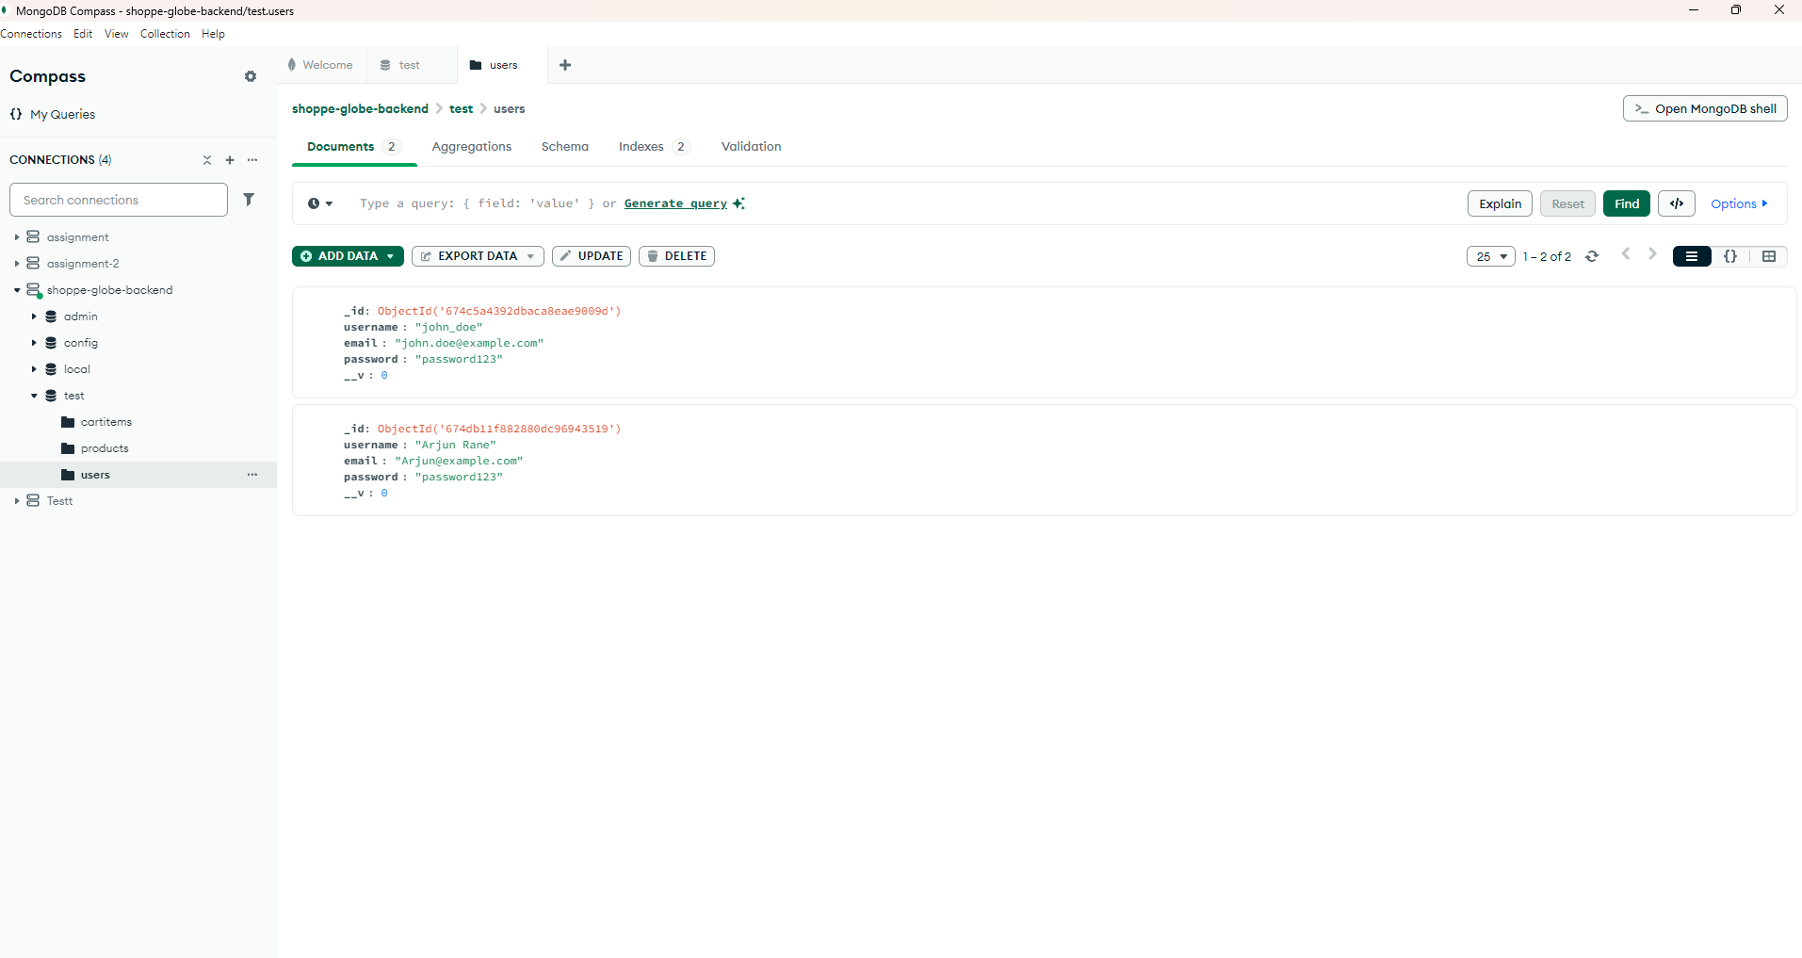
Backend - project
○ POST /register: Register a new user.

Slide 7
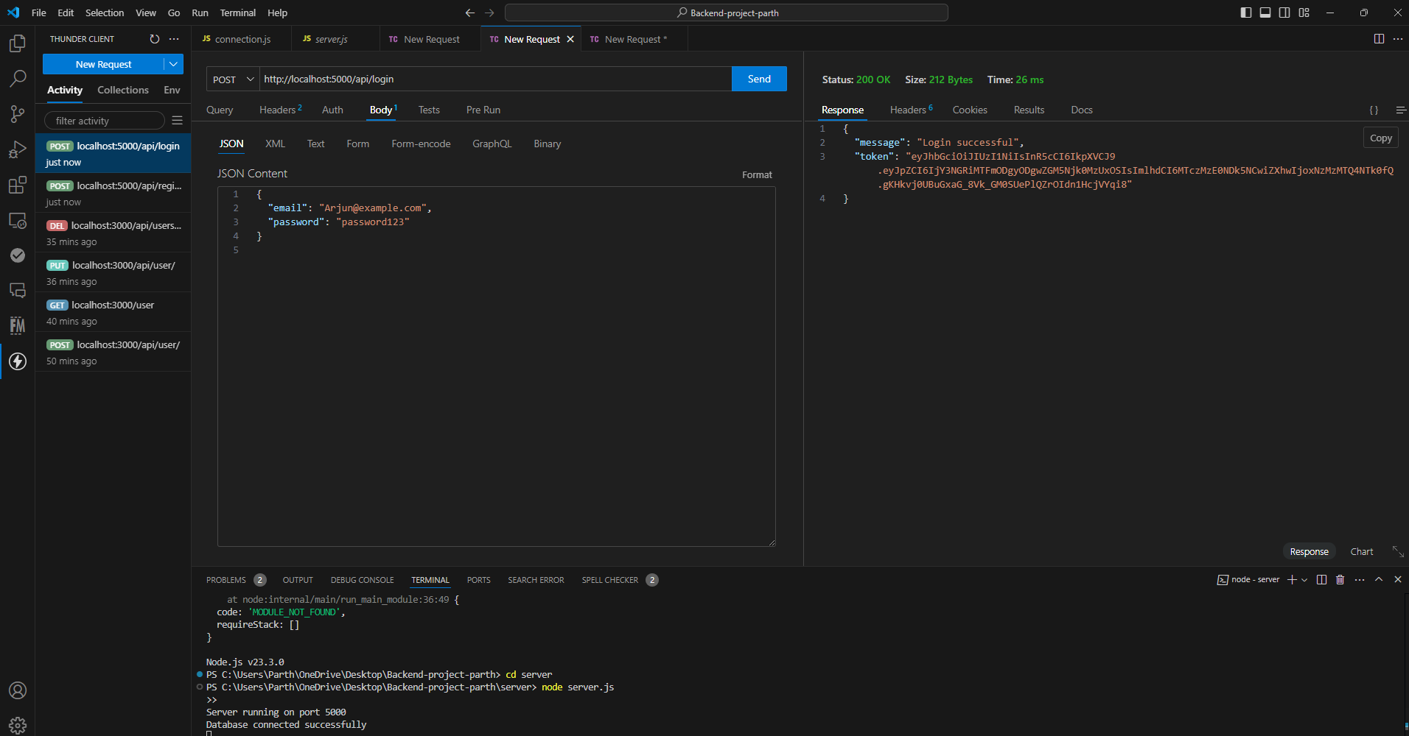
Backend - project
○ POST /login: Authenticate user and return a JWT token.

