Slide 1
Design and implementation of Voice Based Path Planning System
By : Partha Pratim Malakar(170101043)
Supervisor: Prof. Pradip kr. Das
Department of CSE
IIT Guwahati

Slide 2
CONTENTS
INTRODUCTION
REVIEW OF LAST SEMESTER WORK
IMPLEMENTATION OF SPEECH RECOGNITION AND SYNTHESIS
EXTRACTING AND READING DATA FROM GOOGLE MAP
SCALING COORDINATES AND DRAWING
GOOGLE MAP IN VISUAL STUDIO
DRAWING OVER GOOGLE MAP
FUTURE WORK

Slide 3
INTRODUCTION
A software tool to implement path planning
It can we operated using voice commands
Features are implemented in menu based GUI
Flights Paths are shown over google map in rectangular stripes.
Build in Visual studio 2010
Coding Language C++
Use of Windows form application

Slide 4
REVIEW OF LAST SEMESTER WORK
Designed front-end GUI structure in visual C++
I added all the features in list as menu and menuitems
Created a set-up file and added user license agreement.

Slide 5
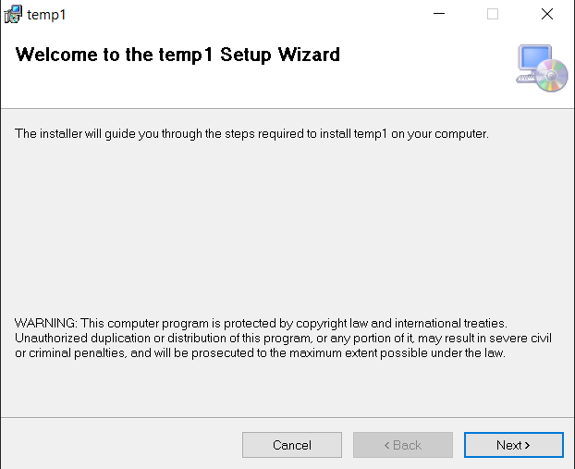
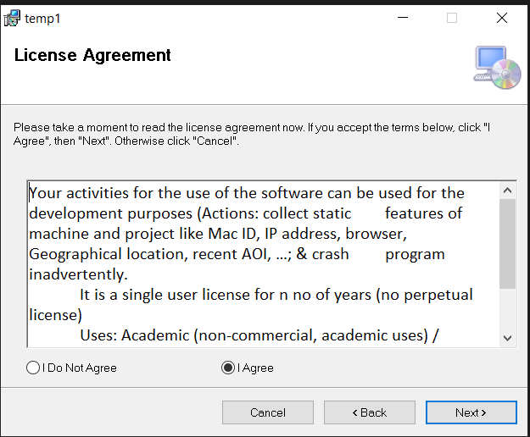
REVIEW OF LAST SEMESTER WORK

Slide 6
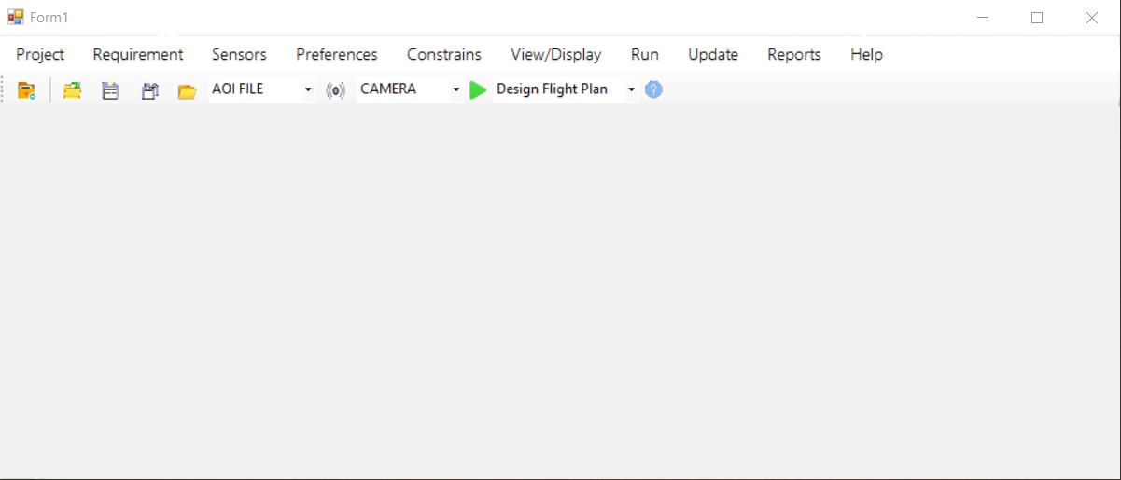
REVIEW OF LAST SEMESTER WORK

Slide 7

IMPLEMENTATION OF SPEECH RECOGNITION
Implementation steps
Add reference to system.speech
Add the following namespace
Add the following code in onload function

Slide 8
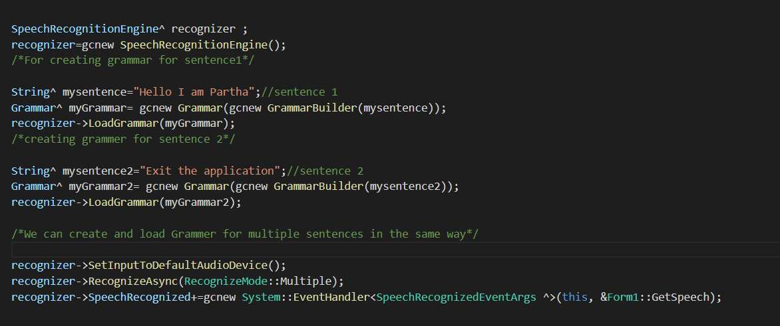
IMPLEMENTATION OF SPEECH RECOGNITION

Slide 9

IMPLEMENTATION OF SPEECH RECOGNITION
Add the following function in form class.
Issues with speech recognition
More recognizable for the US English.
We have to do voice training in windows for better recognition.
Even after voice training, sometimes words are misrecognized.

Slide 10

IMPLEMENTATION OF SPEECH SYNTHESIS
Implementation Steps
Add reference to system.speech and the namespaces.
Create a SpeechSynthesizer variable inside the form class
Inside the form onload function add the following line
To convert text to speech add

Slide 11
EXTRACTING AND READING DATA FROM GOOGLE MAP
A set of points or a path or a polygon can be downloaded from google earth desktop application as a .kml extension file.
.kml files have xml like structure.
Point coordinates are inside <coordinate></coordinate>
I created some test data using iitg boundary coodinates.

Slide 12
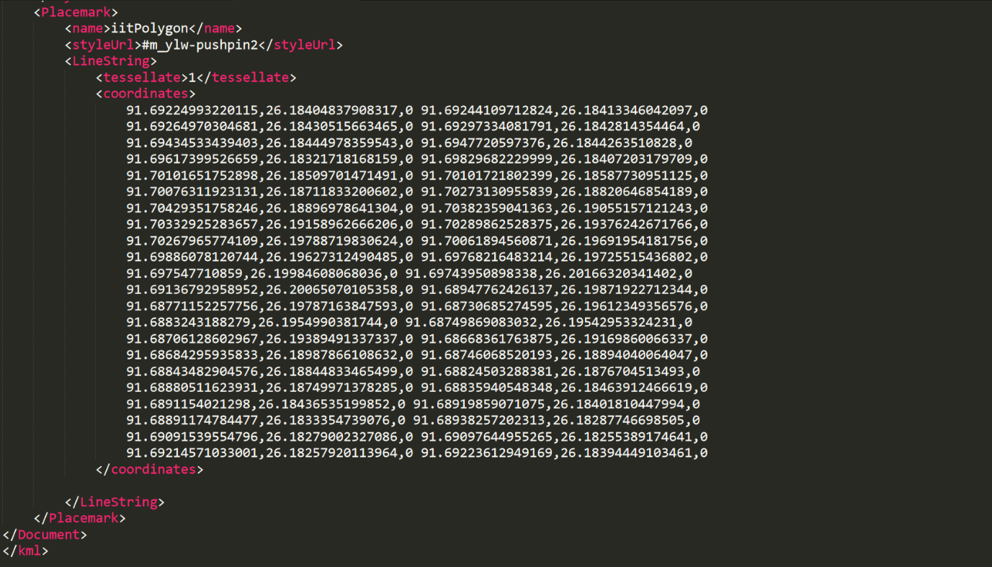
EXTRACTING AND READING DATA FROM GOOGLE MAP

Slide 13
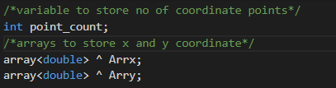
EXTRACTING AND READING DATA FROM GOOGLE MAP
Implementation Steps
Declare the following variables in the form class
Use xmlTextReader to read and store the input in Arrx and Arry

Slide 14
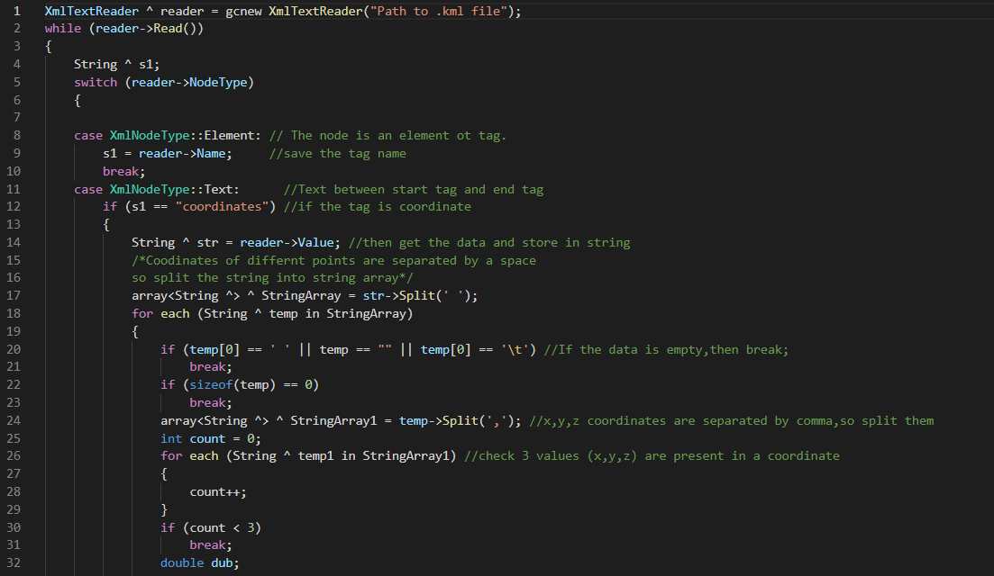
EXTRACTING AND READING DATA FROM GOOGLE MAP

Slide 15
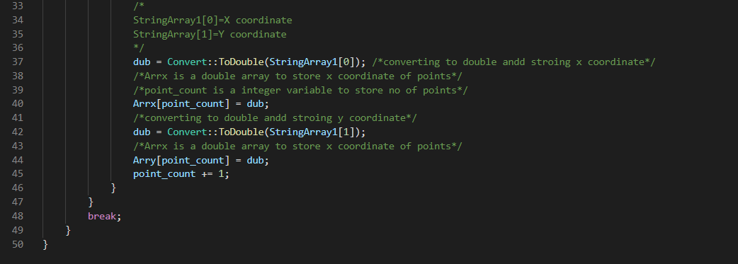
EXTRACTING AND READING DATA FROM GOOGLE MAP

Slide 16
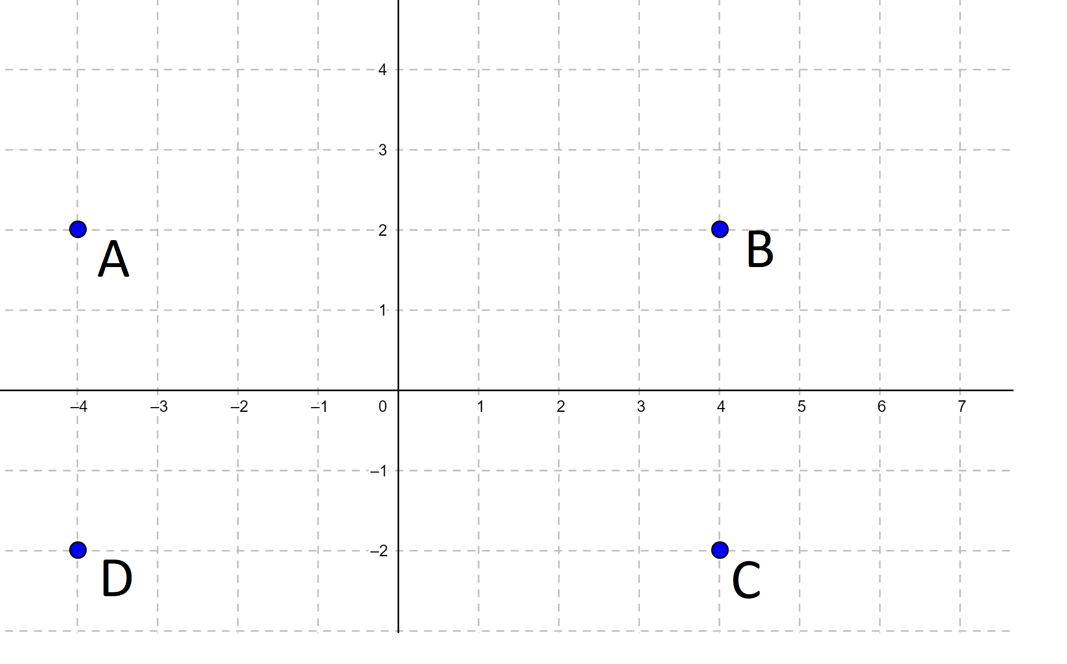
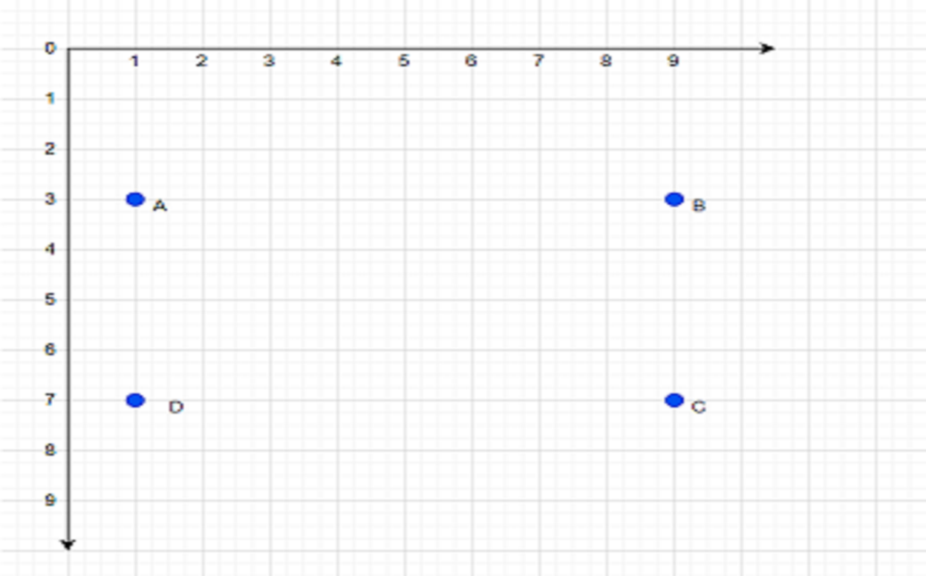
SCALING COORDINATES AND DRAWING
Cartesian Coordinate
Visual studio window

Slide 17
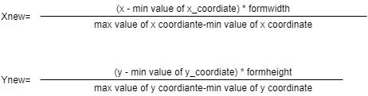
SCALING COORDINATES AND DRAWING
Let P(x,y) is a point in cartesian plane then in visual studio window the point will be Q(X_{new} ,Y_{new}) where
X_{new} = windowsformwidth + x
Y_{new} = windowsformheight − y
For points from google map, X coordinate ranges from -180 to 180 and y coordinate ranges from -180 to 180.Let P(x,y) is a given point. In visual studio window coordinate of P will be, P‘(X_{new} ,Y_{new}) where

Slide 18
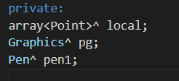
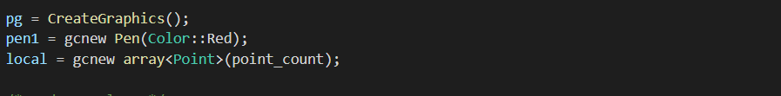
SCALING COORDINATES AND DRAWING
Implementation of drawing
Add the following variables in the windows form class
Initialize the variables in form onload function

Slide 19
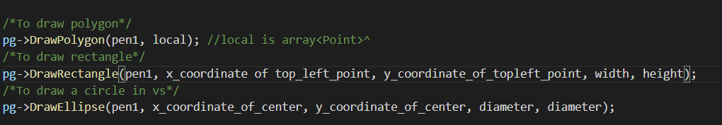
SCALING COORDINATES AND DRAWING
Read data, count the number of points and store the points in the point (local) array.
Draw objects using the following code

Slide 20
GOOGLE MAP IN VISUAL STUDIO
Visual studio uses ‘webbrowser’ from toolbox to open urls or HTML files. By default ,visual studio ‘webbrowser’ uses Internet Explorer
Implementation Steps
Using google map url directly in webbrowser
Errors with this approach
Script error
IE compatibility error
Using HTML files
Using api key
Without api key

Slide 21
DRAWING OVER GOOGLE MAP
Take 2 windows form.
Show google map on 1st windows form
Draw object on 2nd windows form and make it transparent.
Place the 2nd windows form above the first one.

Slide 22
FUTURE WORK
The future work is to add the algorithms which will be used to design the flight paths.
Deployment
Keep track of licensed user
Further updates

Slide 23
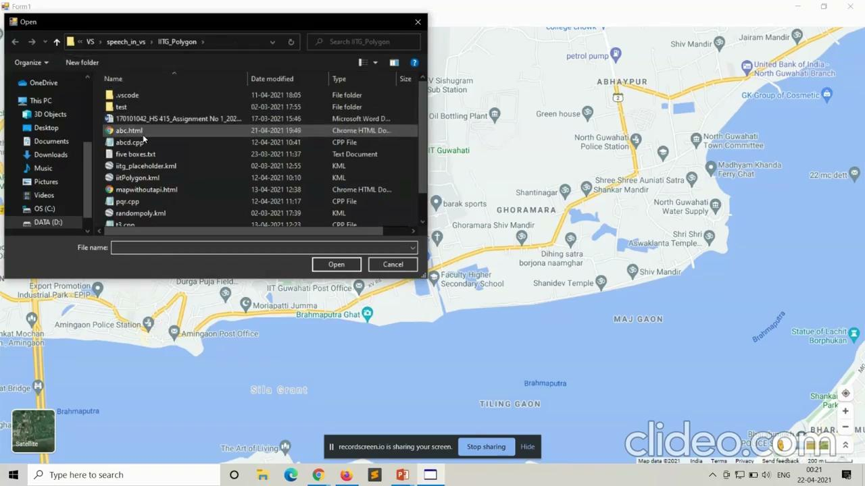

Slide 24
THANK YOU

