Slide 1
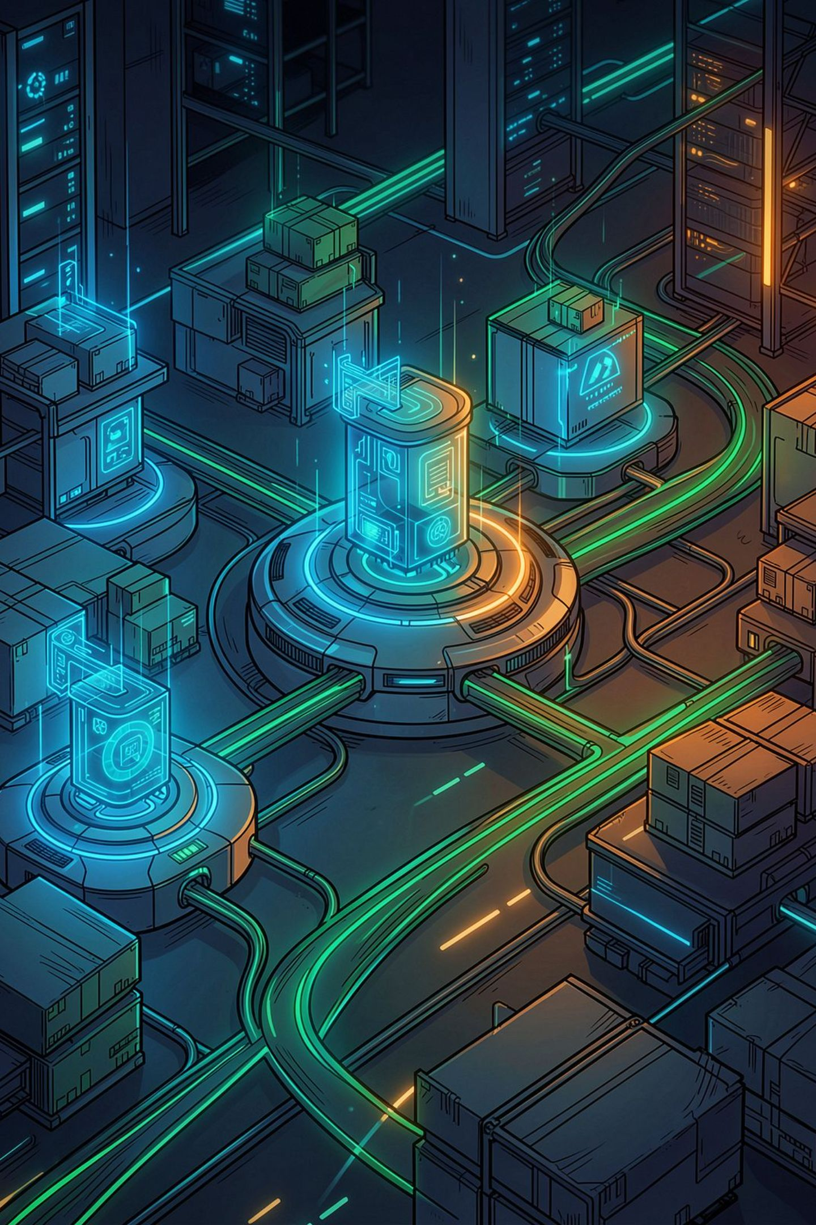
IBM Bob Supply Chain Assistant
Autonomous Risk Mitigation & Cold-Chain Control Tower
Team Astra-Developers — Track: AI / Open
Team Lead: Parth Prajapati | Members: Arman Shaikh, Parin Patel, Bhavya Patel

Slide 2
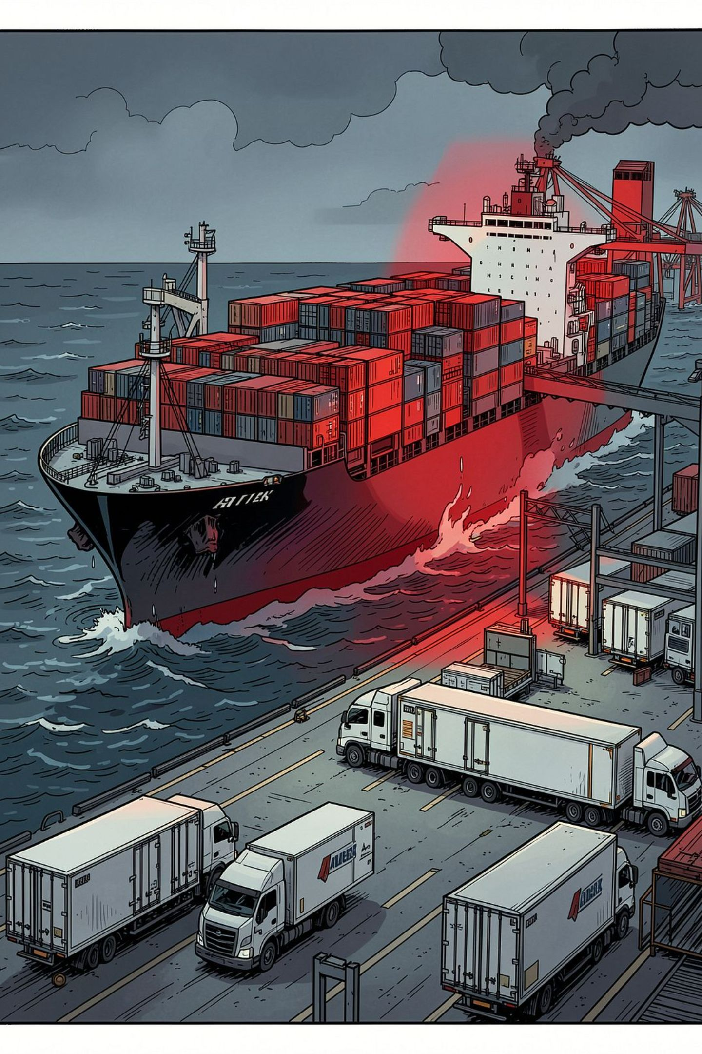
Global Supply Chains are Blind to Disruptions & Thermal Failure
Sudden Disruptions
Idle Assets Unused
Severe Financial Loss
Geopolitical conflicts (Red Sea), port strikes (Rotterdam), and canal closures (Panama) can strand hundreds of shipments within hours.
Neighboring trucks and reefers sit idle while congested nodes accumulate acute backlogs—poor visibility, poor allocation.
Estimated $50B+ pharmaceuticals lost annually to temperature breaches; a single mRNA shipment breach ≈ ₹5.78 Crore ($680K).
Cold-Chain Blindspot
Thermal degradation is typically discovered only at delivery—too late for mitigation or claims avoidance.

Slide 3
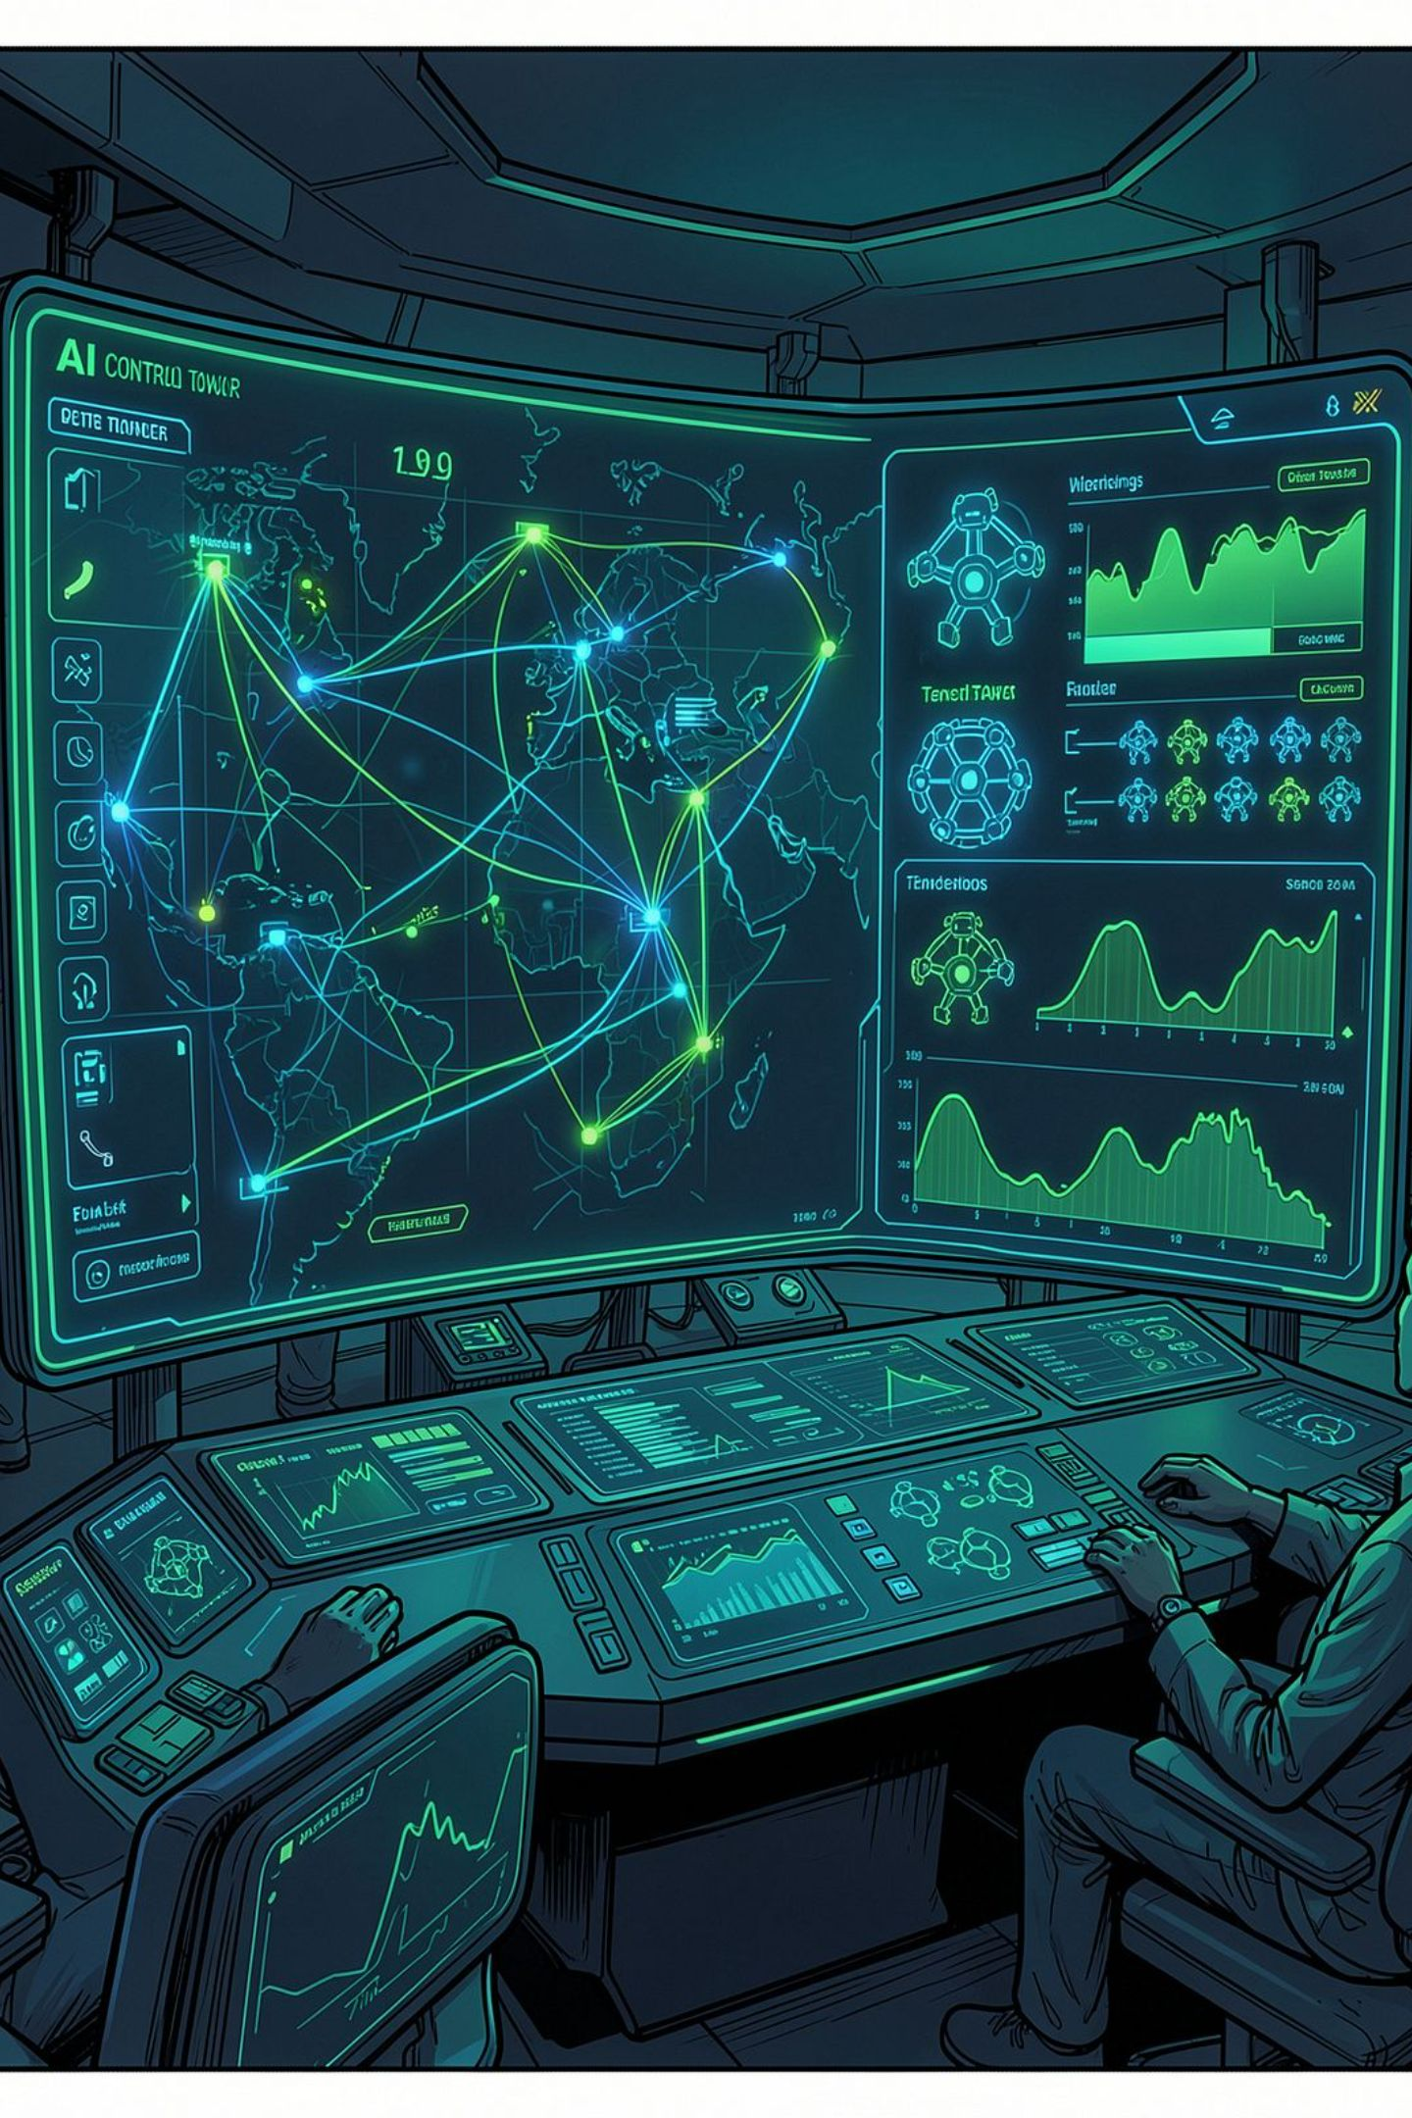


IBM Bob Supply Chain Assistant Overview
Autonomous real-time control tower combining continuous IoT surveillance with multi-agent AI copilot reasoning to prevent disruptions and protect cold-chain integrity.
1
2
3
Disruption Impact Radar
Dynamic Re‑Routing
Fleet Asset Rebalancing
Spatial impact radius matching with localized ₹ INR risk scoring for fast prioritization.
Multi-modal carrier trade-offs showing Cost (₹) vs ETA with probabilistic arrival confidence.
Automated, ROI-optimized repositioning of idle trucks and reefers to preempt bottlenecks.
4
Cold-Chain Safeguard
Continuous IoT time-series analysis, USP <1150> MKT computations, and WHO GDP thermal compliance checks.

Slide 4

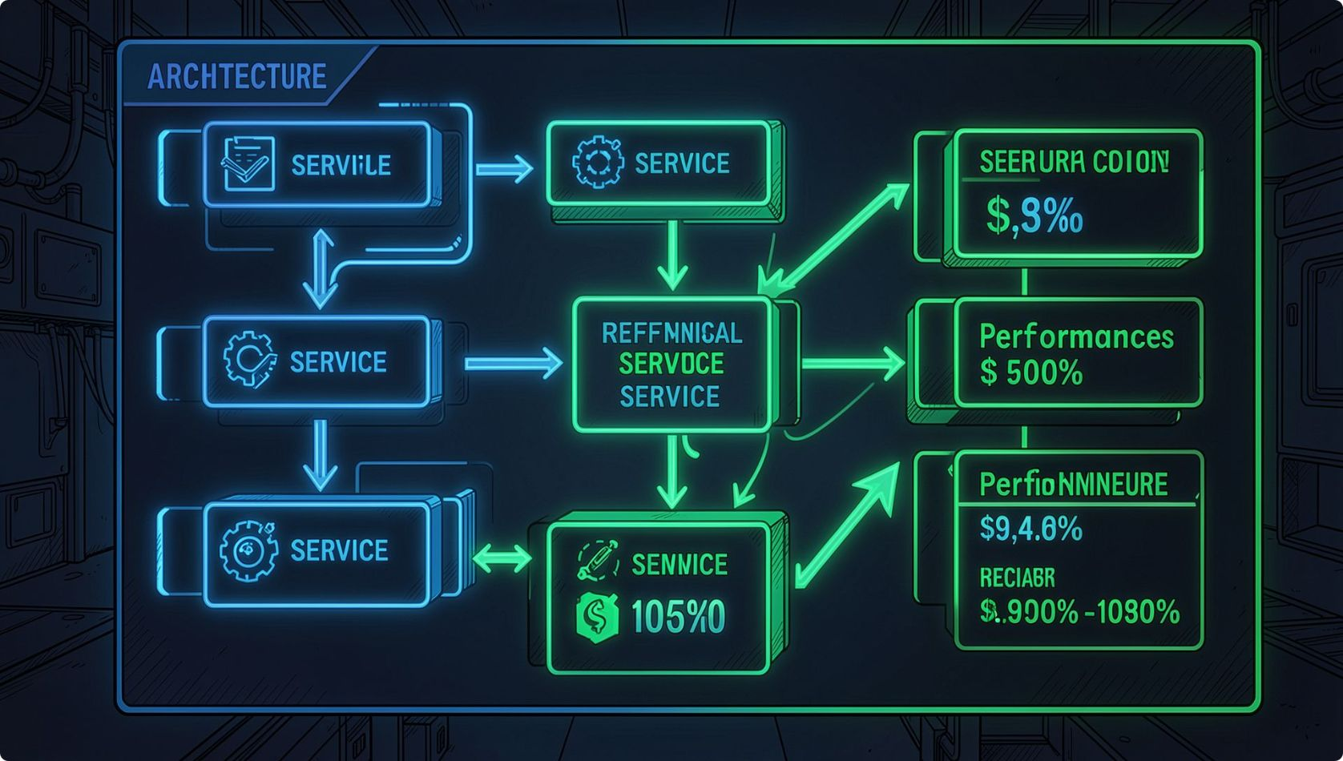
High-Performance Multi-Agent System Architecture
Operator Browser
React 19 Frontend
FastAPI Backend
Engines → LLM
Highlights
Frontend: React 19 + Vite, Glassmorphism, Lucide icons — low-latency operator UX.
Backend: FastAPI on Python 3.13, Pydantic in-memory models — <10ms decision latencies for core services.
AI Engine: Groq Llama 3.3 70B (800+ tokens/sec) with Gemini 2.0 Flash fallback for edge cases and rate-limit resilience.

Slide 5
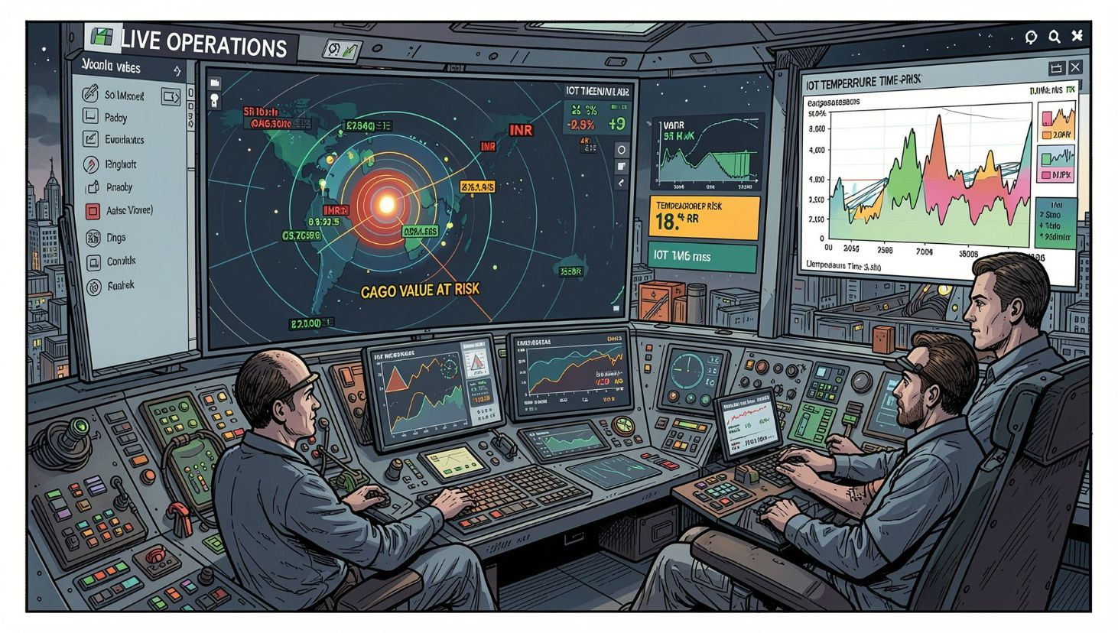

Proactive Risk Mitigation — Control Tower Demo
Features in Action
Live Operations Tab: Real-time spatial disruption epicenter mapping and cargo value‑at‑risk shown in ₹ (Lakhs → Crores).
Cold-Chain Thermal Safeguard: 24h IoT graphs, MKT (USP <1150>) calculations, automatic GDP status flags (WHO/FDA).
One‑Click Copilot Actions: Interactive chat controls — APPLY_REROUTE and EXECUTE_FLEET_REDEPLOYMENT with pre-flight ROI estimates.
Demo-ready flows designed for judges: simulate a port strike and show automated re-route + fleet redeploy in under 10s.

Slide 6
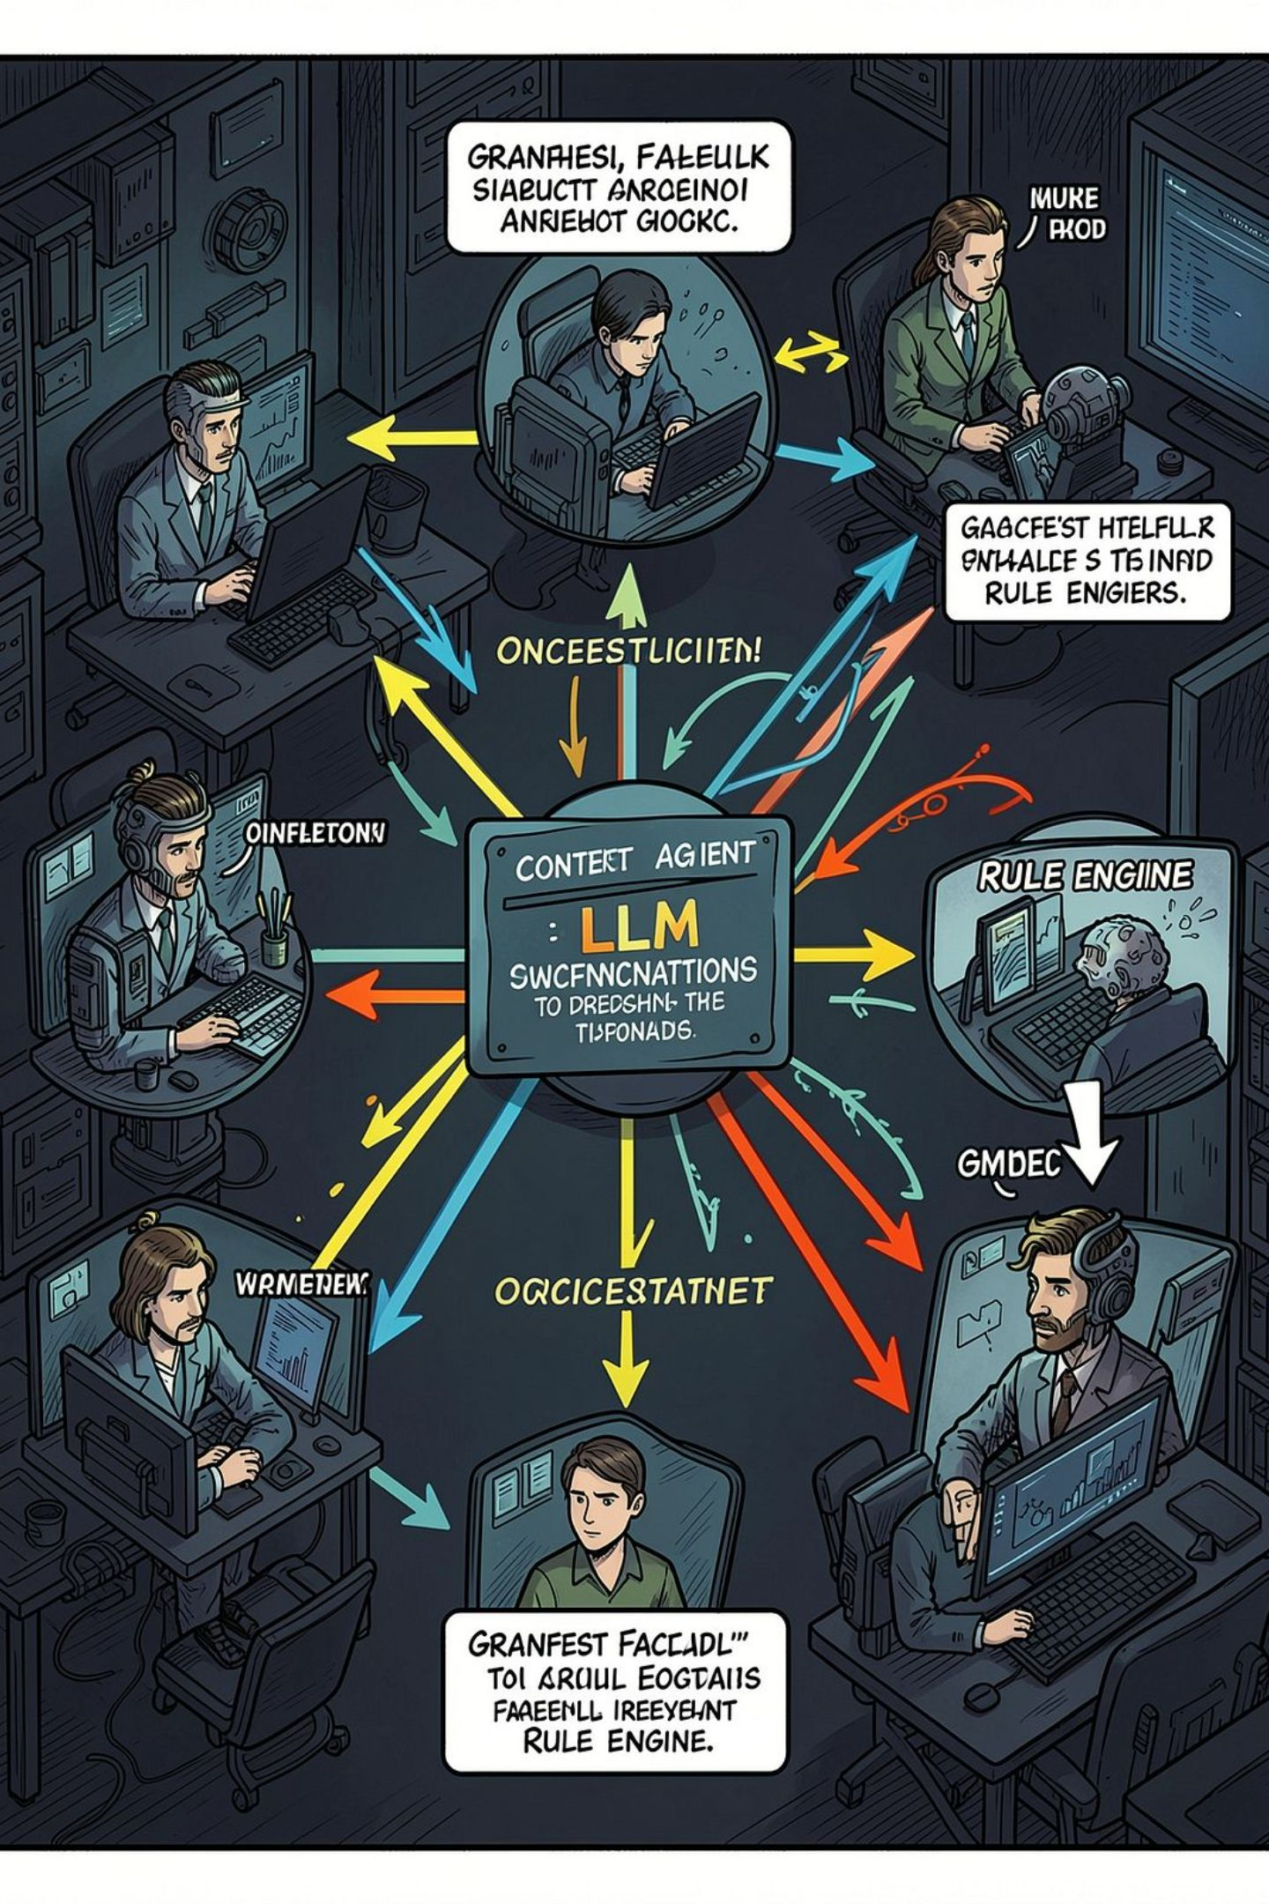



Agentic Workflow & Autonomous Decision Support
Multi-Agent Orchestration
IBM Bob uses agentic workflow patterns to delegate discrete tasks (detection, scoring, action planning) for zero-shot decision execution.
Dynamic Context Injection
Live operational payloads (telemetry, routing, contracts) are injected into Llama 3.3 prompts to produce grounded, audit-friendly recommendations.
Graceful Fallback
When offline or rate-limited, IBM Bob falls back to deterministic, domain-specific rule engines ensuring safety and regulatory compliance.

Slide 7
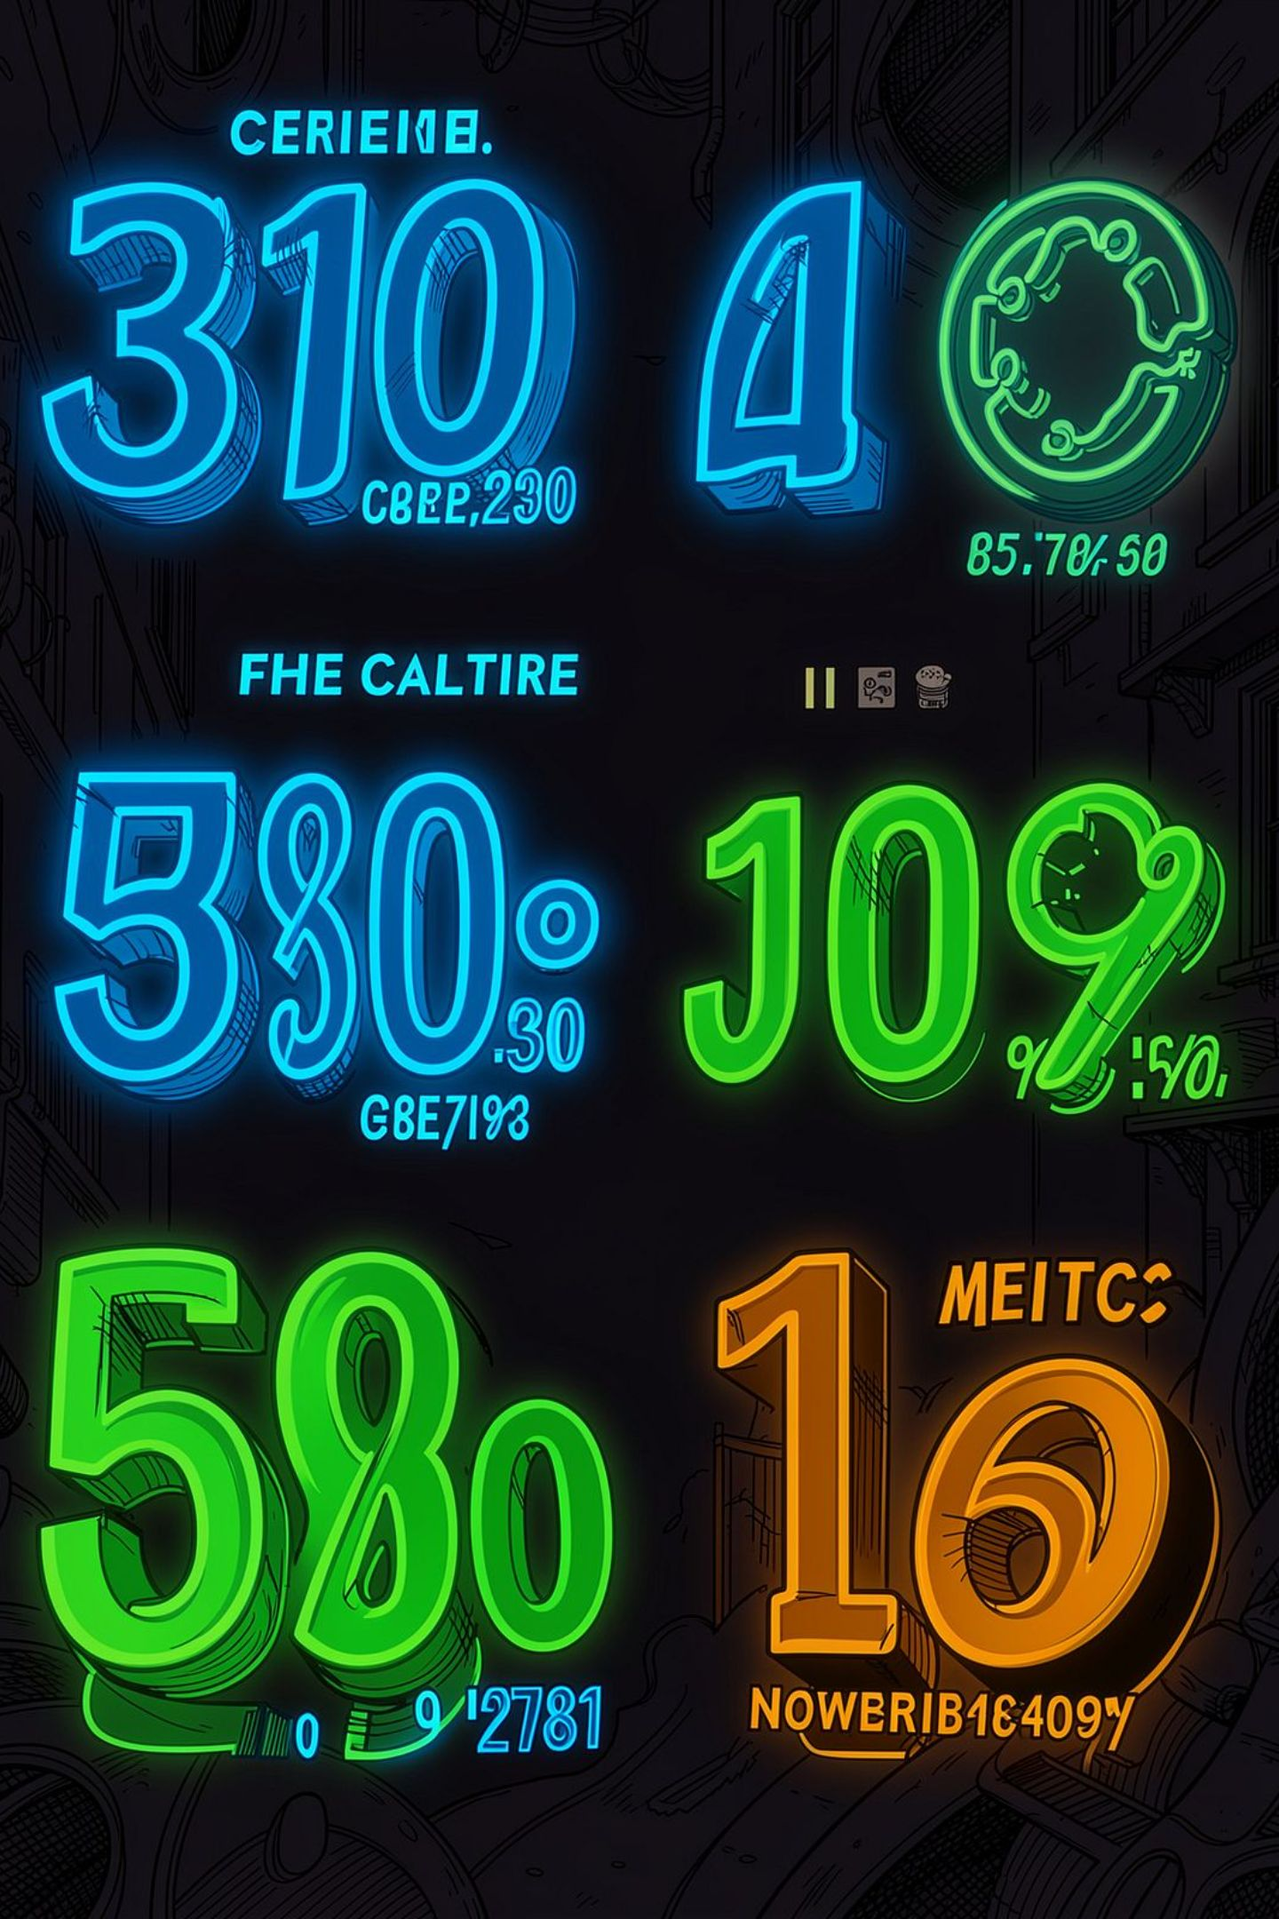
Quantifiable Value & ROI Metrics
<3s
Response Speed
Disruption triage time reduced from 8 hours to under 3 seconds for automated prioritization and suggested actions.
₹5.78 Cr
Prevented Loss
Potential savings per cold-chain shipment—preventing single-shipment losses that previously cost ~₹5.78 Crore (~$680K).
35%+
Fleet Efficiency
Increase in idle truck utilization across regional hubs through automated rebalancing and predictive positioning.
100%
Compliance
Thermal audit compliance target: 100% WHO/FDA GDP alignment for tracked cold-chain flows.

Slide 8

Team Astra-Developers
Parth Prajapati — Team Lead
Architecture, full‑stack AI integration, system design and verification.
Arman Shaikh
Backend services, FastAPI development, low-latency data pipelines.
Parin Patel
Frontend UI, telemetry visualization, operator UX for control tower workflows.
Bhavya Patel
Fleet rebalancing algorithms, optimization models, data modeling.
“Building autonomous AI solutions for resilient global supply chains.”

