Slide 1
Project 0: Encryption and Decryption using monoalphabetic Substitution
Network Security
Udbhav Gupta 2017319 Parth Singh 2018356

Slide 2
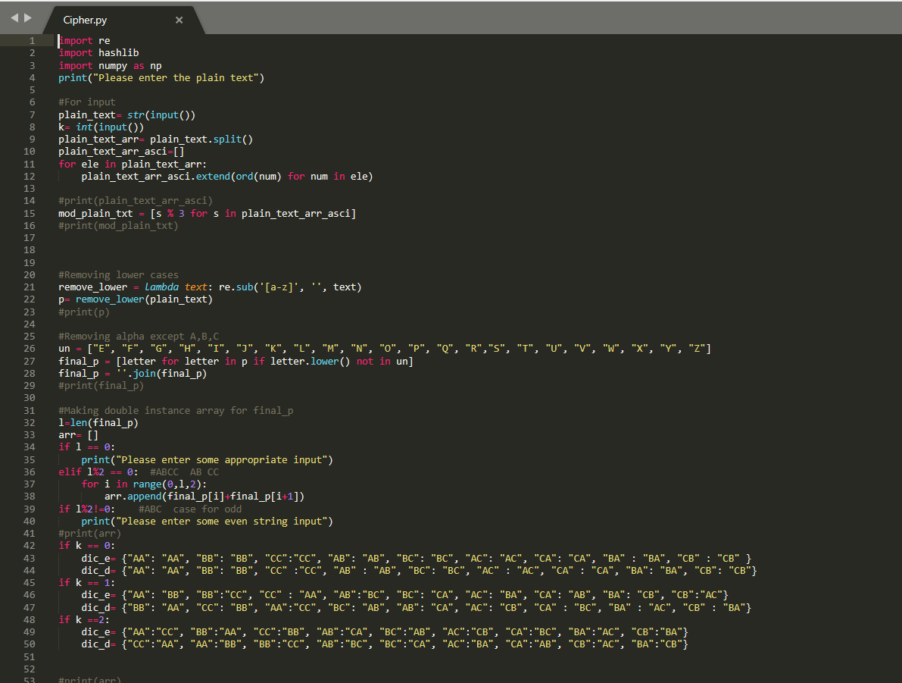
Initial Approach
Removing all the lower cases from the input plain text and also removing upper cases alphabets except A,B,C. Also taking key(k) as input
Making array(arr) which consists of pair of the plain text.
Now initialising Dictionaries which is made with respect to the key value(k)
Like if the key is 1, so AB → BC, BC → CA
But if key value is 0, then it will be, AB → AB, AA→ AA
After this we will make encryption function(encrypt) where we will be accessing the arr elements and finding corresponding elements in the dictionary as set according to the specified key values.

Slide 3
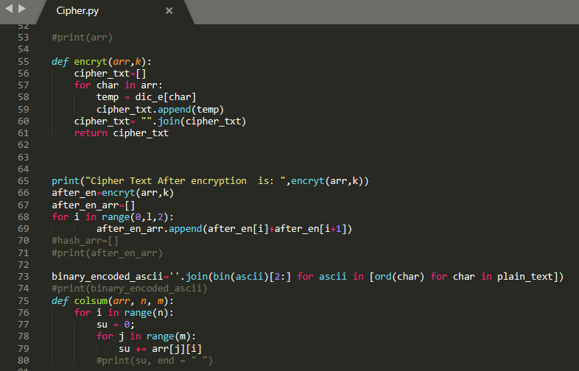
Encryption and Hash Array
Later starting the encryption process. Here we took the parameters arr of the split string and then processing it with the dictionary and then replacing the pairs with the pairs which corresponds their key associated pairs.
Next process is to do hashing. Where we are converting the plain text into the corresponding to ascii value. Input → Matrix(2D), in which the row size is l(len(plain text)) and the column is 4.
The value of the column of the hash array corresponds to the xor of all the elements of the column present at that column number.
--

Slide 4
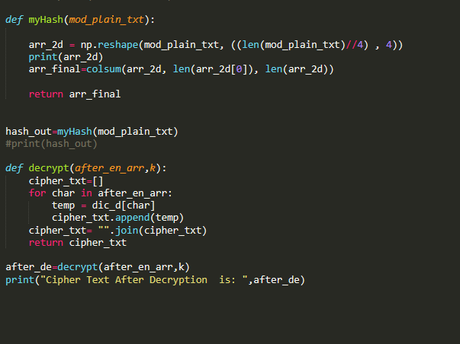
Decryption
Then converting the integer to the corresponding character where 0 represents A, 1→ B, 2→ C.
Here, we performed decryption.
// To be done → Concatenation of the hash function plus encrypted cipher text.
The encrypted text is being passed to the decrypted function from which the value of the pairs has been substituted via the decryption table to find the desired message.

Slide 5
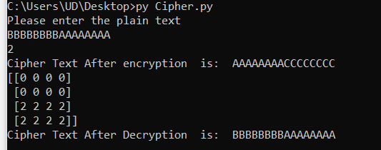
Working
Input: Plain Text :BBBBBBBBAAAAAAAA, Key= 2
Output: Encryption= AAAAAAAACCCCCCCC Decryption= BBBBBBBBAAAAAAAA

