Slide 1

Database Normalization:
This presentation dives into the concept of database normalization, exploring its different forms and their practical implications. We'll demonstrate the normalization process through a real-world example, highlighting the steps and benefits involved.
Author : Parth Masal
Intern -Pune

Slide 2
The Unnormalized EMPLOYEE Table
Initial Schema
Issues
EMPLOYEE (EID, NAME, AGE, SALARY, BASIC, HRA, TA, DA, PF, DESIGNATION, DEPARTMENT, HOD)
Redundancy and inconsistency
Data anomalies

Slide 3
First Normal Form (1NF)
Ensuring Atomicity
Schema
The goal of 1NF is to eliminate repeating groups and ensure that each attribute holds only a single value. This is achieved by splitting the NAME attribute into FNAME and LNAME.
EMPLOYEE (EID, FNAME, LNAME, AGE, SALARY, BASIC, HRA, TA, DA, PF, DESIGNATION, DEPARTMENT, HOD)

Slide 4
Second Normal Form (2NF)
Removing Partial Dependency
Schema
2NF addresses the issue of partial dependency. Attributes like BASIC, HRA, and TA are dependent only on SALARY, not on the entire EMPLOYEE table. We create a separate PAYMENT table to store these components.
1. EMPLOYEE (EID, FNAME, LNAME, AGE, SALARY, DESIGNATION, DEPARTMENT, HOD)
2. PAYMENT (Salary, BASIC, HRA, TA, DA, PF)

Slide 5
Third Normal Form (3NF)
Removing Transitive Dependency
Schema
3NF eliminates transitive dependencies. In our example, HOD is dependent on DEPARTMENT, which is itself dependent on the EMPLOYEE table. We create a separate DEPARTMENT table to remove this dependency.
1. EMPLOYEE (EID, FNAME, LNAME, AGE, SALARY, DESIGNATION, DEPARTMENT_ID, HOD)
2. PAYMENT (Salary, BASIC, HRA, TA, DA, PF)
3. DEPARTMENT (Department_ID, Department_Name, HOD_ID)

Slide 6
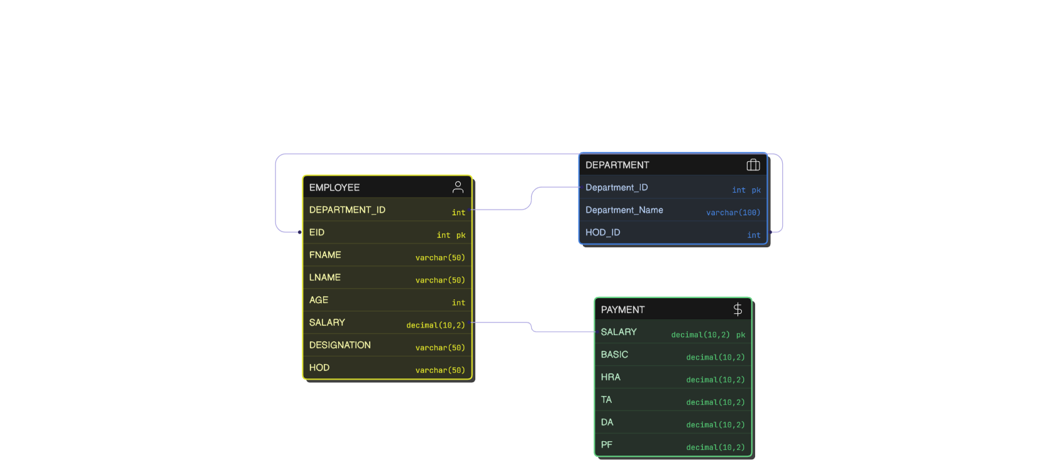

Slide 7


