Slide 1


Semi-Structured Data Using JSON in PostgreSQL
Explore the use of JSON for storing and querying semi-structured data in PostgreSQL
Author :- Parth Masal,
Intern Pune

Slide 2
Introduction
What is Semi-Structured Data?
Examples
Data that does not conform to a rigid schema but still has some structure.
A mix between structured (relational databases) and unstructured data (documents, images, etc.).
Reviews ,docs ,JSON, XML, YAML, NoSQL databases.

Slide 3

Why Use Semi-Structured Data?
Flexible Schema
Easy Integration
Allows for dynamic changes and evolving data structures.
Seamlessly integrates with modern applications and APIs.
Handles Missing Data
Data Storage
Ideal for scenarios with varying or missing data fields.
Supports complex hierarchical data storage.

Slide 4
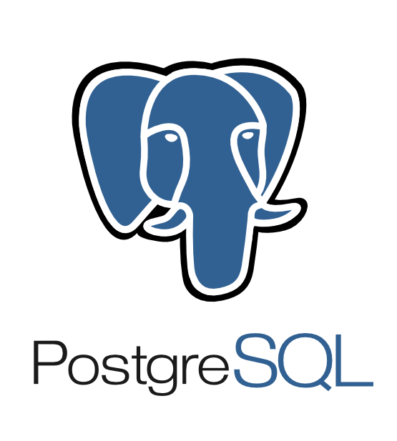

JSON in PostgreSQL
JSON
Text-based storage, faster write operations, slower read and processing.
JSONB
Binary format, optimized for querying and indexing, faster read and processing.

Slide 5
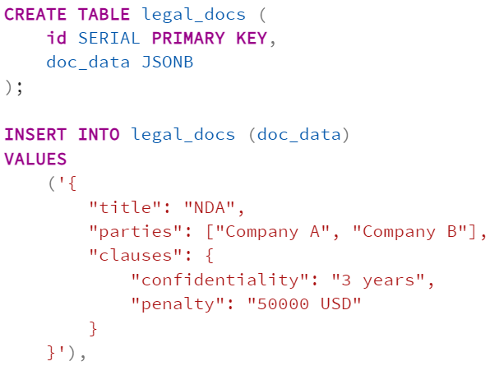
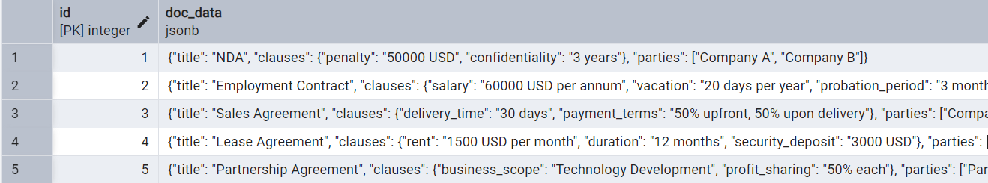
Storing Legal Documents in JSON
Benefits of JSON for Legal Documents
JSON's flexible schema is ideal for legal documents with varying structures and optional fields, simplifying data management.
Fields may be optional, making flexible storage essential.
Nested clauses and references can be easily represented in JSON.

Slide 6
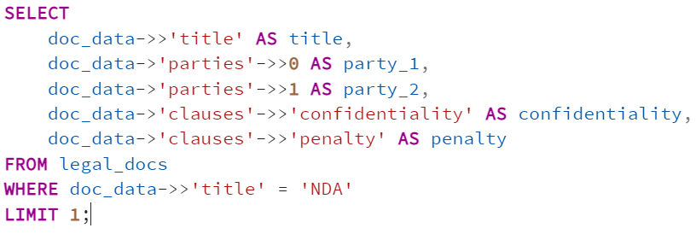

Querying JSON Data in PostgreSQL
-> Extracts JSON object.
->> Extracts JSON text.
jsonb_extract_path_text() Extracts a nested value.
jsonb_exists() Checks if key exists.

Slide 7
JSON vs. Relational Tables
When to Use JSON
When to Use Relational Tables
Data has dynamic attributes, complex nested relationships, read-heavy applications.
Complex nested relationships are required.
Read-heavy applications with fewer modifications.
Data integrity and constraints are critical, high write performance with structured queries.
Transactions and ACID compliance are required.
High write performance with structured queries.

Slide 8
JSON in Modern Applications
APIs
Storing API responses and data exchange.
IoT
Storing sensor data in nested structures.
E-Commerce
Storing product configurations and variations.
Finance
Storing transaction metadata and financial data.

Slide 9

Conclusion
JSON in PostgreSQL provides a powerful solution for managing semi-structured data.
Use JSONB for enhanced performance and indexing capabilities.
Balance between relational and JSON storage for optimal performance.
It's ideal for storing documents, logs, configurations, and hierarchical data.
ThePhoto by PhotoAuthor is licensed under CCYYSA.

