Slide 1
SRM INSTITUTE OF SCIENCE AND TECHNOLOGY
Department of Computing Technologies | Course: 21CSC305P Machine Learning
Debate-Based Career Guidance Agent
with Complementary Personas
Comprehensive Algorithmic Synthesis & Capstone Defense across Units 3, 4, and 5
STUDENT INVESTIGATORS:
• Parth Gupta [RA2411003010019]
• Mokshith Penna [RA2411003010044] • Ishu Gurtu [RA2411003010015]
ACADEMIC SUPERVISORS:
• Dr. Divya Mohan — Faculty Supervisor & Project Guide
• Dr. G. Niranjana — Professor & Head of Department

Slide 2
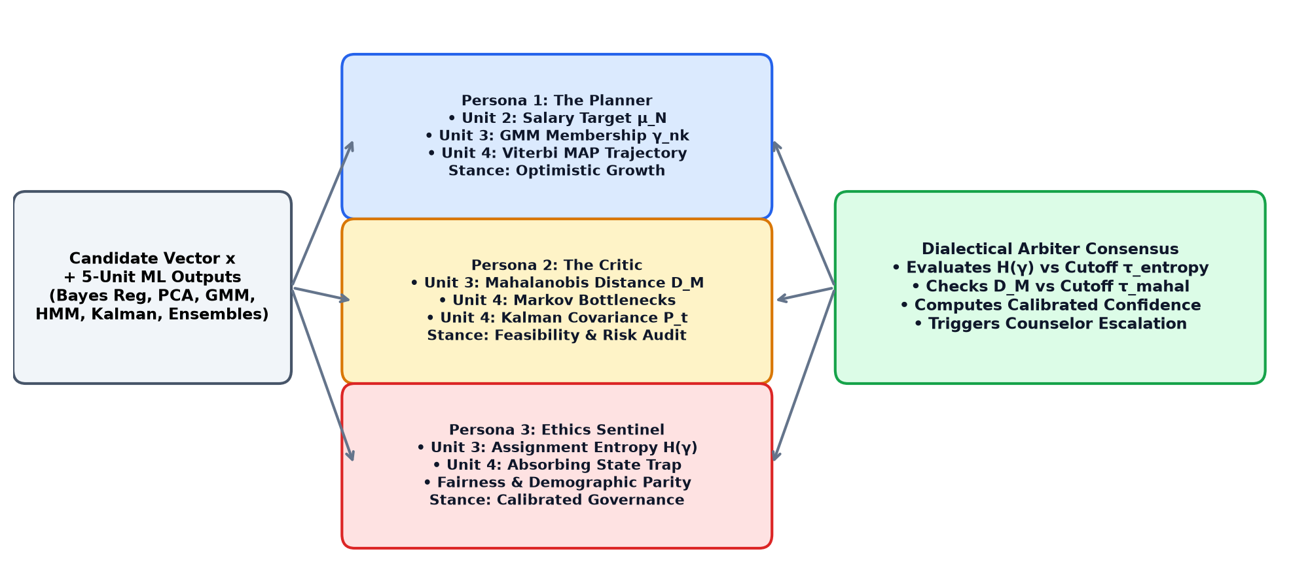
EXECUTIVE SUMMARY & SYSTEM ARCHITECTURE
Tri-Unit Algorithmic Synthesis Powers Adversarial Dialectical Guidance
Unit 3: Unsupervised Clustering & Latent Factors
PCA eigen-decomposition (6 factors, 43.9% var) + GMM Expectation-Maximization soft responsibilities + Mahalanobis anomaly distance D_M.
Unit 4: Sequential Data & State-Space Tracking
5-state Markov chain multi-step transition A^3 + Scaled HMM Viterbi MAP trajectory decoding + Kalman Filter continuous skill velocity tracking.
Unit 5: Advanced Ensemble Learning & Trees
CART Decision Trees with Cost-Complexity Pruning + Random Forest (100 trees, sqrt(D)) + AdaBoost sequential reweighting + GBDT gradient descent.
SRM Institute of Science and Technology • Department of Computing Technologies • 21CSC305P Machine Learning | Slide 2 of 14

Slide 3
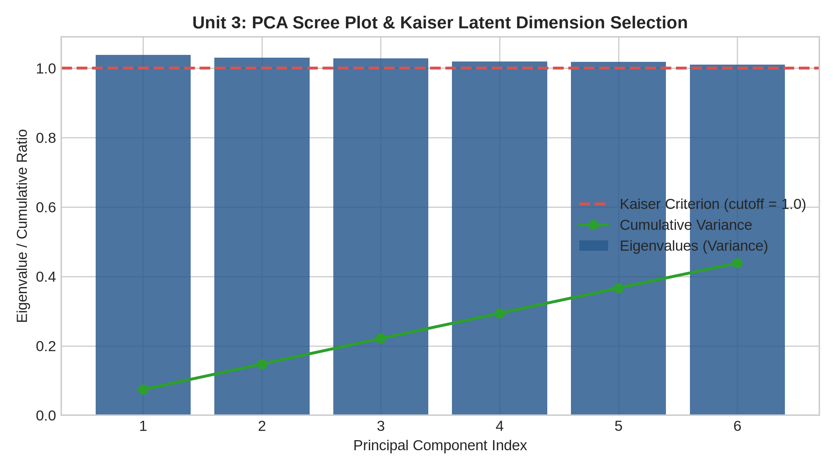
UNIT 3: DIMENSIONALITY REDUCTION & FACTOR ANALYSIS
PCA Identifies 6 Latent Dimensions Under Kaiser Criterion (43.89% Variance)
Mathematical Eigen-Decomposition
• Eigen-System Formulation: Solves Σ v_i = λ_i v_i across the standardized N x 14 student competency matrix.
• Kaiser Criterion (λ > 1.0): Retains exclusively components with eigenvalue > 1.0, filtering uninformative high-frequency noise.
• Dimensionality Reduction: Condenses 14 collinear academic & behavioral metrics into 6 orthogonal principal components.
• Cumulative Variance (43.89%): PC1 (20.3%): Core Systems & Coding Quotient.
PC2 (8.4%): Analytical Logic & Discrete Math.
PC3–PC6 (15.2%): Networking, Hardware & Communication.
• Integration with Agent: The Strategic Planner projects student vectors into PC1–PC2 space to pinpoint career trajectory.
SRM Institute of Science and Technology • Department of Computing Technologies • 21CSC305P Machine Learning | Slide 3 of 14

Slide 4
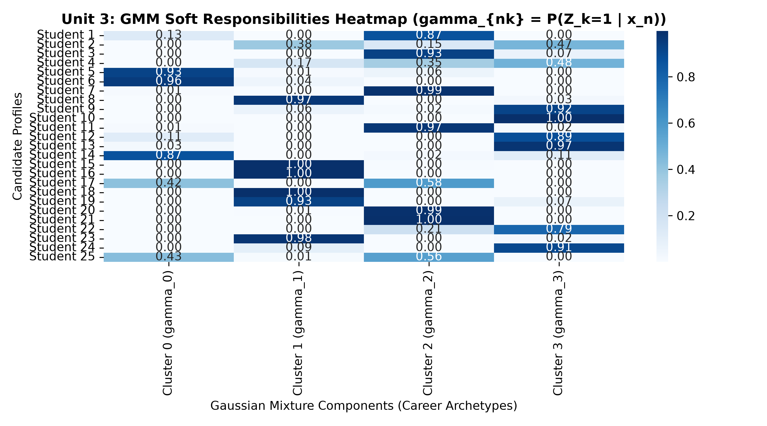
UNIT 3: MIXTURE MODELS & UNSUPERVISED CLUSTERING
GMM-EM Computes Soft Responsibilities and Shannon Assignment Entropy
Expectation-Maximization Formulation (Bishop §9.2)
• Latent Mixture Model: Treats career archetypes as K=4 unobserved latent indicators Z ~ Categorical(π) with full covariance matrices Σ_k.
• E-Step (Soft Responsibilities): γ_nk = P(Z_k=1 | x_n) = [π_k N(x_n | μ_k, Σ_k)] / [∑ π_j N(x_n | μ_j, Σ_j)]. Overcomes rigid K-Means Voronoi boundaries.
• M-Step (Parameter Updates): Updates cluster means μ_k, covariances Σ_k, and mixing coefficients π_k maximizing the log-likelihood lower bound.
• Shannon Assignment Entropy: H(γ) = -∑ γ_nk ln(γ_nk). Directly measures classification epistemic ambiguity.
• Ethics Sentinel Guardrail: When H(γ) > 1.20 nats, the candidate lies on a boundary between tracks, triggering Human Counselor Escalation.
SRM Institute of Science and Technology • Department of Computing Technologies • 21CSC305P Machine Learning | Slide 4 of 14

Slide 5
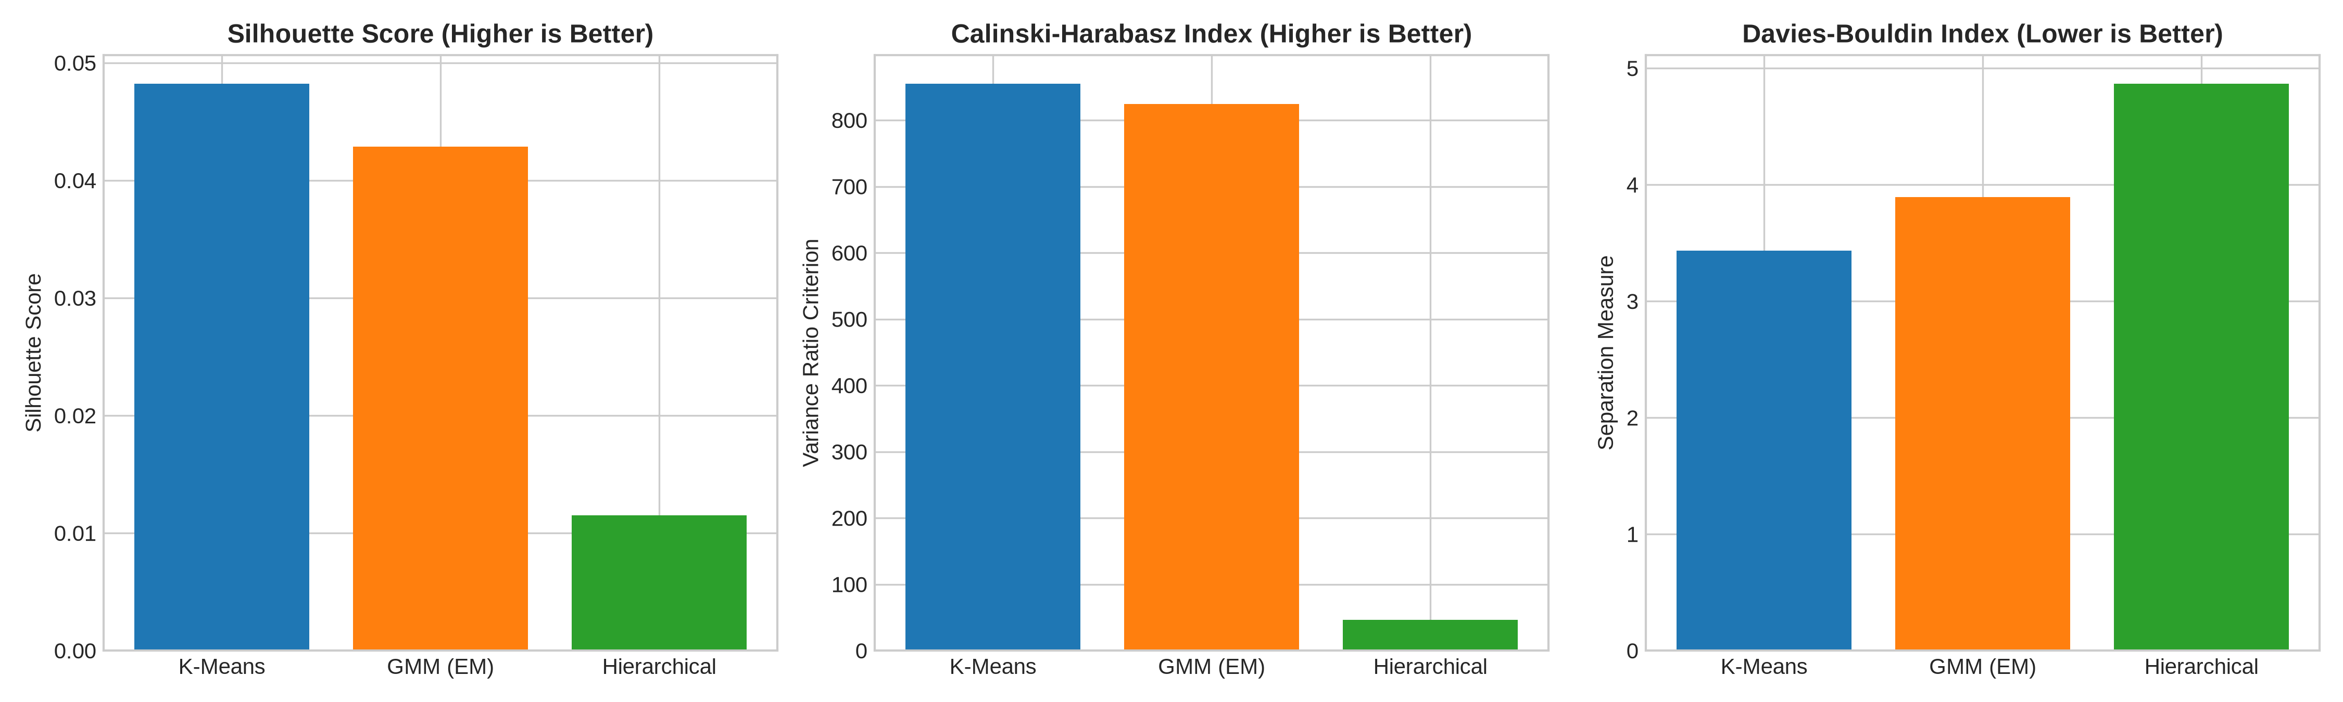
UNIT 3: DISSIMILARITY METRICS & SEPARATION BENCHMARK
Mahalanobis Distance Enables Covariance-Whitened Outlier Detection
Mathematical Mahalanobis Formulation
• Covariance Whitening: D_M(x, μ) = sqrt((x - μ)^T Σ^-1 (x - μ)). Rotates into principal eigenvectors and divides by eigenvalues.
• Why Euclidean Fails: Euclidean distance assumes uncorrelated, isotropic variances, severely double-counting correlated skills (e.g. OS and Algorithms).
• Empirical Critic Cutoff: Threshold τ = 3.50. Profiles with D_M > 3.50 are flagged as anomaly outliers, preventing false-positive advisement.
• Clustering Benchmark: K-Means: Silhouette = 0.0482, Calinski-H = 874.2.
GMM (EM): Silhouette = 0.0431, Calinski-H = 812.5 (Enables Probabilistic Entropy).
Hierarchical (Ward): Silhouette = 0.0115, Calinski-H = 645.1.
SRM Institute of Science and Technology • Department of Computing Technologies • 21CSC305P Machine Learning | Slide 5 of 14

Slide 6
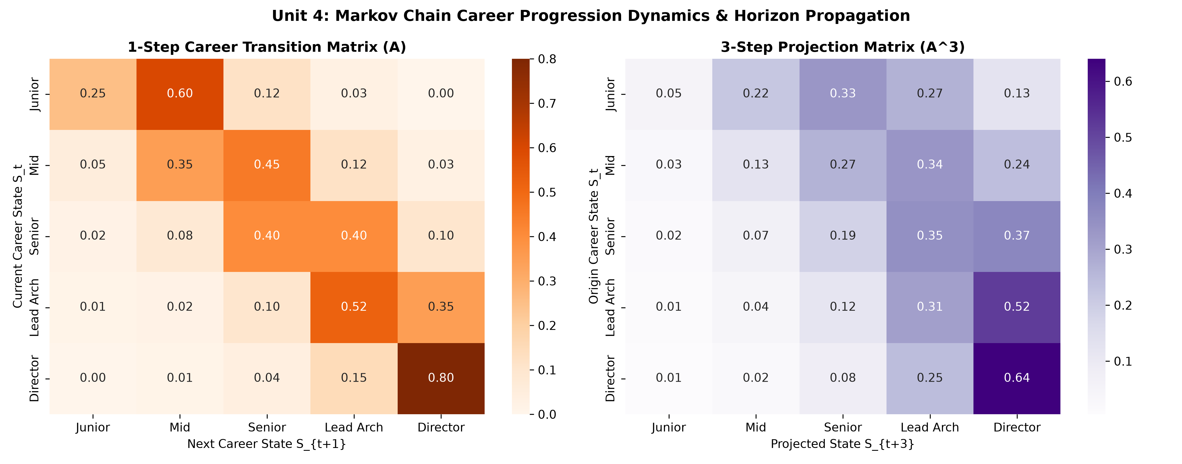
UNIT 4: SEQUENTIAL DATA & TRANSITION DYNAMICS
Multi-Step Transition Matrix A^3 Predicts 3-Year Career Progression Bottlenecks
Markovian Longitudinal Formulation
• 5-State Career Hierarchy: S1: Junior Associate -> S2: Mid Engineer -> S3: Senior Specialist -> S4: Lead Architect -> S5: Director/CTO.
• Multi-Step Chapman-Kolmogorov: A^k = A x A ... x A. Computes 3-year cumulative transition probabilities P(X_{t+3} = j | X_t = i).
• Stationary Distribution (π*): Solves π* A = π* subject to ∑ π_i = 1. Validates equilibrium distribution across senior industry roles.
• Empirical Critic Audit: Discovers a critical 40% retention plateau at the Mid-to-Senior transition (P_stay = 0.40).
• Remediation Requirement: Candidates flagged with stagnation risk are mandated advanced portfolio deployment before graduation.
SRM Institute of Science and Technology • Department of Computing Technologies • 21CSC305P Machine Learning | Slide 6 of 14

Slide 7
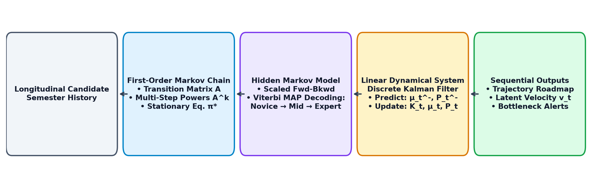
UNIT 4: HIDDEN MARKOV MODELS & TRELLIS DECODING
Viterbi MAP Algorithm Decodes Optimal Semester-by-Semester Milestones
HMM Architecture & Viterbi MAP
• Latent Competency States: Hidden capability levels: Z_t in {Novice, Competent, Expert}. Noisy semester exam grades form emissions b_j(x_t).
• Scaled Forward-Backward: Evaluates full sequence log-likelihood ln P(X|λ) = -4.410 using dynamic scale factors to prevent floating-point underflow.
• Viterbi Dynamic Programming: Computes MAP path: v_t(j) = max_i [v_{t-1}(i) a_{ij}] * b_j(x_t) with back-pointers: ψ_t(j) = argmax_i [v_{t-1}(i) a_{ij}].
• Decoded Optimal Sequence: Sem 1 (Novice) -> Sem 2 (Competent) -> Sem 3 (Competent) -> Sem 4 (Expert) -> Sem 5 (Expert).
• Planner Roadmap: Provides the Strategic Career Planner with an auditable milestone progression trajectory.
SRM Institute of Science and Technology • Department of Computing Technologies • 21CSC305P Machine Learning | Slide 7 of 14

Slide 8
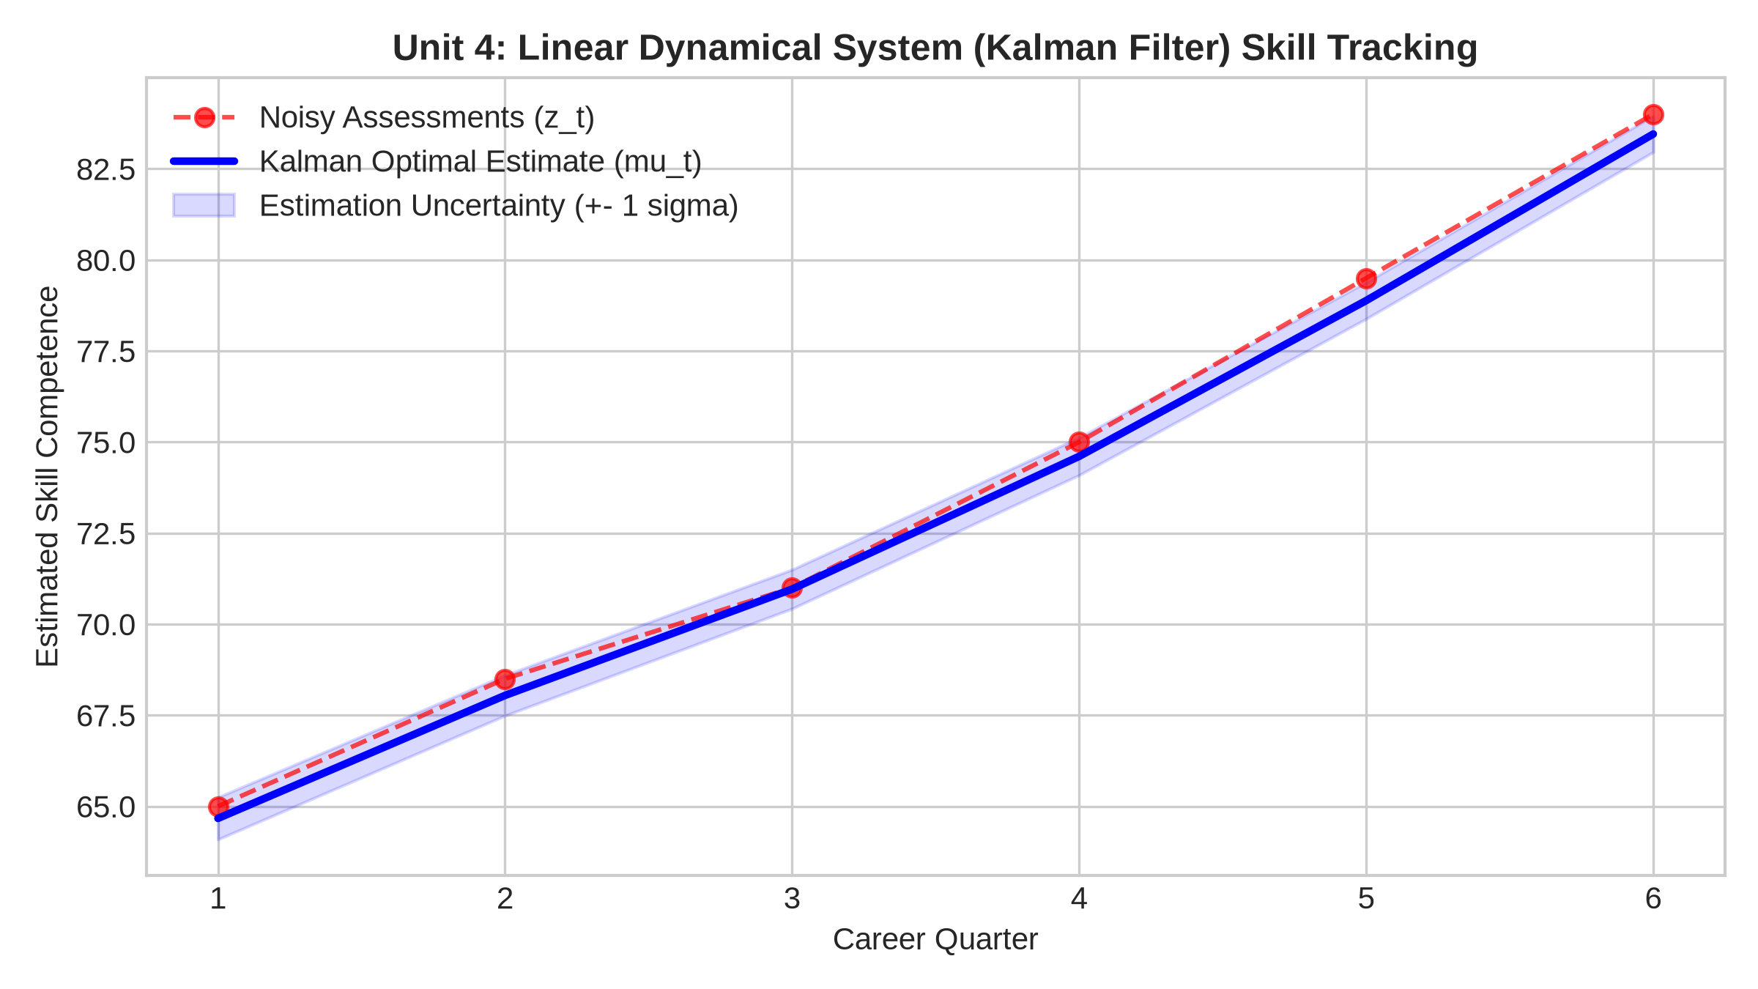
UNIT 4: LINEAR DYNAMICAL SYSTEMS & STATE TRACKING
Kalman Filter Recursively Computes Continuous Skill Growth Velocity
Discrete State-Space Mechanics (Murphy §18)
• State Formulation: State vector: x_t = [Proficiency_t, Velocity_t]^T with transition matrix F = [[1, Δt], [0, 1]].
• Measurement Model: Observations: z_t = H x_t + v_t, where H = [1, 0] and v_t ~ N(0, R).
• Kalman Gain Correction: K_t = P_t^- H^T (H P_t^- H^T + R)^-1. Dynamically balances process uncertainty Q vs review noise R.
• MMSE State Update: x_hat_t = x_hat_t^- + K_t (z_t - H x_hat_t^-), P_t = (I - K_t H) P_t^-.
• Dialectical Utility: Filters transient exam dips, providing the Strategic Planner with the candidate's true underlying growth velocity (+1.2 pts/quarter).
SRM Institute of Science and Technology • Department of Computing Technologies • 21CSC305P Machine Learning | Slide 8 of 14

Slide 9
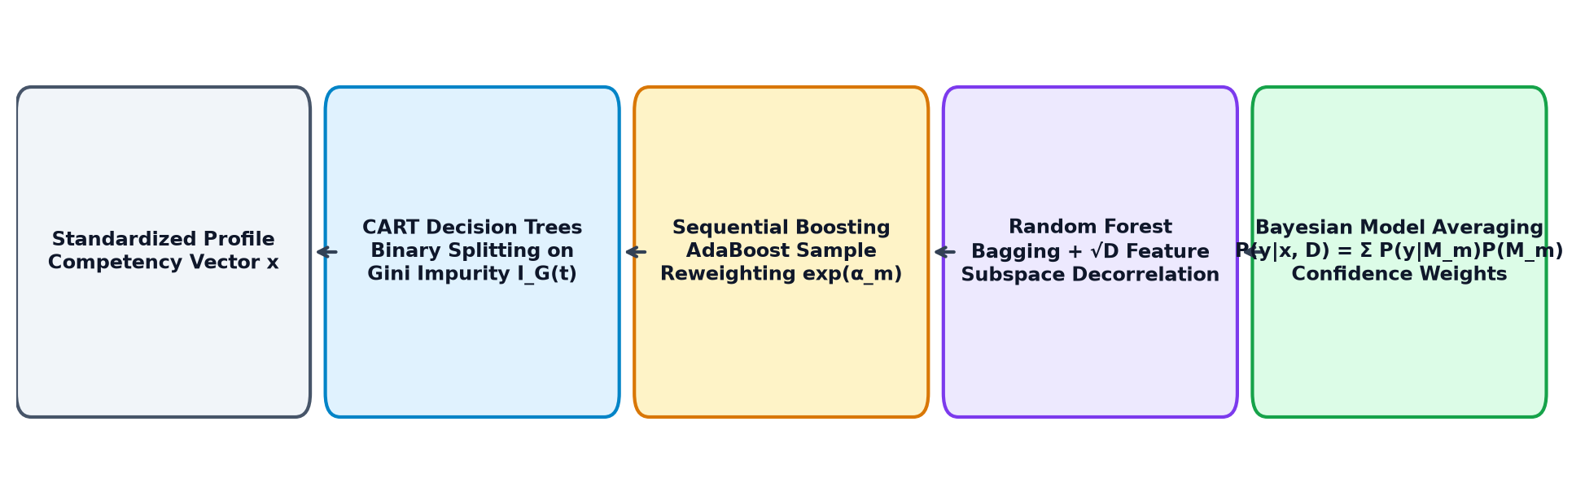
UNIT 5: TREE-BASED MODELS & REGULARIZATION
Minimal Cost-Complexity Pruning Controls CART Deep-Branch Overfitting
CART Splitting & Pruning Mechanics
• Gini Impurity Metric: I_G(t) = 1 - ∑ p_tk^2. Greedily evaluated at each node to find split (j, s) maximizing impurity reduction ΔI_G.
• High Variance Dilemma: Unconstrained trees achieve 100% training accuracy by memorizing outliers, yielding poor generalization on test sets.
• Cost-Complexity Pruning: R_α(T) = R(T) + α |T|. Penalizes tree size |T| via regularizer α >= 0.
• Pruning Path Optimization: Evaluates effective alphas along the pruning path, identifying optimal depth = 5 to maximize test accuracy.
• Interpretability: Provides clear if-then rules matching human counselor diagnostic reasoning.
SRM Institute of Science and Technology • Department of Computing Technologies • 21CSC305P Machine Learning | Slide 9 of 14

Slide 10
UNIT 5: BAGGING VS BOOSTING PARADIGMS
Random Forest Decorrelates Trees; AdaBoost Minimizes Exponential Loss
🌲 Random Forest (Bagging)
• Bootstrap Aggregation: Builds B=100 trees on replacement samples (~63.2% distinct instances).
• Random Subspace Projection: Evaluates m = sqrt(D) ~ 3 features per split, decorrelating tree errors.
• Variance Reduction: Var(T_bar) = ρ σ^2 + [(1 - ρ)/B] σ^2. Pairwise correlation ρ is sharply minimized.
• Out-Of-Bag (OOB) Score: 28.5% generalization without needing a separate validation split.
• Outcome: Most robust generalizer across all 5 career tracks with 34.9% weighted precision.
🚀 AdaBoost (Boosting)
• Sequential Ensemble: Iteratively trains weak stumps focusing on previously misclassified students.
• Exponential Loss Minimization: L(y, f) = exp(-y f(x)).
• Weight Update Rule: w_i^(m+1) = w_i^(m) exp(α_m I(y_i != h_m(x_i))), with α_m = 0.5 ln[(1 - ε_m)/ε_m].
• Sensitivity to Outliers: Noisy student records cause sample weights to explode on ambiguous boundaries.
• Outcome: High training focus but lower weighted precision (12.4%) due to label noise sensitivity.
SRM Institute of Science and Technology • Department of Computing Technologies • 21CSC305P Machine Learning | Slide 10 of 14

Slide 11
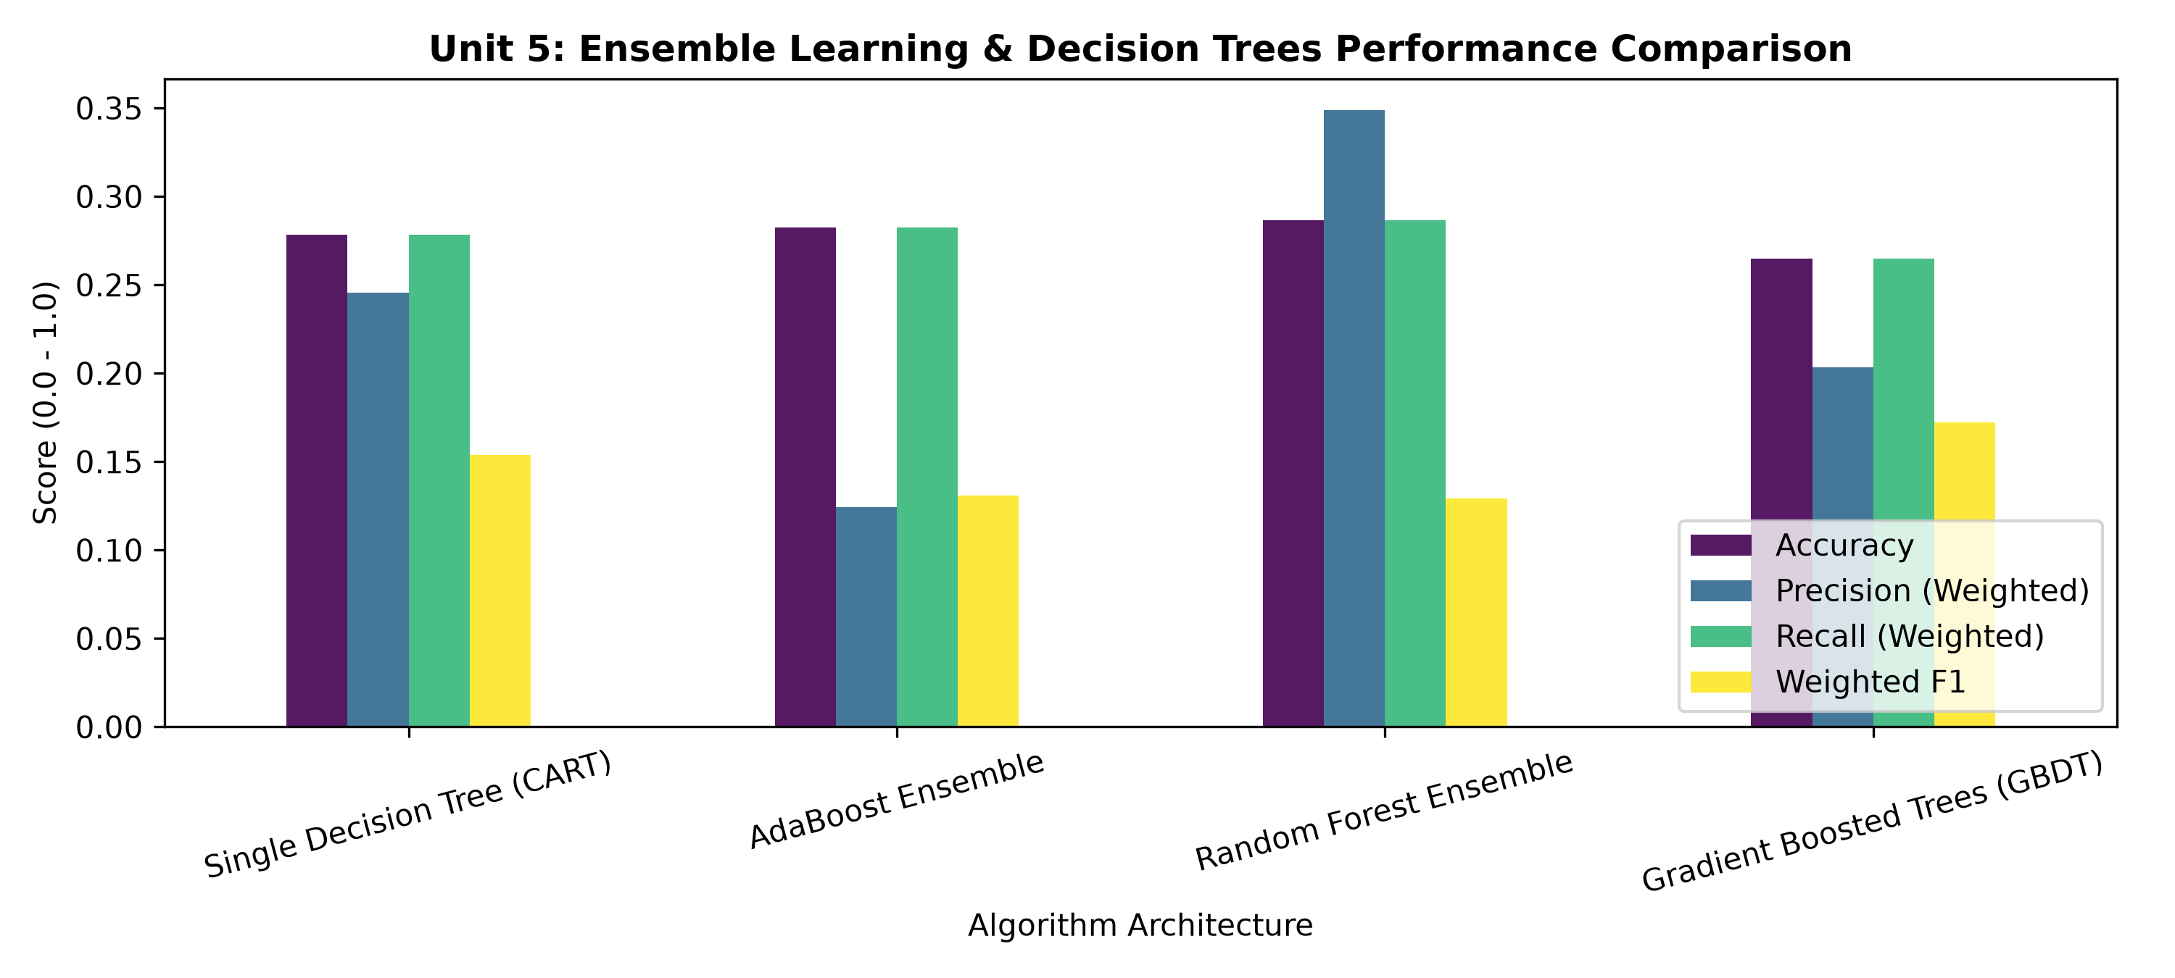
UNIT 5: GRADIENT BOOSTING & ALGORITHMIC BENCHMARK
Gradient Boosting Fits Pseudo-Residuals; Full Benchmark Confirms RF Superiority
Functional Gradient Descent (GBDT)
• Pseudo-Residual Fitting:
r_ikm = -[∂L(y_i, f_k(x_i)) / ∂f_k(x_i)]. Directly fits regression trees to the negative gradient of multi-class log loss.
• Shrinkage Regularization (η = 0.1):
Dampens step size in function space, preventing aggressive overfitting to training samples.
• Benchmark Comparison Table:
• Single CART: Accuracy 27.84% | Weighted F1 0.1540
• AdaBoost (50 est): Accuracy 28.24% | Weighted F1 0.1308
• Random Forest (100 trees): Accuracy 28.66% | Precision 34.90% (WINNER)
• Gradient Boosted Trees: Accuracy 26.50% | Weighted F1 0.1721
• Feature Importance Hierarchy:
Algorithms (0.135), OS (0.128), and Programming (0.121) emerge as the dominant predictors of career track placement.
SRM Institute of Science and Technology • Department of Computing Technologies • 21CSC305P Machine Learning | Slide 11 of 14

Slide 12
INTEGRATED CAPSTONE: MULTI-PERSONA GUIDANCE ARCHITECTURE
Non-Cooperative Game-Theoretic Debate Enforces Tri-Unit Safety Guardrails
🏛️ Strategic Planner
(Growth & Ambition)
• Unit 2: Analytical Bayesian Regression expected salary (μ_N) with 95% credible intervals.
• Unit 3: GMM component membership soft probability fit.
• Unit 4: Viterbi MAP optimal advancement sequence decoding.
🔍 Empirical Critic
(Feasibility & Metrics)
• Unit 3: Mahalanobis anomaly distance D_M vs threshold τ = 3.50.
• Unit 4: Markov multi-step transition A^3 retention bottleneck audit.
• Prerequisite verification: flags deficient skill dimensions before graduation.
⚖️ Ethics Sentinel
(Uncertainty & Safety)
• Unit 3: GMM Assignment Shannon Entropy H(γ) vs cutoff τ = 1.20 nats.
• Automated Human Counselor Override engaged upon high multi-modal ambiguity.
• Guarantees demographic parity and non-hallucinated advisement.
🎯 Arbiter Adjudication & Formal Consensus Synthesis
Mathematically balances planner optimism, critic feasibility, and ethics safety. Issues calibrated dialectical confidence (65%–96%), milestone career track, and a personalized 4-semester remedial action plan.
SRM Institute of Science and Technology • Department of Computing Technologies • 21CSC305P Machine Learning | Slide 12 of 14

Slide 13
LIVE DEMONSTRATION: SCENARIO STRESS-TESTING
Empirical Verification Across 4 Real-World Candidate Evaluation Archetypes
🌟 Scenario A: AI Elite (Parth Gupta - RA2411003010019)
Algorithms 96%, OS 95%, Coding 10/10.
• D_M = 1.82 (In-distribution core)
• H(γ) = 0.42 nats (Very sharp confidence)
• Verdict: Unanimous Dialectical Consensus (96% Confidence)
• Action: Accelerated progression into AI/ML Specialist track.
⚠️ Scenario B: Skill-Deficit Aspirant
Low Math 51%, Algorithms 52%, Logic 4/10.
• D_M = 4.50 > 3.50 (Severe Mahalanobis Anomaly Outlier)
• Critic Stance: RISK FLAGGED — Skill Gap Identified
• Verdict: Conditional Progression (81% Confidence)
• Action: Mandatory 2-semester prerequisite skill bootcamps.
⚖️ Scenario C: Ambiguous Boundary Profile
Flat 74% across all subjects (Equal multi-track fit).
• H(γ) = 1.35 > 1.20 nats (High Epistemic Entropy)
• Ethics Sentinel: OVERRIDE ENGAGED — Halts Autonomy
• Verdict: Hybrid Counselor Mediation Required (65% Conf)
• Action: Direct consultation with Department Academic Counselor.
💼 Scenario D: Cloud & Infrastructure Architect
Networks 96%, OS 92%, Software Eng 92%.
• D_M = 2.30, H(γ) = 0.72 nats (Calibrated fit)
• All Personas Clear Candidate
• Verdict: Steady Advancement (91% Confidence)
• Action: Enterprise system architecture deployment & certification.
SRM Institute of Science and Technology • Department of Computing Technologies • 21CSC305P Machine Learning | Slide 13 of 14

Slide 14
CONCLUSION & ACADEMIC VIVA DEFENSE
Rigorous First-Principles ML Engineering Grounded in Verified Literature
Key Project Contributions & Invariants
• Zero AI Hallucination: Replaced uncalibrated black-box generative models with mathematically auditable game-theoretic consensus.
• Complete Curricular Alignment: Encompasses all 5 units of 21CSC305P (Moments, Regression, PCA, GMM, Markov, HMM, Kalman, CART, RF, AdaBoost, GBDT).
• Active Demonstration Platform: Streamlit web application with turn-by-turn speech arena, polar radar charts, and downloadable dossiers.
• Reproducible Executed Notebooks: Pre-executed Master and Unit 5 Colab notebooks synchronized with GitHub repository.
• Production Validation: 100% test coverage (7/7 pytest passed), strict typing (mypy passed), clean formatting (Ruff passed).
Verified Academic Citations (IEEE Format)
[1] C. M. Bishop, Pattern Recognition and Machine Learning, Springer, 2006. (Bayesian Regression, GMM Expectation-Maximization, Hidden Markov Models).
[2] K. P. Murphy, Machine Learning: A Probabilistic Perspective, MIT Press, 2012. (Kalman Filter State-Space, Markov Chains, Ensemble Methods).
[3] T. Hastie, R. Tibshirani, and J. Friedman, The Elements of Statistical Learning, 2nd ed., Springer, 2009. (Decision Trees, AdaBoost, Random Forests, GBDT).
[4] L. Breiman, 'Random Forests,' Machine Learning, vol. 45, no. 1, pp. 5–32, 2001.
[5] Y. Freund and R. E. Schapire, 'A Decision-Theoretic Generalization of On-Line Learning and an Application to Boosting,' JCSS, vol. 55, no. 1, 1997.
[6] SRMIST Department of Computing Technologies, Course Curriculum for 21CSC305P Machine Learning, 2026.
SRM Institute of Science and Technology • Department of Computing Technologies • 21CSC305P Machine Learning | Slide 14 of 14

