Slide 1
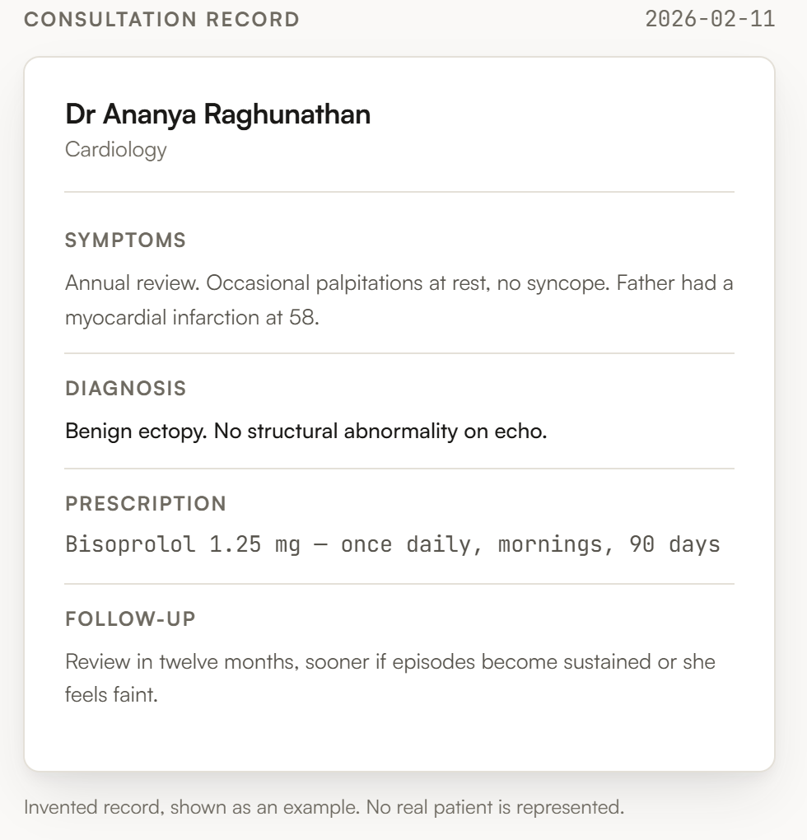
FULL-STACK JAVA PROJECT · PHASE 1
Aldergate Clinic
Doctor Appointment &
Patient Management System
“Every visit starts with the last one.”
React 19 · Vite · React Router · CSS Modules
Spring Boot · MongoDB · JWT — specified, next phase
A consultation record, as the patient sees it
Coursework project. Every doctor, patient and record shown is invented.
Notes:
Aldergate Clinic is a fictional clinic. The project is a doctor appointment and patient management system: patients book, doctors consult, and the consultation record persists between visits. Phase 1 - the React frontend - is built and running against seeded placeholder data.

Slide 2
THE PROBLEM
02 / 10
Booking is the easy half.
A booking app is finished the moment a slot is confirmed. What happens in the room afterwards is written on paper, or nowhere at all — so the next consultation starts from the patient's memory.
This project keeps both halves in one file. The doctor opens tomorrow's list, reads what happened in February, and writes today's visit into the same record.
THE LOOP THAT HAS TO CLOSE
01
A patient books a time
Doctor, date, then a slot that is genuinely free.
02
The doctor opens the file
Previous visits are on screen before the patient sits down.
03
The visit is written down
Where effort has to be split, history wins.
Symptoms, diagnosis, prescription, notes, follow-up — dated and attributed.
Product principle 1 — an appointment booker without
the history is a different, lesser product.
04
Next time, it is already there
Nothing is re-explained from memory. The file is the continuity.
Notes:
The PRD's core workflow, section 5. Success is this loop closing - the record written after one visit is waiting at the next one.

Slide 3
WHO USES IT
03 / 10
Three roles, three different jobs.
NF
AR
CO
Patient
Doctor
Clinic office
Unhurried, on a phone or laptop, outside the clinic.
Reading under load, mid-consultation, patient in the room.
One seeded operator. An access-control mechanism, not a persona.
Registers themselves
Browses and filters doctors by department
Books, views and cancels appointments
Reads their own record only
Today's list and what is booked ahead
Opens a patient file and scans prior visits
Records the consultation as it happens
Moves an appointment through its states
Creates doctor accounts
Lists the roster and who is on leave
Nothing else — deliberately two pages
Doctors never self-register — the clinic office creates their accounts. A deliberate departure from PRD §3, which would let anyone sign up as a doctor and read patient histories.
Notes:
Access is enforced in the API, not by hiding links. A patient can never reach another patient's records; a doctor reaches only patients they have an appointment with.

Slide 4
HOW IT IS BUILT
04 / 10
One repository, two phases.
FRONTEND
BUILT
API
SPECIFIED
DATA
SPECIFIED
React 19 + Vite
Spring Boot (Java 21)
MongoDB
React Router — 20 routes
Role-gated PrivateRoute
CSS Modules per component
One shared token file
Controller → Service → Repository
Spring Security + BCrypt
Stateless JWT, role in the token
@PreAuthorize on services
users · doctors · patients
appointments · medicalRecords
Partial unique index on slots
Soft-delete on cancellation
→
→
REST / JSON + JWT
20
24
3
6,600
routes
components
roles
lines of source
Notes:
The frontend runs today against a seeded data module whose shapes match the planned API contract, so wiring Phase 2 replaces one module rather than every screen.

Slide 5
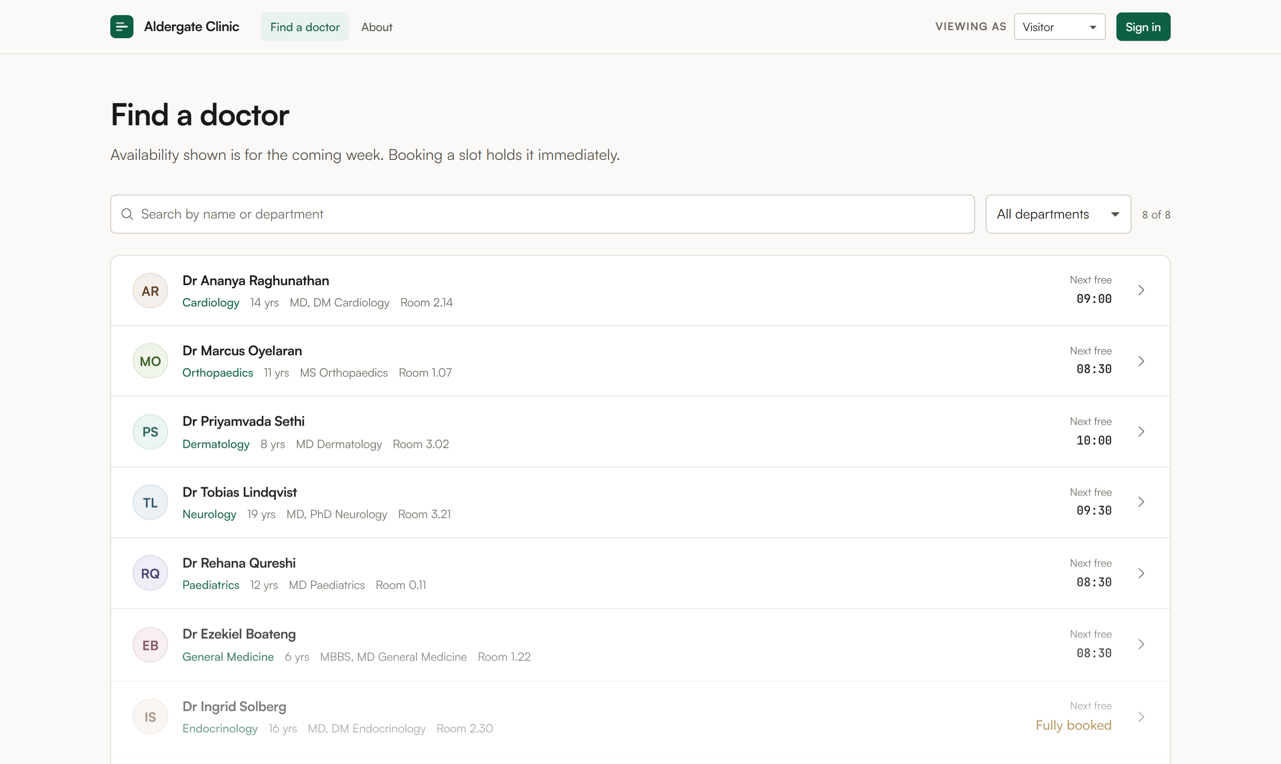
PATIENT — STEP ONE
05 / 10
Find a doctor.
Eight invented practitioners across eight departments. Search by name or department, filter to one specialty, and the next free time sits on the row — so the choice is made before the booking screen opens.
Live search
Name or department, filtered as you type.
Next free
Computed from the doctor's own weekly template.
Fully booked
Shown as a state, not a missing row.
No stock faces
A monogram, not an invented photograph.
Notes:
Doctor avatars are deliberately monograms. Inventing faces for practitioners who do not exist was ruled out in the product brief.

Slide 6
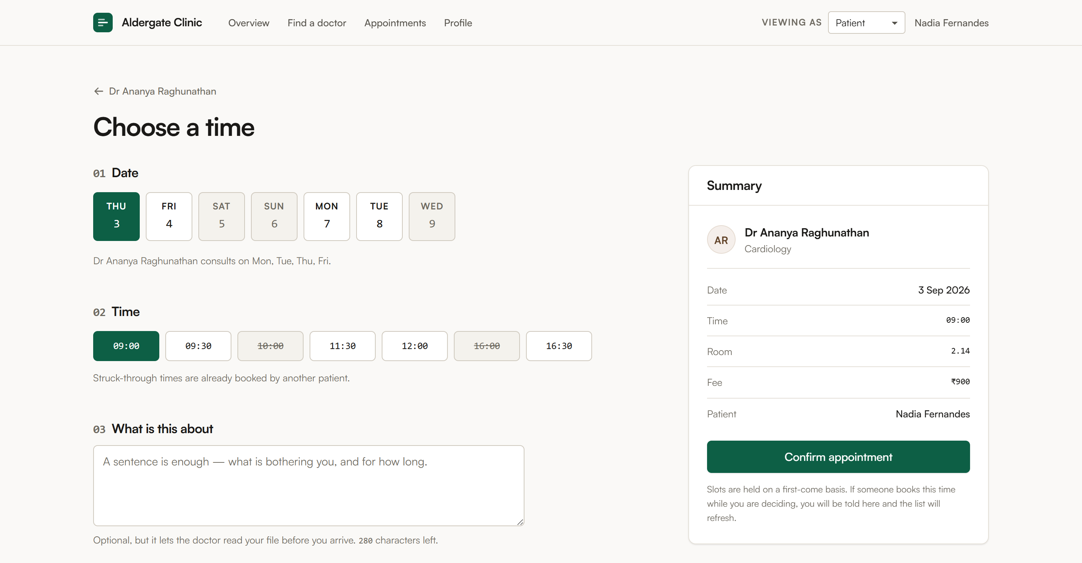
PATIENT — STEP TWO
06 / 10
Doctor → date → slot → confirm.
Struck-through times are already taken. The summary fills in as the choice is made, so nothing is confirmed blind.
THE RACE NOBODY SEES
Two patients open the same slot. Both read “free”. Both insert. Both succeed.
Check-then-insert fails rarely in testing and constantly in a demo. The fix is a database constraint, not application code:
unique index, partial on
active: { $eq: true }
Insert, catch the duplicate key, return 409 — the screen says “that slot was just taken” and refreshes the list.
Notes:
The single highest-risk item in the build. Mongo's partialFilterExpression does not accept $ne, which is exactly why the appointment carries a boolean active flag rather than filtering on status != CANCELLED. Cancelling flips the flag, the row leaves the index, and the slot is bookable again.

Slide 7
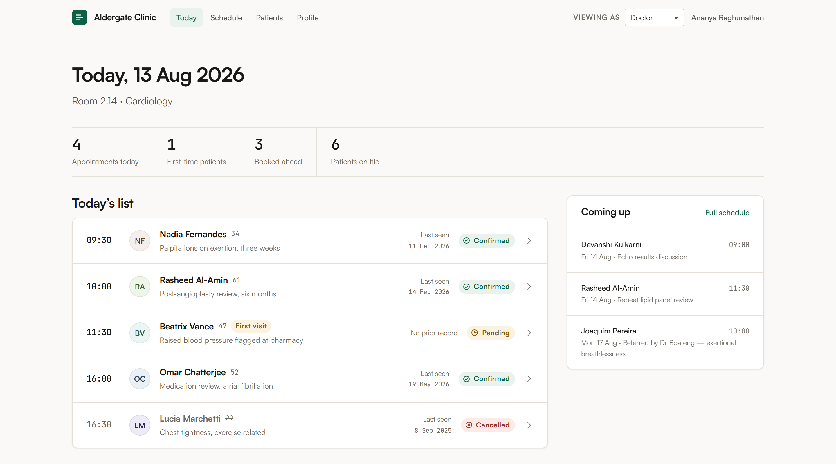
DOCTOR — THE DASHBOARD
07 / 10
The day, in the order it happens.
A doctor reads this between consultations with a patient waiting. It answers one question — who is next, and have I seen them before.
FOUR STATES, EVERYWHERE
Pending
Confirmed
Completed
Cancelled
Each carries an icon and a word, never colour alone — a cancelled appointment read as confirmed is a missed consultation.
Notes:
The status treatment is identical on every screen in both roles. Cancelled rows are struck through as well as coloured.

Slide 8
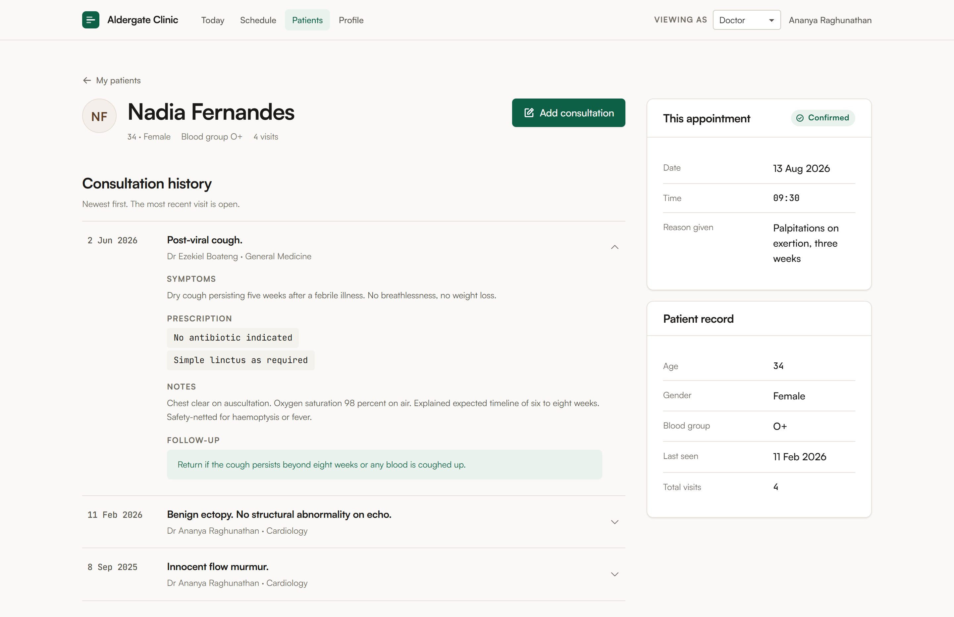
THE CORE FEATURE
08 / 10
One continuous patient file.
This is the half the project is judged on.
Reverse-chronological. The most recent visit is open; the rest collapse to a date and a diagnosis.
Scannable first
Date and diagnosis at a glance; detail on demand.
Written by whom
Every entry is attributed and dated.
Follow-up stands out
The instruction for next time is never buried in notes.
Authorised reads only
A doctor sees a file only where an appointment links them.
Notes:
PRD section 11 asks that history be easy to scan quickly. That is a stated requirement, not a preference - which is why the list collapses rather than showing four full records at once.

Slide 9
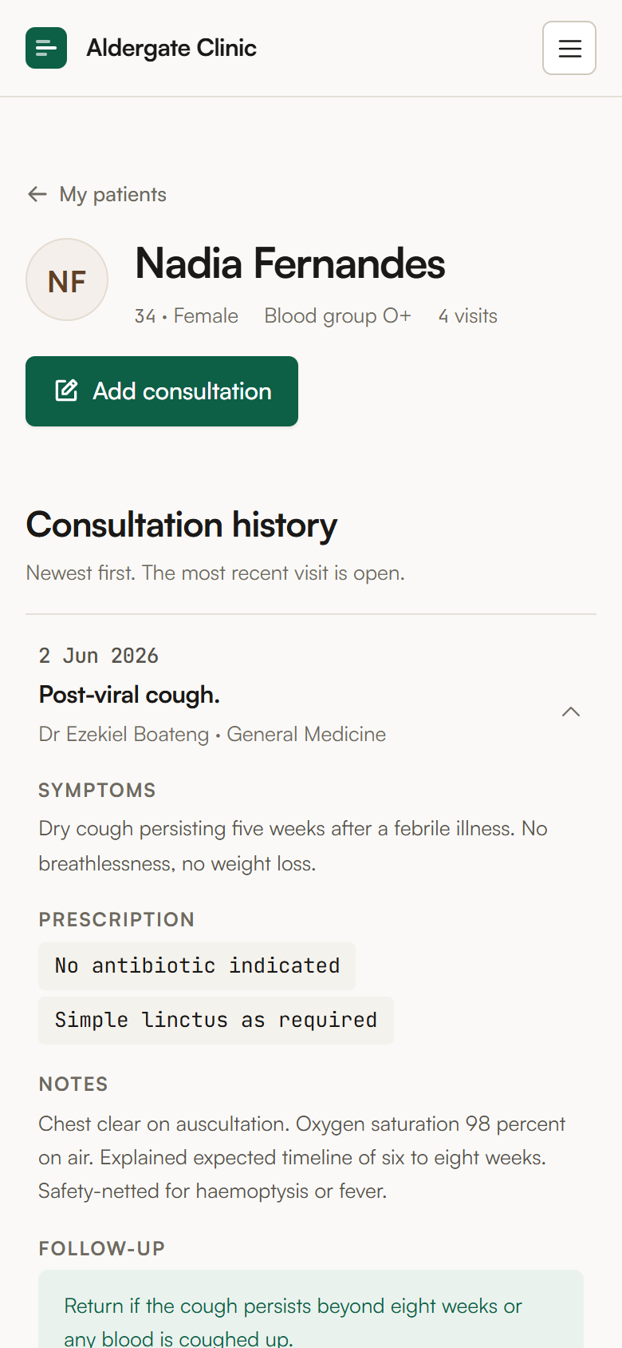
DESIGN SYSTEM
09 / 10
Warm paper, one accent, measured contrast.
#faf9f7
#ffffff
#1a1917
#56534c
#0d5f45
#eaf2ee
--paper
--surface
--ink
--ink-2
--accent
--accent-wash
TEXT CONTRAST, MEASURED
WHAT THIS DESIGN REFUSES
ink on paper
16.70 : 1
Stock photos of smiling doctors
Clinical pastel teal
“10,000+ patients” hero metrics
Cards as the default grouping
A centred hero — the split is 7 / 5
ink-2 on paper
7.29 : 1
ink-3 on paper
5.12 : 1
white on accent
7.66 : 1
Floor is 4.82 : 1 — every pair clears WCAG AA with room to spare.
390 px — the same file, one column
Notes:
No evidence exists for this product - no users, no clinics, no ratings - so the design refuses every element that would imply otherwise. Contrast figures are computed against each colour's real ground.

Slide 10
WHERE IT STANDS
10 / 10
Built, and what is next.
PHASE 1 — RUNNING
PHASE 2 — SPECIFIED
All 20 routes, three role-gated areas
Booking flow with taken-slot handling
Consultation history, collapsed and expandable
Add-consultation form off the appointment
Loading, empty and error states on every list
Responsive at desktop, tablet and 390 px
Spring Boot skeleton, five Mongo documents
BCrypt registration and JWT login
The partial unique index on booked slots
Record authorisation, enforced in the service
Seed data behind a dev profile
Swap the data module for the API client
TWO DELIBERATE DEPARTURES FROM THE PRD
Doctor accounts are created by the clinic office, not self-registered — §3 would let anyone read patient histories. · The frontend was built before the backend, against a data module shaped like the planned API.
Notes:
Both departures are recorded in PRODUCT.md rather than left as quiet drift. Phase 2 is fully specified in IMPLEMENTATION_PLAN.md, including the concurrency test that must pass before booking is called done.

