Slide 1
Investigating Compression Algorithms on Space Magnetometer data
Name: Taran Attavar
Project Partner: Parth Patel

Slide 2
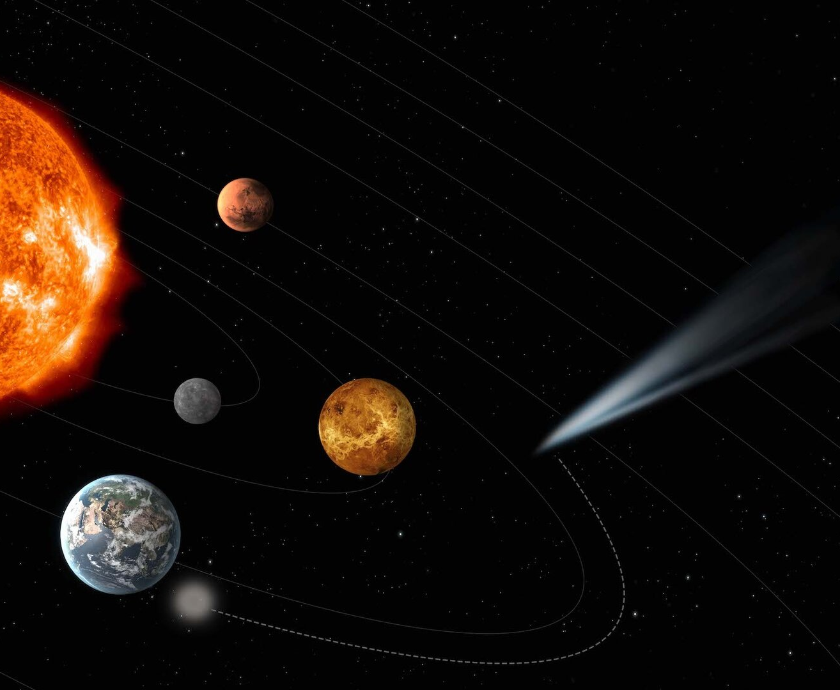
Motivation
ESA Comet Interceptor^{[1]} Mission
F-type mission – fast (means transmission of data is essential)
Looking to achieve a compression factor of 0.6 (or better)
[1] European Space Agency. (2015) ESA’s new mission to intercept a comet. Available from: http://www.esa.int/Science_Exploration/Space_Science/ESA_s_new_mission_to_intercept_a_comet

Slide 3
Why Compression?
Compressed data is quicker to transmit!
Different types of compression – lossy and lossless
We would be looking at lossless techniques since we still want to obtain the raw data from the sub-satellite
Raw data is 14-bit signed integers
Exploit this fact and manipulate the data to achieve higher compression
Since the satellite is rotating, the magnetic field evolves with time so we have to take this into consideration. (different from Bepicolombo)

Slide 4
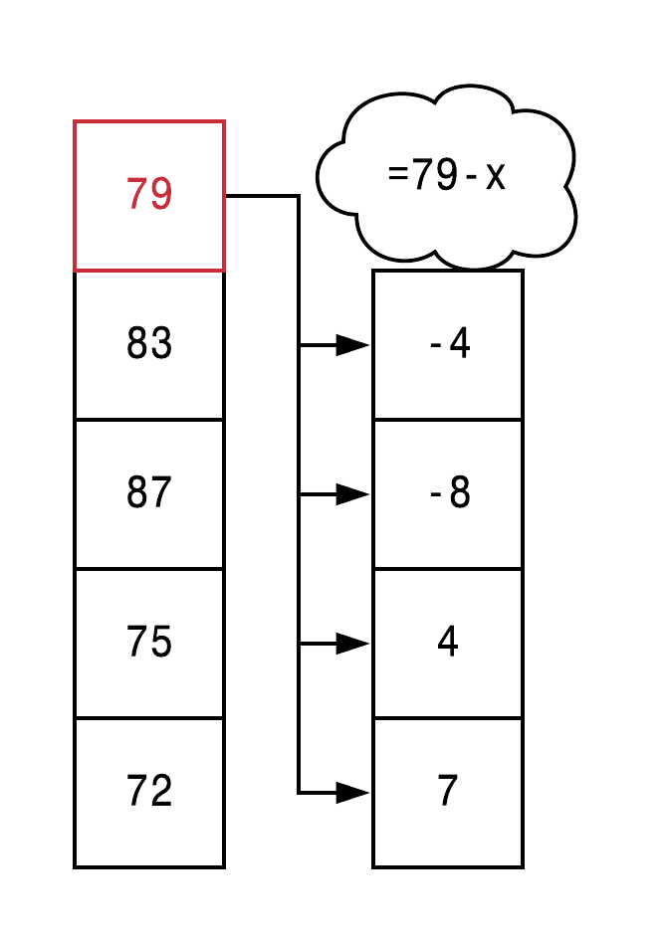
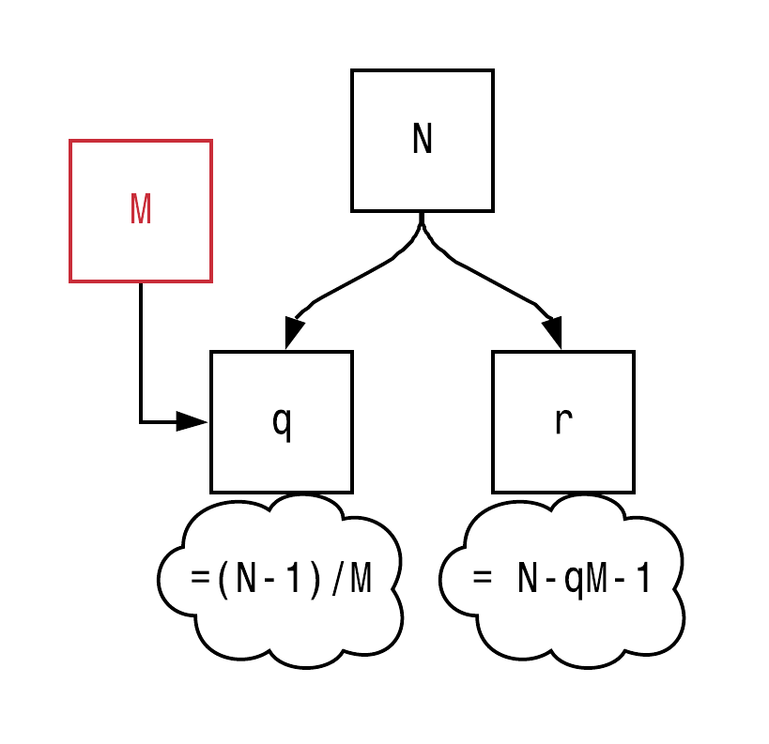
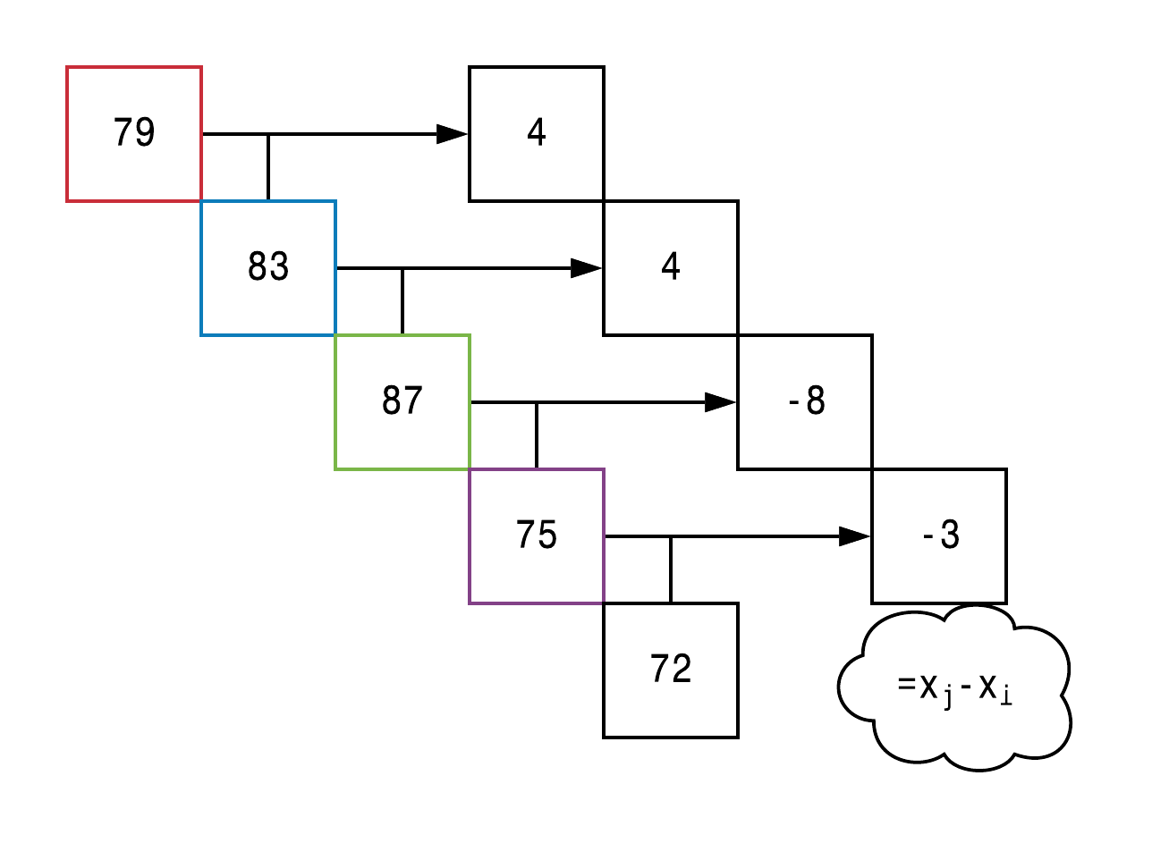
Compression Algorithms
Initial Value Coding
Golomb Coding
Huffman Coding
Differential Coding
Initial Value (IVC)
Previous Value (PVC)
Golomb Encoding
Previous Value Coding

Slide 5

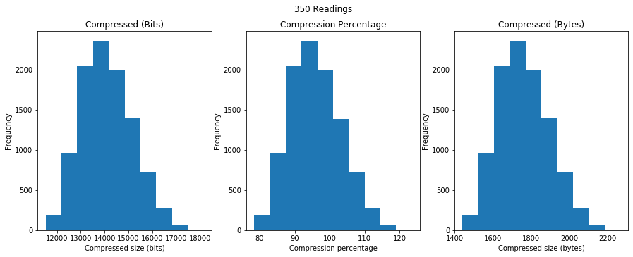
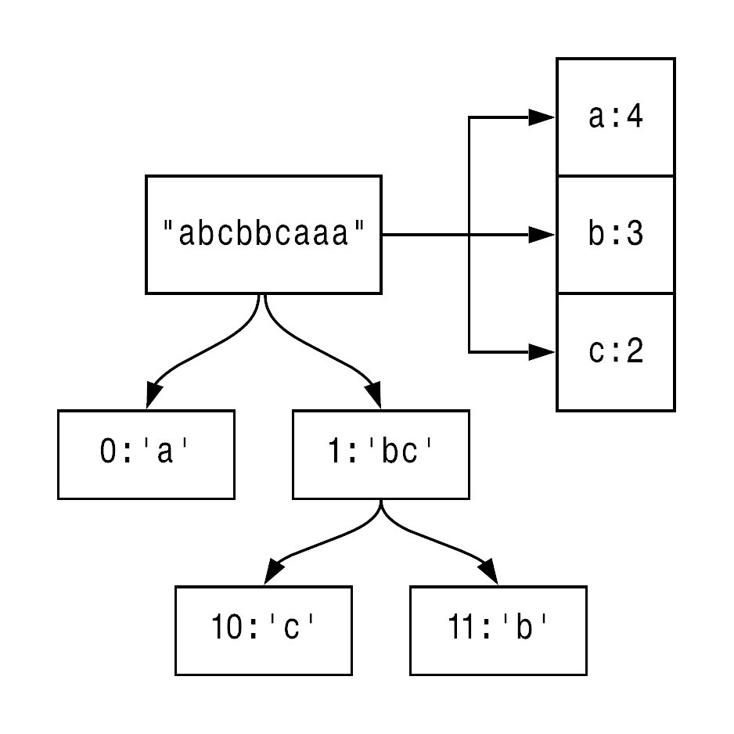
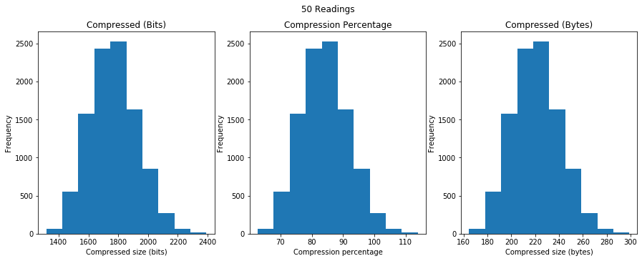
Results – Huffman Coding
Huffman Coding

Slide 6
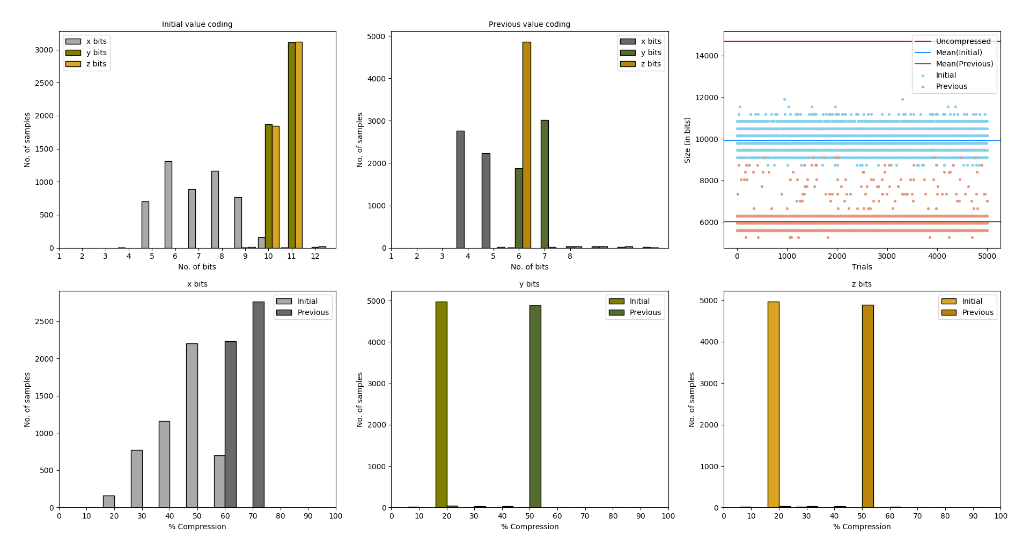
Results – Differential Coding

Slide 7
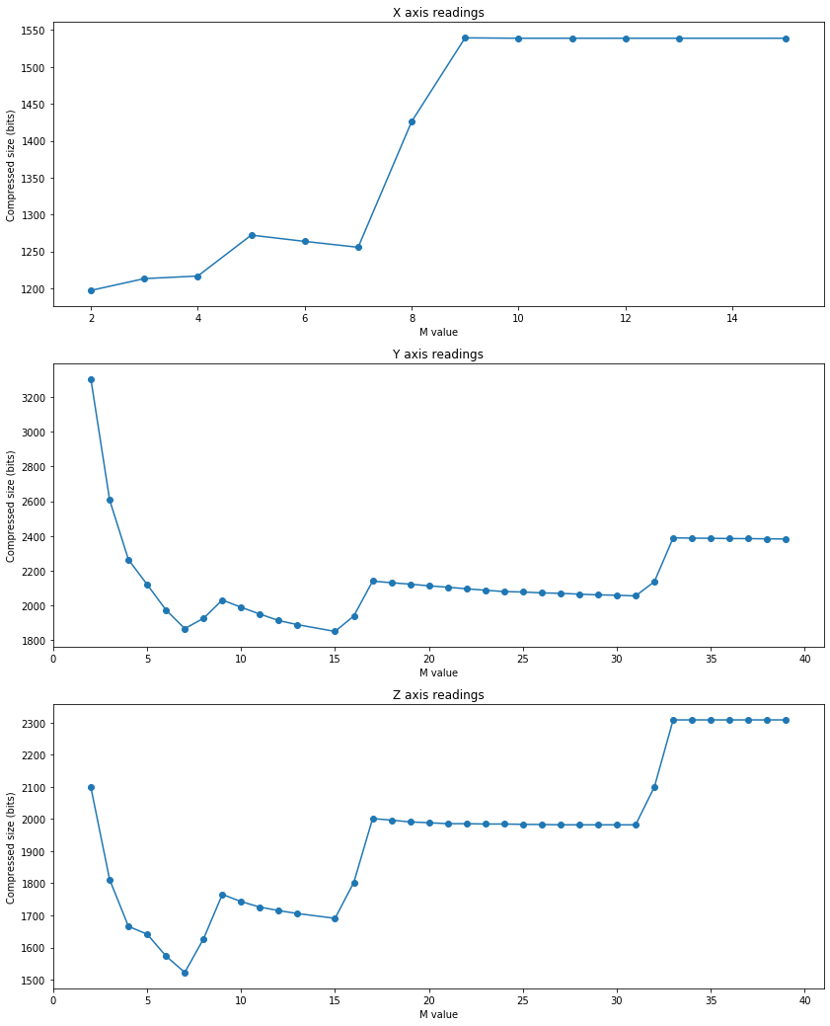
Results – Golomb Coding
Minimum point yields optimum M-value (x:2, y:15, z:7)
For 350 readings, compression factor = 0.31 (lower the better!)
Also tested this on different sample sizes as well – similar compression ratios

Slide 8
Project Outcomes
Huffman coding – not suitable for such data (compression actually increased the file size)
Differential coding – 0.8 (Initial) and 0.5 (Previous)
Golomb encoding – approx. 0.3 (consistent across different readings)
Potential recommendations:
Investigate combinations of algorithms
Simulate mission conditions to obtain simulated data to test compression

Slide 9
THANK YOU!! ☺

