Slide 1



















Providing Scale and Agility Through Digital Engineering
11000⁺
Global Digital Engineers
30+
ENGINEERING
MANAGERS
750+
DIGITAL
ARCHITECTS
500+
AGILE &
SCRUM
MASTERS
800+
DEVOPS CONSULTANTS & ENGINEERS
2000+
UX / VD
SPECIALISTS
7000+
FULL STACK DEVELOPERS
OUR CORE CAPABILITIES
CONSULTING & ADVISORY
GREEN FIELD / BROWN FIELD DEVELOPMENT
APPLICATION TRANSFORMATION
Digital Transformation
Next Gen Architecture
Portfolio 6R Assessment
Human Science Insights
Agile / DevOps Assessment
Product Development
Platform Development
Cloud Native App Dev.
Microservices / API Development
Agile / DevOps Delivery
App Cloud Shift
App Stabilization
App Modernization
Data Modernization
Agile / DevOps Transformation
Product Development
Supply Chain Management
Merchandizing
Store
Operations
Multi
Channel
Sales &
Marketing
Customer
Management
Travel
Hospitality
Travel Intermediaries
Food & Beverages
Beauty & Cosmetics
Personal Care & Electronics
KEY DOMAINS
OMNI CHANNEL COMMERCE| DC TRANSFORMATION | ONE INVENTORY | SC CONTROL TOWER | ORDER VISIBILITY| GUEST EXPERIENCE | CREW MODERNIZATION | AIRCRAFT M&E
STUDIOS
SOLUTION ACCELERATORS
ALLIANCES & PARTNERSHIPS
OneDevOps
DevOps accelerator
USA
UK
IND
ROM
AUS
ARG
CAN
FEGO
Cloud Assessment
COSMOS
Micro Services Development

Slide 2












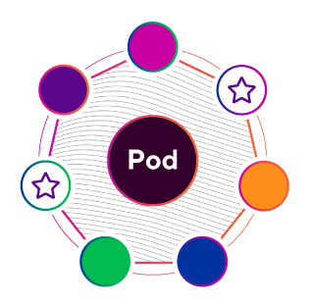
PODS: GLOBAL TALENT AND EXECUTION
TALENT | GUILDS Provides direction and global coordination to communities | COMMUNITIES Help scale specialized talent pools in each studio | STUDIOS Provide a Global Platform
 | Thought Leadership and PoV. Technical Vision and Strategy. Community connection. Right talent specific for client need | Guardians of Local Talent: People development | Globally distributed development centers Key strengths per location
EXECUTION | POD Focus on Products and Solutions, fueled by Communities | POD FRAMEWORK Ensure Efficiency & Predictability in delivery | GAME OF PODS Gamify the delivery process for Continuous Improvement:
 | Cross-functional Design + Engineering End-to-end solutions Outcome focus | KPI-driven Maturity Path Tailored to client’s delivery framework | Viralizes best practices Drives competitiveness

Slide 3









CLIENT EXAMPLE TEAM STRUCTURE AND EVOLUTION
CORE POD
Romania, Argentina & USA
22 Pods, distributed across Romania, USA, India & Argentina.
Lient Members
DIRECTOR OF APPLICATIONS
VP PMO
DIRECTOR OF DEVELOPMENT
DELIVERY DIRECTOR
PRODUCT MANAGER
SCRUM MASTER
TECHNICAL DIRECTOR
CSV Members
POD
POD
POD
POD
POD
POD
POD
DESIGN PHASE
MVP DELIVERY PHASE
POST-MVP DELIVERY PHASE
MOBILE
POD
MICROSERVICES POD
PRODUCTION SUPPORT POD
INTERNATIONAL TRACK POD
PRODUCT DEFINITION POD
MOBILE POD
MICROSERVICES POD
*After MVP launch, client team developers and QAs remained in the Pod structure
Romania & USA
*During MVP development we integrated client team developers and QAs as part of our PODs
Romania, USA, India & Argentina
Romania, USA, India & Argentina
June 2019
July 2019
October 2019

Slide 4
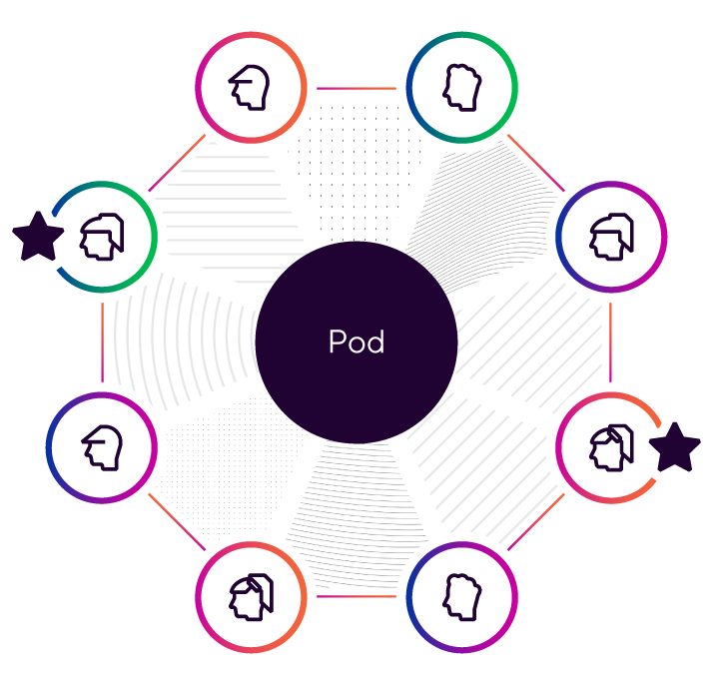
EVOLUTION OF TEAM & DEVELOPMENT STRUCTURE
Before - Skillset grouped
After- Pod Based, aligned by Value Stream
Waterfall evolving towards agile
Product Teams
Design teams
Front End Teams
Back End Teams
Pod
Pod
Pod
Pod
Pod
Pod
 | Branding |  | Product Discovery |  | Account |  | Offers |  | Checkout |  | Payment
# of Pods | 1 |  | 2 |  | 1 |  | 1 |  | 2 |  | 1
 | Comms |  | Store Locator |  | Search |  | DevOps |  | Prod Cat |  | Foundations
# of Pods | 1 |  | 1 |  | 1 |  | 1 |  | 1 |  | 2
Notes:
Implementation Manager across Value Streams

Slide 5
EVOLUTION OF SUCCESS
Before - Goal Based
Measurement
After- Our Maturity Model: KPI Dimensions
Meeting Launch timelines
Limited mechanical issues for launches
Budget and fixed scope related
Limited project based goals
Not tied to overall business success
30%
40%
30%
SPEED
QUALITY
PRODUCT IMPACT
Productivity measured by items delivered within a Sprint
Measures the degree to which product development addresses impact to objectives
Delivering business outcomes that drive success
Number of story points completed / sprint / pod members
Coverage percentage / completed feature for automated tests
Uptime of feature on the QA env. / month
eCommerce Revenue
Conversion rate
Basket size

Slide 6
SUCCESS STORIES
 | World’s largest retailer | Leading travel GDS provider
Why customer did this | High recurring TCO costs Tightly coupled enterprise apps M&A app sprawl, decades old apps Lack of predictivity and lower quality releases | New customer onboarding to the core business platform was time consuming and cost intensive DC to cloud migration at enterprise level Slower pace of adding new features
What was done | Re-architecture, apps decoupling Data redesign for optimal storage use Cloud native services adoption | App modernization analysis and new architecture adoption Holistic people, process and technology changes (new ways of working )
Value realized by app modernization | Concepts to deploy cycle time reduced from 6 months to 2-3 weeks. Storage cost reductions by consolidating 50TB+ on cloud from multiple DC storage locations. Improved apps transactions/processing times adding to better customer experience | 83% time reduction in onboarding new customers 80% reduction in deployments of new features Improvement on app quality and response time (99% code coverage)
How we achieved | 100+ processes/apps migrated to new architecture in 8 months App analysis, App migration/remediation to Azure, new cloud native apps. Leveraged VSM,FEGO for analysis | Single monolith code base with 50+ different services for each customer, analyzed and converted to microservices in every 3 months. Total 250+ microservices created Assisted in setting up Pod models & methodology

