Slide 1
HGV’s CHORUS Portfolio
COGNIZANT PROPOSAL
MARCH 2021

Slide 2
CONTENTS
01 Setting the context
02 Operating Model
03 How we’ll deliver
04 Commercials

Slide 3
Setting the context
© 2021

Slide 4




About HGV’s CHORUS related ask
HGV aims to enhance efficiency & bring innovation in CHORUS support by driving cost optimization, ensuring delivery excellence, and changing operating model
Operating Model Enablement
Robust Governance & KPI Monitoring
Cost Optimization & Innovation
Optimize development and support team structure with higher offshore leverage
Engage with the delivery model that enforces higher degree of continuous improvement inherently
Service delivery governed through pre-agreed metrics – SLA and KPIs
Uniform performance measurement throughout engagement
Reduce cost of delivery (right sizing, right shoring)
Bring in innovation by leveraging our industry experiences

Slide 5
Our value proposition: what we’ll bring to the table
Standardize Baseline velocity for the POD Establish SLA, KPIs depending on IT & business needs Identify the left-shifting & automation opportunities Identify areas of quality & productivity improvement Optimize Create efficiencies & leanness by increasing POD delivery output Realize productivity benefits by implementing tools, accelerators, and automation up to 18% over 3 years Innovate Establish an innovation culture that will support HGV’s portfolios in future by leveraging our innovation framework
Cognizant is strongly committed to our strategic partnership with HGV to continuously drive excellence – with cost-effective delivery, predictable outcomes, and continuous innovation improvements.

Slide 6
Defining operating model

Slide 7






Representative Infiltration/Core Pod
KEY ELEMENTS OF A POD: Product-focused: design & product expertise built in Cross-functional: design, engineering, quality engineering, devops -- any community required for the project, the right people to perform Agile best practices: self-governed, unbossed, functional experts who deliver quality at speed Continuous improvement mindset: collaboration, trust & a constant strive for excellence -- driven significantly by Game of Pods Structured around the project: client business KPIs & target outcomes are always front & center
Sr. UI Engineer (Angular)
Nearshore
Sr. App Dev Engineer (.NET)
Delivery Lead
POD
App Dev Engineer (.NET)
Data Engineer (Cosmos DB)
UI Engineer (Angular)
Delivery lead (Subject Matter Experts) that have the technical, leadership, and communication skills to drive team toward success.
Model 1 – Delivery Lead onsite
Model 2 – Delivery lead at nearshore location
Offshore

Slide 8


SAMPLE POD ARCHITECTURE With GOVERNANCE
HGV TEAM
PRODUCT OWNER
HGV TEAM
MANAGER
HGV TEAM
ANALYST
HGV ROLE
SME
COGNIZANT TEAM
DELIVERY DIRECTOR
COGNIZANT TEAM
CLIENT PARTNER
GOVERNANCE AND EXECUTIVE OVERSIGHT
The Governance team is made of different roles and skill sets that work together to provide
oversight and overall management of the partnership.
Pod 1 – INFLITRATION/CORE POD
Pod 2 - FLEX
Pod 3 - FLEX
POD
-
POD
POD
Leads
Flex pods added as needed in future based on approval

Slide 9
How we’ll deliver
Transition
Measuring
Innovation

Slide 10



















Talent on-boarding process
We will leverage our timeshare domain knowledge and technology know-how to bring resources up to speed
Intimation to join
HGV
CHORUS
Intimation to onboard required engineer(s)
Going through Timeshare
boot camp
Pool of available
engineers
Pool of Skilled Engineers
Engineers identified based on skills and experience
Timeshare Domain knowledge through boot camp
HGV process knowledge such as HGVC DevOps Processes
HGV System knowledge technical and functional
Chorus Knowledge Transition
4 weeks
HGV onboarding
CHORUS KT start
Engineer learnings are validated and ready to onboard HGV CHORUS
Productive and Operational Team

Slide 11
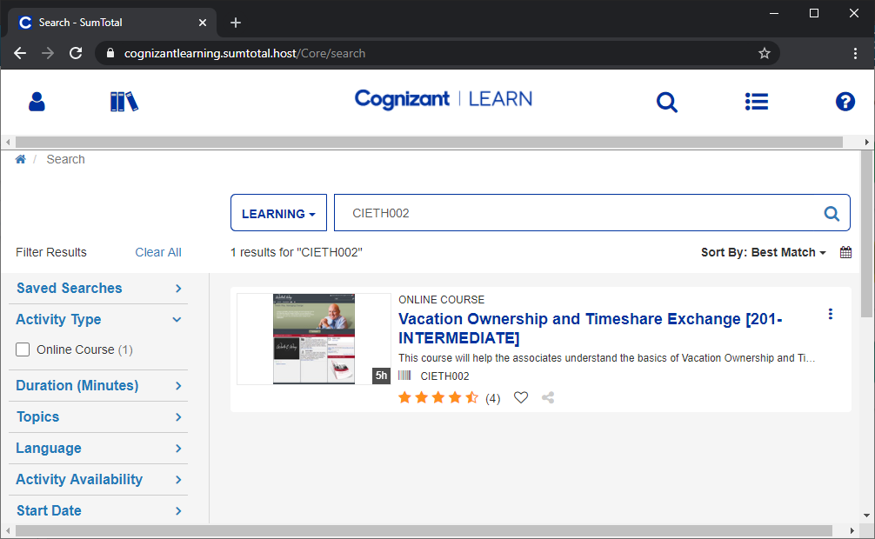


Formal boot camp on timeshare and exchange fundamentals
Cognizant LEARN
platform to impart standardized learning content curated by expert SMEs
VALIDATION
E-learning MODULE
Quizzes at the end of the course to validate understanding
A 5hr comprehensive online e-learning tutorial on timeshare and exchange domain

Slide 12



Plan for knowledge transition & steady state graduation
Plan, DD
Knowledge Acquisition
SHADOW/LEAD
stabilization
Steady-state
Week 0 | Week 1 | Week 2 | Week 3-4 | Month 1-2 | Month 3 Onwards | Year 1+ Onwards
Planning & DD
CHORUS Transition
Standardize
optimize
innovate
Wave 1
Minimal business disruption
Capacity planning and velocity definition
Metrics & SLA Finalization
SLA benchmarking
Innovation & Transformation
Knowledge management
Higher productivity
Wave 3
SLA adherence
Metrics & SLA baseline
Metrics & SLA base delivery
Better Agile Maturity Index
Wave 2
Salesforce

Slide 13
With a detailed KT process, activities, and deliverables
Transition Inputs
Transition
Focus Areas
Target high utilization for the application
Align transition with key business events
Well defined communication plan & Governance
Transition will focus on -
-Application Transition
-Process Transition
-Tools Transition
TRANSITION METHODOLOGY
TRANSITION PLANNING
KNOWLEDGE ACQUISITION
SHADOW/SHARE
LEAD
STEADY STATE
Validating Transition schedule
Identifying HGV SME
Entry / Exit criteria for all the waves
In-depth understanding of functional, technical and operational aspects for the CHORUS Applications
Reverse engineering - SME guidance, self-study and reverse analysis tools
KT documentation and play back sessions
Closely follow and learn from HGV SMEs on support activities
Cognizant team works independently on the changes
Cognizant takes primary ownership for incoming changes
Ownership of Cognizant owned development PODs
Steady State Support
Constantly monitor progress and Continuously Improve services
SLA Discussions 1 monts into the service
Key Deliverables / Outcomes
KT Plan
KT Score Card
KT Process Handbook
Reverse KT
Updated run books and work manuals
Status Report – Weekly
& monthly
Knowledge Portal

Slide 14
What we’ll need from HGV & Incumbents to ensure smooth transition
Transition Planning:
Provide business and technology information on Chorus application and its components
Provide technology and tools and associated open items/issues list
Transition Governance:
Secure incumbent vendor commitments and address escalations
Facilitate vendor changes update to cross functional and business teams
Transition Execution:
Provide access, support for logistics as requested by Cognizant
Ensure retention and availability of key resources till the end of transition
Review at each stage of transition
INCUMBENTS
Transition Governance:
Work with Cognizant to develop detailed transition plans
Transition Execution:
Provide SME time, documentation
Shadow and Reverse Shadow
Phases | CHORUS HGV Owner [hours/day] | HGV CHORUS Team leads/SMEs [hours/day] | Vendor SMEs [hours/day]
Planning (1 week) | 2 | 2 | 0
Knowledge Acquisition (2 weeks) | 2 | 4 | 2
Shadow (1 weeks) | 2 | 3 | 2
Lead (1 weeks) | 1 | 2 | 1

Slide 15




PODs : Measuring What Matters
Pod results are data driven and measured in four dimensions. During Transition phase we will review this and come to mutual agreement with HGV on deciding which ones to leverage during standardization phase.
f
(
)
Velocity Team’s productivity | Quality Degree of Excellence | Product Impact Business impact of our dev team | Autonomy Avoidance of unnecessary overhead
Productivity Burn Down / Burn Up Chart Velocity / Throughput # of Features / Microservices Resolution Rate Predictability Say/Do Ratio Throughput Variability Responsiveness Cycle Time / Lead Time Change Lead Time / Mean Time to Change Wastage | Output # of Defects # of Defects rejected/reopened Escaped defects / Defect spillover Customer Complaints Coverage % of Automated Test Coverage (Unit, Integration, Perf., etc.) Stability Time to restore service Change fail rate Server up/downtime | Product Completed PBI Accepted Ratio # of PBIs Created & Completed Business Growth / Adoption Customer Ratings Revenue Increase Cost Savings | Mastery Core Members Ratio # of Support Requests Trust Visibility / Meeting Participation Scope Change Ratio Proactivity Technical Debt # of Process Improvements Continuous Improvement US

Slide 16
We will commit on continuous YoY efficiency gains
Year 1 benefits would start accruing from the onset of steady-state period (5 to 8 months from completion of transition phase) – expected 4% increase in productivity in first 12 months after transition.*
Productivity Levers | YR 1 | YR 2 | YR 3 | Total Impact
Process standardization Unit tested code & peer review | 1% | 0-1% | 0-1% | 1-3%
System knowledge & Cognizant accelerators Application understanding and continuous usage of tools/accelerators | 2% | 4% | 4% | 10 %
Templatization & architectural improvements Re-usable components, API map, swagger, etc. | 1% | 2% | 2% | 5 %
 | 4% | 6- 7% | 6-7% | 16- 18%
The percentage represents productivity gains in sprint velocity for 10 person core POD.
This are representative numbers.
They will be confirmed before engagement start and will be validated during transition phase

Slide 17

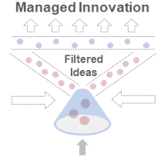
And take things to the next level with thought leadership & innovation
Leveraging our managed innovation framework, we’ll bring in SMEs from Cognizant to work with HGV’s stakeholders & delivery team to create innovations that can improve the customer experience:
Leverage our Hospitality practice including our experience in other leading time sharing brands
Continuously explore our accelerators and offerings for fitment to add value to HGV’s business
Hospitality
Industry
IT
Industry
Industry Trends
Industry Best Practices
HGV IT & Business
Cognizant hospitality
Practice
Industry
Proposals
Approved
Projects
HGV
Innovation Champion
Cognizant
Innovation Champion
Transformational/ Continuous Improvement Ideas
Cognizant
Delivery Team

Slide 18
Commercials

Slide 19
Our resources rate card for this engagement
Resource | US | Nearshore | India
Delivery Lead Responsible for owning the POD delivery, technical guidance, architecture inputs etc. Sr. resource with 8-10 years of experience. Leverages past project experience in technology and domain to drive process improvements and innovation. | $100 | $50 | $35
Sr. UI Engineer (Angular) Responsible driving UI delivery and setting up standards. Also, contributes to the stories and epics. Senior resource with 6-8 years of experience. | $95 | $45 | $29
Sr. App Dev Engineer (.NET) Responsible driving backend delivery leveraging .NET experience Contributes to the stories and epics. Senior resource with 6-8 years of experience. Leverages past CI/CD DevOps experience for driving changes and continuous improvement. | $95 | $45 | $29
App Dev Engineer (.NET) Responsible delivering on backend application changes leveraging .NET experience Contributes to the stories and epics. Resource with 3-5 years of experience | $90 | $40 | $25
UI Engineer (Angular) Responsible delivering on frontend application changes. Contributes to the stories and epics. Resource with 5-7 years of experience | $90 | $43 | $27
UX Engineer (Angular) Responsible delivering on user experience change. Contributes to the stories and epics. Resource with 3 -5 years of experience | $90 | $45 | $29
Data Engineer (Cosmos DB) Responsible delivering changes and maintaining Cosmos DB. Contributes to the stories and epics. Resource with 5 -8 years of experience | $90 | $40 | $25

Slide 20
Predictable, Flexible and Optimized commercial model for HGV
Your asks/terms:
Predictable: you need to be able to accurately calculate the budget impact for any resource changes
Flexible: you need to be able to scale up or down per business needs
Optimized: you need the best cost-effective commercial models
Per your historical trends, you can commit to a Core POD of 6 resources for 3 years
Our proposal:
Predictable, Optimized: For your commitment (10/3), Cognizant provides the below fixed-price which has been arrived by using the rate card provided + partnership discount + free Knowledge Transition
Flexible, Predictable and Optimized: If additional POD members are added above 10, Cognizant can give a further discounted fixed-price Change Request capped at the supplied rate card
Further Optimized: With YoY productivity increase committed; HGV can leverage additional story points capacity available in the pod to provide more business outcomes
Flexible, Predictable: If the Core POD members are reduced below 10, the supplied rate card takes effect
For any resources changes, HGV will be required to give 2 weeks of notice to Cognizant for planning purposes
Model | Monthly Fixed Price based on the Rate Card (6 resources POD) | Monthly Fixed Price with 6%discount & free Knowledge transition (6 resources POD)
Model (Delivery lead is at onsite and all other roles at offshore) | $59,650 | $56,569

Slide 21
Commercials for our program with yearly outlook and assumptions
Price to HGV – Core Team (with discounts)
Portfolio - CHORUS | Year 1 (Jun 2021 – May 2022) | Year 2 (Jun 2022 – May 2023) | Year 3 (Jun 2023 - May 2024) | 3 Year Total
Model (On + Off) | $678,830 | $678,830 | $678,830 | $2,025,648
Pricing Assumptions
Knowledge transition ( 4 weeks) - at no cost to HGV starting from May 2021.
The POD capacity is defined based on the existing count of resources, any additional capacity derived post transition would be handled thru appropriate Core-flex ramp up model.
The velocity of each POD is to be ascertained during stabilization phase and any gap between derived velocity and targeted velocity would be handled thru additional capacity planning, to be mutually agreed upon.

Slide 22
THANK YOU.

