Slide 1
EHCache Migration Approach

Slide 2
Our Understanding of the Requirements and Scope
 | Applications in marketing area are having bad customer experience as well as lost revenue in some cases due to expired coupons not removed or right coupons not loaded in time. In order to alleviate this problem, Macy’s is migrating the existing EHCache version 2.7 to 3.0 and during migration have found out multiple code quality issues mainly attributed to dead code. Macy’s is looking for solution approach to remediate existing code for key/value dead code logic while Ehcache migration is being done.
 | Analyze - Approach to analyze dead code Remediate - Fix code quality issues Test - Perform System Testing
 | Software/ Tool licensing and costs Any customization required in EHCache Server Change of existing business process End User Training and Product training material Design of new Hardware sizing & capacity planning for non-functional requirements of load balancing, high availability, disaster
Our
Understanding
In Scope
Out of Scope

Slide 3
Solution Approach Improving code quality
Pre-Assessment
Code Analysis
Code Remediation
Activities
Gain initial understanding of the applications & the upgrade effort
Application stream analysis to prioritize the applications based on the current production issues and functional priorities
Output:
Analysis plans with finalized tools and application priority list
Cognizant Accelerators:
App Insights
Activities
Comprehensive code quality check to assess the existing state of the code
Analyze Dead Code - Highlights the rules which are possibly not used in the system
Generate reports, which can be used by developers to remove unused codes based on the rules
Database/Content Comparison - compare the old & new environments and report the differences
Output:
Reports customized per Macy’s problem areas
Cognizant Accelerators:
CCAP
CCAP – SSAT
Activities
Remove dead code based on the reports
Provide code hotfix and performing testing in test environment
Support Ehcache upgrade activities based on the code remediation output
Output:
Functionally validated remediated code with improved quality

Slide 4
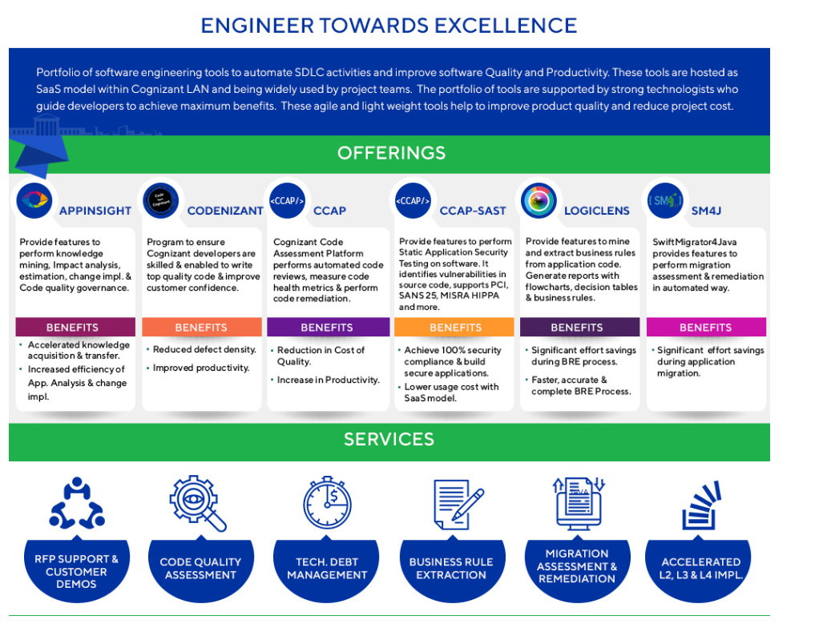
About Cognizant Tools
We will be leveraging following tools to accelerate this effort and provide value faster
od​uct​​ | Description​
App​Insi​g​h​t​​ | ​Provide features to perform knowledg​e mining, Impact analysis, estimation, change impl. & Code quality governance​
CCAP​​ | ​Cognizant Code Assessment Platform performs automated code reviews, measure code health metrics & perform code remediation.​
CCAP-SA​​ST​ | ​Provide features to perform Static Application Security Testing on software. It identifies vulnerabilities in source code, supports PCI, SANS 25, MISRA HIPPA and more.​

Slide 5
Assumptions
Upgrade is already underway and only help required from Cognizant is in regards to improve the code quality
This approach is about fixing the dead code to provide the stability and resiliency while upgrade is being performed in parallel

