Slide 1
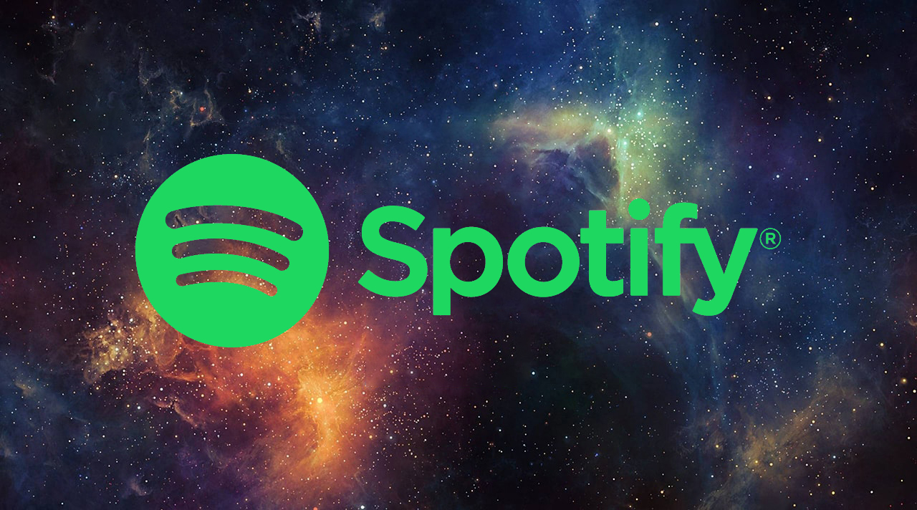
Marketing Analytics
This Photo by Unknown Author is licensed under CC BY-NC-ND

Slide 2
ABout
Spotify is a music streaming company delivering services to 75 million active users globally.
Spotify is currently offering two type of subscriptions: a free and a premium subscription.
This marketing plan is about Spotify finding why do customer churn.

Slide 3
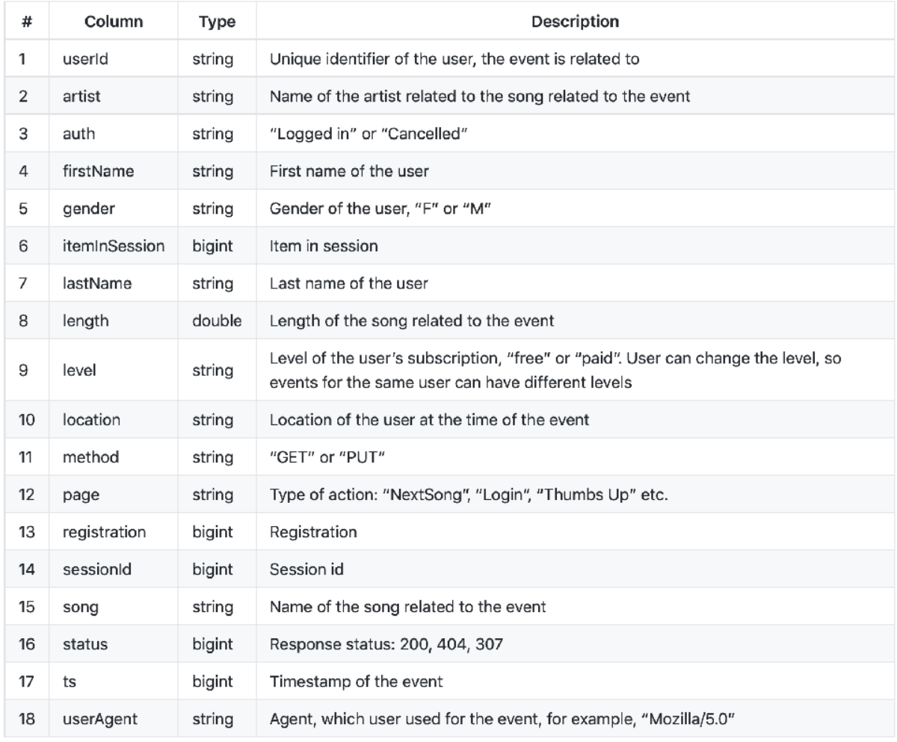
Data description

Slide 4

Data cleaning
& transformation
For data cleaning we have converted timestamp(ts) column into date and time and separated Hour, Day, Month and year.
Removed duplicate values and null values.
Cleaned location column by keeping last characters only that represents state ( eg. CA-California)
Created churn column using page column where if page == Cancellation Confirmation && page == Downgrade && page == Submit Downgrade then customers has churned (1) else not churned(0).

Slide 5

Data Modeling
Data modeling is a process used to define and analyze data requirements needed to support the business processes within the scope of corresponding information systems in organizations.
We have used following models so that we can determine which model is best.
We have also used correlation matrix heatmap to show the relation between the data.

Slide 6

Models
Logistic Regression
Decision tree classifier
Random forest Classifier.
Linear SVC
Navie Bayes

Slide 7
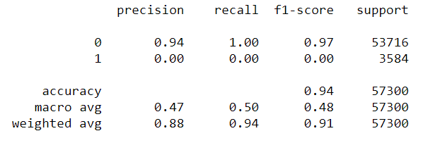
Logistic Regression
The accuracy is 94%

Slide 8
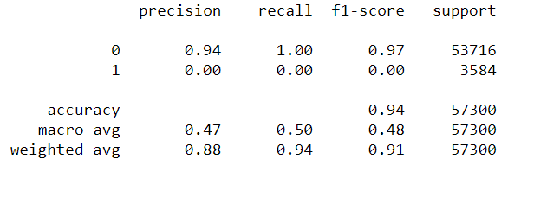
Decision Tree Classifier
The accuracy is 94%

Slide 9
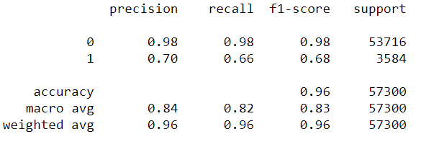
Random Forest Classifier
The accuracy is 96%.

Slide 10
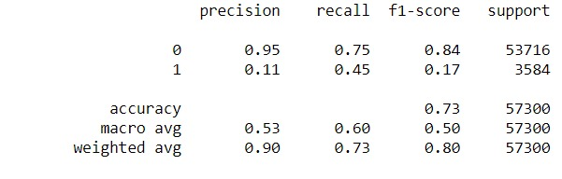
Linear SVC
The accuracy is 73%

Slide 11
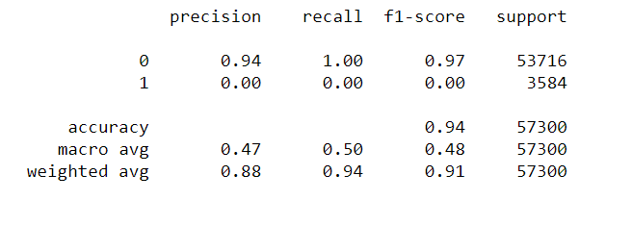
Naive Bayes
The accuracy is 94%.

Slide 12

Model Preferred.
The analysis shows Random forest classifier has the best accuracy which is 96%.

Slide 13
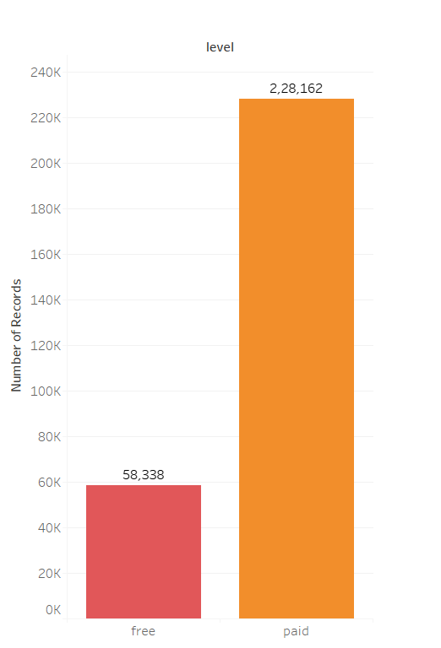
Subscribers vs. free users?
Number of Paid users are 2,28,162.
Number of Free users are 58,338.

Slide 14
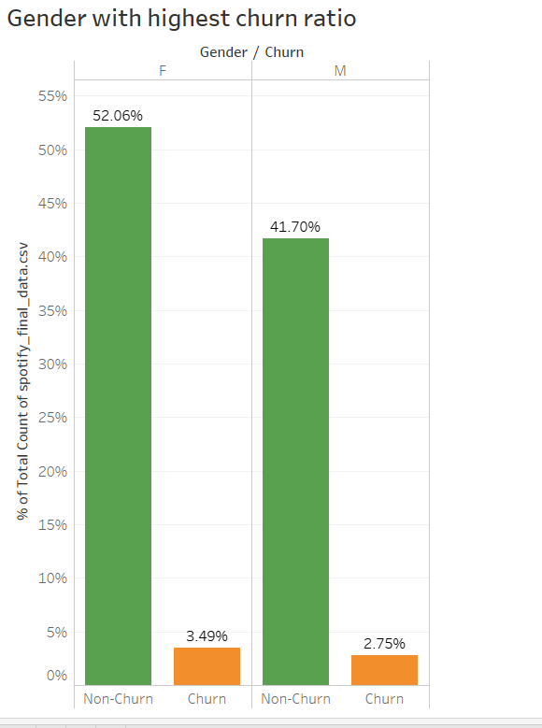
Which gender group churned more??
Comparing churn with overall percentage for male and female.
As result we found that:
Female users are more than male and likewise their churn ratio is also high.

Slide 15
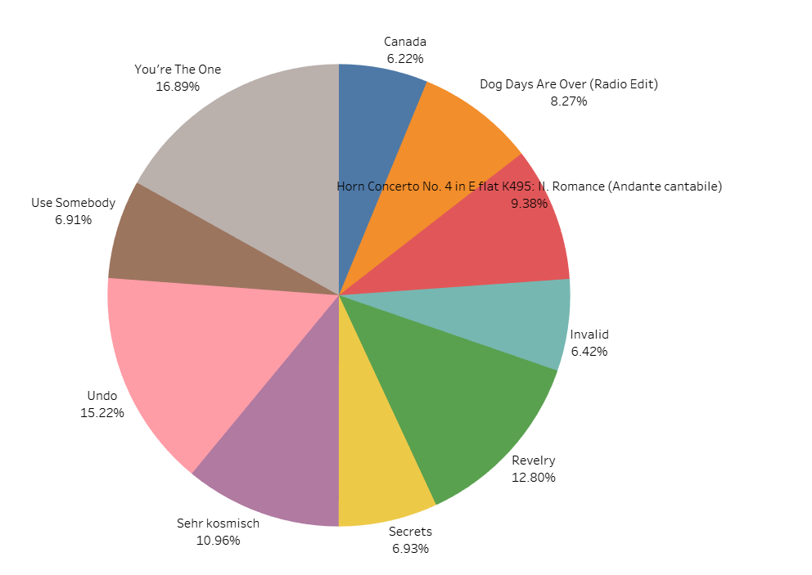
top 10 songs
A percentage wise ratio can be seen in this pie chart.
“You’re the One” seems to be more popular than any other song with 16.89%, followed by “Undo” at 15.22% among top 10 songs.

Slide 16
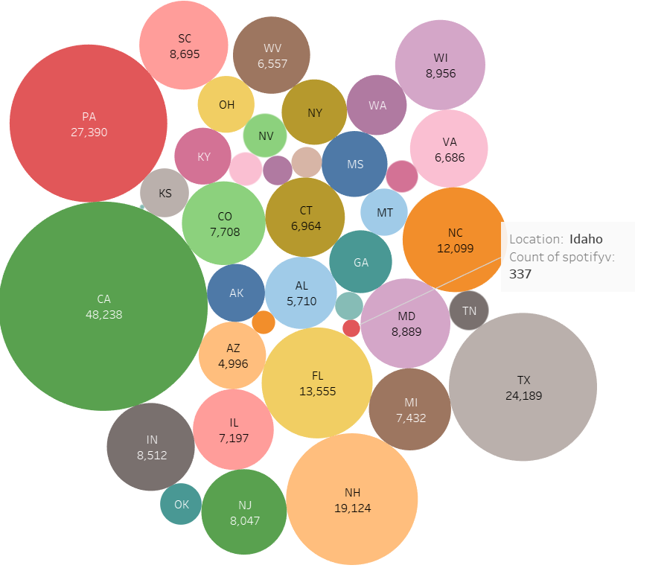
which Location is popular ?
This bubble chart gives a glimpse at what area Spotify got more listeners and where less.
California tops it with 48,238 songs played and Idaho has least with just 337 songs listened.

Slide 17
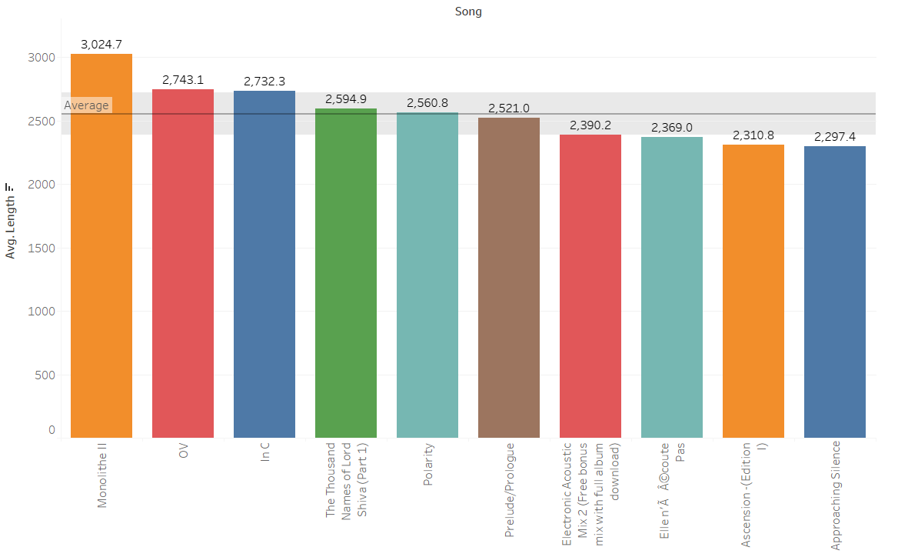
Average time spend on songs
We can see there are people who love to listen songs on repeat mode.
Following Analysis shows which song has the highest average and what is the average of songs listened.
The average marked is 2554.4 times.

Slide 18
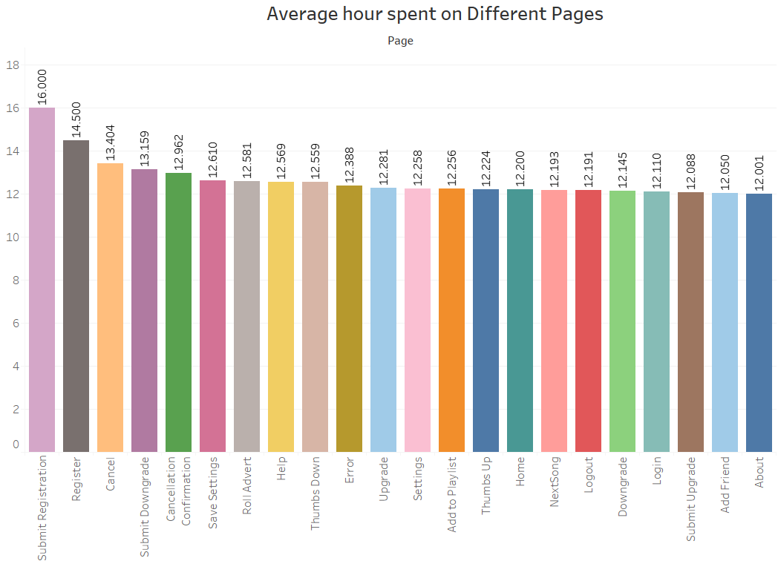
Time spent in Application for other cause.
As noticed 16 hours are spent for the registration process only.
Nearly 12 hours are spent just to know about the application

Slide 19
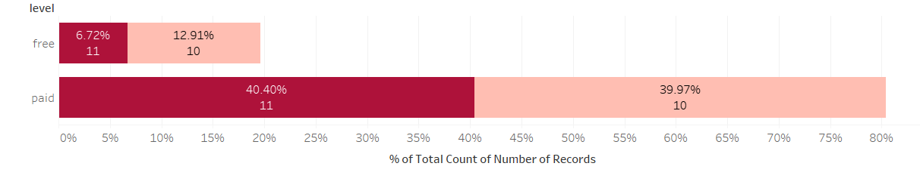
Paid vs. free
Are the people using free services or paid service?
Which month is affected more?
From the analysis we can say that paid subscribers are getting more churn compare to free users in the month of November.
Where dark pink is for November and light pink color represents October.

Slide 20

Thank you

