Slide 1
Crime Analysis in India (2001–2013)
Using MySQL and Power BI
By Parth Deshmukh

Slide 2
Project Overview
Objective:
- Analyze 13 years of crime data across India
- Identify crime trends, high-crime states, and categories
Tools Used:
- MySQL: For data cleaning, transformation & querying
- Power BI: For interactive visualizations and dashboards

Slide 3
MySQL: Data Cleaning & Structure
- Created 'crimes' table with relevant columns
- Imported CSV data
- Cleaned whitespace and fixed data types
- Example queries:
• Total crimes per year/state
• Crime type-wise growth trends
• Top states and districts by crime

Slide 4
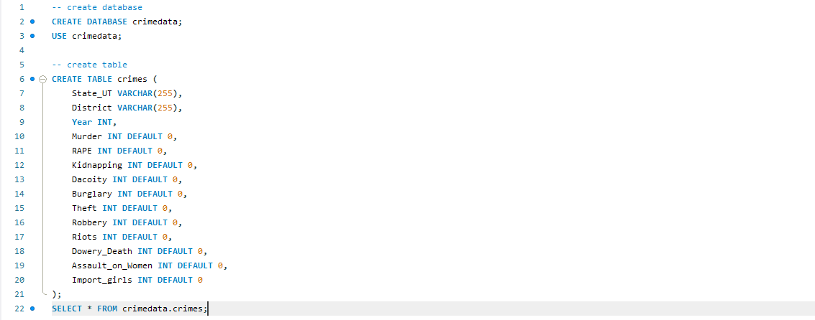
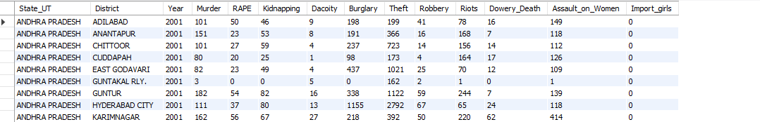
Creating database, table and view table command:
Table :

Slide 5
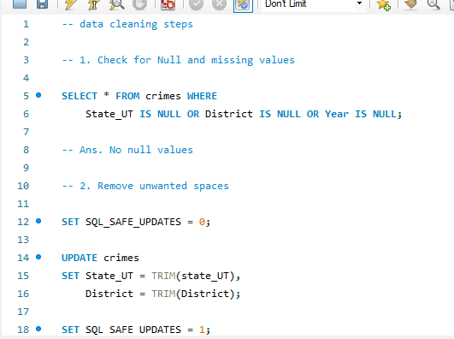
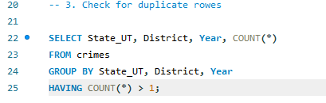
Data Cleaning Command :

Slide 6
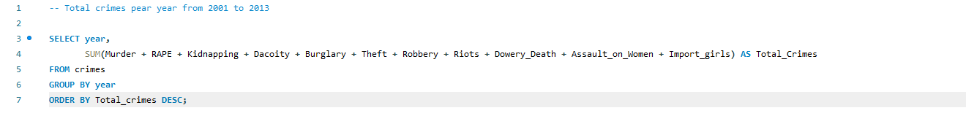
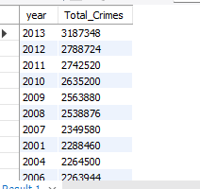
Total Crimes pear year from 2001 to 2013 :
Output:

Slide 7
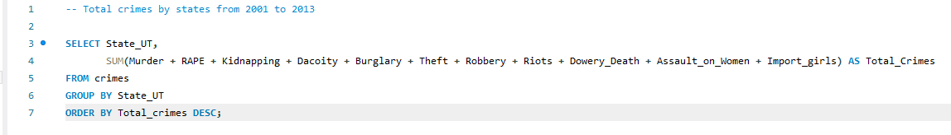
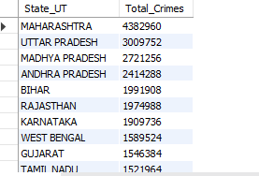
Total crimes by state from 2001 to 2013:
Output :

Slide 8
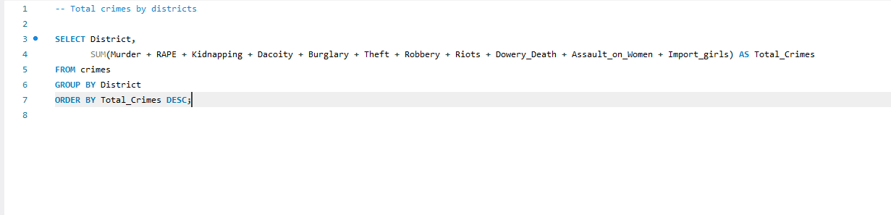
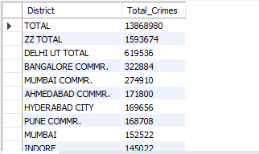
Total crime by districts:
Output :

Slide 9
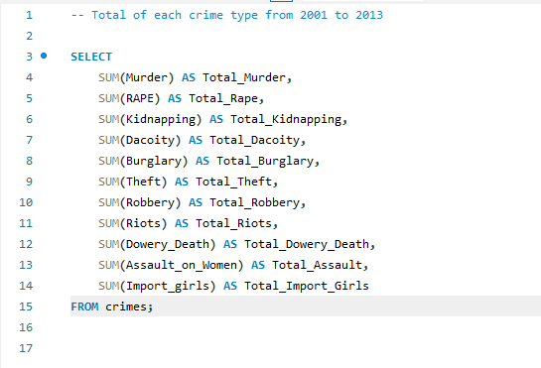
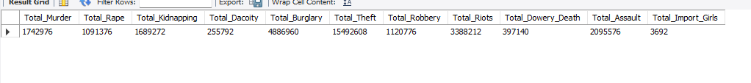
Total of each crime type from 2001 to 2013
Output :

Slide 10
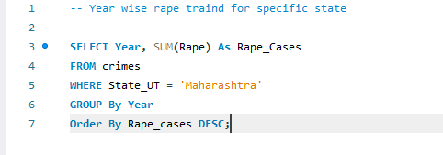
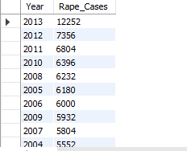
Year wise rape trained for specific state :
Output:

Slide 11
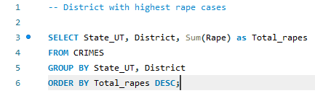
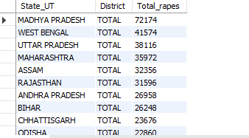
District with highest rape cases :
Output:

Slide 12
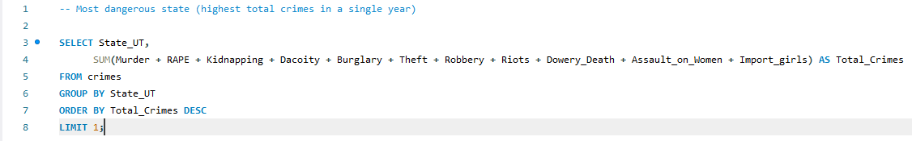

Most dangerous state :
Output:

Slide 13
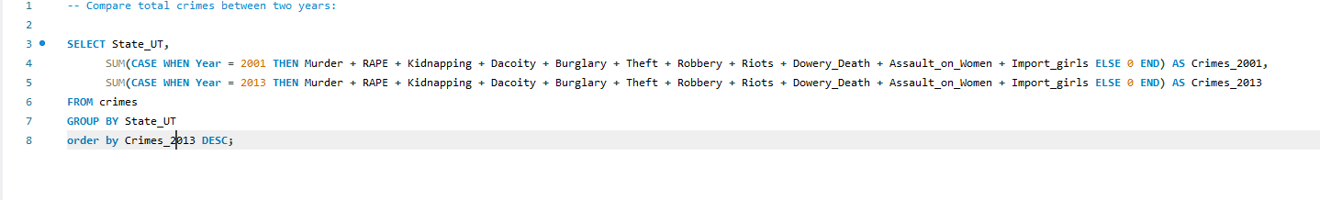
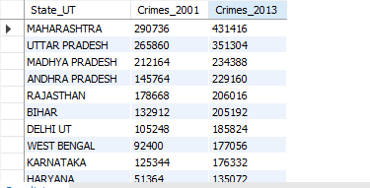
Compare total crimes between two year :
Output :

Slide 14
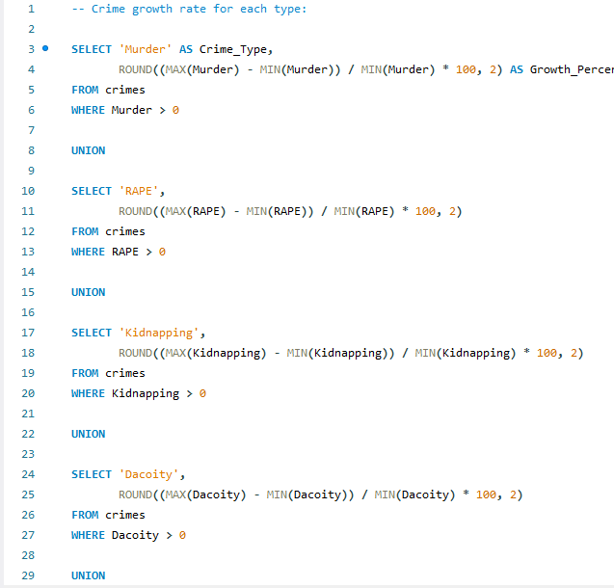
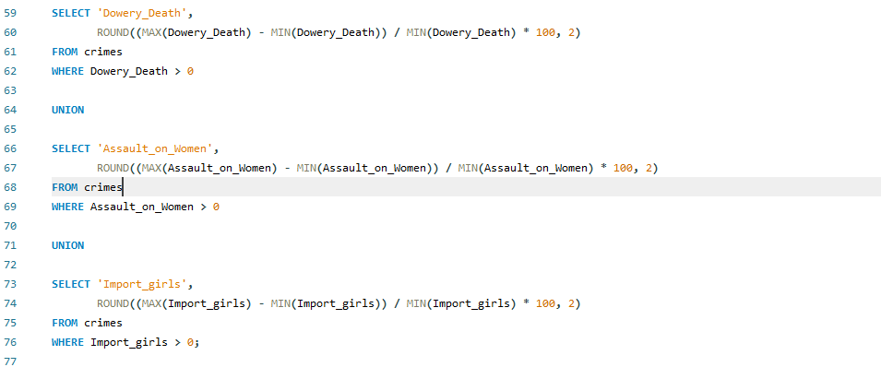
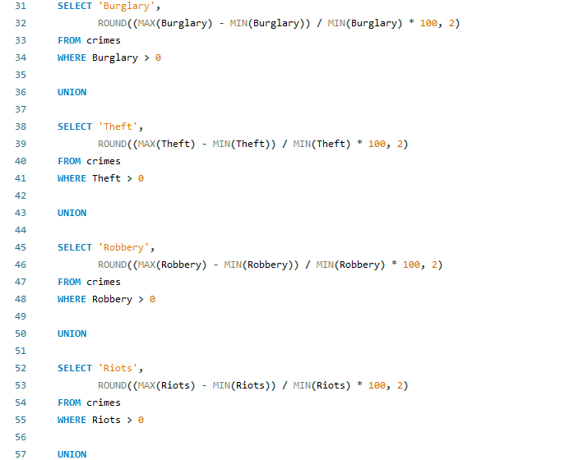
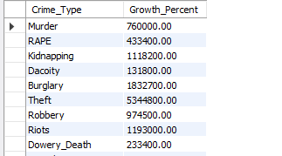
Crime growth rate for each type:
Output:

Slide 15
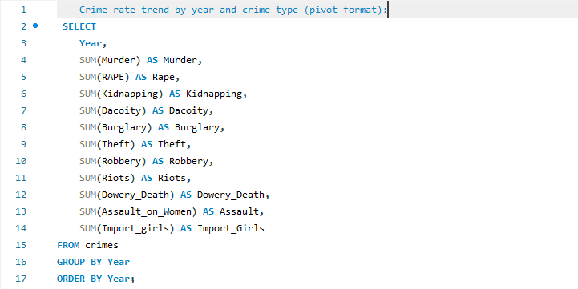
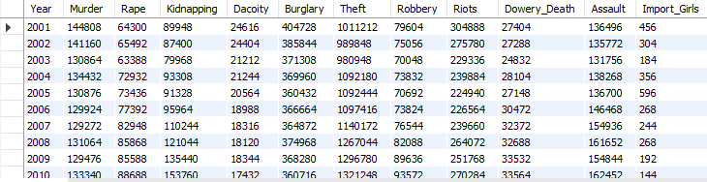
Crime rate trend by year and crime type :
Output :

Slide 16
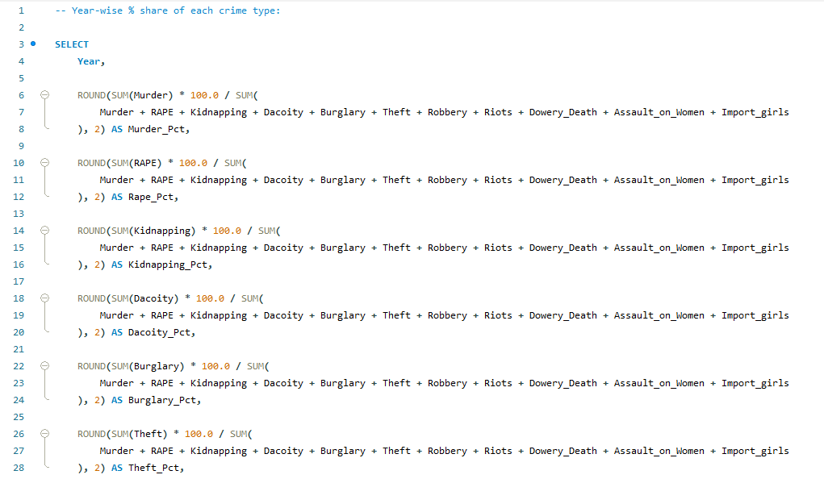
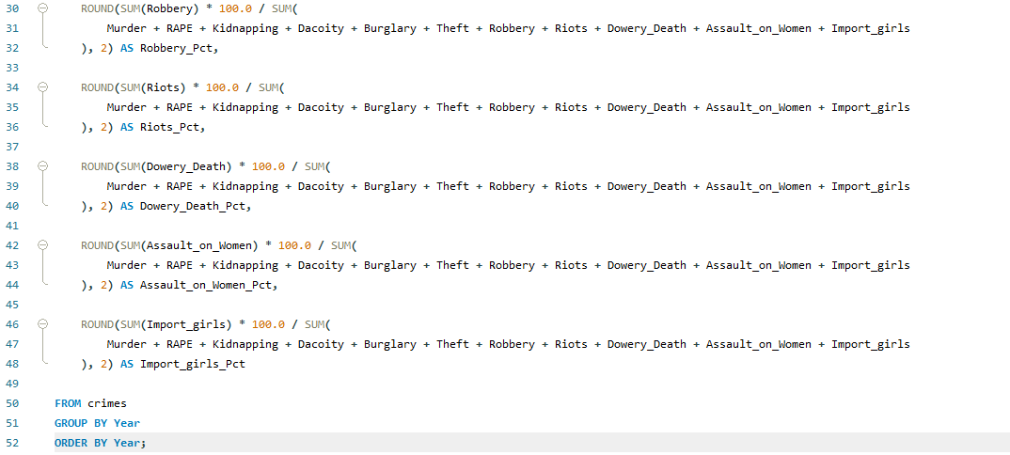
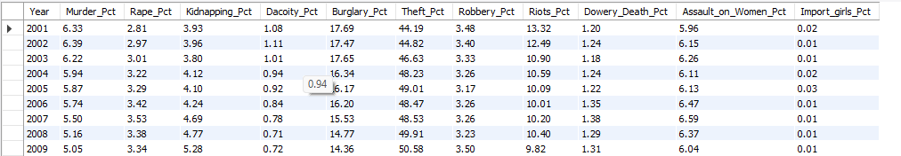
Year-Wise % share of each crime type :
Output :

Slide 17
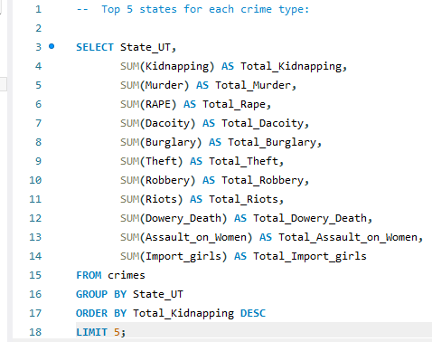
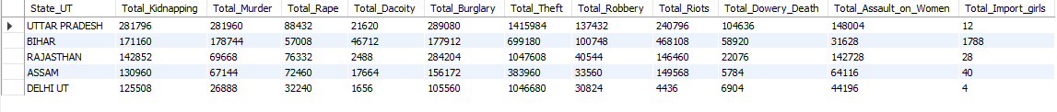
Tope 5 states for each crime type:
Output :

Slide 18
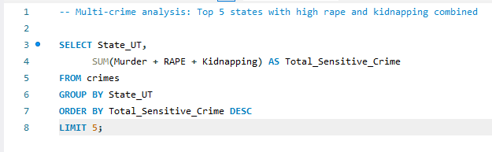
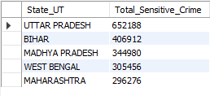
Multi-crime analysis :
Output :

Slide 19
Power BI: Dashboard Components
- Unpivoted data for better analysis
- Created DAX measures for:
• Total Crimes, Crime Growth %, Crime Type Breakdown
- Built visuals:
• Year-wise trends
• State-wise crime maps
• Top crime types and heatmaps

Slide 20
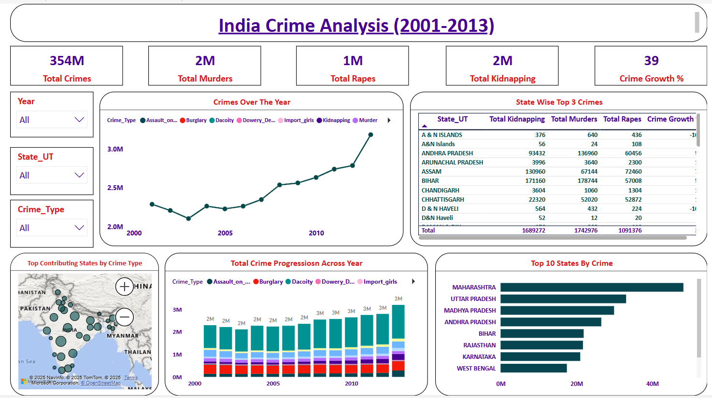

Slide 21
Key Insights
- Maharashtra had the highest total crimes reported
- Crime increased ~45% from 2001 to 2013
- Rape and Kidnapping showed significant growth
- Major states show consistent crime trends year over year

Slide 22
Conclusion & Learnings
- Improved skills in SQL, DAX, and dashboard storytelling
- Understood importance of unpivoting for visualization
- Learned to derive actionable insights from messy data
- Ready for real-world analytics and reporting tasks

Slide 23
Thank You!
Connect with me on LinkedIn
#DataAnalysis #PowerBI #MySQL #DataVisualization

