Slide 1
WALCHAND COLLEGE OF ENGINEERING, SANGLI | DEPT. OF COMPUTER SCIENCE & ENGINEERING
PropTrack
Development-Linked Property Outlook for Sangli
Mini Project Synopsis · 2026-27
Team: Parth Nerkar (23510097), Navjot Singh (23510122), Rakshit Gawde (23510055)
Guides: Dr. A. R. Surve (HOD), Mrs. A. M. Chimanna (Lab Coordinator)

Slide 2
Problem Statement & Proposed Solution
PROBLEM STATEMENT
There is no objective measure of a locality's growth potential.
Property decisions are driven largely by current prices and locality reputation, while the effect of planned infrastructure on an area's future value is hard to quantify. Information on upcoming roads, rail and industrial projects is spread across many sources and varies in reliability and timing, which makes systematic comparison of localities difficult.
PROPOSED SOLUTION
An explainable, rule-based Development Outlook Score for each locality.
PropTrack turns infrastructure data into a transparent 0-100 score, piloted on Sangli-Miraj-Kupwad. Each project is weighed by type, distance, approval stage and completion year, and the result is shown on an interactive map with a breakdown of what drives it. The score is a growth outlook, not a price prediction.

Slide 3
Objectives & Success Measures
1. Requirements & design
2. Core module development
How: Customer connect with local realtors; SRS, ER schema and UML.
Measure: SRS sign-off, schema completeness, consultations logged.
How: Project registry, rule-based scoring engine, buyer and admin modules.
Measure: Scores match hand-computed cases; API test pass rate.
3. Testing & validation
4. Deployment & evaluation
How: Unit, integration and acceptance tests; ±20% weight sensitivity check.
Measure: Test pass rate, defect count, ranking stability.
How: Release a working prototype and collect stakeholder feedback.
Measure: Uptime, feedback score, refinements made.

Slide 4
Literature Review & Gap Analysis
Rosen (1974)
Debrezion, Pels & Rietveld (2007)
Saaty (1980)
Hedonic pricing
Approach: Regresses price on property and location attributes.
Finding: Location attributes carry measurable implicit prices.
Limitation: Needs large transaction data; looks backward, not at planned projects.
Rail stations & property value
Approach: Meta-analysis of studies on station proximity.
Finding: Value effects are tied to proximity and fade with distance.
Limitation: Retrospective; ignores project stage and timing.
Analytic Hierarchy Process
Approach: Pairwise expert comparisons produce criteria weights.
Finding: Judgement can be turned into consistent, auditable weights.
Limitation: Subjective; must be checked and calibrated on local data.
RESEARCH GAP Portals such as 99acres, MagicBricks and Housing.com show listings and locality ratings, but none link a locality to upcoming infrastructure with stage and completion year. PropTrack combines classical weighting methods with a project registry to give an explainable, stage-aware score for Sangli.

Slide 5
Competitor Analysis
Platform | What public sources show | Gap vs PropTrack
99acres | Listings, locality reviews, historical price trends, RERA codes where available | No project-level, stage-aware infrastructure score described
MagicBricks | Locality price trends and locality reviews | Focus on prices and reviews
Housing.com | Residential, commercial and agricultural listings (PropTiger subsidiary) | No land-type rules or infrastructure outlook described
PropEquity, Clicbrics, Settlin | Price trends, transaction history, price estimates | Price-based; project timing not described
IGR ASR / RERA | Tax benchmark values; project registration | Not designed as a growth outlook
PropTrack's difference: project-level, stage-aware, explainable, and land-type aware.
Based on public descriptions reviewed in Oct 2026; internal algorithms are not visible.

Slide 6
Agricultural vs Non-Agricultural Land
Aspect | Agricultural land | Non-agricultural (NA) / urban land
Who may buy | Agriculturists only (MTAL Act s.63), with exceptions such as industrial use | Generally open to any buyer
Benchmark value (ASR) | Per hectare: rain-fed or irrigated | Per square metre for plots
What infrastructure changes | Chance of conversion and development | Access, amenities, resale price
Key risks | Acquisition for the project, no access point on controlled roads | Lower legal risk
In PropTrack: one Outlook Score plus land-type flags (eligibility, conversion readiness, alignment, access point). Legal status is a gate, so it is shown beside the score, not inside it. Flags are informational, not legal advice.

Slide 7
Customer Connect / Requirements
PROPERTY BUYER
LOCAL REALTOR
ADMIN / DATA CURATOR
Need: Compare areas on future growth
Need: Credible, citable area insights
Need: Maintain accurate project data
Simple 0-100 score on a map
Reasons behind every score
Filter by project certainty
Which projects affect an area
Stage and expected year shown
Source of each data point
Add and edit projects
Update stage and dates
Recalculate scores
Value: Confident, informed location choice
Value: A data-backed pitch for clients
Value: Scores stay current and trustworthy
Planned interviews with Sangli realty firms: how they track infra announcements, which data points they trust, and whether they would pilot the platform.

Slide 8
Proposed Methodology: Scoring Model
Impact = W(type) × e^(−d / d0) × C(stage) × T(year)
Area score = sum of category impacts (each capped), converted to a percentile rank across the city (0-100)
W(type)
e^(−d/d0)
C(stage)
T(year)
Type weight
Distance decay
Status certainty
Timing
Importance of project type, set by AHP with local experts.
Haversine distance d; each type has its own reach d0.
Proposed 0.2, approved 0.4, funded 0.7, building 0.9, done 1.0.
Sooner completion counts more; delayed projects are penalised.
Capping each category stops one mega-project dominating. Weights are tested with ±20% sensitivity checks and later a back-test. Land-type conditions (agricultural or NA) appear as flags beside the score.

Slide 9
System Architecture
1
2
3
4
5
Source notices
›
Admin registry
›
Scoring engine
›
REST API
›
Web interface
Municipal, PWD, MIDC, NHAI, railway
Project type, location, stage, year
Node/Express, rule-based formula
Scores and breakdown as JSON
React map, Chart.js charts
TECH STACK
IN SCOPE
OUT OF SCOPE (NOW)
React.js, Chart.js
Node.js + Express
PostgreSQL
Haversine distances
Deterministic, explainable
Sangli-Miraj-Kupwad area
Machine learning
Live GIS or routing
Scout network, price forecast

Slide 10
Scoring Parameters
Project type | Weight W | Reach d0 (km)
Highway | 0.9 | 2.5
Rail upgrade | 0.8 | 2.0
Industrial zone | 0.8 | 2.5
IT park | 0.7 | 2.0
Ring road | 0.7 | 2.5
River bridge | 0.6 | 1.5
Initial values for the Sangli prototype. Final weights will come from AHP sessions with local experts and be tuned by back-testing.
Note: the demo now uses the real projects on the Registry slide.

Slide 11
Database Design & Use Cases
Locality
InfraProject
USE CASES
locality_id (PK)
name
latitude, longitude
grid_cell, land_type flags
project_id (PK)
name, type
latitude, longitude
stage, expected_year
source, access_points
Buyer
View score map
Open per-project breakdown
Filter by stage and year
Admin
Add or update projects
Edit weights and stages
Recalculate scores
Score
Config / Weights
score_id (PK)
locality_id (FK)
score, computed_at
config_version
config_id (PK)
type, weight, reach_km
stage, certainty
updated_by

Slide 12
Real Data: Sangli Infrastructure Registry
Project | Type | Stage | Expected | Source
Pune-Miraj-Londa rail doubling (Sangli-Miraj section) | Rail | Completed | 2024 | Central Railway, Feb 2024
NH-166 Sangli-Borgaon 4-laning, 41.4 km, Rs 1,102 cr | Highway | Completed | 2022 | NHAI / Dilip Buildcon notices
NH-166 Kolhapur-Sangli 4-laning (Ankali end), 33.6 km, Rs 759 cr | Highway | Tendered; bids closed Apr 2026 | ~2029 (est.) | NHAI tender 2026_NHAI_267662_1
NH-166H Peth Naka-Sangli 4-laning, 41 km, Rs 881 cr | Highway | Sanctioned Jan 2023; status to verify | To verify | NBMCW, Jan 2023
Shaktipeeth Expressway (Khanapur taluka, Sangli district) | Expressway | Alignment approved Apr 2026; local opposition | 2028-29 target | 101Reporters; MSRDC
Sangli-Miraj MIDC, 166 ha, est. 1971 | Industrial | Existing anchor | Existing | SMMMA / MIDC
Expected years marked est. or target are not confirmed dates. Map coordinates are approximate and must be verified before final use.

Slide 13
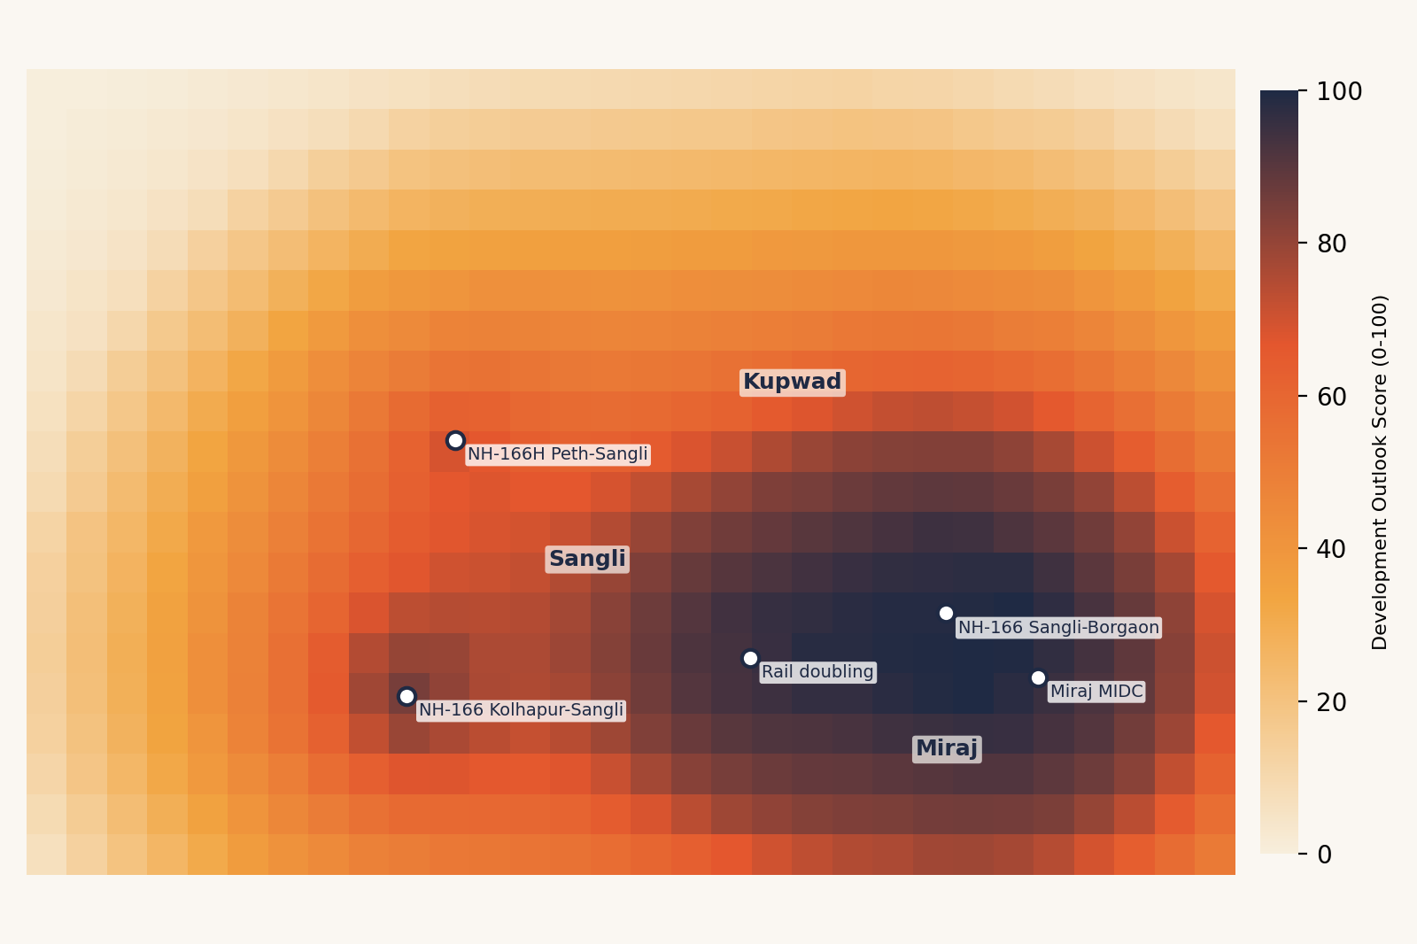
Prototype: Development Outlook Heatmap
HOW TO READ
Darker cells mean a higher outlook score.
Built from 5 real projects around Sangli-Miraj.
The peak near Miraj comes from the completed rail doubling, NH-166 and MIDC.
Scores will shift as more projects are added.

Slide 14
Prototype: Breakdown & Filters
Insert screenshot here
Insert screenshot here
Per-project score breakdown for a selected area
Stage and completion-year filters

Slide 15
Current Progress & SDG Alignment
DONE
DONE
IN PROGRESS
PLANNED
Scoring formula designed
Sangli grid prototype: heatmap, filters, breakdown
Verified project registry from official notices
Backend, database, testing and back-test
SDG 9 Industry, Innovation & Infrastructure
SDG 11 Sustainable Cities & Communities
Makes infrastructure plans visible and usable as open, structured data.
Supports informed, better-distributed urban growth decisions.

Slide 16
Project Timeline & Roles
W1
W2
W3
W4
W5
W6
W7
W8
W9
W10
W11
W12
W13
W14
Requirements & design
Project data registry
Scoring engine & backend
Frontend & heatmap
Testing, validation & report
Data & registry
Engine & backend
Frontend & map
Collect notices, record stage and year, verify coordinates.
Scoring formula, API, database, tests.
Heatmap, filters, breakdown view.
Week plan is indicative; adjust to your semester dates and assign one lead per role.

Slide 17
Risks & Limitations
RISK
RISK
Incomplete or outdated project data
Subjective weights
Mitigation: Record a source and date for every project; admin review before publishing.
Mitigation: Set weights with AHP and local experts; check with ±20% sensitivity and a back-test.
RISK
RISK
Delays or cancellations
Score read as a price forecast
Mitigation: Stage certainty and a delay penalty reduce the weight of uncertain projects.
Mitigation: Call it an outlook, never show rupee values, and add a clear disclaimer.

Slide 18
References & Data Sources
LITERATURE
DATA SOURCES (ACCESSED OCT 2026)
Rosen, S. (1974). Hedonic prices and implicit markets. Journal of Political Economy.
Debrezion, G., Pels, E., & Rietveld, P. (2007). The impact of railway stations on residential and commercial property value: a meta-analysis. J. of Real Estate Finance and Economics.
Bowes, D. R., & Ihlanfeldt, K. R. (2001). Impacts of rail transit stations on residential property values. J. of Urban Economics.
Saaty, T. L. (1980). The Analytic Hierarchy Process. McGraw-Hill.
Full details: PropTrack research paper.
NHAI tender 2026_NHAI_267662_1: 4-laning of Kolhapur-Sangli section, NH-166.
Indian Infrastructure (Feb 2024): Sangli-Miraj section of Pune-Miraj-Londa doubling commissioned.
Indian Infrastructure: Sangli-Borgaon 4-laning (NH-166) completion.
NBMCW (11 Jan 2023): Rs 1,130 cr sanctioned for Kolhapur-Sangli roads, NH-166H.
101Reporters (2026): Shaktipeeth Expressway in Sangli villages.
SMMMA: Sangli Miraj MIDC Industrial Area.
JSA (Jun 2026): MTAL Amendment Act, 2026; CCS: agricultural land laws in Maharashtra.
IGR Maharashtra: Annual Statement of Rates, FY 2026-27.

Slide 19
Outcomes & Future Scope
Deployed web app
Documented formula
Validation report
Map, score and breakdown
Explainable, tested scores
Sensitivity and back-test results
FUTURE SCOPE
01
Freelance scout network and on-ground verified listings
02
Travel-time distances and expressway access-point logic
03
Calibration with IGR transaction data and regression
04
Data/API access for portals, banks and NBFCs
05
Expansion to other Maharashtra cities
Thank you. Open for questions.

