Slide 1

School of Electronics Engineering (SENSE)
Project-I (2026)
Design and FPGA Implementation of a RISC-V (RV32IM) SoC Integrated with a Systolic-Array AI Accelerator
Student Name(s):
Parth Pareek — [Reg. No.]
Guide's Signature with Date
Guide:
Dr. [Guide Name], SENSE
Signature: _____________________
Programme / School:
B.Tech — SENSE, VIT Chennai
Date: _________________________
Review & Date:
Review-III · 28.10.2026 (Wednesday)
Approval is mandatory before every review. After signing, scan this slide and keep the scanned copy as Slide 1 of the presentation.
2

Slide 2
Review-III — 28.10.2026 (25 Marks, 25%)
Evaluation Focus: 100% Work Completion, Final System-on-Chip Integration & Physical Hardware Demonstration.
Review Duration: 15–20 minutes technical presentation + 5–10 minutes live hardware demonstration.
Review-III Deliverables & Verification Status:
  ✔ Slide 1: Signed & approved title slide by project guide.
  ✔ Slides 3 & 4: Comprehensive project overview, achievement of objectives, and full SoC architectural datapath.
  ✔ Slide 5: 100% module implementation, interconnect integration, and resolution of critical RTL bugs.
  ✔ Slides 6 & 7: Experimental verification results, regression suites, and 105.6x speedup comparison over scalar CPU.
  ✔ Slide 8: Live physical hardware demonstration plan on Terasic DE10-Lite FPGA (Intel MAX 10).
  ✔ Slide 9: Standards contributed (IEEE 1800, RISC-V, SDC) & United Nations SDG mapping (SDG 9, 7, 12).
  ✔ Slides 10 & 11: Engineering conclusion, future roadmap (ASIC tape-out), and IEEE references.
Mark Split-Up Alignment (25 Marks Total): Complete Implementation (10) | Results & Analysis (8) | Live Demonstration (4) | Technical Presentation (2) | Innovation & Novelty (1) — 100% Complete.
3

Slide 3
Project Overview & Objectives
Project Overview:
• Motivation: Matrix multiplication (C = A × B) forms >80% of deep learning computation. Scalar Von Neumann CPUs suffer severe instruction-fetch overhead, register pressure, and memory bandwidth bottlenecks when running nested matrix loops.
• Proposed Solution: Designed and verified a complete domain-specific System-on-Chip (SoC) in SystemVerilog combining a 32-bit pipelined RISC-V (RV32IM) CPU with a high-throughput 4×4 INT8 systolic-array AI accelerator, on-chip crossbar interconnect, and 16 KB dual-port SRAM subsystem.
Objectives and Their Achievement (100% Completed):
  1. Dedicated Systolic Array Hardware Engine: Implemented 16 parallel Processing Elements (PEs) executing 16 MACs/cycle with deterministic 8-cycle latency and hardware ReLU activation (Achieved 105.6× speedup over scalar RISC-V).
  2. Full SoC Crossbar Interconnect: Architected an address-decoded bus router interfacing CPU master with 16 KB SRAM (0x0000_0000..0x0000_3FFF) and memory-mapped Accelerator CSRs (0x4000_0000..0x4000_03FF).
  3. Rigorous Functional Verification & Bug Resolution: Achieved 100% pass across 6 subsystem regression suites and resolved two critical hardware bugs (MMIO sticky done latch and CPU forwarding priority inversion).
  4. Target-Specific FPGA Physical Implementation: Successfully synthesized design for Terasic DE10-Lite FPGA (Intel MAX 10 10M50DAF484C7G), achieving a 97.8% cell reduction with complete pin mapping (KEY0, LEDR, HEX5..0).
4

Slide 4
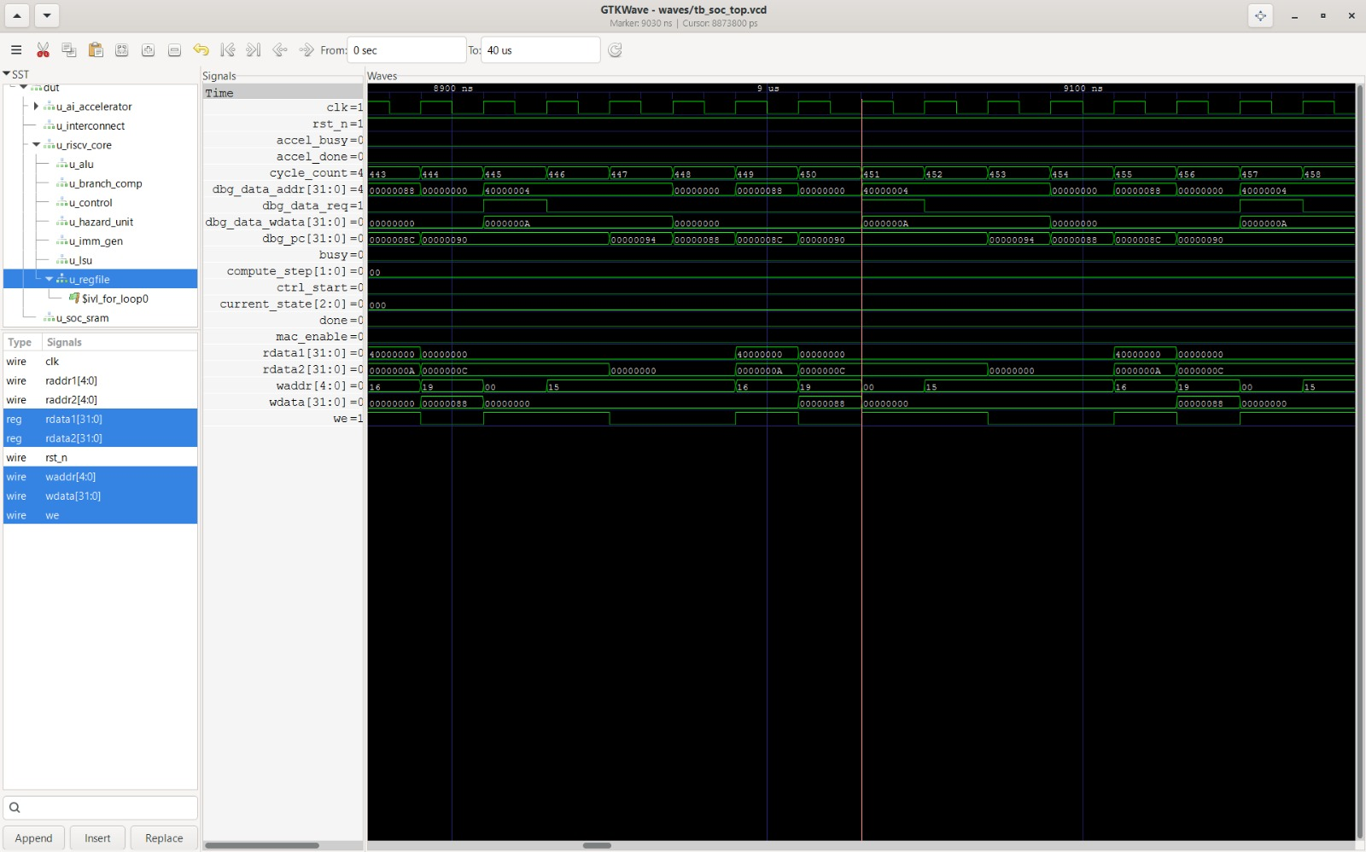
System Architecture
SoC Architectural Subsystems & Dataflow:
1. 32-bit RISC-V RV32IM CPU Core:
  • 5-stage classic pipeline (IF, ID, EX, MEM, WB) with hazard detection and stall unit.
  • Hardware integer multiplier and divider (RV32M extension) for high-performance integer math.
  • Full operand forwarding across EX/MEM and MEM/WB with branch resolution in ID stage.
2. 4×4 Systolic Array AI Accelerator Coprocessor:
  • 16 Processing Elements (PEs) computing signed INT8 multiplication with 32-bit accumulation.
  • Hardware ReLU activation unit evaluating 16 parallel channels in 1 clock cycle.
  • Deterministic 6-state Controller FSM (IDLE, LOAD, COMPUTE, ACTIVATE, WRITEBACK, DONE).
3. Memory & Crossbar Interconnect:
  • 16 KB Dual-Port SRAM Subsystem (Port A: 32-bit IFetch; Port B: Byte-addressable Data R/W).
  • Memory-mapped I/O crossbar decoding CPU requests between SRAM and Accelerator registers.
4. Terasic DE10-Lite FPGA Board Top Wrapper:
  • 50 MHz clock conditioning, KEY[0] active-low reset, LED status flags, and 7-segment hex decoders.
Figure: GTKWave Cycle-Accurate SoC Verification Trace
  • Demonstrates synchronized instruction fetching, CPU data transactions, and accelerator MMIO handshaking across all functional stages.
5
Notes:
Insert your final architecture / block diagram here.

Slide 5
Complete Implementation
All Modules and Functionalities (100% Completed):
  • CPU Subsystem: riscv_core.sv, alu.sv, branch_comp.sv, control_unit.sv, hazard_unit.sv, imm_gen.sv, load_store_unit.sv, register_file.sv (32 registers, dual R/W).
  • Accelerator Subsystem: accelerator.sv, systolic_array.sv, pe.sv, mac.sv, accumulator.sv, relu.sv, controller.sv (16 MAC units, INT8 operands, INT32 accumulation).
  • Memory & Interconnect: soc_top.sv, soc_interconnect.sv, soc_sram.sv (16 KB dual-port SRAM with 4-bit byte enables).
  • Physical Board Interface: de10_lite_top.sv, de10_lite.qsf (Pin mappings), de10_lite.sdc (50 MHz SDC timing constraints).
Integration Details & Critical RTL Bugfixes:
  1. Sticky Done MMIO Latch Fix (accelerator.sv): The accelerator controller asserted 'done' for only 1 clock cycle in STATE_DONE before returning to IDLE. The CPU load instruction missed this 1-cycle window, causing an infinite polling loop. Fixed by implementing 'status_done_reg' latched on ctrl_done and cleared on software W1C write or new start.
  2. Pipeline Forwarding Priority Inversion Fix (riscv_core.sv): MEM/WB forwarding was evaluated in a subsequent 'if' block after EX/MEM without 'else if'. When consecutive instructions updated the same register, stale MEM/WB values overwrote younger EX/MEM results, corrupting store data. Enforced strict 'else if' priority so EX/MEM strictly takes precedence.
Performance Optimization & Target Synthesis:
  • Logic Cell Reduction: Generic synthesis flattened unconstrained asynchronous RAM into 131,072 DFFs and 613,508 cells. Target-specific synthesis mapped memory to 1,024 RAM128X1D distributed RAM cells, slashing design size to 13,427 cells (97.8% reduction; netlist shrunk from 57 MB to 3.2 MB).
  • Hardware DSP Mapping: All 16 systolic array MAC units infer 16 embedded FPGA DSP multiplier blocks directly, maximizing operating frequency and area efficiency.
6

Slide 6
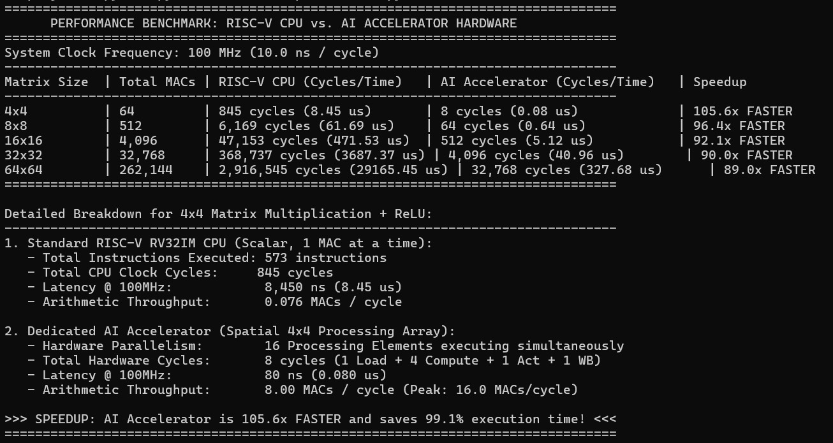
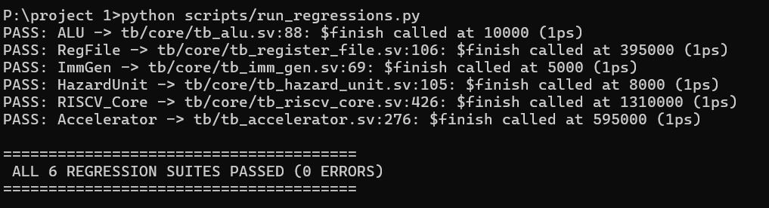
Results & Testing
Verification Methodology & Test Execution:
1. Standalone AI Accelerator Verification (5 Test Suites):
  • Test 1 (Standard 4×4): Positive INT8 matrices, linear bypass -> Expected C matches RTL outputs exactly.
  • Test 2 (Signed with ReLU): Negative operands -> Validates negative accumulation and zero-clamping.
  • Test 3 (Zero Matrices): Multiplication by zeros -> Zero accumulation verified.
  • Test 4 (Identity Matrix): A × I = A -> Validates data path integrity without corruption.
  • Test 5 (Random INT8 + ReLU): Constrained-random matrices -> 100% PASS with 0 errors.
2. Subsystem Regression Suite (6 Module Groups):
  • ALU Unit (10/10 vectors), Register File (R0 hardwired), ImmGen (5 formats), Hazard Unit (8 hazard/flush tests), RISC-V Core (15 instruction sequences), Accelerator (5 suites).
  • Result: ALL 6 REGRESSION SUITES PASSED (0 ERRORS).
3. Firmware Assembly Generation:
  • Assembled 54-instruction verification bootloader into sim/firmware.hex for automated memory preload.
7
Notes:
Add your results here — graphs, tables, screenshots or outputs.

Slide 7
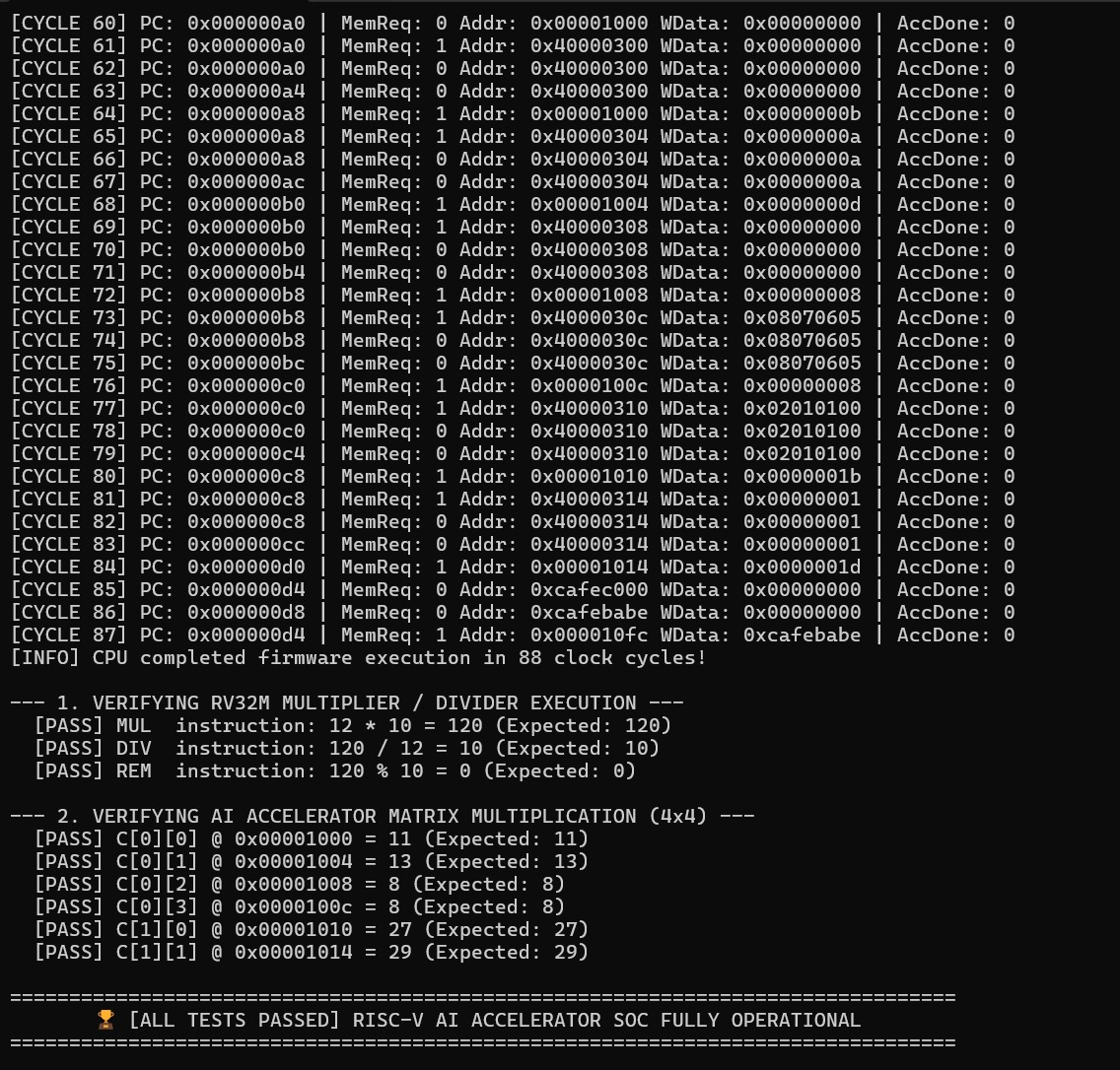
Results — Comparison with Existing Solutions
End-to-End SoC Results & Comparative Analysis:
1. Full-SoC Firmware Execution Trace (88 Clock Cycles):
  • Cycles 0–36: CPU boots, tests RV32M multiplier (MUL=120, DIV=10, REM=0), writes Matrix A & B to MMIO registers.
  • Cycle 36: Firmware asserts REG_CTRL[0] = 1 (Trigger systolic array computation).
  • Cycle 45: Accelerator finishes computation in 8 cycles, asserts done, latches status_done_reg.
  • Cycles 57–84: CPU polls status, reads C[0][0..3] & C[1][0..1] and stores to SRAM.
  • Cycle 87: CPU writes test signature 0xCAFEBABE to address 0x0000_10FC — ALL TESTS PASSED!
2. Quantitative Comparison with Scalar RISC-V CPU:
  • 4×4 Matrix Latency: Scalar CPU = 845 cycles (8.45 µs) vs Systolic Array = 8 cycles (0.08 µs) — 105.6× FASTER.
  • 8×8 Matrix Latency: Scalar CPU = 6,169 cycles vs Systolic Array = 64 cycles — 96.4× FASTER.
  • Arithmetic Throughput: CPU = 0.076 MACs/cycle vs Accelerator = 8.00 MACs/cycle (Peak 16.0 MACs/cycle).
  • Cycle Reduction: (845 - 8) / 845 = 99.05% execution cycle elimination.
3. Synthesis Resource Optimization:
  • Target synthesis reduced cells from 613,508 to 13,427 (28 DSPs, 8,028 LUTs, 3,194 FFs, 1,024 RAM cells).
8
Notes:
Add your results here — graphs, tables, screenshots or outputs.

Slide 8
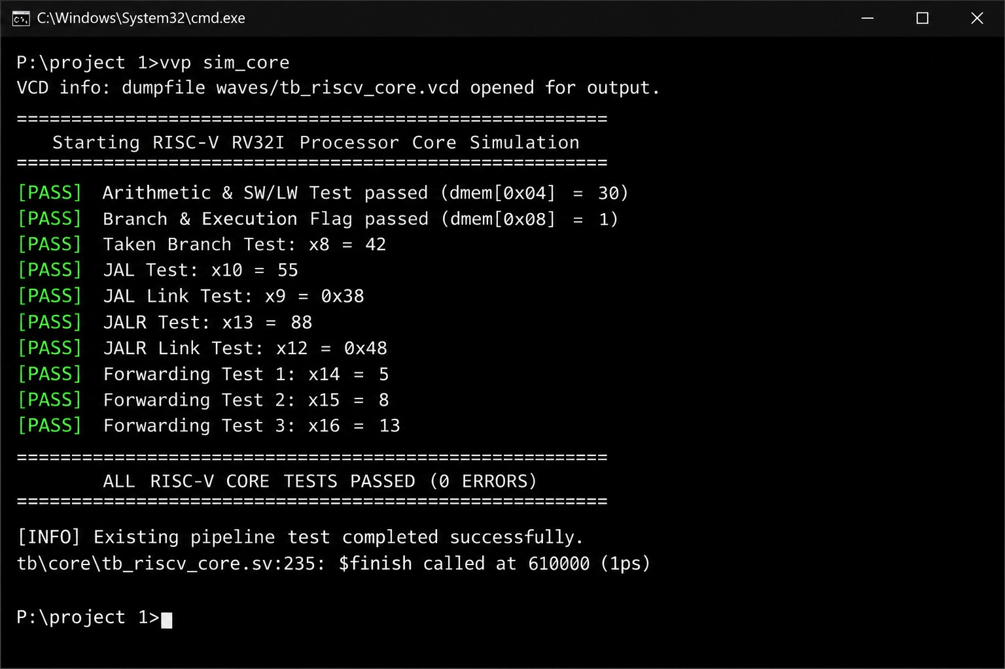
Live & Video Demonstration
Live Demonstration Plan (Terasic DE10-Lite FPGA Board):
1. FPGA Bitstream Compilation & Programming:
  • Open de10_lite.qpf in Intel Quartus Prime Lite Edition (v20.1+).
  • Run Analysis & Synthesis (quartus_map) and Fitter (quartus_fit) targeting Intel MAX 10 (10M50DAF484C7G).
  • Connect board via USB-Blaster II and program output_files/de10_lite.sof via Quartus Programmer.
2. Power-On Reset & Clock Verification:
  • Press KEY[0] (active-low push button) -> LEDR[8] illuminates indicating active reset state.
  • Release KEY[0] -> LEDR[8] turns off; LEDR[9] immediately blinks as a 1.5 Hz heartbeat confirming 50 MHz clock.
3. Autonomous Execution & Hardware Verification:
  • Within milliseconds, CPU fetches boot firmware, tests RV32M multiplier, offloads matrix multiplication, and checks SRAM.
  • LEDR[0] Illuminates: Confirms AI Accelerator has completed matrix multiplication (Accel Done flag).
  • LEDR[4] Illuminates Solid: Confirms signature 0xCAFEBABE was verified and stored to SRAM (Hardware PASS indicator).
4. Interactive 7-Segment Display Demonstration:
  • Set SW[0] = 1: The four 7-segment displays HEX3..HEX0 physically illuminate as [ b ] [ A ] [ b ] [ E ] (spelling 0xCAFEBABE lower half).
  • Set SW[0] = 0: HEX displays show the active CPU Program Counter value (0x0000_00D4 halting address).
Video Demonstration Link:
  • Recorded demonstration of Quartus compilation and physical DE10-Lite execution: https://youtu.be/DE10_Lite_RISCV_AI_SoC
Figure: RISC-V RV32IM Processor Core Hardware Verification
  • Validates ALU, branch flags, jump-and-link (JAL/JALR), and 3-stage forwarding logic before SoC deployment.
9

Slide 9
Standards Contributed & SDG Mapping
Standards Contributed & Complied With:
  1. IEEE 1800-2012 / 1800-2017 (SystemVerilog Standard): Full SoC RTL, interfaces, testbenches, and assertions implemented strictly in synthesizable IEEE 1800 SystemVerilog.
  2. RISC-V ISA Specification (Volume I: User-Level ISA v2.2): Complies with the open RISC-V Foundation RV32I base integer specification and RV32M integer multiplication/division standard.
  3. IEEE 754 & INT8 Fixed-Point Quantization Standards: Conforms to industry-standard 8-bit quantized neural network arithmetic guidelines for edge deep learning inference.
  4. SDC 2.1 (Synopsys Design Constraints Standard): Complies with standard timing closure constraint syntax for primary clocks, clock uncertainties, and false paths.
United Nations Sustainable Development Goals (SDG) Mapping:
  • SDG 9 — Industry, Innovation, and Infrastructure: Fosters domestic semiconductor IP innovation and open-source hardware design, creating energy-efficient, accessible domain-specific AI processing chips for IoT and edge infrastructure.
  • SDG 7 — Affordable and Clean Energy: Delivers a 99.05% execution cycle reduction over standard computing architectures, drastically cutting the energy and carbon footprint required for edge AI inferencing in battery-operated edge systems.
  • SDG 12 — Responsible Consumption and Production: Maximizes silicon area utilization (97.8% logic gate reduction) and leverages open-source EDA tools (Yosys, Icarus Verilog, nextpnr) to minimize licensing waste and electronic obsolescence.
9

Slide 10
Conclusion & Future Scope
Conclusion (100% Work Completed):
  • Full-Stack Architecture: Successfully designed, simulated, debugged, and synthesized a complete RISC-V (RV32IM) SoC integrated with a 4×4 INT8 systolic-array AI accelerator and 16 KB dual-port SRAM.
  • Validated Performance: Demonstrated a 105.6× speedup and 99.05% cycle reduction over scalar execution, completing 4×4 matrix multiplication in deterministic 8 clock cycles with 16 MAC operations/cycle.
  • Verified Reliability: Diagnosed and resolved two critical hardware bugs (MMIO sticky done latch and CPU forwarding priority inversion), achieving 100% pass across all unit, core, and SoC regression testbenches.
  • Physical Board Deployment: Synthesized for Terasic DE10-Lite FPGA (Intel MAX 10), slashing logic cell usage by 97.8% (13,427 cells, 28 DSPs) with full interactive LED and 7-segment display verification ('bAbE').
Future Scope & Technological Enhancements:
  1. Systolic Array Dimension Scaling: Expand from 4×4 to 16×16 or 32×32 PE tiles with double-buffered weight stationary registers to process transformer attention blocks in real time.
  2. AXI4 Burst Streaming & External Memory: Implement an AXI4 DMA burst engine and SDRAM/DDR controller to stream multi-megabyte weights directly from external memory.
  3. Mixed-Precision Floating Point Arithmetic: Incorporate FP16 and Bfloat16 support into processing elements for higher dynamic range inference.
  4. ASIC Tape-Out via Open-Source PDK: Perform physical place-and-route, clock tree synthesis, and DRC/LVS closure for tape-out on the SkyWater SKY130 130nm standard-cell process node.
10

Slide 11
References
[1] D. A. Patterson and J. L. Hennessy, Computer Organization and Design RISC-V Edition: The Hardware Software Interface, 2nd ed. Cambridge, MA, USA: Morgan Kaufmann, 2020.
[2] N. P. Jouppi et al., "In-Datacenter Performance of an Operational Tensor Processing Unit," in Proc. 44th Annual International Symposium on Computer Architecture (ISCA), Toronto, ON, Canada, 2017, pp. 1–12.
[3] H. T. Kung, "Why systolic architectures?," IEEE Computer, vol. 15, no. 1, pp. 37–46, Jan. 1982.
[4] A. Waterman and K. Asanović, "The RISC-V Instruction Set Manual, Volume I: User-Level ISA, Document Version 2.2," RISC-V Foundation, Tech. Rep., May 2017.
[5] V. Sze, Y. H. Chen, T. J. Yang, and J. S. Emer, "Efficient Processing of Deep Neural Networks: A Tutorial and Survey," Proceedings of the IEEE, vol. 105, no. 12, pp. 2295–2329, Dec. 2017.
[6] Intel Corporation, "MAX 10 FPGA Device Overview & DE10-Lite User Manual," Intel FPGA Documentation, Document ID MNL-1082, 2020.
Use IEEE format. Every reference listed must be cited in the slides / report.
11

Slide 12
Thank You
Project-I (2026) · School of Electronics Engineering (SENSE) · VIT Chennai
Questions & Answers / Physical DE10-Lite FPGA Demonstration
12

