Slide 1
EDUCOMPILER
Simulator for Exploring Different Phases of Compiler
By:
Team Name: TechFreaks
Team Id : CD-VI-T083

Slide 2
Introduction to the Compiler Phase Simulator
Language used:
Implementation language :- C++
Chosen for its performance efficiency and close-to-hardware control, ideal for system-level simulation.
Objective:
Focus on enhancing understanding of compiler design
Aims to provide learners with practical insights into how different compiler phases function.
Features:
Interactive exploration of compiler phases
Users can simulate and observe each phase, encouraging active learning through hands-on experimentation.

Slide 3
Roles and Responsibilities
Language used:
Implementation language :- C++
Chosen for its performance efficiency and close-to-hardware control, ideal for system-level simulation.
Objective:
Focus on enhancing understanding of compiler design
Aims to provide learners with practical insights into how different compiler phases function.
Features:
Interactive exploration of compiler phases
Users can simulate and observe each phase, encouraging active learning through hands-on experimentation.

Slide 4
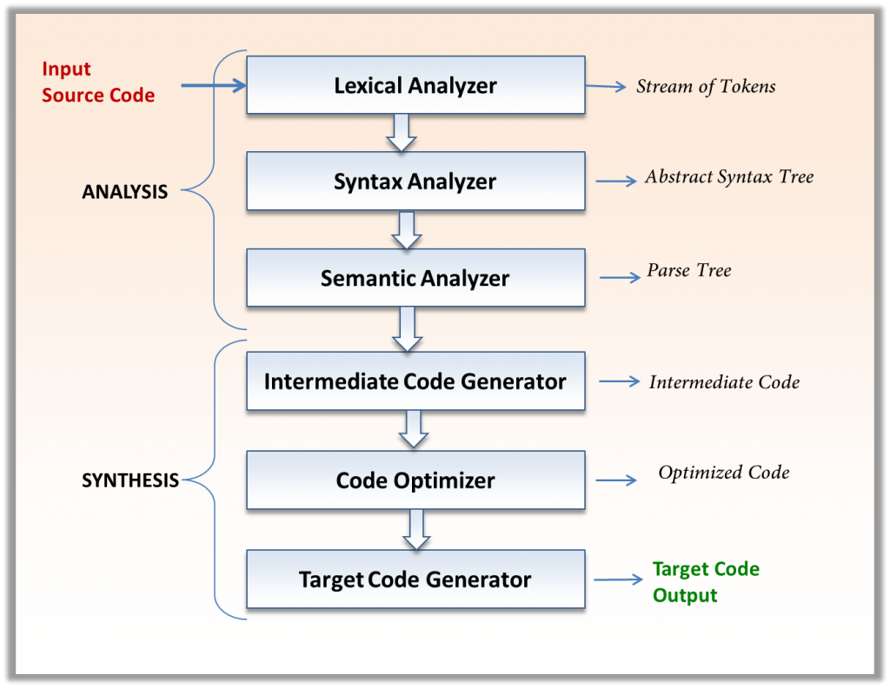
Overview of Compiler Phases
The simulator covers the following key phases of a compiler:
Lexical Analysis
Parsing
Semantic Analysis
Intermediate Code Generation

Slide 5

Lexical Analysis Phase
The Lexical Analysis phase is responsible for converting a sequence of characters into tokens. The simulator represents this phase by allowing users to visualize token generation from input code.

Slide 6

Parsing Phase
The Parsing phase analyzes the token sequence to determine its grammatical structure. The simulator enables users to interact with this phase, showcasing how syntax trees are constructed from tokens.

Slide 7

Semantic Analysis Phase
The Semantic Analysis phase checks for semantic errors and ensures that the program's meaning is correct. The simulator facilitates understanding by providing visual feedback on semantic checks performed during this phase.

Slide 8

Intermediate Code Generation Phase
The Intermediate Code Generation phase translates the parsed and semantically checked code into an intermediate representation. The simulator showcases this process, illustrating how high-level constructs are transformed into lower-level code.

Slide 9

Features of the Simulator
Unique Features:
Modularity: Each phase is developed independently, allowing for focused learning.
CLI-based Interaction: Users can interact with the simulator through a command-line interface.
Visual Output: Each phase provides visual representations to enhance understanding.

Slide 10
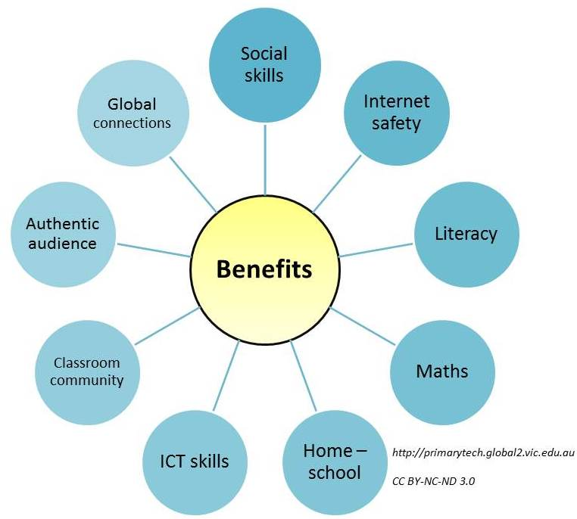
Educational Benefits
The simulator offers several educational benefits:
Incremental Testing: Students can test their understanding phase by phase.
Bridging Theory with Practice: It helps connect theoretical concepts with practical application in compiler construction.

Slide 11

Conclusion and Future Work
In summary, the Compiler Phase Simulator significantly impacts compiler design education by providing an interactive learning tool. Future enhancements may include additional features and support for more complex language constructs, further enriching the educational experience.

