Slide 1
Predicting Accident Severity

Slide 2
Introduction
Road accidents have become very common these days. Nearly 1.25 million people die in road crashes each year, on average, 3,287 deaths a day. Moreover, 20–50 million people are injured or disabled annually. Road traffic crashes rank as the 9th leading cause of death and accounts for 2.2% of all deaths globally. Road crashes cost USD 518 billion globally, costing individual countries from 1–2% of their annual GDP. In the USA, over 37,000 people die in road crashes each year, and 2.35 million are injured or disabled. Road crashes cost the U.S. $230.6 billion per year or an average of $820 per person. Road crashes are the single greatest annual cause of death of healthy U.S. citizens travelling abroad.

Slide 3
Target Audience
1. The Seattle administration: By targeting areas prone to areas to speeding
accidents, interventions such as speed bumps, stop signs etc. can be put in place
to reduce accidents.
2. Car Insurance Companies: Areas where parked cars are prone to getting
damaged. Owners in those localities may be asked to pay more premium on their
car insurance.
3. Health-care workers and emergency services in Seattle: By having enough data
on the crash one can predict the severity and therefore take action more quickly
potentially saving lives

Slide 4
Data Sources
This data set was obtained from kaggle . This is a countrywide traffic accident dataset which covers 49 states of United States. The data is continuously being collected from various APIs like Bing and MapQuest from last 5 years. These APIs broadcast traffic events captured by a variety of entities, such as the US and state departments of transportation, law enforcement agencies, traffic cameras, and traffic sensors within the road-networks. This dataset contains about 3.5 million of rows and 49 columns.

Slide 5
Features of Dataset
Traffic Attributes (12):
1. ID: This is a unique identifier of the accident record
2. Source: Indicates source of the accident report (i.e. the API which reported
the accident.)
3. TMC: A traffic accident may have a Traffic Message Channel (TMC) code
which provides more detailed description of the event
4. Severity: Shows the severity of the accident, a number between 1 and 4,
where 1 indicates the least impact on traffic (i.e., short delay as a result of
the accident) and 4 indicates a significant impact on traffic (i.e., long delay).
5. Start_Time: Shows start time of the accident in local time zone.
6. End_Time: Shows end time of the accident in local time zone.
7. Start_Lat: Shows latitude in GPS coordinate of the start point.
8. Start_Lng: Shows longitude in GPS coordinate of the start point.
9. End_Lat: Shows latitude in GPS coordinate of the end point.
10. End_Lng: Shows longitude in GPS coordinate of the end point.
11. Distance(mi): The length of the road extent affected by the accident.
12. Description: Shows natural language description of the accident

Slide 6
Address Attributes (9):
1. Number: Shows the street number in address field.
2. Street: Shows the street name in address field.
3. Side: Shows the relative side of the street (Right/Left) in address field.
4. City: Shows the city in address field.
5. County: Shows the county in address field.
6. State: Shows the state in address field.
7. Zipcode: Shows the zipcode in address field.
8. Country: Shows the country in address field.
9. Timezone: Shows timezone based on the location of the accident (eastern,
central, etc.).

Slide 7
Weather Attributes (11):
1. Airport_Code: Denotes an airport-based weather station which is the closest
one to location of the accident.
2. Weather_Timestamp: Shows the time-stamp of weather observation record
(in local time).
3. Temperature(F): Shows the temperature (in Fahrenheit).
4. Wind_Chill(F): Shows the wind chill (in Fahrenheit).
5. Humidity(%): Shows the humidity (in percentage).
6. Pressure(in): Shows the air pressure (in inches).
7. Visibility(mi): Shows visibility (in miles).
8. Wind_Direction: Shows wind direction.
9. Wind_Speed(mph): Shows wind speed (in miles per hour).
10. Precipitation(in): Shows precipitation amount in inches, if there is any.
11. Weather_Condition: Shows the weather condition (rain, snow, thunderstorm,
fog, etc.).

Slide 8
POI Attributes (13):
1. Amenity: A Point-Of-Interest (POI) annotation which indicates presence of
amenity in a nearby location.
2. Bump: A POI annotation which indicates presence of speed bump or hump in
a nearby location.
3. Crossing: A POI annotation which indicates presence of crossing in a nearby
location.
4. Give_Way: A POI annotation which indicates presence of give_way sign in a
nearby location.
5. Junction: A POI annotation which indicates presence of junction in a nearby
location.
6. No_Exit: A POI annotation which indicates presence of no_exit sign in a
nearby location.
7. Railway: A POI annotation which indicates presence of railway in a nearby
location.
8. Roundabout: A POI annotation which indicates presence of roundabout in a
nearby location.
9. Station: A POI annotation which indicates presence of station (bus, train, etc.)
in a nearby location.
10. Stop: A POI annotation which indicates presence of stop sign in a nearby
location.

Slide 9
11. Traffic_Calming: A POI annotation which indicates presence of traffic_calming
means in a nearby location.
12. Traffic_Signal: A POI annotation which indicates presence of traffic_signal in a
nearby location.
13. Turning_Loop: A POI annotation which indicates presence of turning_loop in
a nearby location.

Slide 10
Period-of-Day (4):
1. Sunrise_Sunset: Shows the period of day (i.e. day or night) based on
sunrise/sunset.
2. Civil_Twilight: Shows the period of day (i.e. day or night) based on civil
twilight.
3. Nautical_Twilight: Shows the period of day (i.e. day or night) based on
nautical twilight.
4. Astronomical_Twilight: Shows the period of day (i.e. day or night) based on
astronomical twilight.

Slide 11
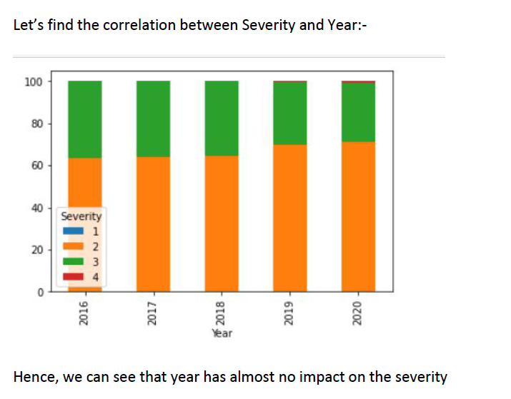

Slide 12
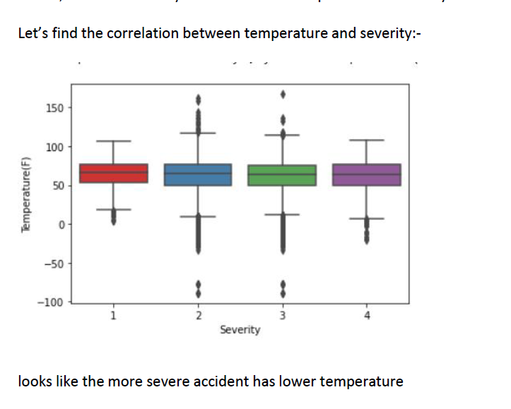

Slide 13
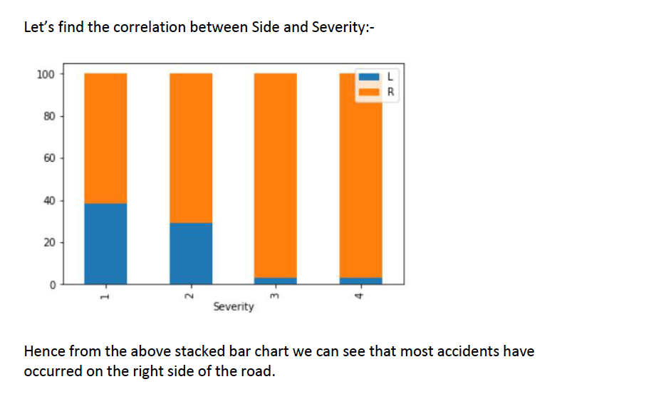

Slide 14
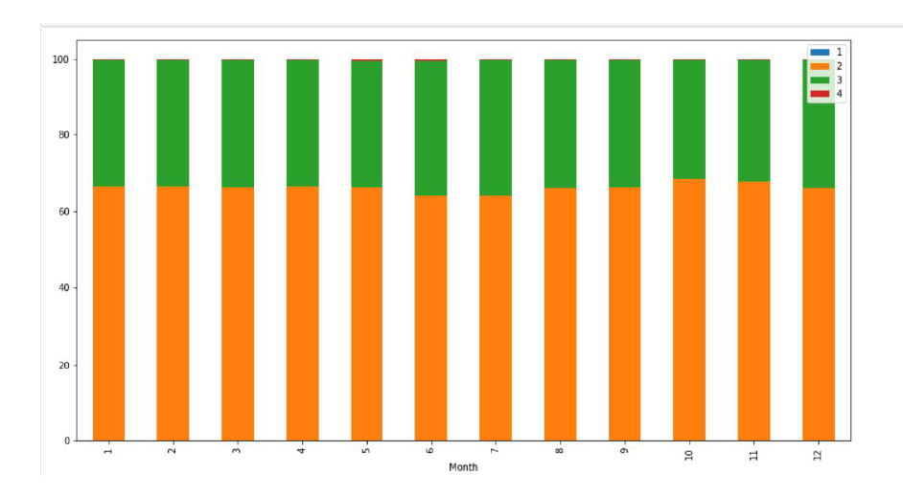
Let's find a correlation between month and severity

Slide 15
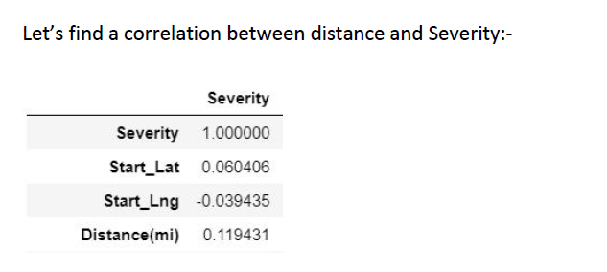

Slide 16
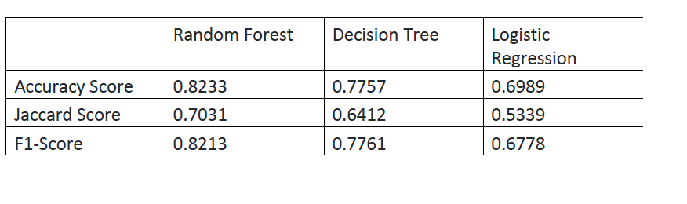

Slide 17
Conclusion
In this study, I analyzed the relationship between Severity of the Accidents and the
various independent variables like Wind_Speed, Start_Lat, etc. to predict the
accident severity using a classification model (i.e. Random Forest). This would help
U.S. government to improve the traffic conditions from the relationships described
in this report.

