Slide 1
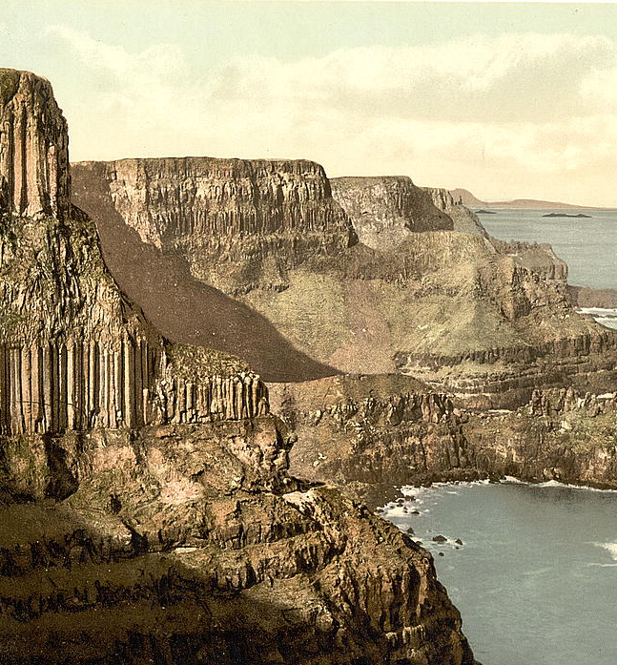

PYTHON COURSE MODULE: 15 & 19
A Discussion on Machine Learning, GeoDataFrames and Git Workspace
Flax & Teal 2024

Slide 2
Agenda
1 Introductions (Module 15 and 19)
2 Methods of Iris, Carparking, Git
3 Outputs of Iris, Carparking, Git
Flax & Teal 2024

Slide 3
MODULE 15
Part I: Enhancing Model Evaluation with Cross-Validation
Overview: The Iris dataset is a famous dataset, consisting of 150 samples of iris flowers with measurements of petal and sepal.
Using an SVM classifier on the Iris dataset we classify the species of iris flowers based on their features.
Objective:
Transition from using a single train-test split to cross-validation for more reliable model performance.
Part II: Creating and Plotting GeoDataFrames in Python
Overview:
Mapping car park locations from the given data which contains 30 carparking area and finding the nearest car parks to a target location with the help of NearestNeighbors.
Objective:
To convert car park data into a GeoDataFrame, visualize it on an interactive map, and perform proximity analysis.
Flax & Teal 2024

Slide 4
MODULE 19
Introduction:
We explored Git version control by initializing a repository and making an initial commit. We managed branches to handle new features and bug fixes, using commands like: git add, git commit, and git merge for changes.
Tools like git log and git diff helped us track and review modifications. Git graph visualizations and empty commits were used to represent project objectives. Finally, we refined the project structure through branch management and deletions to maintain a clean Git history.
Objective:
Demonstrate version control and branch management using Git. Initial setup of Git repository. Branch creation and management. Handling merge conflicts and hotfixes. Visualization of Git branches.
Flax & Teal 2024

Slide 5

Method for Iris
Implementing CrossValidation in Python
Data Preparation:
Ensuring the dataset is available and loading it using pandas. Reordering data to ensure randomness
Splitting features and target variables.
Train-Test Split:
Using train_test_split to divide the dataset into training and testing sets.
Model Training:
Fitting the SVM model on the training data.
Cross-Validation:
Importing cross_val_score from scikit-learn.
Performing 5-fold cross-validation.
Flax & Teal 2024

Slide 6
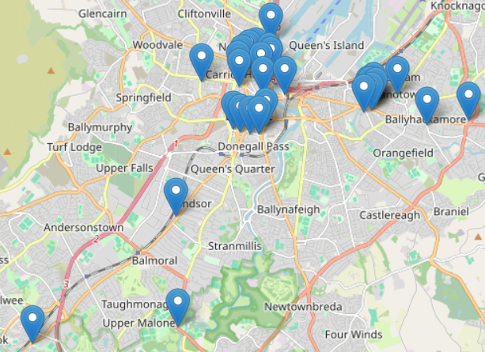
Method for Carpark
Creating and Plotting GeoDataFrames in Python
Data Preparation:
After importing car park data we convert the DataFrame to GeoDataFrame using GeoPandas. Then we define the coordinate reference system (CRS).
Proximity Analysis:
Extracting coordinates from GeoDataFrame.
Using sklearn’s NearestNeighbors to find the closest car parks to a target location.
Calculating and comparing distances between the target and car park locations.
Visualization:
Creating an interactive map centered on a specific location using Folium. Then we add GeoDataFrame data to the map as GeoJson features.
We save the map to an HTML file.
Flax & Teal 2024

Slide 7
Methods in Git
Initializing a Git Repository and Creating Initial Commit: We set up a new Git repository and create an initial empty commit.
Configuring User Information: We also set global Git configuration for user our email and name.
Creating a New Branch and Switching to It: We create a new branch for feature development and switch to it.
Adding a New Function and Committing Changes: We add a new function to a file, stage the changes, and commit them.
Merging Branches: We merged changes from a hotfix branch back into the master branch.
Visualizing the Git Graph: We generated a visual representation of the Git commit history by git tree.
Checking the Git Log: Displaying a concise one-line log of commit history.
Creating Empty Commits to Represent Points: Creating empty commits to represent specific milestones in the project history such as railway stations in the last exercise.
Flax & Teal 2024

Slide 8
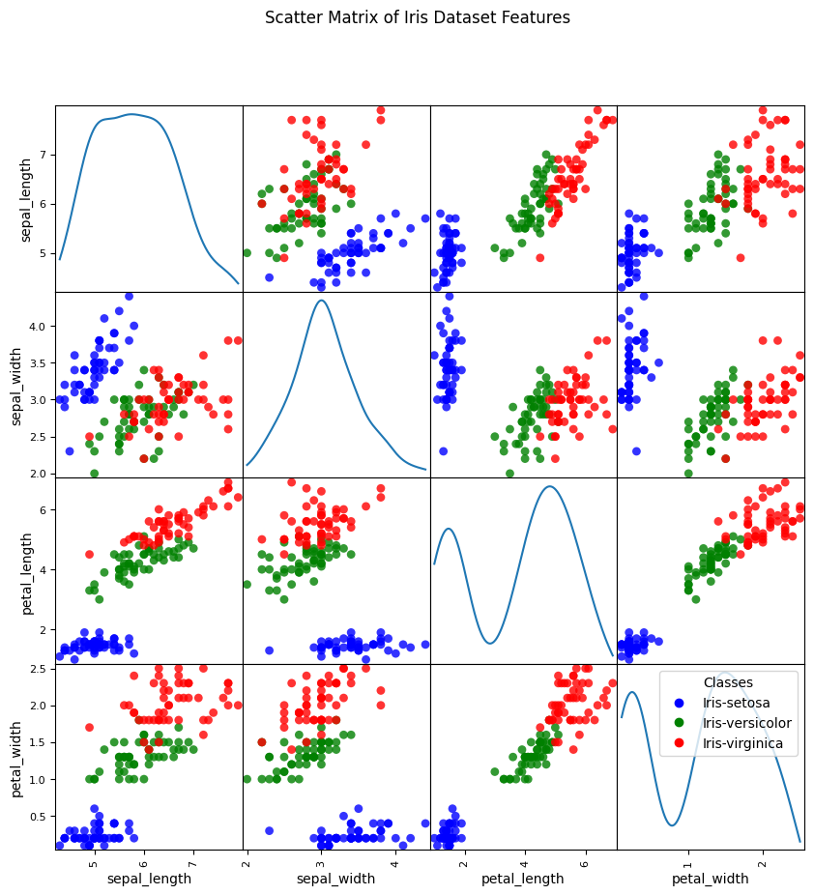
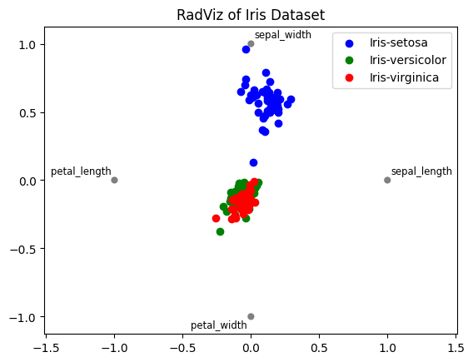
Outputs of Iris
Evaluating model performance
Cross-Validation Scores:
Cross-validation scores: [1. 0.97 0.97 0.97 1. ]
Mean cross-validation score: 0.982
Predicted Class for Sample:
sample = [4.7, 3.4, 1.1, 0.2]
Predicted class for sample
[4.7 3.4 1.1 0.2]: ['Iris-setosa’]
Flax & Teal 2024

Slide 9
Outputs of Carpark
Proximity and Visualization
Proximity Results:
Findings: List of closest car parks to the target location(CompSc. Building 54.5817428, -5.9374874) with relative distances.
Example Output:
Little Victoria Street Car Park is 0.0 percent further than the closest
Hope Street North Car Park is 0.7249818690664878 percent further than the closest
Bankmore Street Car Park is 11.254672797977605 percent further than the closest
Charlotte Street Car Park is 28.92573554717646 percent further than the closest
Interactive Map:
An HTML file displaying an interactive map with car park locations marked.
Features: Zoom functionality, ability to click on markers for more information.
Flax & Teal 2024

Slide 10
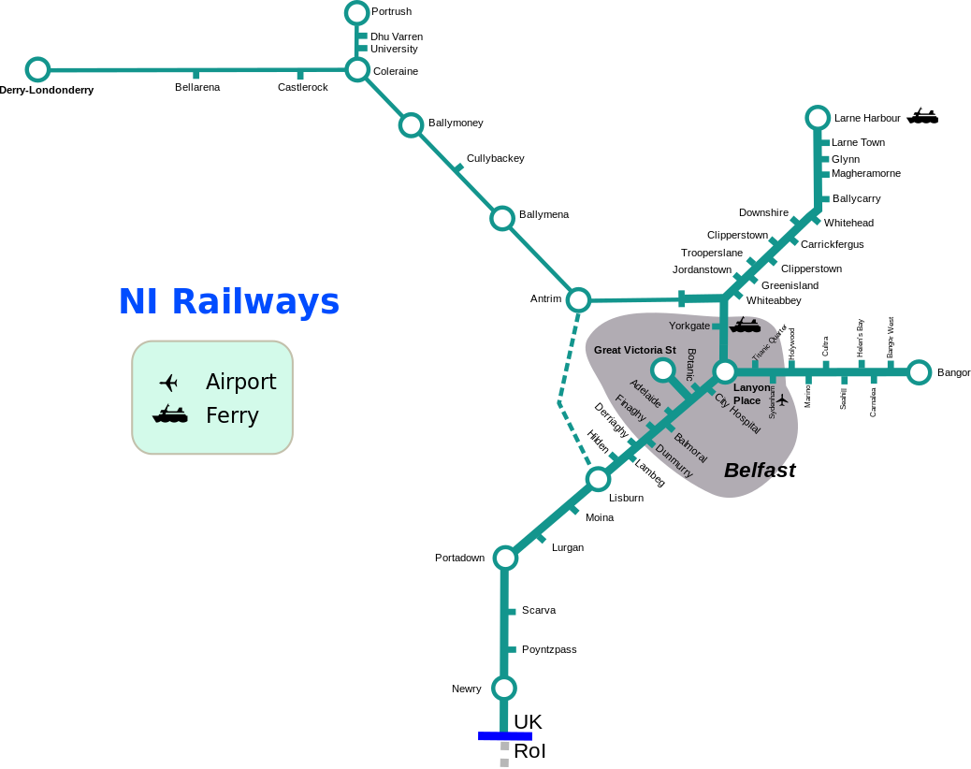
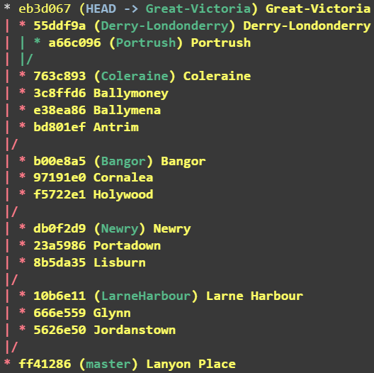
Outputs of Git
Gitgraph Visualization
Flax & Teal 2024

Slide 11
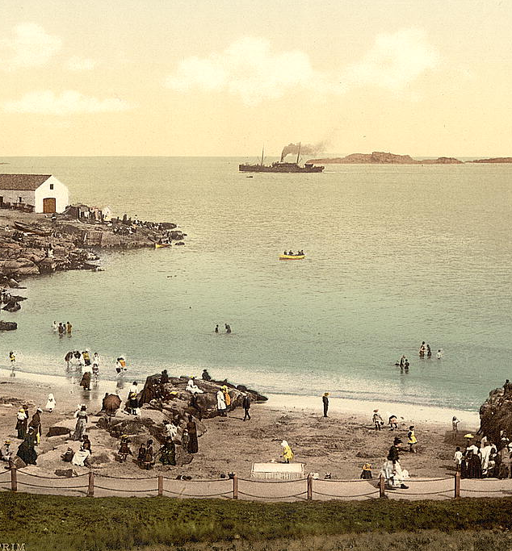
Thank you
Flax & Teal 2024

