Slide 1
VALUE ADDED COURSE PROJECT
AI Data Cleaning Assistant with Python
From messy CSV / Excel to analysis-ready data, with every change explained
Periyannan Ratish N · B.Tech AI & Data Science (III Year)
Dhanalakshmi College of Engineering
Notes:
Introduce yourself and the project: a tool that cleans messy tabular data automatically and explains every change.

Slide 2
Real-world data is messy
Duplicates
Placeholders
Wrong types
27 duplicate rows, some only visible after tidying spaces
'N/A', 'null', '-' and '?' hiding as real values
Salary as 'Rs. 31,499', dates in 4 formats
Spelling noise
Bad values
No audit trail
25 spellings of 6 cities (chennai, CHENNAI, Chenai)
Ages 250 and -5, invalid e-mails, extra spaces
Manual fixes in Excel can't be reviewed or repeated
1
Notes:
Six typical problems that were deliberately injected into the 428-row demo dataset.

Slide 3
Profile, recommend, clean, explain
1
2
3
4
5
Upload
Profile
Recommend
Clean
Audit
CSV or Excel file
Rows, gaps, duplicates, quality score
AI suggests which fixes to run
13-step configurable pipeline
Change log + download
Three interfaces, one engine: Streamlit dashboard, command-line tool and a tested Python library.
2
Notes:
The workflow a user follows in the web app.

Slide 4
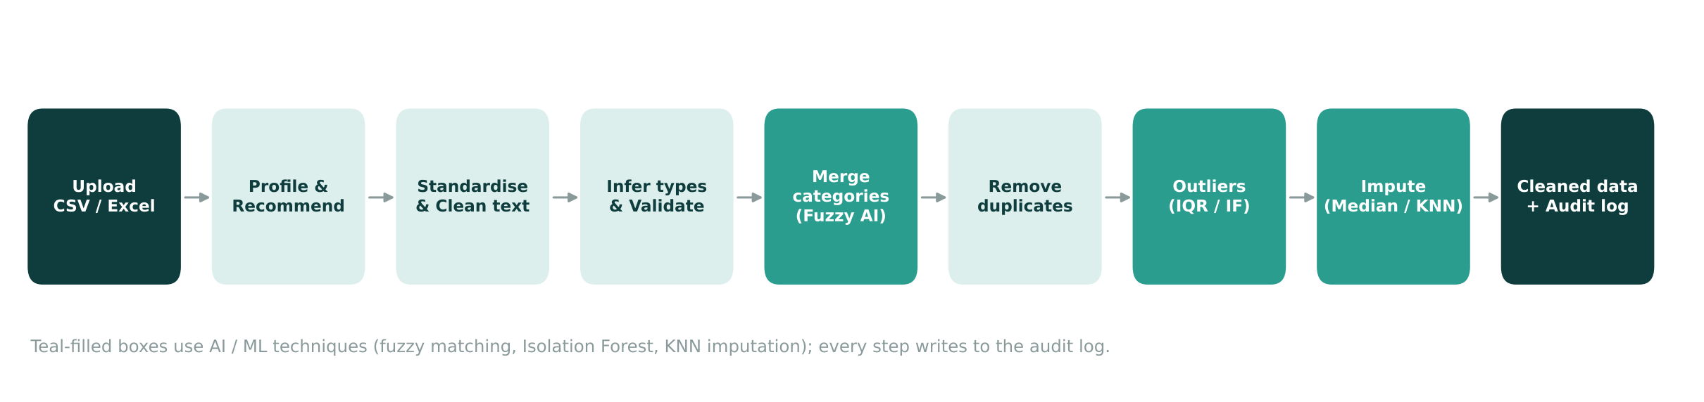
Architecture: small steps, one audit log
cleaning.py holds 15 small, independently tested functions
app.py and clean_cli.py are thin front-ends on the same engine
Teal boxes use AI / ML techniques; all steps write to the log
3
Notes:
Each step is a pure function returning the new DataFrame plus log entries, so it is easy to test.

Slide 5
Where the AI is
Fuzzy matching
Type inference
difflib merges near-duplicate labels: 'Chenai' becomes 'Chennai', but Male and Female stay apart
Detects numbers, dates and booleans hidden in text, including currency symbols
KNN imputation
Isolation Forest
scikit-learn fills numeric gaps from the 5 most similar rows
Finds multivariate outliers that per-column rules miss
Plus a recommendation engine that reads the data profile and suggests which steps to enable.
4
Notes:
Rules handle the obvious fixes; ML handles fuzzy judgement.

Slide 6
What a fix looks like
Problem | Before | After
Currency text | Rs. 31,499 | 31499
Mixed date format | 15-10-2019 | 2019-10-15
Placeholder | null | Chennai (most common city)
Boolean text | Yes / N | True / False
Extra spaces | Suresh Menon | Suresh Menon
Spelling variant | CHENNAI, chennai, Chenai | Chennai
5
Notes:
Real rows from the demo dataset, before and after cleaning.

Slide 7
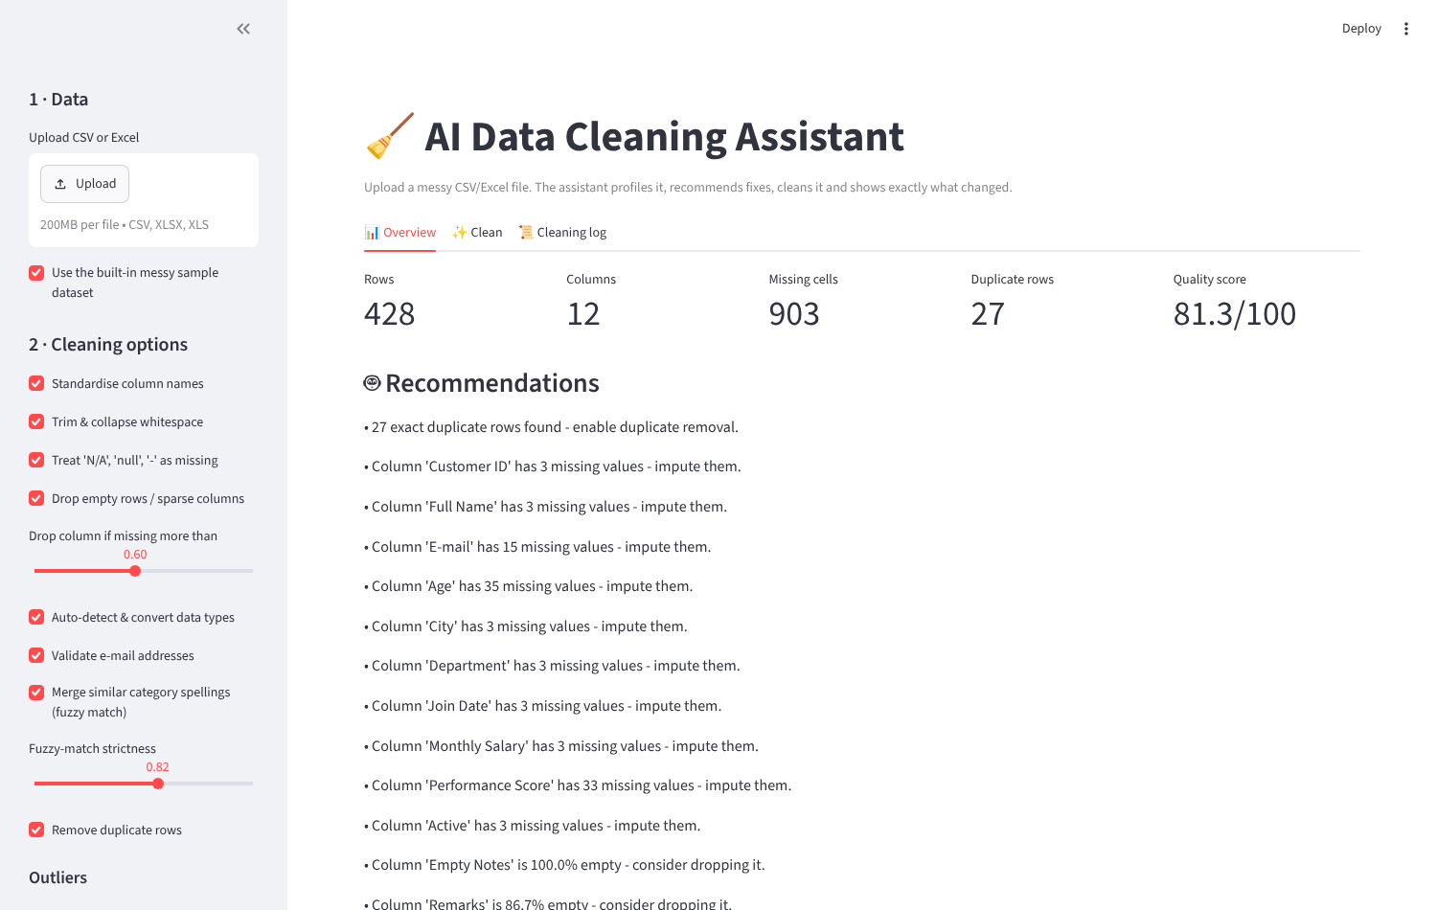
Overview tab: diagnose first
428 rows, 903 missing cells, 27 duplicates
Quality score 81.3 / 100
Plain-English recommendations for each issue
Sidebar exposes every cleaning option
6
Notes:
Live demo: show the overview tab.

Slide 8
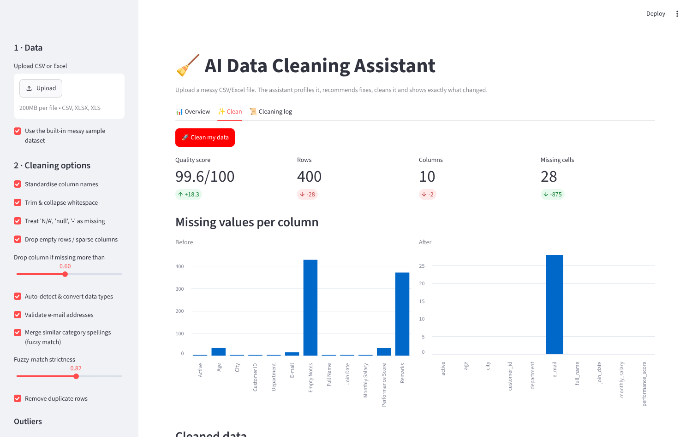
Clean tab: one click
Quality score up 18.3 points
Missing cells down by 875
Before/after charts per column
Download CSV, Excel with log, or log CSV
7
Notes:
Live demo: press Clean my data.

Slide 9
Results on the demo dataset
81.3 → 99.6
903 → 28
Quality score (out of 100)
Missing cells
27 → 0
25 → 7
Duplicate rows
Distinct city spellings
8
Notes:
Quality score combines completeness, uniqueness and type consistency.

Slide 10
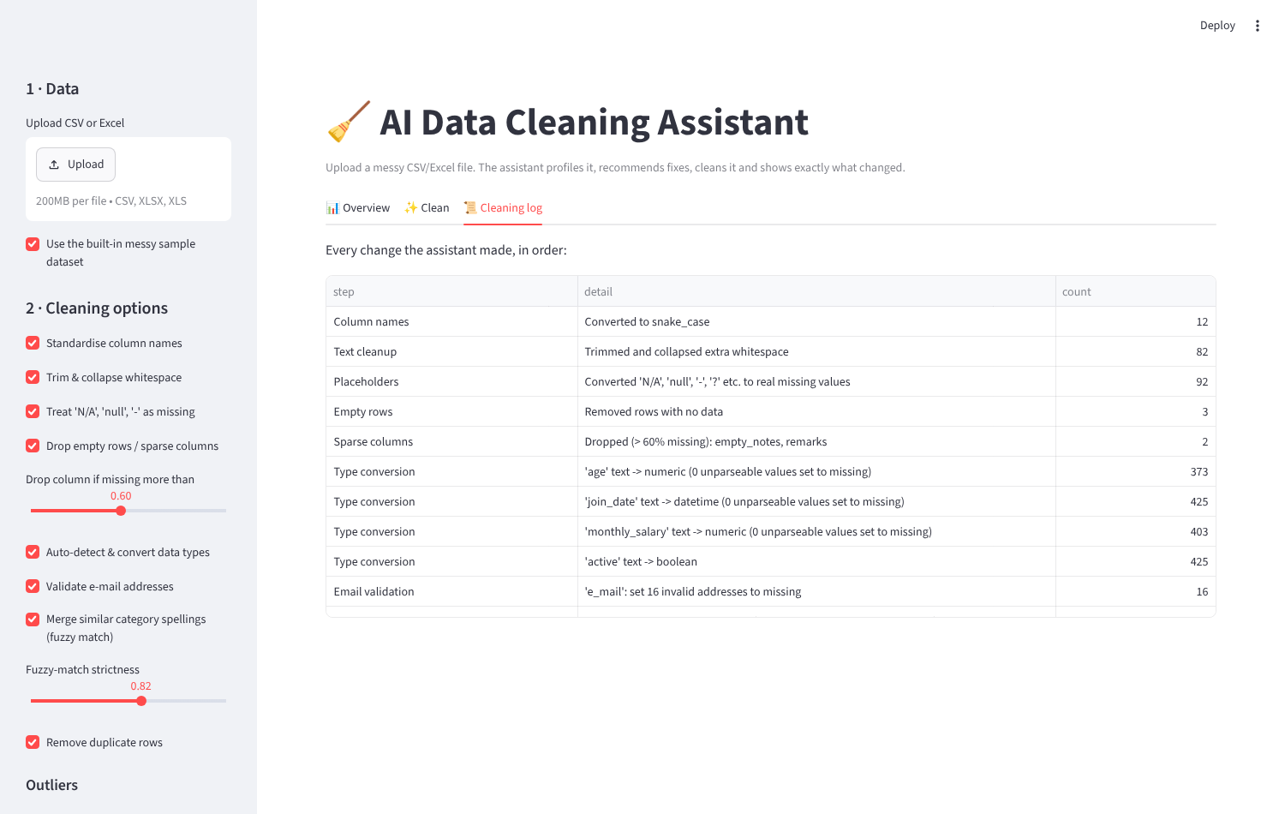
Every change is logged
Step, detail and count for each operation
92 placeholders, 373 ages converted, 16 bad e-mails flagged
Makes the cleaning reviewable and repeatable
Exported inside the Excel download
9
Notes:
Transparency is the key difference from manual cleaning.

Slide 11
Tested, not just demonstrated
Column naming and placeholder handling
15 / 15
Currency to number and date parsing
Fuzzy merge keeps Male and Female apart
automated tests passing
E-mail validation, range rules, outliers
Duplicates found after normalisation
App launches and cleans without errors
10
Notes:
15 pytest tests in tests/, including one that drives the Streamlit app end to end.

Slide 12
Limitations and future scope
Limitations
Future scope
Synonyms (Bengaluru = Bangalore) need the manual-replacement box.
Ambiguous dates like 04/05/2024 are read day-first.
Data is processed in memory, so very large files should use the CLI.
LLM-assisted suggestions for synonyms and column meaning.
Database, JSON and chunked (Dask) support.
Save and re-apply a cleaning recipe to new files.
11
Notes:
Be honest about limits; show you know where to go next.

Slide 13
Conclusion
Routine data preparation can be automated safely when every change is explained.
Quality score 81.3 → 99.6 on the demo data
Fuzzy matching, KNN and Isolation Forest combined with transparent rules
Streamlit app, CLI and 15 tests delivered
Thank you · Questions?

