Slide 1

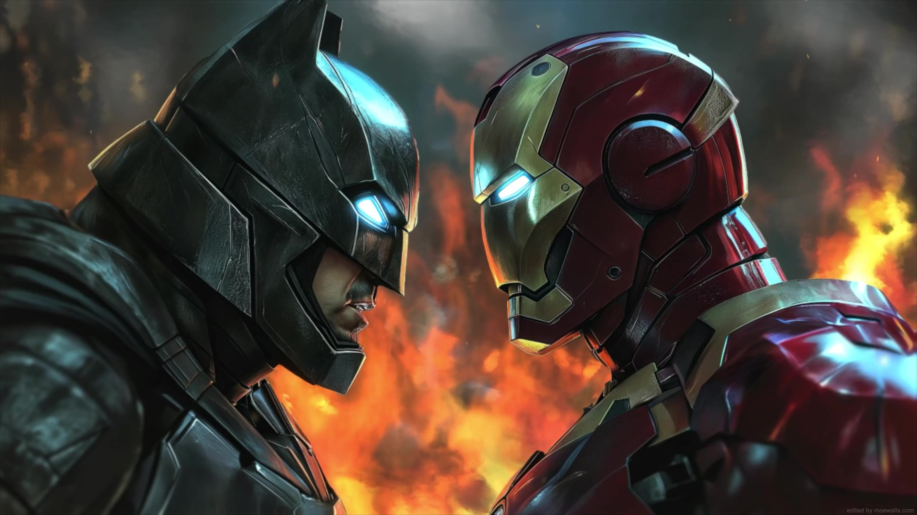

Slide 2

Controlling of electron.
Revolutionize modern world.
Two types:
  Analog Electronics
  Digital Electronics
Replaced mechanical systems & made simple.
1746 – Leyden Jar – Pieter Van Musschenbroek ( Dutch Physicist )

Slide 3
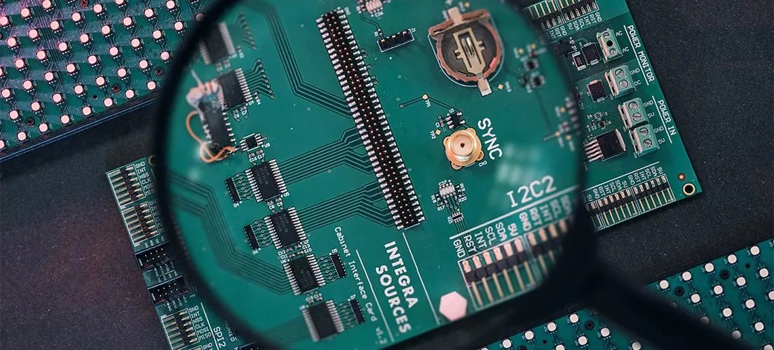
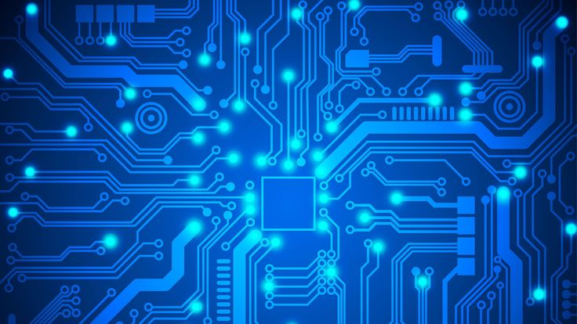

Slide 4


Slide 5
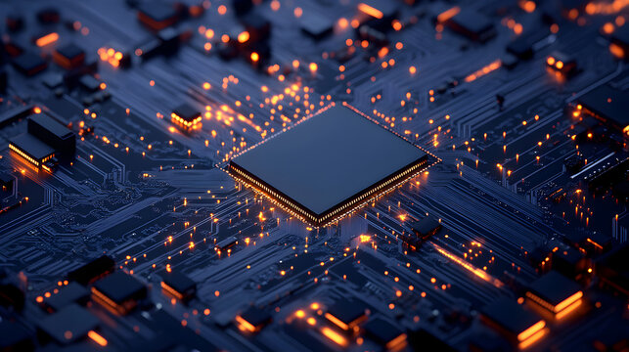
What Actually ?

Slide 6
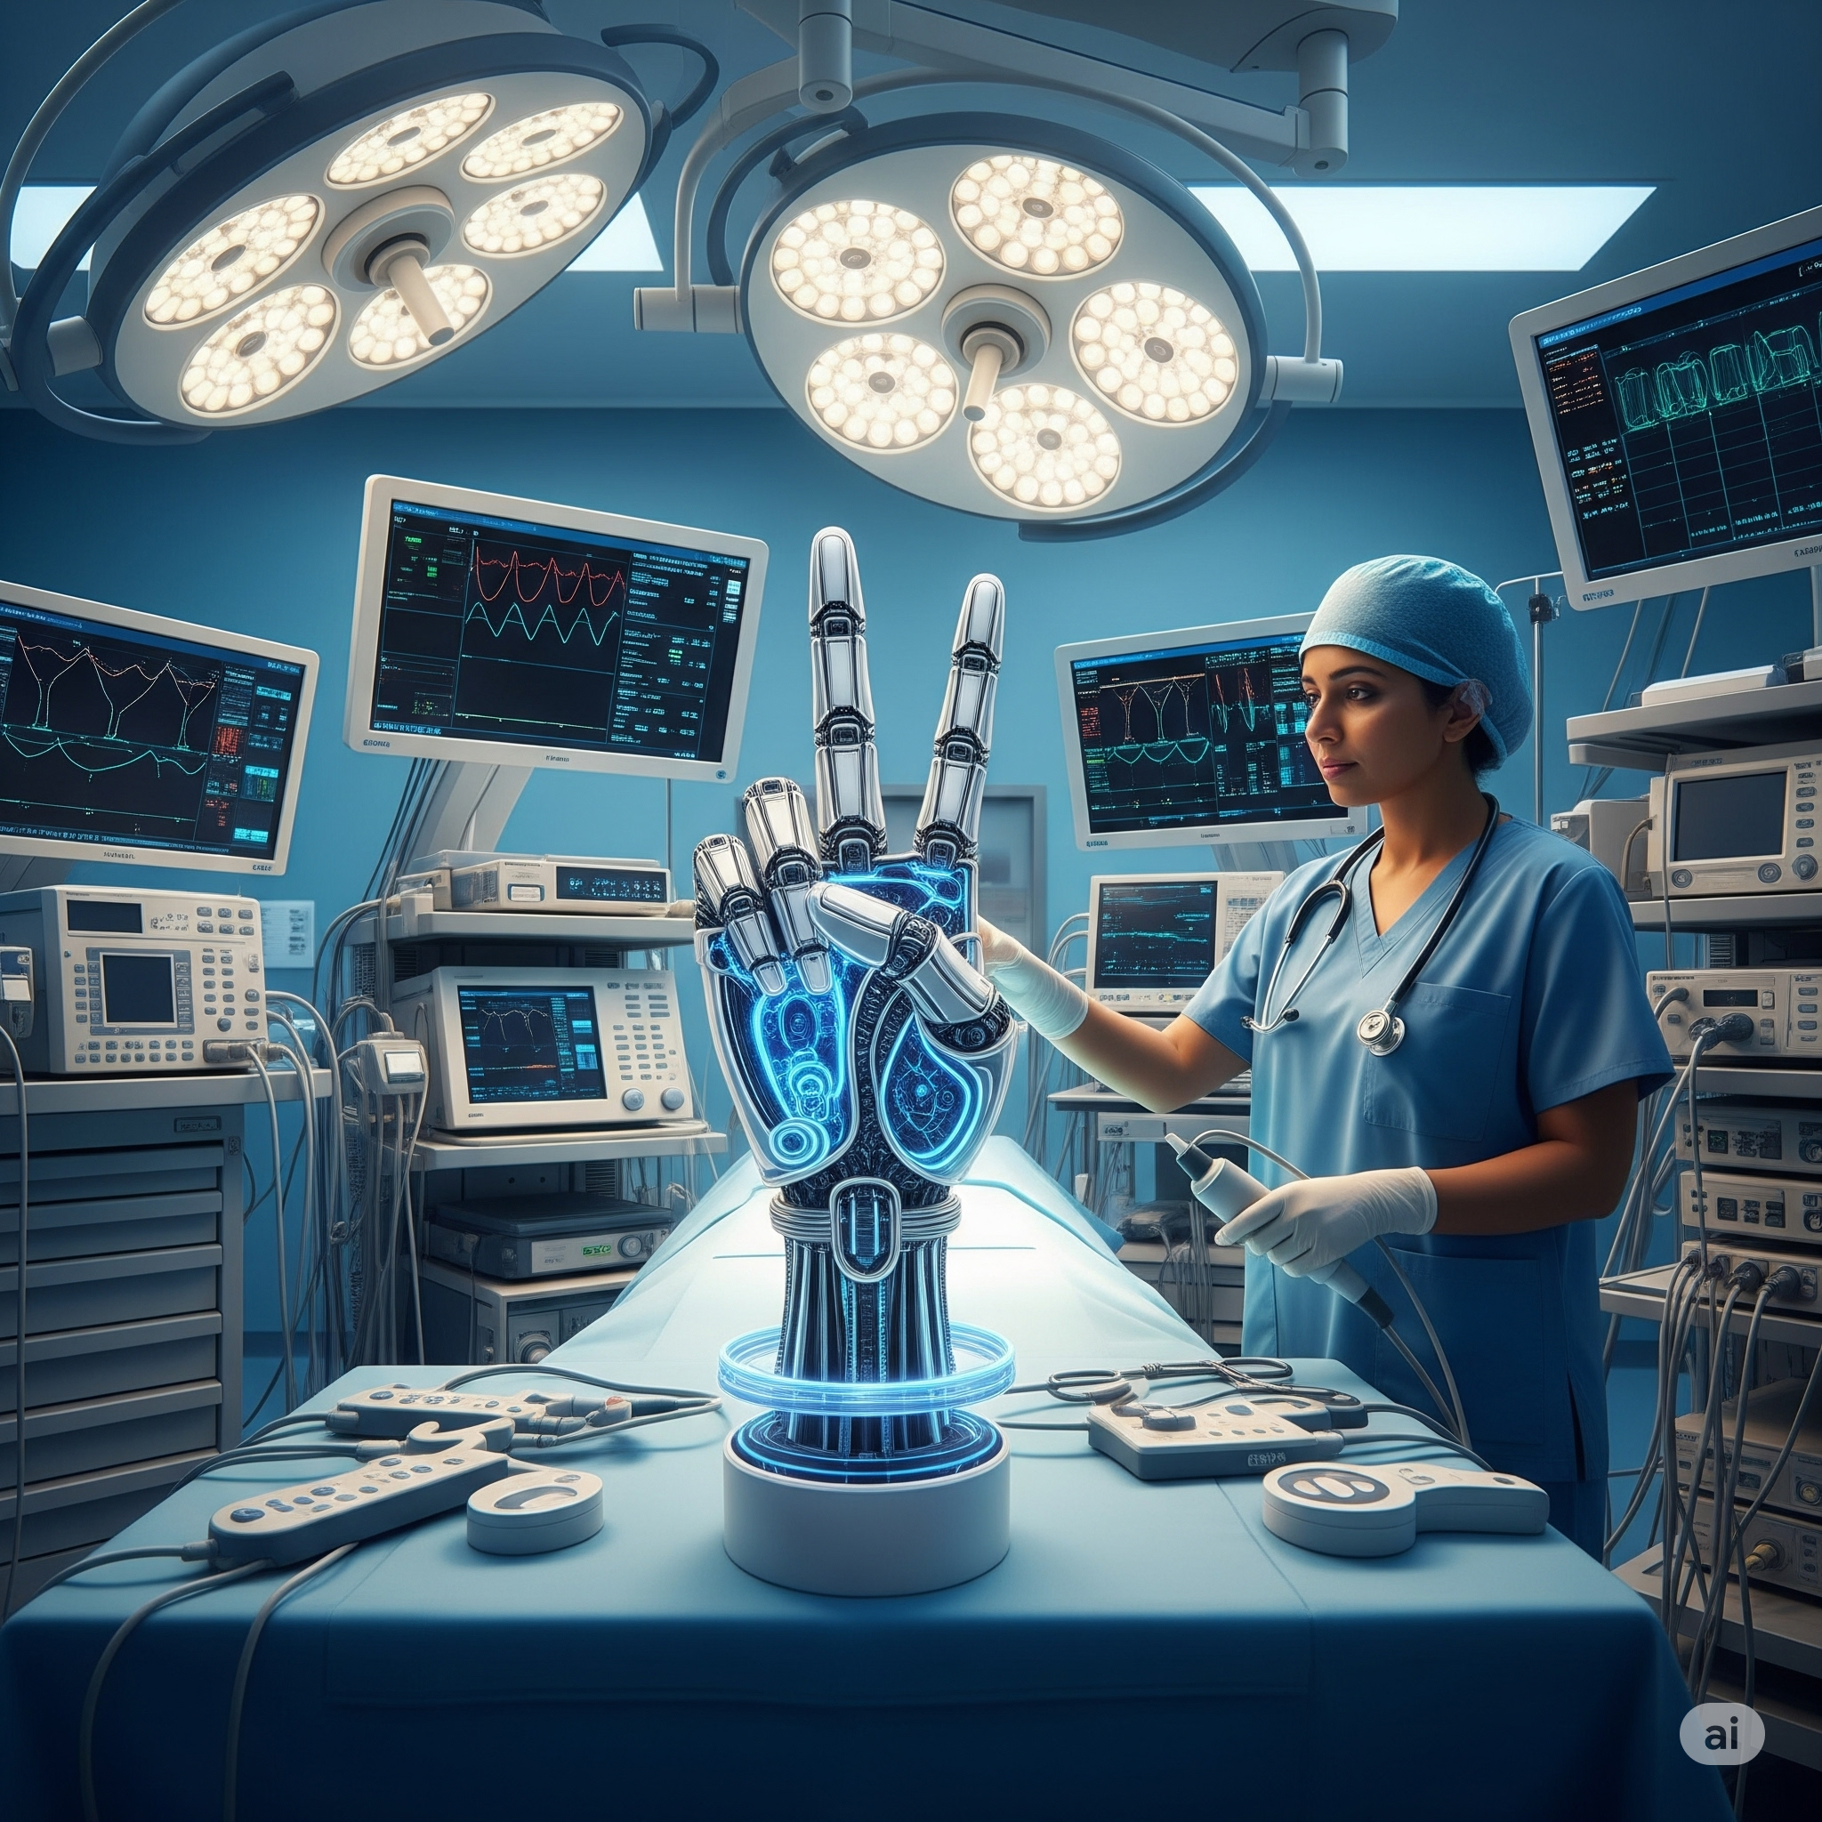

Slide 7
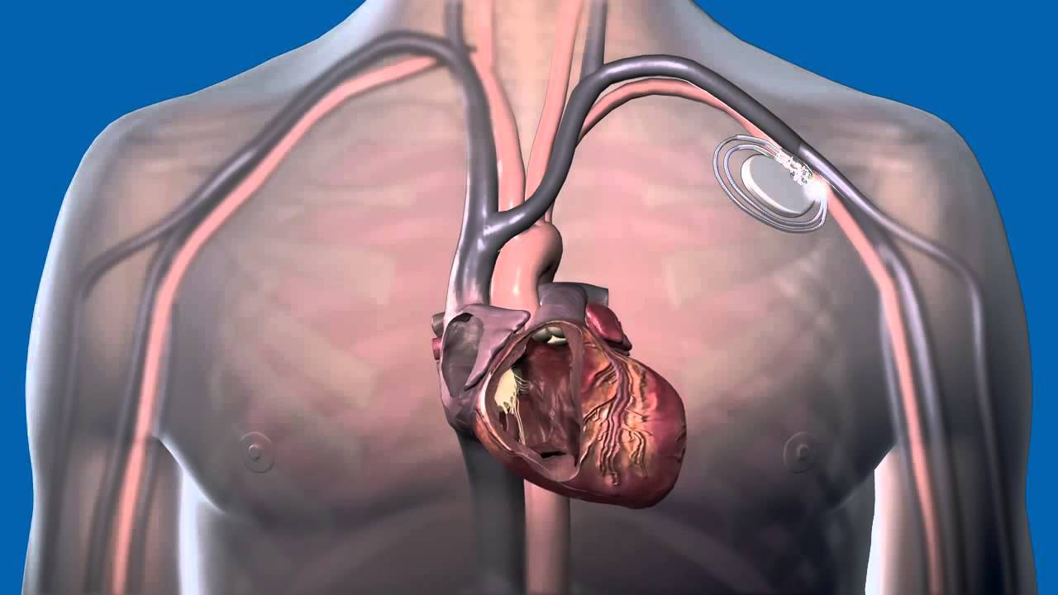
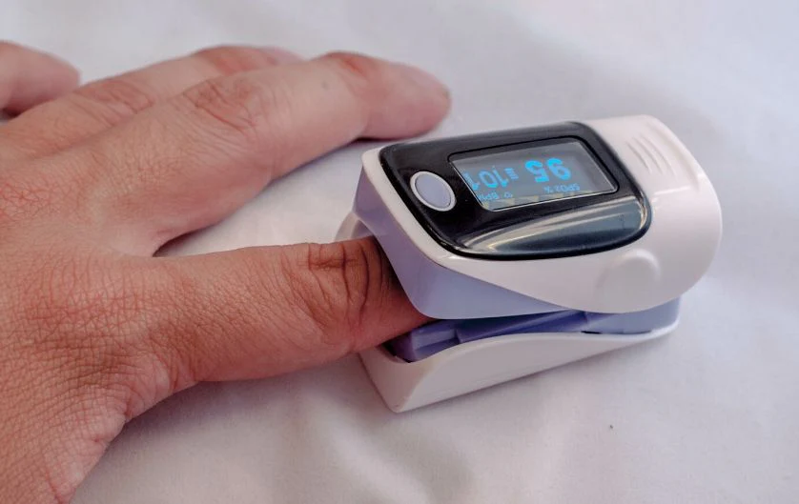
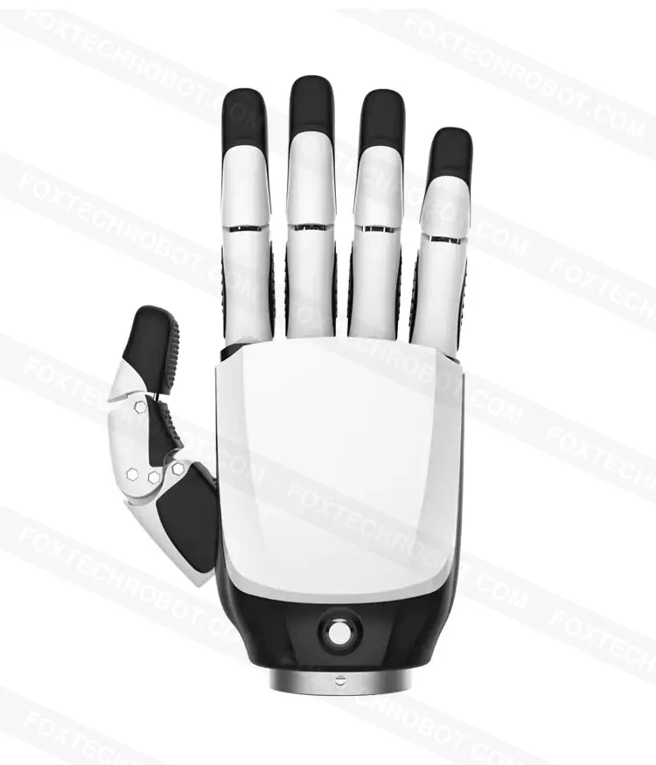
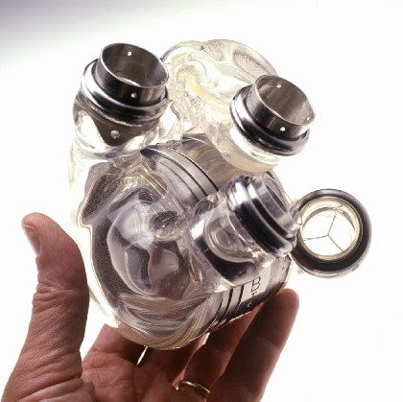

Slide 8
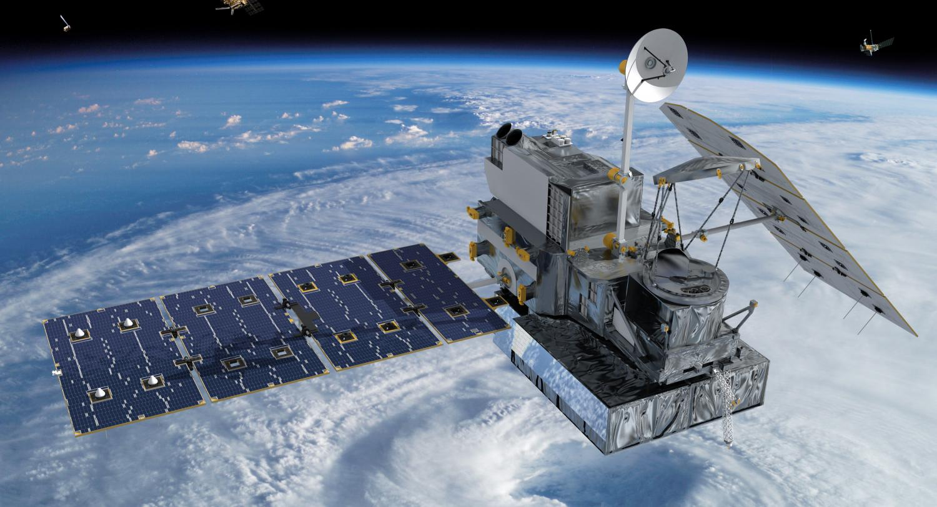
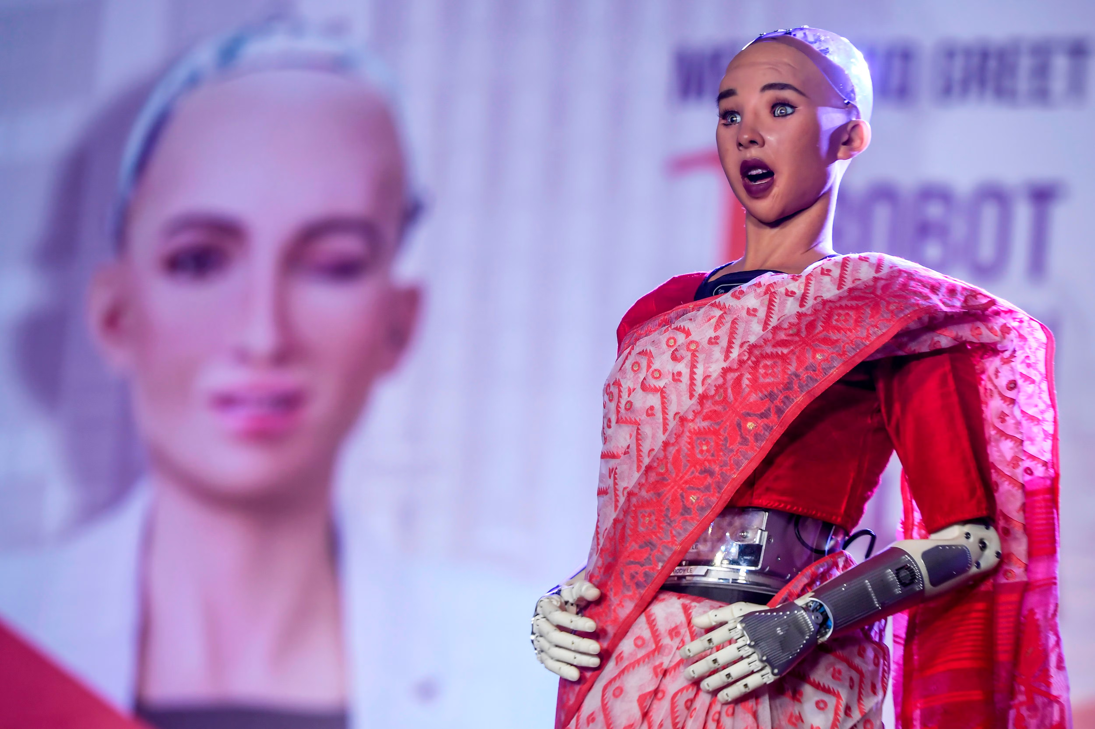

Slide 9
Active Components
Supply energy; Amplify signals; Control flow.
Requires additional power supply.
Eg: Transistor, diode.

Slide 10
Passive Components
Do not generate electricity; Consume; Store; dissipate.
Additional power supply not requires.
Eg: Resistor, Capacitor.

Slide 11
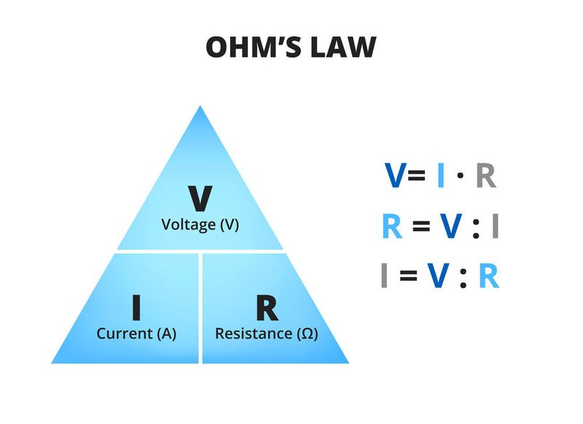

Slide 12
Thank You

