Slide 1
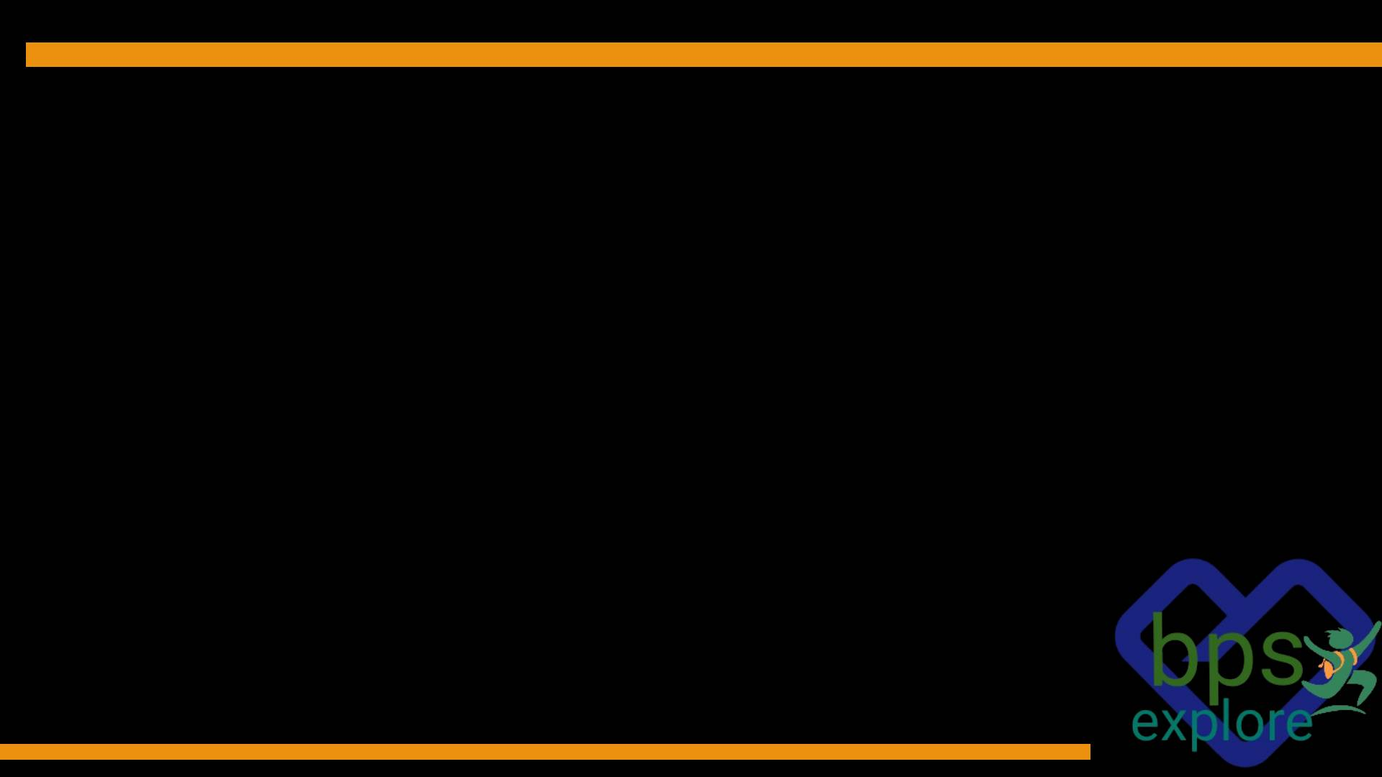
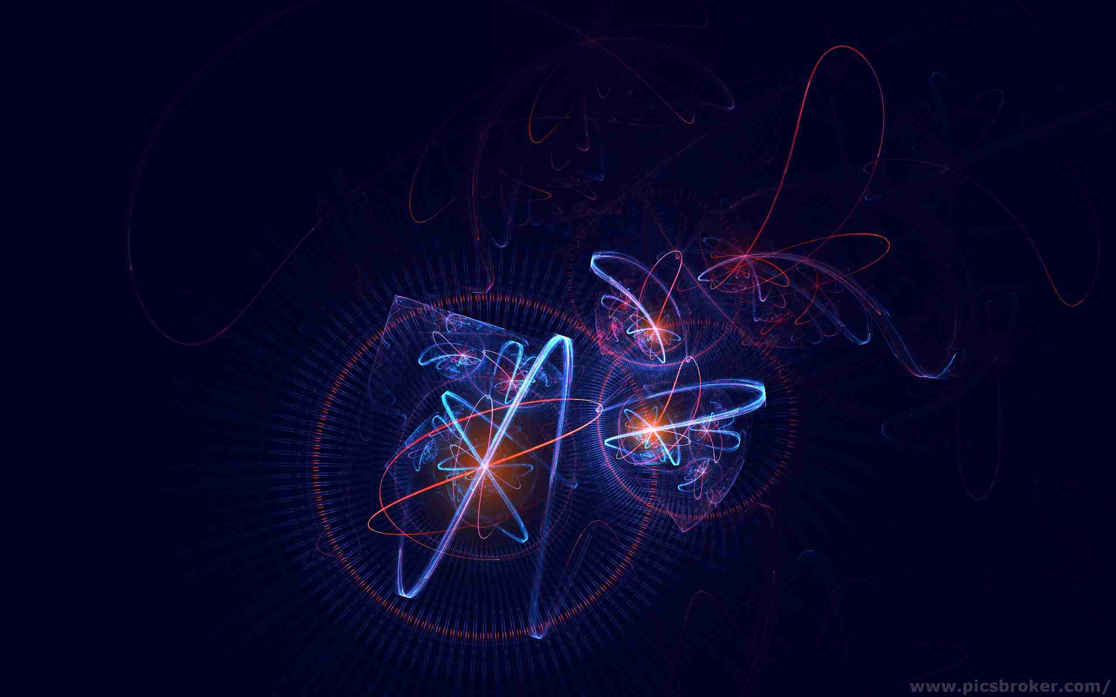
Matters and Anti-mattes
What everything made of?

Slide 2
Matter
The word "matter" has a long and interesting history, with its origins tracing back to the Latin word "materia".
Any substance that has mass and takes up space.
At a minimum, matter requires at least one subatomic particle, although most matter consists of atoms.
The word matter is sometimes used to refer to a pure substance.
According to the Big Bang theory, at the beginning of the universe, all matter erupted from a singularity, a hot, dense speck of matter.
Atoms are the building blocks of all matter and are responsible for its properties, such as color, hardness, and density.
There are four main states of matter: solid, liquid, gas, and plasma. Solids have a definite shape and volume, liquids have a definite volume but no definite shape, gases have neither a definite shape nor volume, and plasmas are ionized gases that contain free electrons and ions.

Slide 3
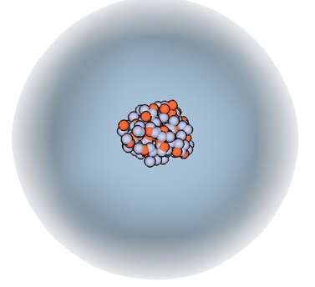
Atom

Slide 4
Atom
Made up of even smaller bits of matter - protons, neutrons, and electrons.
The word derives from the Greek atomos (“indivisible”).
One combine with other atoms to form molecules .
Most of the atom is empty space.
Positively charged nucleus that makes up more than 99.9% of the atom’s mass but only about 1/100,000 of its volume.
Atom’s volume consists of a cloud of electrons that have very small mass and negative charge.
Neutral atom has an equal number of protons (in the nucleus) and electrons.
Atoms that either gain or lose electrons are called ions.
Some elements follow the English term for the element, other elements’ chemical symbols come from their Latin names.

Slide 5
Atomic Mass
The quantity of matter contained in an atom of an element.
Atomic mass is expressed as a multiple of one-twelfth the mass of the carbon-12 atom, 1.992646547 × 10−23 gram, which is assigned an atomic mass of 12 units.
In this scale, 1 atomic mass unit (amu) corresponds to 1.660539040 × 10−24 gram. The atomic mass unit is also called the dalton (Da), after English chemist John Dalton.
For a single atom of a specific isotope, the atomic mass can be calculated by adding the number of protons (atomic number) and neutrons in the nucleus.
The simplified formula is
m≈(number of protons×mass of a proton)+(number of neutrons×mass of a neutron)

Slide 6
Atomic Particle
Consist of three basic particles: protons, electrons, and neutrons.
Electrons,( 1897, J.J. Thomson) the negatively charged, almost massless particles that nevertheless account for most of the size of the atom.
Protons,(1919, Ernest Rutherford) positively charged particles and the number of protons in an atom determines its atomic number.
Neutrons, (1932, James Chadwick) neutral particles (having no charge), help stabilize the nucleus. The number of neutrons can vary within atoms of the same element, leading to isotopes.
Each proton and neutron is made from a combination of up quarks and down quarks.
Subatomic particles fall into two classes, based on their statistical behaviour.
Those particles to which the Pauli exclusion principle applies are called fermions; those that do not obey this principle are called bosons.

Slide 7
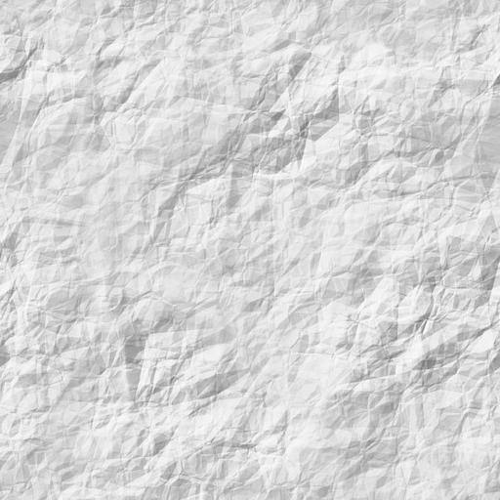
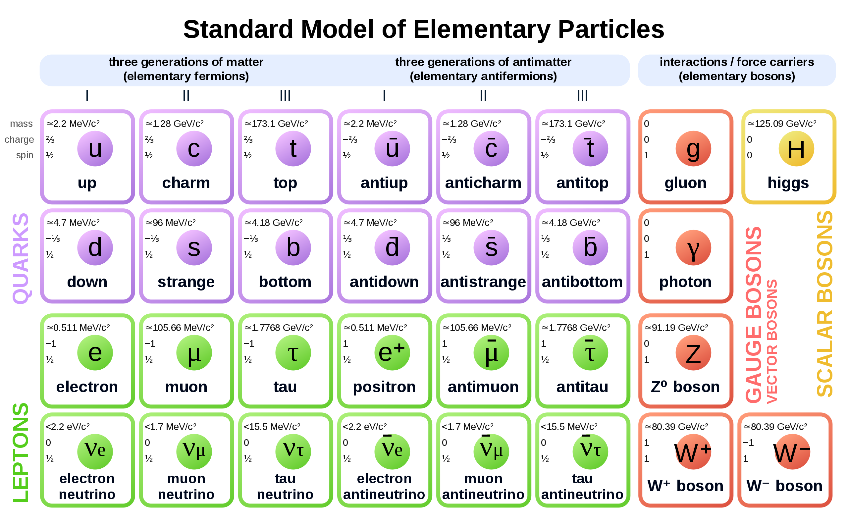

Slide 8
Fermions
Have spin in odd half integer values (1/2, 3/2, and 5/2, but not 2/2 or 6/2).
Fermions include quarks and leptons.
There are six types (flavors) of quarks: up, down, charm, strange, top, and bottom.
Quarks carry fractional electric charges (-1/3 or +2/3) and participate in the strong nuclear force mediated by gluons.
Leptons are another category of fermions, and they do not experience the strong nuclear force.
There are six types of leptons: electron, muon, tau, and their corresponding neutrinos (electron neutrino, muon neutrino, tau neutrino).
Leptons carry integral electric charges (-1 or 0).

Slide 9
Quarks
Quarks are the ultimate building blocks of visible matter in the universe.
The existence of quarks was first theorized in 1964 in the work of two physicists, Murray Gell-Mann and George Zweig, who were both at the California Institute of Technology (CalTech) .
Later in 1968 at the Stanford Linear Accelerator Center (SLAC) in California, experimenters fired electrons, and then later muons, at protons, and found evidence that the electrons and muons were scattering off three smaller particles contained within the protons, each of these smaller particles having their own electric charge. These particles are the quarks.
There are actually six types of quarks in total.
They are always bound together by the strong nuclear force, which allows them to form composite particles called hadrons.
Particles made of two quarks are called mesons, and particles made of three quarks are called baryons, which include protons (two up and one down quark) and neutrons (one up and two down quarks).
The strong force that binds quarks inside hadrons is carried by another kind of tiny elementary particle called gluons.

Slide 10
Leptons
Leptons are another category of fermions, and they do not experience the strong nuclear force.
There are six types of leptons: electron, muon, tau, and their corresponding neutrinos (electron neutrino, muon neutrino, tau neutrino).
Muons were discovered in 1936 by Carl Anderson and Seth Neddermeyer, who were performing experiments with cosmic rays from deep space (Anderson had already discovered the electron's anti-particle, the positron, four years earlier)
Muons are more massive than electrons; 207 times more massive to be precise.
Tau particles were discovered by Martin Perl particle-accelerator experiments in 1975 and, like muons, are also only created in violent particle collisions. Tau particles are even more massive than muons.

Slide 11
Bosons
Bosons have integer values of spin (spin-0, spin-1, or spin-2).
Bosons are particles that carry energy and forces throughout the universe.
Bosons take their name from Indian physicist Satyendra Nath Bose who conducted important research in the 1920s regarding the behavior of the most famous boson — the photon.
Bosons are known for their ability to occupy the same quantum state simultaneously, a phenomenon known as Bose-Einstein condensation.
Allow for the formation of phenomena such as superfluidity and superconductivity, which have important practical applications in fields such as materials science and electrical engineering.

Slide 12
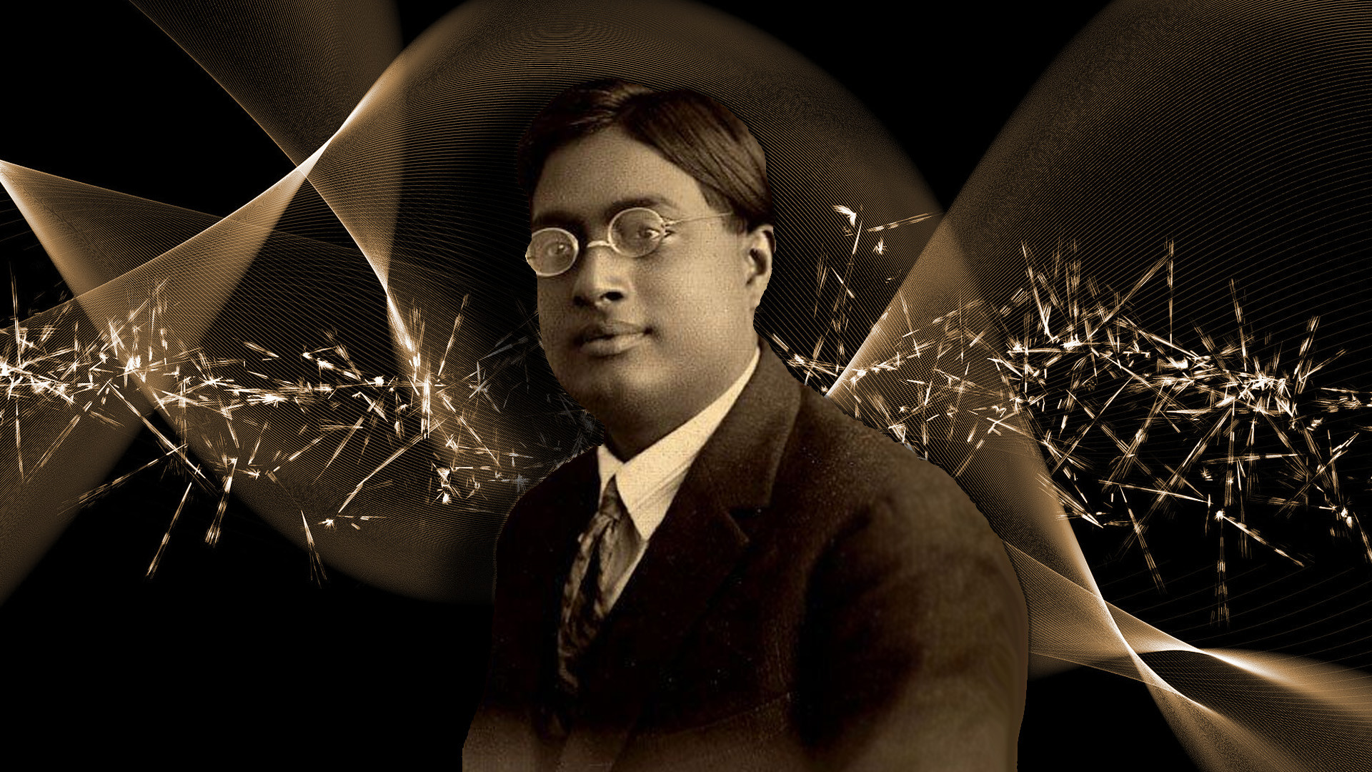

Slide 13
Photon
A photon is a subatomic particle that is the fundamental unit of electromagnetic radiation, including light and is the force-carrying particle for the electromagnetic force.
Photons have no mass, electric charge, or other inherent properties beyond their spin and energy.
They travel at the speed of light in a vacuum and exhibit both wave- and particle-like properties.

Slide 14
Z Boson
The Z boson is a carrier particle for the weak nuclear force, which is responsible for certain forms of radioactive decay and neutrino interactions.
The Z boson is quite massive compared to other elementary particles, with a mass of about 91 GeV/c².
The Z boson is a neutrally charged particle.
The Z boson was first observed in 1983 by the UA1 and UA2 experiments at CERN, through the study of proton-antiproton collisions in the Super Proton Synchrotron.

Slide 15
W Boson
The W boson is also a force carrier for the weak nuclear force, along with the Z boson, but there are some key differences.
There are two types of W bosons, the W+ and the W-, which are each other's antiparticles.

Slide 16

Gluon
A gluon is the elementary force-carrying particle that acts as the exchange particle (or gauge boson) for the strong nuclear force between quarks.
Gluons are massless and have spin 1.
A gluon that has a color charge of red and antigreen can interact with a quark that has a color charge of blue.
The gluon will transfer its color charge to the quark, changing the quark's color charge to red. This is how the strong force works.
Gluons are very difficult to study directly, as they only interact with each other and with quarks.

Slide 17
Higgs boson
The Higgs boson is a subatomic particle that was first theorized by physicist Peter Higgs, among others, in the 1960s.
The “God particle,” the Higgs boson is the particle that is responsible for conferring mass on other particles through their interaction with the Higgs field, which permeates the entire universe.
The Higgs boson was later discovered in 2012 by scientists working at the Large Hadron Collider (LHC) at CERN.
The Higgs boson mediates the force of the Higgs field with those particles that interact with it, even weakly, like the neutrino.

Slide 18

Graviton
According to the theory of general relativity, gravity arises from the curvature of space-time caused by the presence of mass and energy.
In the quantum theory of fields, all forces are thought to arise from the exchange of particles.

Slide 19
Antimatter
It has also been predicted and observed that the twelve fermion matter particles each have a mirror opposite, a particle where everything about their
behaviour is reversed. These are the fundamental particles of antimatter.
The antimatter particles corresponding to electrons, protons, and neutrons are called positrons (e+), antiprotons (p), and antineutrons (n);
Antimatter is the same as ordinary matter except that it has the opposite electric charge.
Humans have created antimatter particles using ultra-high-speed collisions at huge particle accelerators such as the Large Hadron Collider, which is located outside Geneva and operated by CERN (the European Organization for Nuclear Research).
NASA has studied the possibility of using antimatter-driven vehicles to fly to Mars, but the idea has some downsides.
ordinary bananas produce antimatter, releasing one positron—the antimatter equivalent of an electron—about every 75 minutes.

Slide 20

CERN
CERN, international scientific organization established for the purpose of collaborative research into high-energy particle physics.
The European Organization for Nuclear Research, known as CERN (/sɜːrn/; French pronunciation: [sɛʁn]; Conseil européen pour la Recherche nucléaire)
Founded in 1954, the organization maintains its headquarters near Geneva and operates expressly for research of a “pure scientific and fundamental character.”
The site covers more than 100 hectares (250 acres) in Switzerland and, since 1965, more than 450 hectares (1,125 acres) in France.

Slide 21
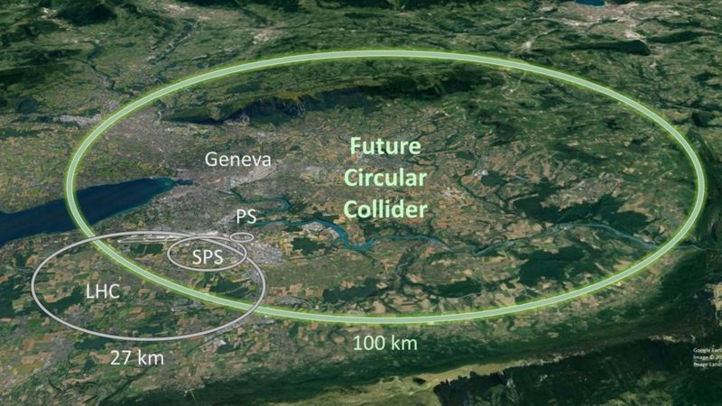

Slide 22
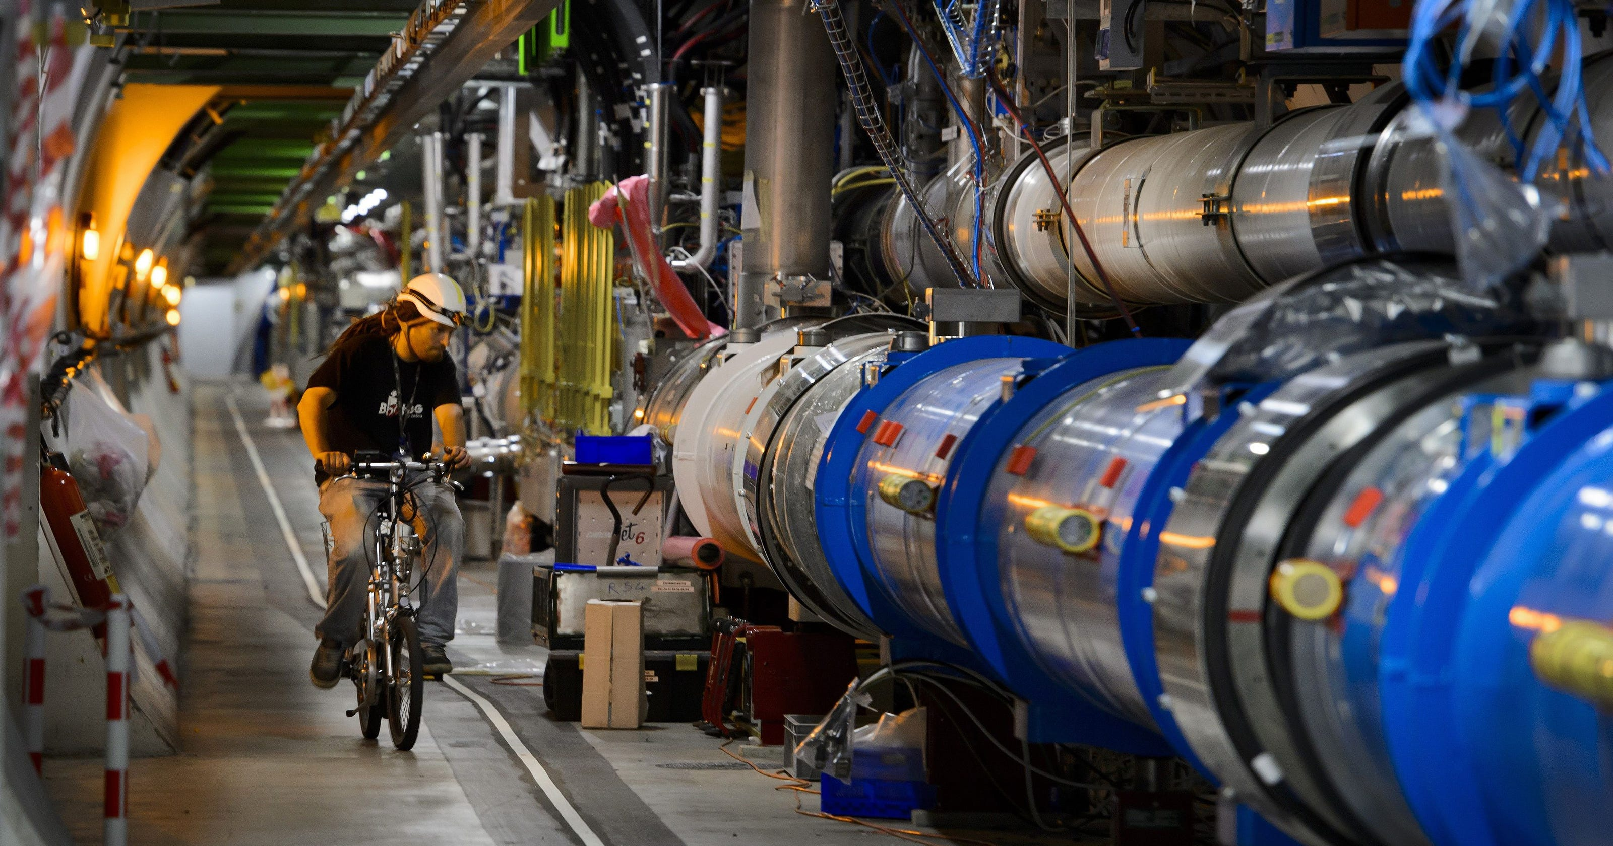

Slide 23
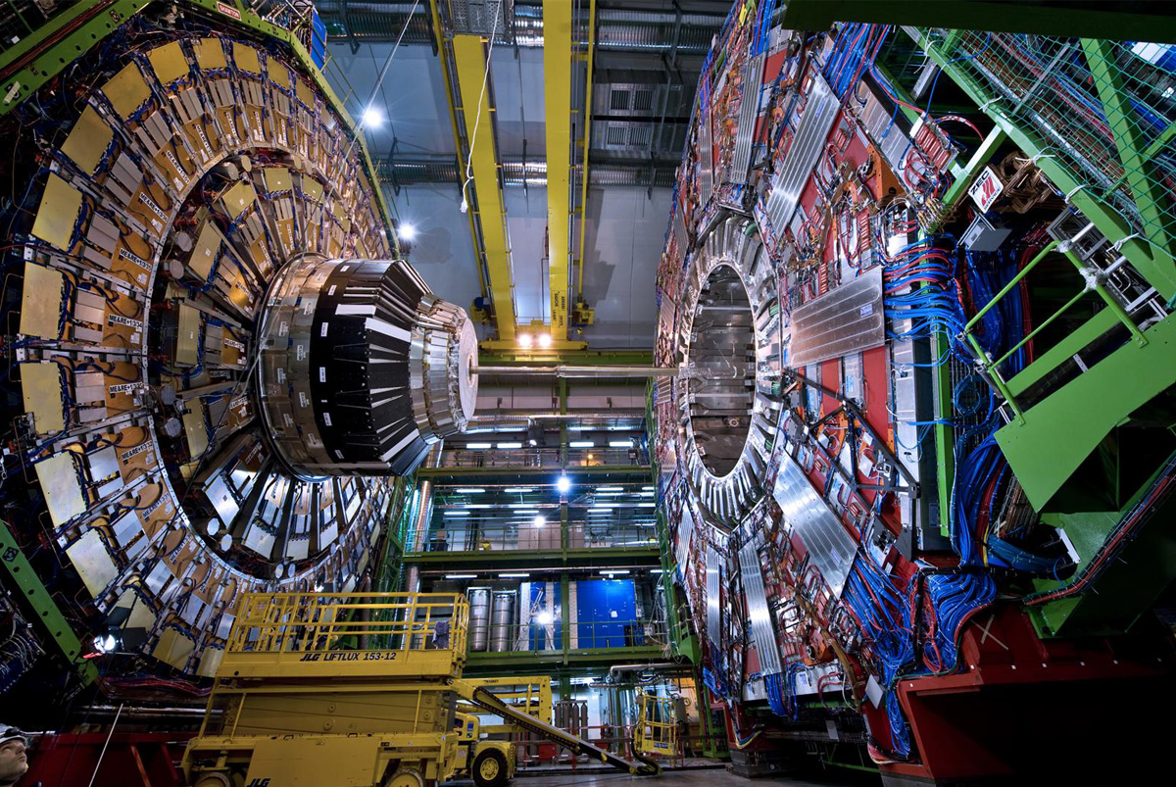

Slide 24
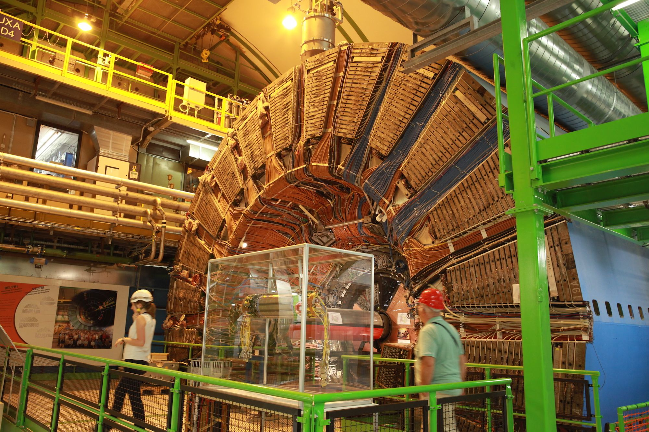

Slide 25
Thank You

