Slide 1

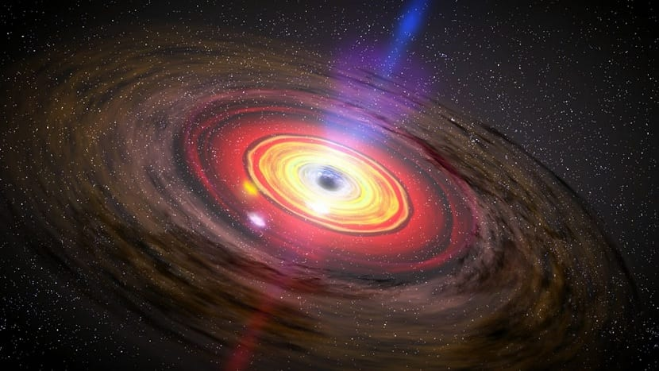
The origin of solar system

Slide 2
Solar system
Complex arrangement of celestial bodies bound together by gravity.
High mass object like sun, star present at center which hold the entire solar system.
The Sun is a G-type main-sequence star (G2V) that provides the energy necessary to sustain life on Earth.
The Solar System includes eight major planets divided into two groups:
Terrestrial Planets: Mercury, Venus, Earth, and Mars. These are rocky and have solid surfaces.
Gas Giants: Jupiter and Saturn. These are large planets with thick atmospheres primarily composed of hydrogen and helium.
Ice Giants: Uranus and Neptune. These have a core of rock and metal and thick atmospheres with more ices like water, ammonia, and methane.

Slide 3
Black hole & Particle
Quantum mechanical effect cause by black hole to create and emit particles as if there were hot bodies with temperature
k is surface gravity of the black hole.
ℏ is reduced planck constant.
M is mass of black hole.
M⊙​ is solar mass.

Slide 4
Big Bang
Russian Physicist George Gamow (1940’s) conceived hot big bang.
The gas expand when cold and compress when hot.
The temperature of the gas is a measure of the average kinetic energy of it's constituent particles.
The faster the particle move the higher the temperature.
Particle collide with objects that are not stationary and it lose it's kinetic energy and decrease in temperature
Particle gets cool when universe expanding.
The temperature in the early universe is inversely proportional to the scalar factor of the universe. T ∝1/a

Slide 5
The universe is infinitely hot at the big-bang as scalar factor is zero.
The universe is mainly made-up of anti-matters and matters.
Surrounding is filled with molecules which are different composition of atoms held together by chemical bond.
At 500K the chemical bond breaks; at 3000K atom break to nuclei and electron; around 10⁸k nuclei break into neutron and proton; above 10¹²K neutron and proton break into quarks.
The earlier our solar system was a hot dense mixture of subatomic particle called "the primeval fireball".

Slide 6
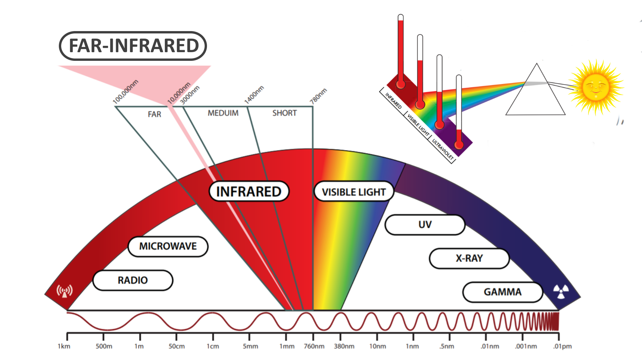
Thermal Radiation

Slide 7
At microscopic level the electromagnetic waves consist of photons and their energy is inversely proportional to their wavelength
The photons are emitted and absorbed by electrically charged particle and interact with it in quantum state. But in classic it was unaffected to electric field.
The universe emit and absorb photons with same rate in earlier stage and equilibrium is formed known as thermal radiation and photons are mixed with another particles.
The total intensity is directly proportional to the 4th power of the temperature, ρ∝T⁴.
The spread of intensity over a ranges of wavelength is called thermal spectrum (German physicist Max Planck).
The peak intensity occurs at a wavelength inversely proportional to the temperature.
λpeak​∝1/T

Slide 8
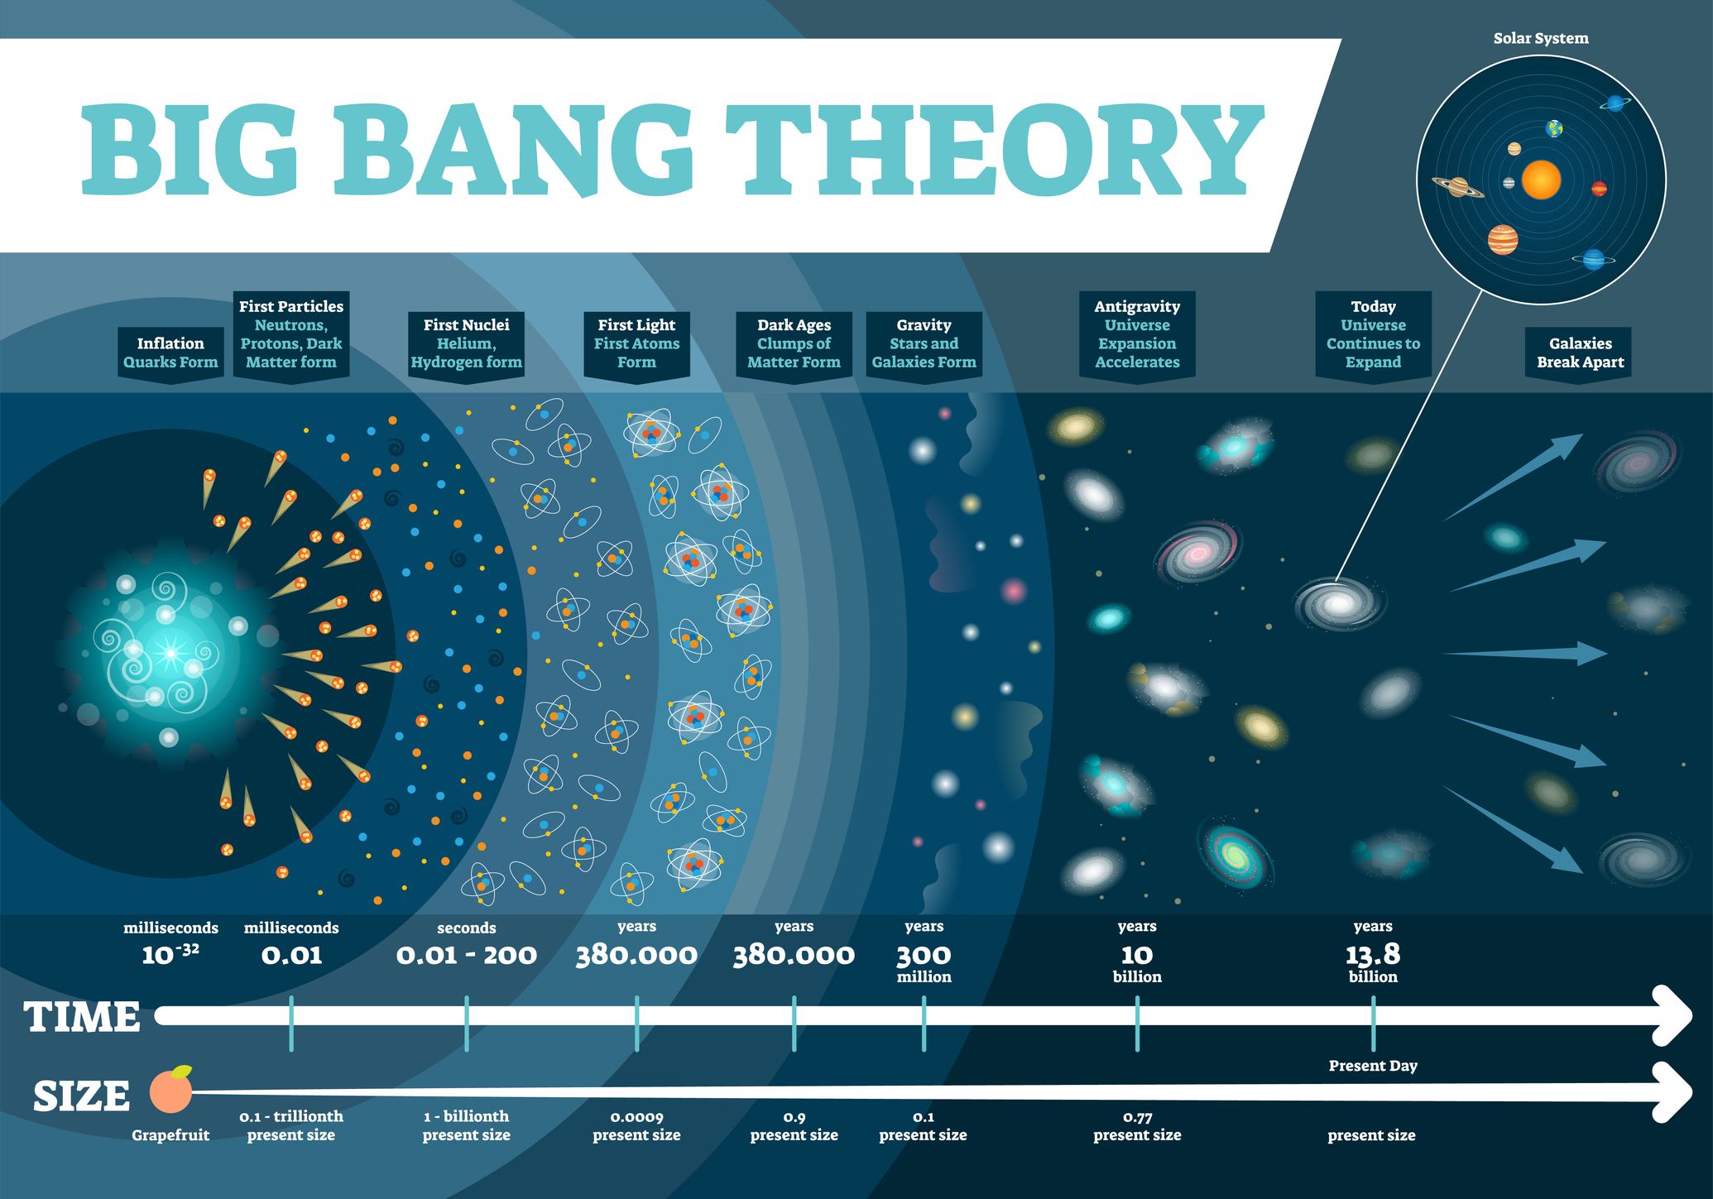

Slide 9
Big Bang Model
The big-bang model deals with the expanding fireball of elementary particles and photon.
As the universe expands, the fireball dilutes, cools down and complex structure forms.
After a minute of expanding the temperature decrease to 109K and proton and neutrons combine to form a nuclei called nucleosynthesis.
3,80,000 years passed the temperature cools to 3000K and electron combine with nuclei forms neutral atom called recombination.
The star, galaxies and galaxy cluster pulled together by gravity.

Slide 10
Primeval Fireball
Predicted first by George Gamow's colleagues Ralph Alpher and Robert Herman in 1940's which will be of 5K.
After a decade and some at Bell Telephone Laboratories in New Jersey, Arno Penzias and Robert Wilson were testing a sensitive radio antenna to use in a study of radio emission from the Milky Way.
The signal were always filled with noise and they examine everything but no clue for noise is found.
They measured the temperature of the noise which is 3K corresponding to microwave of wavelength 2mm and this is of cosmic radiation left over from big-bang.
This noise was now called Cosmic Microwave Background (CMB).

Slide 11
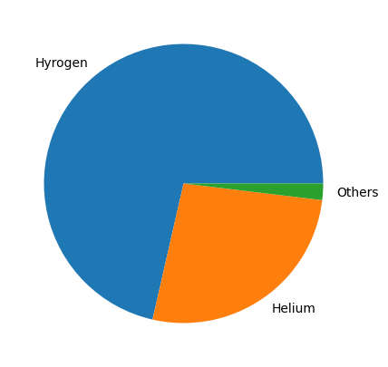
Big Bang Nucleosynthesis

Slide 12

The first step in nucleosynthesis is a neutron to fuse with a proton to make deuterium, or heavy hydrogen.
Then two deuterium combine to form either helium-3 plus a neutron, or tritium plus a proton.
After 1minute of ABB (after big-bang) temperature dropped to one billion Kelvin, and the photon energies are not able break deuterium.
The amount of dark matter in the universe is five times about that in stars and gas.
The big-bang nucleosynthesis does not progress much beyond helium that there are no stable nuclei consisting of 5 nucleons.

Slide 13
Stellar Nucleosynthesis
The stars are gaseous body hold together by gravity and heated by nuclear reaction in the interiors.
Sun surface temperature is 6000 K and the central temperature is 10 7 K.
Hydrogen is burned into helium in the central part and helium ash is collected at the core.
As sun reaches T≈10⁸K, the helium ash starts burning to carbon and oxygen and the nuclear reaction do not go beyond this.
When a star exhausts its nuclear fuel, it may undergo a supernova explosion, dispersing heavier elements into space.

Slide 14
Planet Formation
Solar system begins with a large, slowly rotating cloud of gas and dust, known as a molecular cloud or nebula.
The gravity and rotation force causes the cloud to contract and flatten into a thin disc.
The gravitational potential energy is converted into kinetic energy, causing the cloud to heat up and increase in density, particularly towards the center.
The material become denser and hotter towards center and some of the materials in the disk coalesces into a series of planets.
where temperatures are higher, rocky planets form and in the cooler outer regions, gas giants and ice giants form by accumulating lighter elements like hydrogen, helium, and ices.

Slide 15
Our System
Galaxies come in three main types: spiral, elliptical and irregular.
Milky Way galaxy is roughly 100,000 light years across and about 10,000 light years thick.
Halo is spherical with a diameter 10 times larger than disk.
The Sun sits in the disk about 25,000 light years from the galactic center.
The Milky Way belongs to a small cluster called the Local Group which has group of 40 galaxies.

Slide 16
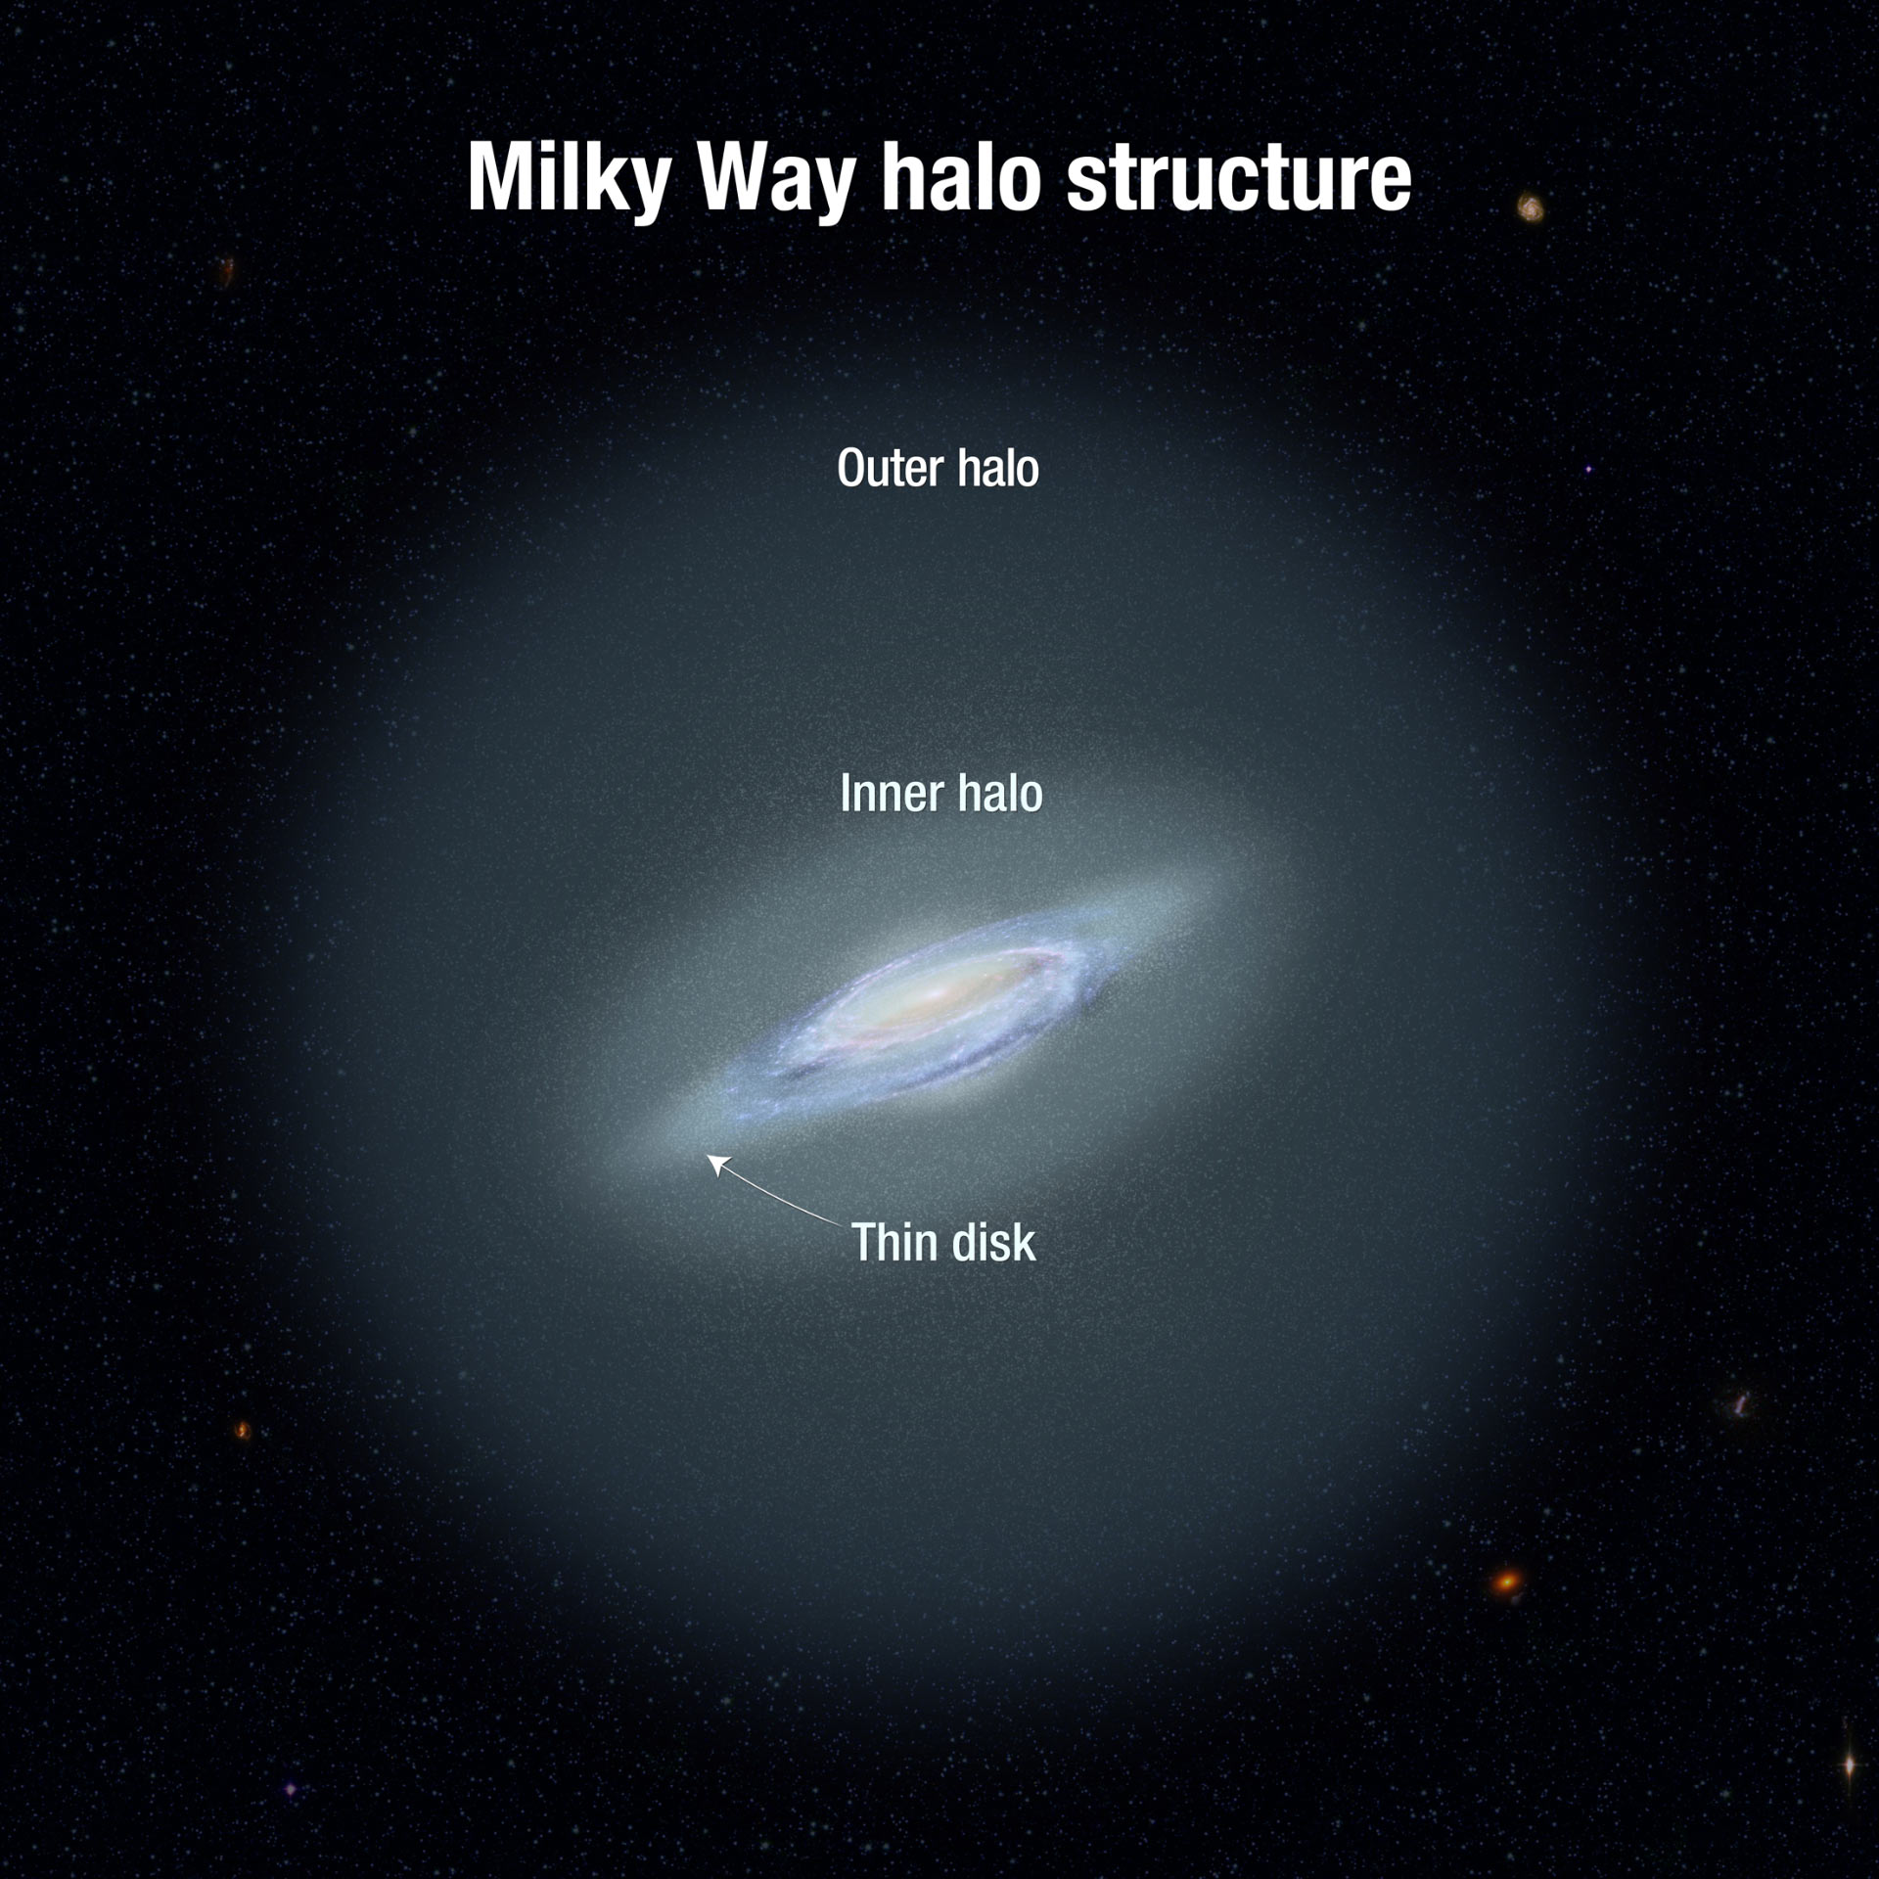

Slide 17
Thank You

