Slide 1

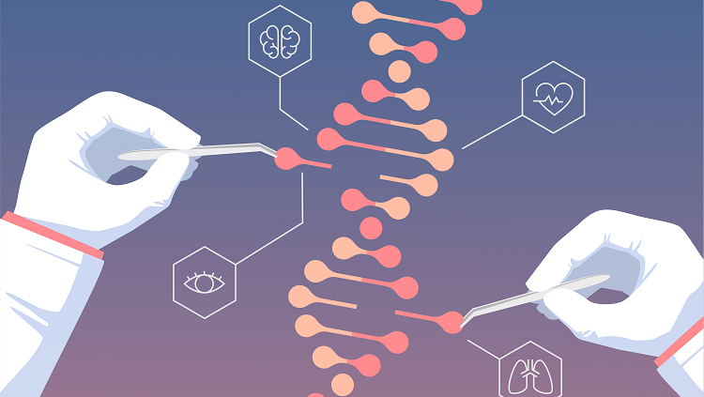
Life & Evolution

Slide 2
