Slide 1

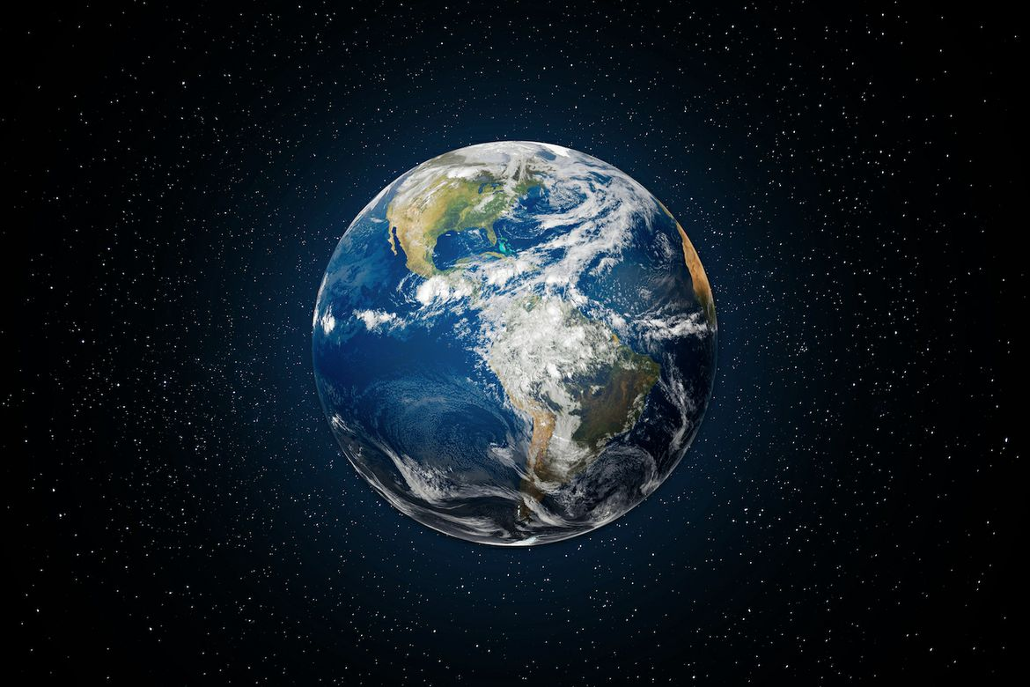
OUR HOME

Slide 2

Fifth Largest in our solar system.
English word – mean ground or soil.
Only life planet.
7 – Continents; 5 – Oceans.
Three Layers.

Slide 3
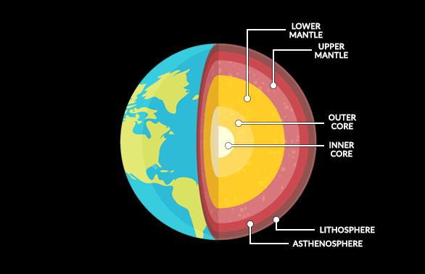

Slide 4
Crust - outer shell; mostly rock of density 2.7 to 3.3 g/cm3/.
Lithosphere - 10 to 200km thick; break under stress and form tectonic plates (crust + uppermost mantle).
Asthenosphere - 100 to 350km; part of upper mantle; exhibit plastic behavior.
Upper Mantle - 35 to 670km; 450−900°C450−900°C;
Mesosphere - Also lower mantle - 670 to 2900km; strong rigi rock; Silicate minerals 3.2 to 5.7g/cm3;
Outer Core - 2400km; nickel & iron - 9.9 to 12.2g/cm3; liquid layer;
Inner Core - 5150km; 5500°C5500°C; 12.9g/cm3;

Slide 5
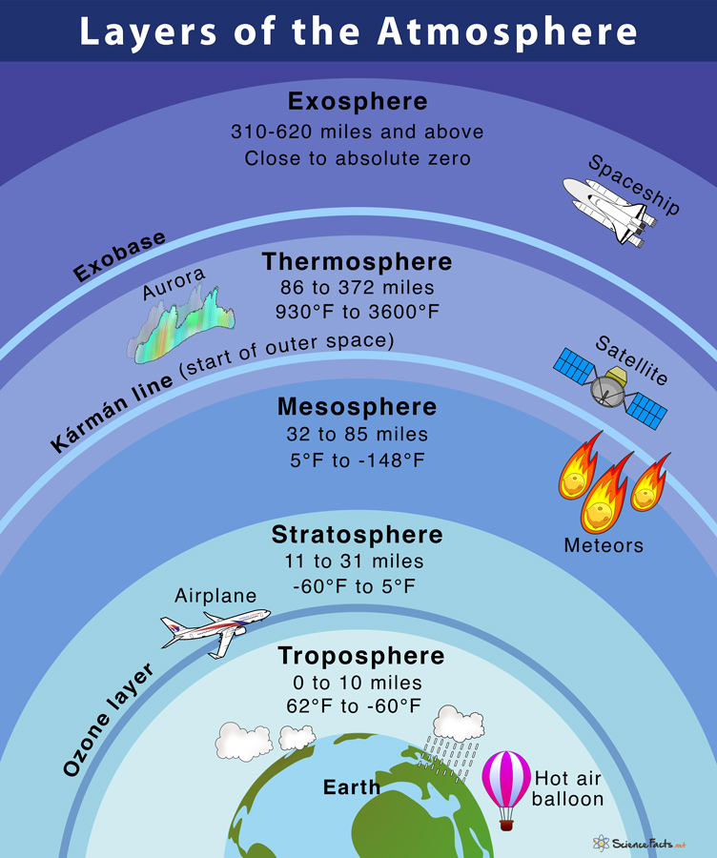

Slide 6
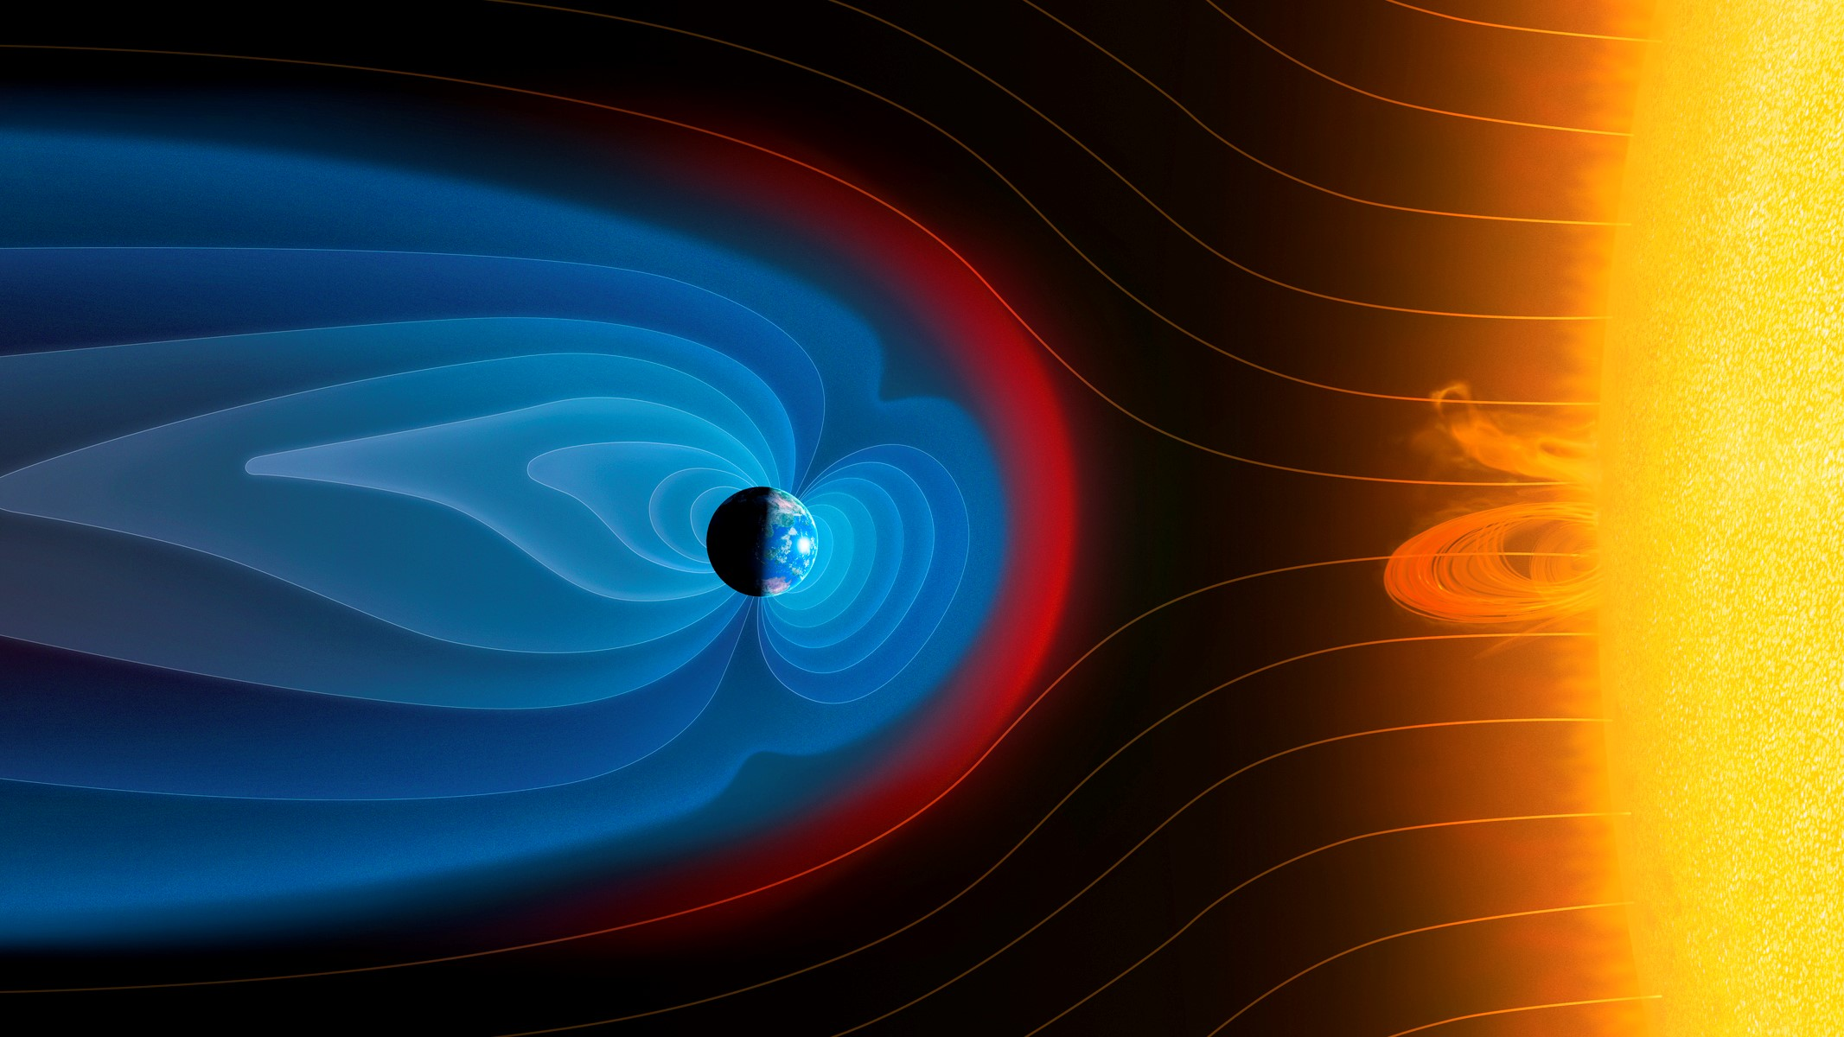
Earth’s Magnetic Field

Slide 7
Introduction :
> Geomagnetic field
> The prefix "geo-" comes from the Greek word "γη" or "γαια," meaning "earth" or "ground". The shape of earth is geoid.
> Magnetic field generated by the movement of molten iron and nickel in the Earth's outer core, and it acts as a giant shield, protecting us from harmful radiation from the sun and similar to that of a bar magnet.
> It is not perfectly aligned with the Earth's geographic poles; it is tilted at an angle of about 11 degrees.
> This tilt causes the magnetic poles to be offset from the geographic poles, and it also means that the strength of the magnetic field varies across the Earth's surface.
>The magnetic field also helps to protect us from cosmic rays, high-energy particles from space that can damage cells and DNA.

Slide 8
History:
Believed to have originated around 3.5 billion years ago, coinciding with the solidification of the planet's outer core. This process, known as the geodynamo, generates the magnetic field through the movement of electrically conductive molten iron and nickel in the outer core.
The German mathematician and astronomer Carl Friedrich Gauss studied Earth’s magnetic field (1830) and concluded that the principal dipolar component had its origin inside Earth instead of outside.
He demonstrated that the dipolar component was a decreasing function inversely proportional to the square of Earth’s radius

Slide 9
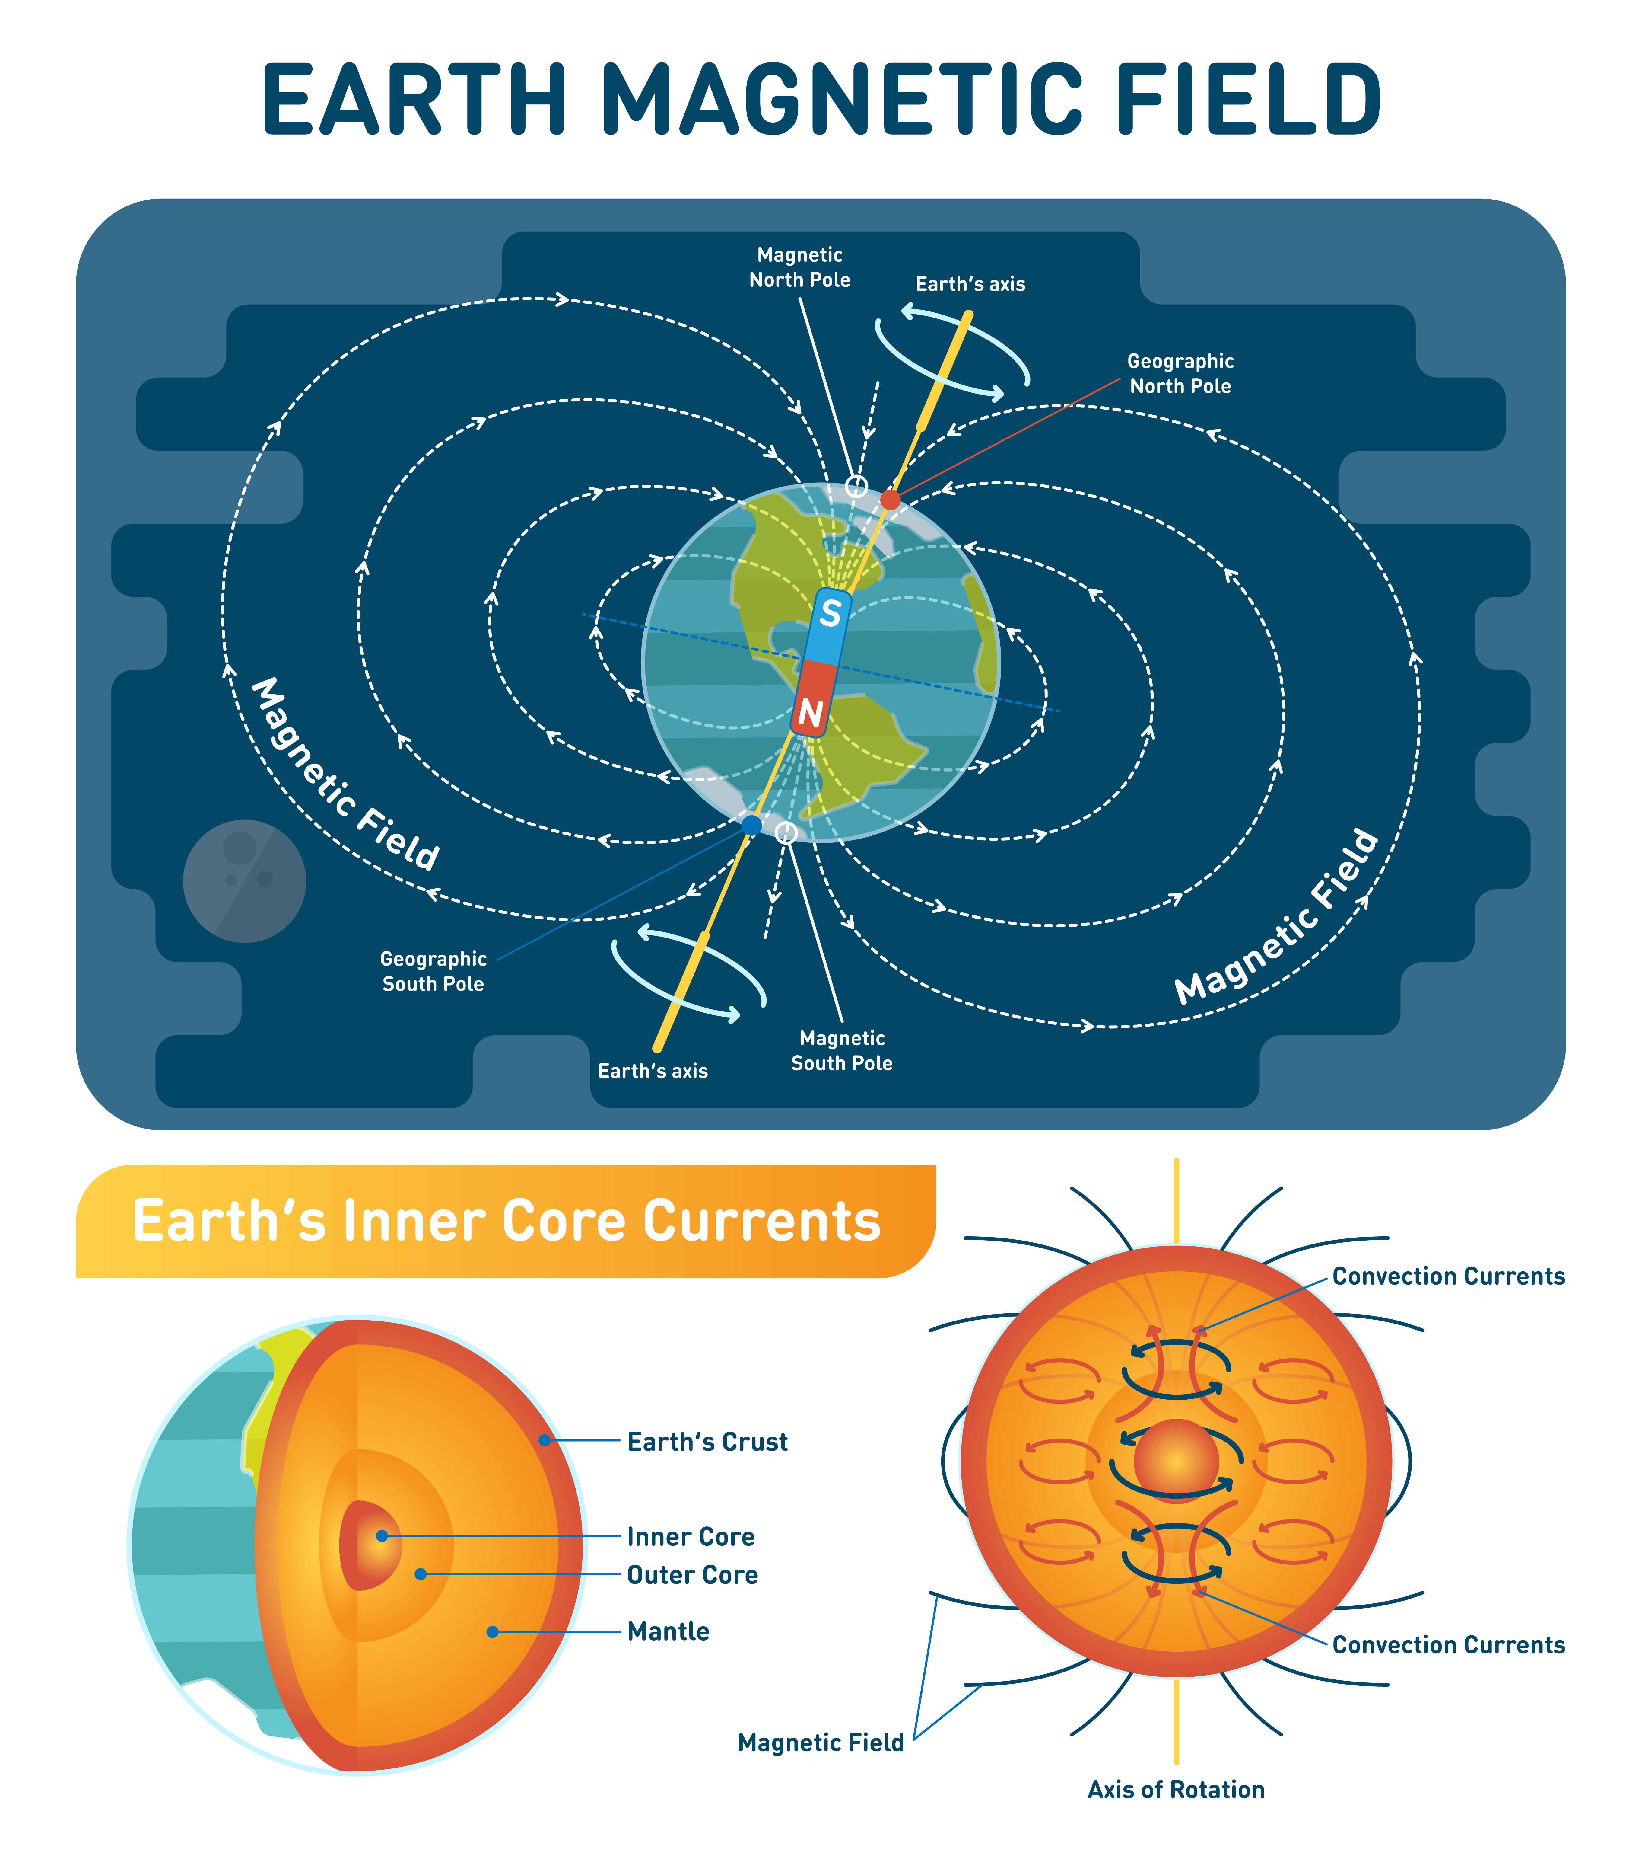
Cause:
Earth's magnetic field is generated by geodynamo process.
Flowing of liquid metal in the outer core of the planet generates electric currents.
The rotation of Earth on its axis causes these electric currents to form a magnetic field which extends around the planet.

Slide 10
Poles:
Geographic poles and Magnetic poles.
Geographic North and South poles are where lines of longitude converge according to GIS Geography.
The Geographic North Pole is located in the middle of the Arctic Ocean(90 degrees north latitude) and the Geographic South Pole is found in Antarctica (90 degrees south latitude).
The average temperature at the geographic north pole is -35 degrees Celsius, and it rarely gets above freezing.
The average temperature at the geographic south pole is -57 degrees Celsius, and it never gets above freezing.
Magnetic poles are located where the magnetic lines of attraction enter Earth.
The Magnetic North Pole is also known as the North Dip Pole and is currently found on Ellesmere Island in Northern Canada
The Earth's magnetic south pole located in Antarctica, near the Vostok Station.
The magnetic north is situated beside the geographical south, while the magnetic south resides along the geographical north.
Because opposite sides of a magnet attract, when the red needle or north magnetic pole of a compass deflects and points towards the geographical north, it is actually being attracted by the south magnetic pole of the Earth’s imaginary bar magnet.

Slide 12
Magnetic Fields on other Planets:
Jupiter, Saturn, Uranus and Neptune all exhibit magnetic fields far stronger than Earth's, according to Union University, though the underlying mechanisms driving these magnetic fields are not yet completely understood.
Mars does not have enough inner heat nor does it possess the liquid interior required to generate a magnetic field.
Venus, on the other hand, has a liquid core but does not spin fast enough to generate a magnetic field.

Slide 13
Magnetic Field:
Magnetic fields are produced by moving electric charges.
The spin of an electron can be either up or down.
In a non-magnetic material, the spins of the electrons are randomly oriented, so they cancel each other out.
In a magnetic material, the spins of the electrons are aligned, creating a net magnetic field.
In quantum mechanics, every element exhibits magnetic properties to some degree due to the arrangement of its electrons including plastics and wood.
This is because electrons possess an intrinsic property called spin, which can be considered as an inherent magnetic dipole moment.

Slide 14
Experiment
Materials: A strong magnet, A piece of unmagnetized metal, such as iron or steel, A compass

Slide 15
Magnetic Pole Reversal:
According to Science Daily, in the last 200 million years alone, Earth's magnetic poles have reversed hundreds of times in a process where north becomes south and south becomes north.
The magnetic poles flip approximately every 200,000 to 300,000 years according to NASA, though it has been more than twice that long since the last reversal.
Earth's most recent magnetic reversal occurred approximately 790,000 years ago so we are rather overdue for another.
The magnetic poles won't just switch overnight, it can take hundreds or even thousands of years for the poles to flip.

Slide 16
Magnetospheric Multiscale Mission:
The Magnetospheric Multiscale Mission (MMS) is a NASA mission that studies Earth's magnetosphere, the region of space surrounding Earth that is dominated by its magnetic field.
The high-energy electrons follow the magnetic field lines.
such as during an event called magnetic reconnection where the lines explosively collide, the particles are shot off their trajectories, as if they were fired from a cannon.
Scientists with MMS have been watching the complex shows electrons put on around Earth and have noticed that electrons at the edge of the magnetosphere often move in rocking motions as they are accelerated.
Finding these regions where electrons are accelerated is key to understanding one of the mysteries of the magnetosphere.

Slide 17
Possibilities:
The Earth's surface acts as one conductive plate of a capacitor, while the ionosphere, a conducting layer of the atmosphere beginning at about 60 km altitude, acts as the other plate.
This large capacitance allows the Earth to store a significant amount of electrical charge.
When lightning strikes, for example, it releases a large amount of electrical energy into the Earth-ionosphere system. This energy is then stored in the form of an electric potential difference between the Earth's surface and the ionosphere.
According to the World Wide Lightning Location Network (WWLLN), an estimated 6,000 lightning strikes occur on Earth every minute, totaling around 8.6 million strikes per day and 3.2 billion strikes per year.
There is an possibility thus those electrons can make earth’s magnetic field as they are incharge to create magnetic field.

Slide 18
Thank You….!

