Slide 1

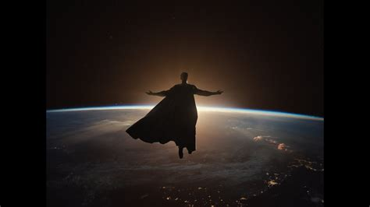
Sun
The Supreme Source of Energy

Slide 2
Why Sun?

Slide 3
The Sun is the star at the center of our solar system.
The scientific name of our sun is “Sol” derived from the Latin word for "sun"
It is a massive, hot ball of plasma, inflated and heated by energy produced by nuclear fusion reactions at its core.
Part of this internal energy is emitted from its surface as light, ultraviolet, and infrared radiation, providing most of the energy for life on Earth.
The Sun's gravity holds the solar system together, keeping everything – from the biggest planets to the smallest particles of debris – in its orbit.
The sun's gravity value is 274 m/s².
It drives weather, ocean currents, seasons, and climate, and makes plant life possible through photosynthesis.
Electric currents inside the sun generate a magnetic field that spreads throughout the solar system.
About 150 million kilometers (93 million miles) from Earth called an astronomical unit (AU).
The science of studying the Sun and its influence throughout the solar system is called heliophysics.

Slide 4
Made of ?

Slide 5
Three quarters of the sun is hydrogen.
Helium created by continuous nuclear fusion of hydrogen.
A very small percentage (1.69 percent) of the sun’s mass is made up of other gases and metals: iron, nickel, oxygen, silicon, sulfur, magnesium, carbon, neon, calcium, and chromium. Its mass is still 5,628 times the mass of Earth.
The radius of the sun is about 700,000 kilometers (432,000 miles).
The sun is not a solid mass.
The sun is made up of six layers: core, radiative zone, convective zone, photosphere, chromosphere, and corona.
The sun rotates counterclockwise, and takes between 25 and 35 days to complete a single rotation.
The sun orbits clockwise around the center of the Milky Way, between 24,000 and 26,000 light-years away from the galactic center.
The sun takes about 225 million to 250 million years to orbit one time around the galactic center.
The fact that our Sun and the stars all have similar compositions and are made up of mostly hydrogen and helium was first shown in a brilliant thesis in 1925 by Cecilia Payne-Gaposchkin, the first woman to get a PhD in astronomy in the United States

Slide 6
Element | Abundance (pct. of total number of atoms) | Abundance (pct. of total mass)
Hydrogen | 91.2 | 71.0
Helium | 8.7 | 27.1
Oxygen | 0.078 | 0.97
Carbon | 0.043 | 0.40
Nitrogen | 0.0088 | 0.096
Silicon | 0.0045 | 0.099
Magnesium | 0.0038 | 0.076
Neon | 0.0035 | 0.058
Iron | 0.030 | 0.014
Sulfur | 0.015 | 0.040

Slide 7
Does sun rotate?

Slide 8
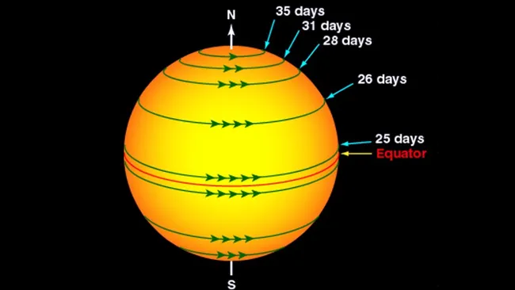

Slide 9
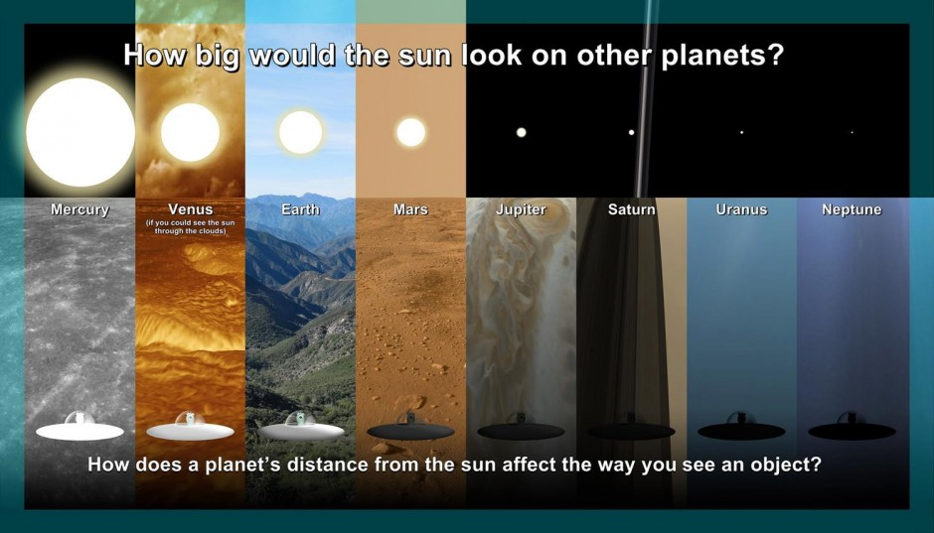

Slide 10
Color of sun?

Slide 11
Planet | Atmosphere | Sun Color
Earth | Thin | Yellow or white
Venus | Thick | Red
Mars | Thin | Reddish-orange
Jupiter | Thick | Orange
Saturn | Thick | Yellow
Uranus | Thick | Green
Neptune | Thick | Blue

Slide 12
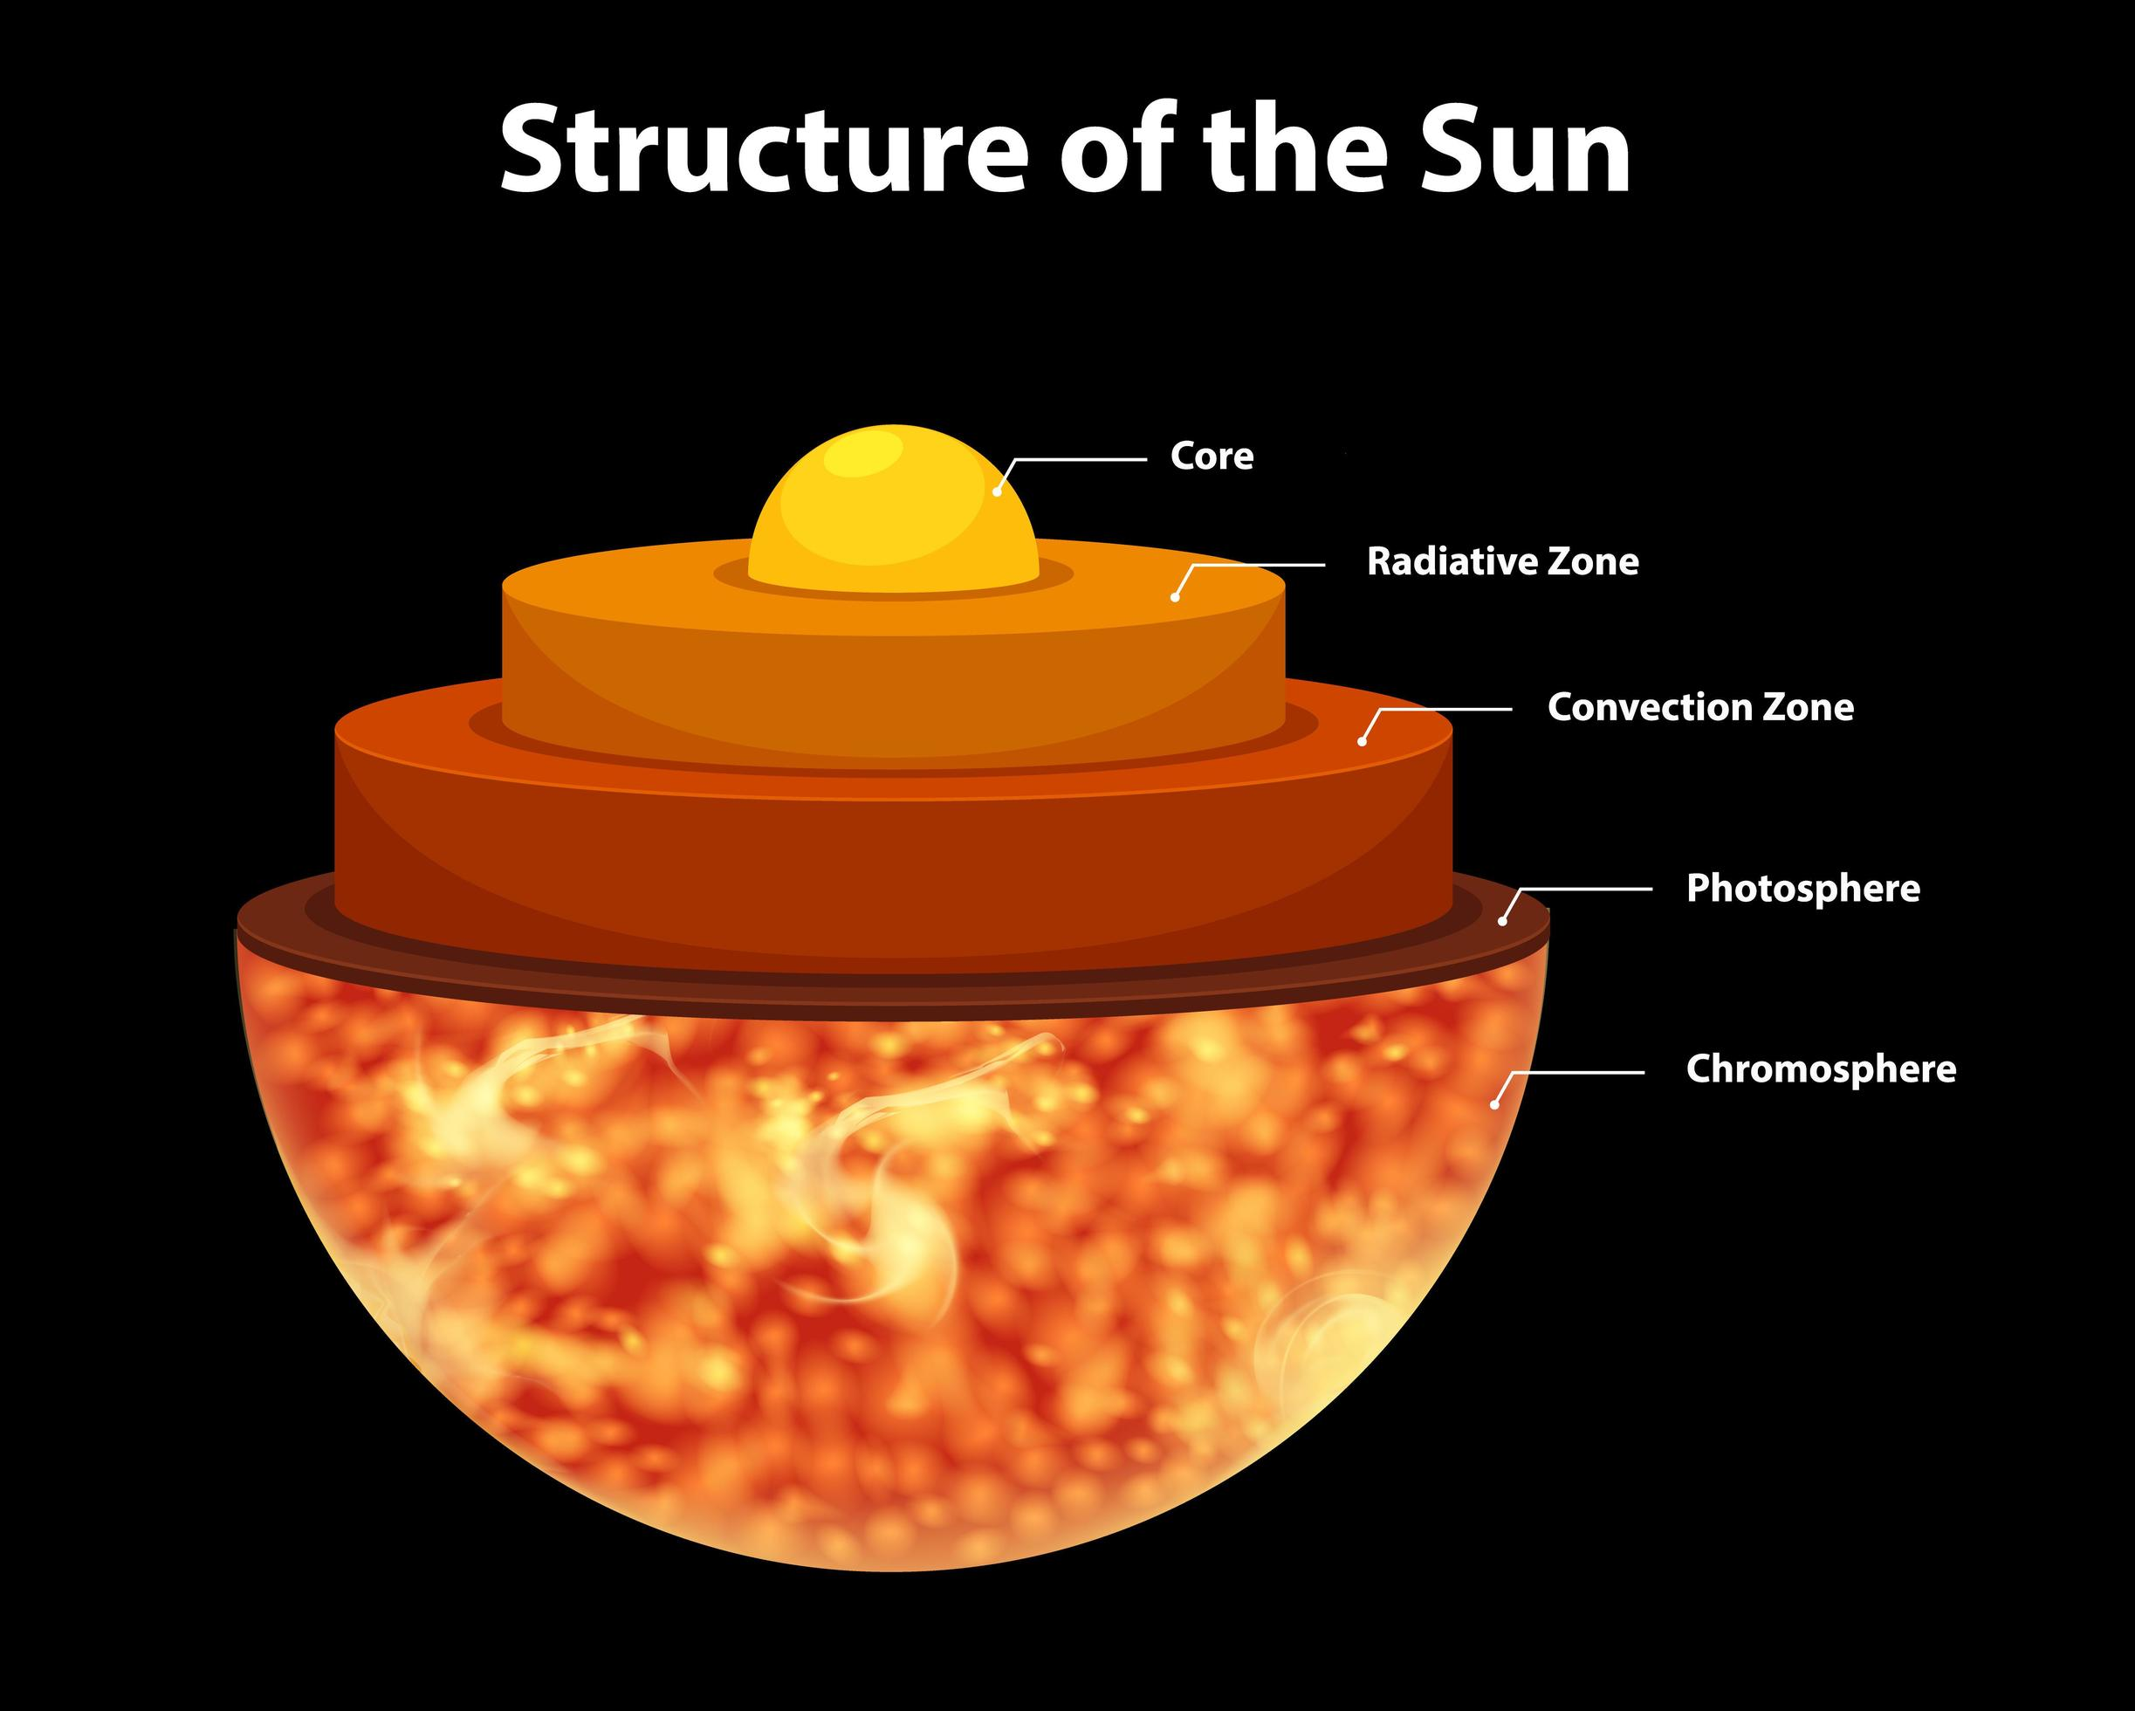

Slide 13
Core:
The Sun’s core is extremely dense and is the source of all of its energy.
The core takes up about 20% of the Sun's total volume.
Hottest part with a temperature of about 15 million degrees Celsius.
Nuclear fusion reactions take place, which convert hydrogen into helium and release a tremendous amount of energy.
As the gases heat up, atoms break apart into charged particles, turning the gas into plasma.
Density of about 150 grams per cubic centimeter (about 15 times the density of Earth).
Proton-Proton chain, chain of thermonuclear reactions that is the chief source of the energy radiated by the Sun and other cool main-sequence stars.
The energy, mostly in the form of gamma-ray photons and neutrinos, is carried into the radiative zone

Slide 14
Radiative Zone:
Named for the primary mode of transporting energy across it.
Starts at about 25 percent of the radius, and extends to about 70 percent of the radius.
Heat from the core cools dramatically, between 12 million°F or 7 million°C to 2 million°C or 4 million°F.
In this zone energy is transferred by a process called thermal radiation.
Photons that were released in the core travel a short distance, are absorbed by a nearby ion, released by that ion, and absorbed again by another.
Energy moves slowly outward, taking more than 170,000 years to radiate through this layer of the Sun.
One photon can continue this process for almost 200,000 years.

Slide 15
Transition Zone (Tachocline):
Present between the radiative zone and the convective zone, created as a result of the sun’s differential rotation.
Differential rotation happens when different parts of an object rotate at different velocities.
The sun’s equator rotates much faster than its poles, for instance.

Slide 16
Convective Zone:
The outer-most layer of the solar interior extends from a depth of about 200,000 km from 70% right up to the visible surface.
Energy continues to move toward the surface through convection currents of the heated and cooled gas.
Convection mean heat transfer in a gas or liquid by the circulation of currents from one region to another.
Convection occurs when the temperature gradient (the rate at which the temperature falls with height or radius) gets larger than the adiabatic gradient (the rate at which the temperature would fall if a volume of material were moved higher without adding heat).
The plasma at the bottom of the convective zone is extremely hot, and it bubbles to the surface where it loses its heat to space.
Once the plasma cools, it sinks back to the bottom of the convective zone.

Slide 17
Photosphere:
The bright yellow, visible "surface" of the sun is about 400 kilometers (250 miles) thick, and temperatures there reach about 6,000K (5,700°C, 10,300°F).
The thermal columns of the convection zone are visible and the columns appear as granules crowded across the sun.
Each granule has a bright center, which is the hot gas rising through a thermal column and the granules’ dark edges are the cool gas descending back down the column to the bottom of the convective zone.
The thermal columns are usually more than 1,000 kilometers (621 miles) across.
Most thermal columns exist for about eight to 20 minutes before they dissolve and form new columns.
There are also “supergranules” that can be up to 30,000 kilometers (18,641 miles) across, and last for up to 24 hours.

Slide 18
Sunspot:
Sunspots are dark, planet-size regions of strong magnetic fields on the surface of the sun.
Darker because they are cooler than their surroundings 6,300 degrees Fahrenheit (3,500 degrees Celsius), whereas the surrounding photosphere is about 10,000 F (5,500 C).
The frequency and intensity of sunspots visible on the surface indicate the level of solar activity during the 11-year solar cycle.
Sunspots form when concentrations of magnetic field from deep within the sun well up to the surface.
Central darker region, known as the umbra, and a surrounding region, known as the penumbra.
The sun magnetic loop get more wound up and "snap," rise and break the surface.
This disturbance in the sun's magnetic field forms pores that can grow and join together to form larger pores, or proto-spots, that eventually become sunspots.

Slide 19
Solar Flares:
The creation of sunspots opens a connection between the corona and the sun’s interior.
Solar matter surges out of this opening in formations called solar flares.
Clouds of ions, atoms, and electrons erupt from solar flares.
Solar flares and solar prominences contribute to space weather, which can cause disturbances to Earth’s atmosphere and magnetic field, as well as disrupt satellite and telecommunications systems.
The intensity of the explosion determines what classification the flare belongs to. The most powerful are X-class flares, followed by M-, C- and B-class; A-class flares are the smallest.

Slide 20
Solar Cycle:
The solar cycle was discovered by amateur astronomer Heinrich Schwabe during his observations of the sun between 1826 and 1843; also determined that the sun rotates once every 27 days. .
The solar cycle is defined by the sun’s magnetic fields, which loop around the sun and connect at the two poles changes every 11 years and the magnetic fields reverse, causing a disruption that leads to solar activity and sunspots.

Slide 21
Chromosphere:
The pinkish-red chromosphere is about 2,000 kilometers (1,250 miles) thick and riddled with jets of hot gas.
visible only when the photosphere was concealed by the Moon during a total solar eclipse.
The name chromosphere, from the Greek for “colored sphere,” was given to this red streak.
The temperature of the chromosphere is about 10,000 K, hotter than the photospher

Slide 22
Corona:
The wispy outermost layer of the solar atmosphere, and can extend millions of kilometers into space.
Gases in the corona burn at about one million K (one million°C, 1.8 million°F), and move about 145 kilometers (90 miles) per second.
The best time to see the corona from Earth is during a total solar eclipse, it can be observed easily from orbiting spacecraft.

Slide 23
Thank You & Discussion Time

