Slide 1

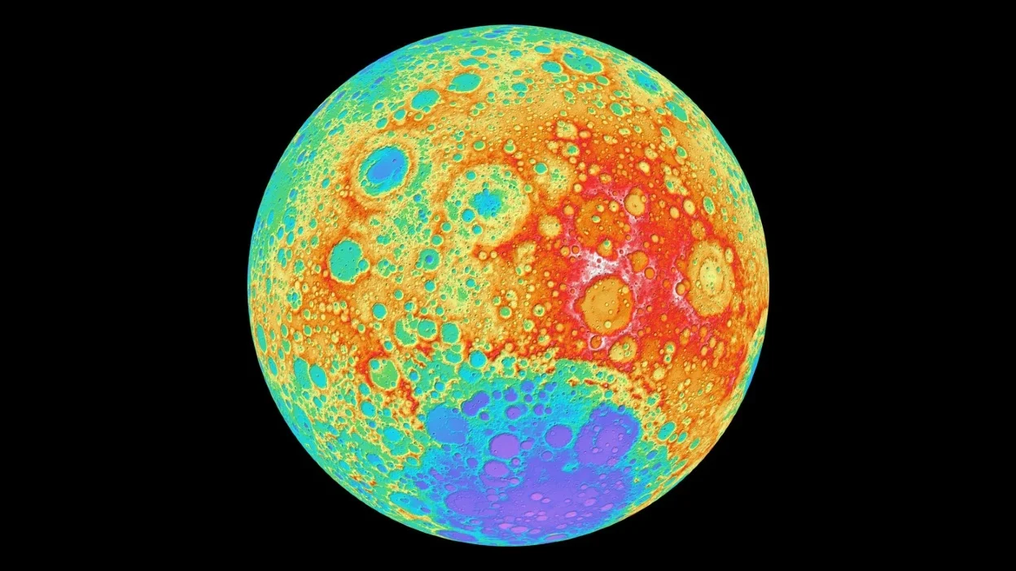
Earth’s Sattelite

Slide 2
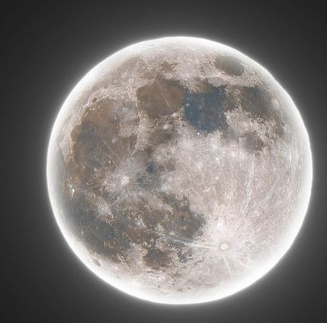

Slide 3
Intro
Only natural satellite.
Closest celestial object.
Diameter => 2159 miles (3475 km) .
Distance => 2,38,860 miles (3,82,500 km) .
Perigee => 2,24,000 miles (Supermoon occur 14% large) .
Apogee => 2,52,000 miles.
Surface area => 37,90,00,000 km².
Mass => 0.0735 x 10²⁴ Kg.
Density => 3.34 g/cm².
Gravity => 1.6 m/sec².
Escape velocity => 2.38 km/sec.
Moon Tour

Slide 4
Formation
The mars sized planet theia collided with early molten earth (giant impact hypothesis) after 95 million year solar system form.
A cloud of dust and derbies formed.
Gravity holds and bound those cloud.
Apollo mission, brought data & 382 kg lunar samples.

Slide 5

Surface
Identical surface with earth.
Three layer- core,mantle and crust.
Core is smaller than others, 149 miles of iron rich inner core surrounded by 56 miles of liquid iron shell. Thickness 93 miles.
Mantle – made of minerals like olivine and pyroxene which are of magnesium, iron, silicon and oxygen atom.
Crust thickness 43 miles on near-side and 93 on far-side. Oxygen, silicon, magnesium, iron, calcium, and aluminum, with small amounts of titanium, uranium, thorium, potassium, and hydrogen are present.

Slide 6
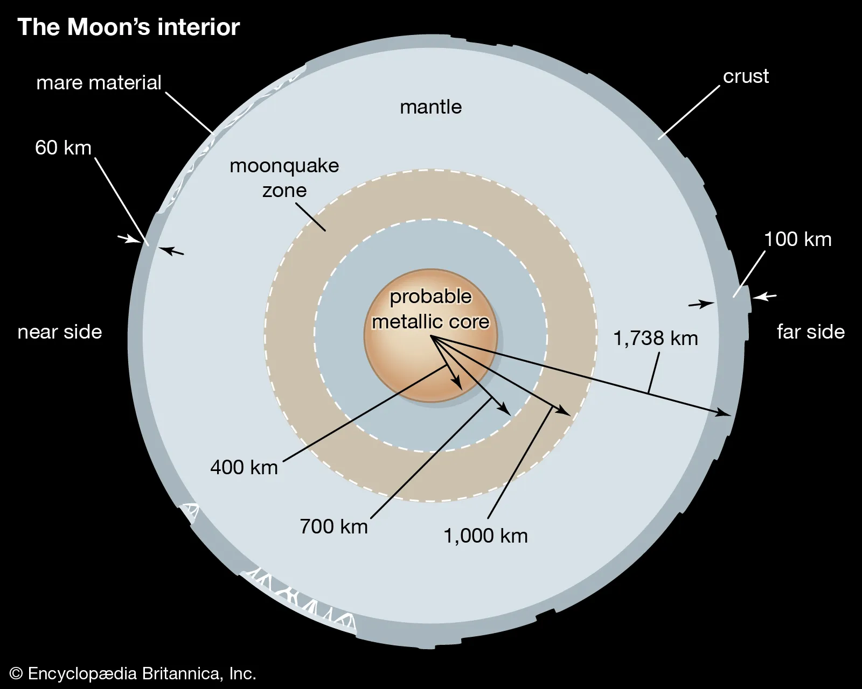

Slide 7
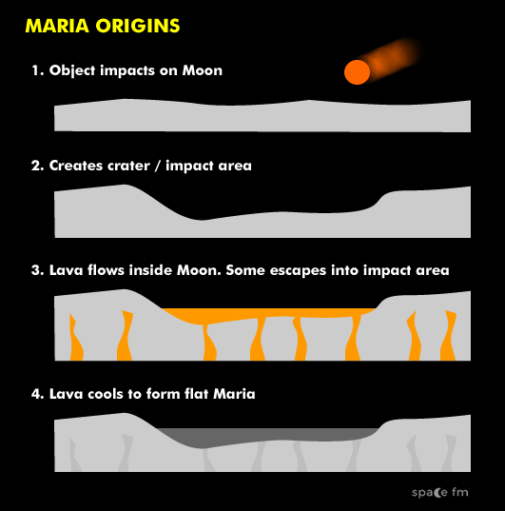

Slide 8
Elements | Percentage %
Oxygen | 43
Silicon | 20
Magnesium | 19
Iron | 10
Aluminum | 3
Chromium | 0.42
Titanium | 0.18
Manganese | 0.12

Slide 9
Atmosphere
Very thin layer; dust/footprints remains for centuries.
Temperature vary wildly.
Temperature => day 273°F (134°C) and night 243°F (-153°C).
Some place have magnetic field.

Slide 10

Phases
The change in moon’s appearance.
Due to geometry of sun , moon and earth.
Eight phase over period of 29.5 days.
New Moon (solar eclipse occur)
Waxing Crescent
First Quarter
Waxing Gibbous
Full Moon (Lunar eclipse occur)
Waning Gibbous
Last Quarter
Waning Crescent

Slide 11
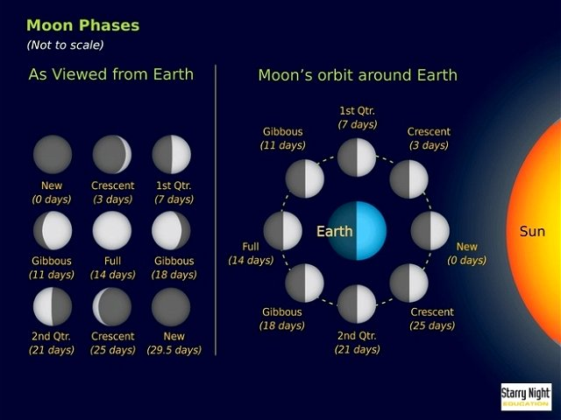

Slide 12
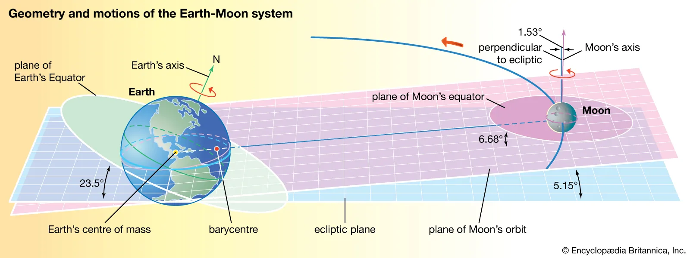

Slide 13
Moon & Tide
Moon’s gravity affect whole earth.
Strongest pull on nearest point and week on far point.
Spring tide (high tide) – sun, moon and earth aligned straight.
Neap tide (half tide) - When three at right angle sun force cancel moon’s tide creating force.
Earth gravity cause land tide on moon measured by laser which will about 4-6 inch.

Slide 14
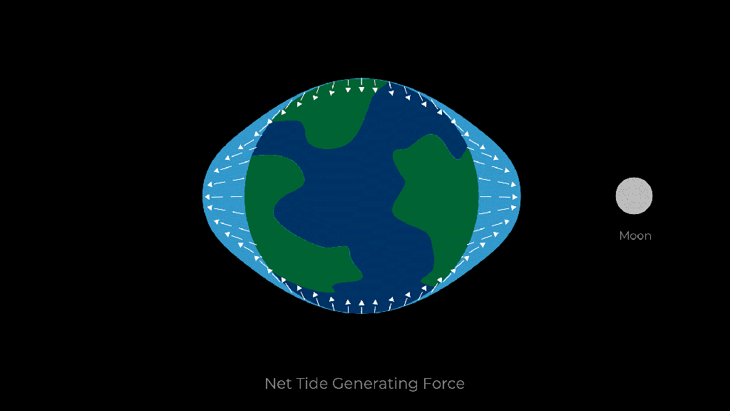

Slide 15
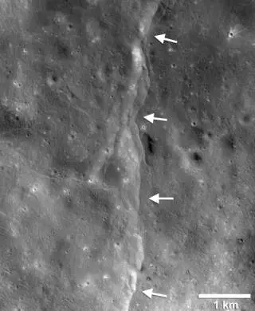

Slide 17
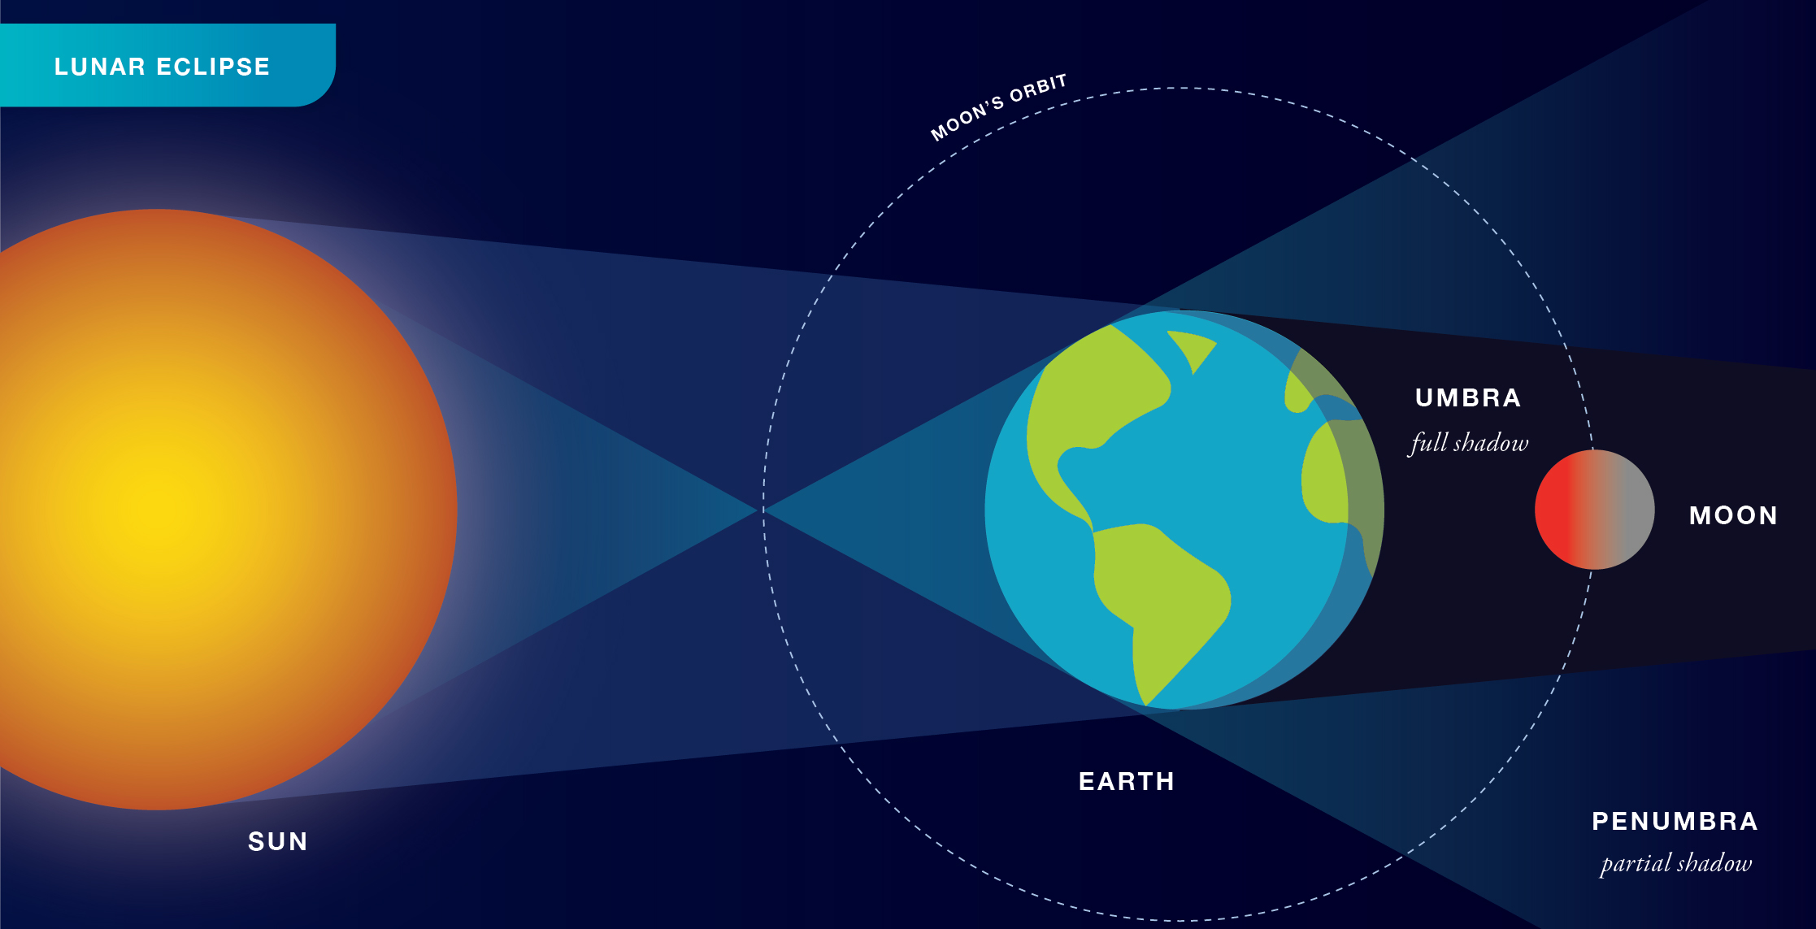

Slide 18
Discussion Time

Slide 19
Thank You

