Slide 1

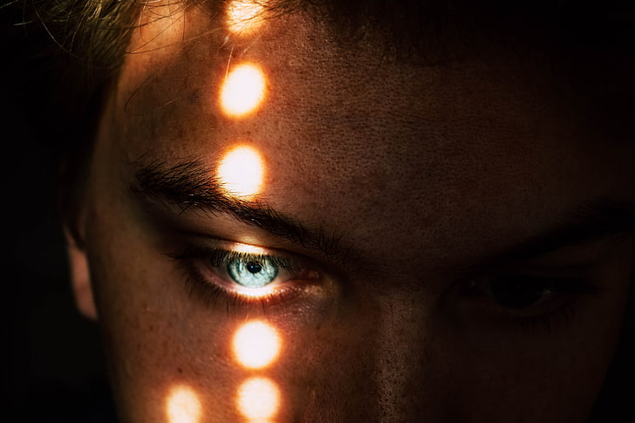

Slide 2
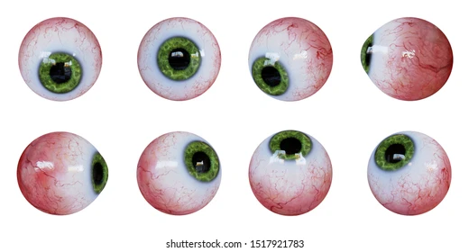
Parts of Eye ball

Slide 3
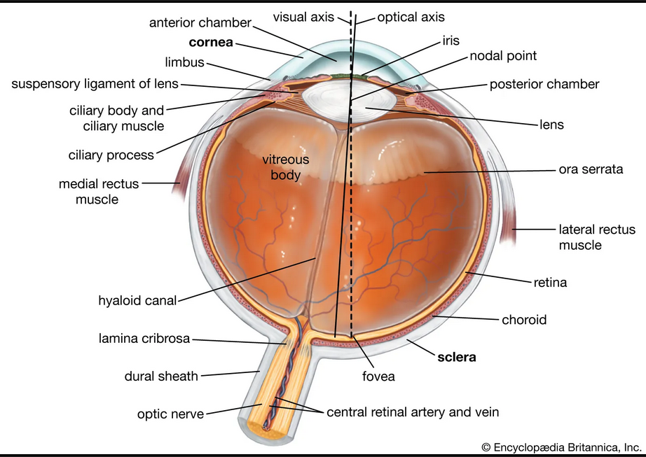

Slide 4
Present in bony socket – orbit.
Six extraocular muscles attached to eye for movements.
Maximum part of eyes covered with Sclera, a white layer of strong tissue.
The surface of eye including sclera is covered with clear membrane – Conjunctiva.
Conjunctiva, transparent mucous membrane – prevent drying.
The tear film covers the cornea, Light pass through it.
Tear film made of three layers including conjunctiva, watery layer and oil layer.
Oil layer s made by meibomian gland present below the eye.
Cornea behind it helps to focus light.

Slide 5
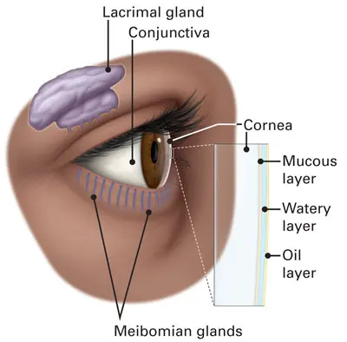

Slide 6
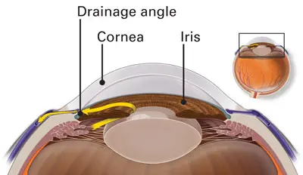

Slide 7
Anterior chamber present below cornea, a fluid filled layer.
The fluid is called aqueous humor, produced regularly for maintaining eye pressure.
Iris colored part present beneath it, controls the amount of light enters the eye by
constrict and dilate the pupil.
The pupil is the hollow space in center of iris.
The lens is subjected behind the pupil. Changes shape to focus object close.
Zonules attached to capsule holding lens, and is connected to ciliary body.
The ciliary body controls the shape of lens.
The vitreous cavity located between lens and retina, a gel like fluid called vitreous humor which holds shape of eye.

Slide 8
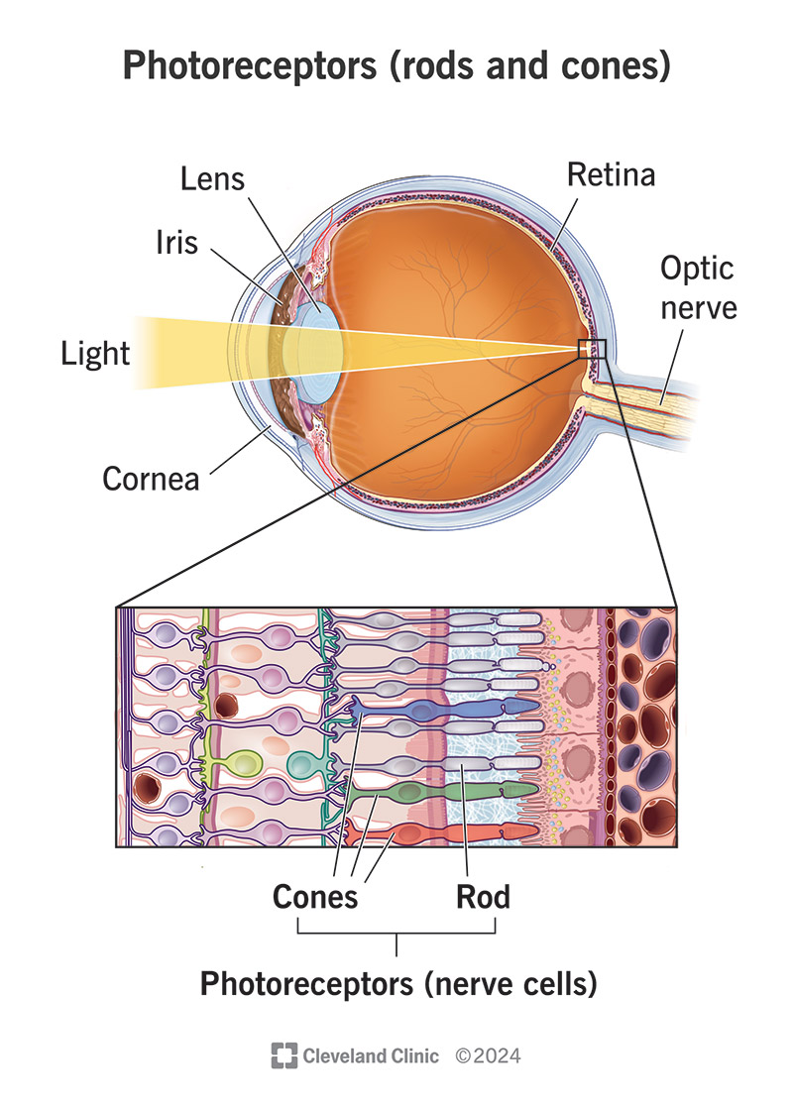

Slide 9
Retina – the light sensitive tissue lining at the back of eye.
The light reaches retina create chemical reaction in a layer and converted to electric signals.
The retina has two cells called rods and cones, commonly known as photoreceptors.
Rods – (120 million) more sensitive to light, help to see low light. Do not allow colors.
Cones – (7 million) allow color but need more intensity.

Slide 10
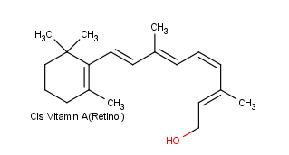
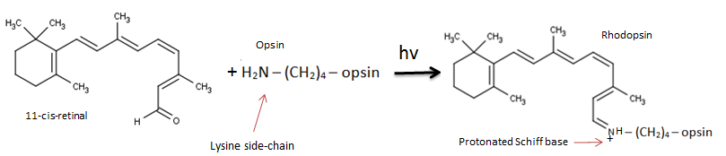
Vitamin-A, known as retinol or anti-dry eye vitamin.
Retinol converted to retinal (chemical necessary for rhodopsin).
Rhodopsin light-sensitive protein found in retina.
The molecule cis-retinal absorb light at specific wavelength.
As light enters the eye, the 11-cis-retinal is isomerized to the all-"trans" form.
The molecule cis-retinal absorb light at specific wavelength.

Slide 11
The cone contains photopigments similar to rhodopsin called photopsin.
Three types of cone cells:
* L-cone – Erythrolable – Red light (~560mn)
* M-cone – chlorolable – Green light (~530nm)
* S-cone – cyanolable – Blue light (~420nm)
The change in protein geometry initiates biochemical reaction results potential difference.
This potential difference is carried and converted to image by brain.

Slide 12
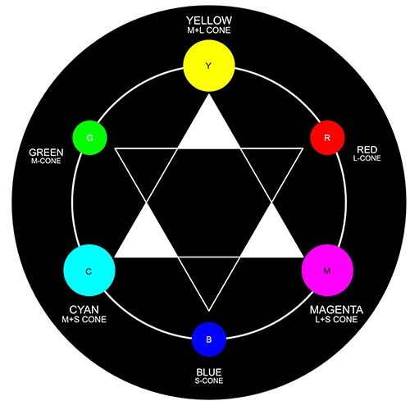

Slide 13
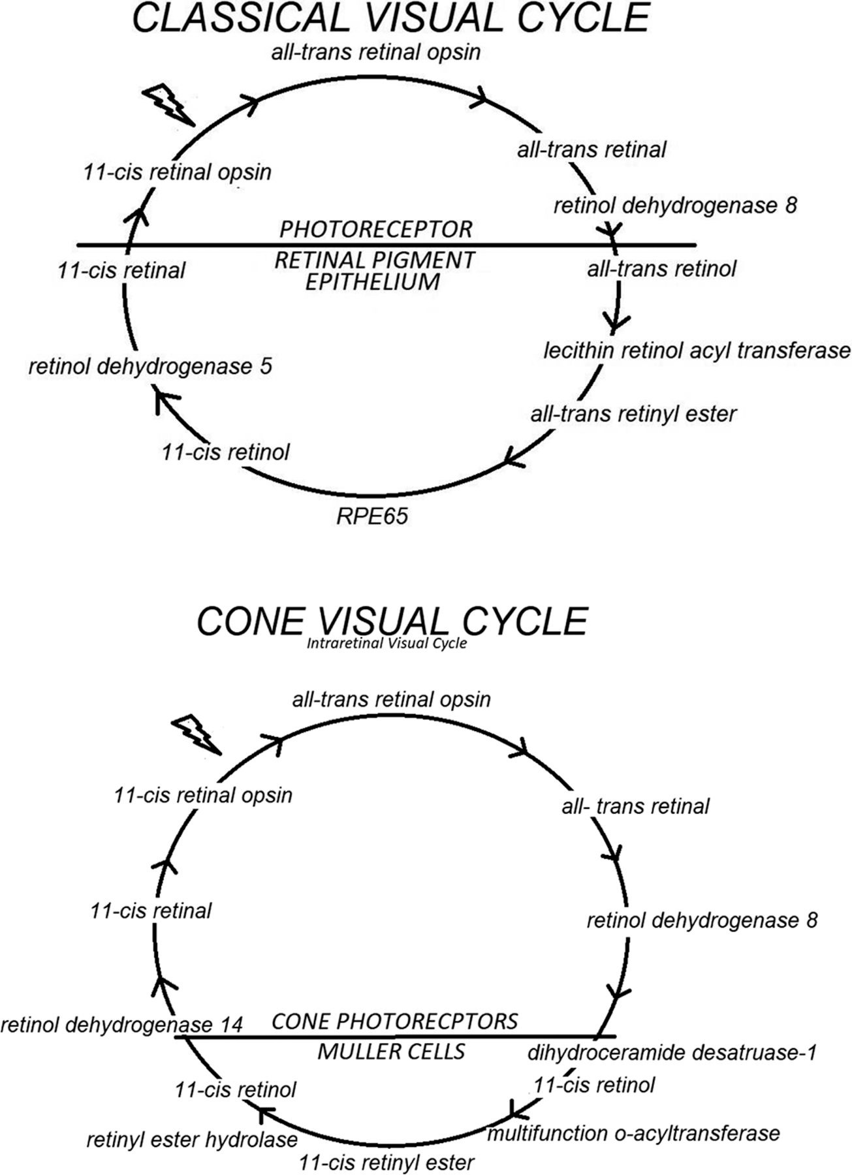

Slide 14
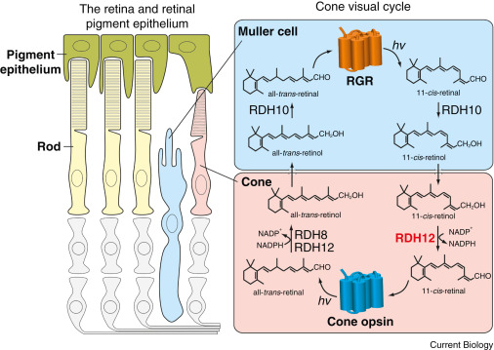

Slide 15

Eye Defects

Slide 16
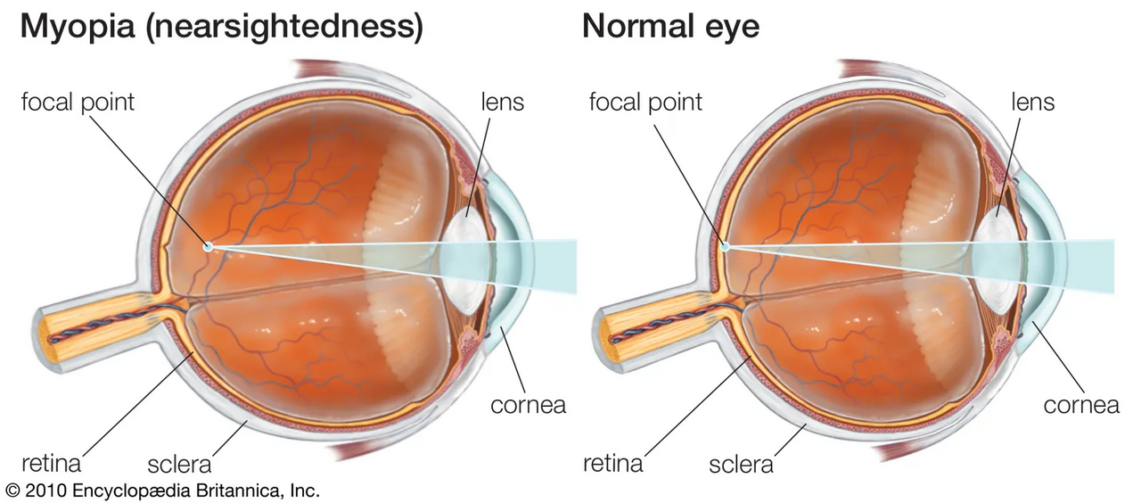

Slide 17
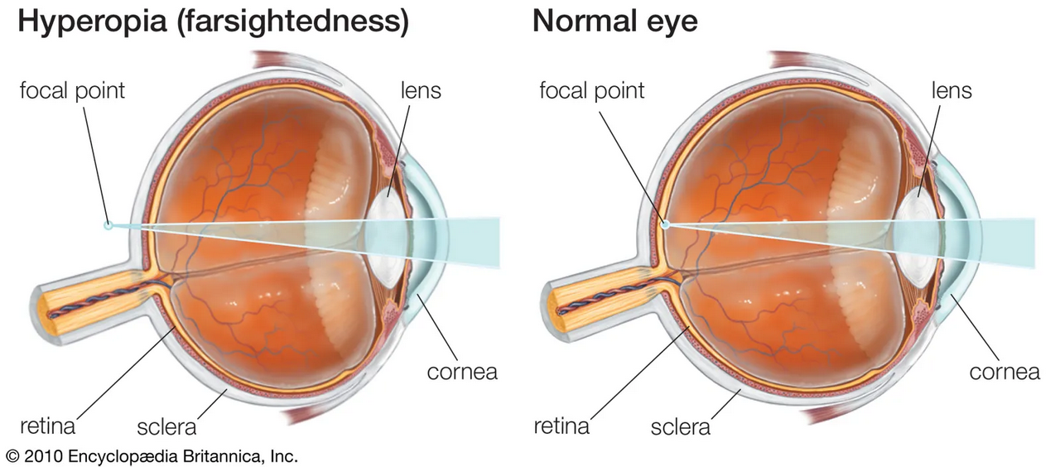

Slide 18
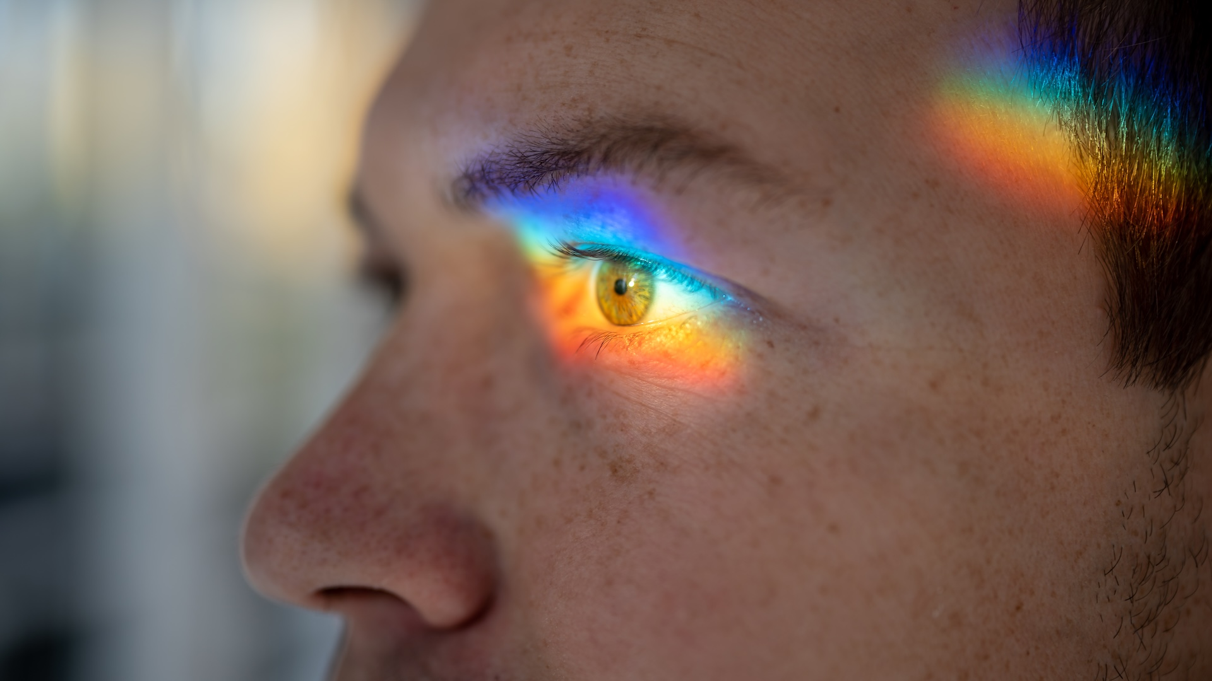

Slide 19
Thank You

