Slide 1
The Sun
Goals:
-Summarize the overall properties of the Sun.
-Explain how energy travels from the solar core, through the interior, and out into space.
-Name the Sun's outer layers and describe what those layers tell us about the Sun's surface composition and temperature.
-Outline the process by which energy is produced in the Sun's interior.

Slide 2
The Sun
Our Sun is a star, and a fairly average star at that, but with one unique feature:
it is very close to us
It is 300,000 times closer than our next nearest neighbor, Alpha Centauri.
Alpha Centauri is 4.3 light years from us
the Sun is only 8 light minutes away from us.

Slide 3
The Sun
star
A glowing ball of gas held together by its own gravity and powered by nuclear fusion in its core.
The Sun is very similar to most other stars, regardless of when and where they formed.
That is why we study it.

Slide 4
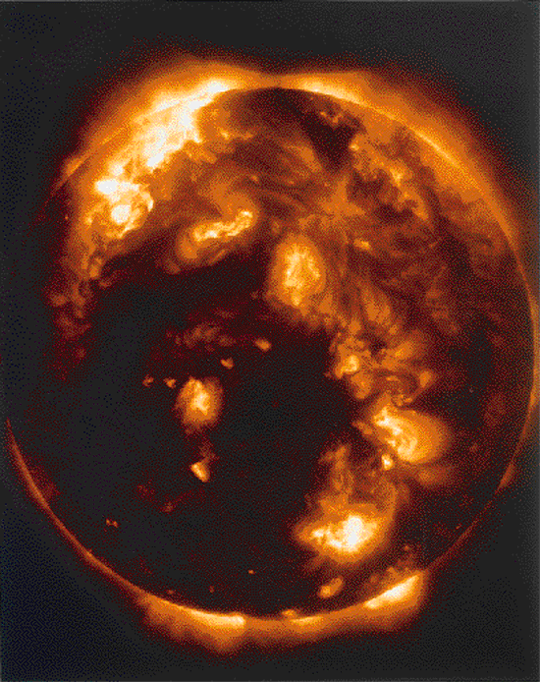
The Sun
The Sun's radius is roughly 700,000 km
How do we know this?

Slide 5
The Sun
It is determined by measuring its angular size (0.5° or how many arc minutes?) and then using geometry

Slide 6
The Sun
The Sun's The Sun's mass, 2.0 x 10³⁰ kg
How do we know this?

Slide 7
The Sun
Through the application of Newton's laws of motion and gravity to the observed orbits of the planets.

Slide 8
The Sun
The average solar density is approximately 1400 kg/m³, and is quite similar to that of the jovian planets and about one-quarter the average density of Earth.

Slide 9
The Sun
The solar rotation period is found by timing sunspots and other surface features as they traverse across the sun
These observations indicate that the Sun rotates in about a month, but it does not do so as a solid body.
Instead, it spins differentially—faster at the equator and slower at the poles, like Jupiter and Saturn.

Slide 10
The Sun
The Sun's surface temperature is measured by applying the radiation laws to the observed solar spectrum.
The distribution of solar radiation has the approximate shape of a blackbody curve for an object at about 5800 K.
The average solar temperature obtained in this way is known as the Sun's effective temperature.

Slide 11
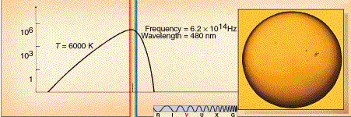
The Sun
The Sun's surface, at 6000 K, is brightest in the visible region of the electromagnetic spectrum.

Slide 12
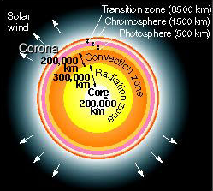
The Sun -- Structure
The Sun's structure, not drawn exactly to scale.

Slide 13
The Sun – Properties
The properties of size, mass, density, rotation rate, and temperature are familiar from our study of the planets.
(i.e. YOU SHOULD BE FAMILIAR WITH)
The Sun has an additional property:
- the most important of all from the point of view of life on Earth
-it radiates a great deal of energy into space, uniformly in all directions.

Slide 14
The Sun – Luminosity
How do can we measure the amount of radiation we receive?

Slide 15
The Sun – Luminosity
How do can we measure the amount of radiation we receive?
Get a light-sensitive device—a solar cell.
Hold it perpendicular to the Sun's rays
Measure how much solar energy is received per area of the solar cell, per second.
Figure out how much energy per square meter of surface area every second

Slide 16
The Sun – Luminosity
solar constant
The amount of solar energy reaching Earth per unit area per unit time, approximately 1400 W/m².

Slide 17
The Sun – Luminosity
How do we find the total amount of energy radiated in all directions from the Sun?
i.e. Not just the small fraction intercepted by our detector or by Earth.

Slide 18
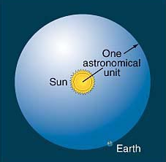
The Sun – Luminosity
We can draw an imaginary sphere around the Sun so that the sphere's edge passes through Earth's center. The radius of this imaginary sphere equals one astronomical unit. By multiplying the sphere's surface area by the solar constant, we can measure the Sun's luminosity, the amount of energy it emits each second.

Slide 19
The Sun – Luminosity
Imagine a three-dimensional sphere that is centered on the Sun and is just large enough that its surface intersects Earth's center.
The sphere's radius is 1 A.U., and its surface area is therefore 4 x pi x (1 A.U.)², or approximately 2.8 x 10²³ m².
Multiplying the rate at which solar energy falls on each square meter of the sphere (i.e., the solar constant) by the total surface area of our imaginary sphere, we can determine the total rate at which energy leaves the Sun's surface. This quantity is known as the luminosity of the Sun.
It turns out to be just under 4 x 10²⁶ W.

Slide 20
The Sun
quiet Sun
The underlying predictable elements of the Sun's behavior, such as its average photospheric temperature, which do not change in time

Slide 21
The Sun
As we look into the atmosphere at the surface of the Sun, the view becomes more and more opaque.
The point where it appears to become completely opaque is called the photosphere.
Thus, the photosphere may be thought of as the imaginary surface from which the solar light that we see appears to be emitted.
The diameter quoted for the Sun usually refers to the diameter of the photosphere.

Slide 22
The Sun
active Sun
The unpredictable aspects of the Sun's behavior, such as sudden explosive outbursts of radiation in the form of prominences and flares.

Slide 23
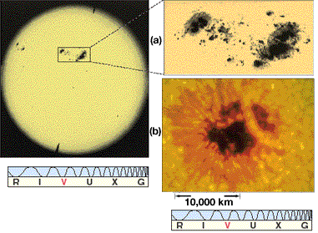
The Sun
This photograph of the entire Sun, taken during a period of maximum solar activity, shows several groups of sunspots.
The largest spots in this image are over 20,000 km across—twice the diameter of Earth. Typical sunspots are only about half this size.

Slide 24
The Sun
sunspot
An Earth-sized dark blemish found on the surface of the Sun.
The dark color of the sunspot indicates that it is a region of lower temperature than its surroundings.

Slide 25
The Sun
(a) An enlarged photograph of the largest pair of sunspots.
Each spot consists of a cool, dark inner region called the umbra, surrounded by a warmer, brighter region called the penumbra
The spots appear dark because they are slightly cooler than the surrounding photosphere..
(b) A high-resolution, true-color image of a single sunspot shows details of its structure as well as much surface granularity surrounding it.
The spot is about the size of Earth.

Slide 26
The Sun
The Sun is gaseous and rotates differentially, and these facts radically affect the character of solar magnetism.
Because the Sun rotates more rapidly at the equator than at the poles, the differential rotation distorts the solar magnetic field, wrapping it around the solar equator, eventually causing the original north—south magnetic field to reorient itself in an east—west direction.
Convection then causes the magnetized gas to upwell toward the surface, twisting and tangling the magnetic field pattern.

Slide 27
The Sun
In some places, the field becomes kinked like a knot in a garden hose, causing it to increase in strength.
Occasionally, the field strength becomes so great that it overwhelms the Sun's gravitational field and a "tube" of field lines bursts out of the surface and loops through the lower atmosphere, forming a sunspot pair.
The general east—west organization of the underlying solar field accounts for the observed polarities of the pairs in each hemisphere.

Slide 28
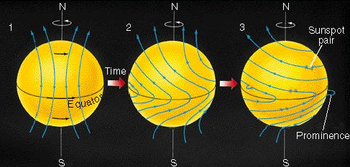
The Sun
This diagram illustrates how the Sun's differential rotation wraps and distorts the solar magnetic field.
Occasionally, the field lines burst out of the surface and loop through the lower atmosphere, thereby creating a sunspot pair.
The underlying pattern of the solar field lines explains the observed pattern of sunspot polarities.

