Slide 1
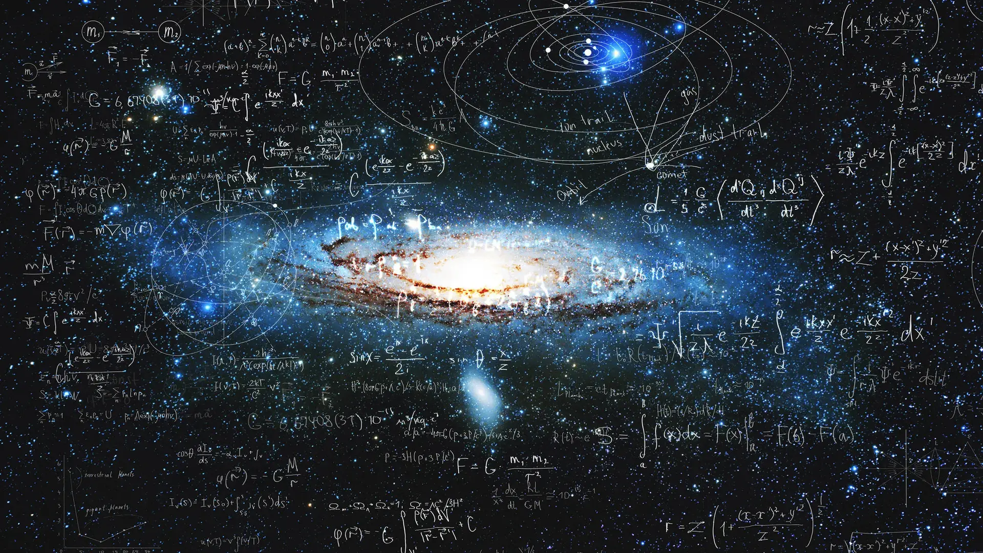

Slide 2
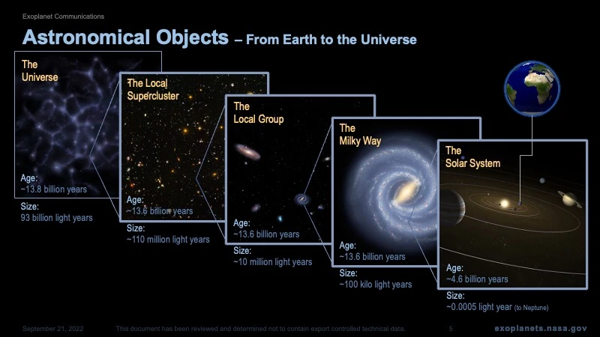

Slide 3
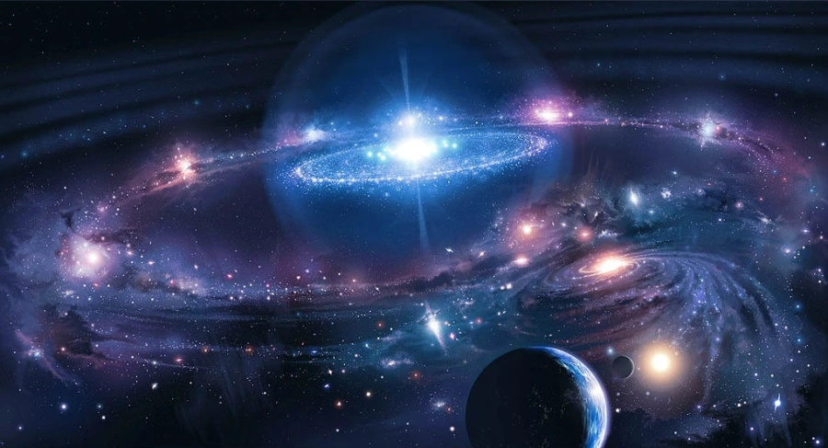

Slide 4
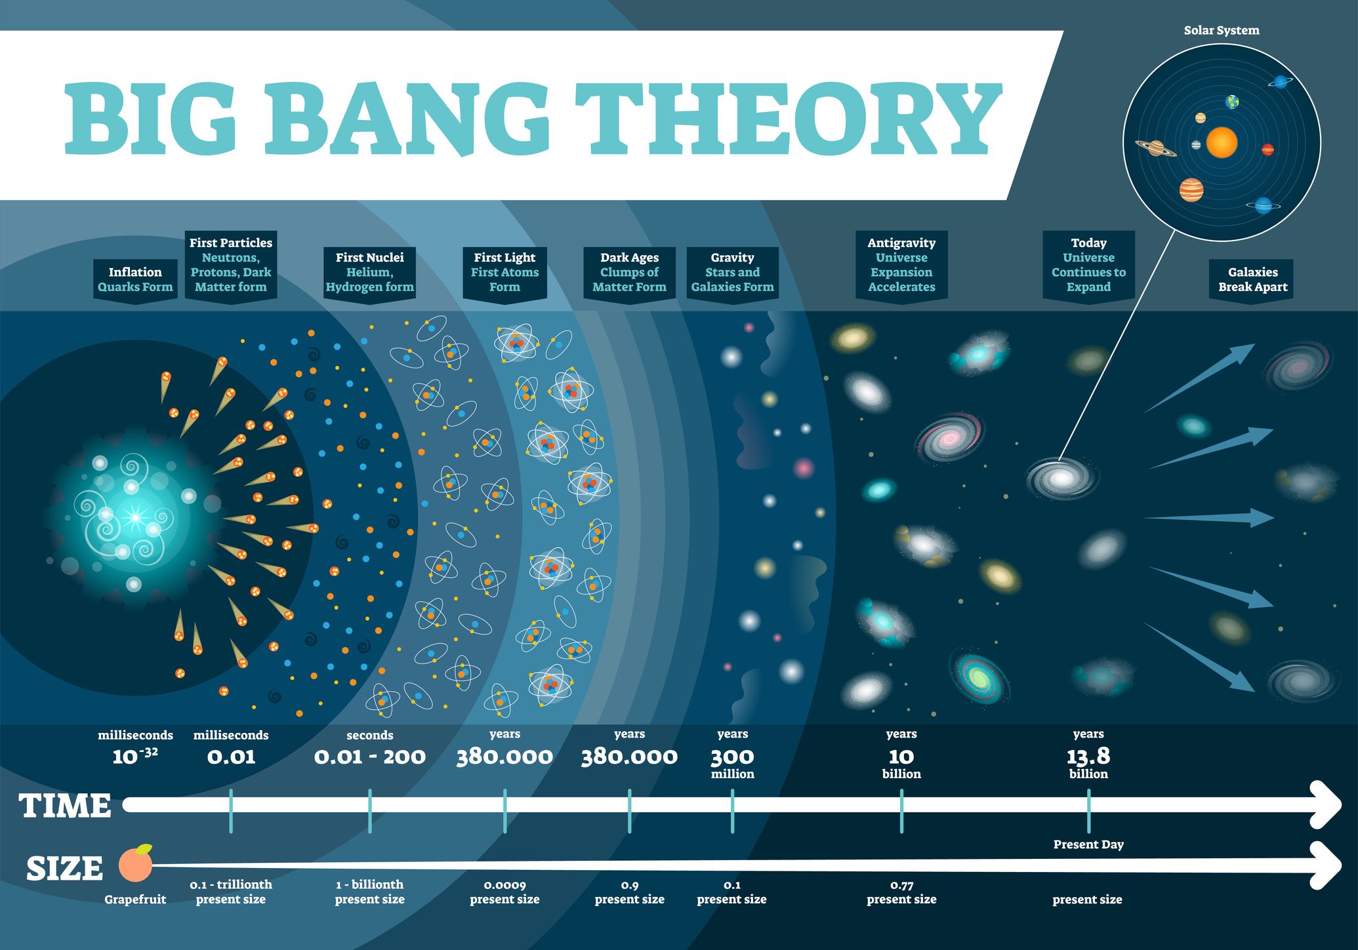

Slide 5

Big Bang
1922 – Alexander Friedmann 🔹 Proposed that the universe is expanding using Einstein’s equations.
1927 – Georges Lemaître 🔹 Suggested the universe began from a "Primeval Atom" (early Big Bang concept).
1929 – Edwin Hubble 🔹 Discovered that galaxies are moving away (Redshift), proving expansion.
1940s – George Gamow & Ralph Alpher 🔹 Developed the Hot Big Bang Model and predicted Cosmic Microwave Background Radiation (CMB).
1965 – Arno Penzias & Robert Wilson 🔹 Discovered CMB Radiation, proving the Big Bang Theory.
1990s – NASA’s COBE & WMAP Missions 🔹 Mapped CMB, confirming early universe temperature fluctuations.
2013 – Planck Satellite 🔹 Provided the most precise measurement of the CMB, supporting Big Bang predictions.

Slide 6
Russian Physicist George Gamow (1940’s) conceived hot big bang.
The gas expand when cold and compress when hot.
The temperature of the gas is a measure of the average kinetic energy of it's constituent particles.
The faster the particle move the higher the temperature.
Particle collide with objects that are not stationary and it lose it's kinetic energy and decrease in temperature
Particle gets cool when universe expanding.
The temperature in the early universe is inversely proportional to the scalar factor of the universe. T ∝1/a
The earlier our solar system was a hot dense mixture of subatomic particle called "the primeval fireball".

Slide 7
Big Bang Model
The big-bang model deals with the expanding fireball of elementary particles and photon.
As the universe expands, the fireball dilutes, cools down and complex structure forms.
After a minute of expanding the temperature decrease to 109K and proton and neutrons combine to form a nuclei called nucleosynthesis.
3,80,000 years passed the temperature cools to 3000K and electron combine with nuclei forms neutral atom called recombination.
The star, galaxies and galaxy cluster pulled together by gravity.

Slide 8
Primeval Fireball
Predicted first by George Gamow's colleagues Ralph Alpher and Robert Herman in 1940's which will be of 5K.
After a decade and some at Bell Telephone Laboratories in New Jersey, Arno Penzias and Robert Wilson were testing a sensitive radio antenna to use in a study of radio emission from the Milky Way.
The signal were always filled with noise and they examine everything but no clue for noise is found.
They measured the temperature of the noise which is 3K corresponding to microwave of wavelength 2mm and this is of cosmic radiation left over from big-bang.
This noise was now called Cosmic Microwave Background (CMB).

Slide 9
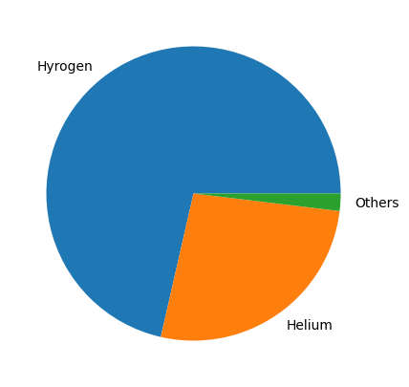
Big Bang Nucleosynthesis

Slide 10

The first step in nucleosynthesis is a neutron to fuse with a proton to make deuterium, or heavy hydrogen.
Then two deuterium combine to form either helium-3 plus a neutron, or tritium plus a proton.
After 1minute of ABB (after big-bang) temperature dropped to one billion Kelvin, and the photon energies are not able break deuterium.
The amount of dark matter in the universe is five times about that in stars and gas.
The big-bang nucleosynthesis does not progress much beyond helium that there are no stable nuclei consisting of 5 nucleons.

Slide 11
Stellar Nucleosynthesis
The stars are gaseous body hold together by gravity and heated by nuclear reaction in the interiors.
Sun surface temperature is 6000 K and the central temperature is 10⁷ K.
Hydrogen is burned into helium in the central part and helium ash is collected at the core.
As sun reaches T≈10⁸K, the helium ash starts burning to carbon and oxygen and the nuclear reaction do not go beyond this.
When a star exhausts its nuclear fuel, it may undergo a supernova explosion, dispersing heavier elements into space.

Slide 12
Planet Formation
Solar system begins with a large, slowly rotating cloud of gas and dust, known as a molecular cloud or nebula.
The gravity and rotation force causes the cloud to contract and flatten into a thin disc.
The gravitational potential energy is converted into kinetic energy, causing the cloud to heat up and increase in density, particularly towards the center.
The material become denser and hotter towards center and some of the materials in the disk coalesces into a series of planets.
where temperatures are higher, rocky planets form and in the cooler outer regions, gas giants and ice giants form by accumulating lighter elements like hydrogen, helium, and ices.

Slide 13
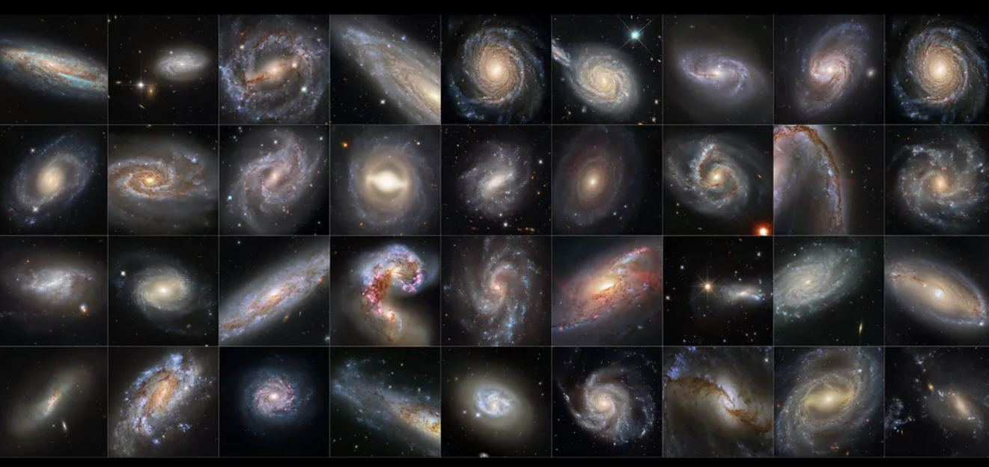

Slide 14
Spiral Galaxy
Elliptical Galaxy
Irregular Galaxy
Lenticular Galaxy

Slide 15
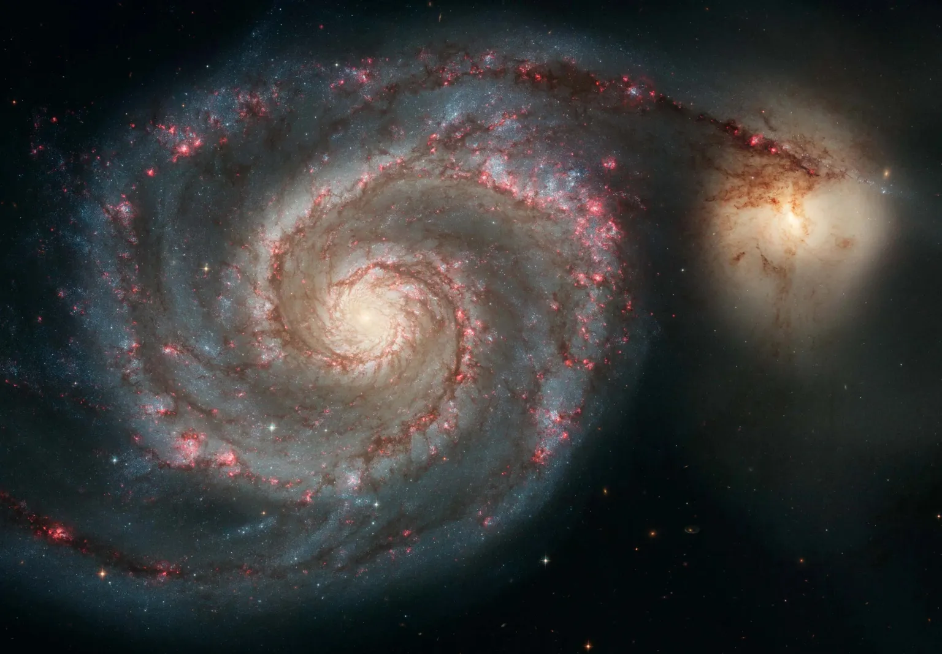
Spiral Galaxy

Slide 16


Disk shaped with spiral arms.
Features:
Central bulge with older stars.
Spiral arms contain young, bright stars and gas for star formation.
Example: Milky Way Galaxy, Andromeda Galaxy.

Slide 17
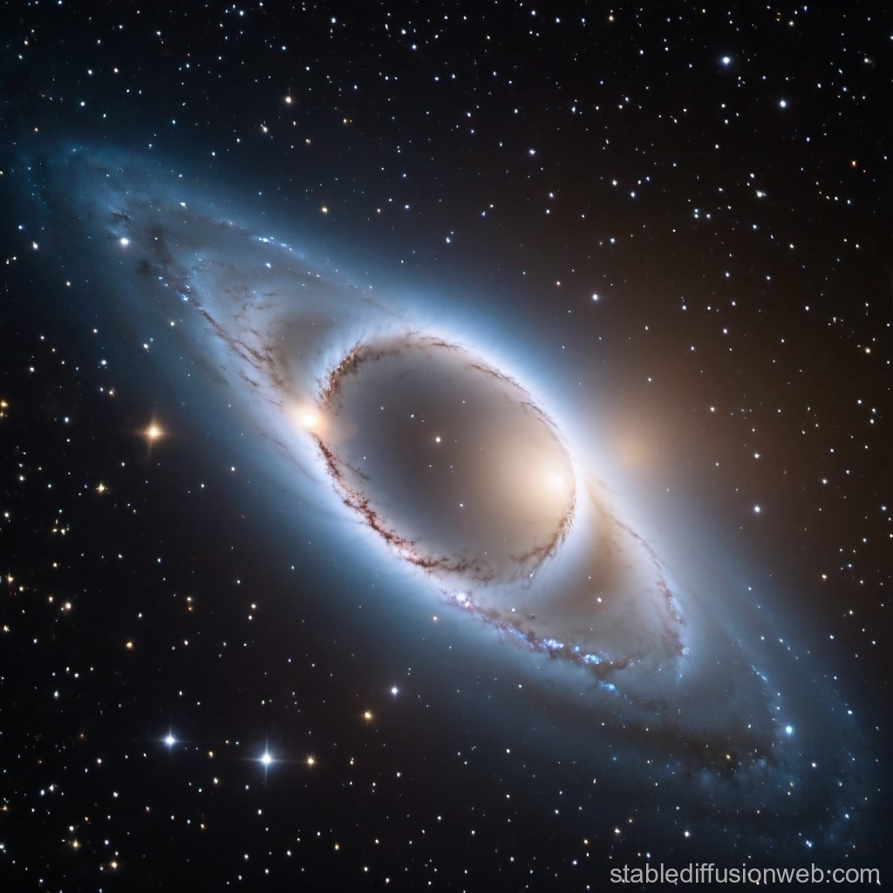
Elliptical Galaxy

Slide 18


Oval or spherical, smooth structure.
Features:
Little gas and dust, fewer new stars.
Mostly made of old stars.
Example: Messier 87 (M87), IC 1101.

Slide 19
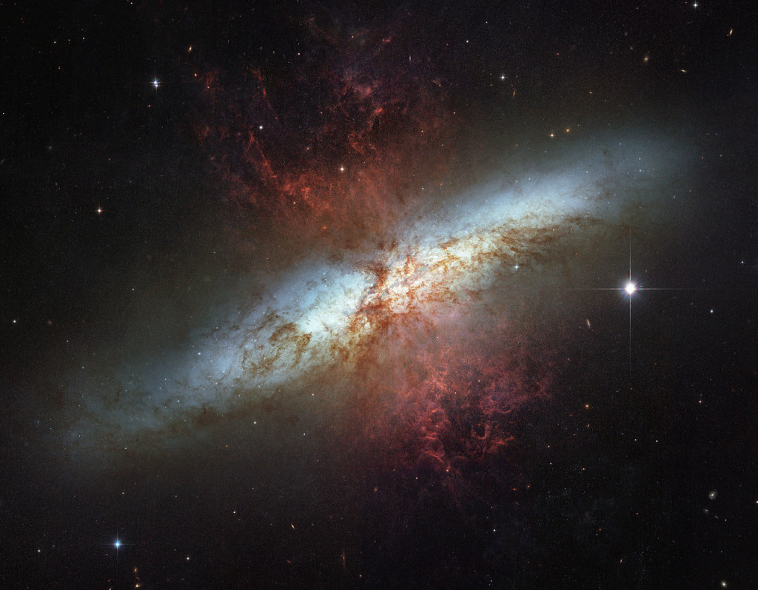
Irregular Galaxy

Slide 20
No definite structure.
Features:
Chaotic appearance due to collisions or gravitational influence.
Rich in gas, forming many new stars.
Example: Large Magellanic Cloud (LMC), Small Magellanic Cloud (SMC).

Slide 21
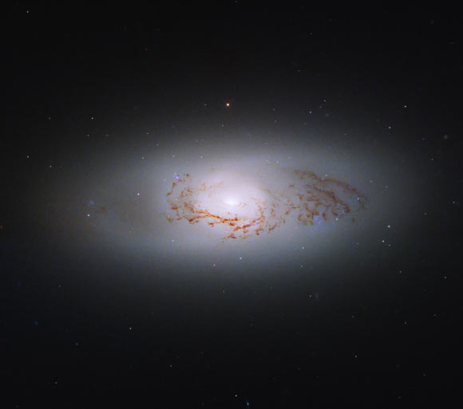
Lenticular Galaxy

Slide 22
Disk-shaped but no spiral arms.
Features:
A mix between spiral and elliptical galaxies.
Contains old stars but little gas.
Example: NGC 5866, Sombrero Galaxy.

Slide 23
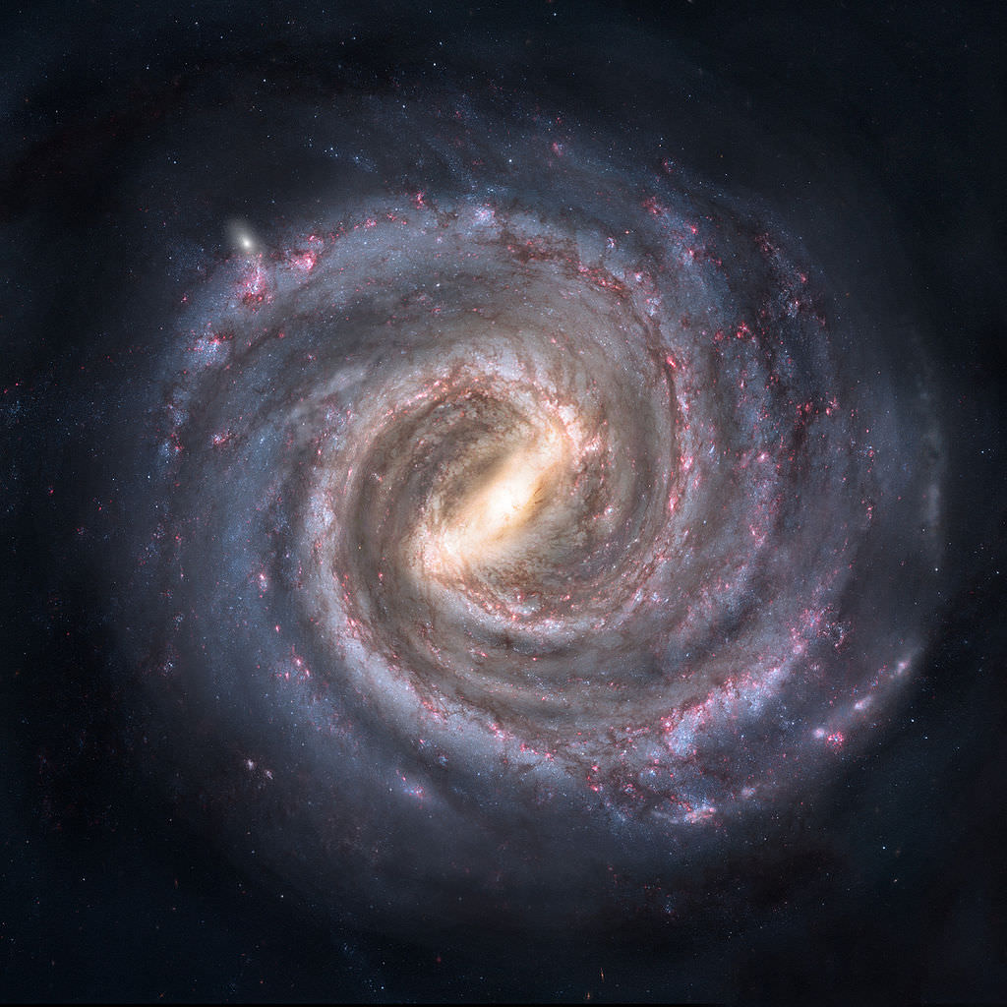
Milky Way Galaxy

Slide 24
Home galaxy.
Contains billions of stars.
About 100,000 light-years in diameter.
Age: Around 13.6 billion years old.
Spiral Arms – Four major arms with young stars, gas, and dust.
Halo – A spherical region of old stars and dark matter surrounding the galaxy.
Galactic Core – Contains a supermassive black hole (Sagittarius A).
It produces about 7 new stars per year.

Slide 25
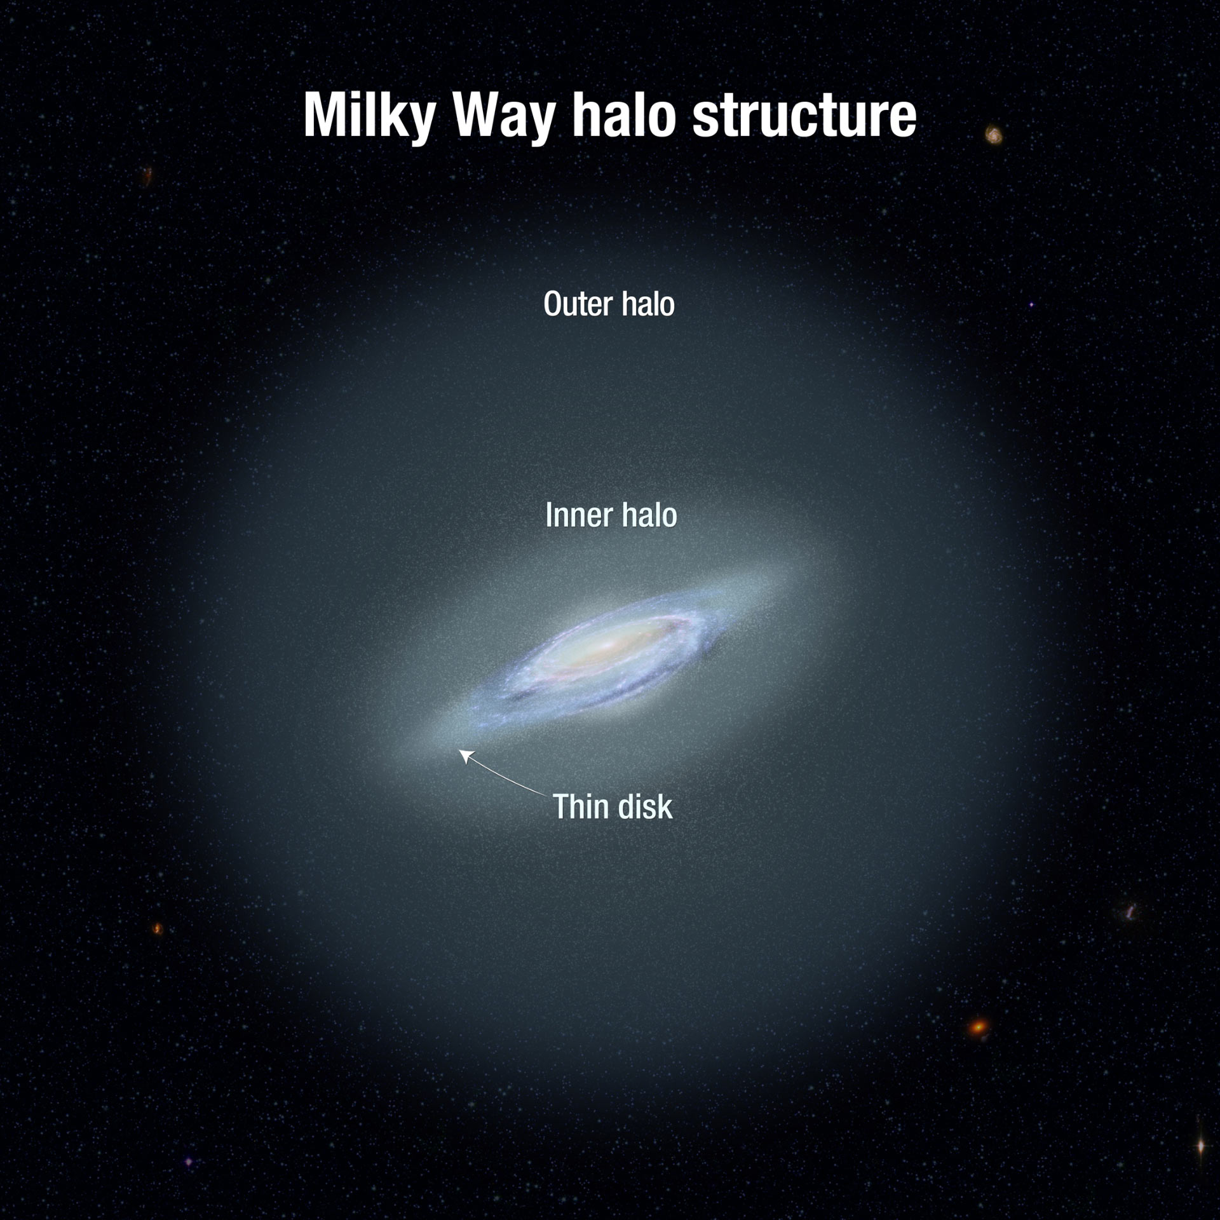

Slide 26
Thank you

