Slide 1
TAMILNADU MODEL SCHOOL
ASTRO CLUB
TOPIC 3
TELESCOPE AND BINOCULAR
TASS

Slide 2
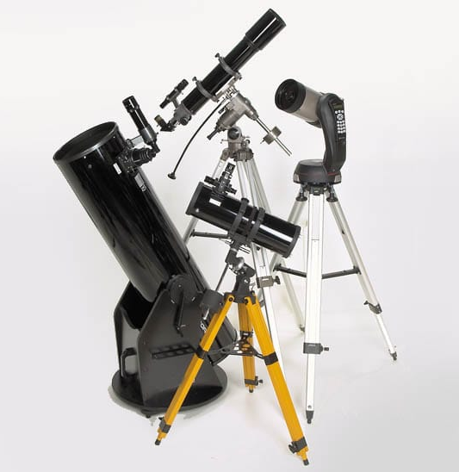
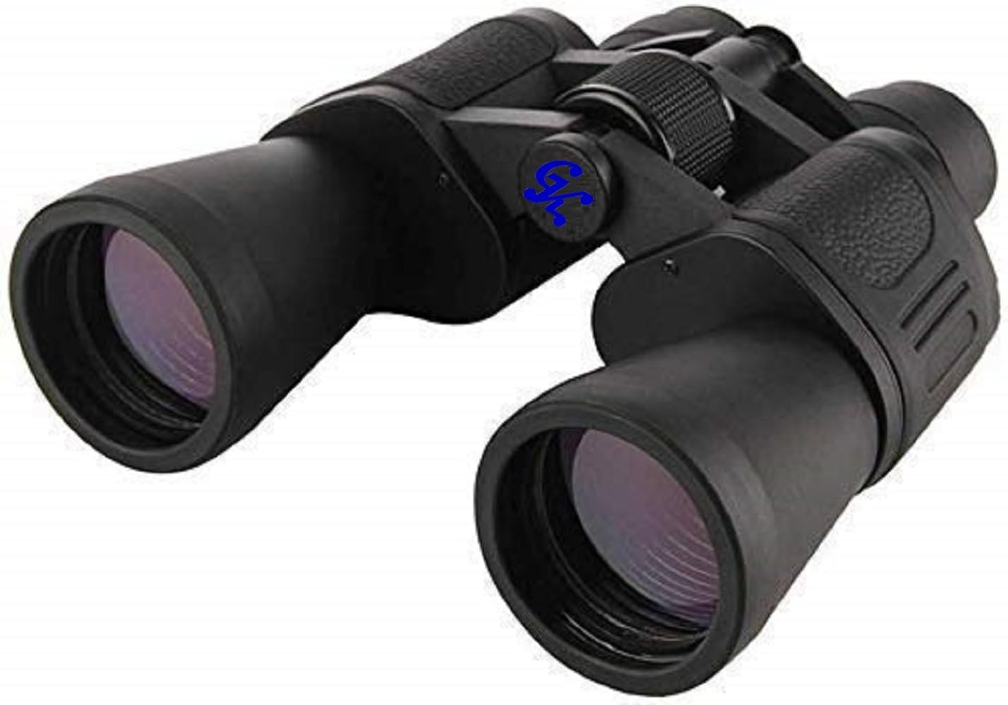
TELESCOPE AND BINOCULAR
S SAKTHIVEL
BT ASSISTANT
GHS KATTRAMBAKKAM

Slide 3
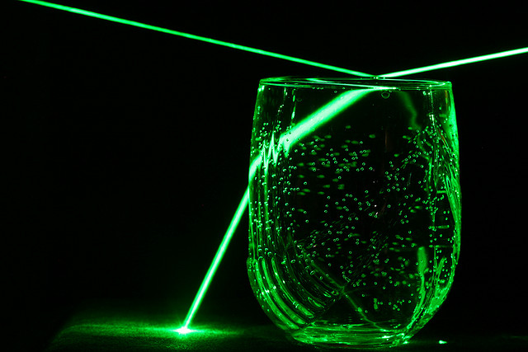
Two principles of light
Reflection and refraction

Slide 4
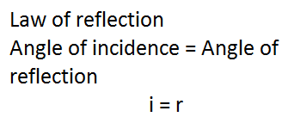
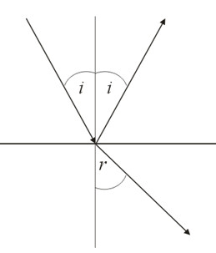

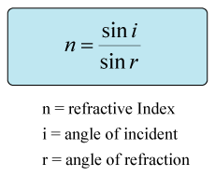
Two laws
Law of Reflection and Snell’s law

Slide 5
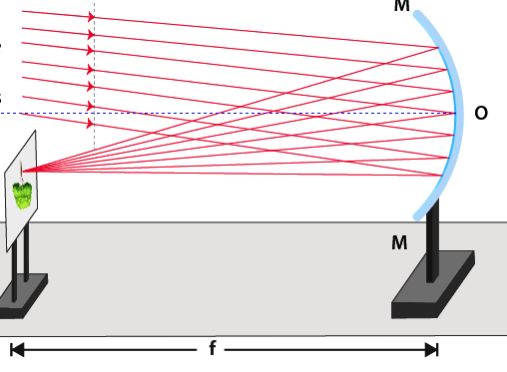
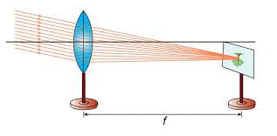
Two devices for image formation
Convex Lens and Concave mirror

Slide 6
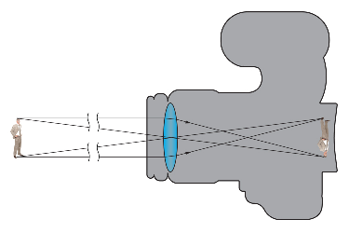
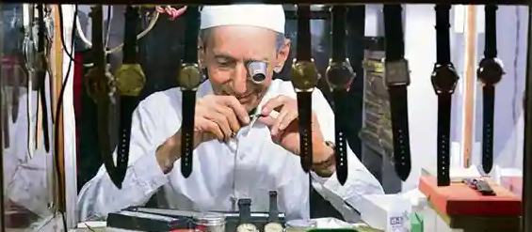
Two ways of using lenses
Camera and Magnifier

Slide 7
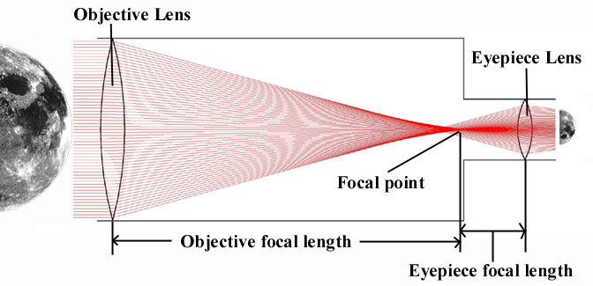
Telescope as a combination of
Camera and Magnifier

Slide 8
Two numbers to remember
Focal length and Aperture
1. Focal length of the telescope is the distance between the objective lens/mirror and its focus. (Larger focal length gives bigger image)
2. Aperture of telescope is the diameter of the Objective lens/mirror. (Larger aperture gives brighter image

Slide 9
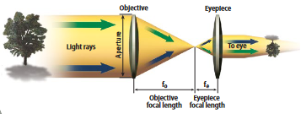
Focal Length
Focal Length

Slide 10
Purpose of a Telescope
To collect more light
To provide greater resolution
Type of Telescopes
Refractors . . . Use a combination of Lenses
Reflectors . . . Use a combination of Mirrors and lenses
Catadioptrics . . . Use a combination of mirrors and lenses

Slide 11
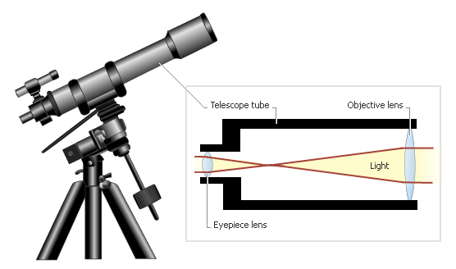
Refracting Telescopes

Slide 12
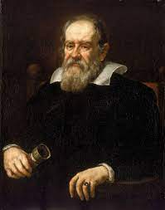
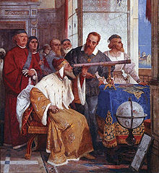
Galileo Galilei

Slide 13
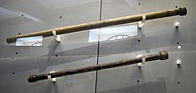

Slide 14
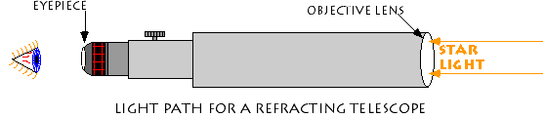

Slide 15
Advantages
  Simplicity of design, require little or no maintenance,
  Good for distant terrestrial viewing,
  Offer high-contrast images with no secondary mirror or diagonal obstruction,
  Sealed optical tube reduces image-degrading air currents and protects optics,
  Have permanently mounted and aligned objective lenses.
Disadvantages
  More expensive, heavier, longer and bulkier than equivalent-aperture reflectors and catadioptrics,
  Less suited to viewing small and faint deep-sky objects because of practical aperture limitations.

Slide 16
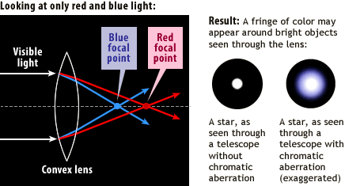
Chromatic Aberration

Slide 17
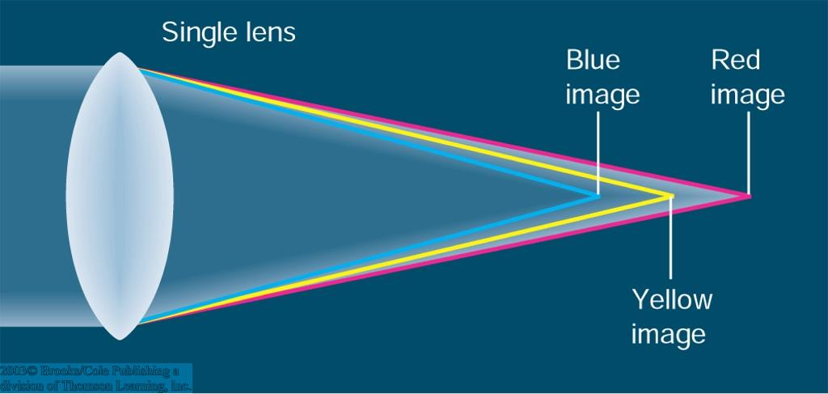

Slide 18
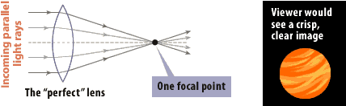
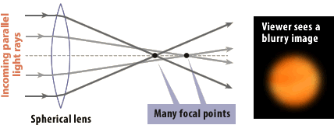
Spherical Aberration
A blue halo is seen especially on bright objects, including planets.
All wavelengths of light are not brought to the same point of focus results in a blue halo surrounding the star image.
The larger the aperture and faster the focal ratio of the telescope, the worse the blue halos will appear.
Apochromatic refractors use special extra-low dispersion (ED) glass and different optical designs to minimize this aberration.
A true apochromatic refractor should show little to no blue halo effect.

Slide 19
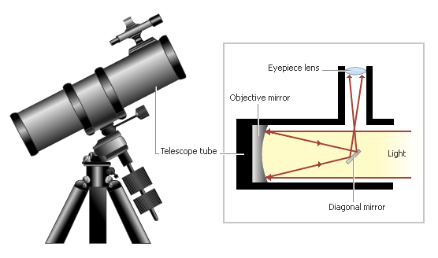
Reflecting Telescopes

Slide 20
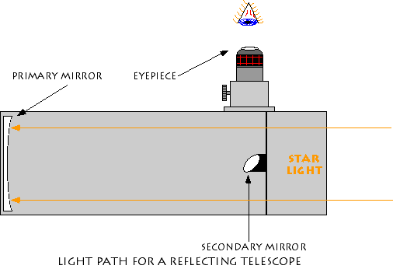

Slide 21
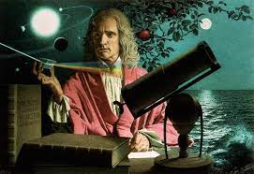

Slide 22
Advantages:
  Lower cost per inch of aperture than offered by refractors and catadioptrics, since mirrors can be produced at less cost than lenses in refractors in medium to large apertures.
  Reasonably compact and portable.
  Excellent for faint, deep-sky objects, such as remote galaxies, nebulae and star clusters, because of their larger apertures.
  Deliver very bright images with few optical aberrations.
Disadvantages:
  Generally not suited to terrestrial observation.
  Slight light loss due to obstruction from the secondary mirror.

Slide 23
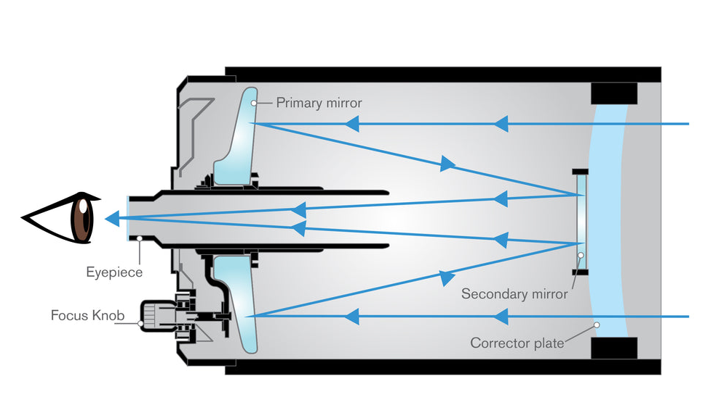
Maksutov-Cassegrain Telescopes

Slide 24
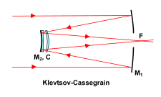

Slide 25
Advantages & Disadvantages
The Maksutov is heavier than the Schmidt and, because of the thick correcting lens, takes a long time to reach thermal stability at night in larger apertures.
The Maksutov optical design typically is easier to make, but its corrector lens requires more material than the Schmidt Cassegrain’s

Slide 26
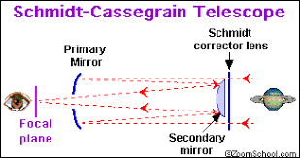
Schmidt-Cassegrain Telescopes

Slide 27
Binoculars

Slide 28
The first number tells you the magnification power --- 8x, 10x 12x etc.
  An 8X40 pair has an 8x magnification; a 10X40 pair has a 10x magnification and so on.
the second tells you the size of the objective lens in millimeters, -- 21mm to 50mm etc.
  An 8X40 pair has a 40mm lens diameter; a 10X52 pair has a 52mm lens diameter.
A bigger objective lens captures more light and produces a brighter and clearer image.

Slide 29
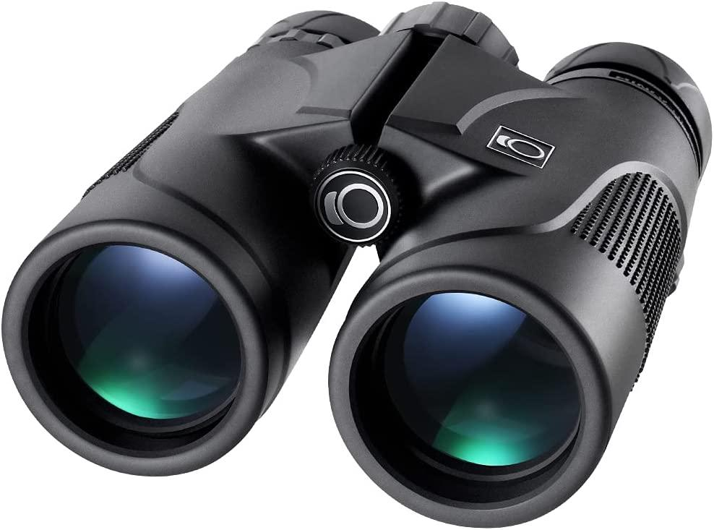

Slide 30
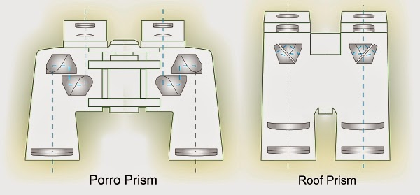

Slide 31
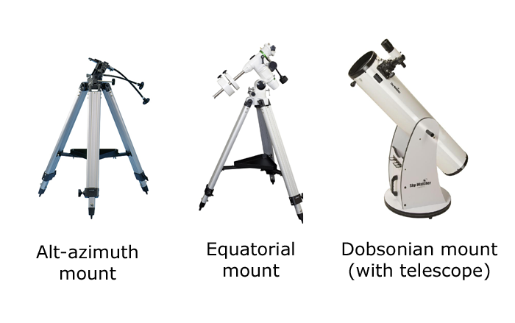
Telescope Mounts

Slide 32
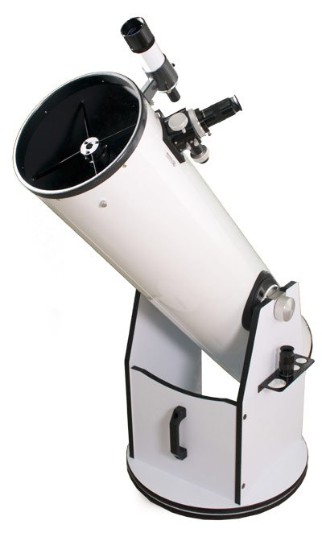
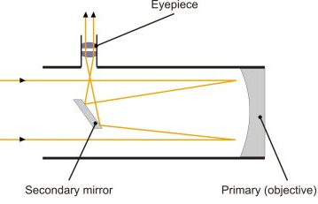
DOBSONIAN TELESCOPE

Slide 33
GSO 10” DOBSONIAN
Aperture 254 mm (10”)
Focal Length 1250 mm (F/5)
Eye piece 1 30mm (2” 1.7 deg)
Eye piece 2 9mm (1.5” 0.37 deg)
Finder 8x50

Slide 34
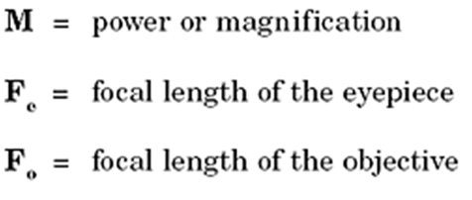
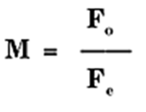
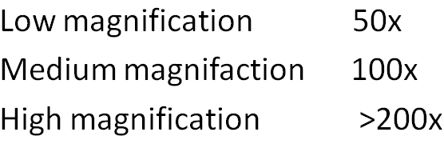
Two formulas to remember
Magnification and Maximum Magnification

Slide 35
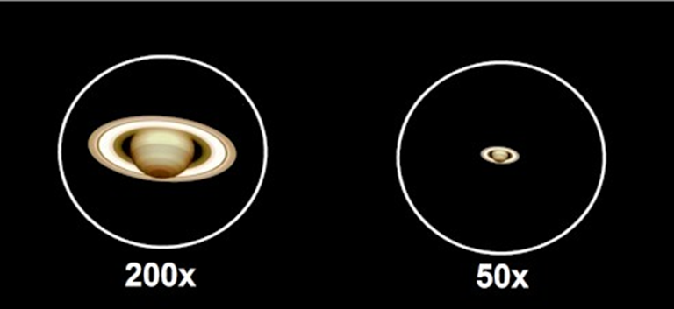
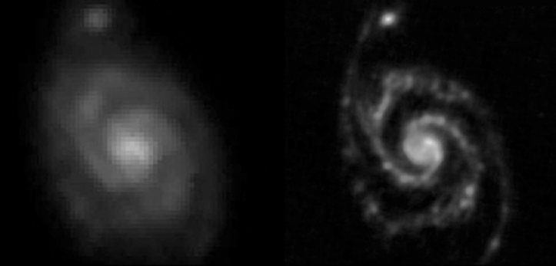
Magnification and Resolution

Slide 36
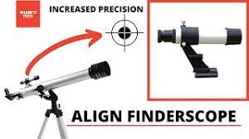
FINDERSCOPE ALIGNMENT

Slide 37
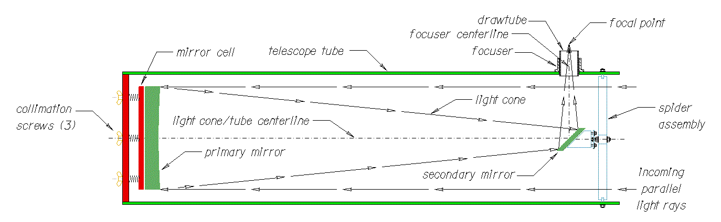
COLLIMATION

Slide 38
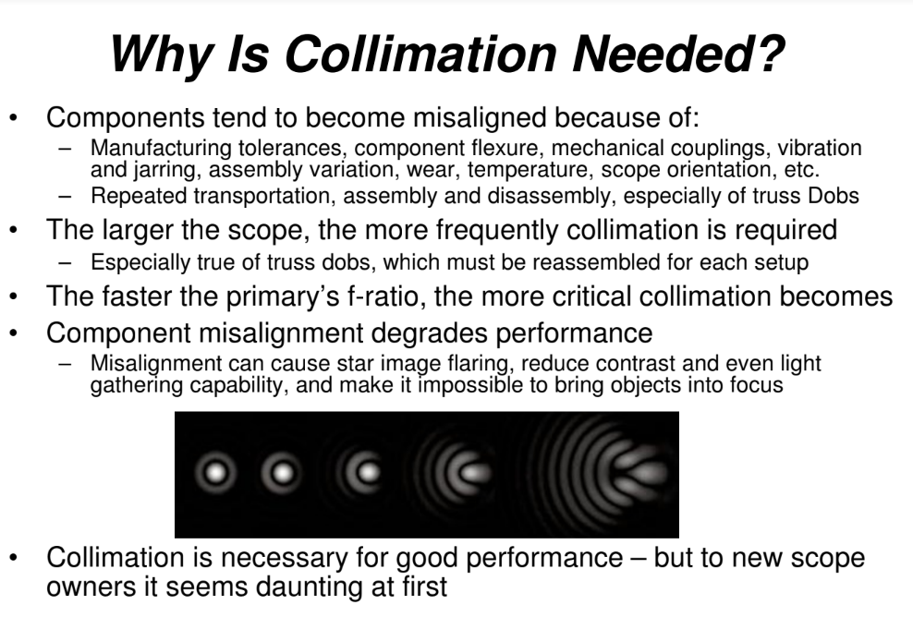

Slide 39

MY SINCERE THANKS TO PROF SAKTHIVEL SIR JAYAPAL SIR

