Slide 1

BSS MEET

Slide 2
Ball Experiment

Slide 3
Scale & Measure

Slide 4
Sound Travel

Slide 5
Ultrasonic
Frequency above 20 kHz.
Not audible to humans.
Used in medical and industrial fields.
Travels better in solids and liquids.
Bats and dolphins use it for echolocation.

Slide 6
Magnetism

Slide 7
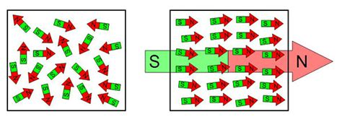

Slide 8
Electrochemical Cell

Slide 9
Microscope

Slide 10
Discussion

Slide 11
Thank You

