Slide 2
Abstract
Developed a smart fish detection and water monitoring system using ESP32-S3 CAM and OV3660 camera.
Applied embedded computer vision techniques for real-time fish detection and activity monitoring.
Integrated sensors such as DS18B20, ultrasonic sensor, GPS module, and water quality sensor.
Monitored important environmental parameters including temperature, water level, location, and water quality.
Provided a low-cost and intelligent solution for efficient aquaculture and aquatic environment management.

Slide 3
OBJECTIVES
To develop a real-time fish detection system using the ESP32-S3 CAM module.
To monitor water parameters such as temperature, water level, and water quality using sensors.
To integrate computer vision and IoT technologies for smart aquaculture monitoring.
To provide real-time data visualization through a web-based interface.
To improve aquaculture management using an automated and cost-effective monitoring system.

Slide 4
INTRO
Aquaculture requires continuous monitoring of fish and water conditions for better productivity.
Traditional monitoring methods are manual, time-consuming, and less efficient.
IoT and computer vision technologies enable smart and automated aquaculture systems.
The proposed system uses ESP32-S3 CAM, sensors, and YOLO-based fish detection for real-time monitoring.
The system helps improve fish health, water quality management, and sustainable aquaculture practices.

Slide 5
Literature Review
Authors | Title | Content
Abdul Azeem | IoT-Based Smart Aquaculture Monitoring System (2024) | Real-time water quality monitoring using sensors.
Prathiba P | Smart Aquaculture System Using IoT (2019) | Automated fish feeding and water monitoring.
Ritish Biswas | IoT-Based Smart Aquaculture Monitoring Solution | Sensor-based monitoring and automated feeding system.

Slide 6
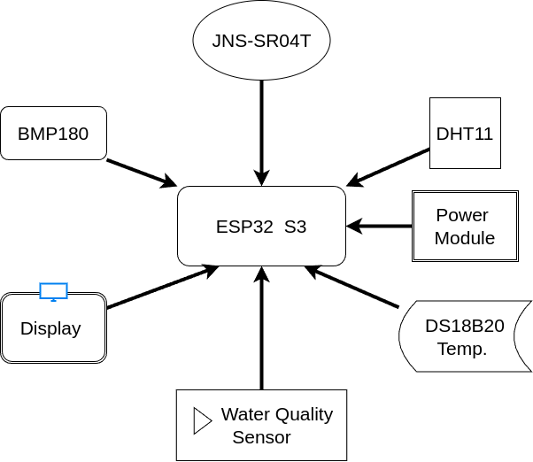
Block Diagram

Slide 7
Hardware & Software List
ESP32-S3 CAM Module
OV3660 Camera
DS18B20 Temperature Sensor
JNS-SR04T Ultrasonic Sensor
DHT11 Temperature & Humidity Sensor
Turbidity Sensor
BMP180 Pressure Sensor
Arduino IDE
Python
Flask Framework
OpenCV Library

Slide 8
Methodology
ESP32-S3 CAM module is used as the main controller and processing unit.
OV3660 camera captures live images and video of the aquatic environment.
DS18B20 sensor measures water temperature continuously.
Ultrasonic sensor monitors the water level in the pond or tank.
Turbidity and other sensors collect real-time water quality data.

Slide 9
Methodology
Sensor data is collected and processed by the ESP32-S3 module.
Video stream is transmitted through Wi-Fi using HTTP communication.
Flask server receives sensor readings and camera data.
OpenCV processes incoming image frames for analysis.
YOLO deep learning model detects fish in real time.

Slide 10
Methodology
Sensor readings and detection results are combined into one system.
Real-time fish activity is displayed on a web dashboard.
Environmental parameters are shown using live updates and graphs.
Users can access monitoring data through laptop or mobile devices.
The system improves aquaculture management with automated monitoring.

Slide 11
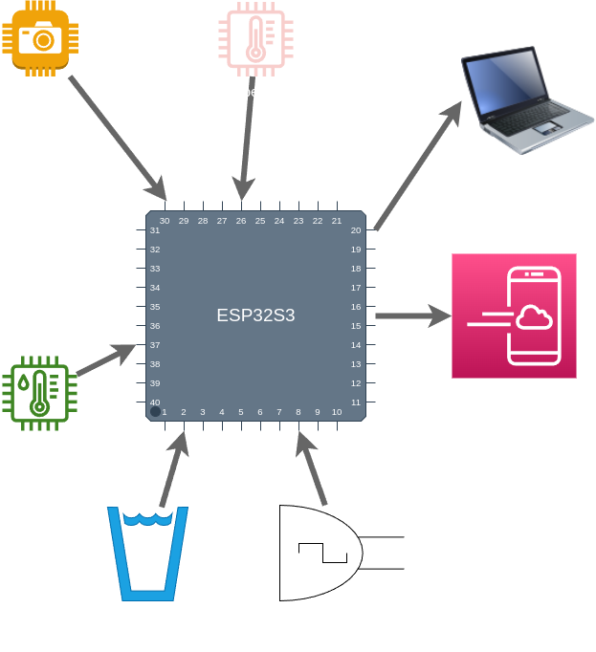
Workflow

Slide 12
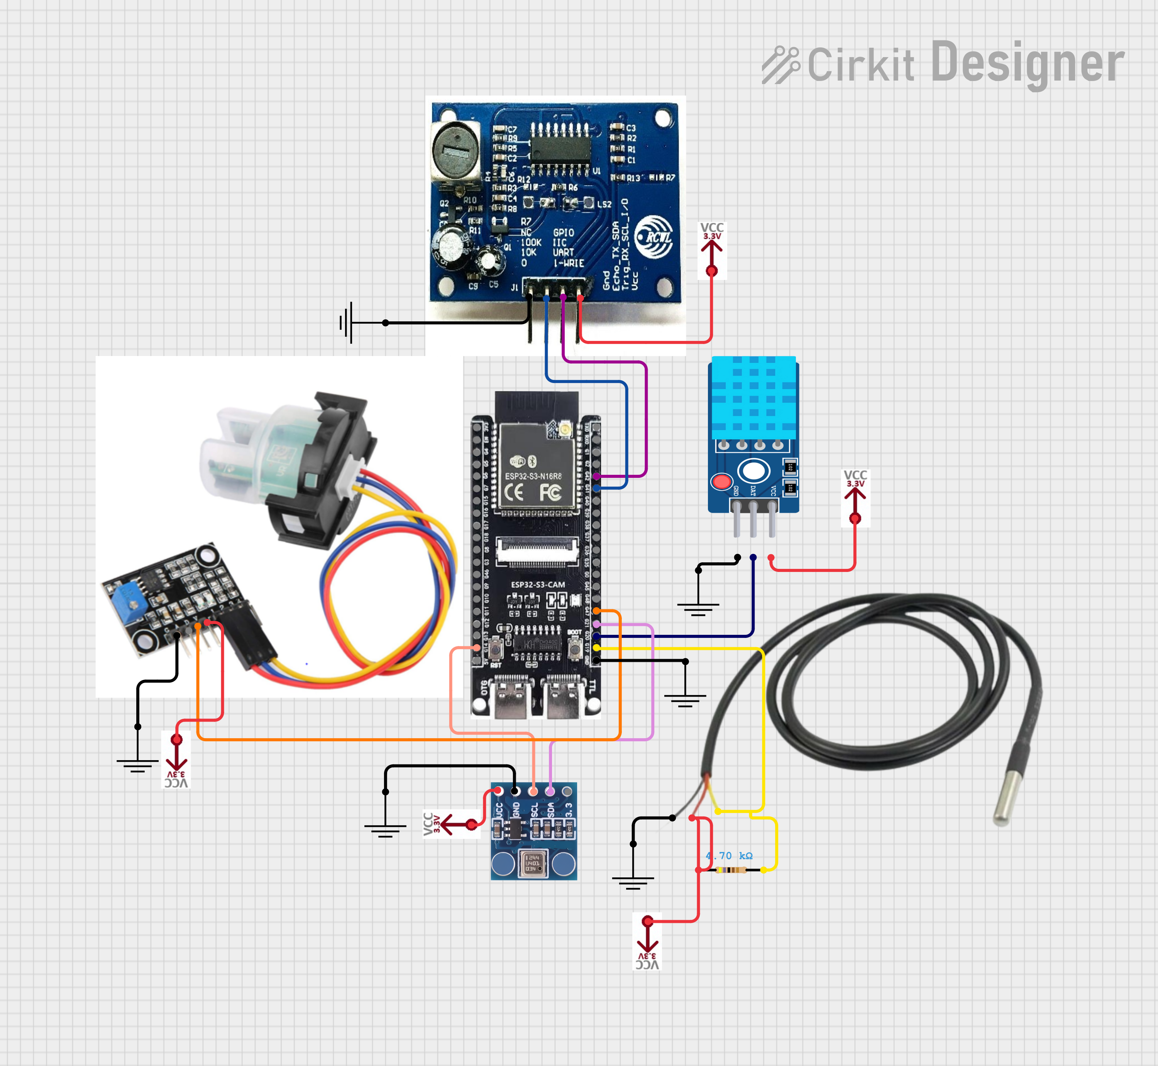
Circuit Diagram

Slide 13
Result
The system successfully detected fish in real time using the YOLO model and ESP32-S3 CAM.
Water parameters such as temperature, water level, and turbidity were monitored continuously.
Sensor data and live video were displayed through a web-based dashboard.
The integrated IoT system reduced manual monitoring effort and improved accuracy.
The project provided a cost-effective and efficient solution for smart aquaculture monitoring.

