Slide 1

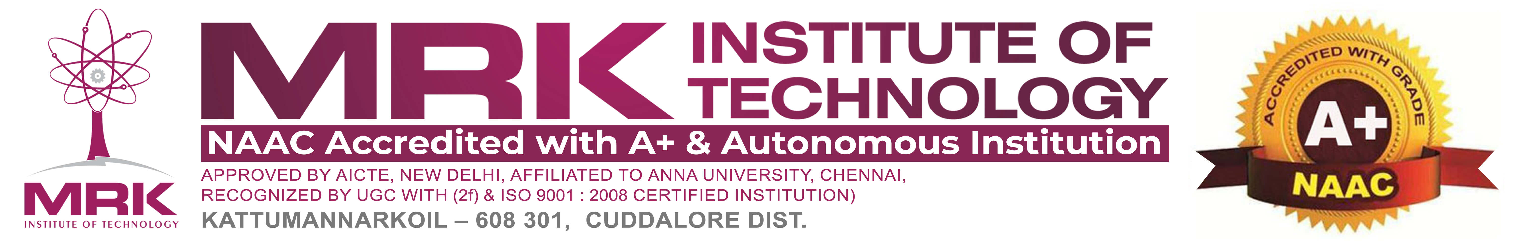
AUTONOMUOS ROBOTIC BOAT FOR MARINE PLASTIC WASTE COLLECTION
TEAM MATES:
GUIDE :

Slide 2
PROBLEM STATEMENT
Marine plastic pollution is a serious and escalating environmental issue. It poses a major threat to aquatic life, damages ecosystems, and endangers human health. Every year, millions of tons of plastic waste enter oceans, rivers, and lakes, accumulating and persisting for decades. This pollution disrupts food chains and affects the livelihood of communities dependent on marine resources. Traditional cleanup methods are often inefficient, costly, and unable to cover vast or remote areas. Manual collection is labor-intensive and slow, making it unsustainable for large-scale impact. Inaccessible and highly polluted zones remain largely untouched by current efforts. A more effective and scalable approach is urgently needed to address this growing crisis.

Slide 3
ABSTRACT
Marine plastic pollution poses a significant threat to aquatic ecosystems and human health, requiring an efficient and autonomous cleanup solution. This project proposes an Autonomous Robotic Boat that utilizes AI, sensors, and IoT to detect, collect, and store floating plastic waste. The system integrates GPS-based navigation, a waste collection mechanism, and solar power for continuous operation. Real-time data transmission enables remote monitoring and optimization of cleanup efforts. This innovative approach enhances marine waste management, promoting sustainability and environmental conservation.

Slide 4
OBJECTIVES
Develop an Autonomous Navigation System – Implement GPS, AI, and sensors for efficient path planning, obstacle avoidance, and precise waste collection.
Design an Efficient Waste Detection & Collection Mechanism – Utilize computer vision and robotic systems to identify, capture, and store floating plastic waste.
Ensure Sustainable & Continuous Operation – Integrate solar power and energy-efficient components for long-term, eco-friendly performance.
Enable Remote Monitoring & Data Analysis – Use IoT and cloud-based systems to track operations, analyze pollution patterns, and optimize waste collection strategies.

Slide 5
INTRODUCTION
Marine plastic pollution has become a critical environmental issue, threatening marine life, destabilizing ecosystems, and exacerbating global climate change. Existing waste collection techniques are often ineffective, expensive, and unable to reach large or isolated areas. An Autonomous Robotic Boat provides a smart, scalable solution by automating the detection and removal of plastic waste from water bodies. Using AI-driven computer vision, GPS navigation, and IoT connectivity, the boat operates with minimal human oversight. A conveyor-based system ensures efficient retrieval and storage of waste. Solar power enables continuous, eco-friendly operations, while real-time data transmission supports remote monitoring and optimization of collection routes. This technology seeks to improve marine waste management, contributing to cleaner oceans and a more sustainable environment.

Slide 6
LITERATURE SURVEY
S.NO | AUTHOR NAME | TITLE | YEAR | REMARKS
1 | Dr. N. Sankar, M.Kumaravel, | Design and Development of an Affordable Ocean Waste Collecting Robot | 2024 | A cost-effective robot for removing floating plastic and oil from oceans.
2 | S.Mohanapriya, TR.Nithiya, K.Srinithi | ROBOT FOR EFFECTIVE PLASTIC WASTE COLLECTION IN RIVER | 2024 | A low-cost, smartphone-controlled robot for collecting floating plastic waste in water bodies.
3 | Sagar Gavade , Ghanashyam Phadke, | Autonomous Ocean Garbage Collector | 2020 | automatic ocean garbage collector robot that cleans floating debris while monitoring water pollution using IoT and sensor technology.
4 | Rupavathi N, Dhineshkumar A, Manokar G, | Plastic Waste Collection from Rivers and Lakes by Robotic System |  | a robotic system using computer vision and robotics to efficiently collect plastic waste from rivers and lakes, protecting marine ecosystems.
5 | Hirdy Othman, Mohammad Iskandar Petra | Automated trash collector design |  | an autonomous robotic system to tackle plastic pollution in water bodies.

Slide 7
EXISTING SYSTEM
Manual Cleanup Methods – Labor-intensive processes involving nets, boats, and divers to collect floating waste.
Booms and Barriers – Static floating barriers deployed in rivers and oceans to trap plastic waste for later removal.
Skimmer Boats – Mechanized boats with conveyor belts that collect floating debris and store it onboard.
Waste-Collecting Drones – Remote-controlled or semi-autonomous water drones designed to gather floating trash.
Ocean Cleanup Systems – Large-scale passive collection systems using ocean currents to accumulate plastic waste in designated areas.

Slide 8
Demerits of the Existing system
High Labor and Maintenance Costs – Manual cleanup methods require significant human effort and frequent maintenance.
Limited Efficiency – Static barriers and skimmer boats are ineffective in collecting microplastics and dispersed waste.
Environmental Impact – Some existing systems disturb marine life and ecosystems during waste collection.
Restricted Coverage – Many systems operate in specific areas and struggle to clean large or remote water bodies effectively.
Dependency on External Factors – Passive collection methods rely on ocean currents, making waste accumulation unpredictable.

Slide 9
PROPOSED SYSTEM
Autonomous Waste Collection – Utilizes GPS, and sensors for self-navigation and efficient plastic and oil removal.
Enhanced Efficiency – Features a conveyor belt or robotic arm to collect and store floating waste effectively.
Sustainable Operation – Solar-powered system ensures continuous, eco-friendly functionality.
Multi-Sensor Integration – Uses advanced sensors to detect and differentiate waste types for better collection.
Compact & Cost-Effective – Designed to be affordable, scalable, and easy to deploy in various water bodies.

Slide 10
MERITS of the Proposed System
Autonomous & Efficient – Operates without human intervention, ensuring continuous waste collection.
High Waste Collection Accuracy – Advanced sensors help detect and remove plastic and oil effectively.
Eco-Friendly & Sustainable – Uses solar power, reducing energy consumption and environmental impact.
Cost-Effective Solution – Designed with affordable materials, making it accessible for large-scale deployment.
Versatile & Scalable – Can be deployed in various water bodies, from lakes to oceans, for efficient pollution control.

Slide 11
HARDWARE REQUIREMENTS
ESP32 Microcontroller
GPS Module
Ultrasonic & IR Sensors
Conveyor Belt/Robotic Arm
Floating Body (Hull)
Solar Panels & Battery
Motors & Propellers

Slide 12
SOFTWARE REQUIREMENTS
Thonny
Python3

Slide 13
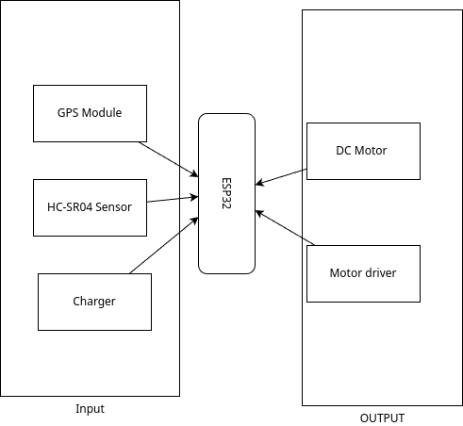
BLOCK DIAGRAM

Slide 14
BLOCK DIAGRAM DESCRIPTION
ESP32 (Controller) – Processes data and controls the system.
GPS Module – Provides real-time location tracking.
HC-SR04 Ultrasonic Sensor – Detects obstacles for collision avoidance.
Motor Driver – Controls motors and propellers for movement.
Charger – Powers the system for continuous operation.

Slide 15
APPLICATION
Marine Plastic Waste Cleanup – Removes floating plastic from oceans, rivers, and lakes.
Water Body Conservation – Helps maintain clean and healthy aquatic ecosystems.
Autonomous Waste Management – Reduces the need for manual labor in waste collection.
Environmental Protection Projects – Supports government and NGO initiatives for pollution control.
Scalable Waste Removal System – Can be deployed in various water bodies for large-scale cleaning.

Slide 16
CONCLUSION
Plastic pollution in water bodies poses a significant threat to marine ecosystems and biodiversity. The proposed autonomous robotic boat efficiently collects floating plastic waste, reducing environmental damage. With its cost-effective and sustainable design, the system offers a practical solution for large-scale water cleanup. The integration of sensors and a conveyor mechanism enhances waste collection efficiency. This innovation contributes to a cleaner and healthier aquatic environment. Future improvements may include enhanced automation and scalability for wider deployment.

Slide 17
FUTUTRE ENHANCEMENT
The robotic boat can be improved by integrating AI-based image processing for better waste detection and classification. Enhancing automation with advanced sensors will allow more precise navigation and obstacle avoidance. Increasing battery efficiency and optimizing solar power usage can extend operational time. Additionally, scaling the design for larger water bodies will enhance its impact on marine pollution control.

Slide 18
THANK YOU TO ALL

