Slide 1

Annamalai University DEPARTMENT OF ELECTRONICS AND COMMUNICATION ENGINEERING FACULTY OF ENGINEERING AND TECHNOLOGY, ANNAMALAI UNIVERSITY, ANNAMALAINAGAR - 608002 ACADEMIC YEAR 2023-2024 [EVEN SEM]
PROJECT
Automated Wire Harness Management and Diagnostic System
SUBMITTED BY B.E (ECE) -VIII SEMESTER
Afra seemeen A | - | 221010002
Dhanuja R | - | 221010010
Femina F | - | 221010017
Guide :
Dr. P. Sakthibalan
Assistant professor, ECE
Automated Wire Harness Management and Diagnostic System

Slide 2
Abstract
The project develops an automated wire harness diagnostic system to address limitations of traditional manual testing methods.
It integrates ESP32 microcontroller for signal integrity, continuity testing, and propagation delay measurement.
Arduino Nano module performs electrical load testing and thermal analysis using ACS712 current sensor and DS18B20 temperature sensor.
The system successfully detects multiple faults including open/short circuits, high resistance, signal delay, and overheating.
Real-time visual and audio feedback improves testing efficiency, accuracy, reliability, and safety in automotive and industrial applications.

Slide 3
Objectives
To design and develop an automated wire harness diagnostic system for efficient testing.
To integrate signal integrity and continuity testing using ESP32 microcontroller.
To perform electrical load and thermal analysis using Arduino Nano, ACS712, and DS18B20 sensors.
To detect faults such as open circuit, short circuit, high resistance, propagation delay, and overheating.
To provide real-time results with visual and audio feedback for improved reliability and safety.

Slide 4
Problem Statement
Traditional wire harness testing is mostly manual, time-consuming, and prone to human error.
Manual methods cannot effectively detect subtle faults like signal propagation delay and gradual overheating under load.
Increasing complexity of modern wire harnesses in automotive and industrial systems demands faster and more reliable testing.
Existing systems often focus only on continuity testing and lack integrated thermal and load analysis.
Poor wire harness quality can lead to system failures, safety hazards, and high maintenance costs.

Slide 5
Literature Review
Authors | Title | Content
J. Smith & R. Brown | Wire Harness Systems (2018) | Emphasized design & maintenance for reliability; faults can cause system failure
P. Singh & A. Rao | Integrated Diagnostics (2023) | Multi-parameter (signal + current + thermal) testing is essential
R. Gupta & P. Sharma | Automated Testing (2022) | Microcontroller systems improve efficiency but lack thermal analysis

Slide 6
Hardware and Software
ESP32-WROOM Microcontroller
Arduino Nano (ATmega328)
ACS712 Current Sensor (30A)
DS18B20 Temperature Sensor
IRFP150N MOSFET
10W Power Resistor
OLED Display (SSD1306)
16x2 LCD Display with I2C
Battery
Thonny
Arduino

Slide 7
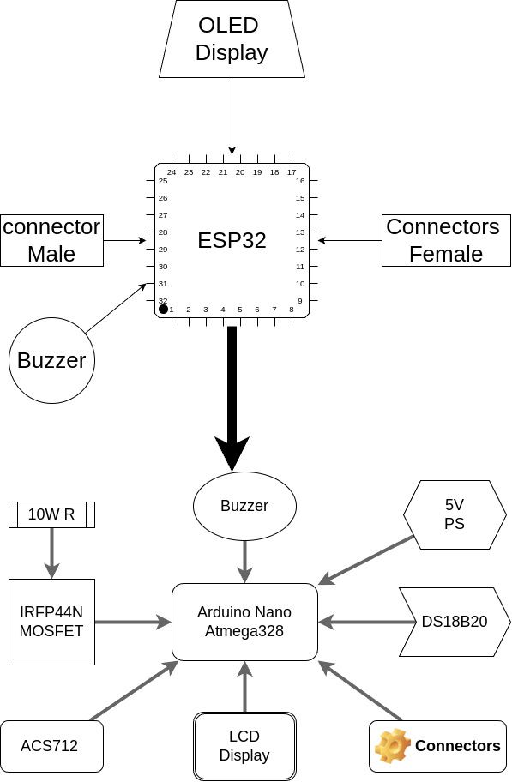
Block Diagram

Slide 8
Methodology
Develops an automated diagnostic system for wire harness testing
Combines two independent modules for comprehensive analysis
Module 1: Signal integrity & continuity testing (ESP32)
Module 2: Electrical load & thermal analysis (Arduino Nano)
Aims to detect electrical, signal, and thermal faults in real-time

Slide 9
Methodology
Signal Testing Unit: ESP32-WROOM + OLED Display + Buzzer
Performs continuity and propagation delay testing
Load & Thermal Testing Unit: Arduino Nano + ACS712 + DS18B20
Applies controlled load and monitors current & temperature
Uses male/female connectors for easy wire harness interfacing
Provides visual (OLED + LCD)

Slide 10
Methodology
Initialize both microcontrollers and peripherals
Stage 1: ESP32 performs signal integrity test (one wire at a time)
Measures propagation delay → PASS / WARNING / FAIL
Stage 2: Arduino applies load via MOSFET & 10W resistor
Monitors current (ACS712) and temperature (DS18B20)
Real-time display of results with buzzer alerts for faults
Complete evaluation of electrical and thermal performance

Slide 11
Results and Conclusion
The developed system successfully detects open circuits, short circuits, high resistance connections, and propagation delays with high accuracy.
Real-time load and thermal analysis effectively identifies overheating and overcurrent conditions under electrical stress.
The dual-module approach (ESP32 + Arduino Nano) provides reliable visual and audio feedback for quick fault diagnosis.
The automated system significantly reduces testing time and human error compared to traditional manual methods.
The project demonstrates an efficient, cost-effective solution that enhances the reliability and safety of wire harnesses in automotive and industrial applications.

