Slide 1
Neighborhoods-Final_project
Final project of Coursera capstone Project

Slide 2
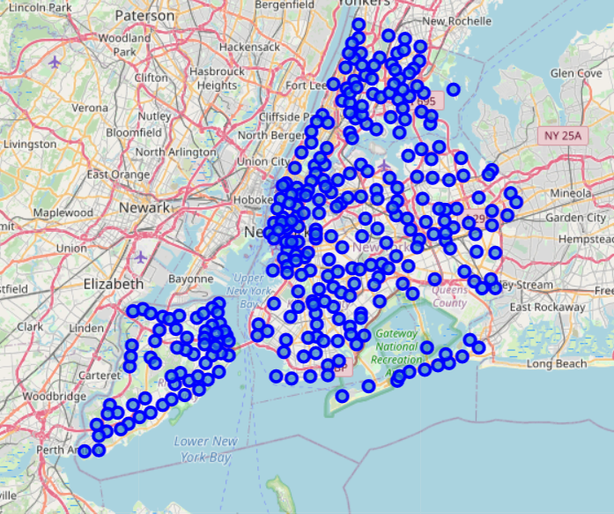
The neighbourhood data
This is the initial un-clustered neighborhood data
Here we can see all the neighborhoods points based on the latitude and longitude

Slide 3
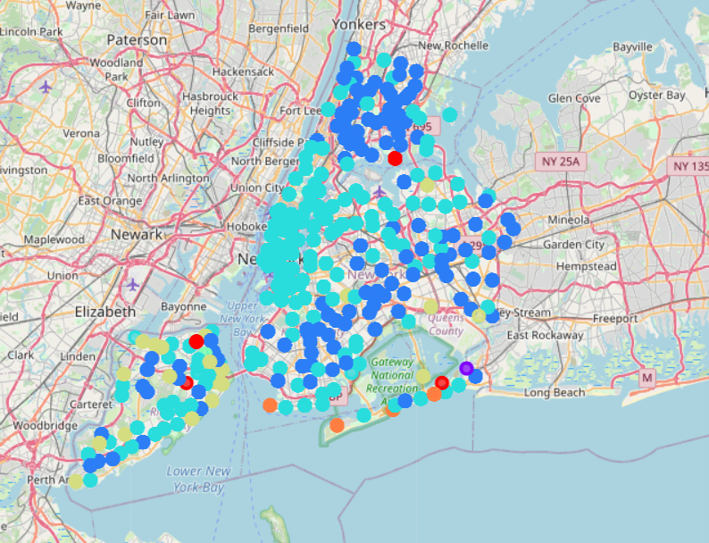
The clustered neighbourhood data
The data is now distributed between 7 cluster
The similar neighborhood are pointed in the same colour

Slide 4
Conclutions
We started this project to help to derive 2 important decision to make
Which area is more suitable for a person when someone come from a different location to pursue their corporate carrier
In which corner of area in Newyork city is more suitable for which business options like kind of cuisine restaurants, groceries shops, book store are a few example
Coming to the 1st point
We have highlighted the major similer cluster to identify the similer neighborhoods.
Someone needs to move from 1 place to other place he/she will get a very clear idea about the new place with the common and top venues of their likes.
And now 2nd point
The above prediction is also depicts in area which is the most populer venue. With respect to starting a business the above prediction will help which is the most populer business one can start or the missing one in that perticuler area.

