Slide 1

Applets in Java

Slide 2

Introduction
▶ Applet is small java program that can be easily
transported over the network from one
computer to other.
▶ used in internet applications.
▶ embedded in an html page, can be downloaded
from the server and run on the client, so as to
do a specific kind of job.

Slide 3
Types of Java Programmes
▶ Standalone
▶ Web based

Slide 4
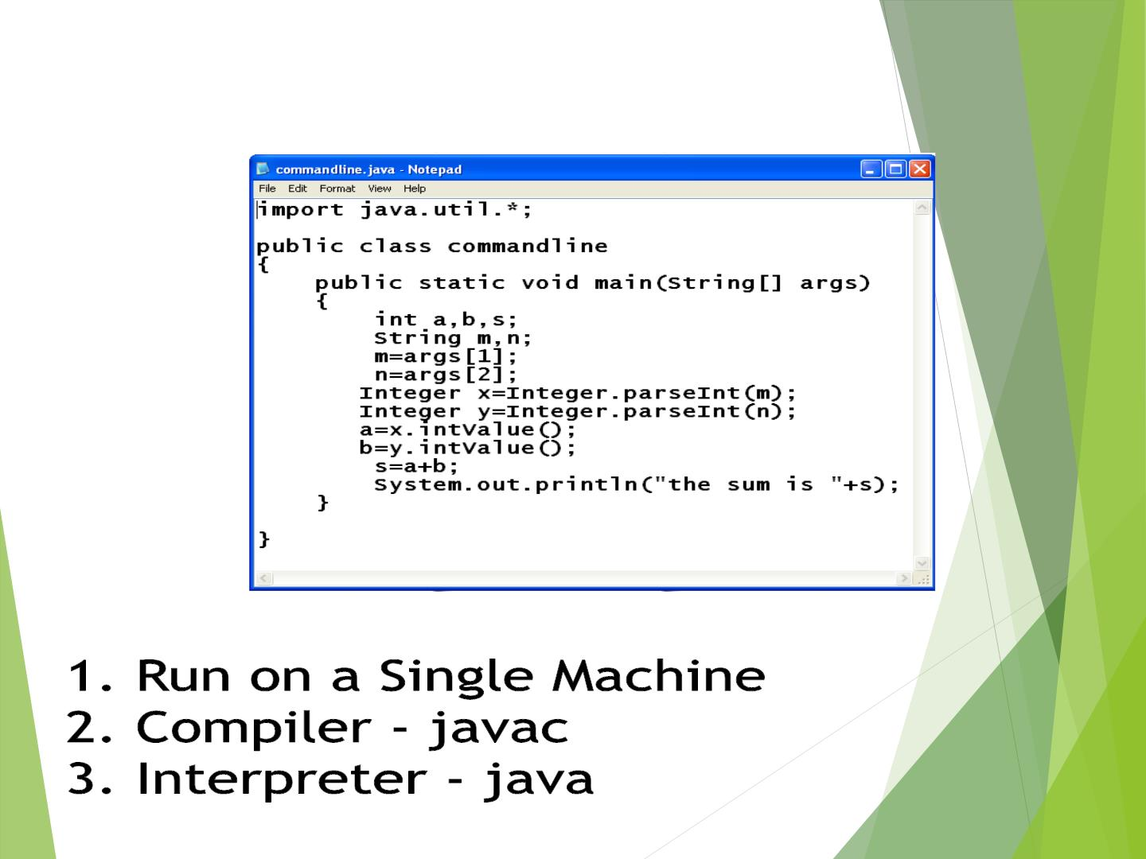
Stand Alone Program

Slide 5
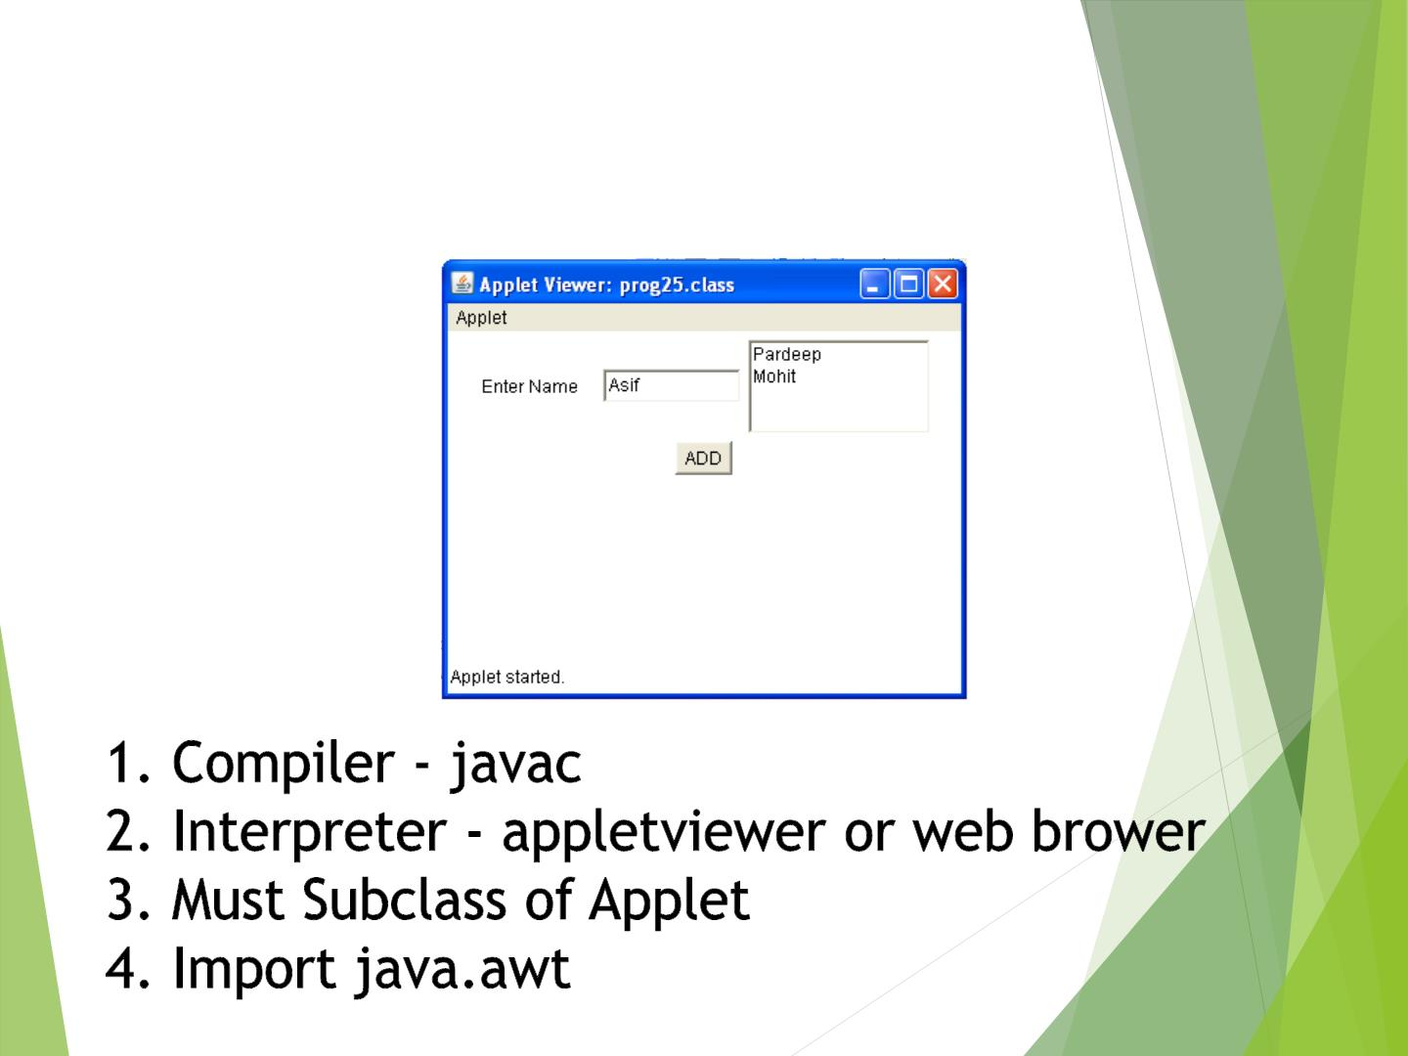
Web-Based Program

Slide 6
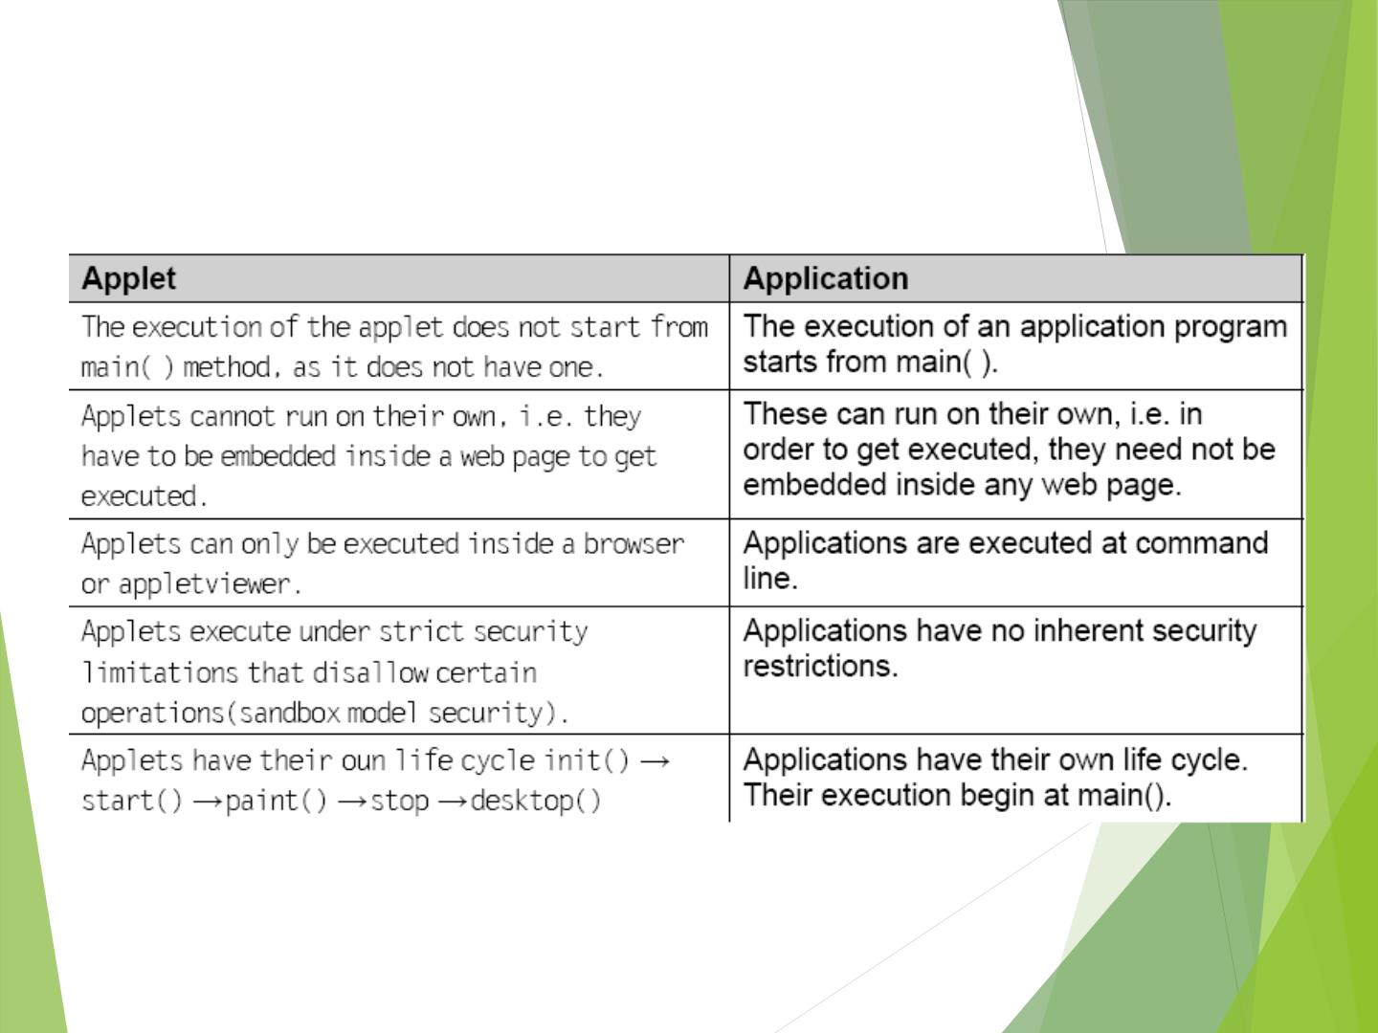
Difference between an
applet and application

Slide 7
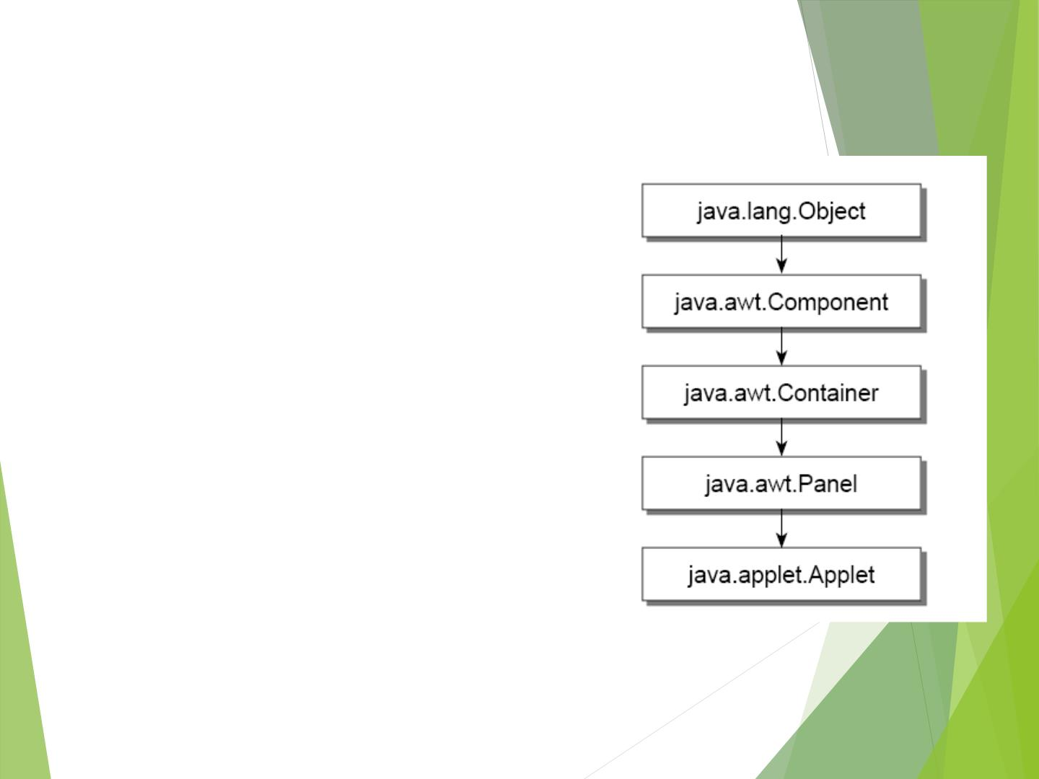
APPLET CLASS
▶ java.applet.Applet is the
super class of the all the
applets.
▶ Applet class has a
predefined hierarchy

Slide 8
Applet Example
import java.applet.*;
import java.awt.*;
public class FirstApplet extends Applet {
public void paint(Graphics g) {
g.drawString(“Welcome in Applets”,10,50);
}
}

Slide 9
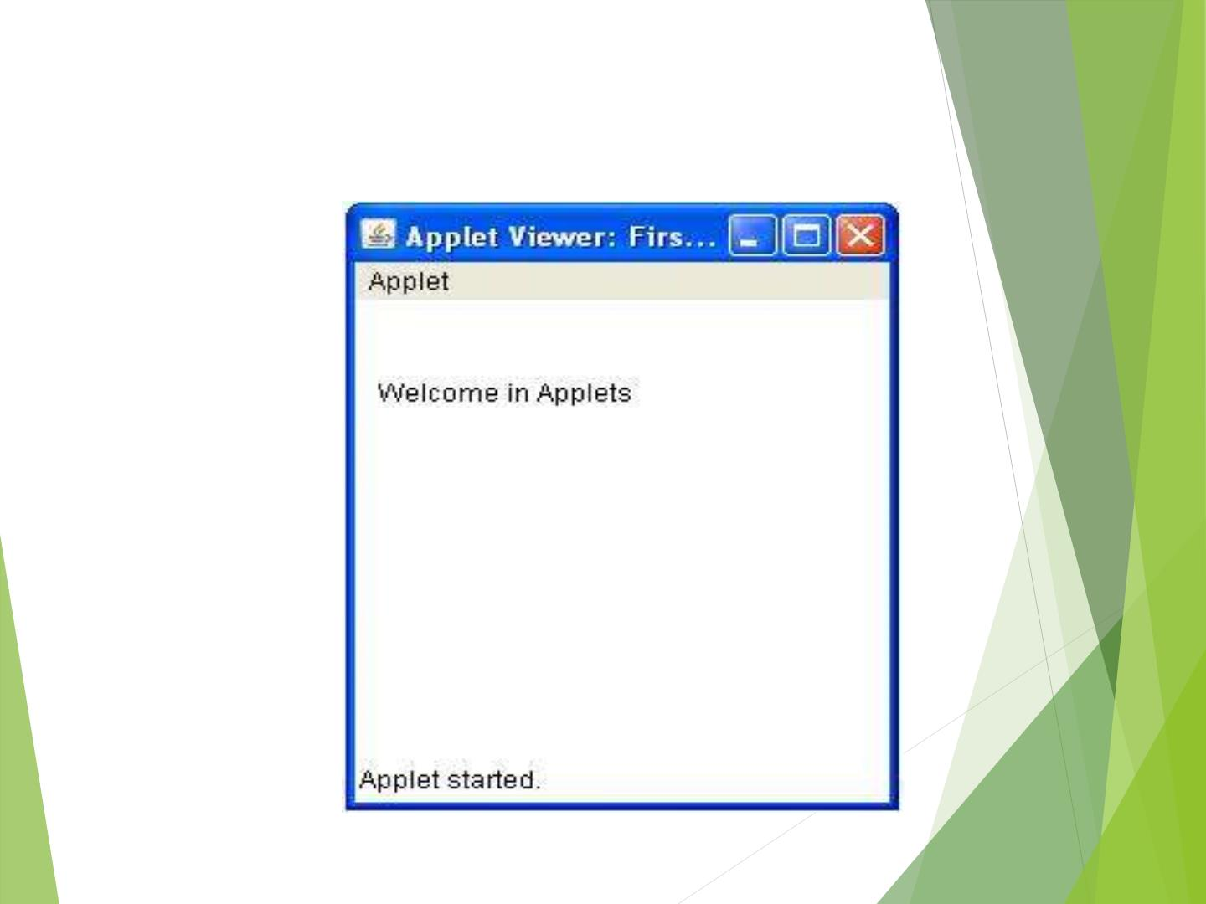
The Output

Slide 10
Applet Life cycle
▶ An applet may move from one state to another
depending upon a set of default behaviours inherited in
the form of methods from ‘Applet’ class.
▶ These states are
▶ Born
▶ Running
▶ Idle
▶ Dead

Slide 11
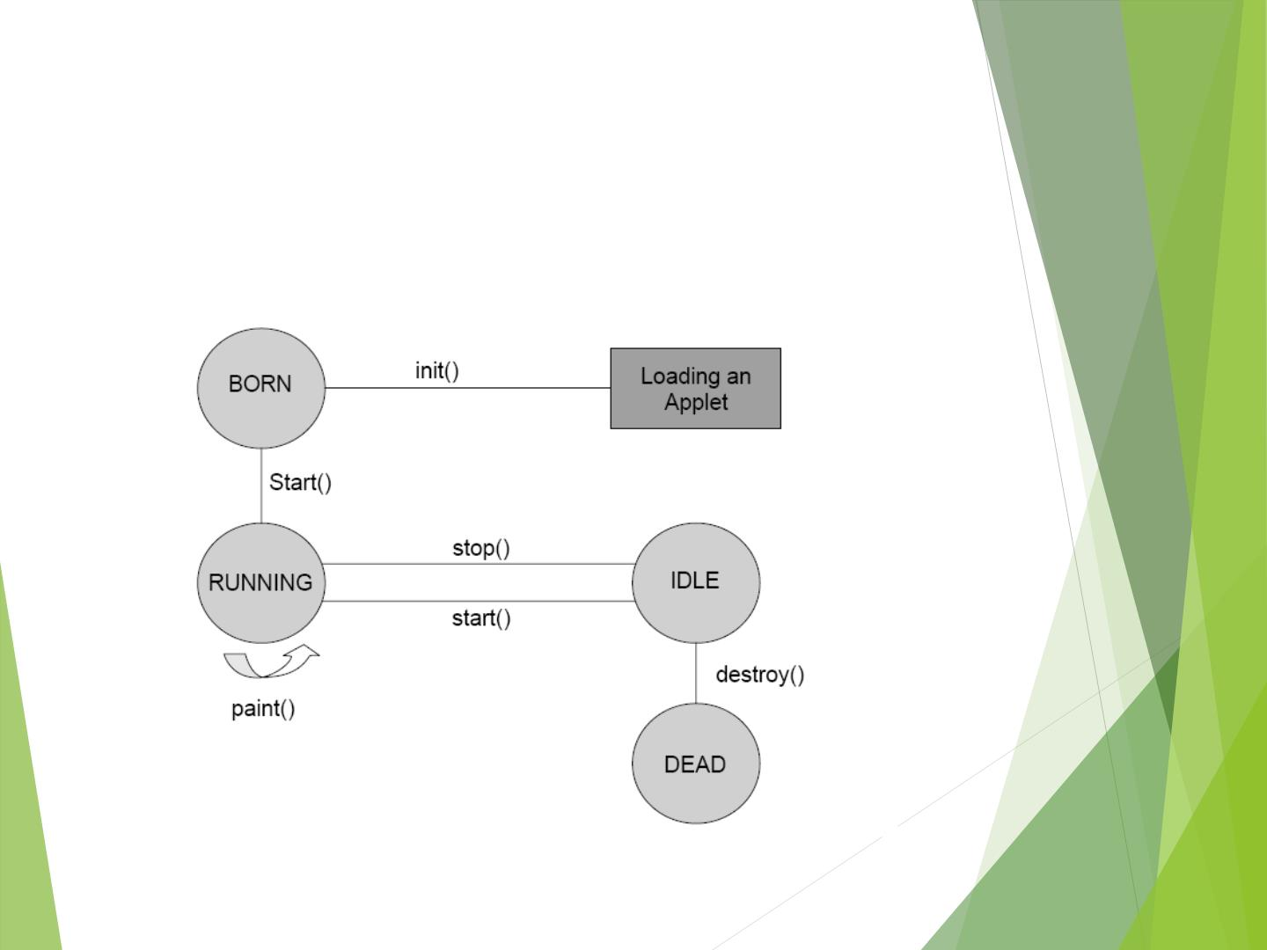
Applet State Diagram

Slide 12
Life cycle of Applet
▶ init() –
▶ creates the objects needed by the applet;
▶ sets up initial values, load font and images or set up colors.
▶ called only once during the lifetime of on Applet.
▶ start()-
▶ moves to this phase automatically after the initialization state.
▶ if the applet is stopped or it goes to idle state, start() method must be called in
order to force the applet again to the running state.
▶ paint() -
▶ This method is called each time to draw and redraw the output of an applet.
▶ stop()-
▶ idle state, once it is stopped from running
▶ destroy()-
▶ An applet goes to dead state when it is destroyed by invoking the destroy() method
of Applet class.
▶ It results in complete removal of applet from the memory.

Slide 13
Common Methods
▶ drawString()-
▶ member of Graphics class, used to output a string to an applet.
▶ It is typically called from within the paint() or update() method.
▶ void drawString(String msg,int a, int b)
▶ setBackground() & getBackground()
▶ belongs to Component class, used to set and get the background color.
▶ void setBackground(Color anyColor)
▶ predefined constants for each color, such as Color.red can be used.
▶ setForeground() & get Foreground()
▶ set and gets the color of the text to be displayed on the foreground of the
applet window.
▶ void setForeground(Color anyColor)
▶ showStatus()
▶ display any string in the status window of the browser
▶ void showString(String text)

Slide 14
Graphics class
import java.awt.* ;
import java.applet.* ;
public class DrawLineRect extends Applet {
public void paint(Graphics g){
g.drawRect(10,60,40,30);
g.fillRect(60,10,30,80);
g.fillOval(140,160,170,170);
g.drawRoundRect(10,100,80,50,10,10);
g.fillRoundRect(20,110,60,30,5,5);
g.drawArc(280,210,250,220,30,90);
g.drawLine(100,10,230,140);
g.drawLine(100,140,230,10);
}}

Slide 15

The Output

Slide 16

Now your turn..!!!
▶ How to programme this…..????

Slide 17
HTML Ta g
<applet code="Bubbles.class" width="350" height="350">
</applet>

Slide 18
