Slide 1
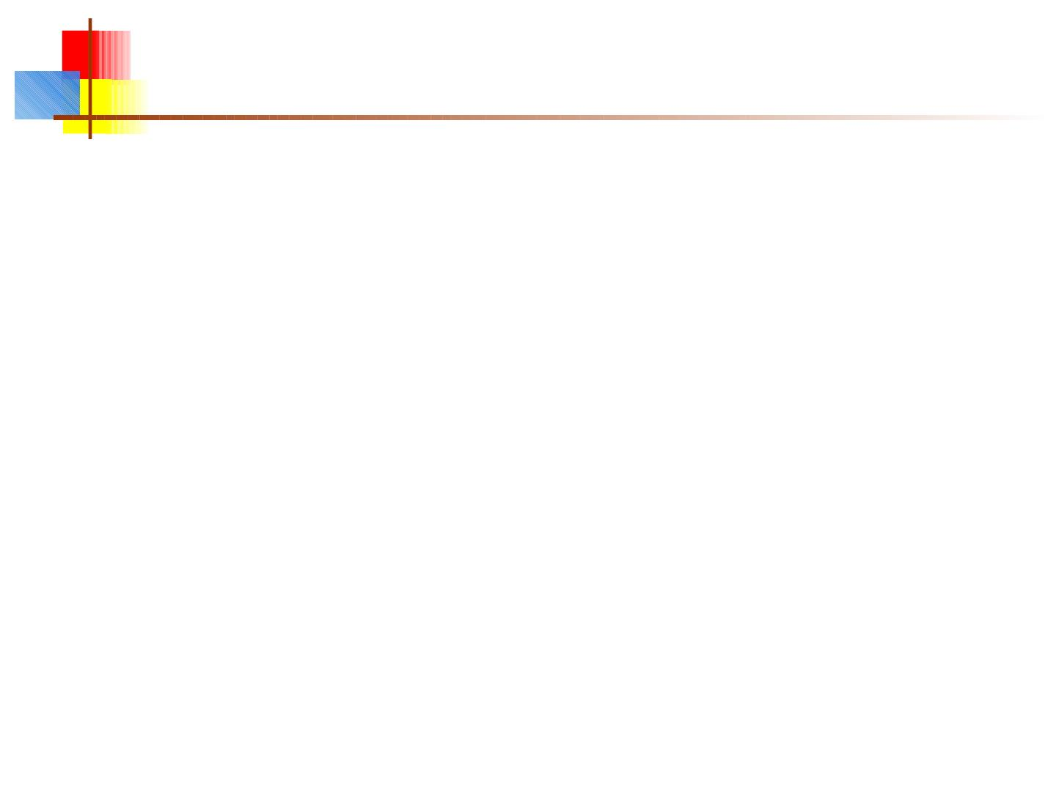
GUI in JAVA
AWT & SWINGS
Dr. Reema Ajmera

Slide 2
Agenda of today Presentation
■
■
■
■
■
■
■
■
■
Introduction to GUI
Introduction to AWT
Introduction to Swing
Difference b/w Swing and Awt
Why we'll recomend to use "SWING"
Introduction to Component,Container,Panels,window,Frame
Implemention of JFrame and Adding component
We can add component directly on frame
Working with NETBEANS to make GUI

Slide 3
What is GUI( graphical user interface)?
■
■
A GUI (pronounced “GOO-ee”) gives an application a
distinctive “look and feel.”
A graphical user interface is a visual interface to a
program. GUIs are built from GUI components
(buttons,menus, labels etc). A GUI component is an
object with which the user interacts via the mouse or
keyboard.
■
■
Together, the appearance and how user interacts with
the program are known as the program "look and feel".
The classes that are used t o create GUI components
are part of the java.awt or javax.swin g package.
Both these packages provide rich set of user
interface components.

Slide 4
GUI vs Non-GUI
■
■
■
The classes present in the awt and swing packages
can be classified into two broad categories. GUI
classes & Non-GUI Support classes.
The GUI classes as the name indicates are visible
and user can interact with them. Examples of these
are JButton, JFrame & JRadioButton etc
The Non-GUI support classes provide services and
perform necessary functions for GUI classes. They
do not produce any visual output. Examples of
these classes are Layout managers & Event
handling(will discussed latter by another group)

Slide 5
What is AWT?
■
■
AW T stands for Abstract Windowing Toolkit contains original
but not pure GUI components that came with the first release
of JDK.
These components are tied directly to the local platform‘s
(Windows, Linux, MAC etc)graphical user interface
capabilities. Thus results in a java program executing on
different java platforms(windows, Linux, Solaris etc) has a
different appearance and sometimes even different user
interaction on each platform.
■
AW T components are often called Heavy Weight
Components (HWC) as they rely on the local platform‘s
windowing system.
■
■
AW T component it creates a corresponding process on the
operating system.
Inshort component of AW T are OS depended

Slide 6
About Swing
■
These are the newest GUI components. Swing components
are written, manipulated and displayed completely in java,
therefore also called pure java components. The swing
component s allow the programmer to specify a
uniform look and feel across all platforms.
■
■
■
■
■
■
javax.swing package is use to import
not dedpend on operating system
99% have lightweight components
A rich set of class whic contain
Jpanels,Jbutton,JTextarea,...............and so
Name start from J of swing class

Slide 7
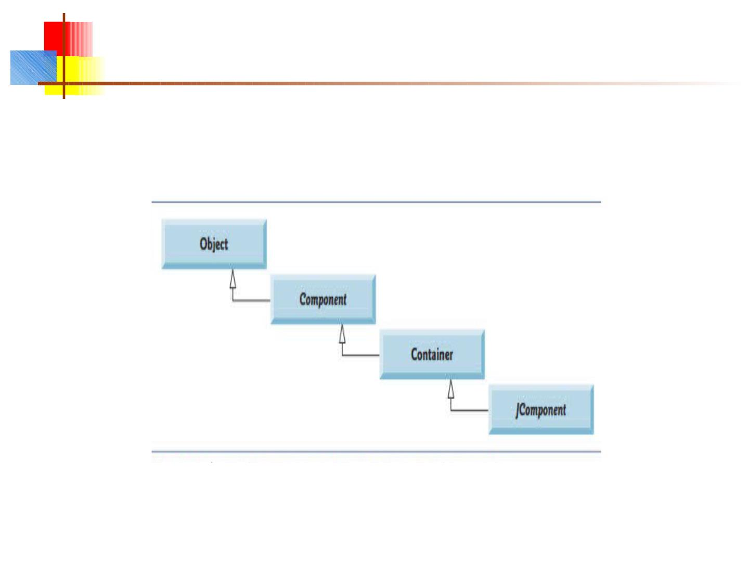
Superclasses of Swing’s Lightweight GUI Components
The Fig. shows an inheritance hierarchy of classes from which
lightweight Swing components inherit their common attributes and behaviors.

Slide 8
Swing vs AW T
■
■
■
OS independent
■
■
■
OS dedpendent
Heavy weight
Light weight
base on Write once use
anywhere
Not consistent as
compared to Swing
■
■
feel and look
■
■
change behaviour due to
os
rich set of object
less as compared to
swing

Slide 9
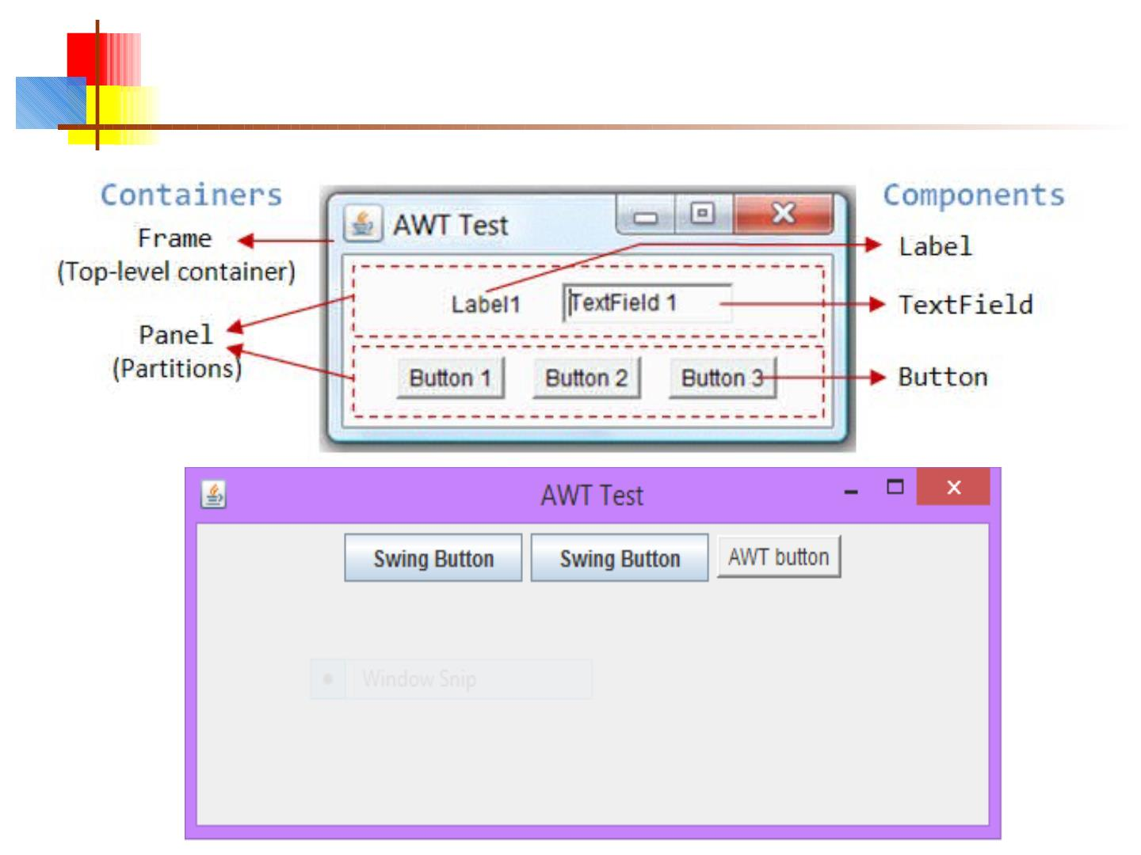
Visual diff.

Slide 10
Why we prefer to Swing
On the Basis of last slide that we disscused so we
can say that Swing is better becoz
not depend on OS
light weight
new version of JDK
write once use anywhere base

Slide 11
Component
■
At the top of the AWT hierarchy is
theComponentclass.Componentis an abstract
class that
encapsulates all of the attributes of a visual
component. All user interface elements that are
displayed on the screen and that interact with the
user are subclasses ofComponent. It defines over
a hundred public methods that are responsible
for managing events, such as mouse and
keyboard input, positioning and sizing the
window, and repainting.

Slide 12
components examples
■
■
■
■
■
■
■
■
■
■
JButton button = new JButton("Click me!");
JLabel label = new JLabel("This is a JLabel");
JTextField textField1 = new JTextField("This is the initial text");
JTextField textField2 = new JTextField("Initial text", columns);
JTextArea textArea1 = new JTextArea("Initial text");
JTextArea textArea2 = new JTextArea(rows, columns);
JTextArea textArea3 = new JTextArea("Initial text", rows, columns);
JCheckBox checkbox = new JCheckBox("Label for checkbox");
JRadioButton radioButton1 = new JRadioButton("Label for button");
ButtonGroup group = new ButtonGroup();
group.add(radioButton1); group.add(radioButton2); etc.
■
This is just a sampling of the available constructors; see the javax.swing API
for all the rest
12

Slide 13
Container
■
TheContainerclass is a subclass ofComponent. It has
additional methods that allow other Componentobjects
to be nested within it. OtherContainerobjects can be
stored inside of a Container(since they are themselves
instances ofComponent). This makes for a multileveled
containment system. A container is responsible for
laying out (that is, positioning)
Two important methods the container class has add and setLayout.
Container are classified into two broad categories that are
Top Level containers andGeneral Purpose Containers Top
level containers can contain (add) other containers
as well as basic components (buttons, labels etc) while
general purpose containers are typically used to collect
basiccomponents and are added to top level containers.

Slide 14
Panel
■
ThePanelclass is a concrete subclass ofContainer. It
doesn’t add any new methods; it simply implements
Container. A Panel may be thought of as a recursively
nestable, concrete screen component.
■
■
When screen output is directed to an Frame/applet,it is
drawn on the surface of a Panel object.
Panelis a window that does not contain a title bar, menu
bar, or border

Slide 15
Window
■
TheWindowclass creates a top-level
window. A top-level window is not
contained within any other object; it sits
directly on the desktop. Generally, you
won’t createWindowobjects directly.
Instead, you will use a subclass of Window
called Frame, described next.

Slide 16
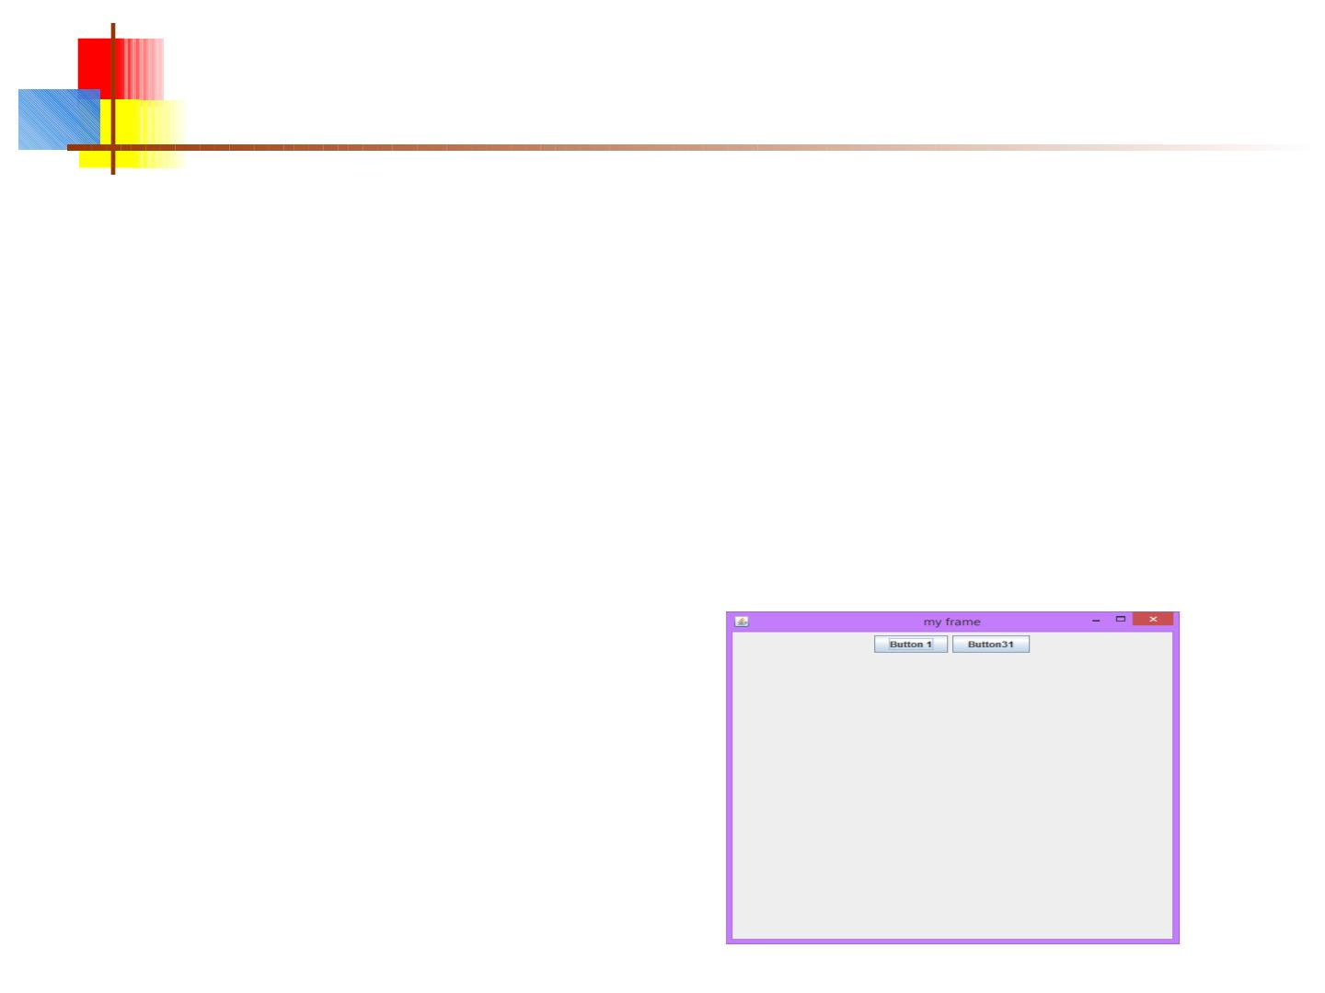
Frame
■
Frame encapsulates what is commonly thought of as a
“window.” It is a subclass of Window and has a title bar,
menu bar, borders, and resizing corners.
■
■
It contain Jlabel,textarea,button etc
in previous hierarchy we observe that JFrame is a
frame is a window. So, it can be interpreted as
JFrame is a window.
■
A simple frame

Slide 17
How to build a GUI
■
■
Create a window in which to display things—usually a JFrame
(for an application), or a JApplet
Use the setLayout(LayoutManager manager) method to
specify a layout manager
■
■
Create some Components, such as buttons, panels, etc.
Add your components to your display area, according to your
chosen layout manager
■
Write some Listeners and attach them to your Components
■
Interacting with a Component causes an Event to occur
■
A Listener gets a message when an interesting event occurs, and executes
some code to deal with it
■
Display your window
17

Slide 18
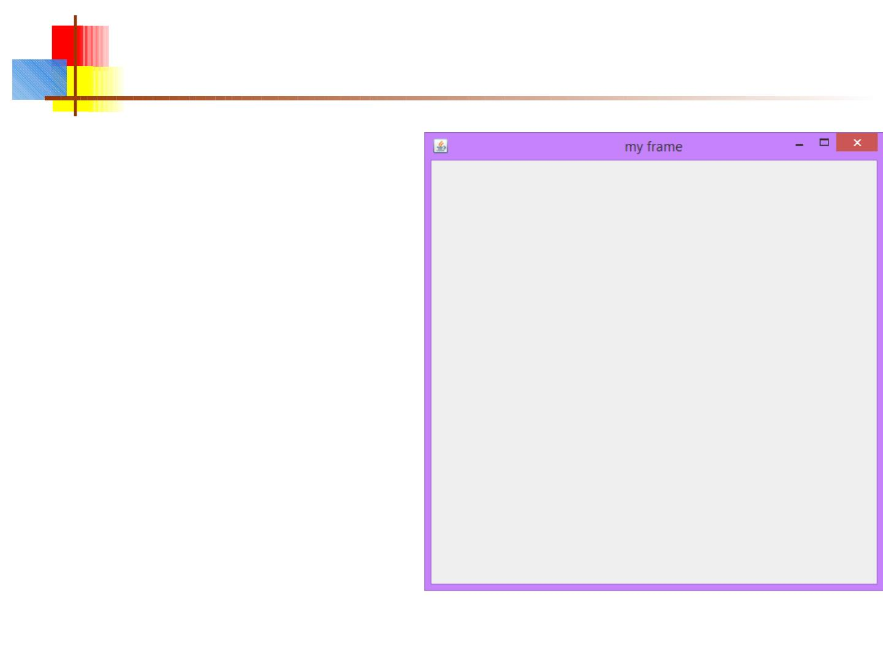
Step 1 and 2: Code for JFrame
import pakages
public class MyFirstFrame{
public static void main(String[] args) {
JFrame myFrame=new
JFrame("my frame");
myFrame.setSize(500, 500);//size
of the frame widht and height
myFrame.setVisible(true);
//this v.impt visibilty
myFrame.setDefaultCloseOperation
(JFrame.EXIT_ON_CLOSE);
}
}

Slide 19
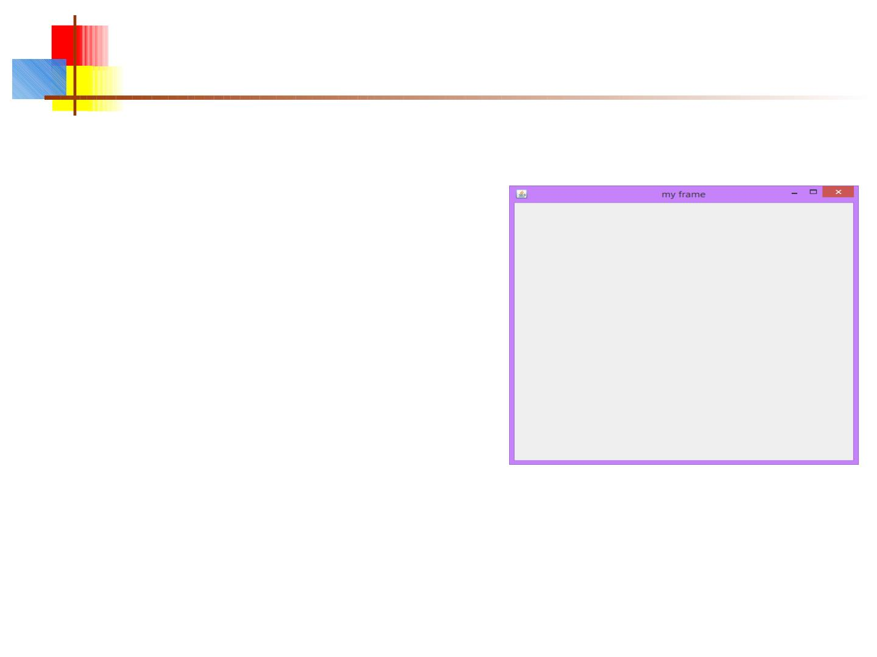
step#3: code for getting content area
JFrame myFrame=new JFrame("my frame");
myFrame.setSize(333, 333);
myFrame.setVisible(true);
myFrame.setDefaultCloseOperation(JFrame.
EXIT_ON_CLOSE);
■
Container c =
myFrame.getContentPane(
);
■
So now we are able to add component in
that area of frame

Slide 20
step#4: code for Applaying layout
JFrame myFrame=new JFrame("title of frame");
myFrame.setSize(333, 333);
myFrame.setVisible(true);
myFrame.setDefaultCloseOperation(JFrame.EXIT_ON_CLOSE);
Container c = myFrame.getContent Pane();
c.setLayout( new FlowLayout());
❖
❖
There are different method of layout but we will use one
for the code and introduce all in the next slide
The purpose of layout that how they component are
apear in frame

Slide 21
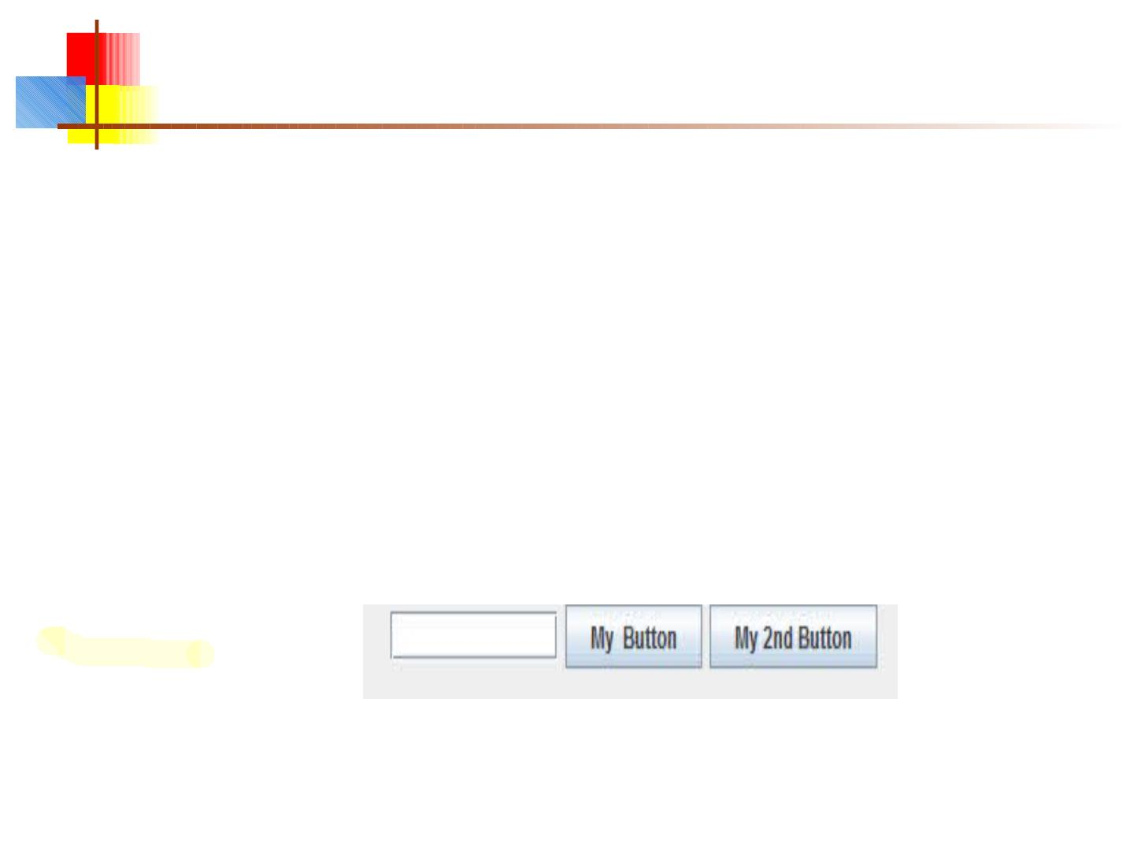
Step 5: create & add components
JTextField t f = new
JTextField(10) ;
JButton b1 = new
JButton( "My Button");
JButton b2= new JButton("My
2nd Button");
Button b=new Button("Awt
button");
//Adding commponent to
container
c.add(tf);
c.add(b1);

Slide 22
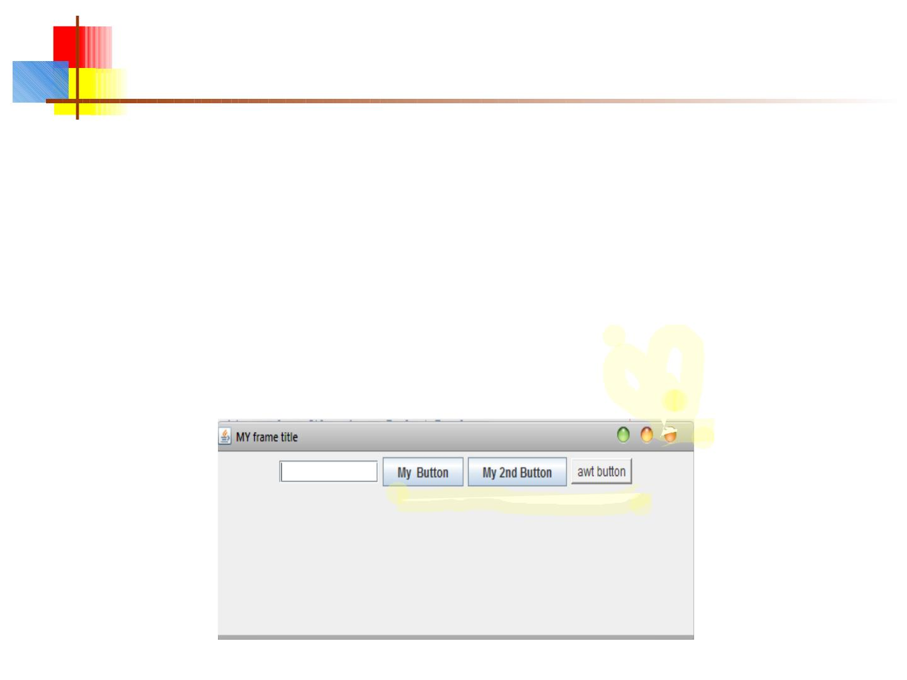
Step 6: set size of frame and make it visible
myFrame.setDefaultCloseOperat
ion(JFrame.EXIT_ON_CLOS
E);
myFrame.setSize(200,150);
myFrame.setVisible(true);
output:

Slide 23
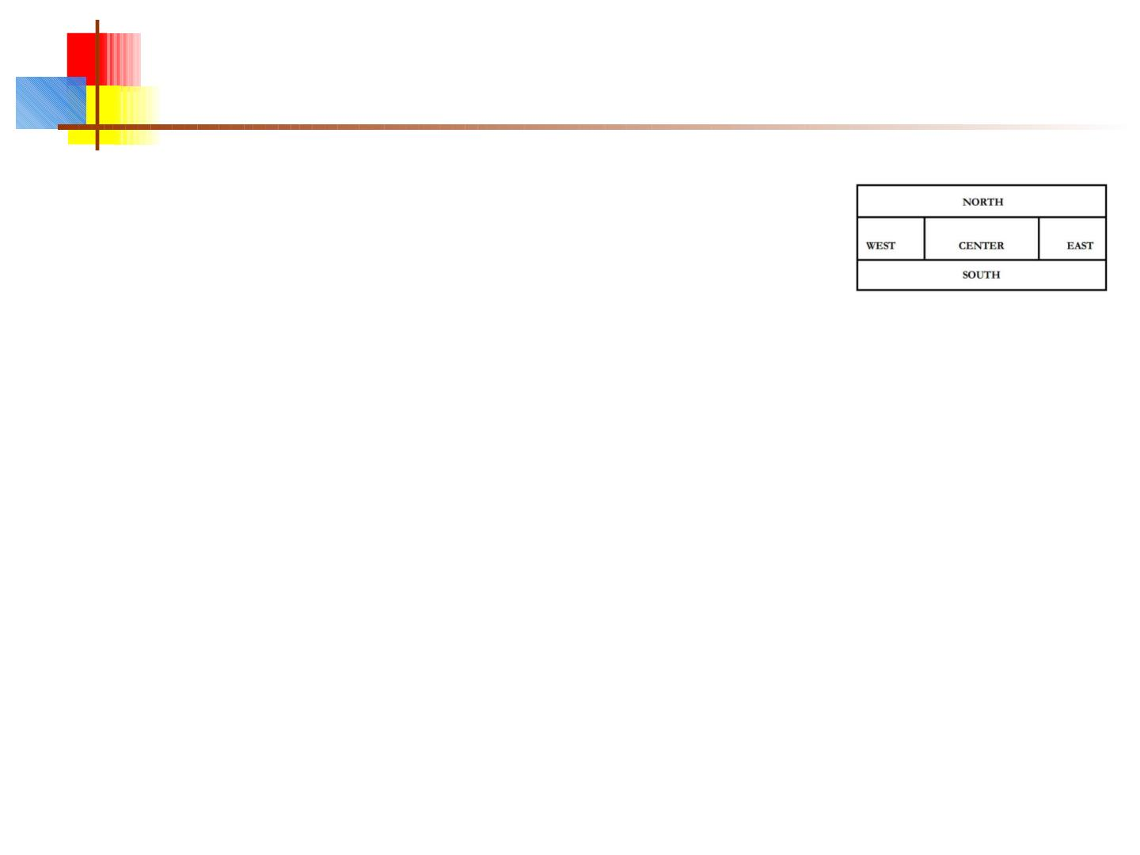
Add a layout manager
■
The most important layout managers are:
■
BorderLayout
■
Provides five areas into which you can put compon
■
This is the default layout manager for both JFrame and JApplet
■
FlowLayout
■
Components are added left to right, top to bottom
■
GridLayout
■
Components are put in a rectangular grid
■
All areas are the same size and shape
■
BoxLayout
■
Creates a horizontal row or a vertical stack
■
This can be a little weird to use
23

Slide 24
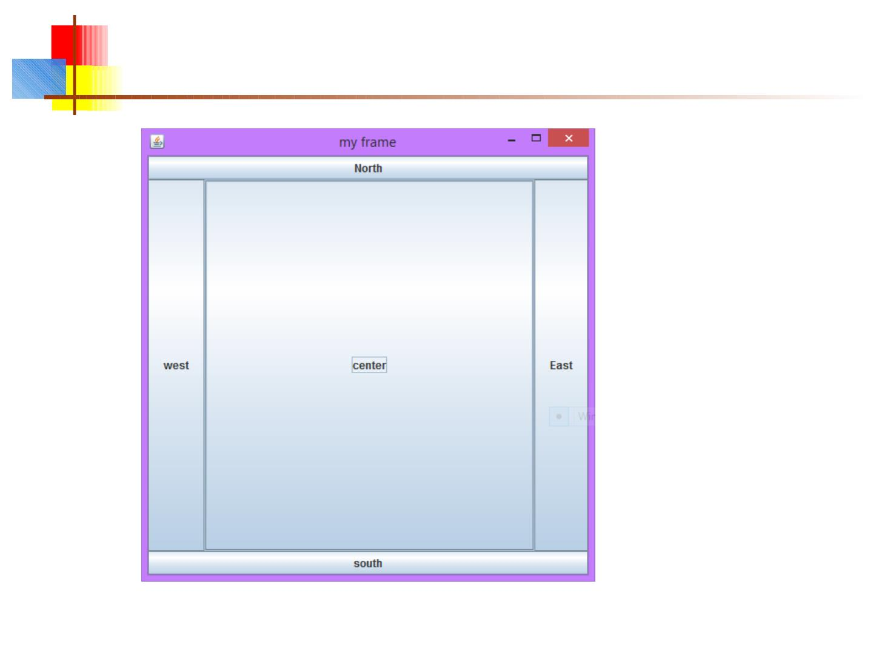
BorderLayout
24

Slide 25
mport java.awt.BorderLayout;
import java.awt.FlowLayout;
import javax.swing.JButton;
import javax.swing.JFrame;
/**
* @author Adil M
*/
public class JavaApplication9 {
///code for border layout
public static void main(String[] args) {
// TODO code application logic here
JFrame a=new JFrame("my frame");
a.setLayout(new BorderLayout());
JButton bt=new JButton("North");
a.add(bt,BorderLayout.NORTH);
JButton bt1=new JButton("west");
a.add(bt1,BorderLayout.WEST);
JButton bt2=new JButton("center");
a.add(bt2,BorderLayout.CENTER);
JButton bt3=new JButton("East");
a.add(bt3,BorderLayout.EAST);
JButton bt4=new JButton("south");
a.add(bt4,BorderLayout.SOUTH);
a.setSize(500,500);
a.setVisible(true);
a.setDefaultCloseOperation(JFrame.EXIT_ON_CLOSE);
}
}

Slide 26
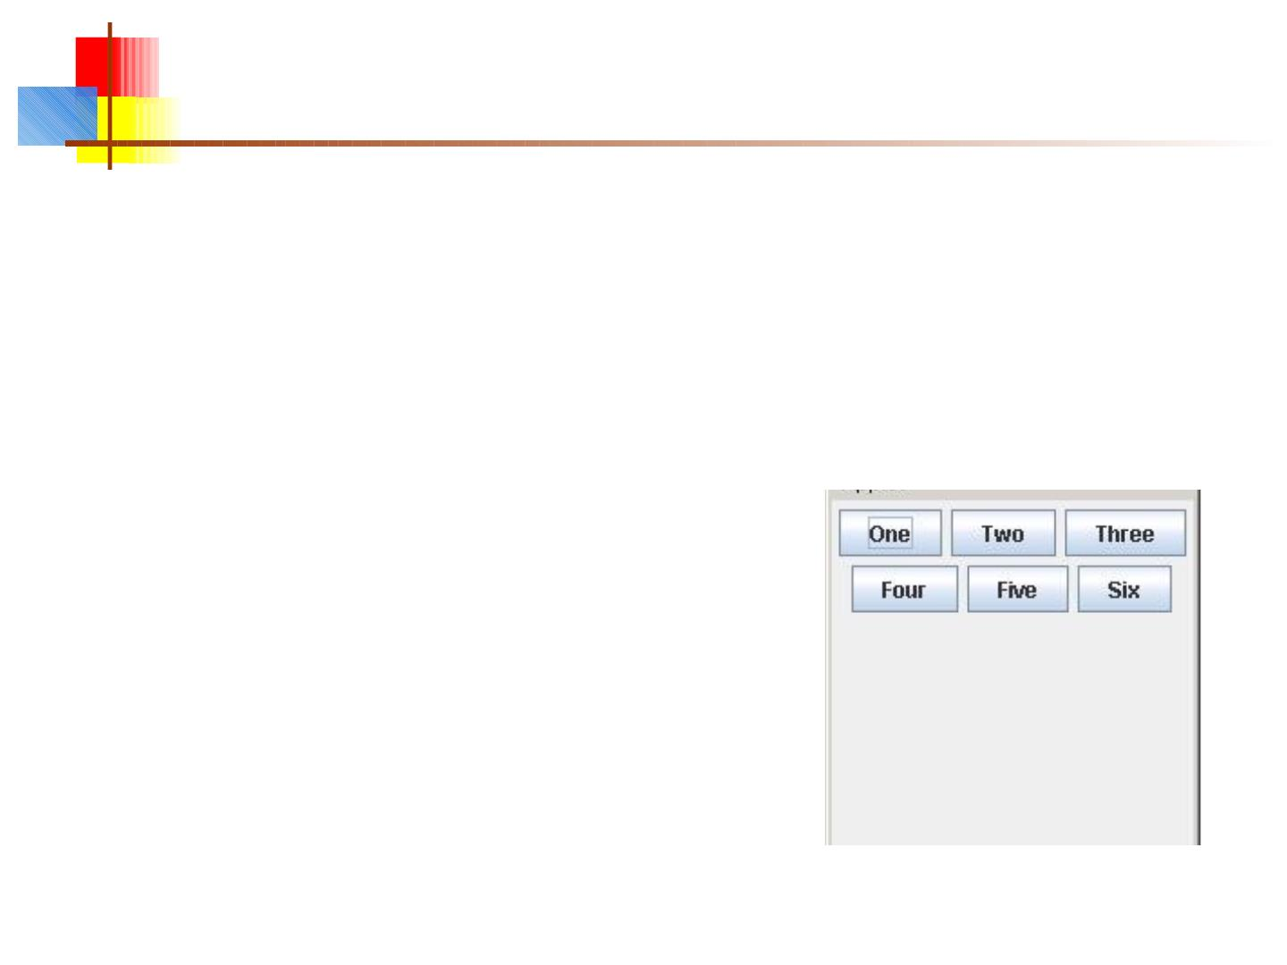
FlowLayout
■
public class FlowLayoutExample extends JFrame {
public void init () {
setLayout(new FlowLayout ());
add(new JButton("One"));
add(new JButton("Two"));
add(new JButton("Three"));
add(new JButton("Four"));
add(new JButton("Five"));
add(new JButton("Six"));
}
}
26

Slide 27
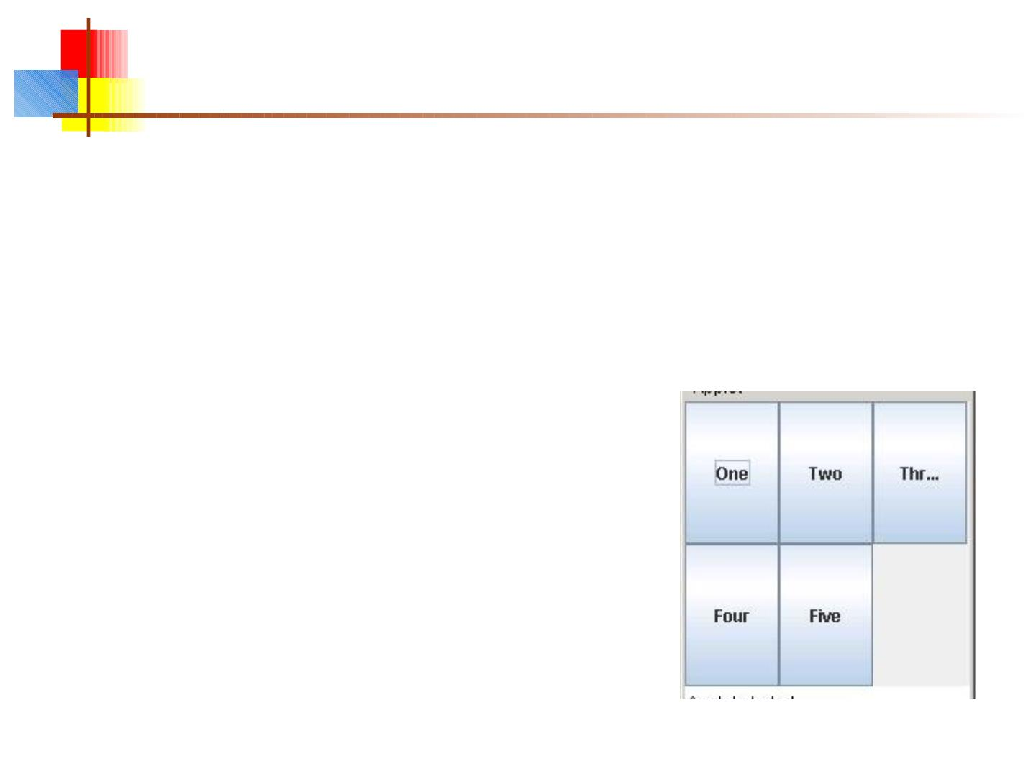
GridLayout
■
public class GridLayoutExample extends JApplet {
public void init() {
setLayout(new GridLayout(2, 4));
add(new JButton("One"));
add(new JButton("Two"));
add(new JButton("Three"));
add(new JButton("Four"));
add(new JButton("Five"));
}
}
27

Slide 28
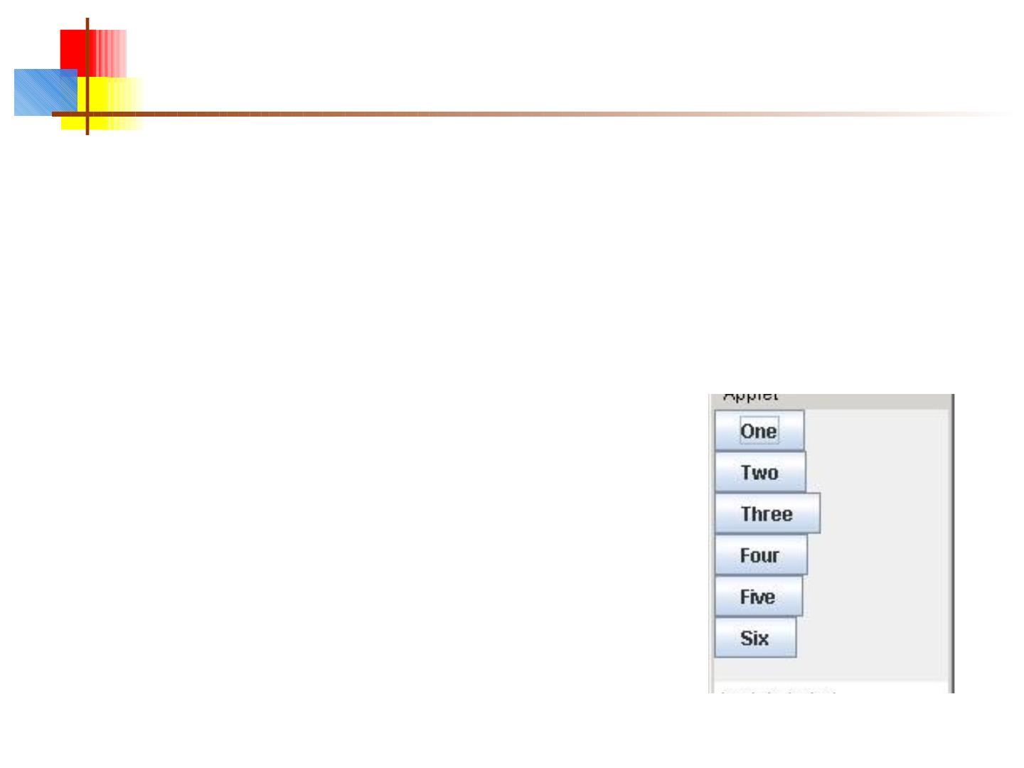
BoxLayout
■
public class BoxLayoutExample extends JApplet {
public void init () {
Box box = new Box(BoxLayout.Y_AXIS);
add(box);
box.add(new JButton("One"));
box.add(new JButton("Two"));
box.add(new JButton("Three"));
box.add(new JButton("Four"));
box.add(new JButton("Five"));
box.add(new JButton("Six"));
}
}
28

Slide 29
Nested layouts
■
■
■
A JPanel is both a JContainer and a Component
■
Because it’s a container, you can put other components into it
■
Because it’s a component, you can put it into other containers
All but the very simplest GUIs are built by creating
several JPanels, arranging them, and putting
components (possibly other JPanels) into them
A good approach is to draw (on paper) the arrangement
you want, then finding an arrangement of JPanels and
their layout managers that accomplishes this
29

Slide 30
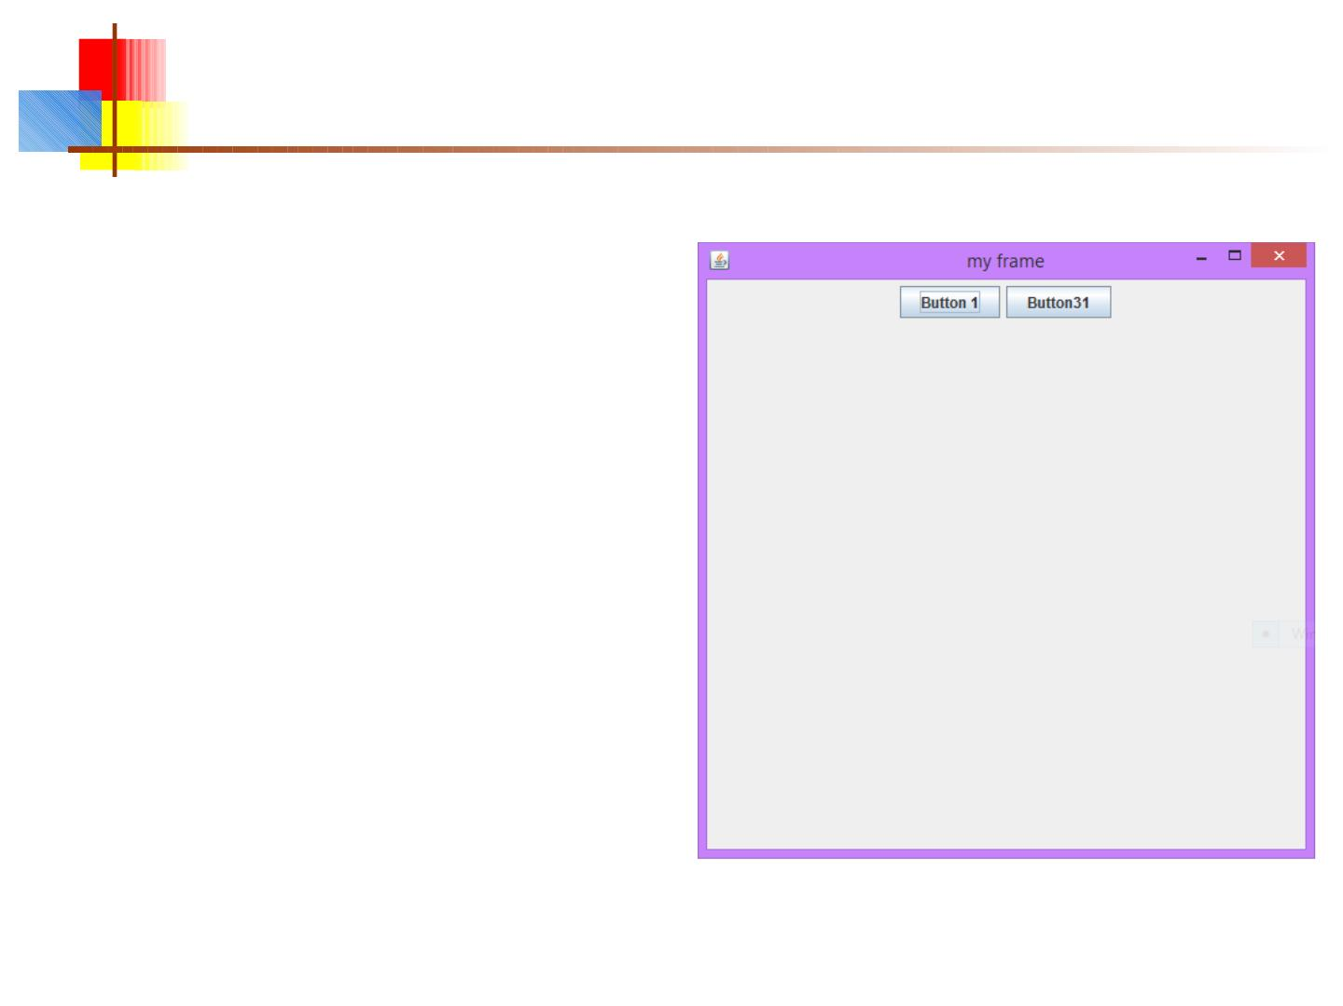
We can Add commponents on frame
import java.awt.FlowLayout;
import javax.swing.JButton;
import javax.swing.JFrame;
public class JavaApplication9 {
public static void main(String[] args) {
JFrame a=new JFrame("my frame");
//SET LAYOUT FOR FRAME most imp
a.setLayout(new
FlowLayout());
JButton bt=new JButton("Button 1");
a.add(bt);
JButton bt1=new JButton("Button31");
a.add(bt1);
a.setSize(500,500);
a.setVisible(true);
a.setDefaultCloseOperation(JFrame.EXIT_ON_C
LOSE);

Slide 31
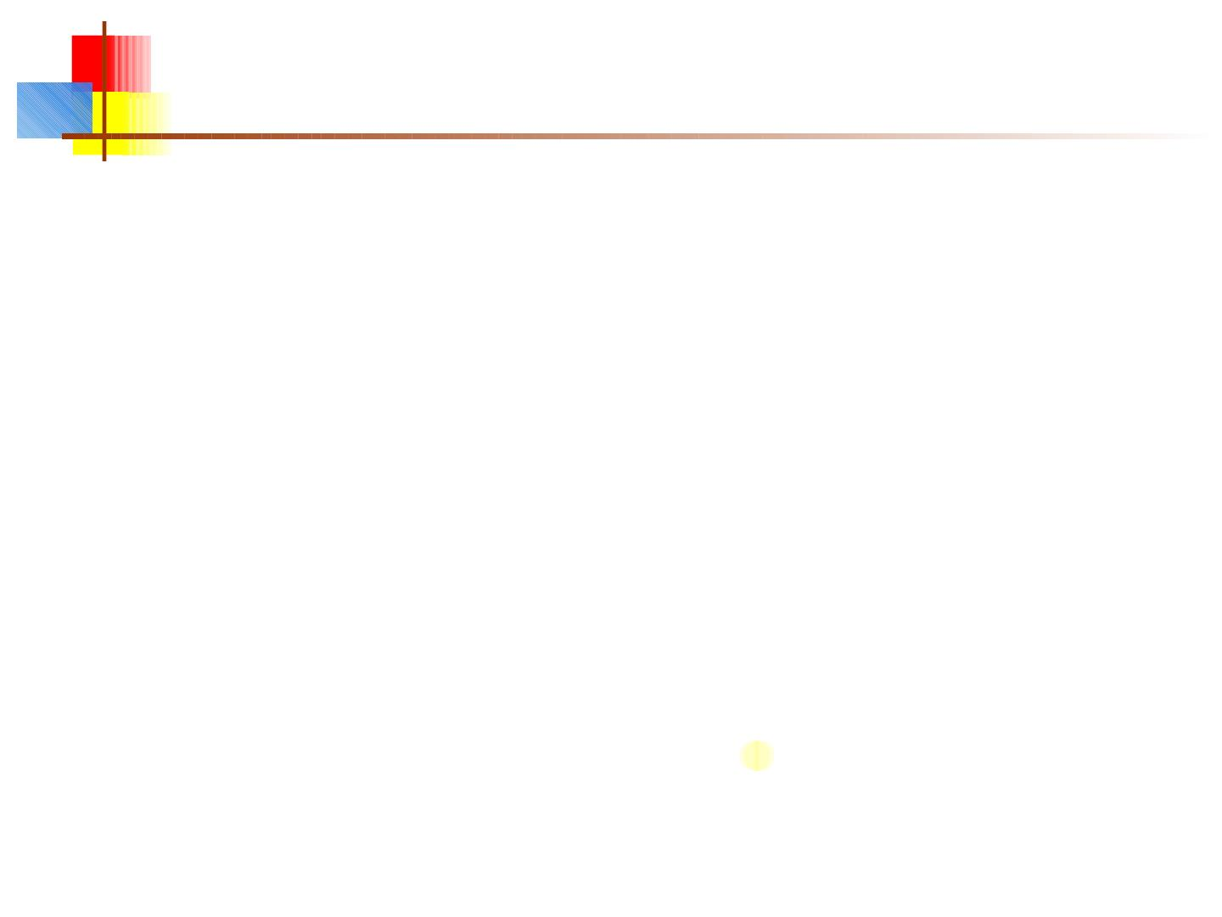
How to build a GUI(Step by Step)
Code for Simple GUI
// File GUITest.java
//Step 1: import packages
import java.awt .*;
import javax.swing.*;
public class GUITest {
JFrame myFrame ;
JTextField tf;
JButto n b;
//method used for set ting layout of GUI
public void initGUI ( ) {
//St ep 2: setup the top level cont ainer
myFrame = new JFrame();
31

Slide 32
continue......
//St ep 3: Get the component area of top-level container
Container c = myFrame.getContent Pane();
//Step 4: Apply layo ut s
c.setLayout( new FlowLayout( ) );
//Step 5: create & add components
JTextField t f = new JTextField(10) ;
JButton b1 = new JButton( "My Button");
c.add(tf);
c.add(b1);
//Step 6: set size of frame and make it visible
myFrame.setDefaultCloseOperation(JFrame.EXIT_ON_CLOSE);
myFrame.setSize(200,150);
myFrame.setVisible(true);
} //end initGUI method

Slide 33
continue......
public GUITest ( ) { // default constructor
initGUI ();
}
public static void main (Strin g args[ ]) {
GUITest gui = new GUITest();
}
}

Slide 34
Code for simple layout of calculator
To make the calculator GUI shown
above, take JFrame (top level
container) and set it s layout to
border. Than take JPanel (general
purpose container) and set its layout
to Grid with 4 rows and 4 columns.

Slide 35
calculator cont......
public class NewClass {
JFrame fCalc=new JFrame("Swing Presentation by Adil");
JButton b1, b2, b3, b4, b5, b6, b7, b8, b9, b0;
JButton bPlus,bMinus,bMul,bPoint,bEqual,bCl ,ear;
JPanel pButtons;
JTextField tfAn, swer;
JLabel lMyCalc;
public static void main(String[] args)
{
NewClass v= new NewClass();
}
public void method(){
try
{
bPlus=new JButton("");
b1=new JButton("1");
b2=new JButton("2");
b3=new JButton("3");
b4=new JButton("4");
b5=new JButton("5");
b6=new JButton("6");
b7=new JButton("7");
b8=new JButton("8");
b9=new JButton("9");
b0=new JButton("0");

Slide 36
calculator cont......
bMinus = new JButton("-");
bMul = new JButton("*");
bPoint = new JButton(".");
bEqual = new JButton("=");
bCl = new JButton("C");
tfAn = new JTextField(10);
tfAn.setSize(20, 20);
lMyCalc = new JLabel("My Clacualator");
//creating panel object and setting its layout
pButtons = new JPanel (new GridLayout(4,4));
//adding components (buttons) to panel
pButtons.add(b1);
pButtons.add(b2);
pButtons.add(b3);
pButtons.add(bCl);

Slide 37
calculator cont......
pButtons.add(b4);
pButtons.add(b5);
pButtons.add(b6);
pButtons.add(bMul);
pButtons.add(b7);
pButtons.add(b8);
pButtons.add(b9);
pButtons.add(bMinus);
pButtons.add(b0);
pButtons.add(bPoint);
pButtons.add(bPlus);
pButtons.add(bEqual);
// getting componenet area of JFrame
Container con=new Container();
con=fCalc.getContentPane();
con.setLayout(new BorderLayout()) ;
//adding components to container
con.add(tfAn, BorderLayout.NORTH);
con.add(lMyCalc, BorderLayout.SOUTH);
con.add(pButtons, BorderLayout.CENTER);
fCalc.setDefaultCloseOperation( JFrame.EXIT_ON_CLOSE);
fCalc.setSize(300, 300);
fCalc.setVisible(true);
}

Slide 38
catch(Exception ex)
{
JOptionPane.showMessageDialog(null,ex.getStackTrace());
}
}
public NewClass ()
{ // default const ructor
method();
}
}

Slide 39
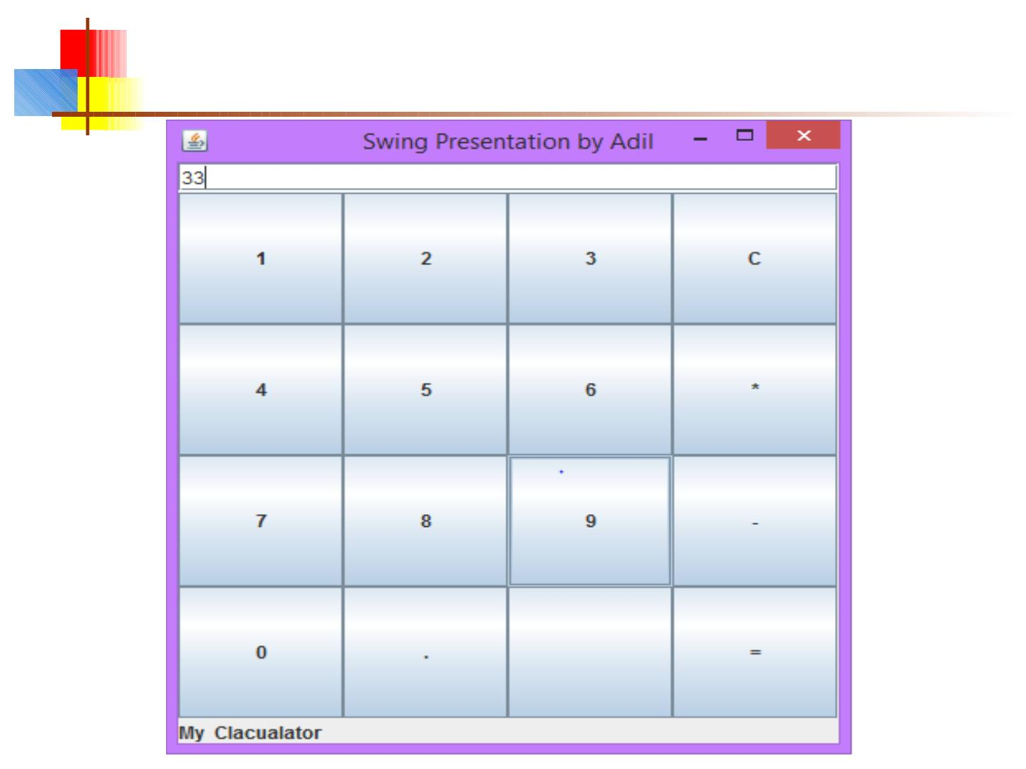
out put

Slide 40
Getting values
■
■
Some user actions normally cause the program to do
something: clicking a button, or selecting from a menu
Some user actions set values to be used later: entering
text, setting a checkbox or a radio button
■
You can listen for events from these, but it’s not usually a
good idea
■
Instead, read their values when you need them
■
String myText = myJTextField.getText();
■
String myText = myJTextArea.getText();
■
boolean checked = myJCheckBox.isSelected();
■
boolean selected1 = myJRadioButton1.isSelected();
40

Slide 41
Enabling and disabling components
■
It is poor style to remove components you don’t want
the user to be able to use
■
“Where did it go? It was here a minute ago!”
■
It’s better to enable and disable controls
■
Disabled controls appear “grayed out”
■
The user may wonder why?, but it’s still less confusing
■
anyComponent.setEnabled(enabled);
■
Parameter should be true to enable, false to disable
41

Slide 42
Dialogs
■
A dialog (small accessory window) can be modal or
nonmodal
■
When your code opens a modal dialog, it waits for a result
from the dialog before continuing
■
When your code opens a nonmodal dialog, it does so in a
separate thread, and your code just keeps going
■
■
Sun supplies a few simple (but useful) modal dialogs for
your use
You can create your own dialogs (with JDialog), but
they are nonmodal by default
42

Slide 43
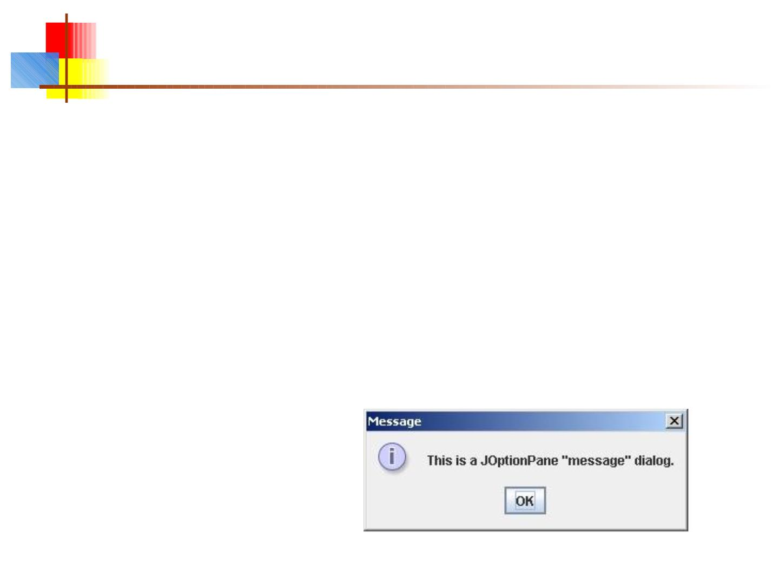
Message dialogs
■
JOptionPane.showMessageDialog(parentJFrame,
"This is a JOptionPane \"message\" dialog.");
■
■
Notice that showMessageDialog is a static method of
JOptionPane
The “parentJFrame” is typically your main GUI
window (but it’s OK to use null if you don’t have a
main GUI window)
43

Slide 44
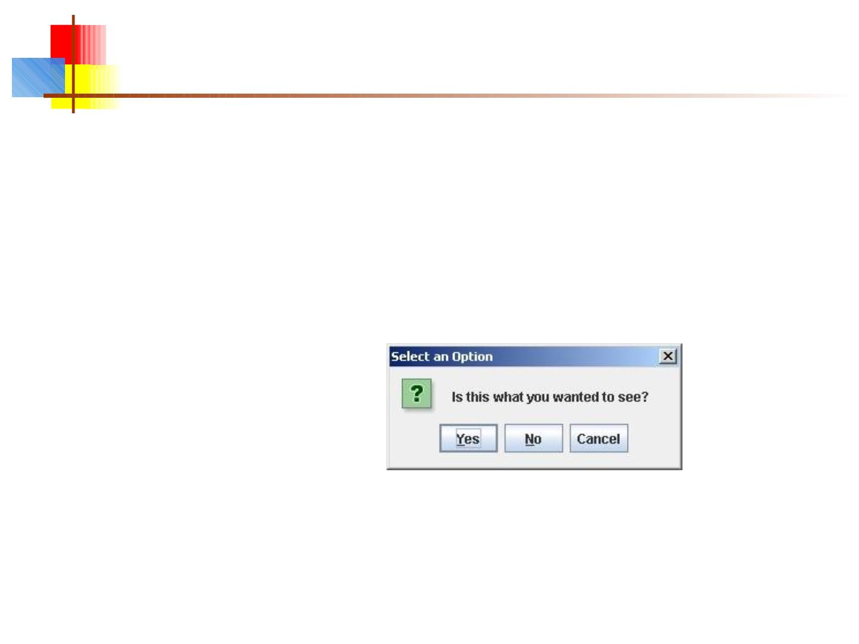
Confirm dialogs
■
■
int yesNo =
JOptionPane.showConfirmDialog(parentJFrame,
"Is this what you wanted to see?");
if (yesNo == JOptionPane.YES_OPTION) { ... }
44

Slide 45
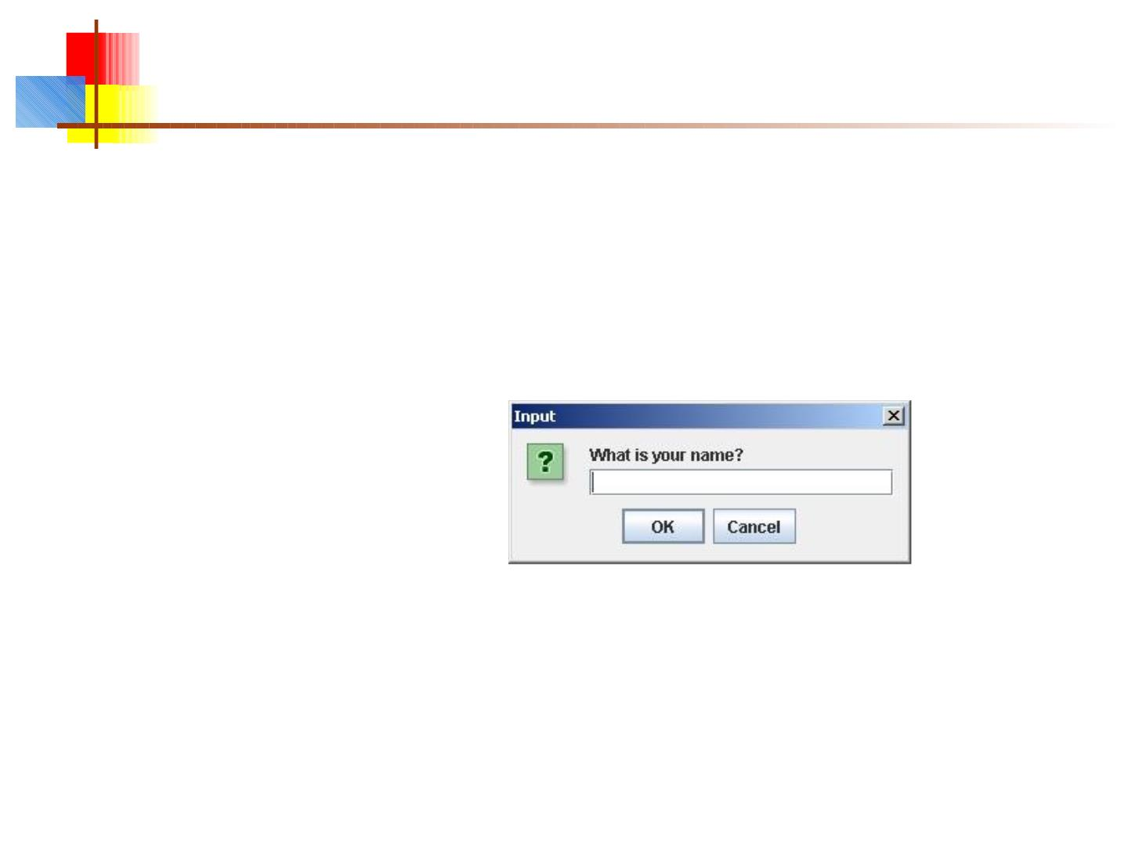
Input dialogs
■
String userName =
JOptionPane.showInputDialog(parentJFrame,
"What is your name?")
45

Slide 46
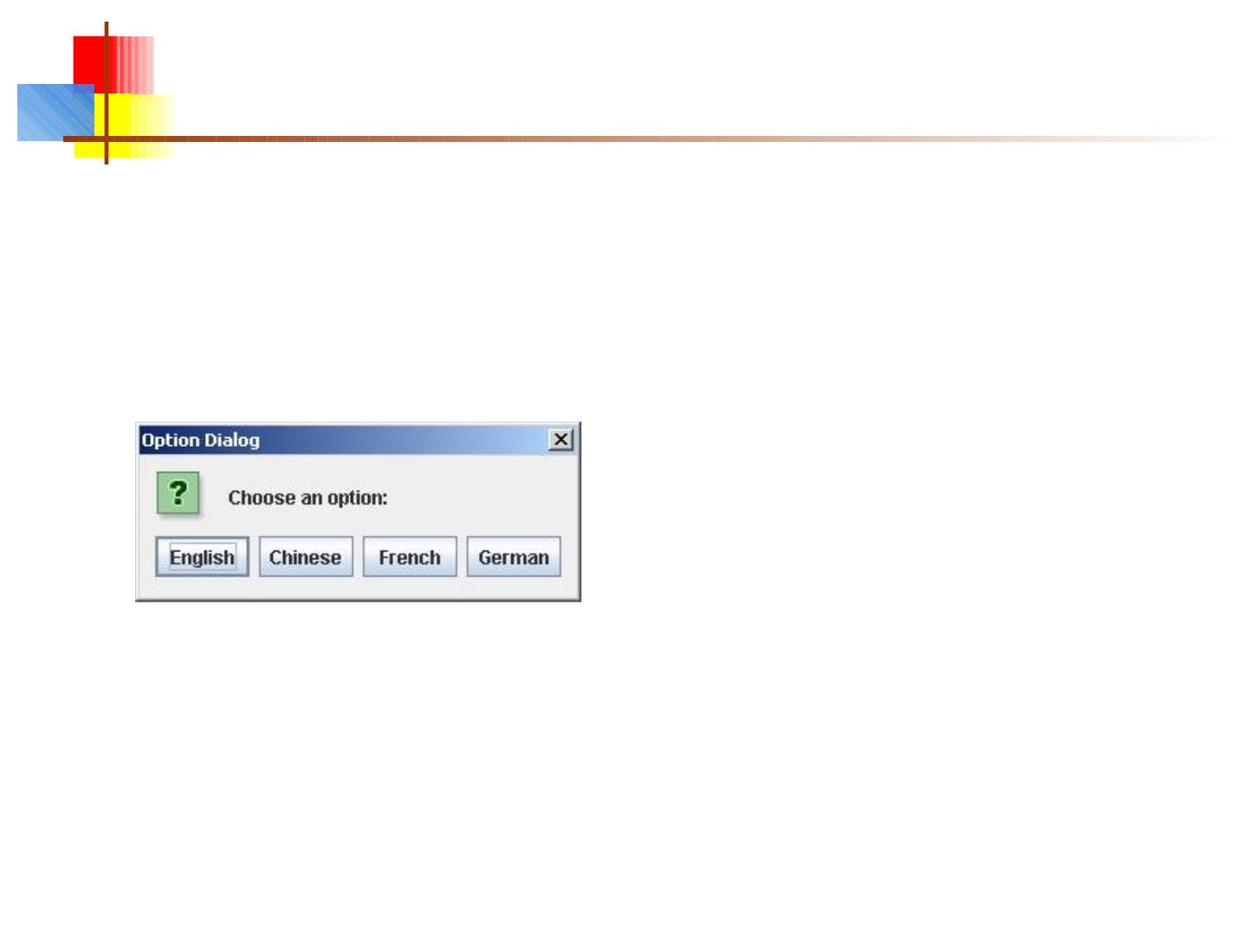
Option dialogs
■
Object[] options =
new String[] {"English", "Chinese", "French", "German" };
int option =
JOptionPane.showOptionDialog(parentJFrame,
"Choose an option:",
"Option Dialog",
JOptionPane.YES_NO_OPTION,
JOptionPane.QUESTION_MESSAGE,
null,
options,
options[0]); // use as default
■
Fourth argument could be JOptionPane.YES_NO_CANCEL_OPTION
■
Fifth argument specifies which icon to use in the dialog; it could be one of
ERROR_MESSAGE, INFORMATION_MESSAGE, WARNING_MESSAGE, or
PLAIN_MESSAGE
■
Sixth argument (null above) can specify a custom icon
46

Slide 47
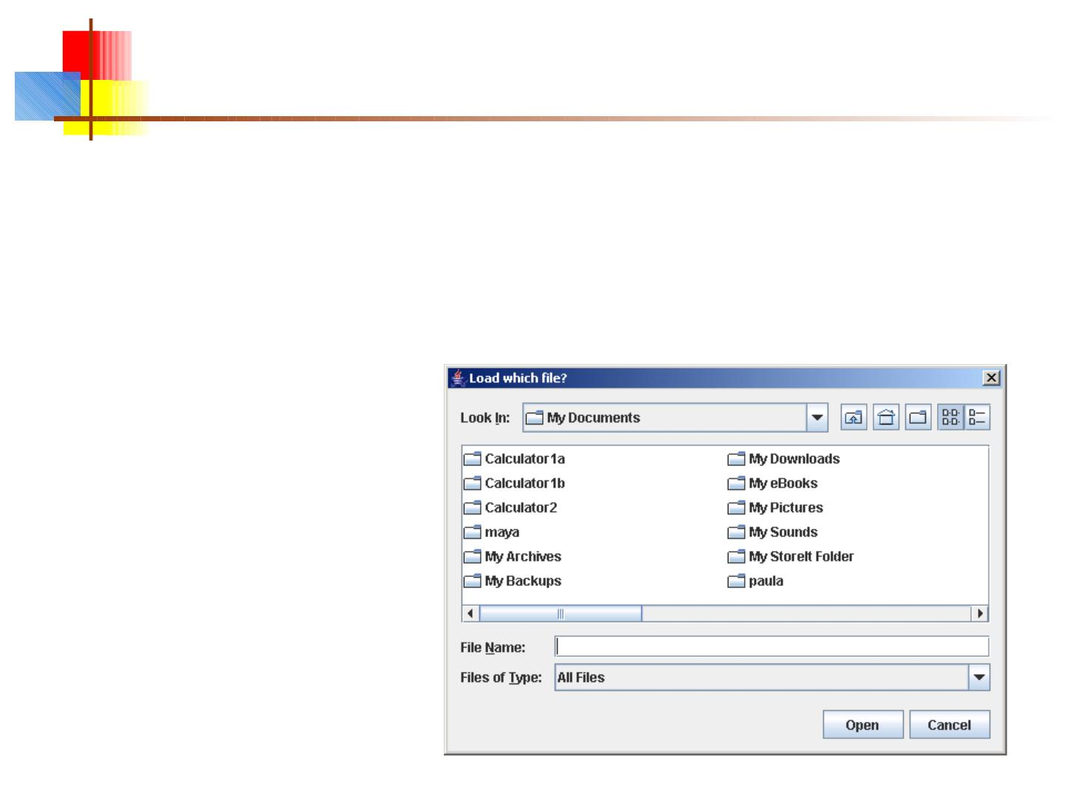
Load file dialogs
■
■
JFileChooser chooser = new JFileChooser();
chooser.setDialogTitle("Load which file?");
int result = chooser.showOpenDialog(enclosingJFrame);
if (result == JFileChooser.APPROVE_OPTION) {
File file = chooser.getSelectedFile();
// use file
}
■
You could also test for
CANCEL_OPTION or
ERROR_OPTION
■
You will get back a File
object; to use it, you must
know how to do file I/O
47

Slide 48
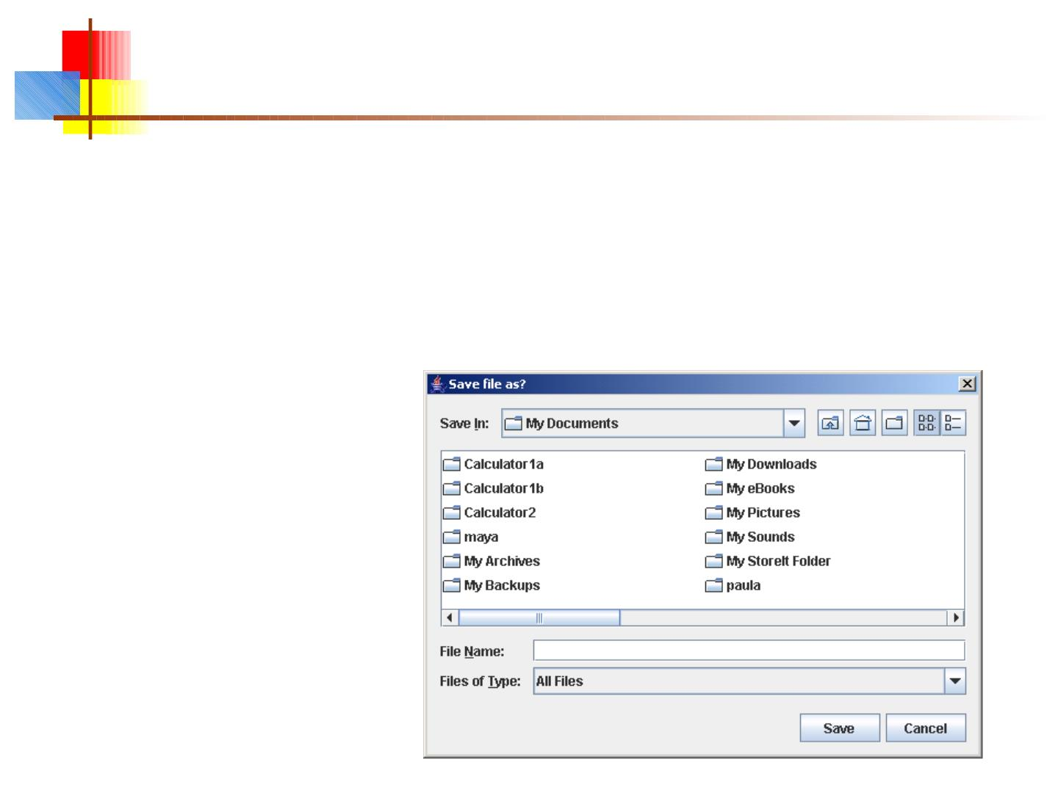
Save file dialogs
■
■
JFileChooser chooser = new JFileChooser();
chooser.setDialogTitle(“Save file as?");
int result = chooser.showSaveDialog(enclosingJFrame);
if (result == JFileChooser.APPROVE_OPTION) {
File file = chooser.getSelectedFile();
// use file
}
■
You could also test for
CANCEL_OPTION or
ERROR_OPTION
■
You will get back a File
object; to use it, you must
know how to do file I/O
48

Slide 49
Review
■
■
■
■
■
■
■
■
Introduction to GUI
Introduction to AWT
Introduction to Swing
Difference b/w Swing and Awt
Why we'll recomend to use "SWING"
Introduction to Component,Container,Panels,window,Frame
Implemention of JFrame and Adding component
Working with NETBEANS to make GUI

